Slide 1
Sub Circuits in HSPICE and Cadence Virtuoso
Liaquat Ali
Sehtab Hossain

Slide 2
HSPICE sub-circuit
Sub circuit to make AND gate
NAND + NOT → AND

Slide 3
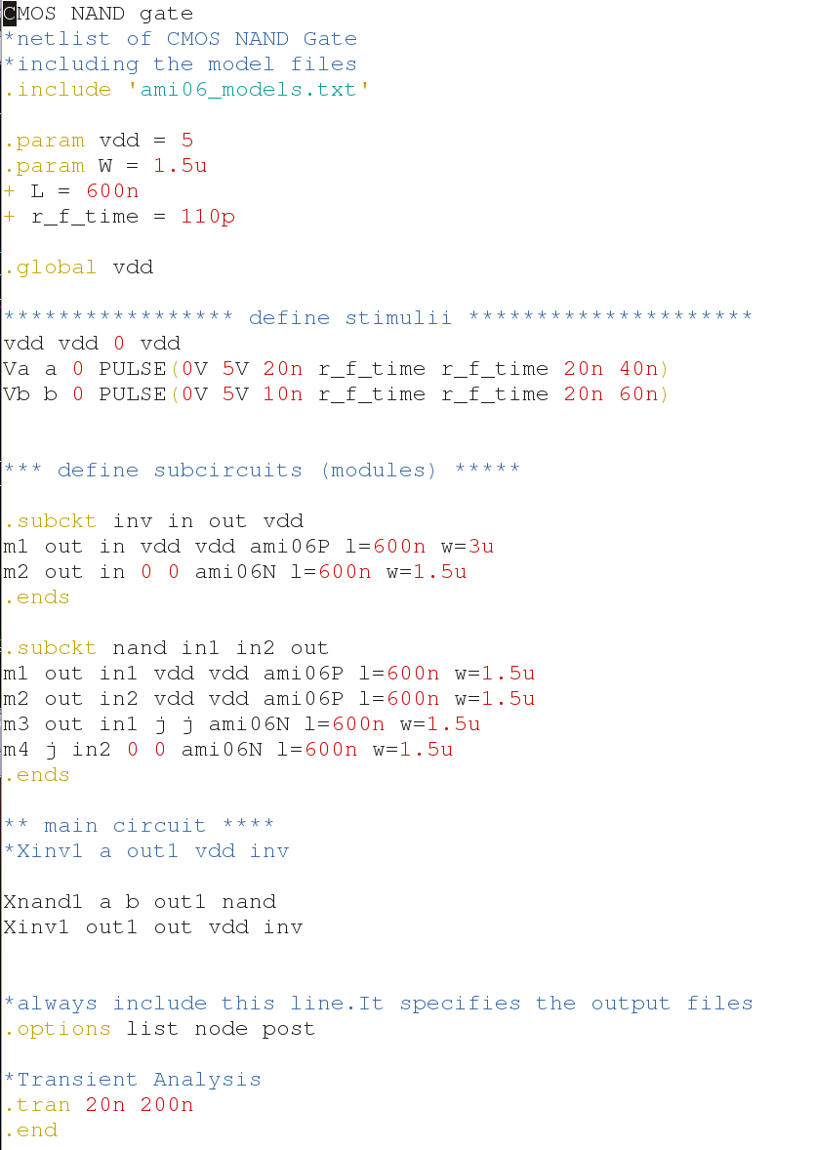
HSPICE sub-circuit

Slide 4
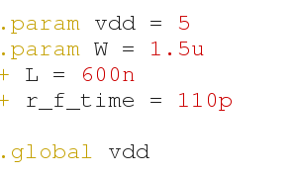
.param & .global
.param vdd= 5
.param W = 1.5u
+ L = 600n
+ r_f_time = 110p
.global vdd

Slide 5
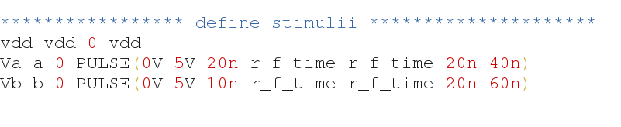
Voltage sources
Define the
vdc
vpulse 1
vpulse2

Slide 6
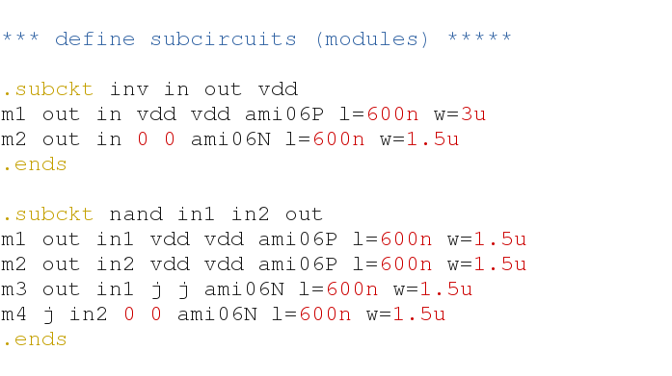
Sub circuits
.subckt → command name
.ends → to end the statement

Slide 7

Main circuits
Remember the first line and define the node name as you defined in subcircuit

Slide 8
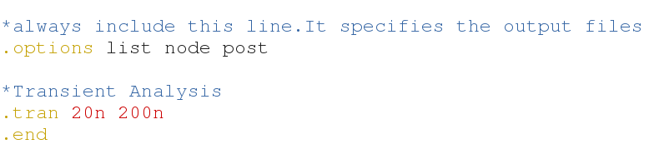
Simulation properties
As we did in last class

Slide 9
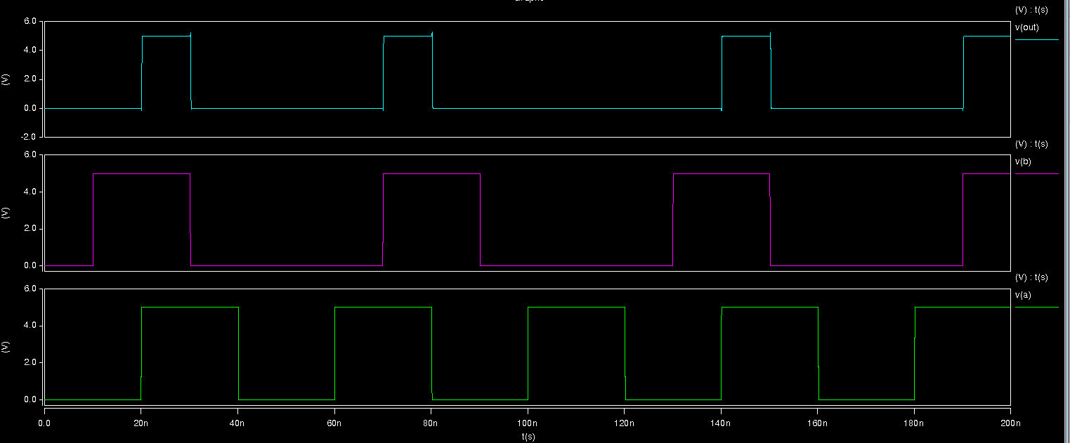
HSPICE sub-circuit
Result

Slide 10
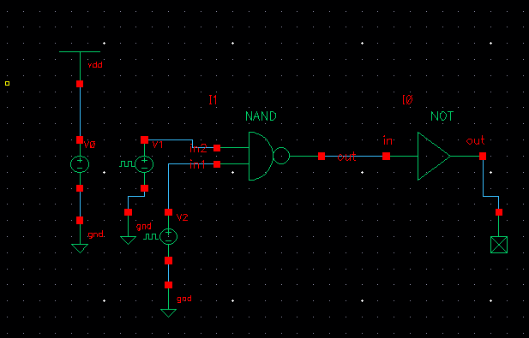
Cadence Virtuoso
Insert your previous symbol and make new circuits.

Slide 11
Only schematic you can do like this
But you need to do layout again from scratch.

