Slide 1
ShevachApp
Eyal Diskin, Liav Alter, Ran Hadar,
Nir Yazdi, Yoni Hauser, Avner Duchovni

Slide 2
Problem Statement - Research
Who?
Students at Givat Ram who like cheap and tasty food
When/Where?
CS Open space, from noon to evening (11:00-21:00)
What is their problem?
Food at campus closes at 19:00 the latest, and isn’t so tasty
Why does it matter?
Studying on an empty stomach is ineffective! And so is spending a lot of $ on food.
Notes:
Who is affected? Who is experiencing the problem? Can this user be further specified (by demographic, persona, motivation, reason for being in the situation)?
What is the problem? What are the struggles? What task needs to be accomplished? What pain point needs to be relieved?
Where does it happen? What is the context in which the user experiences the problem? Is it in a physical or digital space? Who else is involved?
What is stopping them? What are the obstacles they are facing?
Why does it matter? Why is this problem worth solving? What value does it bring to the user? What value does it bring to the business?
https://www.toptal.com/designers/product-design/design-problem-statement
https://productcoalition.com/how-to-write-a-good-customer-problem-statement-a815f80189ba
https://medium.com/eightshapes-llc/how-to-build-a-problem-statement-d1f21713720b
https://hbr.org/2017/01/are-you-solving-the-right-problems

Slide 3
Problem Statement
Students should be able to get tasty food for a reasonable price, even at later times of the day.
Our solution should be easy to use, fast, affordable, and tasty!
Notes:
Our (who) has the problem that (what) when (where). Our solution should deliver (why).

Slide 4
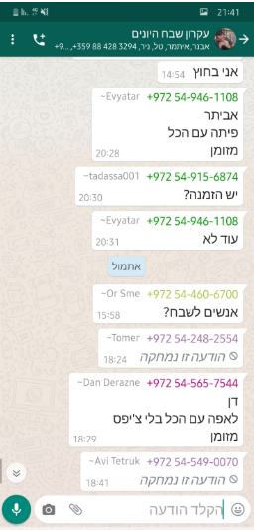
Existing solution
Whatsapp group with 170 students…
Notes:
Our (who) has the problem that (what) when (where). Our solution should deliver (why).

Slide 5

Existing solution
Whatsapp group with 170 students…
Notes:
Our (who) has the problem that (what) when (where). Our solution should deliver (why).

Slide 6
Our Solution...
Android user friendly app !
Notes:
Our (who) has the problem that (what) when (where). Our solution should deliver (why).

Slide 7
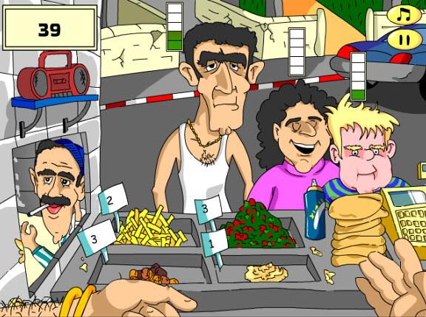
We started
with...

Slide 8
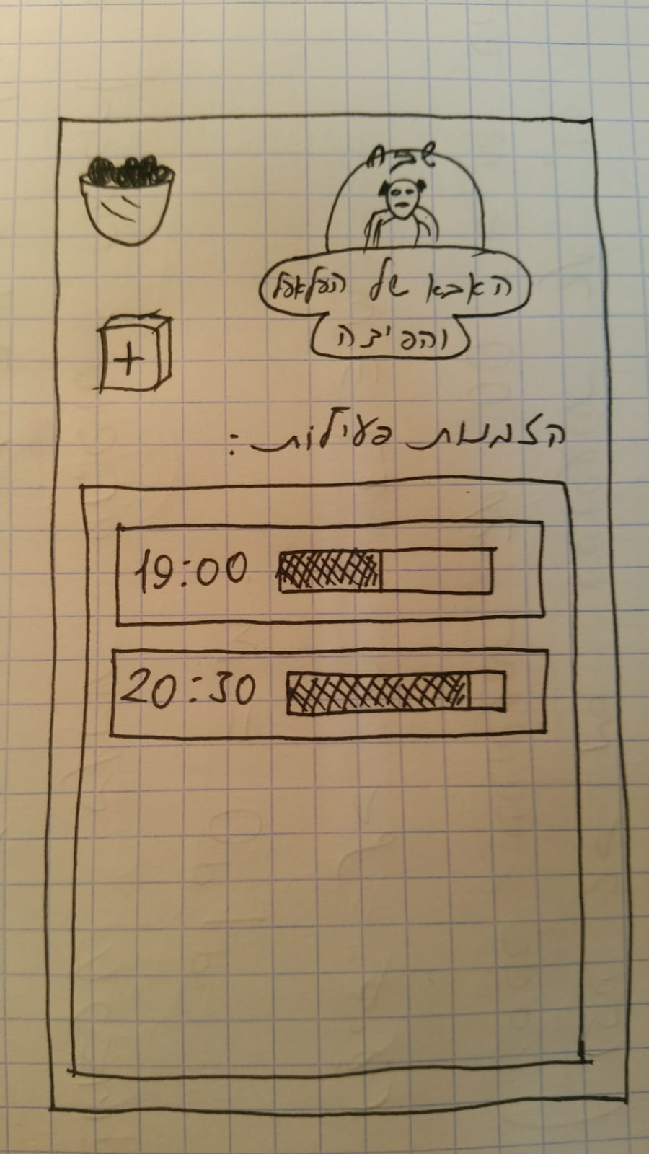
We started
with...

Slide 9
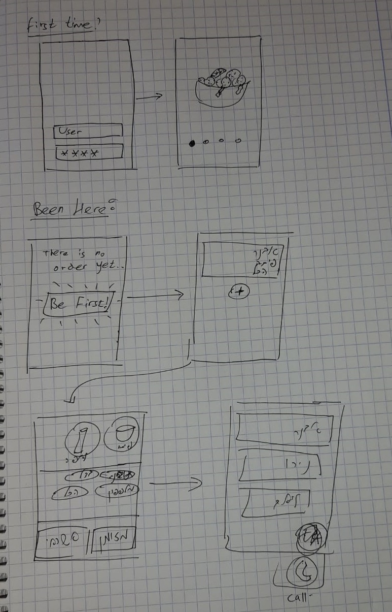
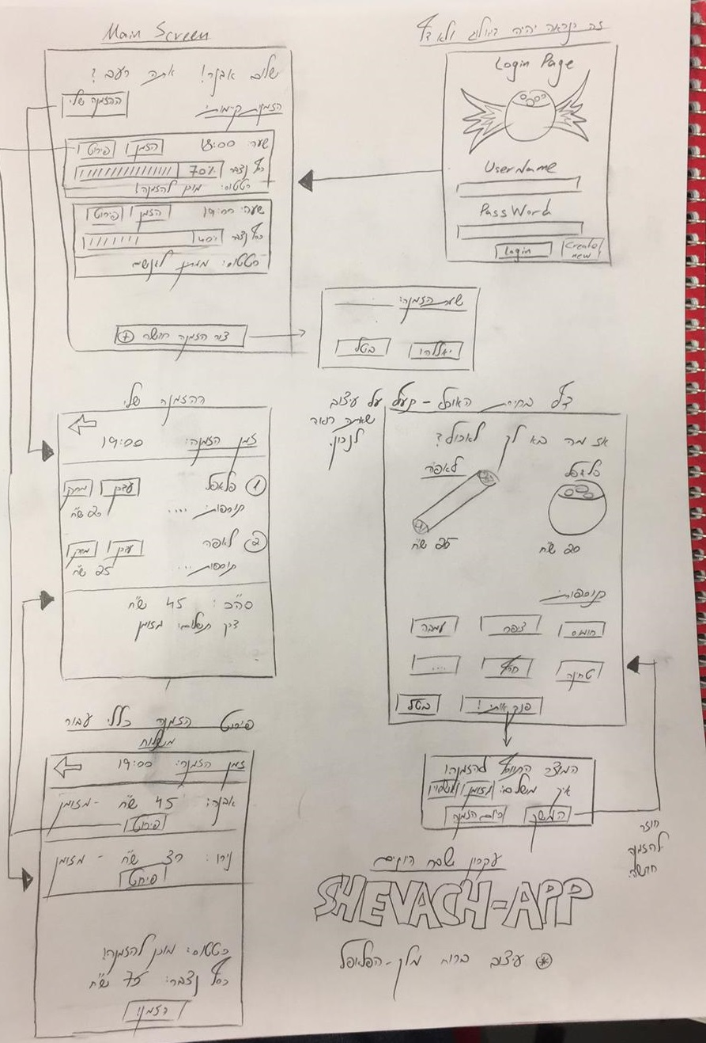
We started
with...

Slide 10
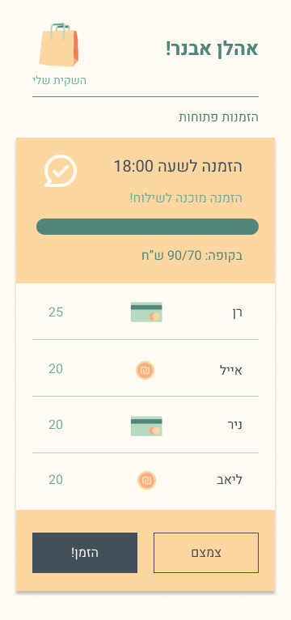
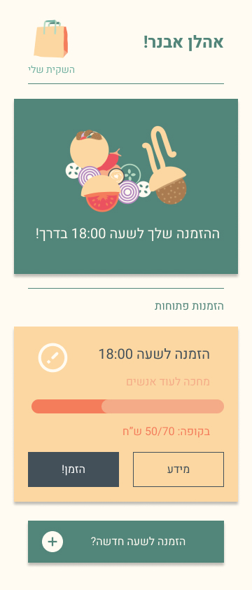
And then…
(High Fidelity Mockups)

Slide 11
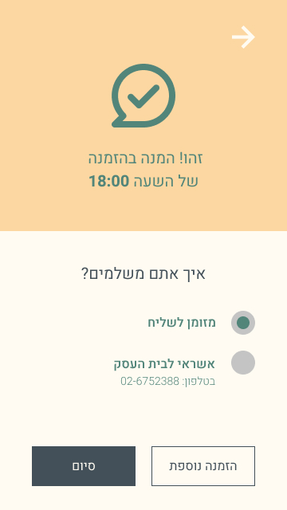
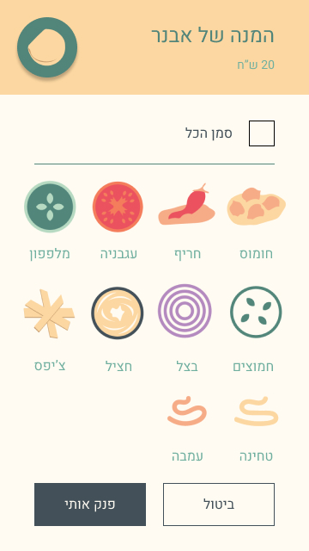
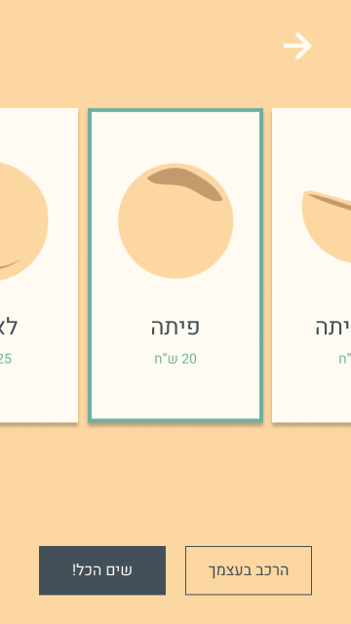

Slide 12
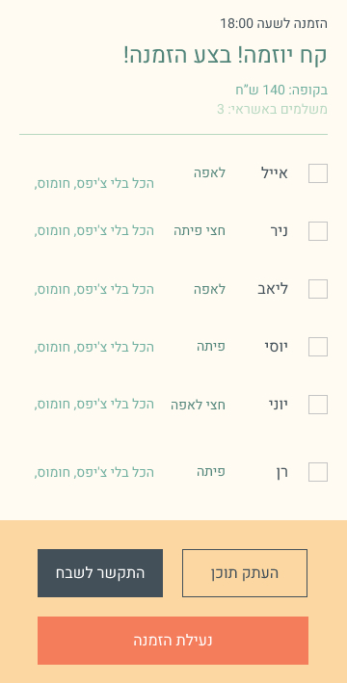
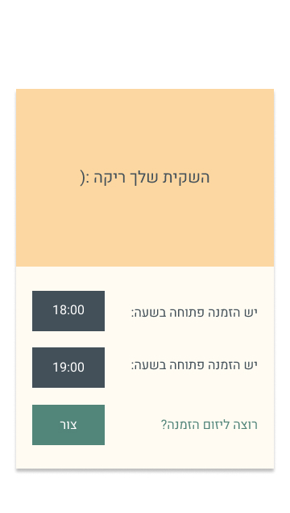
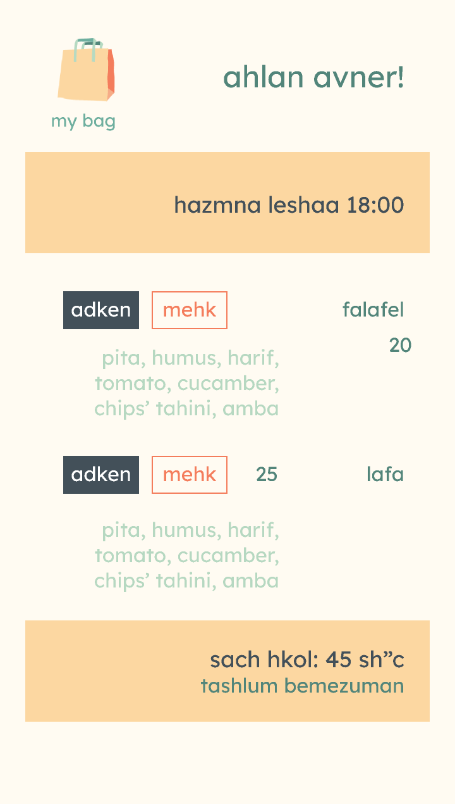

Slide 13
Final Product

Slide 14
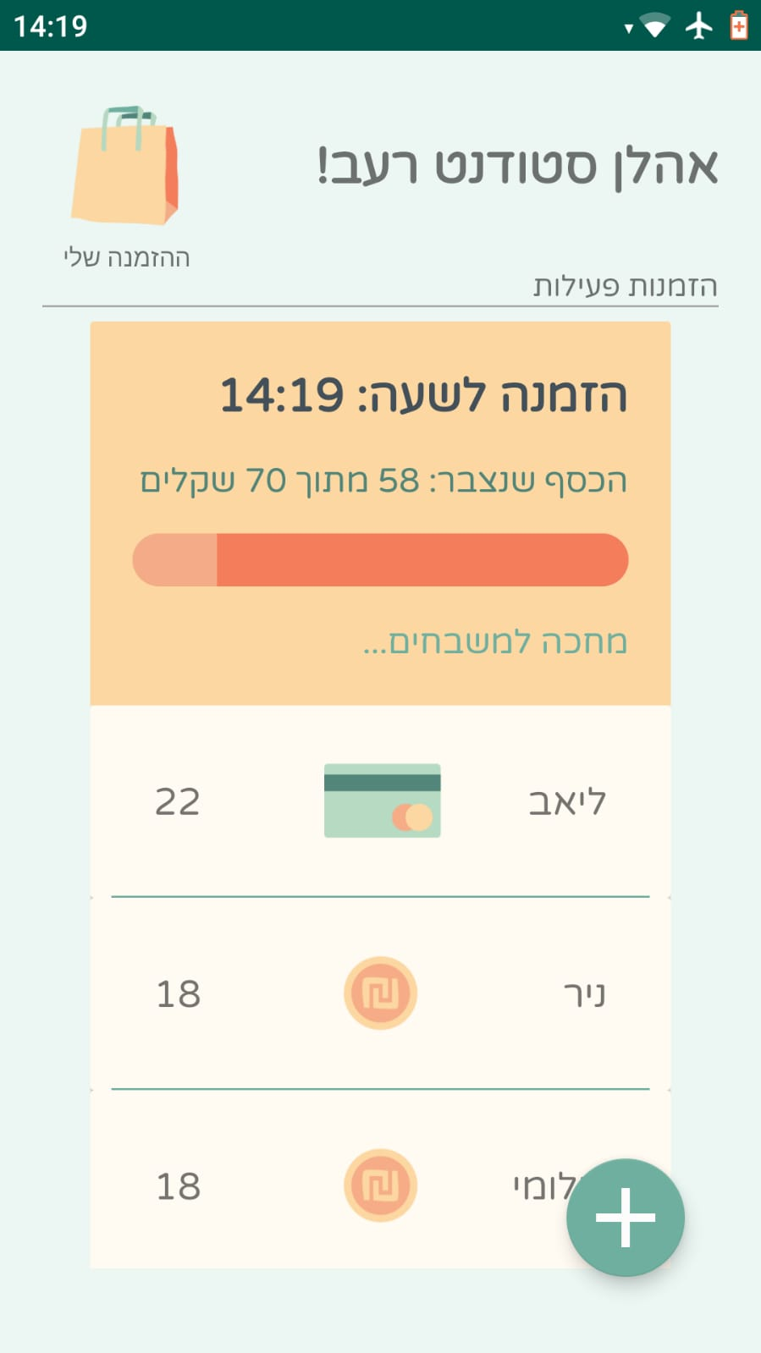
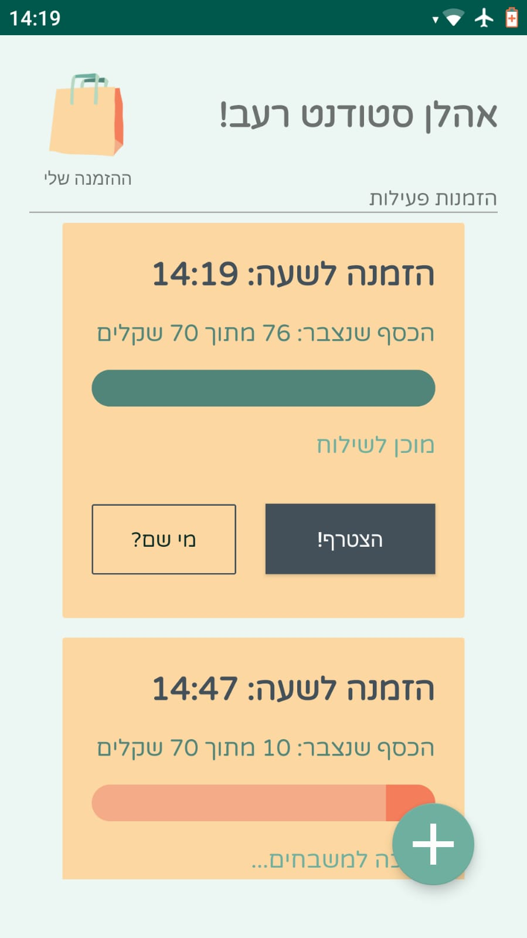
Final Product

Slide 15
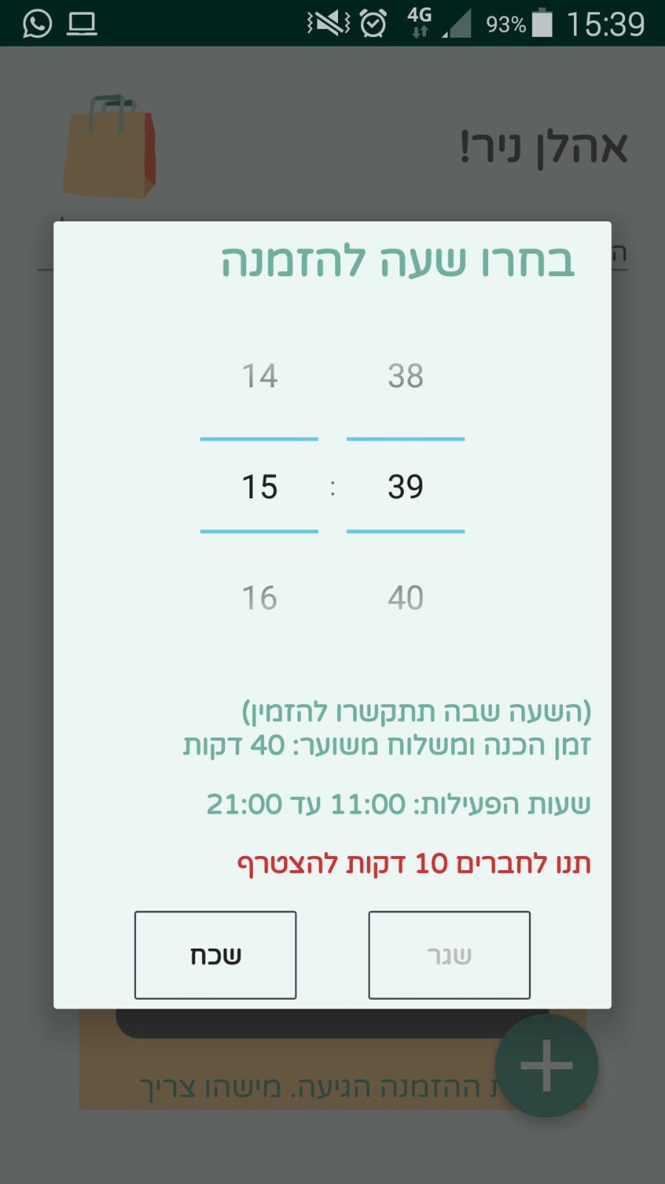

Slide 16
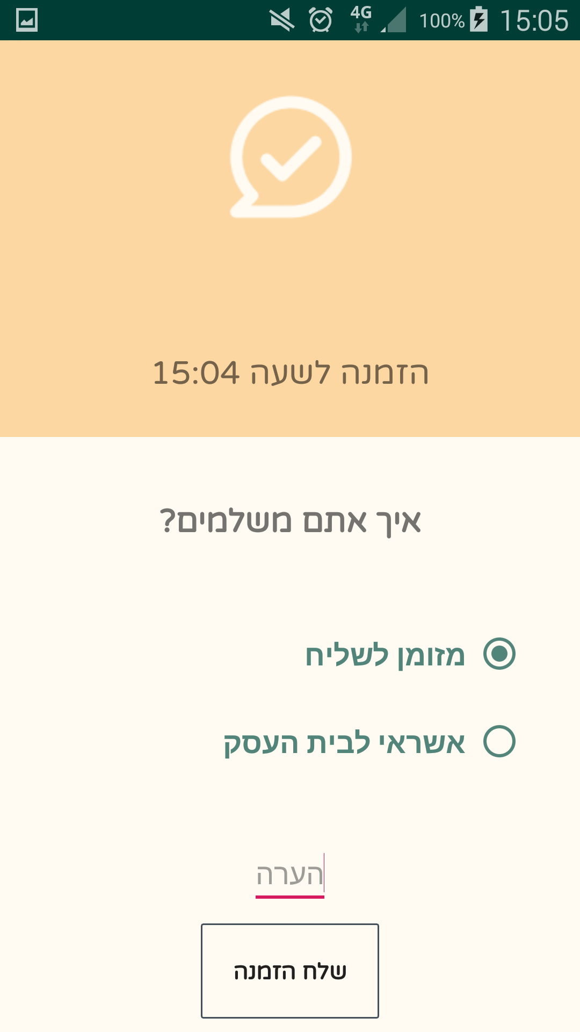
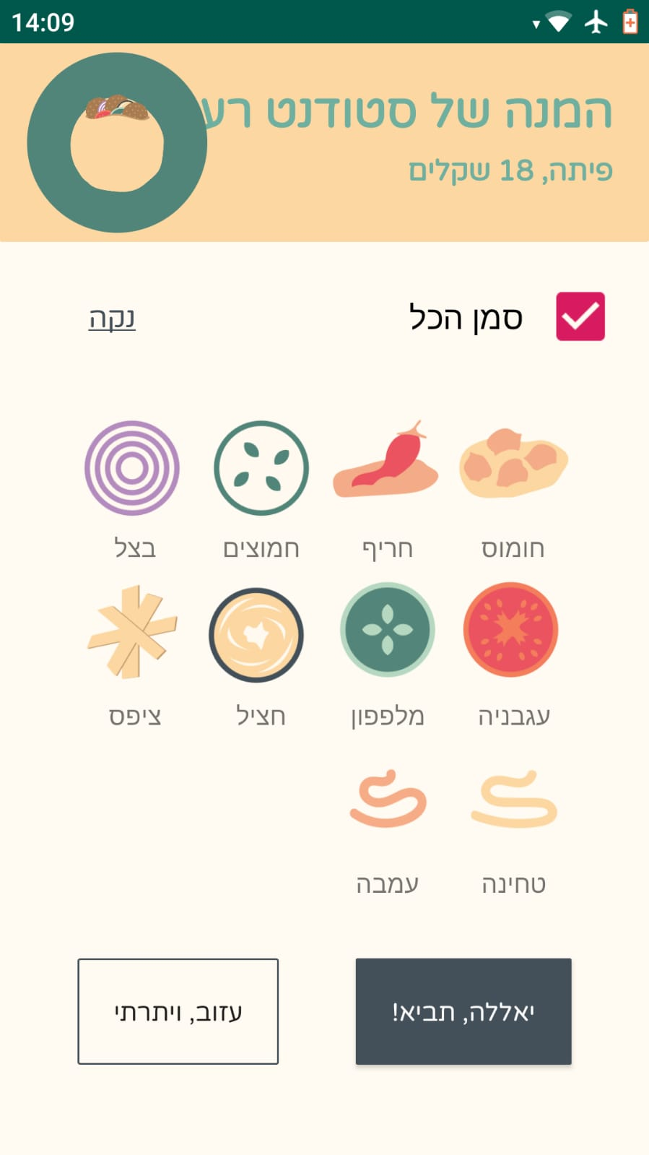
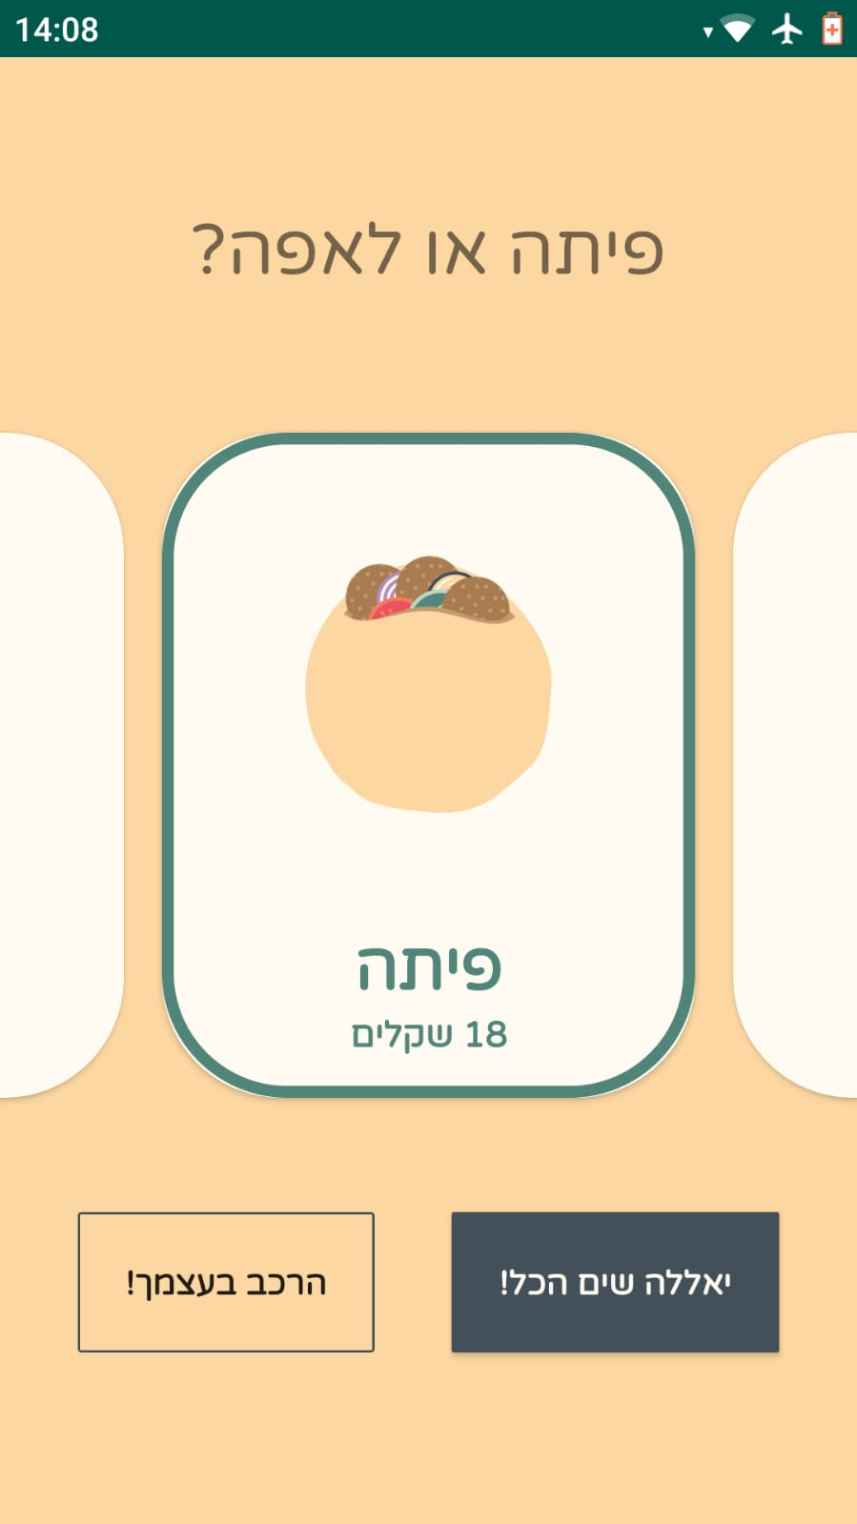

Slide 17
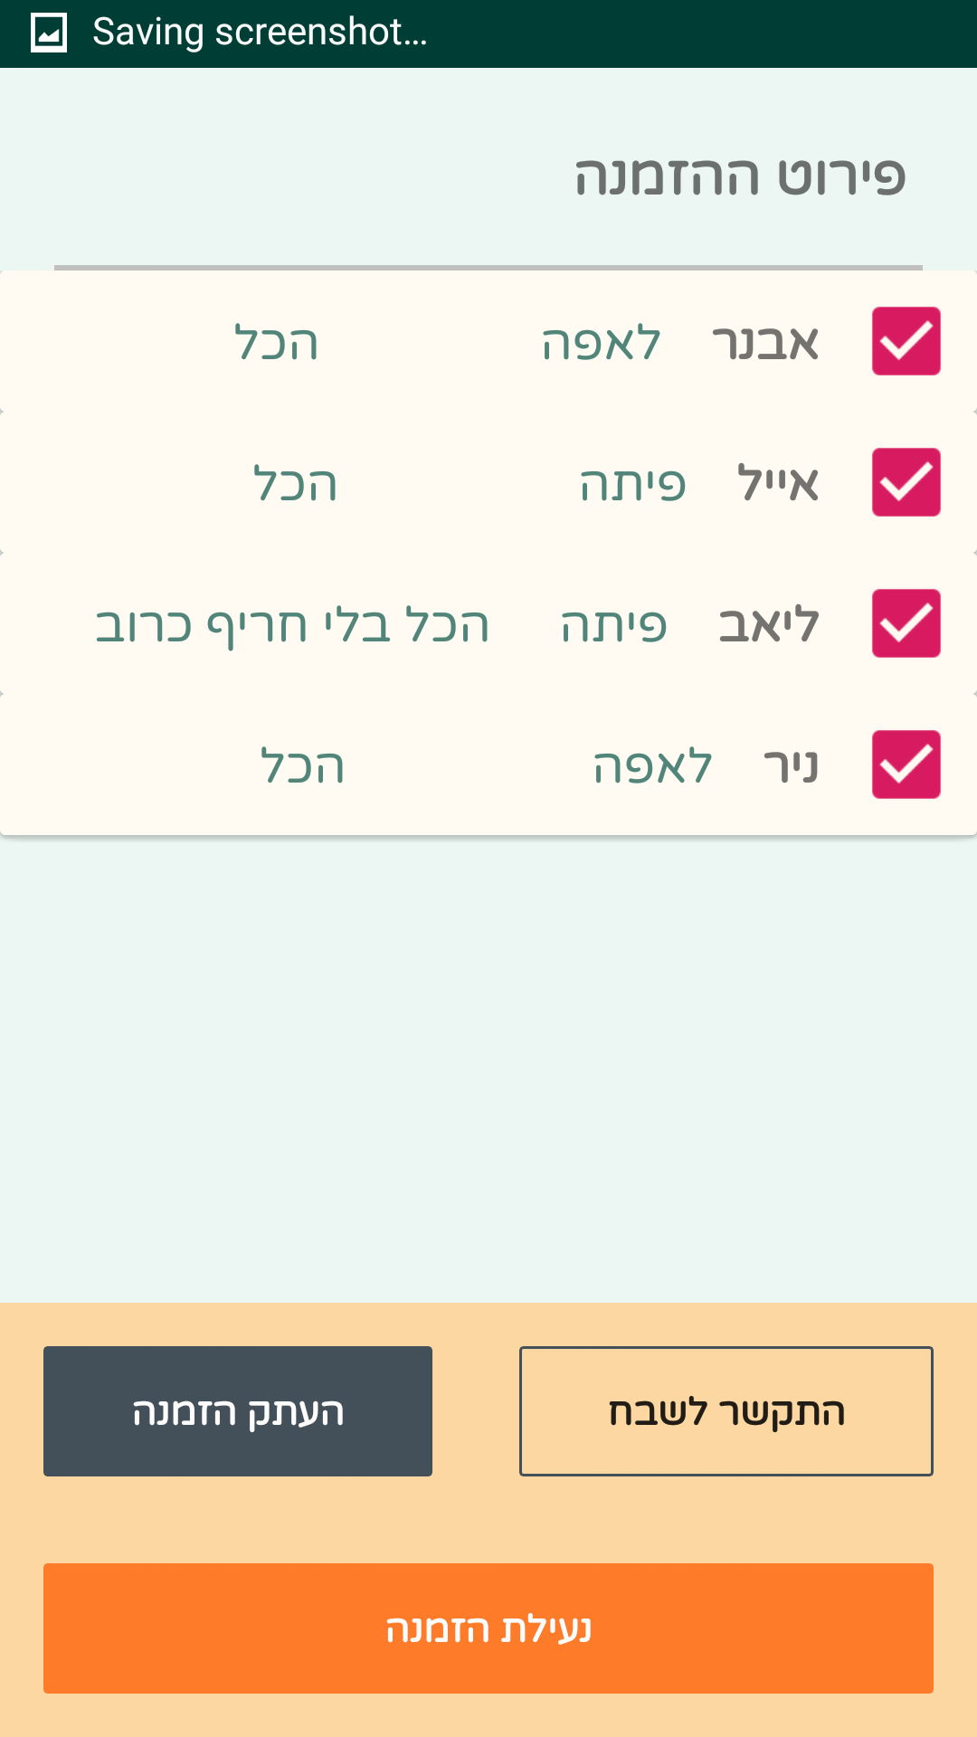
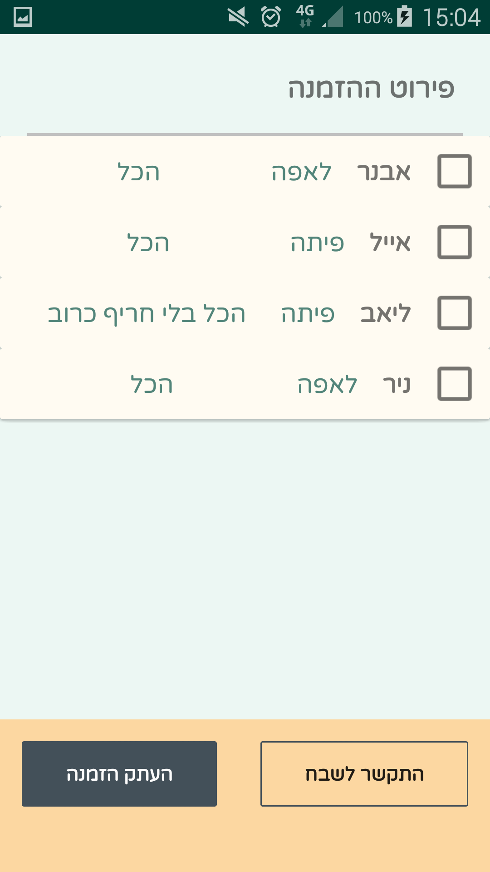

Slide 18

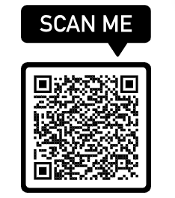
Final Product
Wanna try ???

Slide 19
Conclusion and Takeaways
1. What went as planned?
We were satisfied with the final product - a useful, intuitive and elegant app to solve a dire problem
2. What didn't go as planned?
Especially at the beginning of the project - we weren’t focused and had problems getting things started.
3. What did you learn?
Working as a team, collaborating efficiently, and splitting work among members.

Slide 20
Conclusion and Takeaways
4. Major Challenges.
Working correctly with an asynchronous db, using git correctly, and embedding design ideas into actual code

Slide 21
Thank you!
& Bon Appétit!

