Slide 1
GPU Virtualization:
What we should know today
Liang Yan (lyan)
Virtualization Team

Slide 2
Outline
Scheduled Downtime
1. Background
GPU
Virtualization
2. GPU virtualization
Definition and Classification
Use scenario
3. Critical techniques
SRIOV vs MDEV
4. Demo
5. Current status and Todo
SUSE
Outside Provider
6. Q&A

Slide 3
Background

Slide 4
GPU Graphic Process Unit
• 1980’s – No GPU. PC used VGA controller
• 1990’s – Add more function into VGA controller
• 1997 – 3D acceleration functions:
Hardware for triangle setup and rasterization
Texture mapping
Shading
• 2000 – A single chip graphics processor ( beginning of GPU term)
• 2005 – Massively parallel programmable processors
• 2007 – CUDA (Compute Unified Device Architecture)
Notes:
Unplanned downtime impacts more to you than the planned one. The top causes of unplanned downtime, according to Forrester, are operational failures, natural disasters and human-caused events. You may already know that power failure and IT hardware failure might cause the downtime. Natural disasters, of course, may bring lots of trouble to you. And interestingly, human error are causing 13% of the downtime. This might be an area that people omit and it might be easier to fix than natural disaster.

Slide 5
GPU Purpose
Graphic Render
    3D hardware acceleration
      DirectX
      OpenCL
      Vulkan
General Compute
    Big Data, Machine Learning: Tensor-flow, Caffe2
      CUDA Compute Unified Device Architecture
      OpenCL Open Computing Language
Notes:
Let’s take a closer look at the workloads that are prone to downtime. The first type of workload is business critical (or mission critical) workloads. These workloads have a big impact on the daily operation of the business, or impact a lots of users. Examples are SAP applications, Databases, transactional workloads and more.
Another type of workload is virtualization host. As more and more companies are centralizing workloads onto a big virtual host machine to save cost, the availability of the underlying host is becoming critical. Downtime of the host might impact many virtual guests and applications.

Slide 6
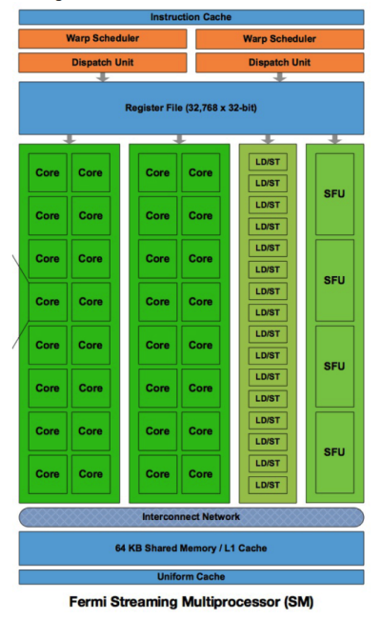
GPU Structure
Fermi
First generation of Tesla
Unified Architecture
MIMD ==> but better performance with SIMD
VLIW
Different Storage Unit
  Register File
  L1
  L2
  GPU Memory VRAM

Slide 7
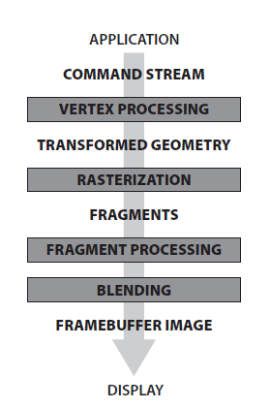
GPU
GPU Pipeline Structure
Traditional Pipeline Structure
Vertex Shader
Fragment/Pixel Shader
Other Shader
====================
New Unified Architect:
Unified shader
Notes:
IT systems are playing more and more critical role for the overall business. From earlier year silo systems towards the direction of more connected computing model. As a result, more and more systems are considered critical. According to a recent Forrester survey, about 72% of applications and data are considered mission-critical or business-critical. One common challenge to these application and data is: downtime!

Slide 8
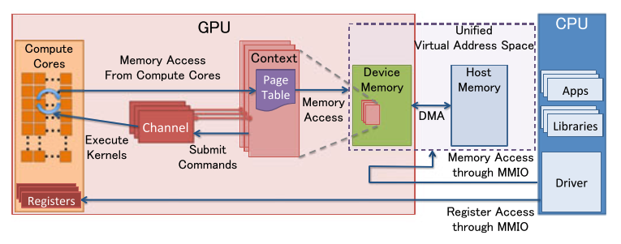
GPU resource management
1. Channel
a command submission system,which is used to launch GPU
programs, start DMA operations or synchronize CPU and GPU
2. Context
3. Memory
VRAM: frame buffer
GTT: ring buffer for channel here
Source: NVIDIA, Inc.
Notes:
Unplanned downtime impacts more to you than the planned one. The top causes of unplanned downtime, according to Forrester, are operational failures, natural disasters and human-caused events. You may already know that power failure and IT hardware failure might cause the downtime. Natural disasters, of course, may bring lots of trouble to you. And interestingly, human error are causing 13% of the downtime. This might be an area that people omit and it might be easier to fix than natural disaster.

Slide 9

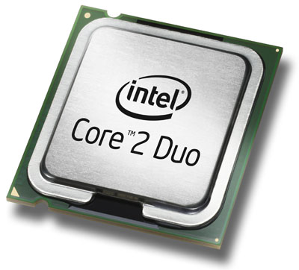
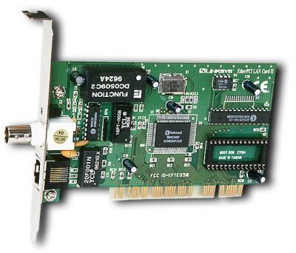
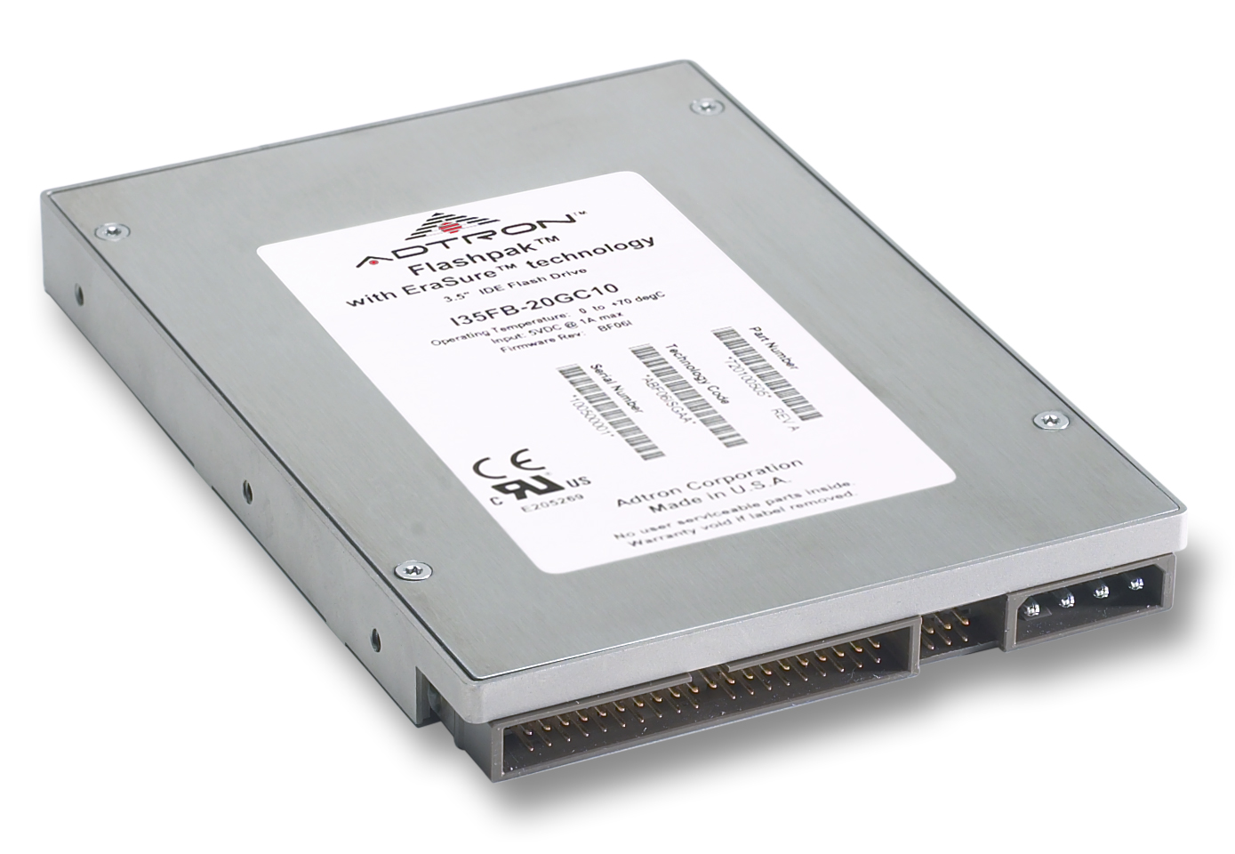
Virtualization
What is virtualization?
App. A
App. B
App. C
App. D
Virtual
Machine
OS
What is virtualization?
Choices:
KVM, XEN, Cirtrix XEN-Server, VMWare Vsphere, Hyper-V
Virtual
Machine
OS
App. A
App. B
App. C
App. D
Operating System
Virtualization
Hardware
Hardware
Why?
New infrastructure, fundamental of Cloud
Efficient, Security,
Choices:
KVM, XEN, Cirtrix XEN-Server, VMWare Vsphere, Hyper-V
Notes:
Unplanned downtime impacts more to you than the planned one. The top causes of unplanned downtime, according to Forrester, are operational failures, natural disasters and human-caused events. You may already know that power failure and IT hardware failure might cause the downtime. Natural disasters, of course, may bring lots of trouble to you. And interestingly, human error are causing 13% of the downtime. This might be an area that people omit and it might be easier to fix than natural disaster.

Slide 10
Virtualization
Basic idea:
Try to make VM access Physical Resource directly, decrease the overload by Virtualization.
Different Stage:
Emulation (QEMU, Bachs)
Para virtualization (XEN pv, QEMU virtio)
Full (Hardware assistant) virtualization
CPU:
VT-x Root and None-Root Mode
Memory:
EPT/NPT
IO device
VT-d/ AMD-Vi /SMMU
SR-IOV/MR-IOV
Virtual
Machine
OS
Virtual
Machine
OS
Virtualization
Hardware
Notes:
Unplanned downtime impacts more to you than the planned one. The top causes of unplanned downtime, according to Forrester, are operational failures, natural disasters and human-caused events. You may already know that power failure and IT hardware failure might cause the downtime. Natural disasters, of course, may bring lots of trouble to you. And interestingly, human error are causing 13% of the downtime. This might be an area that people omit and it might be easier to fix than natural disaster.

Slide 11
GPU Virtualization

Slide 12
GPU Virtualization
Virtual GPU for Guest VM
Like a real GPU as much as possible
GPU virtualization, different stage like Virtualization
Software Virtualization
● Software Emulated
CPU “trap and emulate” GPU instruction
Slow, limited function
● API forwarding
Frontend intercept APIs and forward
Backend translate and send back
Simple idea, but painful for API compatible
IO virtualization, GPU as a PCIe device today.
● GPU Passthrough
● Full GPU Virtualization
Notes:
Unplanned downtime impacts more to you than the planned one. The top causes of unplanned downtime, according to Forrester, are operational failures, natural disasters and human-caused events. You may already know that power failure and IT hardware failure might cause the downtime. Natural disasters, of course, may bring lots of trouble to you. And interestingly, human error are causing 13% of the downtime. This might be an area that people omit and it might be easier to fix than natural disaster.

Slide 13
GPU Passthrough
GPU as a PCIe device today.
Full API support in Guest VM
Stable, supported by all Vendors with hardware requirement
From SLES 12SP2
SOC 8
Native-close performance, 95~97%
PCI resources:
PCI configure space, ROM, BARs(PIO, MMIO)
Key Components:
IOMMU: Hardware
VFIO: DMA operation in userspace level
Notes:
Unplanned downtime impacts more to you than the planned one. The top causes of unplanned downtime, according to Forrester, are operational failures, natural disasters and human-caused events. You may already know that power failure and IT hardware failure might cause the downtime. Natural disasters, of course, may bring lots of trouble to you. And interestingly, human error are causing 13% of the downtime. This might be an area that people omit and it might be easier to fix than natural disaster.

Slide 14
VFIO and IOMMU
PCI resources:
PCI configure space, ROM, BARs(PIO, MMIO)
IOMMU: Hardware
DMA remapping
Interrupt remapping
VFIO: userspace driver for PCI device
Configure space QEMU emulated with VFIO
PIO I/O bitmap of VMCS
MMIO EPT
Interrupt IOEVENTFD IRQFD IOMMU
DMA IOMMU GPA <==> HPA

Slide 15
Full GPU Virtualization
Run native graphics driver in VM
Achieve good performance and moderate multiplexing capability
● Split
Time Slices
framebuffer memory
● Isolate
Give a neat access between VM and Host Physical Device
IOMMU/Mdev and VFIO
DMA
Interrupt
● Schedule
Efficient and Robust
Pretty fix for AMD,
More flexible for NVIDIA, RR, BOND
Notes:
Unplanned downtime impacts more to you than the planned one. The top causes of unplanned downtime, according to Forrester, are operational failures, natural disasters and human-caused events. You may already know that power failure and IT hardware failure might cause the downtime. Natural disasters, of course, may bring lots of trouble to you. And interestingly, human error are causing 13% of the downtime. This might be an area that people omit and it might be easier to fix than natural disaster.

Slide 16
Full GPU Virtualization
vGPU Investments Upstream
● NVIDIA (GRID)
● Intel (GVT-G)
● AMD(GIM)
Intel has no VRAM
AMD has IOMMU support
SRIOV 97%
MDEV 80~90%

Slide 17
Full GPU Virtualization
Nvidia
Tesla Series: Volta Pascal Maxwell M6 M10 M60 P4 P6 P40 P100 V100
GRID: Kepler K1 K2 (VDI and application virtualization)
http://www.nvidia.com/object/grid-certified-servers.html
AMD
FirePro S7150 S7150x2
Radeon Pro V320 V340
Radeon Instinct MI6 MI8 MI25(Machine learning interface, CUDA compatible with HIP)
https://lists.freedesktop.org/archives/amd-gfx/2016-December/004075.html
Intel
Haswell(3VMs) Broadwell(7VMs) Skylake, Kaby Lake
https://github.com/intel/gvt-linux/wiki

Slide 18
SRIOV vs Mdev

Slide 19
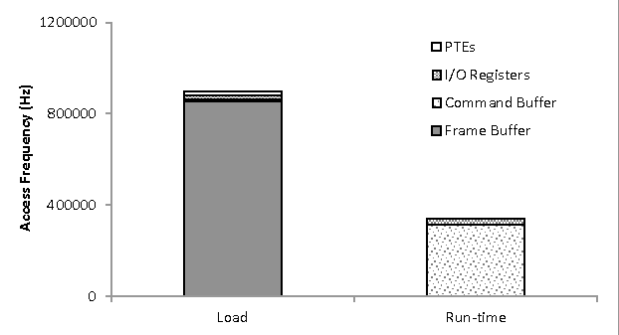

Slide 20
SR-IOV devices
supported by standard VFIO PCI (Direct Assignment)
Established QEMU VFIO/PCI driver, KVM agnostic and well-defined UAPI Virtualized PCI config /MMIO space access, interrupt delivery Modular IOMMU, pin and map memory for DMA
Mediated devices
non SR-IOV, require vendor-specific drivers to mediate sharing Leveraging existing VFIO framework, UAPI Vendor driver - Mediated Device – managing device’s internal I/O resource

Slide 21
MEDIATED DEVICE FRAMEWORK
Mediated core module (new) Mediated bus driver, create mediated device Physical device interface for vendor driver callbacks Generic mediate device management user interface (sysfs)
Mediated device module (new) Manage created mediated device, fully compatible with VFIO user API
VFIO IOMMU driver (enhancement) VFIO IOMMU API TYPE1 compatible, easy to extend to non-TYPE1

Slide 22
Registers VFIO MDEV as driver
Vendor driver registers devices
Vendor driver registers Mediated CBs
User writes mdev sysfs to create mdev device
QEMU calls VFIO API to add VFIO dev to IOMMU container, group, get fd back
QEMU access device fd and present it into VM
A mediated pass-through solution for graphics virtualization •
Pass-through performance critical resources •
Trap-and-emulate privileged operations •
Maintain a device model per VM

Slide 23
Demo

Slide 24
Demo
Intel GVT-G
    3D hardware acceleration
      DirectX
      OpenCL
      Vulkan
Nvidia GRID
    Big Data, Machine Learning: Tensor-flow, Caffe2
      CUDA Compute Unified Device Architecture
      OpenCL Open Computing Language
Notes:
Let’s take a closer look at the workloads that are prone to downtime. The first type of workload is business critical (or mission critical) workloads. These workloads have a big impact on the daily operation of the business, or impact a lots of users. Examples are SAP applications, Databases, transactional workloads and more.
Another type of workload is virtualization host. As more and more companies are centralizing workloads onto a big virtual host machine to save cost, the availability of the underlying host is becoming critical. Downtime of the host might impact many virtual guests and applications.

Slide 25
Use Scenario
GPU as a service
IVI
Visual Cloud

Slide 26
Current Status and ToDo

Slide 27
Most of the work is done by Intel Nvidia IBM and RH unfortunately
SUSE
- Intel KVMGT technical ready
- Nvidia GRID technical ready
- AMD MxGPU ongoing
- GPU passthrough stage for Cloud
- GPU virtualization for CAAS
Outside
- Remote display
- IOMMU compatible
- Live Migration
- Scalability

Slide 28
Question?

Slide 29
REFERENCE
VGPU ON KVM
An Introduction to PCI Device Assignment with VFIO - Alex Williamson,
Red Hat [Qemu-devel] [PATCH v7 0/4] Add Mediated device support
[libvirt] [RFC] libvirt vGPU QEMU integratio
https://yq.aliyun.com/articles/590909?spm=a2c4e.11153940.blogcont599189.23.f2016d7bXPo7TD
https://zhuanlan.zhihu.com/p/35489035

Slide 31
Unpublished Work of SUSE. All Rights Reserved.
This work is an unpublished work and contains confidential, proprietary, and trade secret information of SUSE.
Access to this work is restricted to SUSE employees who have a need to know to perform tasks within the scope of their assignments. No part of this work may be practiced, performed, copied, distributed, revised, modified, translated, abridged, condensed, expanded, collected, or adapted without the prior written consent of SUSE.
Any use or exploitation of this work without authorization could subject the perpetrator to criminal and civil liability.
General Disclaimer
This document is not to be construed as a promise by any participating company to develop, deliver, or market a product. It is not a commitment to deliver any material, code, or functionality, and should not be relied upon in making purchasing decisions. SUSE makes no representations or warranties with respect to the contents of this document, and specifically disclaims any express or implied warranties of merchantability or fitness for any particular purpose. The development, release, and timing of features or functionality described for SUSE products remains at the sole discretion of SUSE. Further, SUSE reserves the right to revise this document and to make changes to its content, at any time, without obligation to notify any person or entity of such revisions or changes. All SUSE marks referenced in this presentation are trademarks or registered trademarks of Novell, Inc. in the United States and other countries. All third-party trademarks are the property of their respective owners.
257-000020-001

