Slide 1
GPU Virtualization:
What we should know today

Slide 2
Outline
1. Background
GPU
Virtualization
2. GPU virtualization
Definition and Classification
Use scenario
3. Critical techniques
4. Demo
5. Current status
Outside Provider
SUSE
6. Todo in SUSE and Outside
7. Q&A

Slide 3
GPU
Graphic: 3D hardware acceleration
DirectX
OpenCL
Vulkan
General Compute(Heterogeneous computing): Big Data, Machine Learning such as Tensorflow and Caffe2
CUDA Compute Unified Device Architecture
OpenCL Open Computing Language
DirectCompute DirectX GPGPU

Slide 4
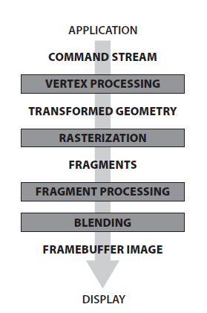
GPU
Pipeline Structure
Vertex Shader
Fragment/Pixel Shader (2x or 3x)
Geometry Shader
==
Unified shader
Unified Architecture

Slide 5
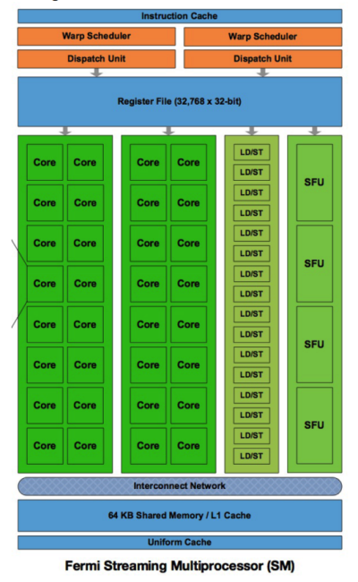
GPU
Fermi
Unified Architecture
First generation of Tesla
Changed a lot today for Volta
MIMD ==> but better performance with SIMD
VLIW
Different Storage Unit
Register File
L1
L2
GPU Memory VRAM
unified Memory

Slide 6
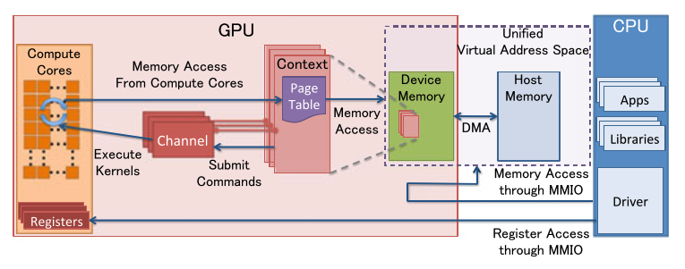
GPU
1. Channel
For command batches
2. Context
3. Memory
VRAM: frame buffer
GTT: ring buffer for channel here

Slide 7

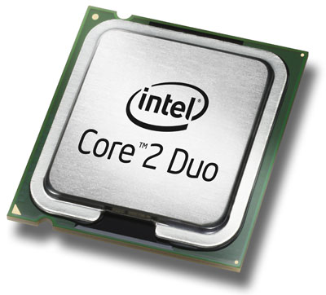
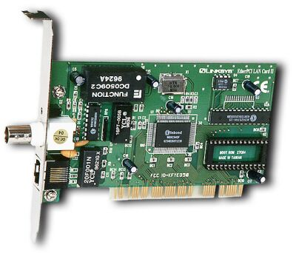
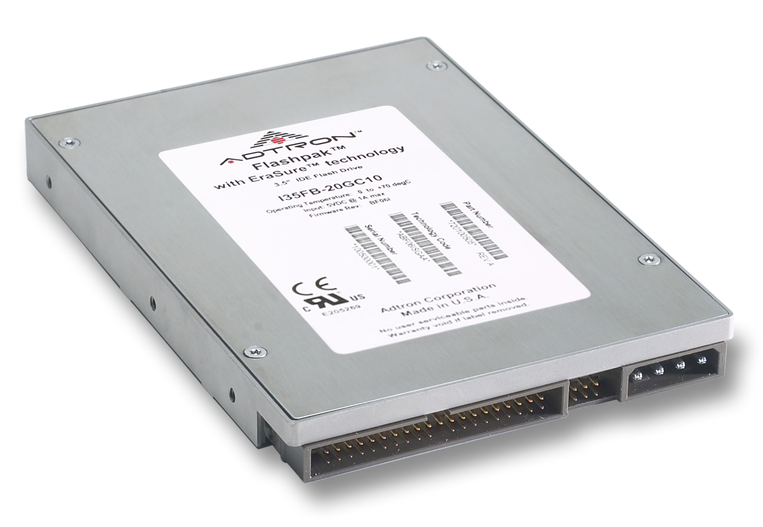
Virtualization
What is virtualization?
Choices:
KVM, XEN, Cirtrix XEN-Server, VMWare Vsphere, Hyper-V
App. A
App. B
App. C
App. D
Virtual
Machine
Operating
System
Virtual
Machine
Operating
System
App. A
App. B
App. C
App. D
Operating System
Virtualization
Hardware
Hardware
Why?
New infrastructure, fundamental of Cloud
Efficient, Security,

Slide 8
Virtualization
Why use virtualization?
Efficient
Security
Convenient
How been used today?
CPU:
VT-x Root and None-Root Mode
Memory:
EPT
IO device
VT-d/ AMD-Vi /SMMU
SR-IOV/MR-IOV

Slide 9
GPU virtualization
Belongs to IO virtualization, AS GPU is a PCIE device today.
GPU virtualization
● Software Emulated
● API forwarding
● GPU Passthrough
● Full GPU Virtualization

Slide 10
Use Scenario
GPU as a service
IVI
Visual Cloud

Slide 11
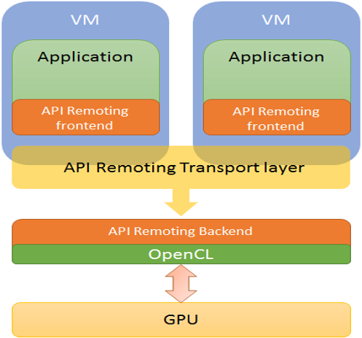
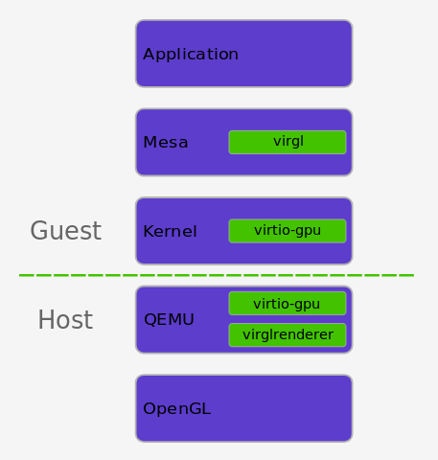

Slide 12
Great performance Full API compatibility
– GPU vendor driver inside the virtual machine Poor density
– limited by PCI-E resource Minimal visibility of the device on the host
– generic vfio_pci owns this device, and only perform enable/disable/route interrupts, reset the device Difficult to cover all graphics workload
– either underutilized or too small to scale V

Slide 13
Full GPU virtualization
In order to share
● Split
Hardware or Software
SRIOV/Mdev
● Isolate
Give a clean and secure access between VM device to Physical Device
IOMMU/Mdev and VFIO
DMA
Interrupt
● Schedule
Efficient and Robust
Pretty fix for AMD,
More flexible for NVIDIA, RR, BOND

Slide 14
GPU virutlization
vGPU Investments Upstream
● NVIDIA (GRID)
● Intel (GVT-G)
● AMD(GIM)
Intel has no VRAM
AMD has IOMMU support
SRIOV 97%
MDEV 80~90%

Slide 15
First implemented on Haswell - Intel 4th Generation Processor
And for XenGT, 2013
Achieve 80% performance of native Linux in VM
• Experimental formal support of Windows VM
• Support up to 3 VMs
• Target rich virtual client usage
Now: KVMGT

Slide 16
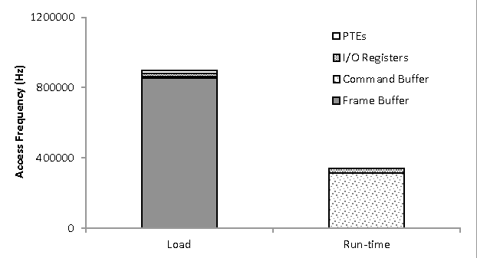

Slide 17
Full GPU virtualization
SR-IOV devices
supported by standard VFIO PCI (Direct Assignment) today Established QEMU VFIO/PCI driver, KVM agnostic and well-defined UAPI Virtualized PCI config /MMIO space access,
interrupt delivery Modular IOMMU, pin and map memory for DMA
Mediated devices
non SR-IOV, require vendor-specific drivers to mediate sharing Leveraging existing VFIO framework, UAPI Vendor driver - Mediated Device – managing device’s internal I/O resource

Slide 18
MEDIATED DEVICE FRAMEWORK
Mediated core module (new) Mediated bus driver, create mediated device Physical device interface for vendor driver callbacks Generic mediate device management user interface (sysfs)
Mediated device module (new) Manage created mediated device, fully compatible with VFIO user API
VFIO IOMMU driver (enhancement) VFIO IOMMU API TYPE1 compatible, easy to extend to non-TYPE1

Slide 19
Registers VFIO MDEV as driver
Vendor driver registers devices
Vendor driver registers Mediated CBs
User writes mdev sysfs to create mdev device
QEMU calls VFIO API to add VFIO dev to IOMMU container, group, get fd back
QEMU access device fd and present it into VM

Slide 20
Virtualization
A mediated pass-through solution for graphics virtualization •
Pass-through performance critical resources •
Trap-and-emulate privileged operations •
Maintain a device model per VM
Run native graphics driver in VM
Achieve good performance and moderate multiplexing capability

Slide 21
Production
Nvidia
Tesla Series: Volta Pascal Maxwell M6 M10 M60 P4 P6 P40 P100 V100
GRID: Kepler K1 K2 (VDI and application virtualization)
http://www.nvidia.com/object/grid-certified-servers.html
AMD
FirePro S7150 S7150x2
Radeon Pro V320 V340
Radeon Instinct MI6 MI8 MI25(Machine learning interface, CUDA compatible with HIP)
https://lists.freedesktop.org/archives/amd-gfx/2016-December/004075.html
Intel
Haswell(3VMs) Broadwell(7VMs) Skylake, Kaby Lake
https://github.com/intel/gvt-linux/wiki

Slide 22
DEMO:
1. Intel VGPU
Requirement:
Kernel 4.12+, QEMU 2.7+
SLES 15 SLES 12SP3
2. NVIDIA VGPU

Slide 23
Status & Todo
SUSE
- Intel KVMGT technical ready
- Nvidia GRID technical ready
- AMD MxGPU ongoing
- GPU passthrough stage for Cloud
- GPU virtualization for CAAS
Outside
- Remote display
- IOMMU compatible
- Live Migration
- Scalar

Slide 24
REFERENCE
VGPU ON KVM
[1] An Introduction to PCI Device Assignment with VFIO - Alex Williamson,
Red Hat [Qemu-devel] [PATCH v7 0/4] Add Mediated device support
https://lists.nongnu.org/archive/html/qemu-devel/2016-08/msg03798.html
[libvirt] [RFC] libvirt vGPU QEMU integratihttps://www.redhat.com/archives/libvir-list/2016-August/msg00939.html
https://yq.aliyun.com/articles/590909?spm=a2c4e.11153940.blogcont599189.23.f2016d7bXPo7TD
https://zhuanlan.zhihu.com/p/35489035

Slide 25
Question?

