Slide 1
Scoreboard
David Culler
Electrical Engineering and Computer Sciences
University of California, Berkeley

Slide 2
Scoreboard: a bookkeeping technique
Out-of-order execution divides ID stage:
  1. Issue—decode instructions, check for structural hazards
  2. Read operands—wait until no data hazards, then read operands
Scoreboards date to CDC6600 in 1963
Instructions execute whenever not dependent on previous instructions and no hazards.
CDC 6600: In order issue, out-of-order execution, out-of-order commit (or completion)
  No forwarding!
  Imprecise interrupt/exception model for now

Slide 3
Scoreboard Architecture (CDC 6600)
FP Mult
FP Mult
FP Divide
Registers
Functional Units
FP Add
Integer
SCOREBOARD
Memory

Slide 4
Four Stages of Scoreboard Control
Issue—decode instructions & check for structural hazards (ID1)
  Instructions issued in program order (for hazard checking)
  Don’t issue if structural hazard
  Don’t issue if instruction is output dependent on any previously issued but uncompleted instruction (no WAW hazards)
Read operands—wait until no data hazards, then read operands (ID2)
  All real dependencies (RAW hazards) resolved in this stage, since we wait for instructions to write back data.
  No forwarding of data in this model!

Slide 5
Four Stages of Scoreboard Control
Execution—operate on operands (EX)
  The functional unit begins execution upon receiving operands. When the result is ready, it notifies the scoreboard that it has completed execution.
Write result—finish execution (WB)
  Stall until no WAR hazards with previous instructions:
  Example: DIVD F0,F2,F4
  ADDD F10,F0,F8
  SUBD F8,F8,F14
  CDC 6600 scoreboard would stall SUBD until ADDD reads operands

Slide 6
Three Parts of the Scoreboard
Instruction status:
Which of 4 steps the instruction is in
Functional unit status:—Indicates the state of the functional unit (FU). 9 fields for each functional unit Busy: Indicates whether the unit is busy or not
Op: Operation to perform in the unit (e.g., + or –)
Fi: Destination register
Fj,Fk: Source-register numbers
Qj,Qk: Functional units producing source registers Fj, Fk
Rj,Rk: Flags indicating when Fj, Fk are ready
Register result status—Indicates which functional unit will write each register, if one exists. Blank when no pending instructions will write that register
Notes:
What you might have thought
1. 4 stages of instruction executino
2.Status of FU: Normal things to keep track of (RAW & structura for busyl):
Fi from instruction format of the mahine (Fi is dest)
Add unit can Add or Sub
Rj, Rk - status of registers (Yes means ready)
Qj,Qk - If a no in Rj, Rk, means waiting for a FU to write result; Qj, Qk means wihch FU waiting for it
3.Status of register result (WAW &WAR)s:
which FU is going to write into registers
Scoreboard on 6600 = size of FU
6.7, 6.8, 6.9, 6.12, 6.13, 6.16, 6.17
FU latencies: Add 2, Mult 10, Div 40 clocks

Slide 7
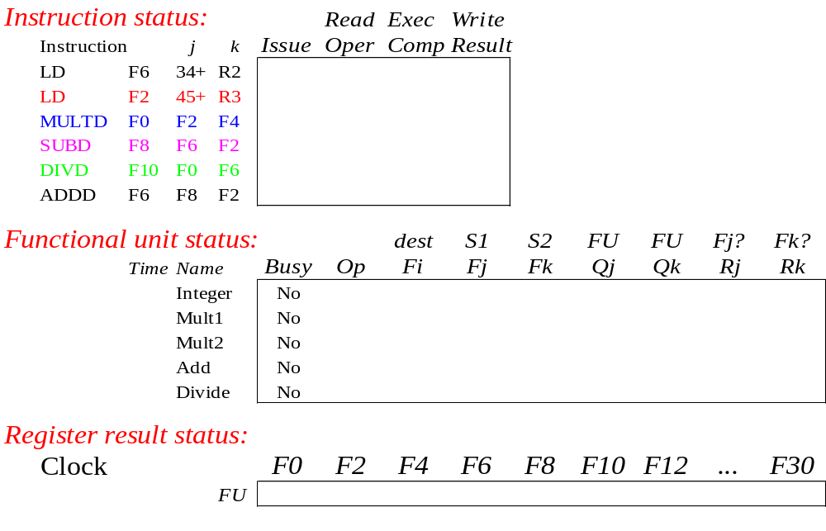
Scoreboard Example

Slide 8
Detailed Scoreboard Pipeline Control
Instruction status
Wait until
Bookkeeping
Issue
Not busy (FU) and not result(D)
Busy(FU) yes; Op(FU) op;
Fi(FU) `D’; Fj(FU) `S1’;
Fk(FU) `S2’; Qj Result(‘S1’);
Qk Result(`S2’); Rj not Qj;
Rk not Qk; Result(‘D’) FU;
Read operands
Rj and Rk
Rj No; Rk No
Execution complete
Functional unit done
Write result
f((Fj(f)≠Fi(FU)
or Rj(f)=No) & (Fk(f)≠Fi(FU) or
Rk( f )=No))
f(if Qj(f)=FU then Rj(f) Yes);
f(if Qk(f)=FU then Rj(f) Yes); Result(Fi(FU)) 0; Busy(FU) No
Notes:
1.Issue - if no structural haards AND non wAW (no Funtional Unit is going to write this destination register; 1 per clock cycle
2. Read -(RAW) if no instructions is going to write a source register of this instruction (alternatively, no write signal this clock cycle) +> gein exection of the instruction; many read ports, so can read many times
3. Execution Complete; multiple during clock cyle
4. Write result - (WAR) If no instructiion is watiing to read the destination register; assume multiple wriite ports; wait for clock cycle to write and tehn read the results; assume can oerlap issue & write
show clock cyclesneed 20 or so
Latency: minimum is 4 through 4 stages

Slide 9
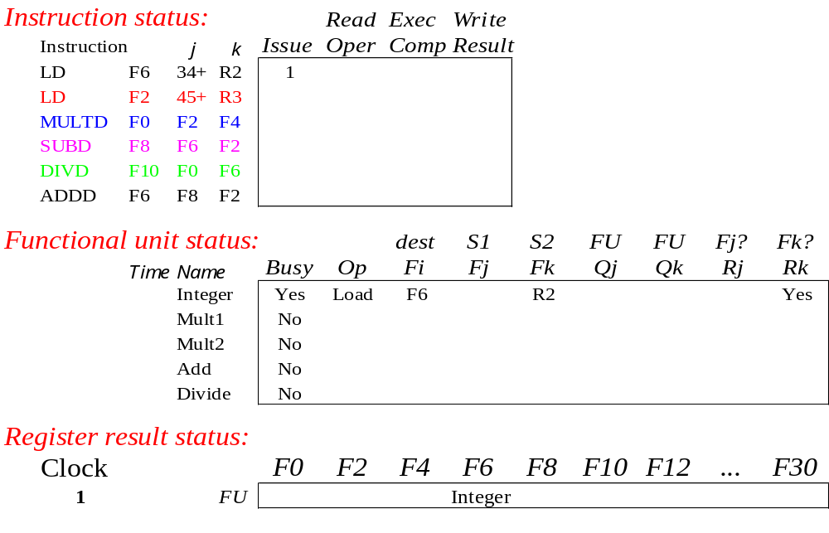
Scoreboard Example: Cycle 1

Slide 10

Scoreboard Example: Cycle 2
Issue 2nd LD?

Slide 11

Scoreboard Example: Cycle 3
Issue MULT?

Slide 12
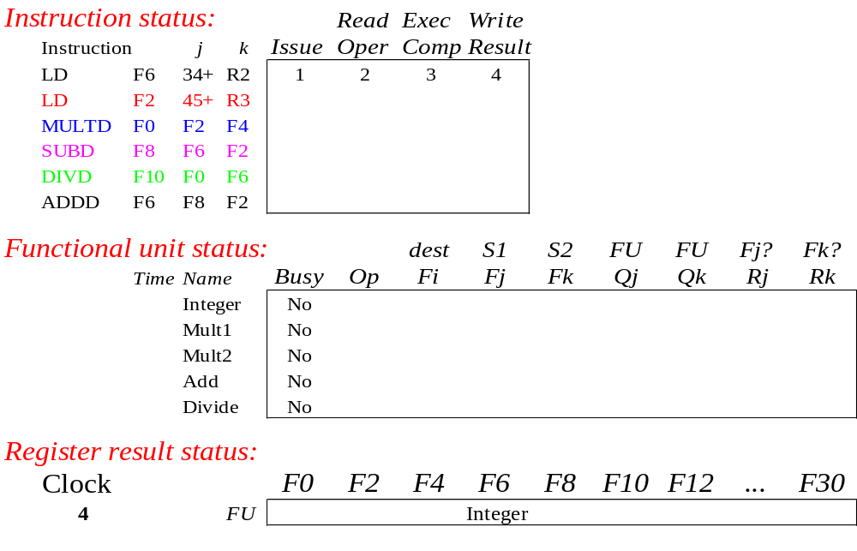
Scoreboard Example: Cycle 4

Slide 13
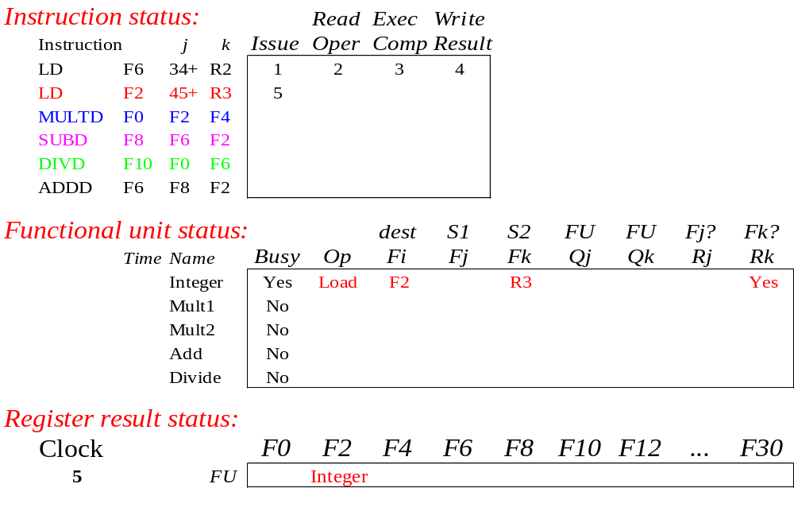
Scoreboard Example: Cycle 5

Slide 14
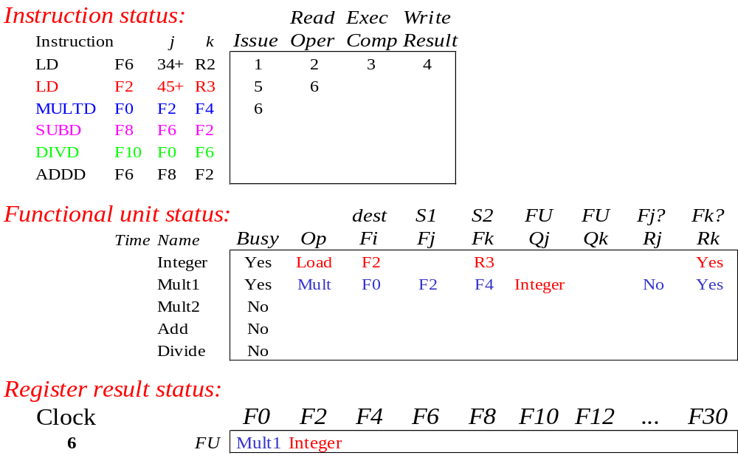
Scoreboard Example: Cycle 6

Slide 15
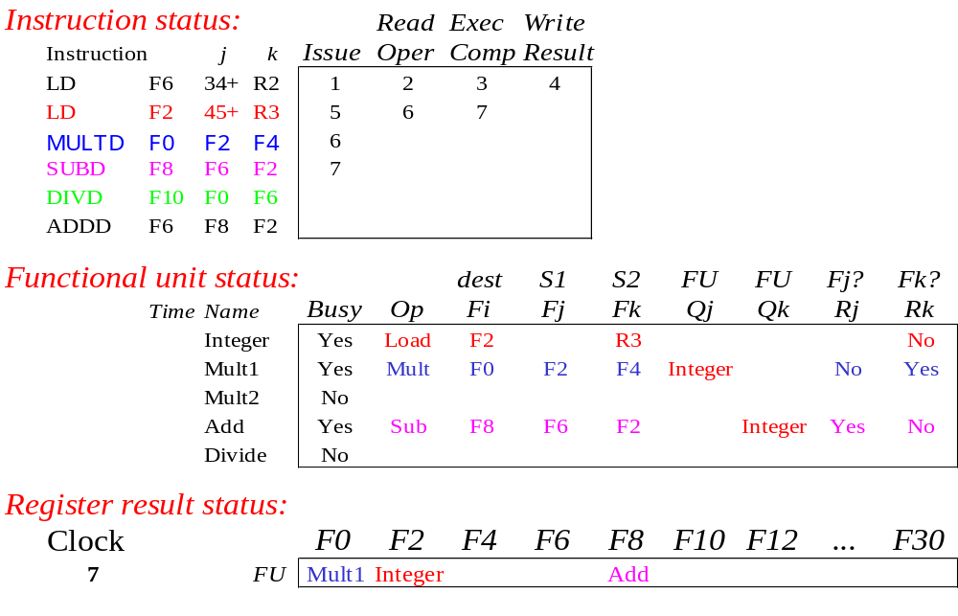
Scoreboard Example: Cycle 7
Read multiply operands?

Slide 16
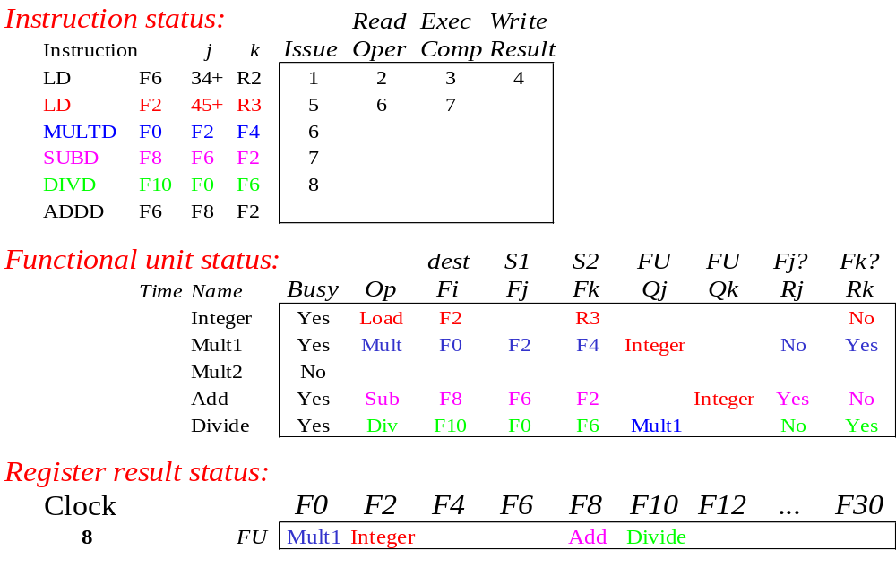
Scoreboard Example: Cycle 8a
(First half of clock cycle)

Slide 17
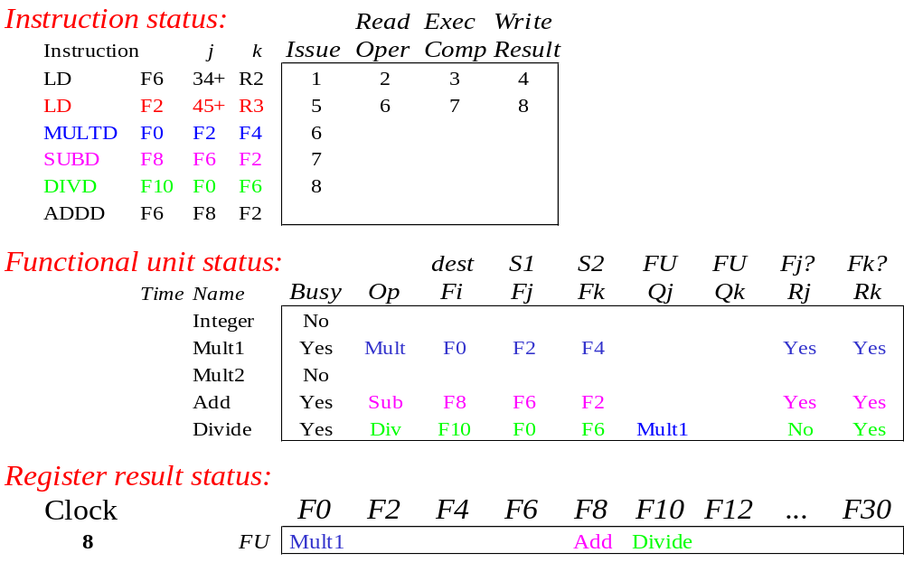
Scoreboard Example: Cycle 8b
(Second half of clock cycle)

Slide 18
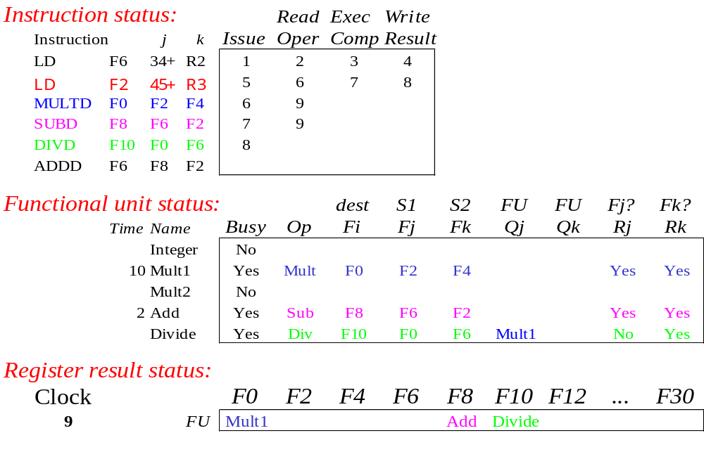
Scoreboard Example: Cycle 9
Note
Remaining
Read operands for MULT & SUB? Issue ADDD?

Slide 19

Scoreboard Example: Cycle 10

Slide 20

Scoreboard Example: Cycle 11

Slide 21
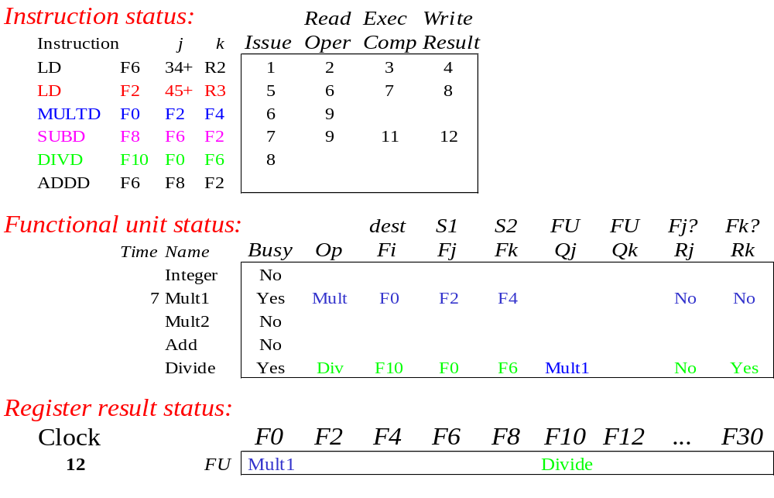
Scoreboard Example: Cycle 12
Read operands for DIVD?

Slide 22
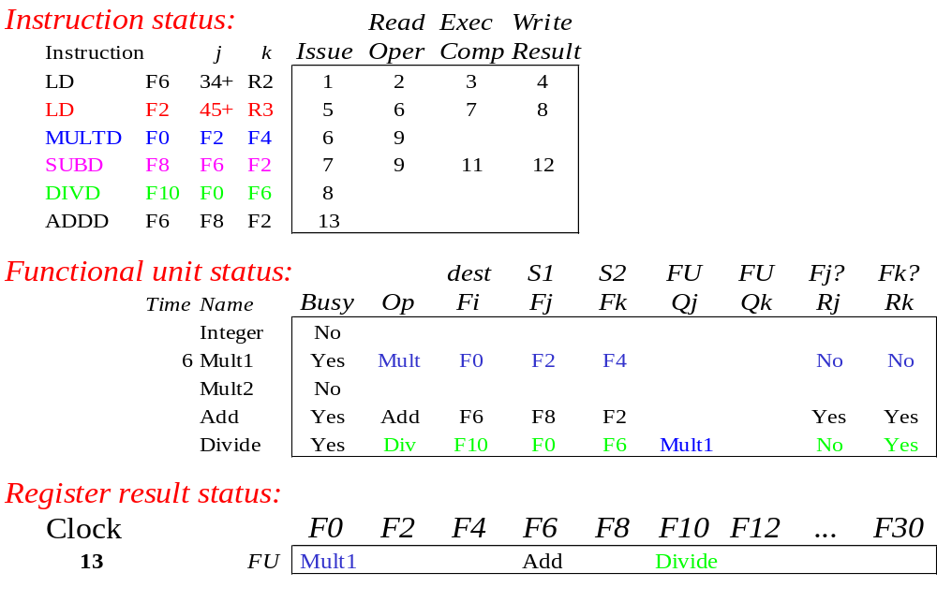
Scoreboard Example: Cycle 13

Slide 23
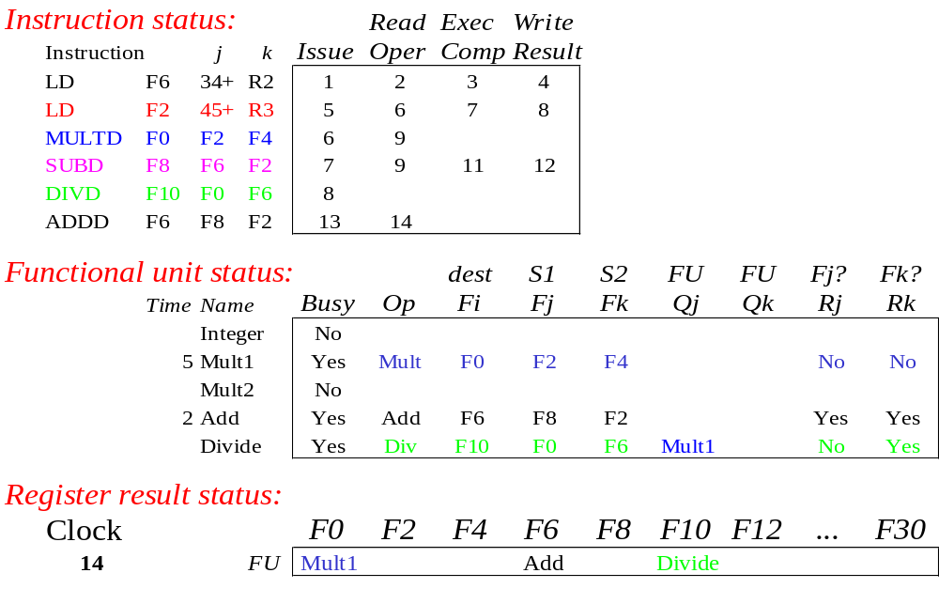
Scoreboard Example: Cycle 14

Slide 24

Scoreboard Example: Cycle 15

Slide 25

Scoreboard Example: Cycle 16

Slide 26

Scoreboard Example: Cycle 17
WAR Hazard!
Why not write result of ADD???

Slide 27

Scoreboard Example: Cycle 18

Slide 28
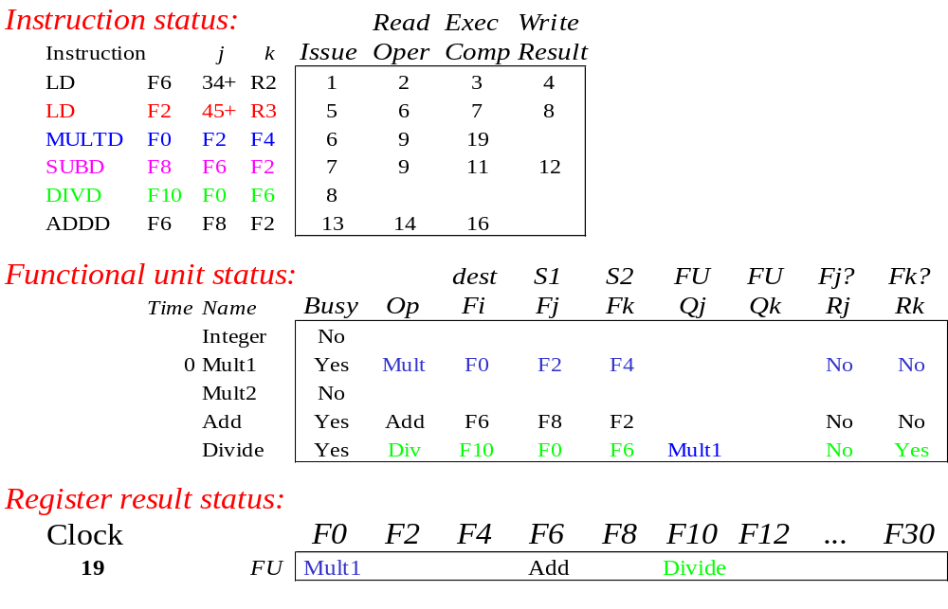
Scoreboard Example: Cycle 19

Slide 29
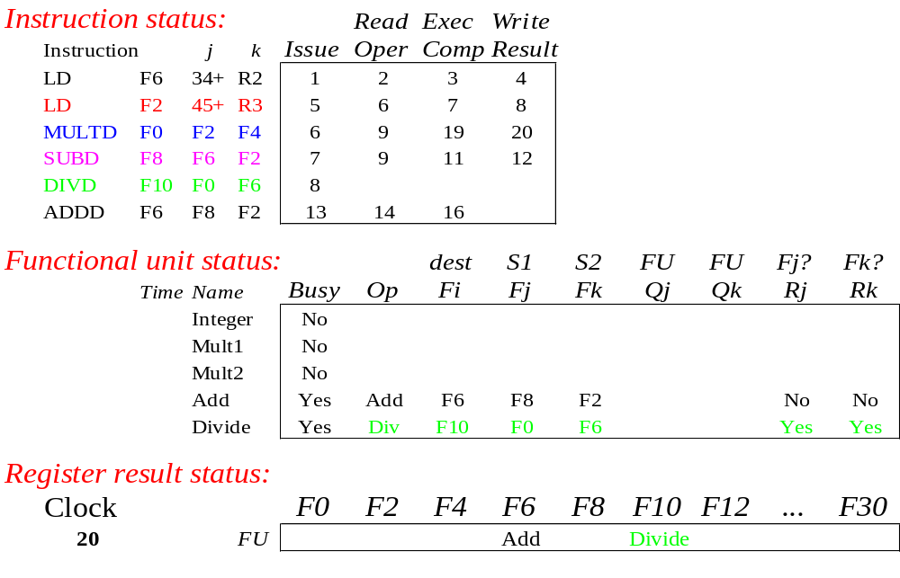
Scoreboard Example: Cycle 20

Slide 30

Scoreboard Example: Cycle 21
WAR Hazard is now gone...

Slide 31
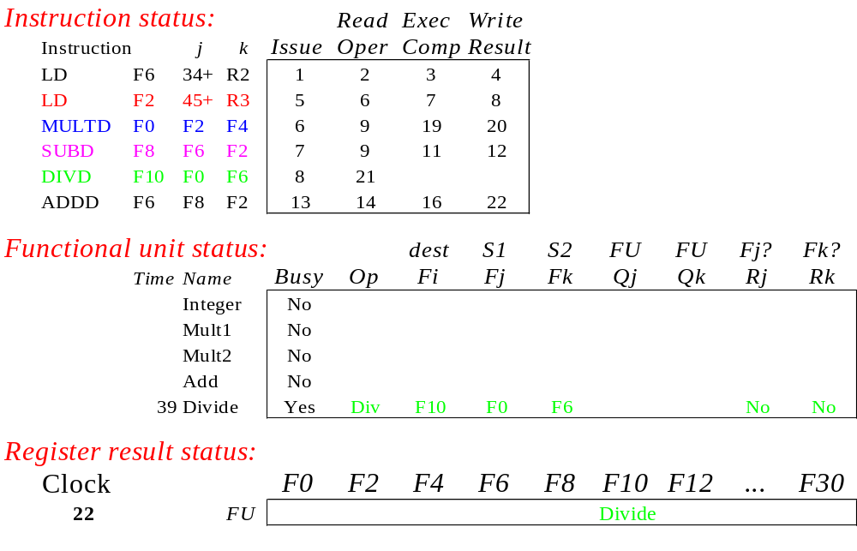
Scoreboard Example: Cycle 22

Slide 32
Faster than light computation
(skip a couple of cycles)

Slide 33
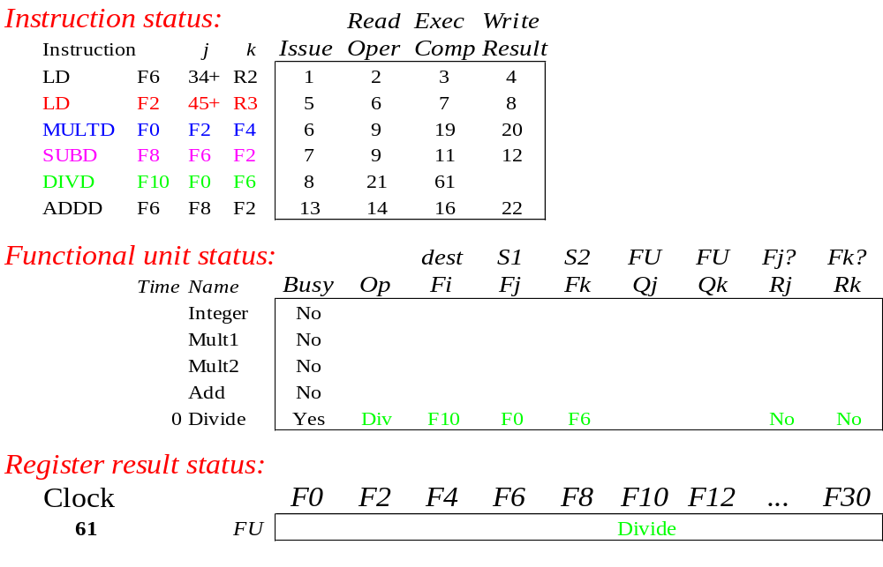
Scoreboard Example: Cycle 61

Slide 34
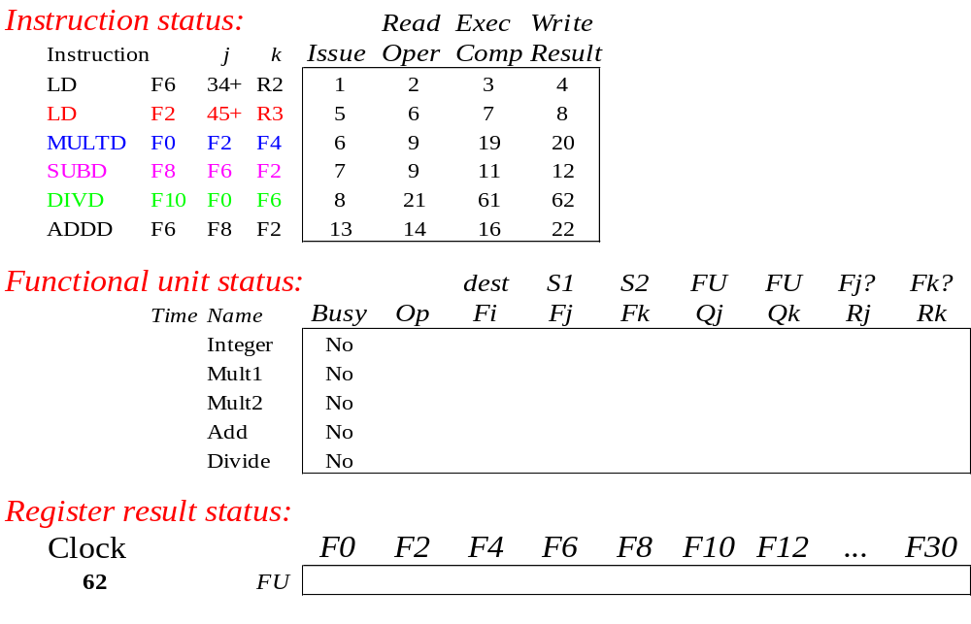
Scoreboard Example: Cycle 62

Slide 35
Review: Scoreboard Example: Cycle 62
In-order issue; out-of-order execute & commit

Slide 36
CDC 6600 Scoreboard
Speedup 1.7 from compiler; 2.5 by hand
BUT slow memory (no cache) limits benefit
Limitations of 6600 scoreboard:
  No forwarding hardware
  Limited to instructions in basic block (small window)
  Small number of functional units (structural hazards), especially integer/load store units
  Do not issue on structural hazards
  Wait for WAR hazards
  Prevent WAW hazards

