Slide 1
Transformers – Foundations of AI and Architecture Study
Through - Attention is all you need
By Khushi RJ
https://www.linkedin.com/in/khushi-j-64562762
05-April-2025
Notes:
Turing test 1950 – imitation game – movie, Turing Award
Chatgpt not possible

Slide 2
Agenda
Tokens and Tokenizers
Background RNN, LSTM and GRU
vanishing gradient problem
Transformers Advantage
Transformers Overview
Encoder – Decoder
Types of Transformers Architecture
Input Embeddings
Positional Encodings
Self Attention Overview
Self attention - Q , K , V
Multiheaded Attention
Residual and Layer Normalization
Positional Embeddings
So Much Fuss! But Why the Hard Work?
Sample Code (simple one)

Slide 3
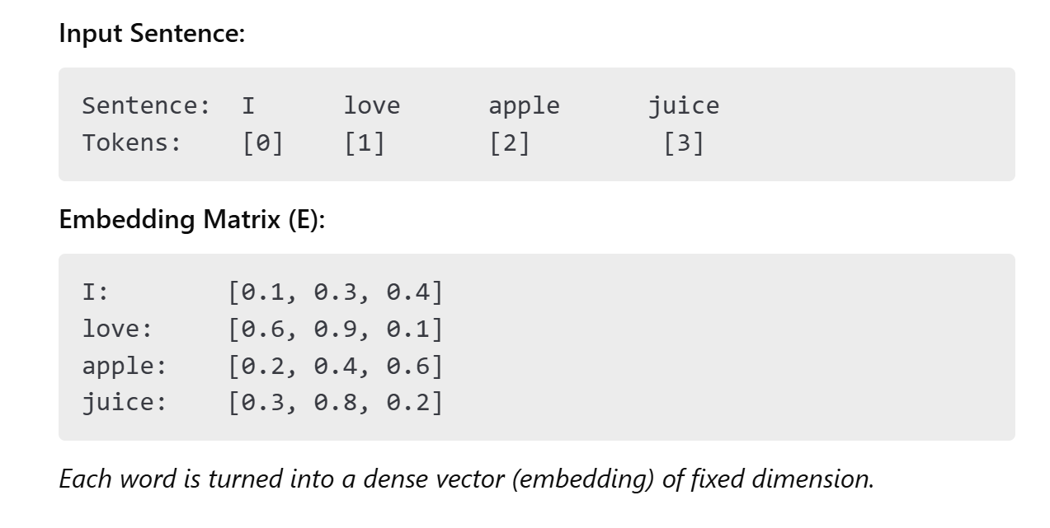
Token to Embedding
Notes:
I am going to office on weekdays

Slide 4
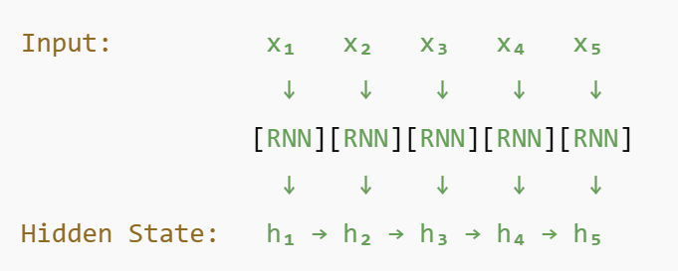
Background RNN, LSTM and GRU
Recurrent Neural Network (RNN) Architecture
RNNs pass hidden state from one timestep to the next, attempting to “remember” the past through recursion.
Cannot retain dependencies for long sequences due to vanishing gradients.

Slide 5
LSTM and GRU
LSTM (Long Short-Term Memory)
Introduces memory cells and gates to better manage what to keep or forget.
Better at learning long-term dependencies.
Still bottlenecked by sequential processing.
Gated Recurrent Unit (GRU)
Lightweight alternative to LSTM
Same sequential memory issues when the input length is long.

Slide 6
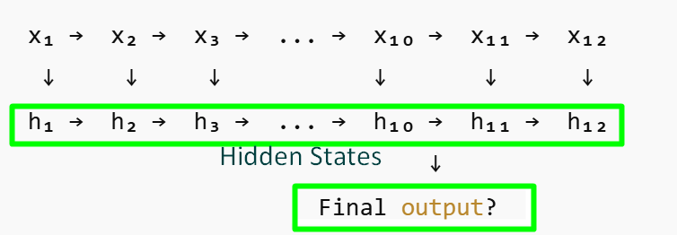
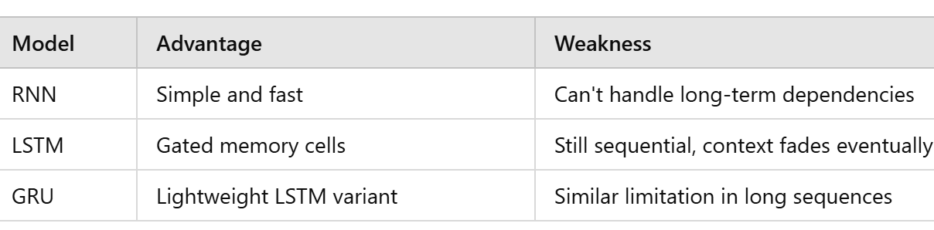
Context Window Limitation in Long Sequences
“She saw the documents, which were delayed because the man, whom the judge criticized, forgot to send them.”
Visualizing How Context Gets Lost
Earlier words like "judge" and "criticized" lose influence over time.
Later words dominate the final output.
The model forgets who did what.

Slide 7
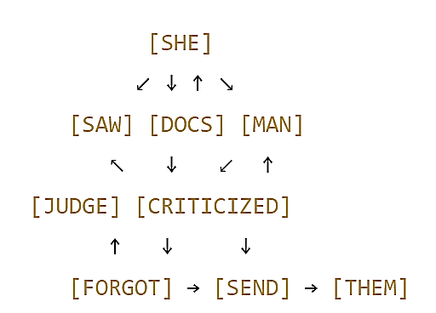
Transformers Advantages
No recurrence - they process the entire sequence in parallel
Self-attention - each token sees all others at once
Global context - even distant relationships are directly connected
Position encoding - since there’s no order naturally, they inject it explicitly
Multi-head attention - model different types of relationships in parallel
Every token
Looks at all other tokens through attention and weights
No dependence on step-by-step memory
All relationships are learned dynamically

Slide 8
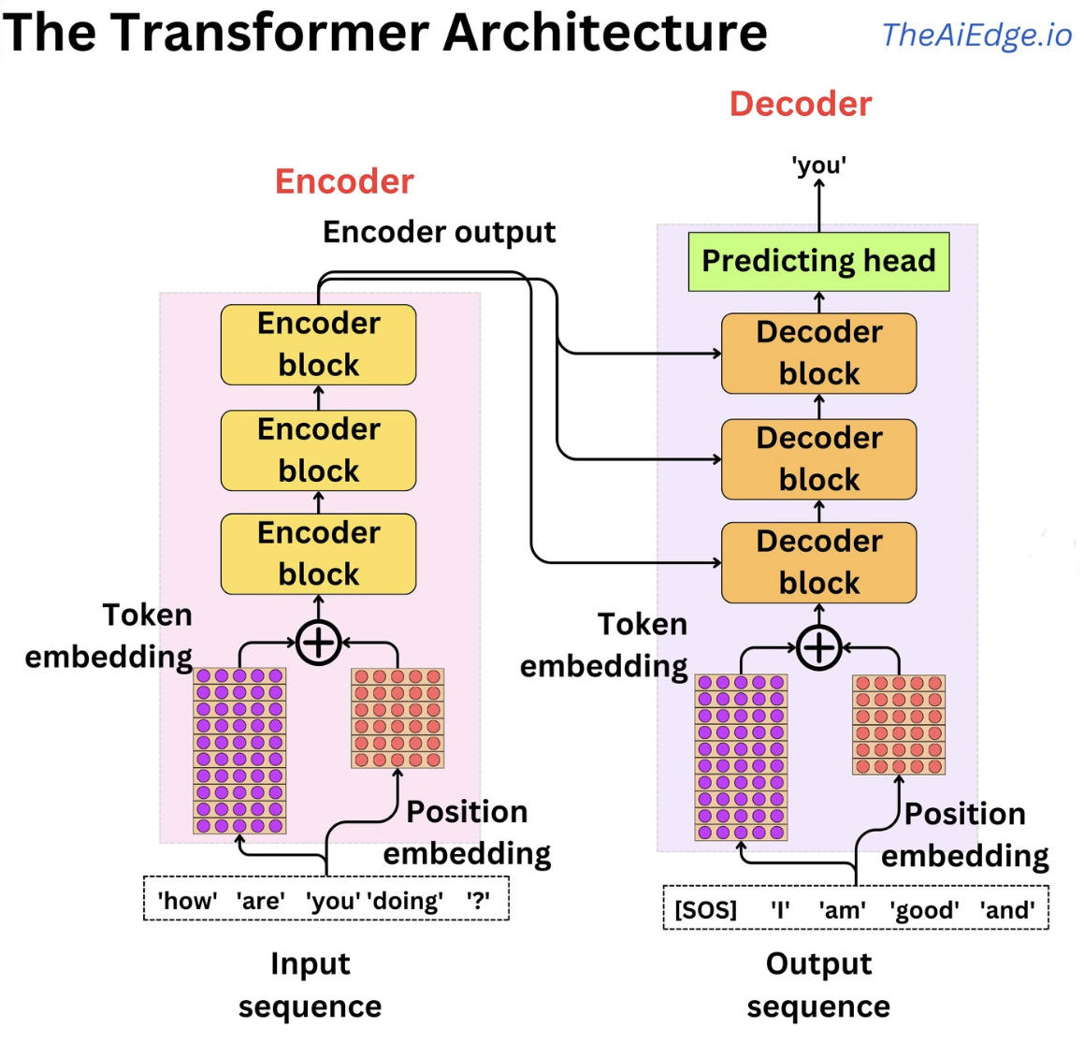
Encoder-Decoder
Encoder: Reads and deeply understands the input.
Decoder: Takes that understanding and generates the output.
It separates understanding (encoder) from generation (decoder)
It's parallelizable (no recurrence like RNNs)
It captures context globally
It can be adapted for translation, summarization, Q&A, code generation, and more

Slide 9
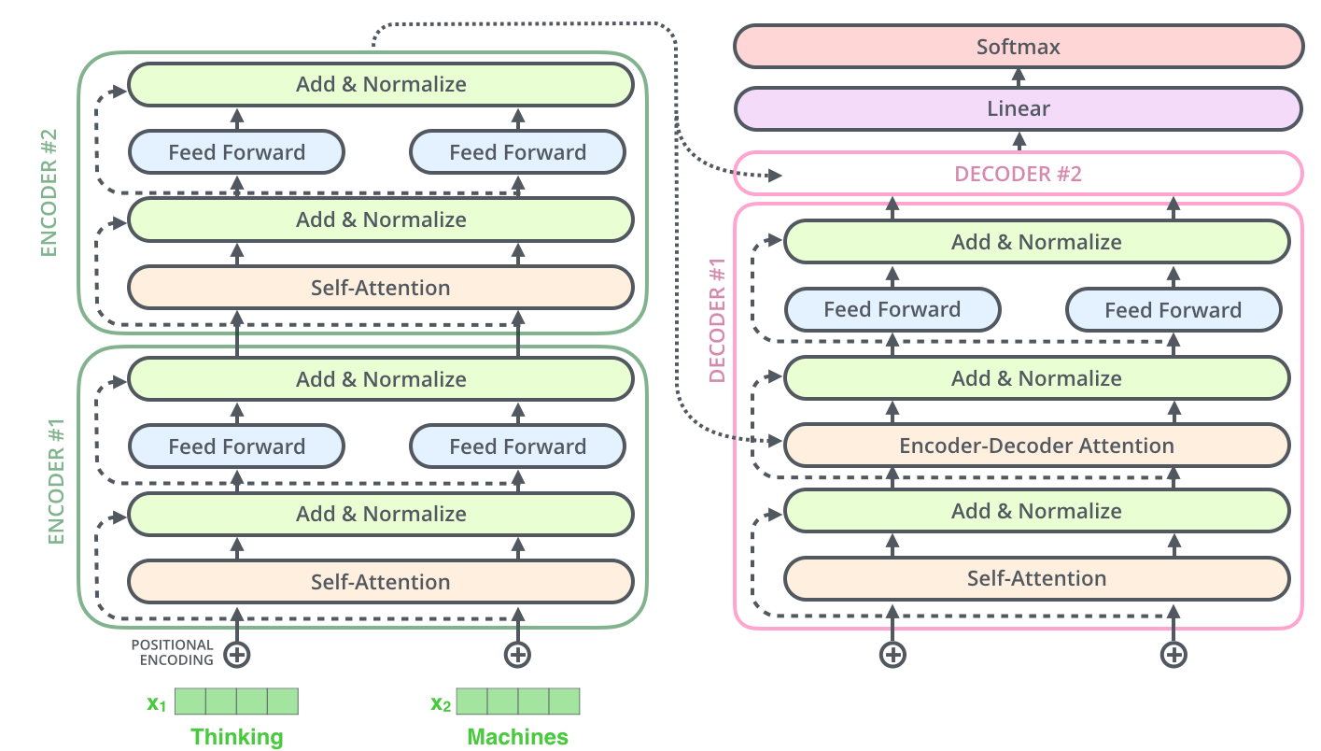
Transformers Overview

Slide 10
Types of Transformers Architectures
Architecture | Description | Key features | Examples | Examples
Encoder-only | Text comprehension | Bidirectional self-attention (each token attends to all others). Strong contextual understanding. | Classification, NER, sentiment analysis | BERT, Roberta, ALBERT, Distilbert, Xlnet, Longformer, Linformer
Decoder-only | Text generation | Causal (unidirectional) self-attention (tokens see only previous tokens). Strong generative capabilities. | Chatbots, creative writing, code generation | GPT-2, GPT-3, GPT-4, Chatgpt, Gpt-neo, GPT-J, Gopher, Llama
Encoder-decoder (seq2seq) | Sequence-to-sequence tasks | Encoder processes input bidirectionally. Decoder generates output autoregressively. Uses cross-attention to link encoder and decoder. | Machine translation, summarization, text-to-text generation | T5, Mt5, BART, M2M-100, Marianmt

Slide 11
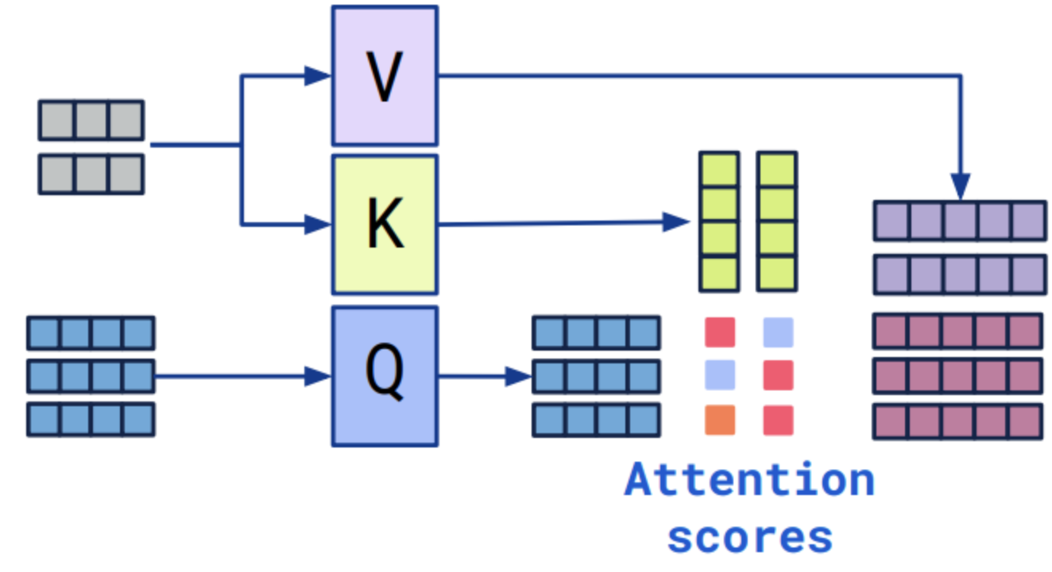
Self Attention Overview
Used token based cross self attention model
Encoder -Decoder structure architecture for translation tasks
In self-attention, the word "bank" checks other words to grasp its meaning:
In "I crossed river to reach the bank," "bank" notices "river," interpreting itself as riverbank.
In "I carried my Cheque to the bank," "bank" sees "Cheque," realizing it's a financial bank.

Slide 12
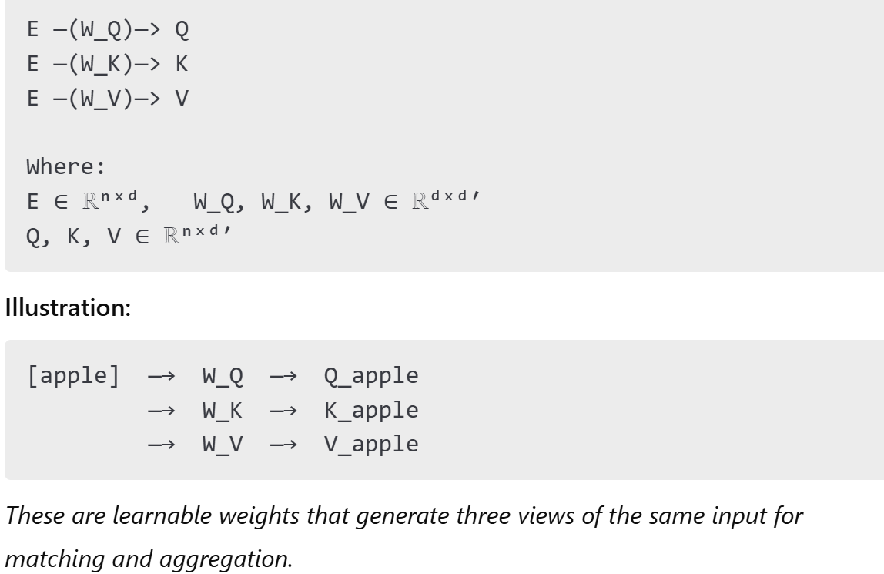
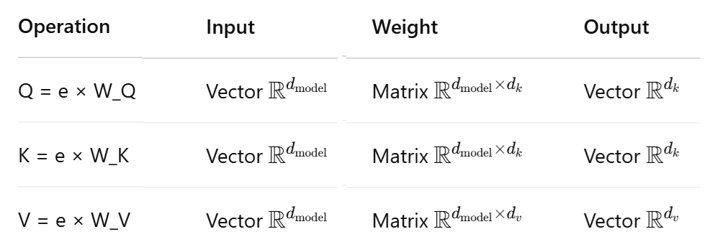
Self Attention : Linear Transformations for Q, K, V
Vector × Matrix = Vector

Slide 13

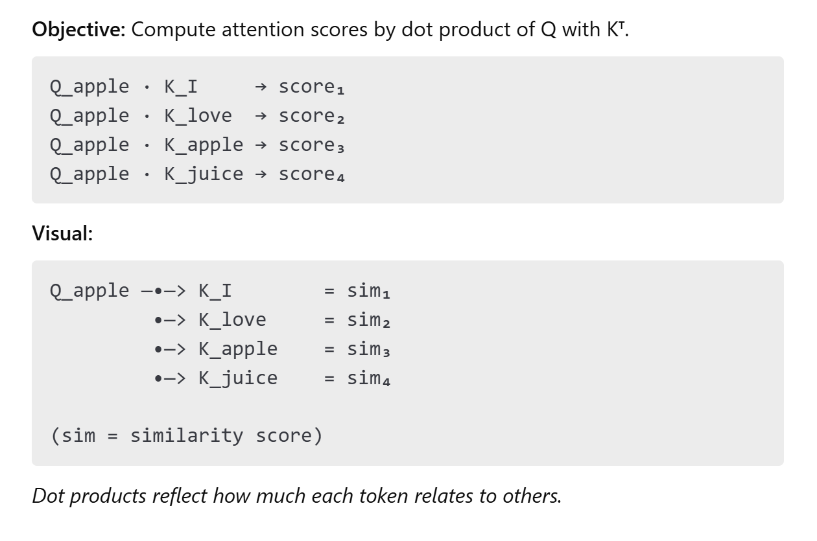
Self Attention :

Slide 14
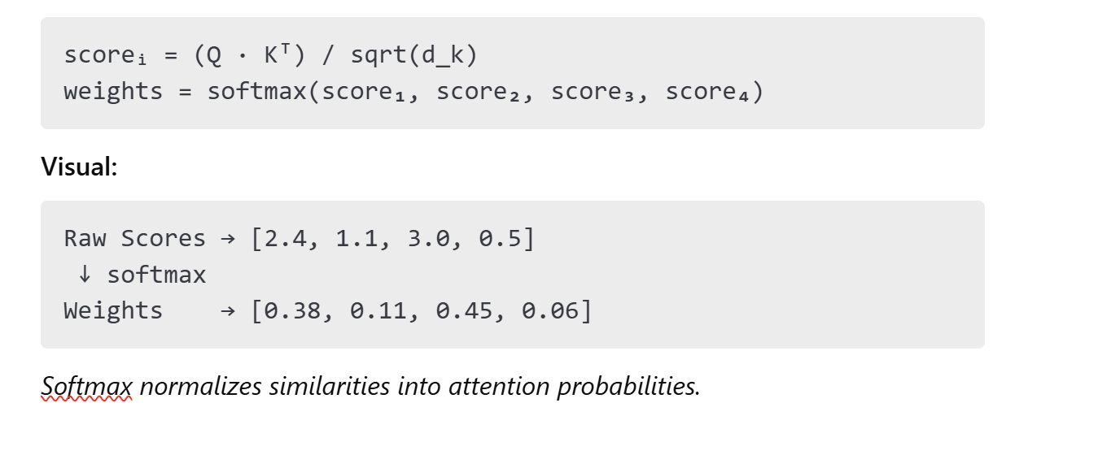
Self Attention : Scaled Dot Product + Softmax
Notes:
The magnitude of a dot product between two vectors increases with the number of dimensions, assuming the values are not shrinking correspondingly.
Softmax is a function that takes a bunch of numbers and turns them into probabilities.
To make the model's parameters more learnable and stable, by preventing the softmax from being dominated by large dot product values as dimensionality increases.

Slide 15
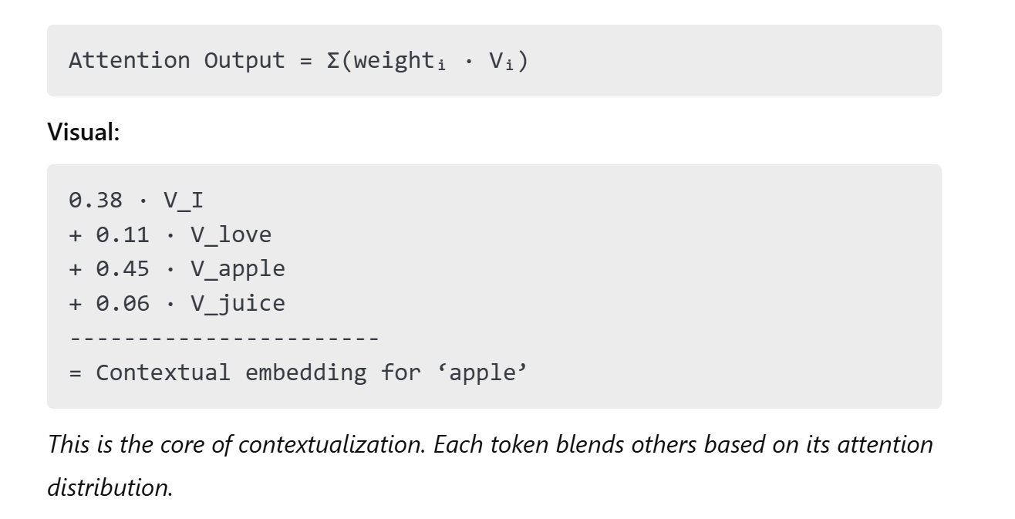
Self Attention : Weighted Sum of V Vectors
Notes:
The attention mechanism decides how much each word matters for the current word being processed. The weights come from the attention scores → converted to probabilities using softmax → and then used to blend the Value vectors.
Input embedding for 'apple'
→ Compute attention scores with all tokens
→ Softmax → attention weights [0.38, 0.11, 0.45, 0.06]
→ Weighted sum of value vectors:
0.38·V_I + 0.11·V_love + 0.45·V_apple + 0.06·V_juice
→ Contextual embedding for 'apple'

Slide 16
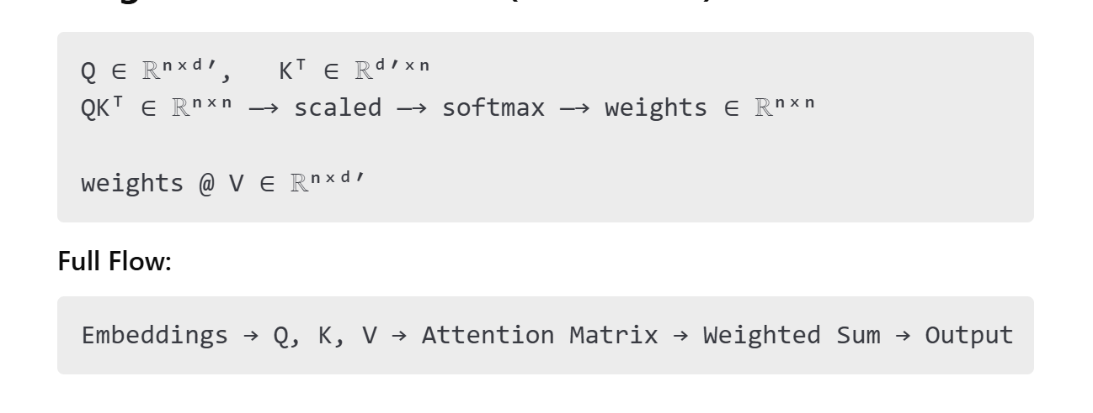
Self Attention : Matrix Form (All Tokens)
Notes:
The attention mechanism decides how much each word matters for the current word being processed. The weights come from the attention scores → converted to probabilities using softmax → and then used to blend the Value vectors.
Input embedding matrix (n × d_model)
→ Linear projections → Q, K, V
→ Compute Q·Kᵀ / √d
→ Softmax → attention matrix (n × n)
→ Multiply attention matrix @ V
→ Output: contextual embeddings for all tokens (n × d)

Slide 17
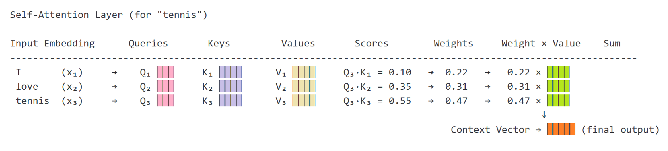
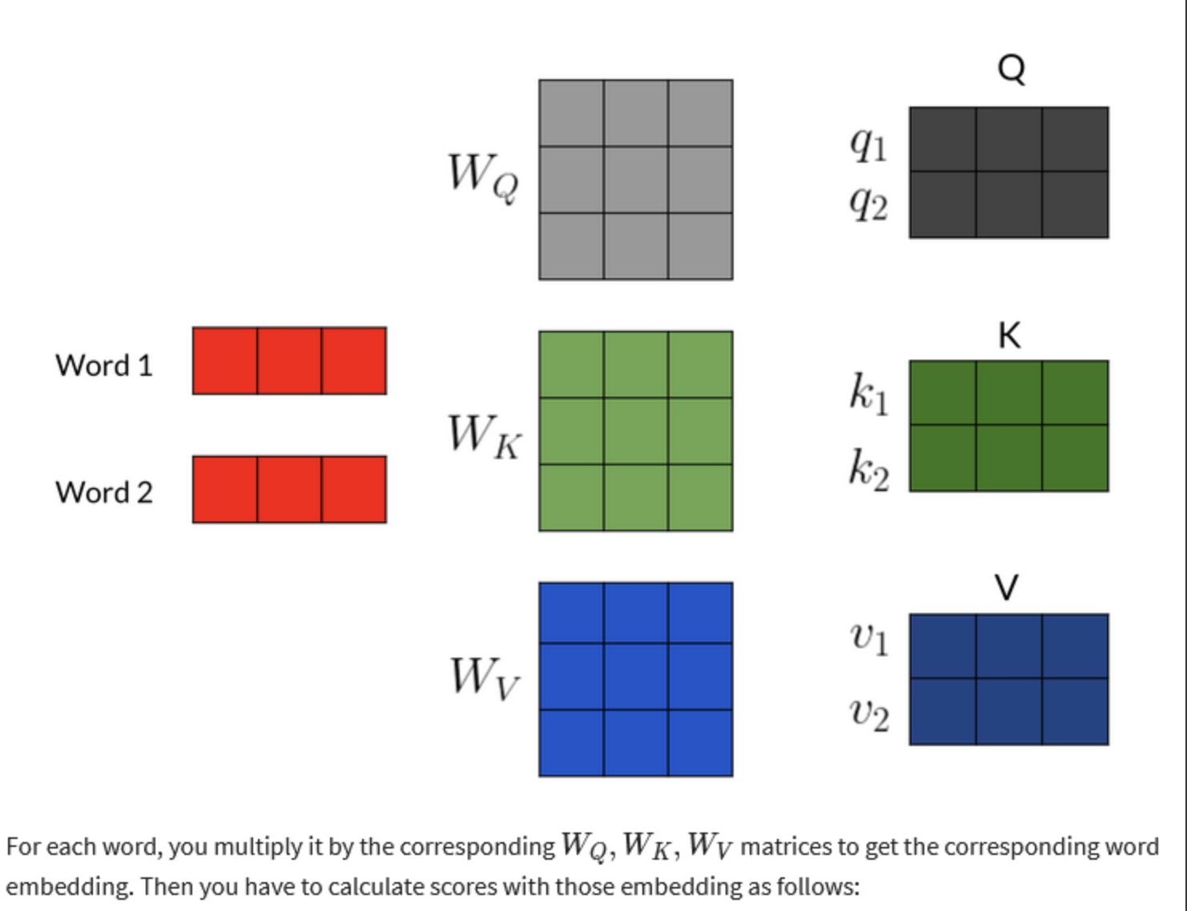
Visualize

Slide 18
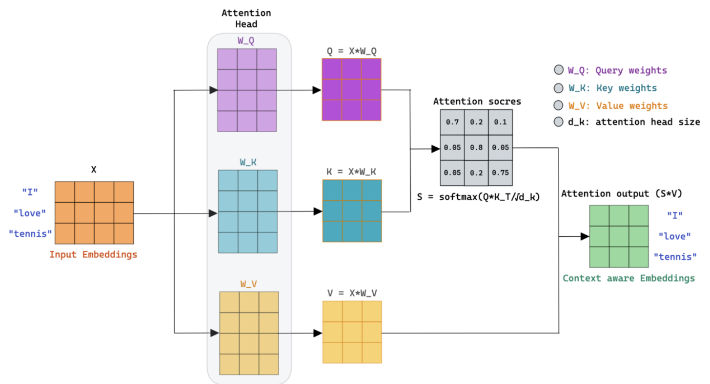
Visualize further

Slide 19
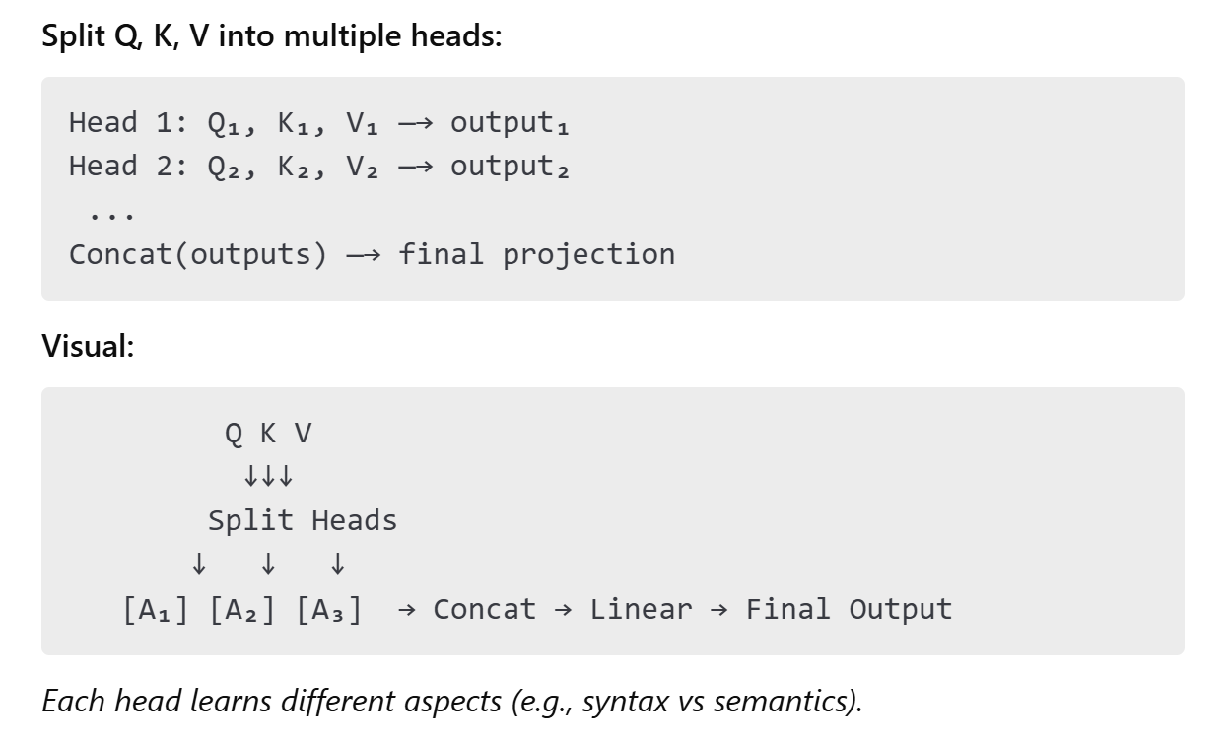
Self Attention : Multi-Head Attention
Notes:
Each head specializes — learns to focus on different linguistic features
Get the nuanced meaning and perspectives of a language like tone, sentiments, links between the sub contexts, of general intent etc.
Multi-head attention can capture sub-contexts, hierarchical structure, and directional dependencies in a sentence — all at once.
Input Embedding
→ Projected to Q/K/V for each head
→ Each head: self-attention → vector output
→ Concatenate all head outputs
→ Final linear projection
→ Output: rich, contextual embedding

Slide 20
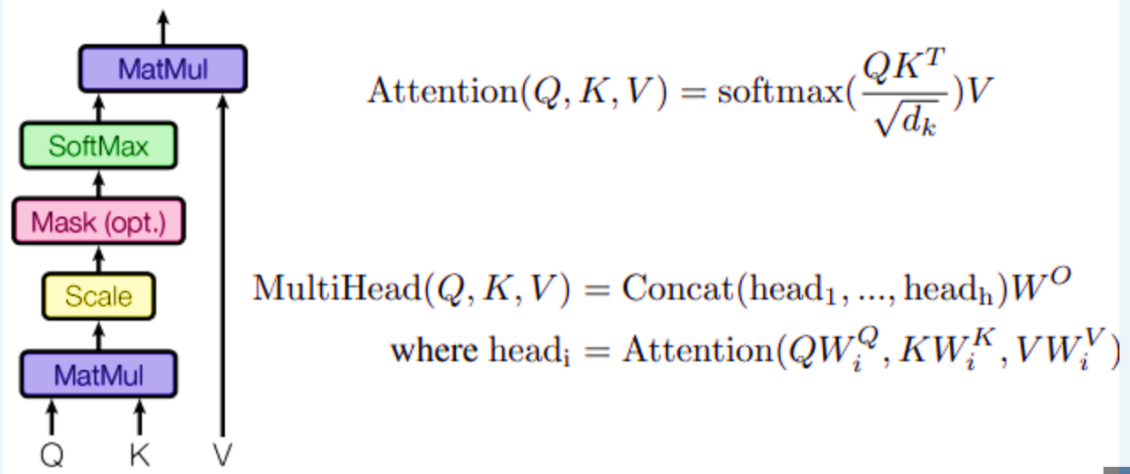
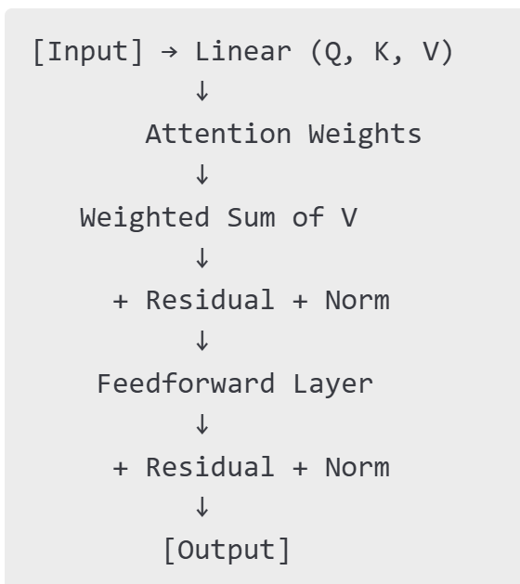
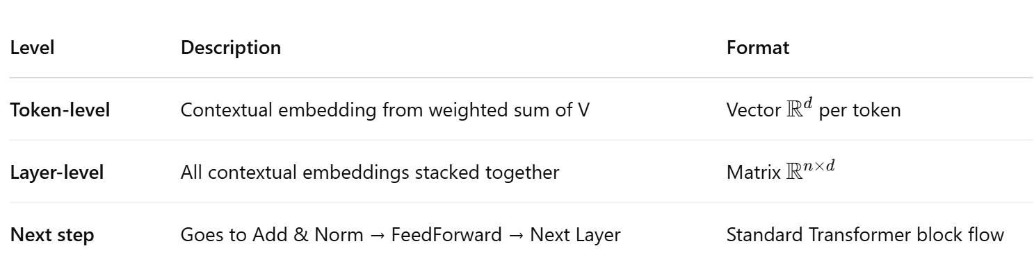
Self-Attention Block Summary
Single block structure:
Input Embeddings → [Q, K, V] → Attention → Add & Norm → FFN → Add & Norm → Output

Slide 21
Add & Layer Normalization
The output of Multi-Head Attention is added to the original input (residual connection).
Then Layer Normalization is applied
Prevents exploding or vanishing activations
Stabilizes training by ensuring all token vectors behave uniformly
Helps with convergence — especially in deep networks
Think of it as "sanity-checking" the attention output

Slide 22
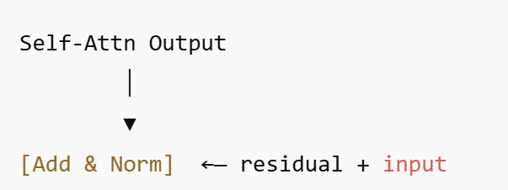
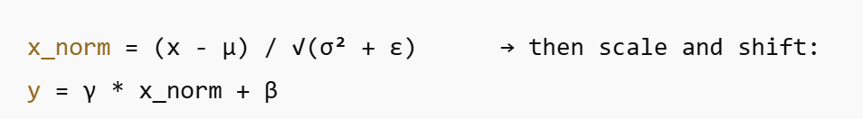
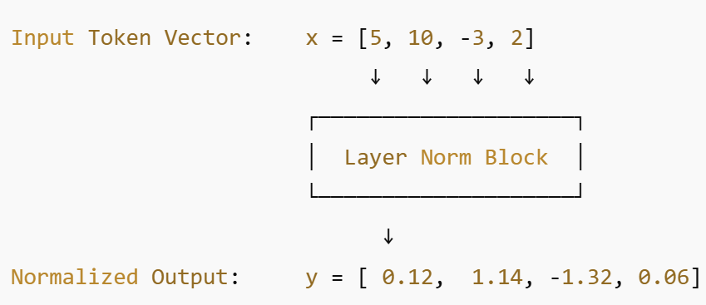
What is Residual Connections (“Add”) and Layer Normalization (“Norm”)
Let’s say you have a pipeline of layers:
x → Layer1 → Layer2 → Layer3 → Output
Without “residual connections” , it will
Learn the entire transformation from scratch
Gradients pass through every single layer
With Residuals
x → [Layer1(x) + x] → [Layer2(x) + x] → ...
Layer Norm is applied:
After self-attention output
After feedforward output
Notes:
The original input is always carried forward, even if the transformation is imperfect.
Residual connection helps preserve the signal
This leads to more stable representations, especially in deep networks like Transformers.
LayerNorm helps make the optimization contour rounder and smoother, which in turn makes gradient descent more stable and efficient.

Slide 23
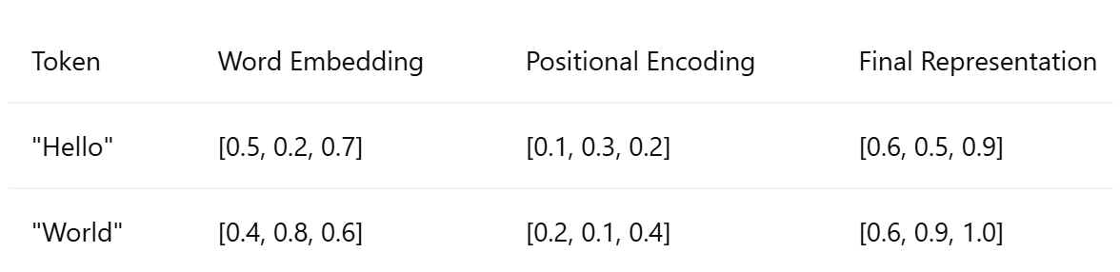
Positional Embeddings
Positional Encodings help Transformers understand where words occur without breaking parallel processing
Sinusoidal encodings are fixed
We Compute Positional Encoding using sine/cosine.
And Add positional encoding to word embeddings.
Without positional embeddings, Transformers would treat text as a bag of words (losing sentence meaning)
Example:

Slide 24

So Much Fuss! But Why the Hard Work?
What Transformers Are Actually Trained To Do????
Let us explore through quiz!!!!
Notes:
All This Just to Guess the Next Word?
Input: "The cat sat on the [MASK]."
Target: "ma

Slide 25
Quiz 1
What is a language model really doing at its core?
A. Memorizing dictionaries B. Learning syntax trees C. Estimating probability distributions over sequences D. Solving algebra problems

Slide 26
Quiz 2
Q: What makes GPT and BERT different if they both use Transformers?
A. The number of layers B. One uses attention, the other doesn’t C. BERT uses a bidirectional encoder and masking; GPT uses unidirectional decoder and predicts next token D. They’re the same but trained on different datasets

Slide 27
Quiz 3
Q: If BERT is bidirectional and GPT is not, which model would be better at filling in the middle of a sentence?
A. GPT — it can hallucinate well B. BERT — it was designed for masked tokens in any position C. Neither — Transformers can’t do that D. Both — they’re equally capable

Slide 28
Quiz 4
What is the training signal for a model like GPT, when all it does is predict the next word?
A. It learns from human feedback B. It compares its guess to the actual next word and updates itself C. It creates random losses to adjust weights D. It uses grammar-checking software

Slide 29
Challenges & Limitations
Costs: Why training requires GPUs/TPUs.
Hallucination Problem: When AI makes things up.
Token Limitations: Why models struggle with long contexts

Slide 30
References
https://learn.theaiedge.io/
https://jalammar.github.io/
Attention Is All You Need →https://arxiv.org/pdf/1706.03762
https://www.youtube.com/watch?v=mMa2PmYJlCo&list=PL86uXYUJ7999zE8u2-97i4KG_2Zpufkfb

