Slide 1
ChatTube
Talk With People In Youtube Revolutionizing Youtube Interaction
BAICE

Slide 2
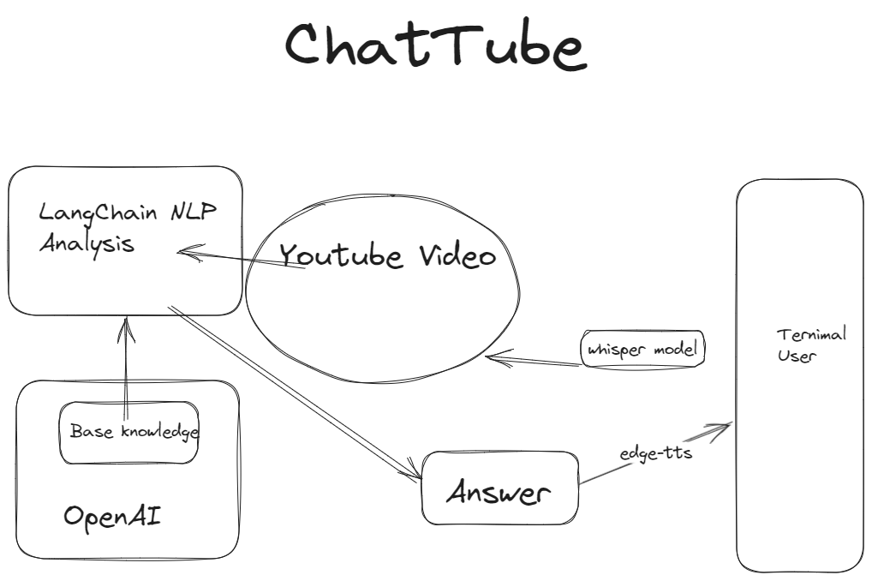

Slide 3

From Summarization to Active Engagement
Challenge with existing plugins: Summarization versus Inspiration
ChatTube: Seeking "Eureka" moments
Specific phrase, or image provoking deep thought

Slide 4

Driven by Interest and Curiosity
The process of mastering:
The role of sustained interest
ChatTube:
Active information-seeking approach
Example: Conversing with "Steve Jobs"

Slide 5

Non-linear Thinking
Human brain: Non-linear and discontinuous thinking
Role of ChatTube: Encouraging exploration of new topics
Impact: Enhanced focus and curiosity

Slide 6
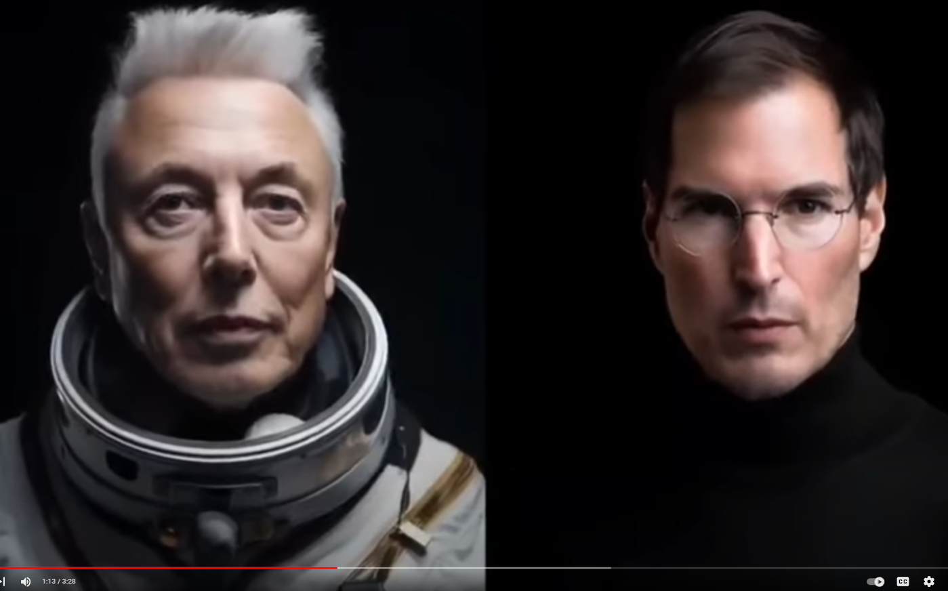
Time-traveling Talks
Training individual "persons" with ChatTube
Examples: Chatting with Qin Shi Huang, Charles Darwin, J. Robert Oppenheimer, Steve Jobs
Potential: Continuous learning and discussing

Slide 7

Voice and Text
The History of Voice and Text: Understanding the timeline and familiarity
Emphasis on Voice: Expression versus Recording
Role of Voice in modern interaction

Slide 8

Talk 2 Earn Economic Model Design
Old Model: Youtubers, Videos, and Ads
New Model: Users generating ideas, creating content, Earn
Beneficiaries: Users, Creators, Advertisers

Slide 9
