Slide 1
INTERNET BANKING
Task - 2

Slide 2

Your Project Name
Internet banking has become an integral part of modern banking services. The goal of this project is to create a user-friendly and secure internet banking website that offers a range of financial services and ensures the privacy and security of customer information.
LMS Username | Name | Batch
2115a928 | JANANI S | A9
2115a929 | JOSHIKA J | A9
2115a935 | LIBA KEERTHIKA S | A9

Slide 3
Task - 2
Create UI and implement various components using react
Split design into components and Higher order Components
Define structure of the components
Set the basic ui components with dummy data
Integrate the APIs to frontend to ensure the dynamic feature of website
Point base api to the severs base url
Design api calls for each element
Handle errors in the output
Render output of apis to different low level components
Secure content of post apisx
Evaluation Metric:
100% Completion of the above tasks
Learning Outcome
Developing complicated UI using react components
Using props drilling and context to pass variables
Getting familiar with different type of api calls
Handling different input data

Slide 4
Login.html
<!DOCTYPE html>
<html lang="en">
<head>
<meta charset="UTF-8">
<meta name="viewport" content="width=device-width, initial-scale=1.0">
<title>Internet Banking</title>
</head>
<body>
<header>
<h1>Internet Banking</h1>
</header>
<nav>
<ul>
<li><a href="#">Home</a></li>
<li><a href="#">Accounts</a></li>
<li><a href="#">Transfer Money</a></li>
<li><a href="#">Payments</a></li>
<li><a href="#">Settings</a></li>

Slide 5
</ul>
</nav>
<main>
<h2>Welcome to Internet Banking</h2>
<p>Please log in to your account to access your banking information.</p>
<form id="login-form" action="dashboard.html">
<label for="username">Username:</label>
<input type="text" id="username" name="username"><br>
<label for="password">Password:</label>
<input type="password" id="password" name="password"><br>
<input type="submit" value="Log in">
</form>
</main>
<footer>
<p>&copy; 2023 Internet Banking. All rights reserved.</p>
</footer>
</body>
</html>

Slide 6
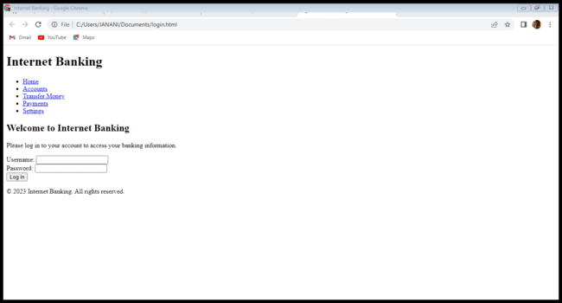

Slide 7
Assessment Parameter
Setup Project for Calculator project
Setup basic structure of text-editor project
Create a main component with the outer structure of calculator
Check-List
Create main component with all feature buttons
Create a button component with on click handler
Create a json object to store data for text editor
Create a ` evaluateExpresion` function to evaluate value
Push both code to github

Slide 8
Submission Github
https://github.com/libakeerthika/online-banking

