Slide 1

Rechnerarchitekturen für Deep-Learning Anwendungen (RADL)
Dustin Heither, Maximilian Achenbach and Robert Kagan

Slide 2
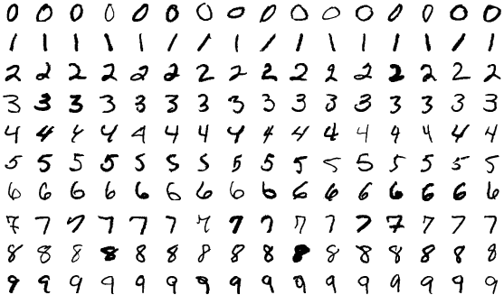
Application
Dustin Heither, Maximilian Achenbach and Robert Kagan
Application purpose: Classification
Dataset: MNIST
Kind of application: General purpose laptops and desktops

Slide 3
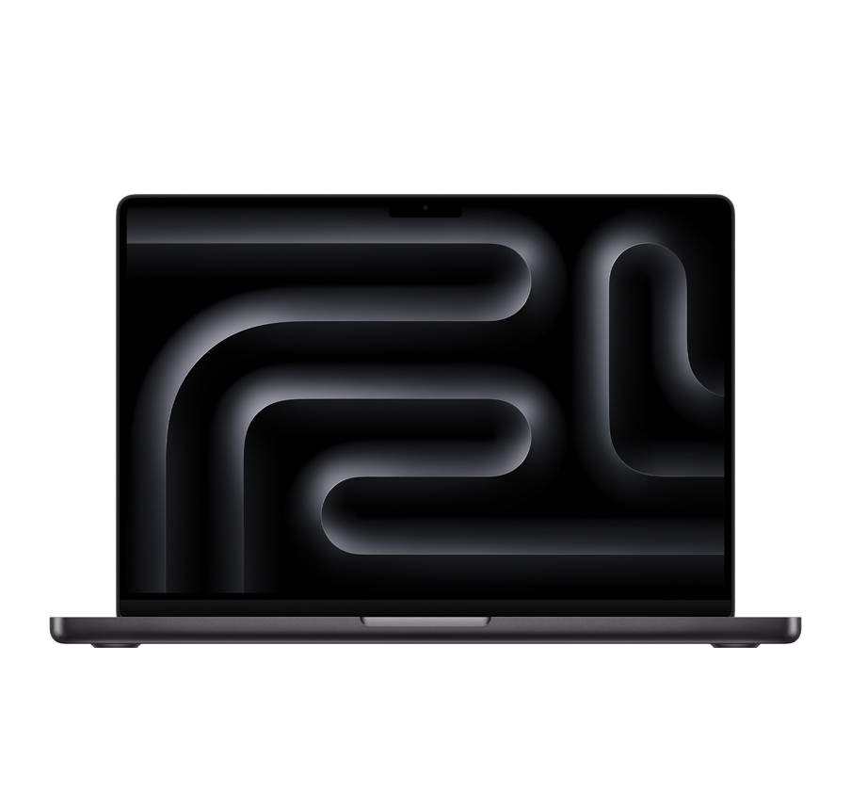
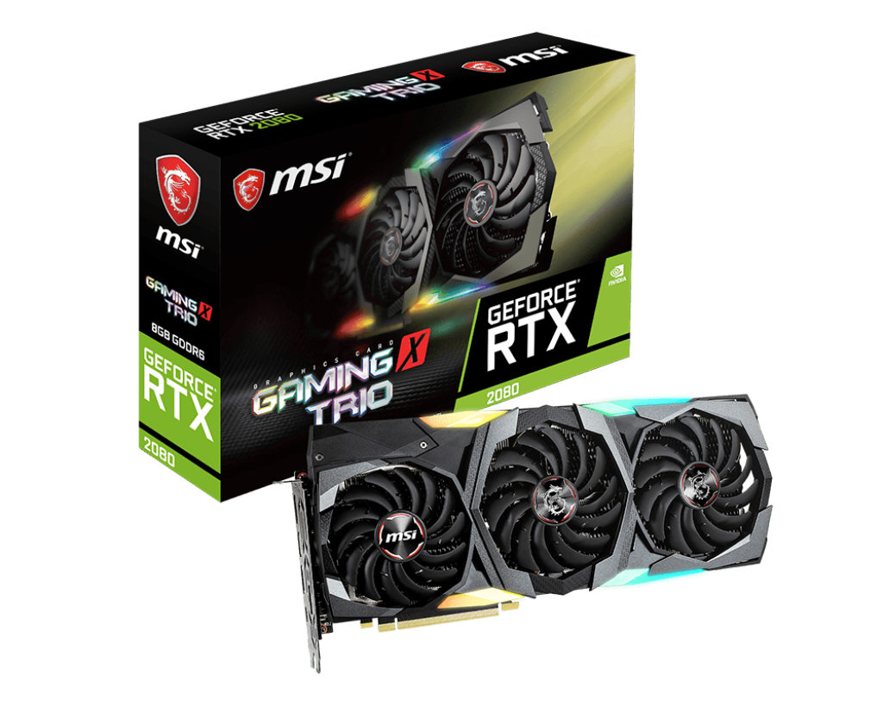
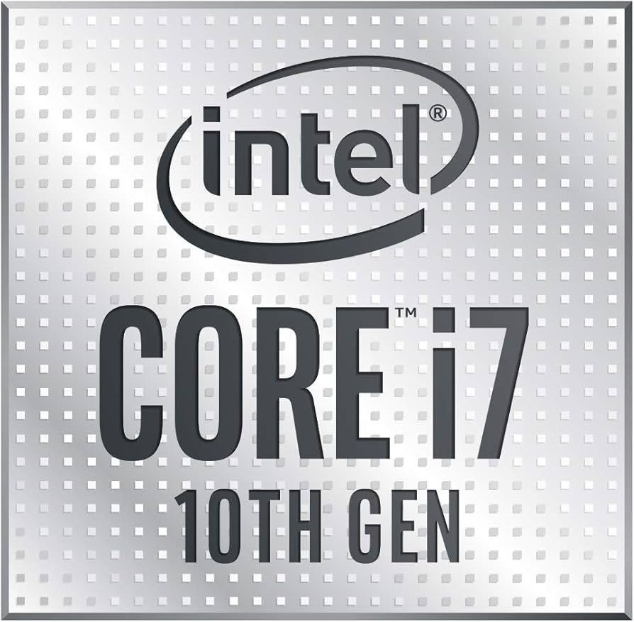
Targeted architecture
Dustin Heither, Maximilian Achenbach and Robert Kagan
Hardware: CPU vs. GPU
Device: Developer:
Apple M3 Pro (ARMv8.6-A) Dustin Heither
Intel Core i7 1065G7 (x86-64-v4) Robert Kagan
Nvidia GeForce RTX 2080 Maximilian Achenbach

Slide 4
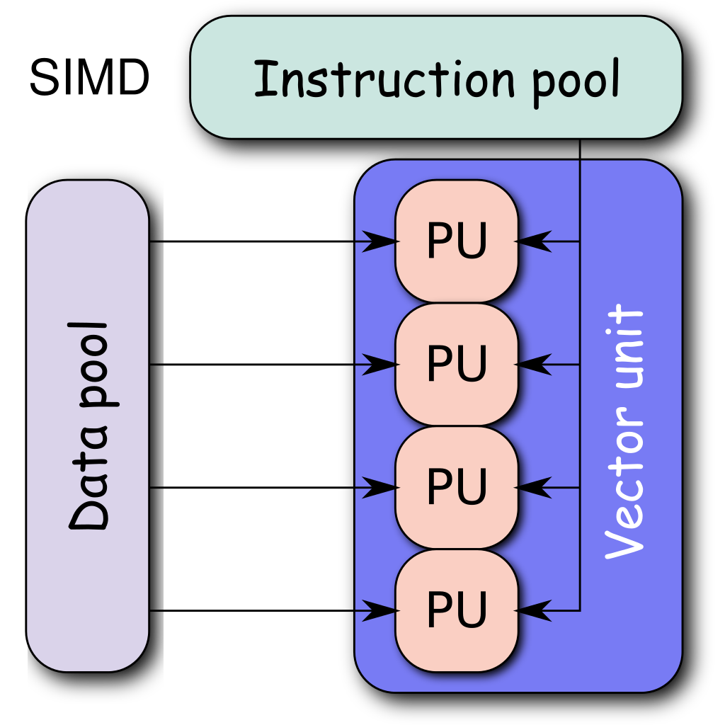
Approach and responsibilities
Dustin Heither, Maximilian Achenbach and Robert Kagan
The final result:
Deep Learning Framework with CPU-GPU switch
Combination of Multithreading and SIMD
Evaluation of:
Performance gains
Resource consumption
Performance per watt
PCIe latency

Slide 5
Approach and responsibilities
Dustin Heither, Maximilian Achenbach and Robert Kagan
Kind of optimization: Developer:
(Apple M3 Pro NPU) Dustin Heither
Multithreading Dustin Heither, Robert Kagan
SIMD
Arm Neon Dustin Heither
Quantization Dustin Heither, Robert Kagan
SSE vs. AVX2 vs. AVX-512 Robert Kagan
ICC vs. GCC Robert Kagan
CUDA tuning Maximilian Achenbach

