Slide 1
Team 5 Project
Libby Stephan, John Salmon, Connor Rounds, & Natalie Simkins
Notes:
Natalie

Slide 2
Essential Question
What Features of Seattle Buildings Can Be Used To Predict Emission Severity Levels?
Seattle has committed to reducing carbon emissions as part of its climate action goals.
Understanding these features can help inform policies, optimize energy use, and reduce carbon footprints
Notes:
Natalie
Climate change is a growing problem around the world, and the city of Seattle is committed to reducing climate change by controlling the factors that cause it
After thorough research, it has been found that the main cause of climate change is the use of fossil fuels, the primary source of heat and electricity in our current infrastructure.
As a large city, Seattle is a epicenter of fossil fuel use, and wants to change that status by controlling the emissions of each building.
To start to reduce these emissions, the city has created a dataset to try and figure out what factors contribute to overall GHG emissions.
Knowing which of these factors are important helps inform policy, optimize energy use, and reduce carbon footprint

Slide 3

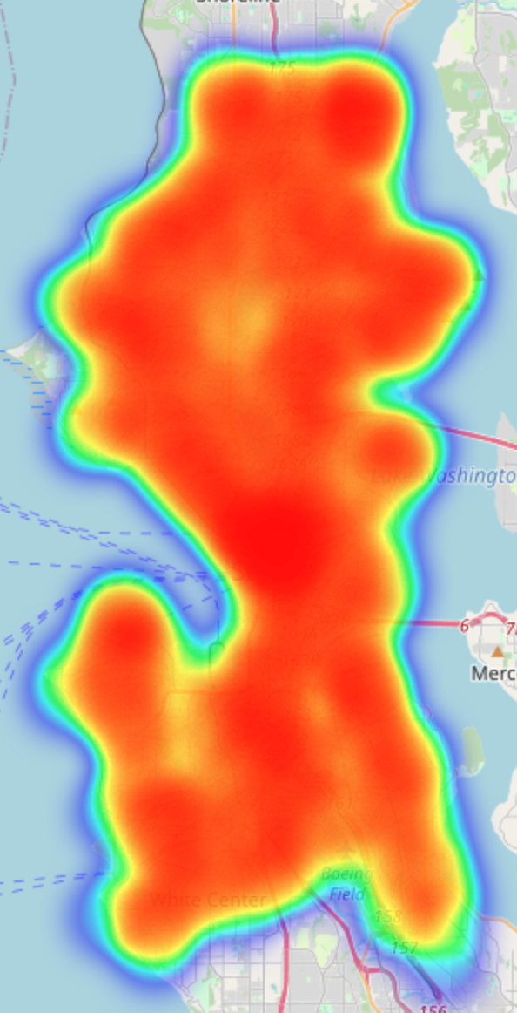
Overview of Data
Data collected through the City of Seattle Energy Benchmarking Program (2022)
https://data.seattle.gov/Built-Environment/2022-Building-Energy-Benchmarking/5sxi-iyiy/about_data
Before Cleaning: 3654 buildings (rows) and 42 features (columns)
After Cleaning: 3653 buildings and 23 building features
Cleaning Process:
Removed Feature columns with minimal data.
Some columns were imputed with the mean and some were filled with 0 to handle null values.
Ex. a null steam use value was set to 0 to indicate the building used no steam, while a building with a missing electrical use value was filled with the mean
Notes:
Natalie
This dataset is provided by the City of Seattle’s Energy Benchmarking program and includes buildings from 2022
The ordinance that started the creation of the dataset requires all owners of non-residential and multifamily buildings over 20,000 square feet to report their energy use yearly. This data is generally complete, since per the ordinance, building owners fined if non-compliant with data standards.
Before cleaning, there were 3654 buildings or rows, and 42 features or columns in the dataset.
After cleaning, there were 3653 buildings, one was removed because it did not include complete information, and 23 building features left
In order to clean, we removed features that had minimal data and some columns were imputed with the mean of all the values and some others were filled with zero to handle null values.
For example, a null steam use value was set to zero to indicate the building used no steam, while a building with a missing electrical use value was filled with the mean.

Slide 4
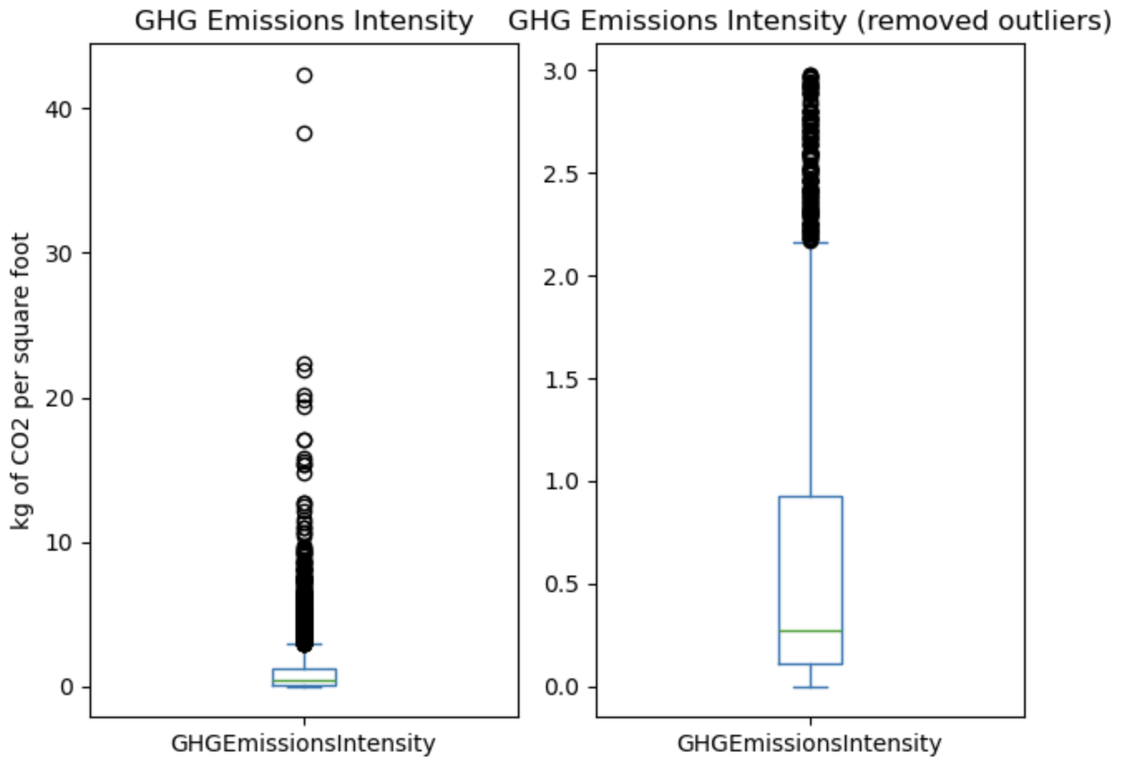
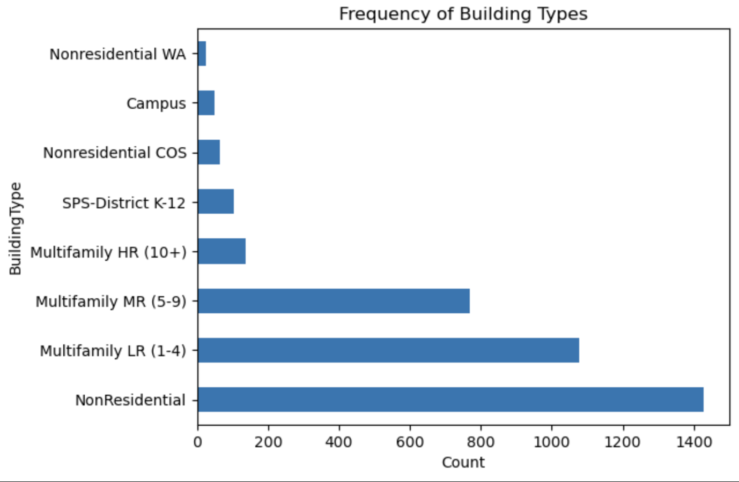
Data Exploration
Examined the Distribution and Validity of Our Data:
Histograms and Boxplots indicate a solid variety of data with a manageable number of larger outliers
Scatter plots demonstrate some small relationships between building features
Notes:
Libby

Slide 5
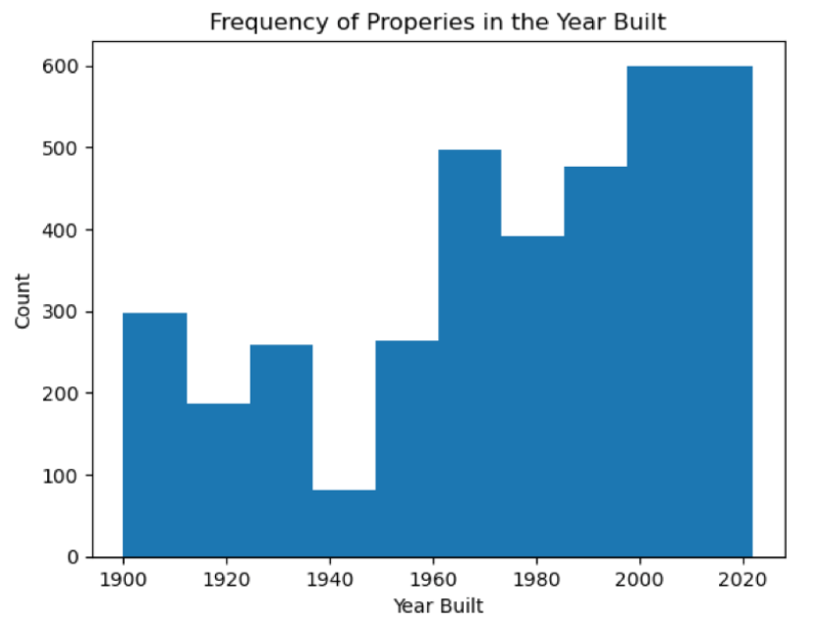
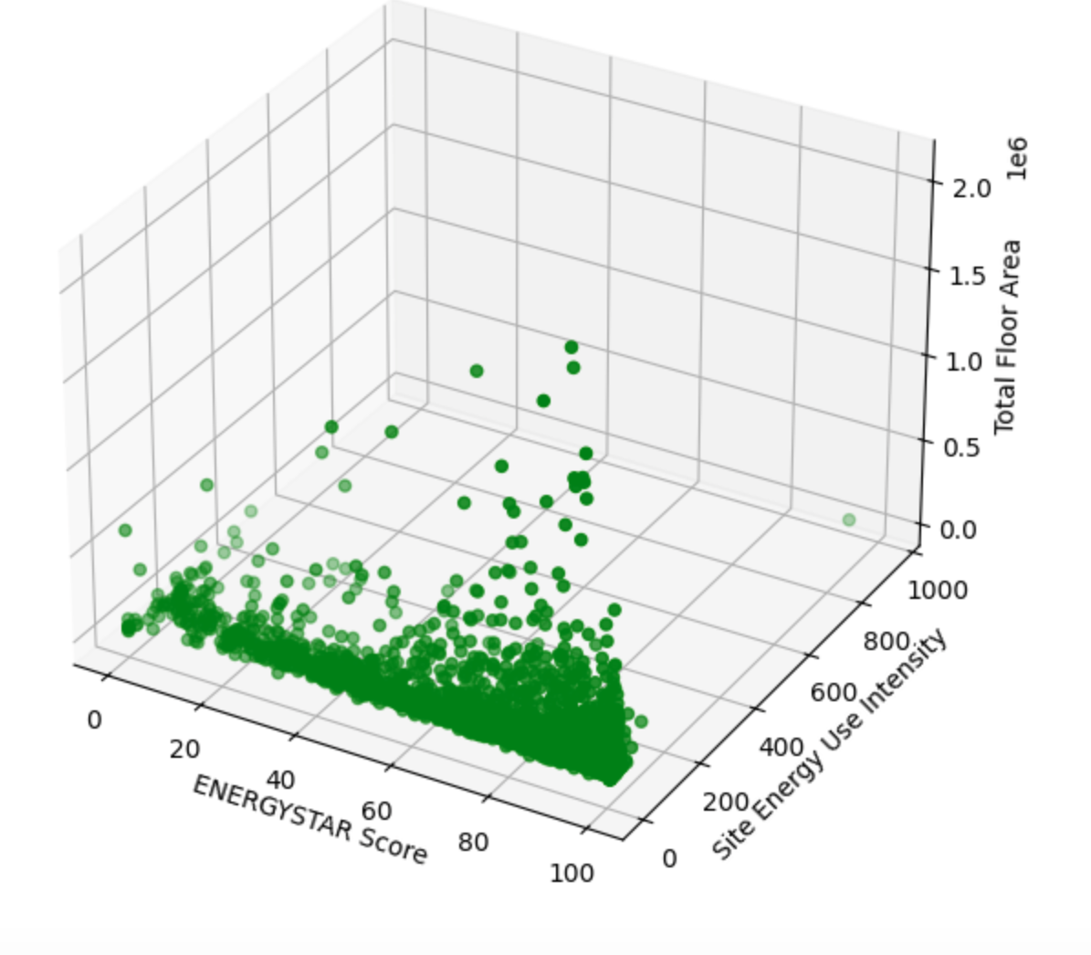
Data Exploration
Notes:
Libby

Slide 6
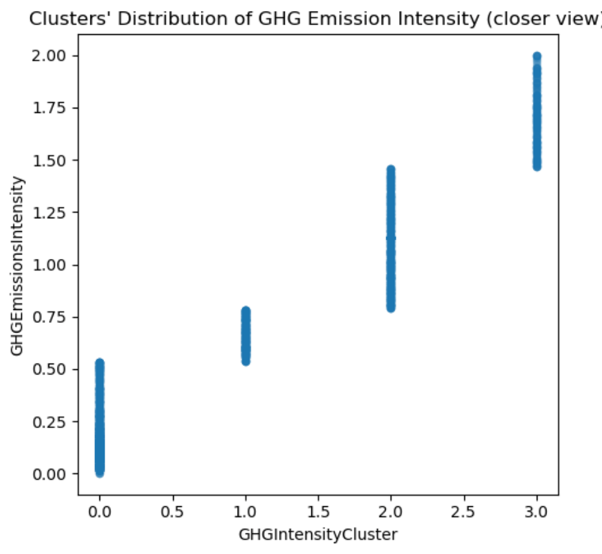
Data Exploration
DBSCAN (Density Based Spatial Clustering Applications with Noise) was performed to examine possible emissions categories
Yielded 4 categories: Low, Medium, High, & Extreme High (outliers)
Notes:
Libby

Slide 7
Model Summaries
DBSCAN was performed on the training set to establish emissions categories as the target value to be predicted
Principal Component Analysis was performed to find the 5 most influential traits to use as input features
Electricity, Steam Use, Natural Gas, Gross Floor Area, & Source Energy Intensity were selected to be the input variables
A Decision Tree was fitted to the training data and grid search hyperparameter tuning with 10 fold cross validation was used to train the model.
The final accuracy metric was 86.71% on unseen data. Meaning that the model’s probability of making a mistake was about 1 in 7.
Notes:
John
Initial decision tree had an accuracy ~ 75%
Tried other models
Neural Network
Naive Bayes
Quantile regression
After PCA, implementing the top PC features we saw an improvement of 11%
Used hyperparameter tuning to maximize accuracy of our model, as we determined it was the right level of complexity
10-fold cross validation because of a large number of rows
Final Accuracy Metric suggests that the selected features have an impact on the outcome
And model provides accurate and useful estimations

Slide 8
Project Conclusions
Summary: Our project explored the capabilities of a decision tree classifier in predicting a buildings emissions level.
Natural Gas and Electricity use emerged as significant predictors
Gross Floor Area, Steam, and Source Energy Use also played an important role for the classification
Implications: Managing the energy use of a building by minimizing electricity and natural gas use can significantly reduce emissions. We can now predict whether a building will be energy efficient before it is built.
Future Work:
Explore other variable selection techniques to refine model accuracy.
Expand model predictions to individual values (regression) instead of categories.
Extend dataset to include buildings from other major cities and regions.
Notes:
Connor

Slide 9
Shiny Demo
Notes:
Connor
-

Slide 10
Thank You!
Notes:
All together

