Slide 1


基于人工智能方法的基因树和蛋白树系统比较研究
汇 报 人： | 张茹涵、谭振宇、龚诗媛
指导教师： | 李勃
重庆市第十八中学校
2023年6月25日，重庆师范大学

Slide 2
汇报内容
❖ 1. 项目介绍
❖ 2. 成员与指导教师
❖ 3. 项目完成情况
❖ 4. 研究成果展示
❖ 5. 学习心得与体会
❖ 6. 总结

Slide 3
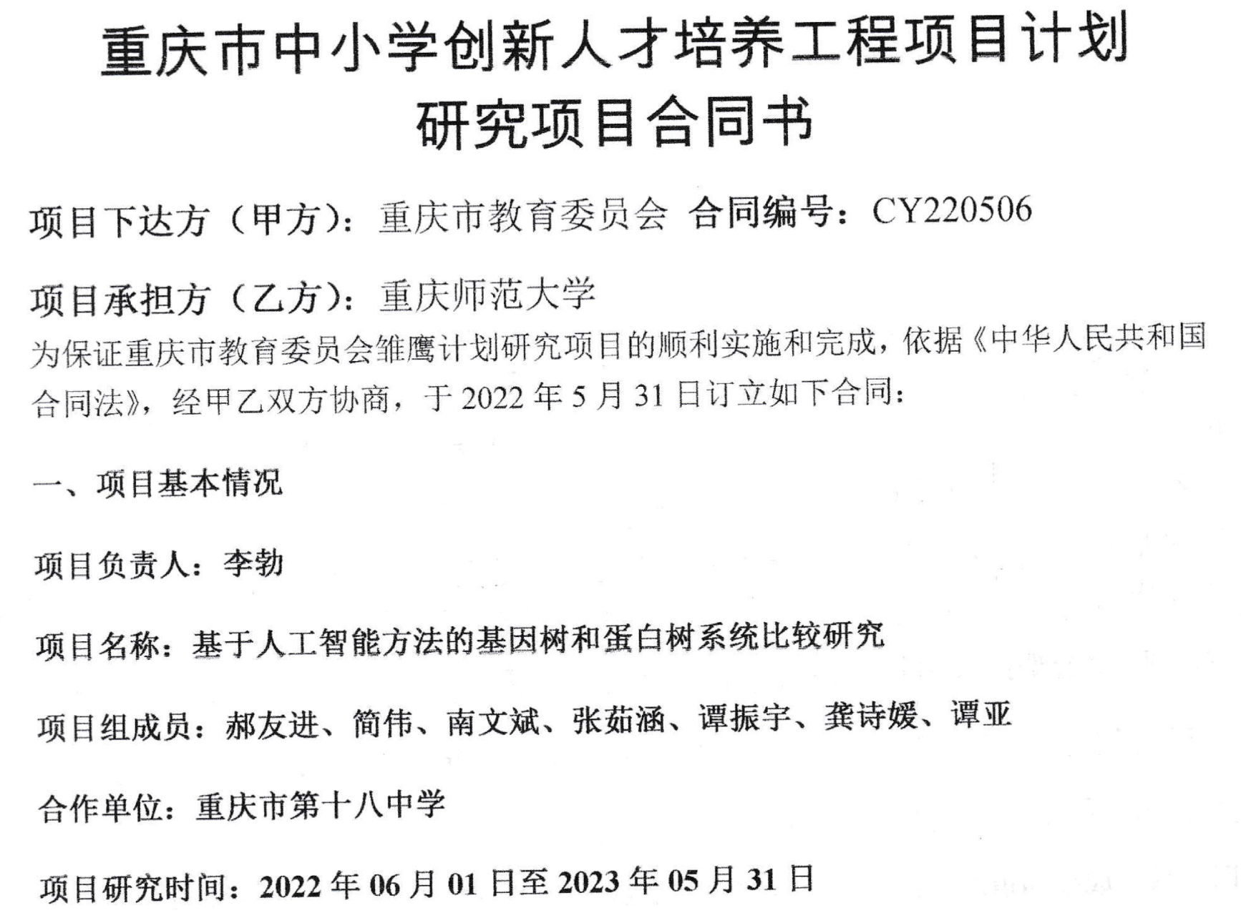
❖ 1.项目介绍

Slide 4
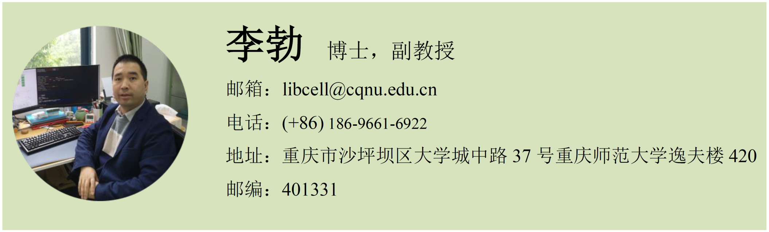
项目成员与指导教师
张茹涵，谭振宇，龚诗媛

Slide 5
❖ 2.项目成员与指导教师研究背景
张茹涵，谭振宇，龚诗媛

Slide 6


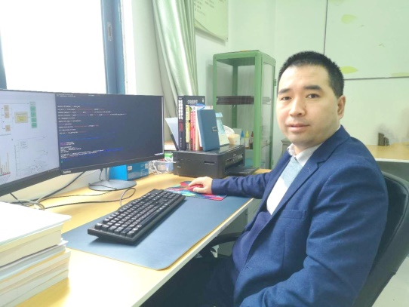
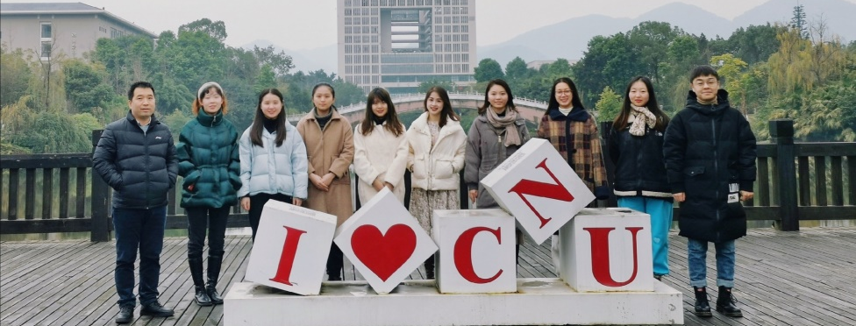
❖ 6. 授课教师
Members in CIBG
李勃
职称：副教授
职务：硕士生导师
单位：生命科学学院
九三学社社员
湖北省优秀学士学位论文指导教师
重庆市生物信息学会常务理事、四川大学学位论文评审专家
重庆市自然科学基金评审专家
重师大“最受毕业生欢迎的教师”、优秀毕业论文指导教师、本科生优秀导师、教学优秀奖获得者
Frontiers in immunology客座编辑， NAR、Briefings in Bioinformatics等SCI杂志审稿人
主持/主研省部级及以上项目7项，发表论文50篇（IF>10有7篇，单篇最高19.7），主编教材1部
研究方向：1）数据驱动的发育与衰老生物学研究；
2）机器学习与transOmics方法学；
3）生物信息学数据库及软件开发；
4）人工智能与药物发现。

Slide 7

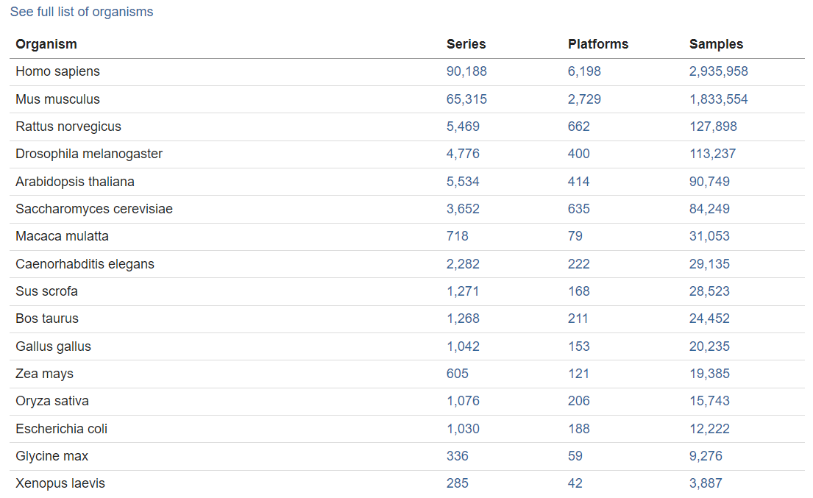
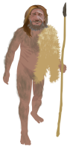
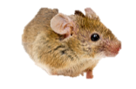






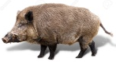
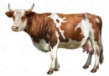

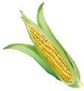

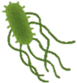
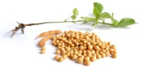
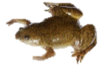
选择代表性物种
Organism Categories Platforms Samples
智人
小鼠
大鼠
果蝇
拟南芥
酵母
猕猴
秀丽隐杆线虫
野猪
家牛
原鸡
玉米
水稻
大肠杆菌
大豆
非洲爪蟾
数据来源：https://www.ncbi.nlm.nih.gov/geo/summary/?type=tax

Slide 8
Organism Name | Organism Groups | chromosome | Organelle | Size (Mb)
Homo sapiens | Eukaryota; Animals; Mammals | 24 | 1 | 3,298.43
Mus musculus | Eukaryota; Animals; Mammals | 21 | 1 | 2,728.22
Rattus norvegicus | Eukaryota; Animals; Mammals | 22 | 1 | 2,647.92
Drosophila melanogaster | Eukaryota; Animals; Insects | 7 | 1 | 143.726
Arabidopsis thaliana | Eukaryota; Plants; Land Plants | 5 | 2 | 119.669
Saccharomyces cerevisiae | Eukaryota; Fungi; Ascomycetes | 16 | 1 | 12.1571
Macaca mulatta | Eukaryota; Animals; Mammals | 22 | 1 | 2,971.33
Caenorhabditis elegans | Eukaryota; Animals; Roundworms | 6 | 1 | 100.286
Sus scrofa | Eukaryota; Animals; Mammals | 20 | 1 | 2,501.91
Bos taurus | Eukaryota; Animals; Mammals | 30 | 1 | 2,711.21
Gallus gallus | Eukaryota; Animals; Birds | 41 | 1 | 1,053.33
Zea mays | Eukaryota; Plants; Land Plants | 10 | 2 | 2,182.79
Oryza sativa | Eukaryota; Plants; Land Plants | 12 | 2 | 374.423
Escherichia coli | Bacteria; Pseudomonadota; Gammaproteobacteria | 1 | - | 5.5946
Glycine max | Eukaryota; Plants; Land Plants | 20 | 2 | 978.942
Xenopus laevis | Eukaryota; Animals; Amphibians | 18 | 1 | 2,742.47
数据来源：https://ncbi.nlm.nih.gov/genome/browse#!/overview/

Slide 9
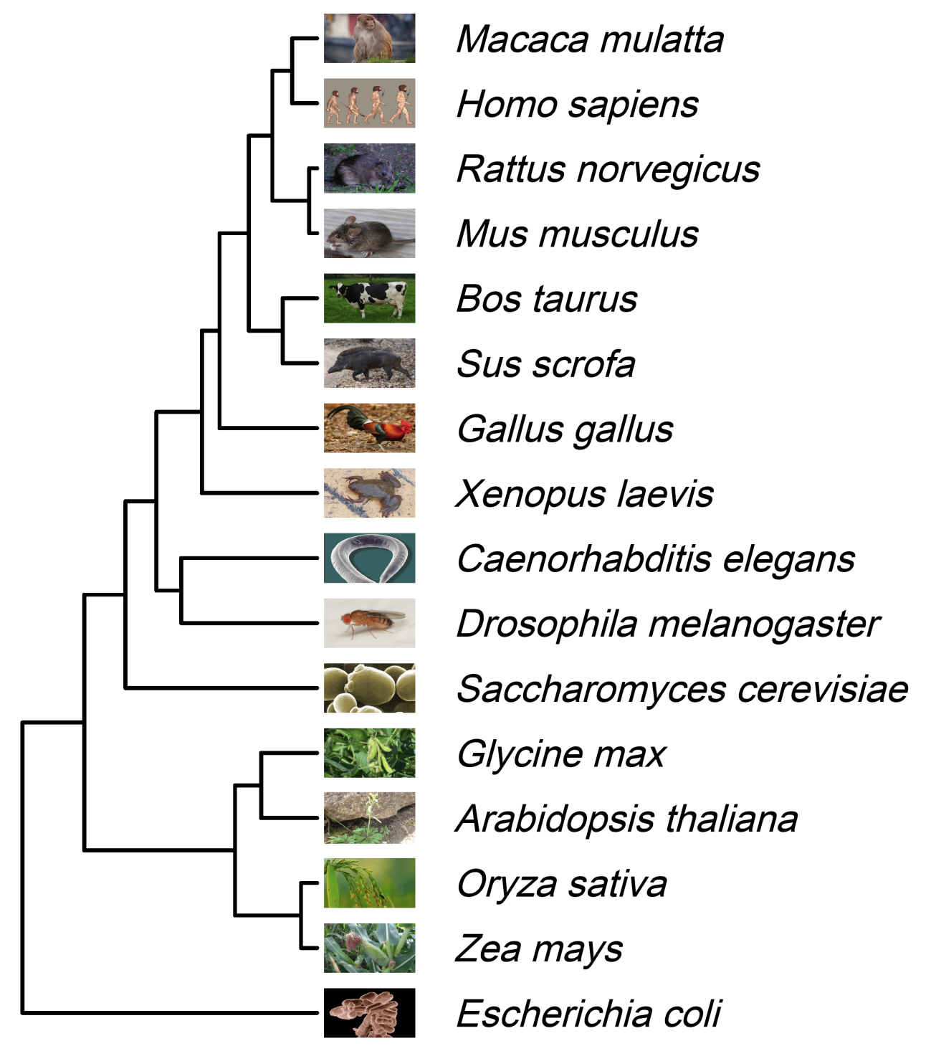
CDS | miRNA | ncRNA | rRNA | tRNA
21121 | 580 | 2644 | 61 | 22
20619 | 1913 | 1452 | 761 | 22
22229 | 463 | 2351 | 139 | 22
22292 | 1227 | 2380 | 68 | 22
20981 | 797 | 1644 | 16 | 22
20666 | 315 | 1 | 4 | 22
17478 | 718 | 272 | 97 | 22
34476 | . | 990 | 377 | 22
19984 | 260 | 23702 | 23 | 843
13968 | 262 | 896 | 111 | 22
6017 | . | 107 | 14 | 299
47065 | 659 | 1823 | 458 | 56
27562 | 326 | 860 | 14 | 684
28073 | . | . | 11 | 60
34177 | 164 | 897 | 2436 | 38
5449 | 1 | 9 | 22 | 98
Animal
Eukaryote
Fungi
Plant
Prokaryote

Slide 10
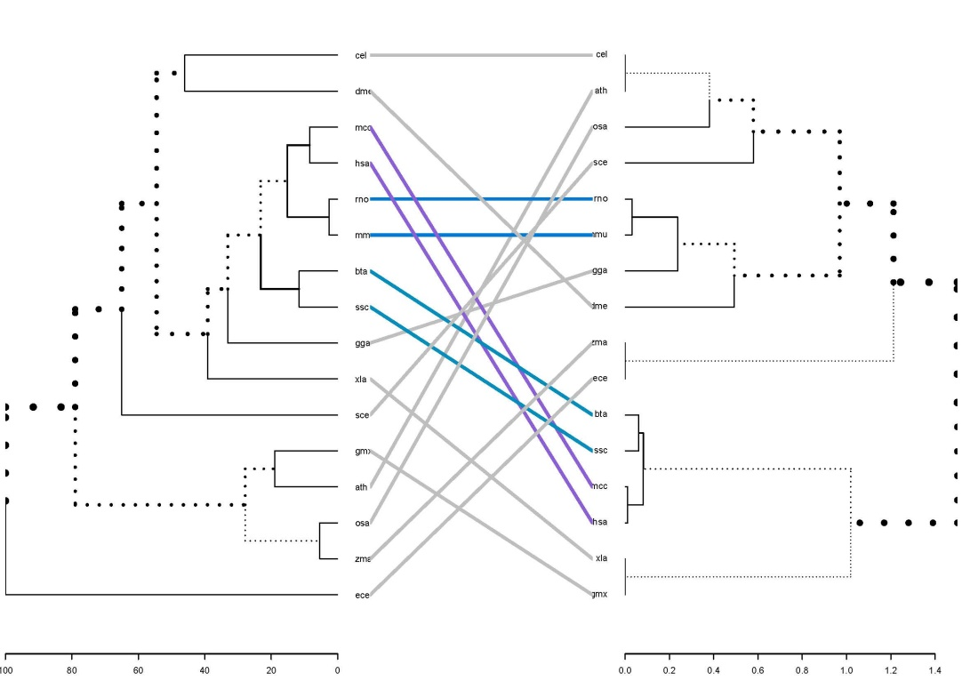
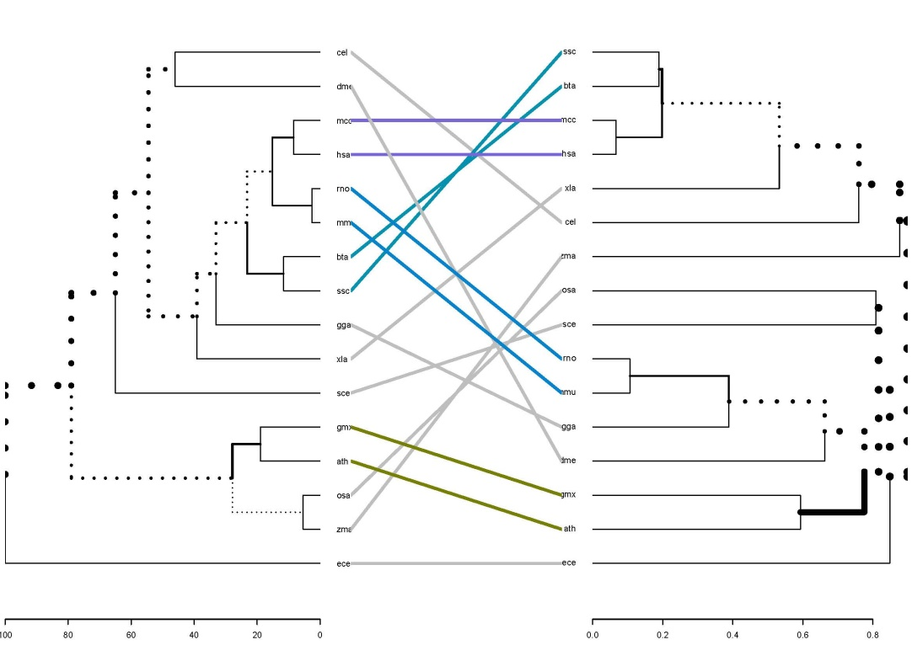
Species Tree
Gene Tree
Species Tree
Protein Tree

Slide 11

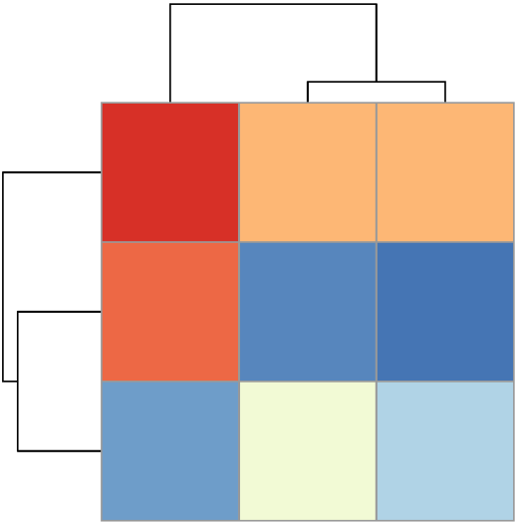
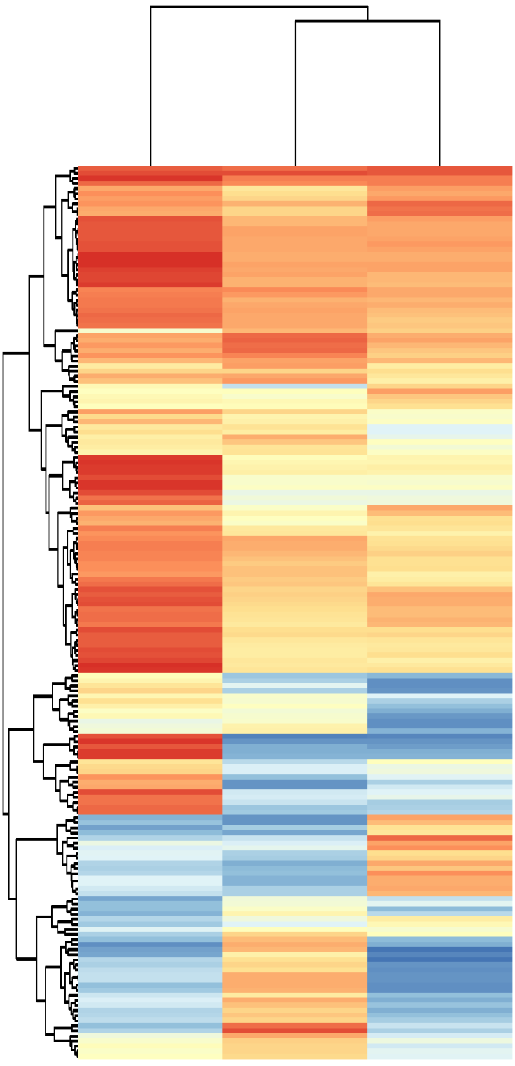

Gene-Protein
Gene-Species
Protein-Species
Cluster A: 86 genes
K00058
K00927
K03841
K02959
K03217
K00616
K00600
K03768
K01835
K04487
K04043
K06173
K00942
K02257
K01890
K03522
K07277
K00820
K01934
K00033
K00275
K00797
K01803
K02948
K02355
K00826
K02946
K00688
K01756
K02954
K00764
K00008
K02911
K11206
K00963
K04079
K00382
K04077
K00088
K13288
K01785
K00031
K02835
K01689
K00995
K00700
K07566
K01881
K02956
K00939
K07304
K00943
K01681
K02926
K04567
K03676
K00784
K01079
K00789
K01897
K01011
K01887
K01870
K07560
K01895
K01868
K03106
K01883
K00627
K02907
K01872
K00854
K00121
K00111
K02519
K01807
K17686
K01937
K00759
K01519
K02992
K01679
K01070
K01772
K00791
K01784
K04564
K03113
K00965
K00605
K02961
K01939
K00873
K01874
K01823
K00850
K01069
K04082
K06997
K01810
K00799
K02838
K01783
K02864
K01265
K00763
K06133
K01489
K02963
K02876
K01580
K00645
K00615
K02871
K01893
K00602
K03781
K06176
K01869
K01889
K01613
K02884
K01873
K01875
K01647
K00134
K01915
K00864
K01951
K03650
K02913
K01952
K01495
K03644
K04565
K00940
K00981
K03495
K01885
K09458
K01876
K00831
K06158
K00164
K01867
K01262
K01866
K00626
K00858
K00286
K03424
K03671
K00852
K02863
K02906
K01953
K01082
K02895
K02879
K01886
K00281
K02996
K02902
K02967
K00658
K03544
K00948
K01892
K02437
K03687
K02935
K01611
K00876
K01809
K04078
K00868
Cluster B: 29 genes
Cluster C: 61 genes
Cluster A
PHGDH | HSPA9 | PNPO | PPAT | GALM | MSRA | MPST | AARS1 | MRPS7
PGK1 | PUS1 | SRM | SORD | IDH1 | DTYMK | RARS2 | XYLB | FH
FBP1 | GUK1 | TPI1 | MRPL32 | MTRF1L | ACO1 | IARS1 | ADH5 | ESD
MRPS16 | COX10 | MRPS11 | NIT1 | ENO1 | MRPL4 | DTD2 | GPD2 | FECH
OXA1L | FARSB | GFM2 | UGP2 | PGS1 | KARS1 | ACSS2 | MTIF2 | TRIT1
TALDO1 | ETFA | BCAT1 | HSP90AA1 | GBE1 | GLRX | TARS3 | RPIA | GALE
SHMT1 | SAMM50 | MRPS10 | DLD | YRDC | ELAC1 | SRP54 | ATP7A
PPIB | GFPT1 | PYGB | HSPD1 | PARS2 | PSPH | CARS2 | CTPS1
PGM1 | ST20-MTHFS | ADSL | IMPDH1 | MRPS15 | MAT2B | DLAT | APRT
NFS1 | PGD | MRPS14 | REXO2 | AK7 | ACSL1 | MRPL30 | ITPA
Cluster B
SOD2 | MRPS17 | IDI1 | PLPBP | RPE | AASDHPPT | GAD1 | NARS1
EIF1 | ADSS1 | PFKL | GPI | MRPL10 | CDA | MCAT
GALT | PKM | HAGH | GSTO2 | METAP2 | MRPS18C | TKT
AMT | MARS1 | HSCB | MRRF | NAPRT | MRPL15 | MRPL13
ATIC | VARS2 | GTPBP3 | CDS1 | OGDH | TATDN3 | MRPL24 | DLST | AMD1
CAT | SARS2 | MRPL33 | MTO1 | WARS2 | TXN2 | MRPL17 | CLPX | UCKL1
PUS7 | CS | PFAS | EARS2 | XPNPEP3 | RBKS | QARS1 | PRPS1L1 | MPI
LARS2 | GAPDH | GCH1 | OXSM | YARS2 | MRPL1 | GLDC | HARS2 | HSPE1
FARS2 | GLUL | LIAS | DARS2 | ACAT1 | MRPL3 | MRPS9 | GCSH | PDXK
PISD | GK | SOD1 | PSAT1 | NADK2 | ASNS | MRPL28 | GRPEL2
MRPL19 | GMPS | NME6 | ABCF3 | PYCR2 | BPNT1 | MRPS2 | MRPL12
Cluster C

Slide 12
