Slide 1

Welcome!
You can already open the links for today’s workshop:
Wooclap: https://www.wooclap.com/FBGMTZ
Collaborative Document(s): https://tinyurl.com/liber-dslib-doc

Slide 2
LIBER Conference 2022
DSLib Working Group
Data Science in Libraries
Neha Moopen Utrecht University Library

Slide 3
Workshop Agenda
09:00 – 10:15
Connect practitioners of data science in research libraries, in order to share experiences and ideas.
10:15 – 10:30
☕ Coffee Break ☕
10:30 – 12:00
Further develop landscape analysis and survey with the input of workshop attendees.

Slide 4
Practical Things
Links
Wooclap: https://www.wooclap.com/FBGMTZ
Collaborative Document(s): https://tinyurl.com/liber-dslib-doc
Social Media
Tweet with @LIBERConference & @LIBEREurope!
Before tweeting, check for any privacy-related concerns in the group.
I’m also happy to make new library friends @NehaMoopen
Subgroups
Assign Roles: timekeeper, moderator, notetaker/summarizer, reporter/presenter.
Links to subgroup documents are in the main document.
Have fun!

Slide 5
PART 1 09:00 – 10:15

Slide 6
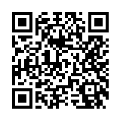
Introductions!
Share:
Name
Affiliation
Role
Also:
Go to https://www.wooclap.com/FBGMTZ and tell us what brought you to the workshop today.

Slide 7
Data Science in Libraries
Definitions
Share our ideas and definitions of data science in libraries.
DSLib Activities
Discuss examples of data science activities within subgroups.
Categories
Group DS Activities into the categories being considered by the WG.

Slide 8
DSLib Definition(s)
What is your definition/idea of data science in libraries?
Go to https://www.wooclap.com/FBGMTZ and share with us!

Slide 9
DSLib Definition(s)
The LIBER DSLib Working Group defines data science as a set of computational methods for the identification of novel and actionable insights from data. Computational methods used in data science include, but are not limited to, descriptive and inferential statistics, visualization, text mining, image processing and computer vision, machine learning, and data engineering. Data science in libraries is the use of these methods in the delivery and/or improvement of library services and the delivery of data science training or services.
The above is the WG’s working definition of data science in libraries. We have a number of other definitions in our WG’s open notes: https://hackmd.io/@nehamoopen/liber-dslib .

Slide 10
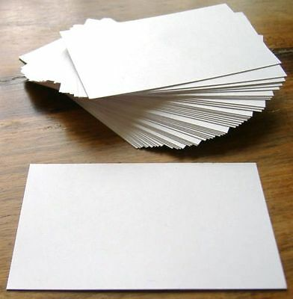
DSLib Activities
What are some examples of data science activities you (wish to) carry out at your library?
✏ Draw them on the flashcards!
Draw on one side, just have fun with it.
Put a caption/explainer on the other side.
In pairs, try to interpret each other’s masterpieces.
🗨 Discuss with your subgroup as you go.
📃 Provide a summary in the Google Doc and report back to the whole group.

Slide 11
Collections as Data
Data science activities that facilitate the use of library collections in computationally-driven research and teaching. This can include activities that ensure that data from library collections are high-quality, rich with information, reliable, suitable for analysis, and easily accessible for computational interactions.
Examples: data pipelines that are created to enhance the quality of data, machine learning and computer vision techniques used to: generate data, discover resources, identify and extract rich metadata and/or full-text from documents.

Slide 12
Library Intelligence
Data science activities geared towards the improvement of traditional library services and support for decision-making by library management.
Examples are data-driven item suggestions for library patrons, the application of machine learning techniques in the management of library material flows, the use of library loan data analytics in collection management, and automated library analytics for day-to-day planning and annual reports.

Slide 13
Research Support
Data science activities to support researchers through the research lifecycle. This can cover areas such as research data management, research data/software engineering, digital humanities, and (digital) information skills.
Examples include data management planning, research data/software engineering, ensuring FAIRness (findability, accessibility, interoperability, reusability) of data, data curation and preservation, working with Linked Open Data and digital corpora, the use of data science methods in (automated) systematic searches and reviews of literature.

Slide 14
Research Intelligence
Data science activities in compiling and visualizing data for decisions and benchmarking within the scientific community. Given the scale of the data available, Research Intelligence often requires the implementation of data pipelines and dashboard tools.
Examples of data collected are metadata of publications and other research outputs, and data related to these outputs such as citations. An integral part of RI is also the continuous development of analysis workflows, for instance combining traditional citation metrics with alternative metrics such as policy citations.

Slide 15
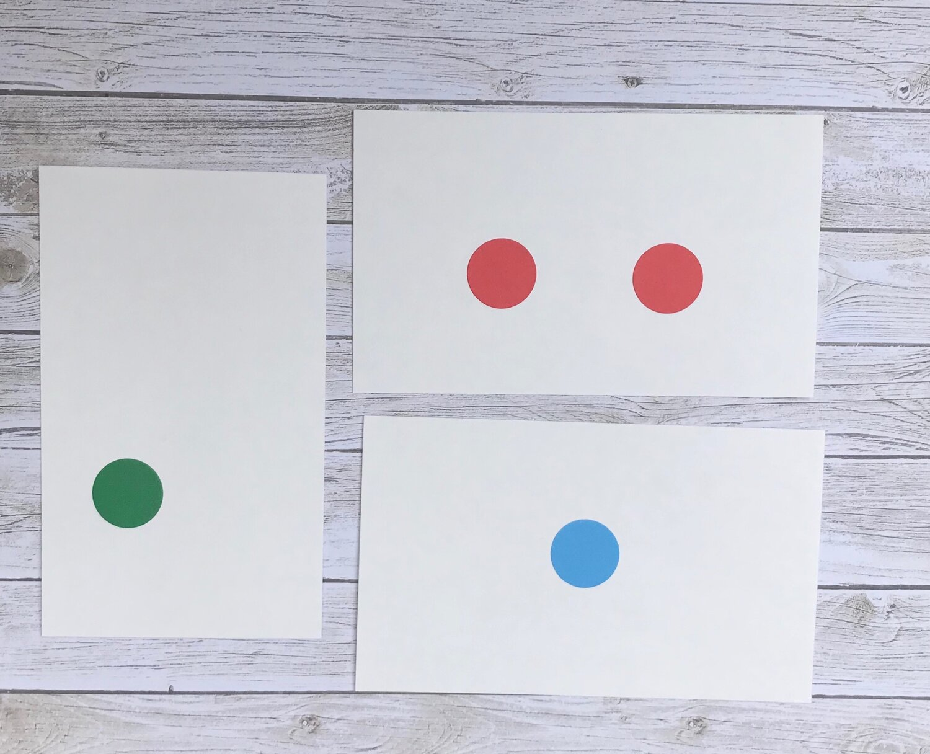
DSLib Categories
Categorize your own DS activities + the examples!
Tag the flashcards with stickers. More than one category is possible!
🟢 Collections as Data
🔵 Library Intelligence
🟡 Research Support
🔴 Research Intelligence
🗨 Discuss with your subgroup as you go.
📃 Provide a summary in the Google Doc and report back to the whole group.

Slide 16
Wrap-Up of PART 1
Go to the flipcharts/whiteboard and stick your flashcards under the (most) relevant categories. Feel free to propose new categories too!
.

Slide 17
Wrap-Up of PART 1
Discussion & Feedback on the categories/typologies At least one person reports back on the subgroup’s reflection/feedback on the typologies
.

Slide 18
Coffee Break ☕ 10:15 – 10:30

Slide 19
PART 2
10:30 – 12:00

Slide 20
Landscape Analysis
The WG needs your input to develop the landscape analysis!
✏ Write out your thoughts and ideas in your subgroup’s collaborative document.
🗨 Discuss with your subgroup as you go.
📃 Provide a summary in the Google Doc and report back to the whole group.
Some discussion/reflection prompts:
What kind of data do you (wish to) work with?
What are the opportunities and challenges with respect to carrying out data science in libraries?
If the WG works on a landscape analysis/report/advice/recommendation:
What kind of information would you like to see?
What kind of information do you think all libraries would benefit from?
What else would you want out of our WG’s activities? Where can we provide the most valuable input?
.

Slide 21

DSLib Survey
Link:https://survey.uu.nl/jfe/form/SV_eswlDMEJuaf9nGS
👁‍🗨 Skim through the survey and imagine filling it out yourself/for your library.
What are points for improvement? What is missing?
🗨 Discuss with your subgroup as you go.
📃 Provide a summary in the Google Doc and report back to the whole group.

Slide 22
Wrapping Up…

Slide 23
Closing
Thanks for being here!
Would you be open to being contacted for the survey?
Would you like to join our WG or contribute in any other way?
Links:
WG website: https://libereurope.eu/working-group/liber-data-science-in-libraries-working-group/
WG open notes: https://hackmd.io/@nehamoopen/liber-dslib/
.

Slide 24
Thanks!
Email: n.moopen@uu.nl Twitter: @NehaMoopen

