Slide 1



Distribution Shift

Slide 2
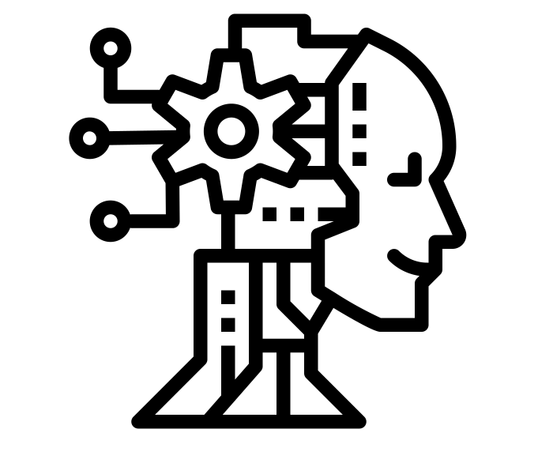

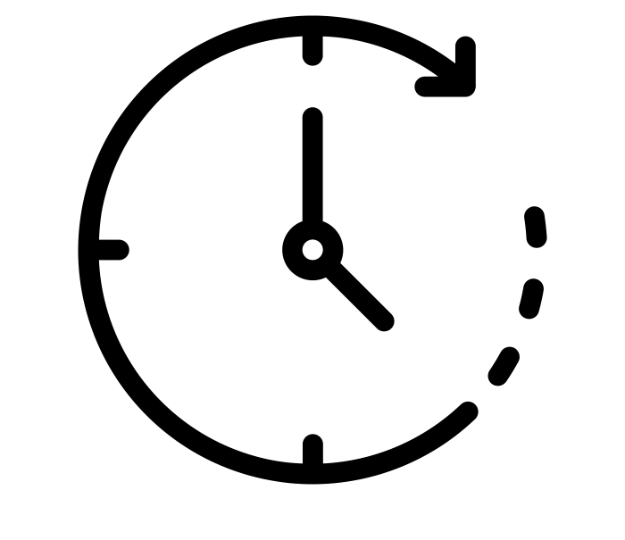
Algorithms
Task t
Task t+1

Slide 3
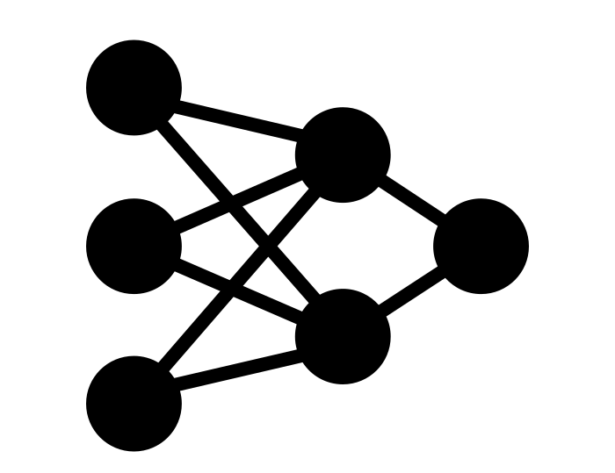


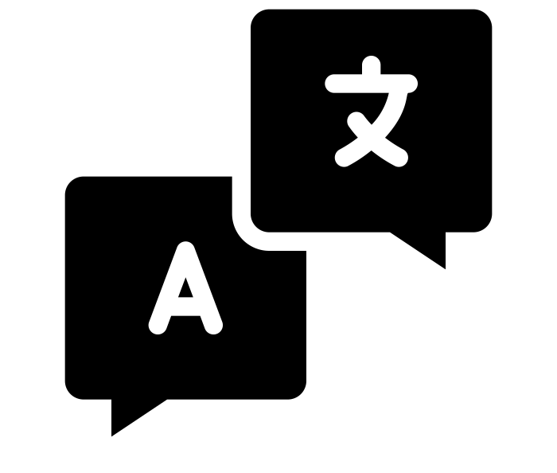
Neural Architectures

Slide 4
Task Ordering

Slide 5

Pretraining Effect
Pretrained Policy

