Slide 1

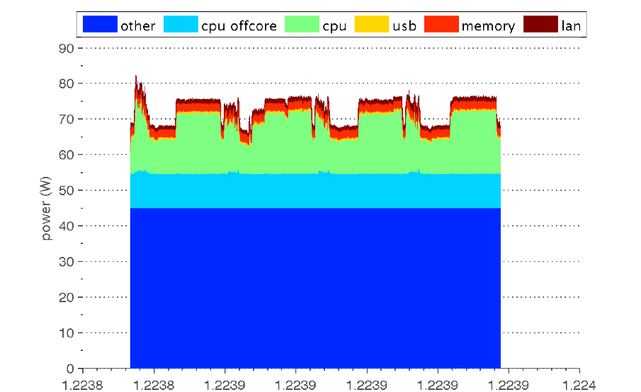
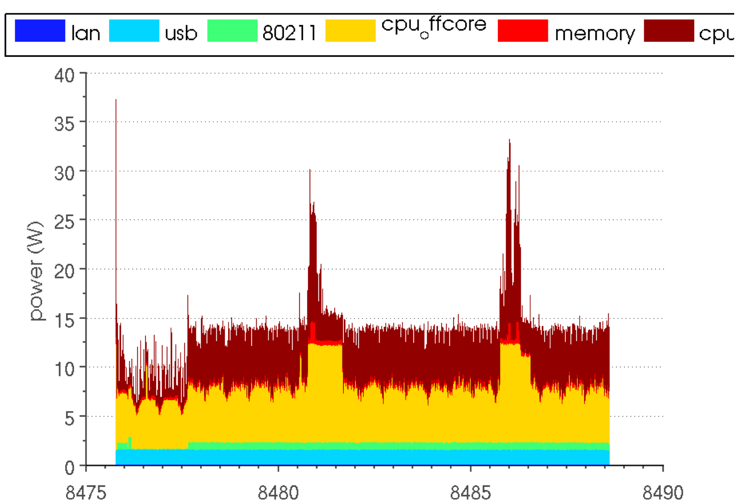
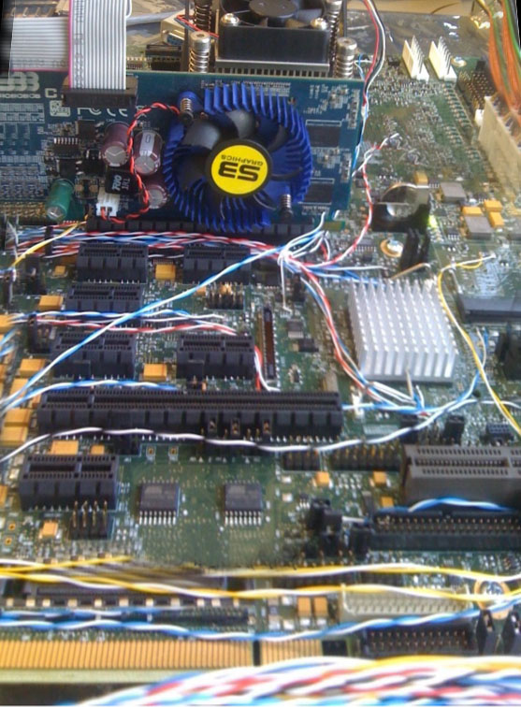
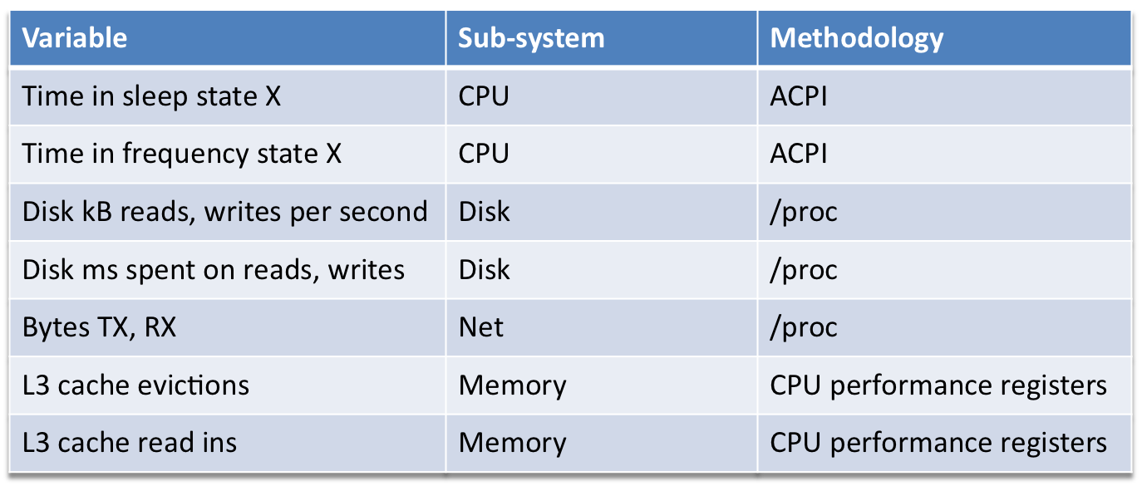
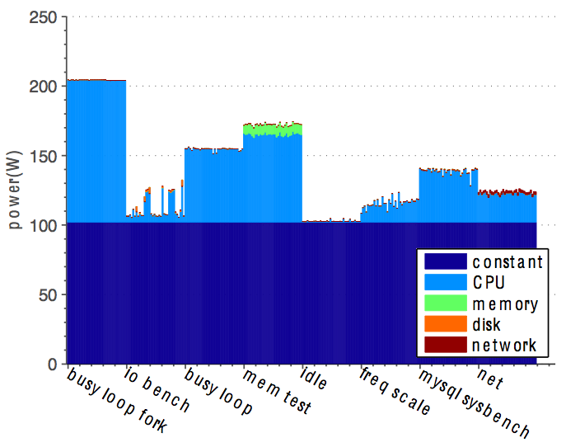
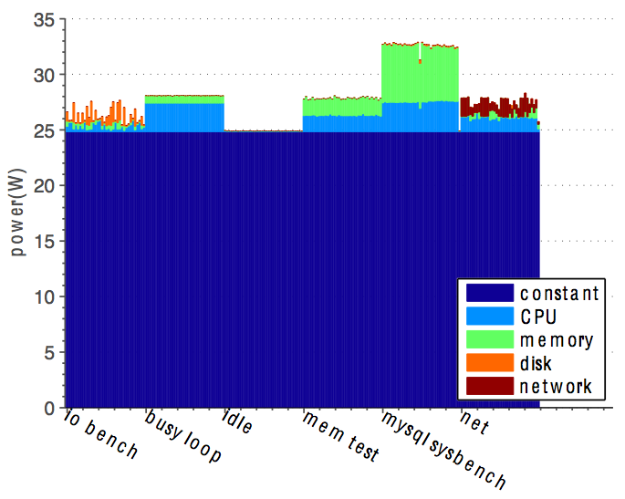
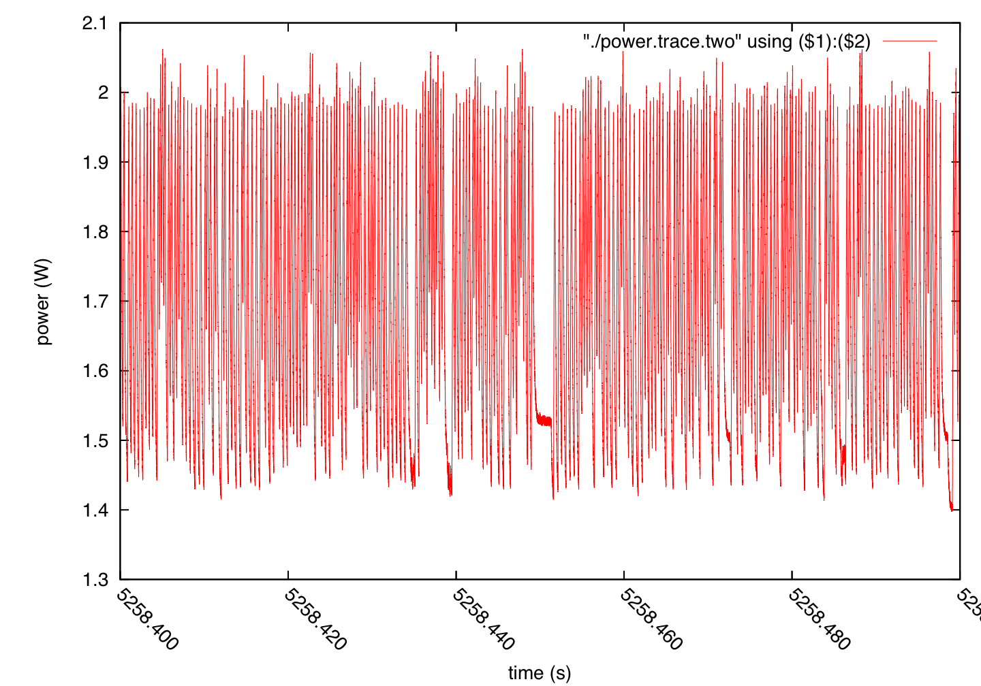
Energy Profiling in Computers
Stephen Dawson-Haggerty, Andrew Krioukov
Goals
Energy breakdown by hardware component and software process/functions
Real-time measurement
Help developers reduce energy consumption
Hardware Instrumentation Method
Instrumented Intel “Westmere” based mobile system.
Breakdown of total energy during object recognition workload.
Partial breakdown of energy during file transfer over wireless network.
Software Counter Method
Approach:
Measured counters:
Workloads:
Model power usage based on counter values observable through software. Initial model “training” using wall-power measurements.
Workload | Description | Targeted subsystems
idle | Does nothing | All
busy_loop | Multi-threaded math loop | CPU
mem_test | Sequential and random memory accesses | Memory
freq_scale | Runs busy_loop while controling frequency scaling | CPU
net | scp back and forth | Network card
io_bench | Sequential and random out-of-cache disk accesses | Disk, cpu
mysql_sysbench | OLTP benchmark | Holistic
Model:
A x = b
A = Matrix of counter values
b = Vector of wall power measurements
Solve for x, the vector of coefficients.
Measurement | Source
Wall power | ACme
Hard disk drive power | Logging multimeter
Results
Core i7
Intel Core i7-965 3.2GHz, Intel X58 Chipset
Root Mean Square Error = 2.2 Watts
Atom
Intel Atom 330 1.6GHz, Intel 945CG Chipset
Root Mean Square Error = 1.16 Watts
Wireless card
Intel 802.11N wireless card
45Mbps, 3x3 MIMO

