Slide 1
Energy Efficient Web Server Cluster
Andrew Krioukov, Sara Alspaugh, Laura Keys, David Culler, Randy Katz

Slide 2
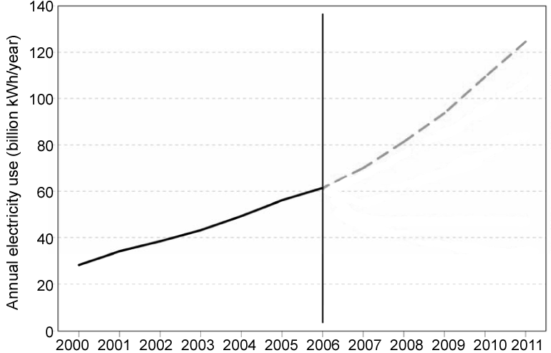
Energy consumption in data centers
$7.2 billion
Doubling
in 5 years
(EPA Report on Server and Data Center Energy Efficiency, 2007)
Notes:
- Energy consumption in data centers growing very rapidly
- So reducing this energy will be an increasingly important

Slide 3
Web Applications
Clients
Database / SAN
Frontend /Load Balancer
Web Server
Web App
Web Server
Web App
Web Server
Web App
Web App

Slide 4
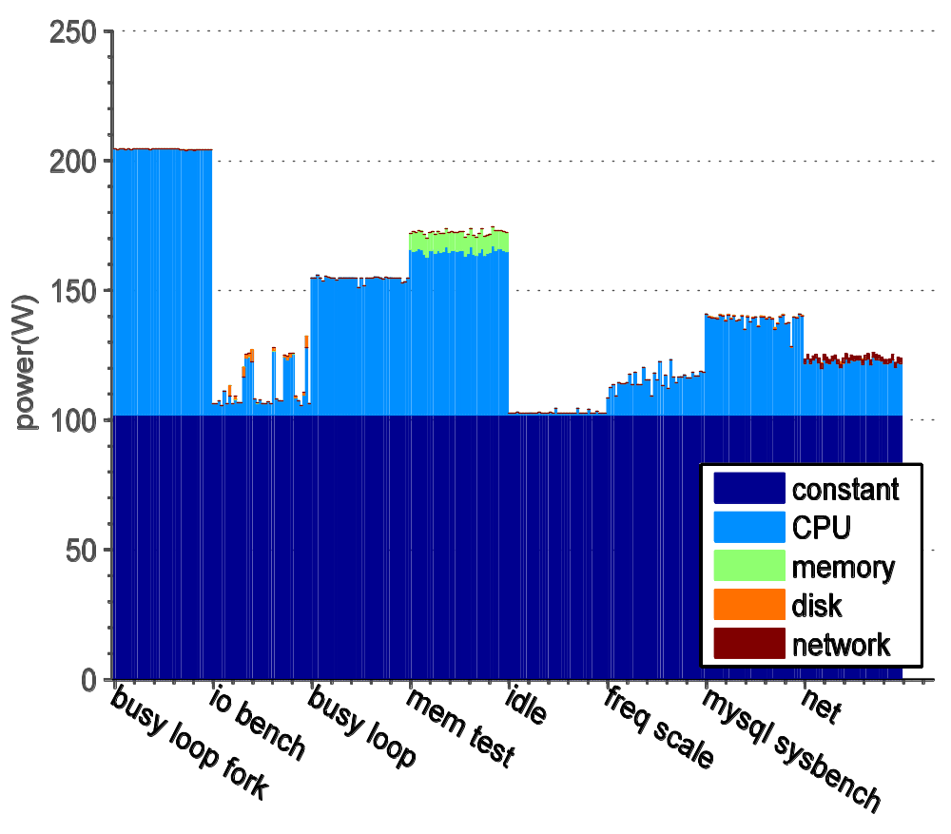
Core i7
50% Idle Power

Slide 5
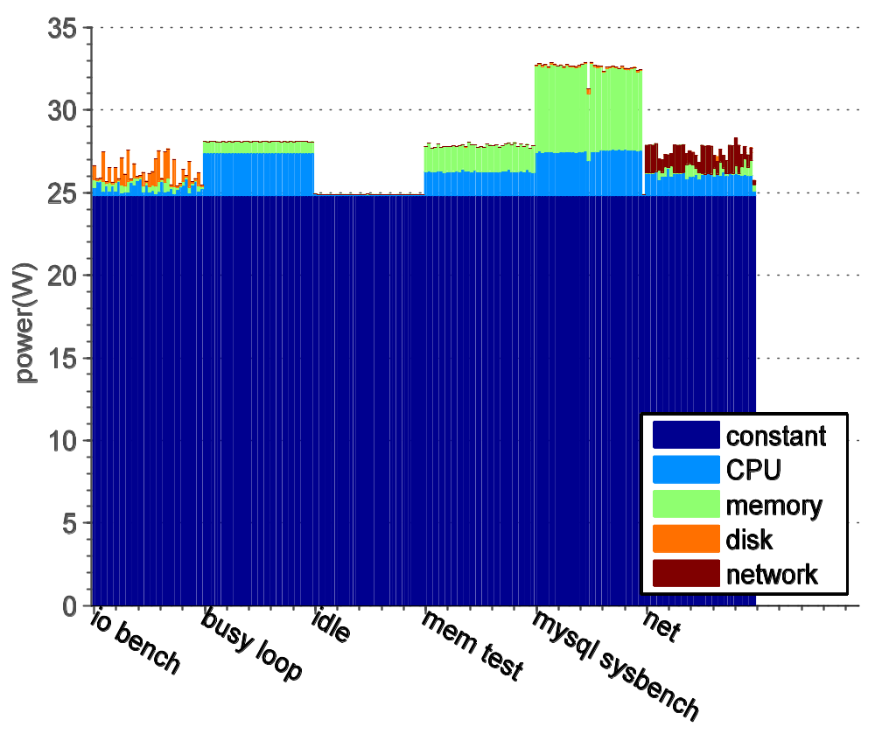
Atom
80% Idle Power

Slide 6
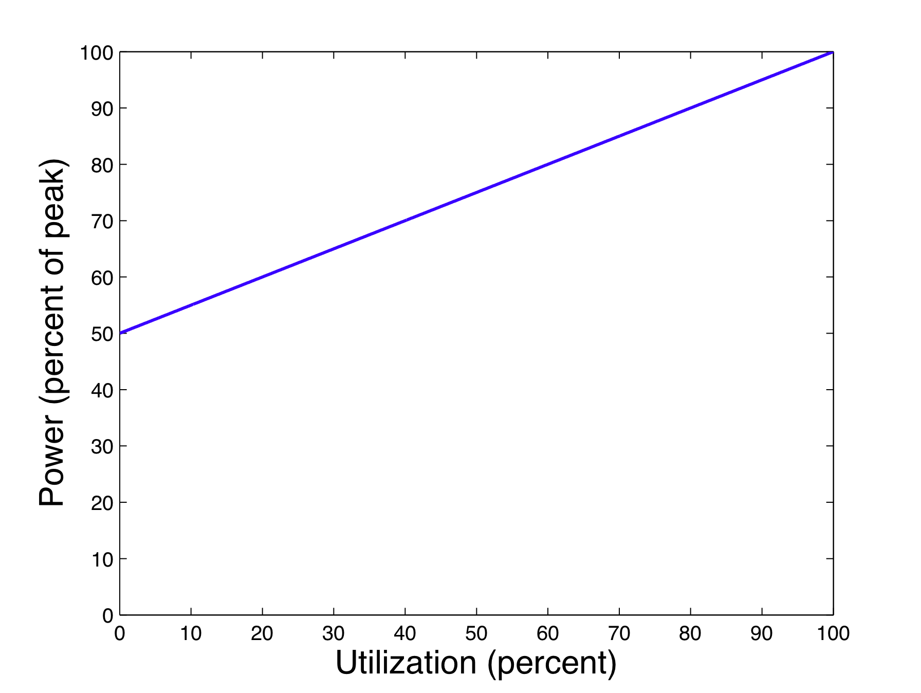
Server energy consumption
Active
Idle
Sleep / Off

Slide 7
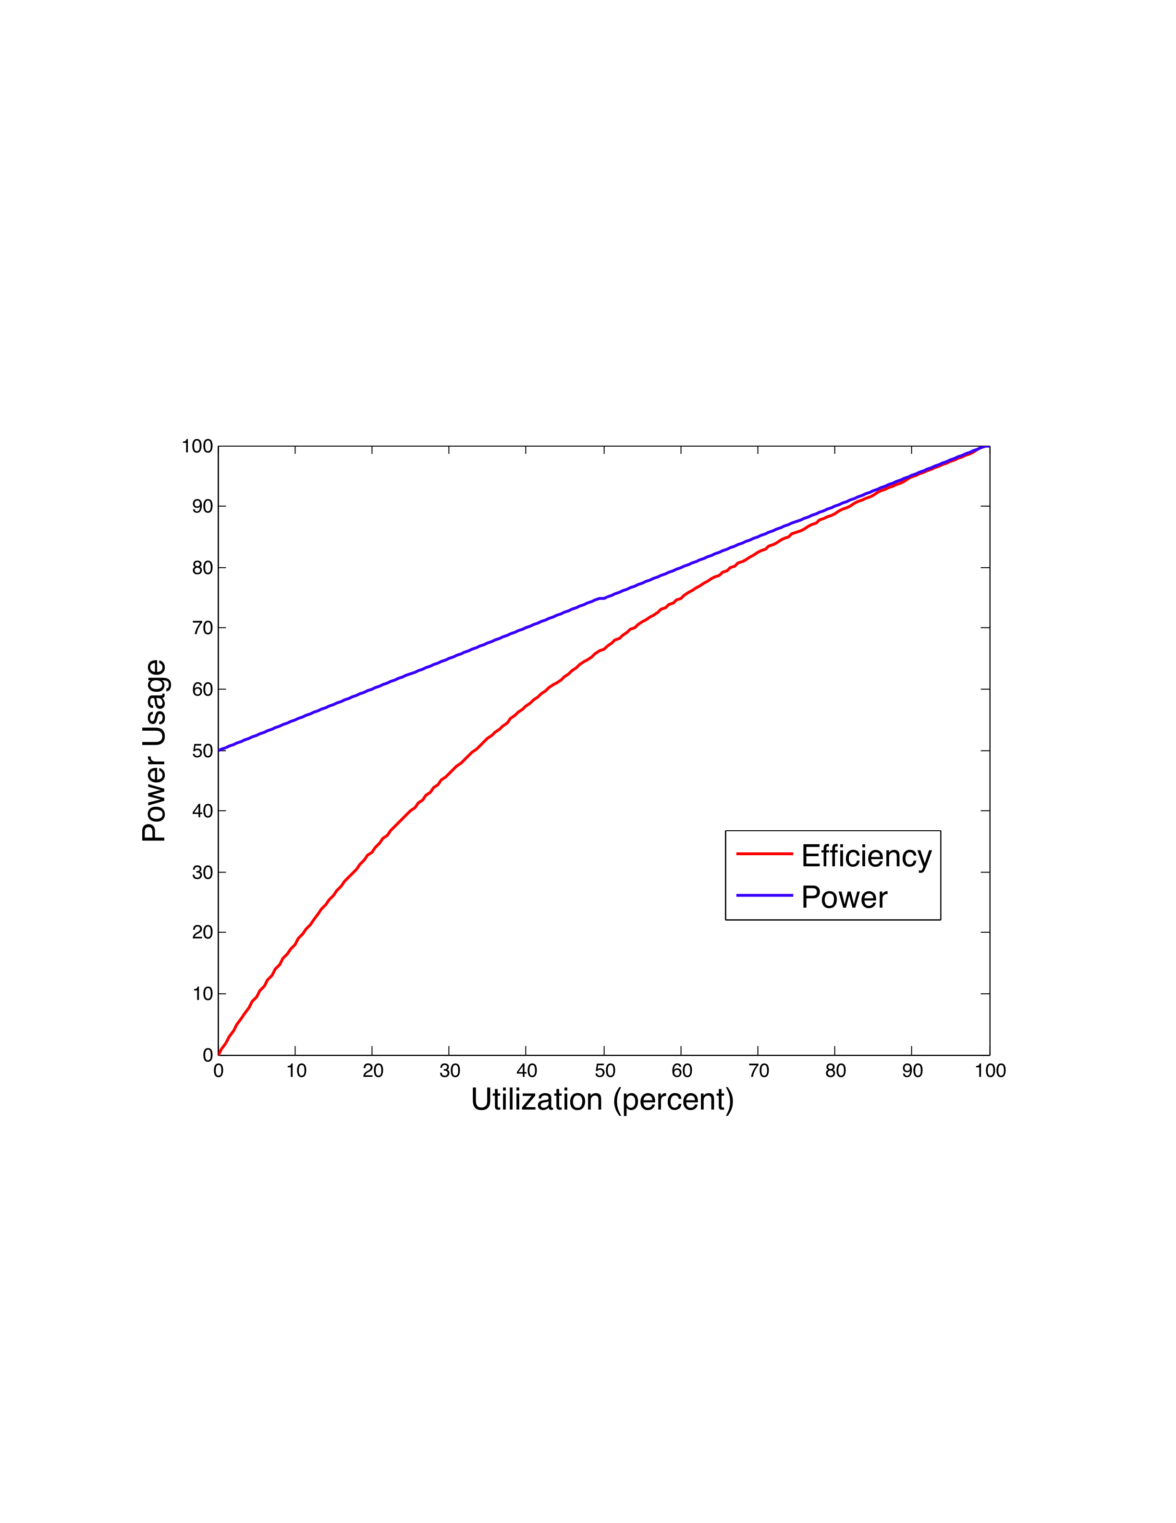
Server energy efficiency
Energy Efficiency = Work / Energy
Percent Efficiency
Notes:
Power proportional if blue line started at zero

Slide 8
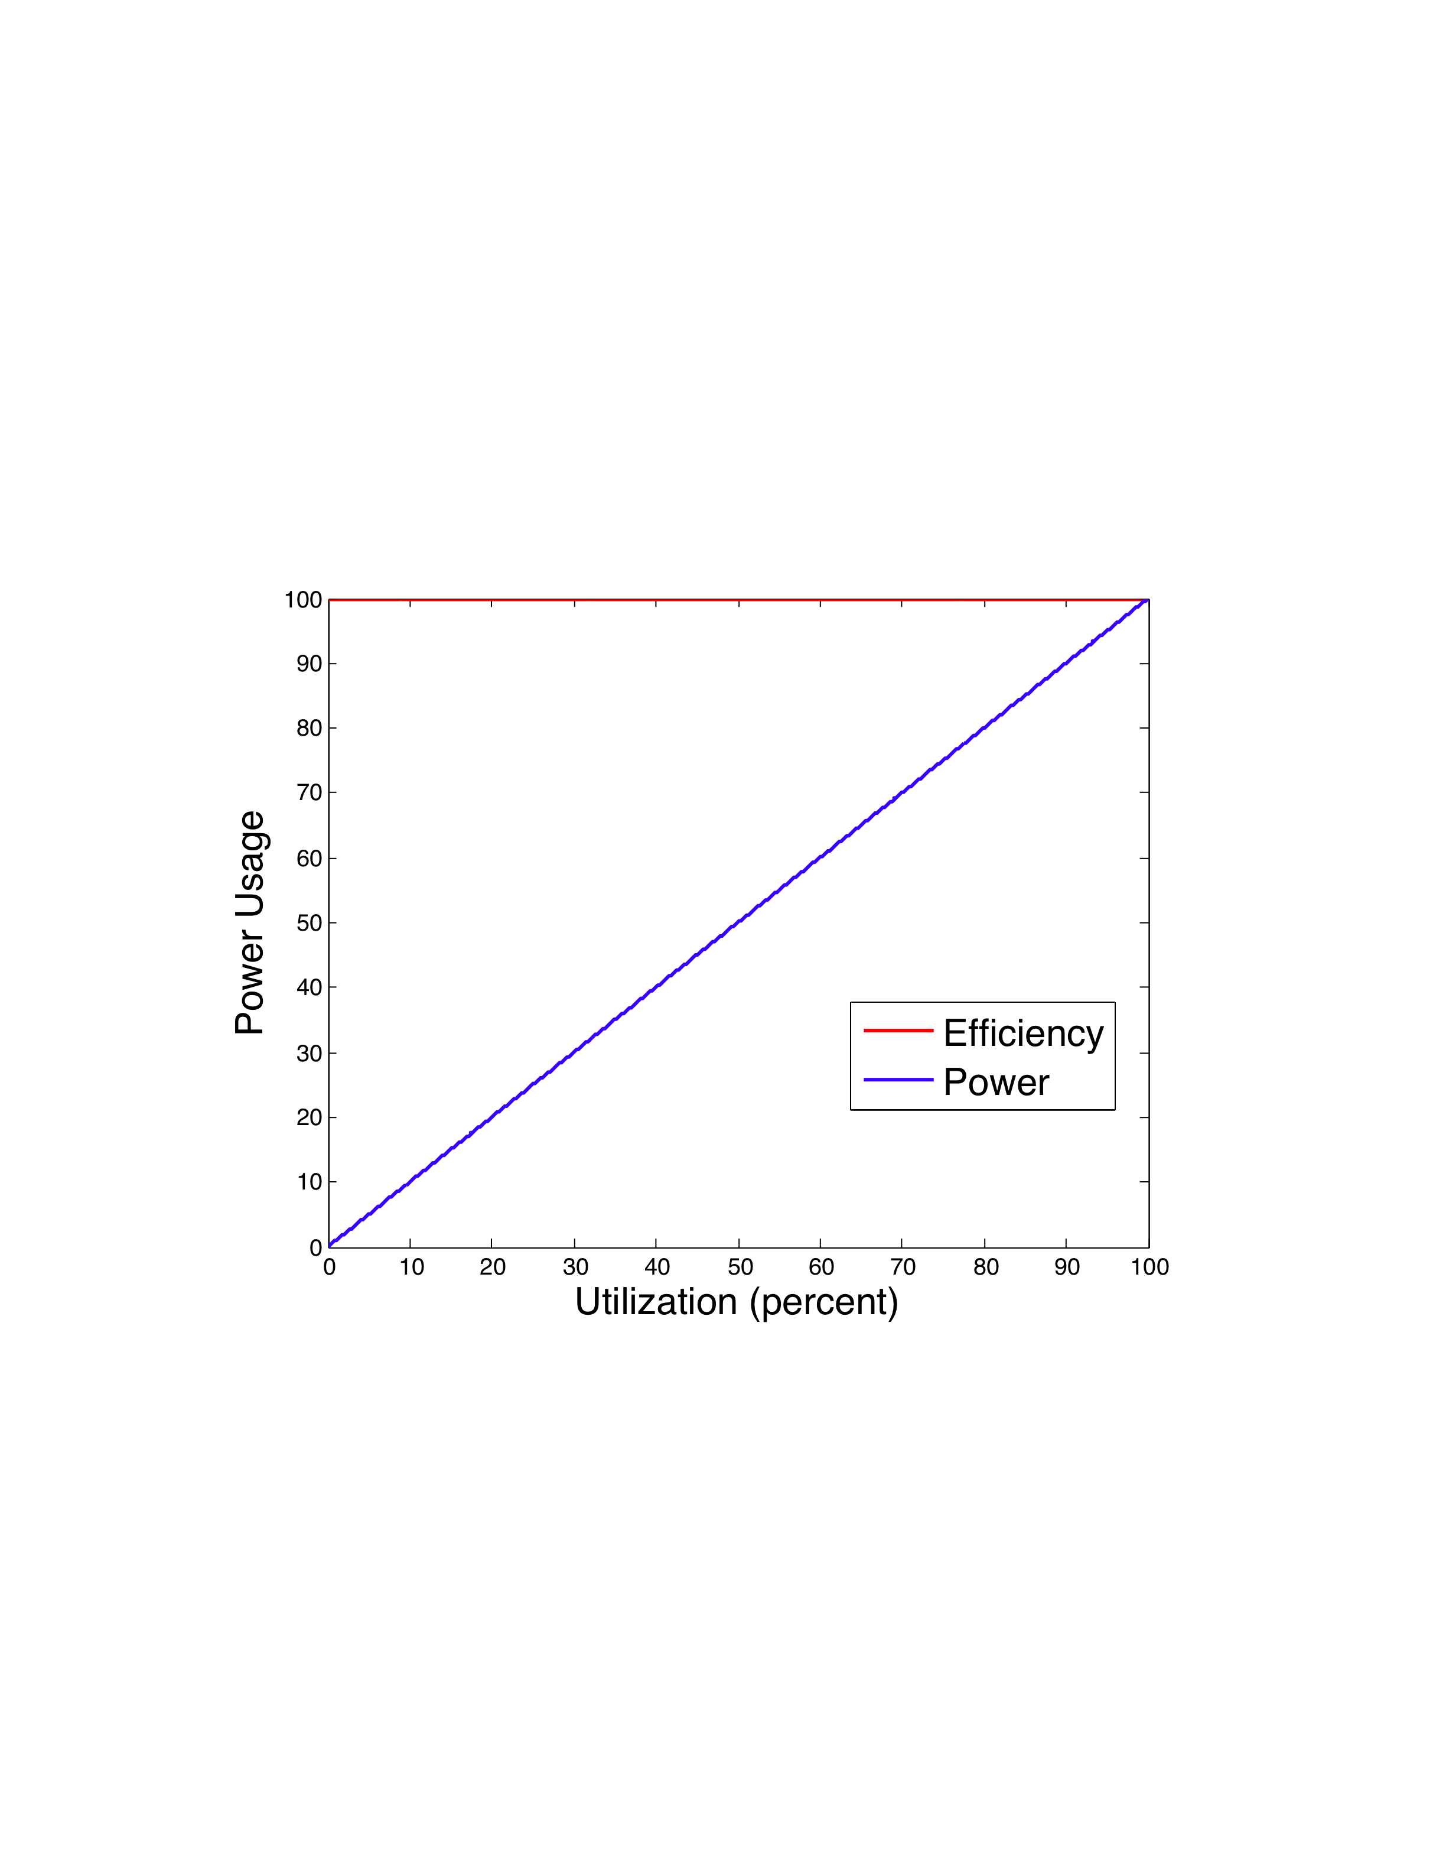
Power Proportional Server

Slide 9
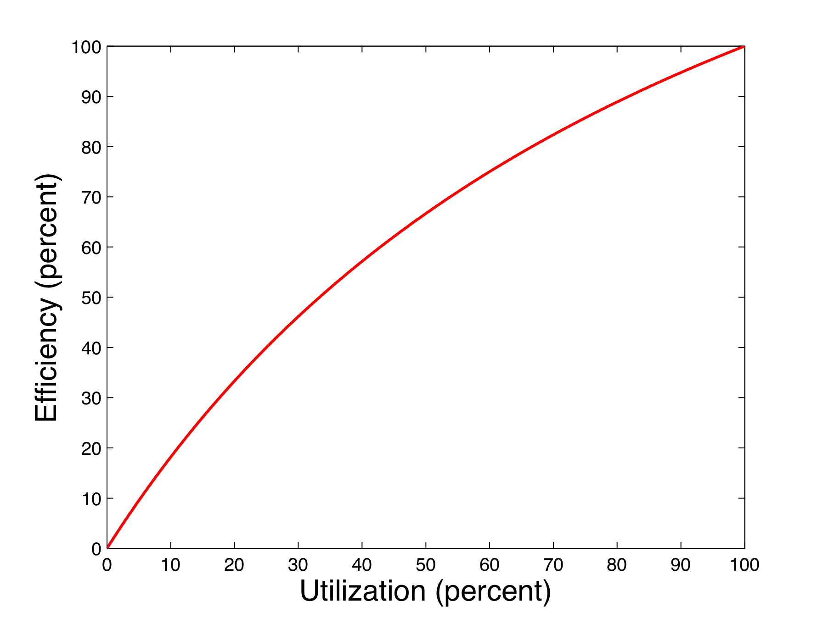
Problem
Servers are energy efficient at high utilization
Typical server utilization is low
  Google: average server utilization 30%

Slide 10
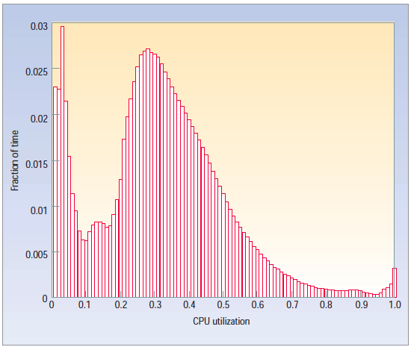
Google CPU Utilization
5,000 servers at Google during a six-month period
The Case for Energy-Proportional Computing
Luiz Barroso, Urs Holzle 2007

Slide 11
Solutions
Make servers power proportional
  Requires fixing hardware & software
Make power proportional cluster
  Run nodes at high utilization or “off”
  Consolidate workload

Slide 12
Web Servers
Stateless
Short requests
Requests can be served by multiple machines
Large variation in load

Slide 13
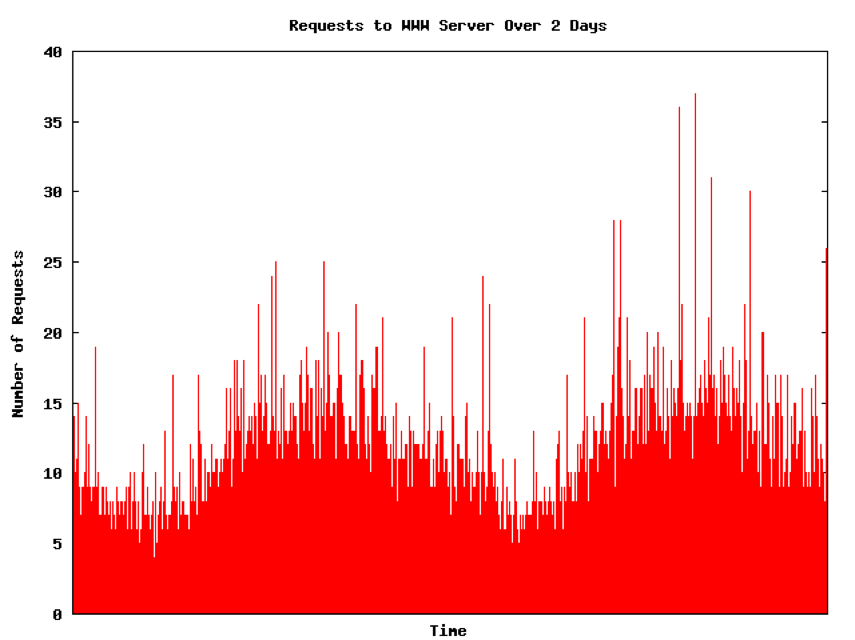
Web Server Load
ISP web server trace from Internet Traffic Archive

Slide 14
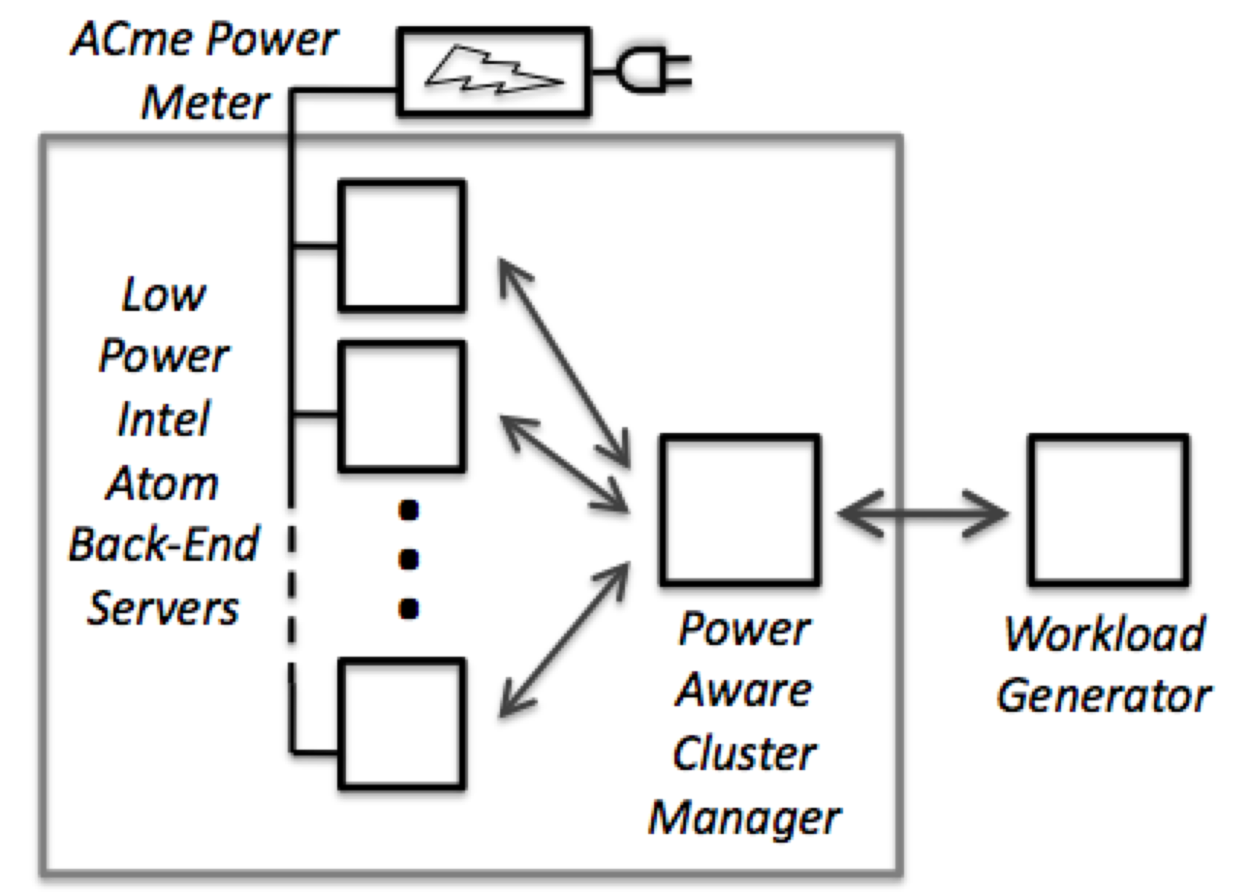
Cluster Architecture

Slide 15
Atom Nodes
Intel Atom 330 with 945CG chipset
1.6 GHz, 2 cores
CPU spec sheet TDP: 8W
Chipset spec sheet TDP: 22.2W

Slide 16
Atom Nodes
Power states:
  Active
  Idle: CPU enters C-states
  Sleep: Suspend to RAM
  Off
 | Power (Watts) | Time to Resume (seconds)
Active | 22 – 24 W | -
Idle | 22.08 W | 0 s
Sleep | 1.6 W | 2.5 s
Off | 0 W | 61 s

Slide 17
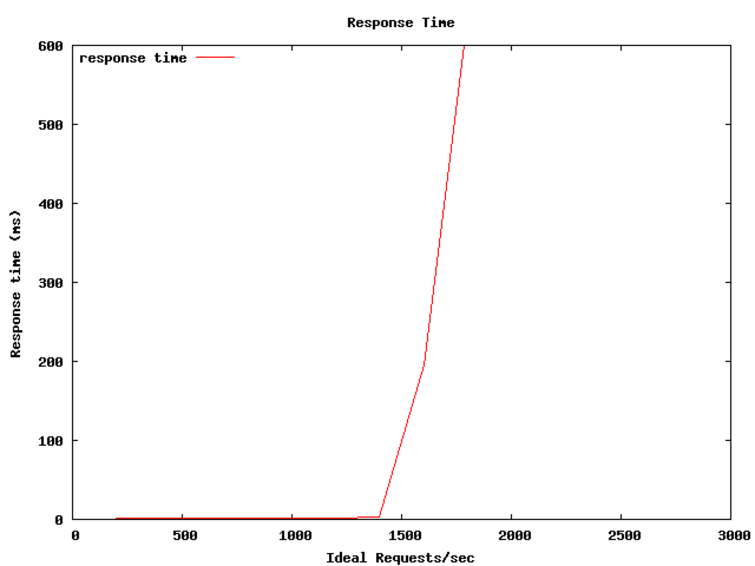
Node Performance
Max request rate

Slide 18
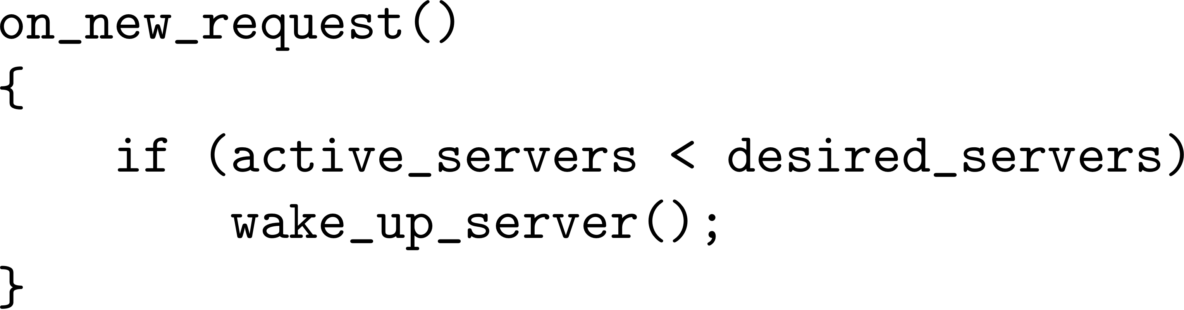
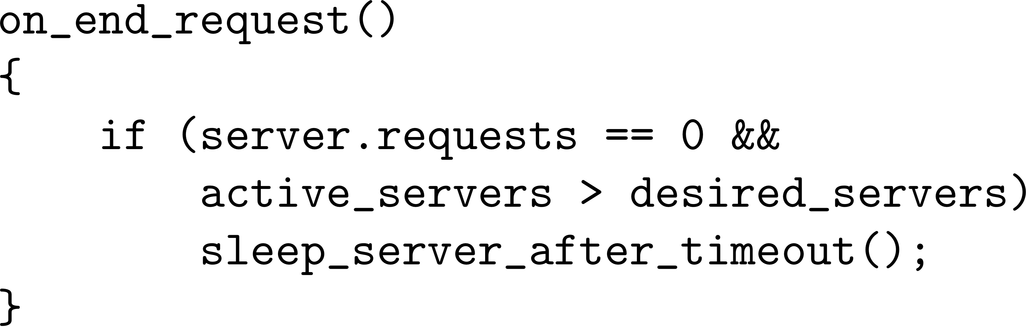
Scheduler Algorithm
Keep awake desired_servers
Put servers to sleep after a timeout

Slide 19
Evaluation
Httperf workload generator
Synthetic workload
  Request files in Zipf distribution
  Ramp request rate up and down
Working on using real web server traces

Slide 20
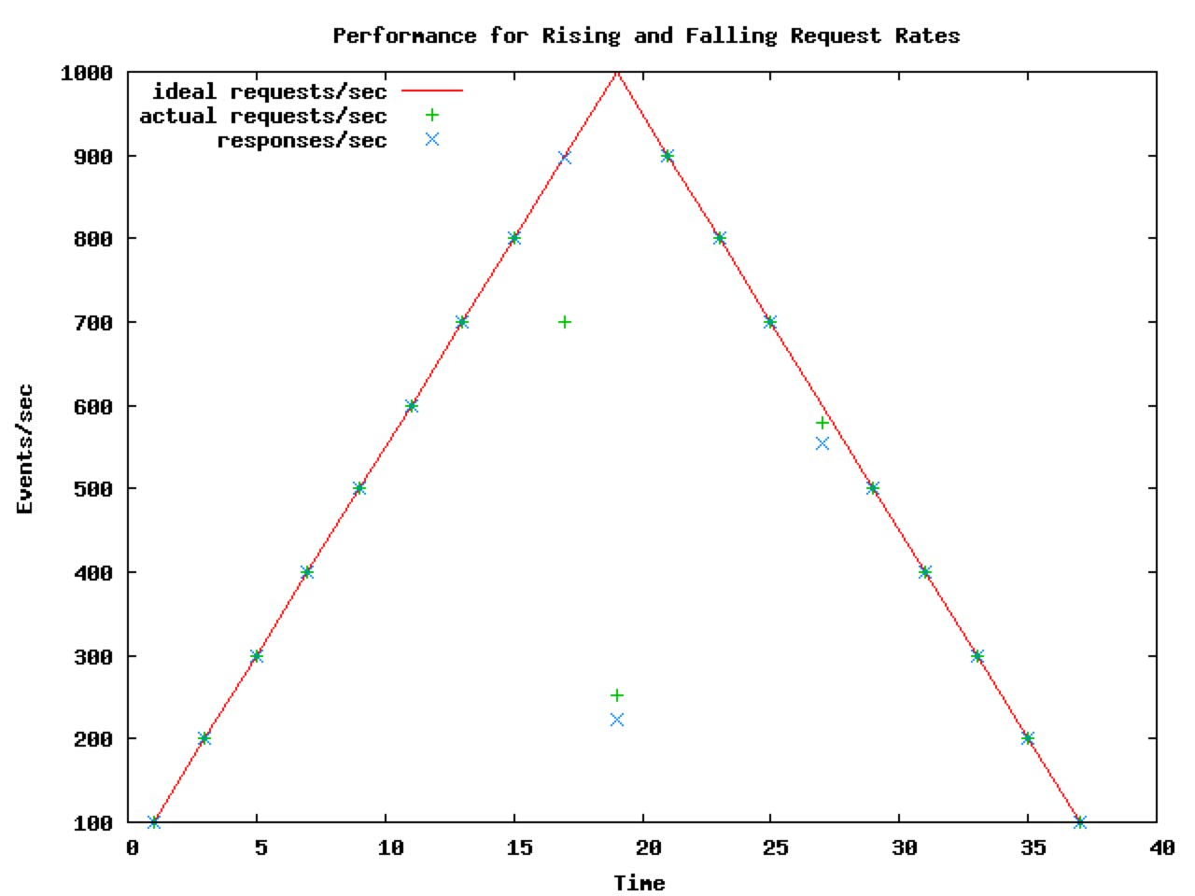
Throughput

Slide 21
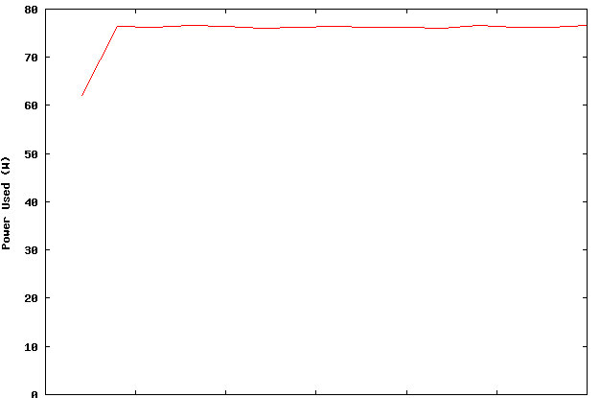
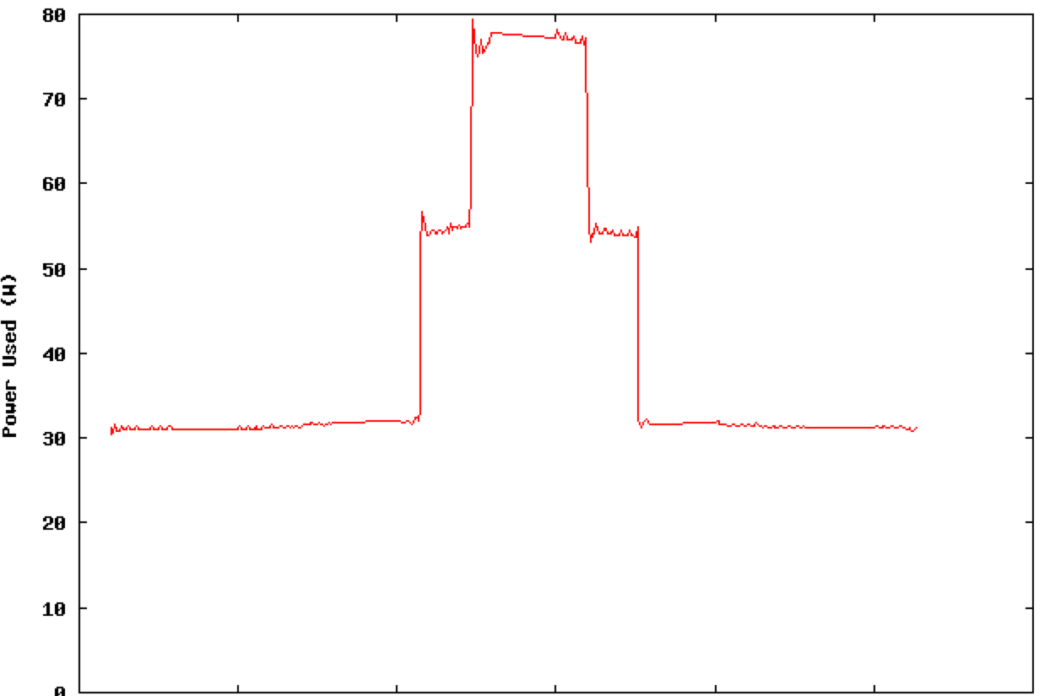
Energy Savings
Simple Load Balancer
Power Aware Cluster Manager

Slide 22
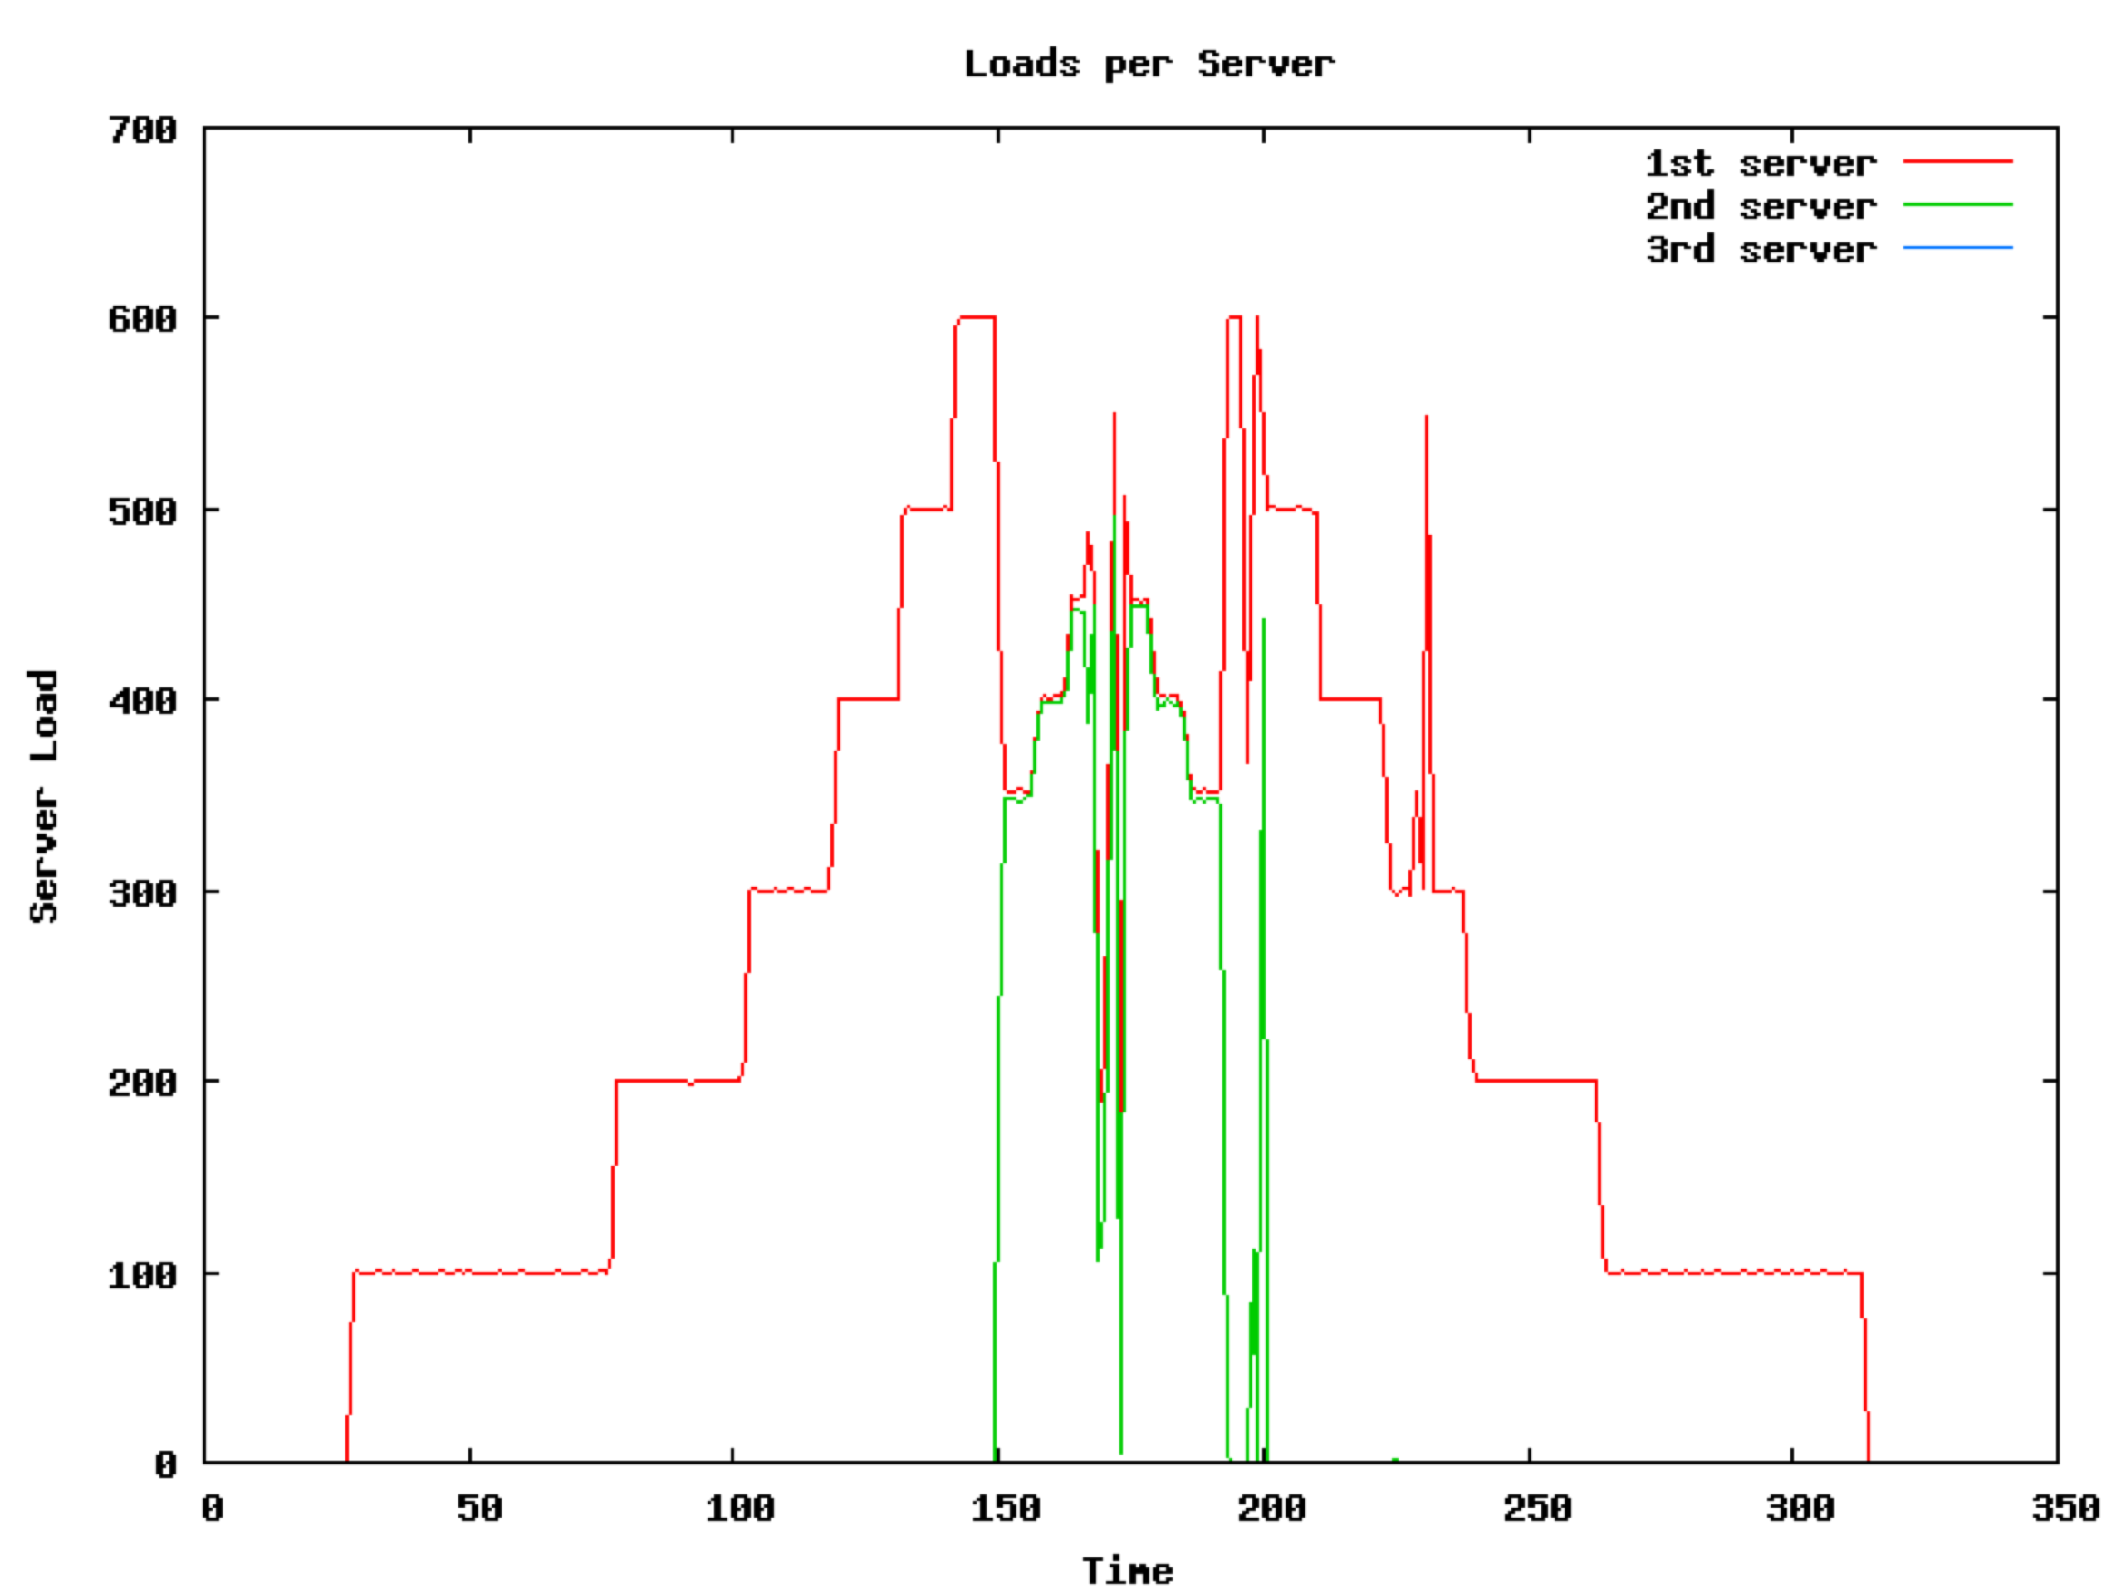
Load per Server

Slide 23
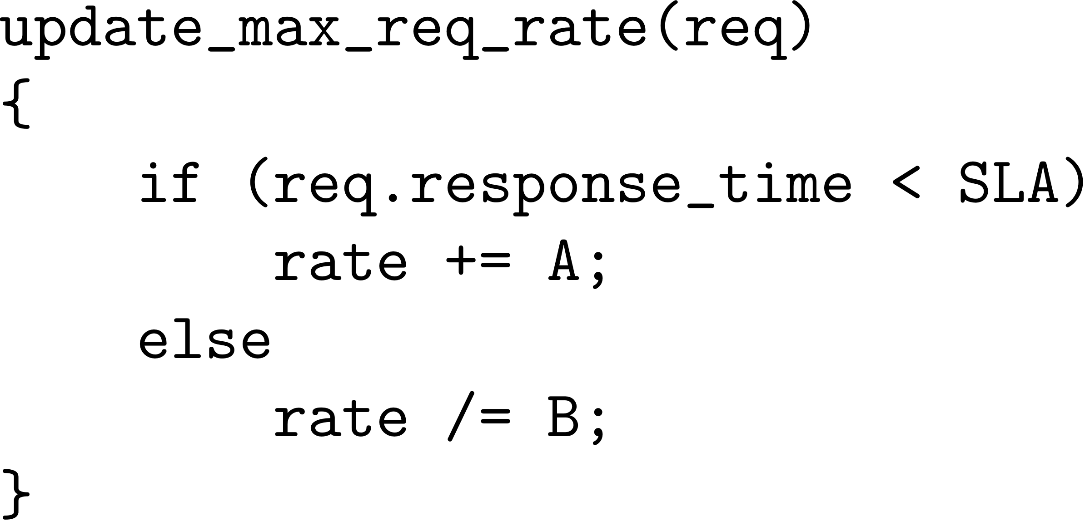
Future Work
Heterogeneous hardware
  Small nodes for low utilization
Adjust to changes in request types
  Dynamic vs. static requests
  Adjust max requests per server

Slide 24
Questions

Slide 25
Adjust to request types

Slide 26
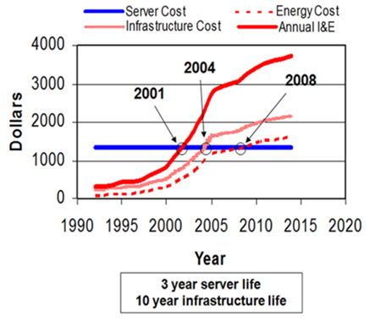
Power vs. server cost
In the data center, power and cooling costs more than the IT equipment it supports
Christian L. Belady, HP 2007

Slide 27
Saving Energy
Turn off unused resources
  Use lower states
Improve power in states
Active
Power
Idle
Sleep
Off

