Slide 1
Noise Removal

Slide 2
Patient-specific supervised learning
Patient-specific
model
Base process
for signal input
Pre-trained
model
Patch 1 Hour Signal
Raw Signal
MIT-BIH
Analyzable
Noise
Denoising with DWT
Noise Generator
Noise Generator
Split into
3 seconds
Analyzable
Synthetic
noise
Analyzable
Synthetic noise
Calculate FFT coefficients
CNN Network
CNN Network

Slide 3
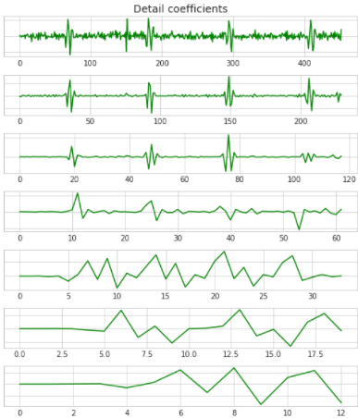
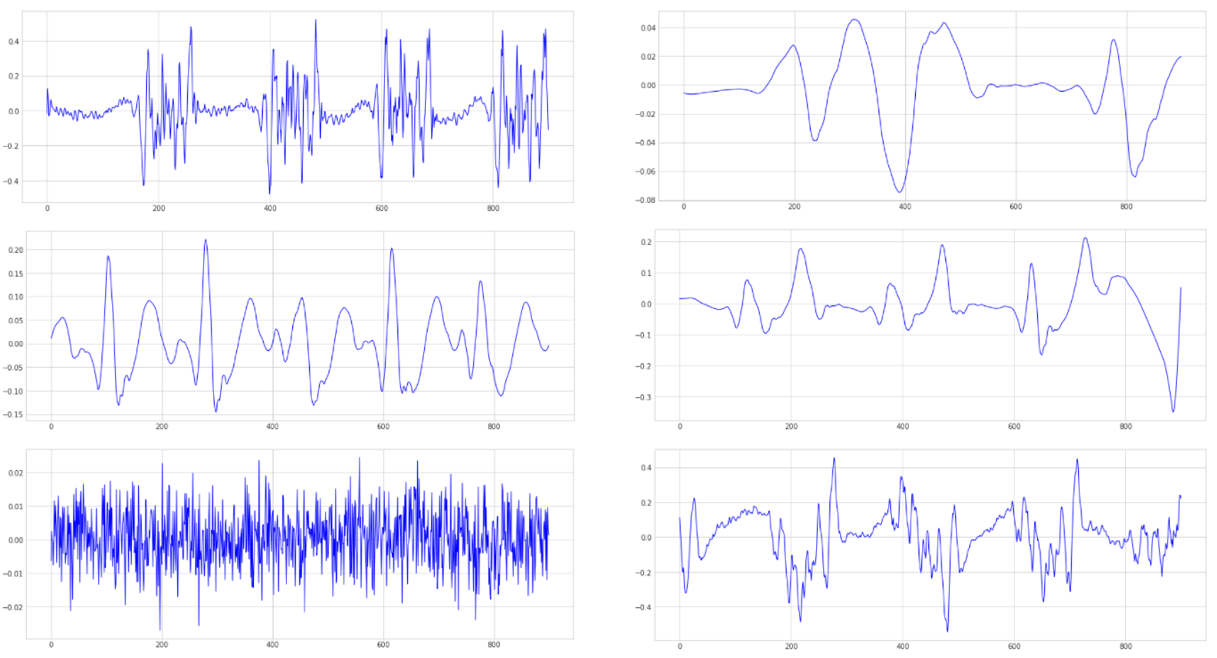
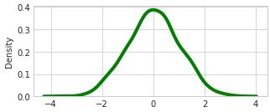
How to synthesize noise
주파수 대역 별 Normal signal 분해
Synthesize
High frequency noise extraction
QRS Frequency bands)
Synthesize
Low frequency noise extraction
White Noise generation
Scaling

Slide 4
Synthetic noise

Slide 5
R-peak detection

Slide 6
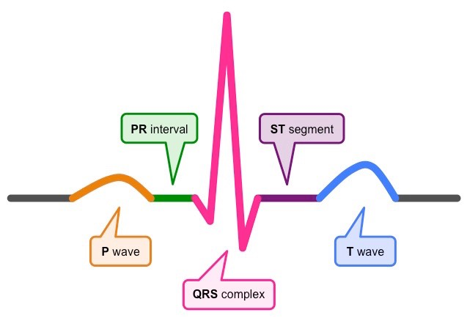
QRS complex

Slide 7
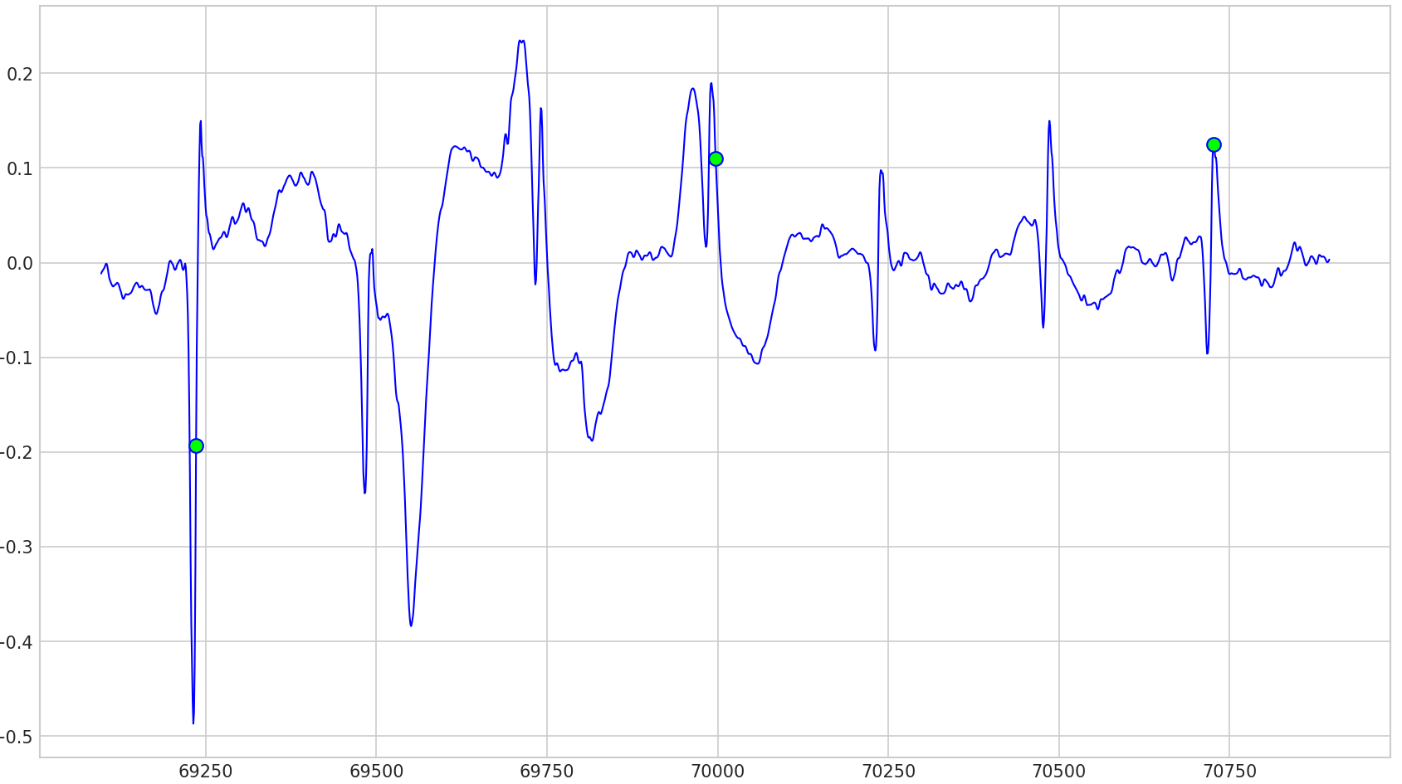
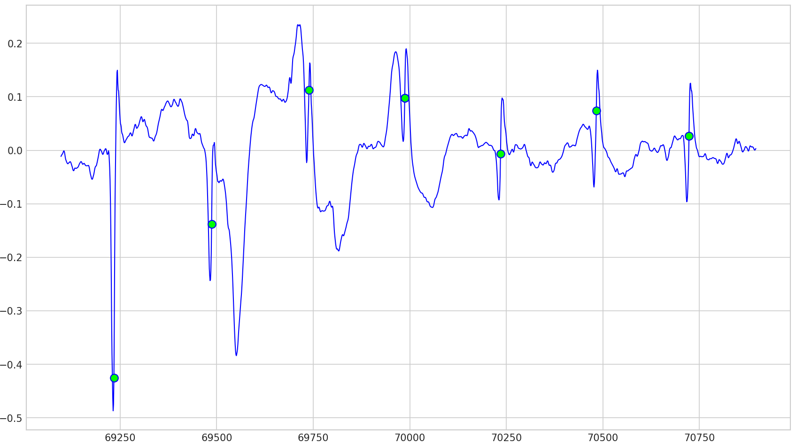
2-stage detection
Apply Pan-Tompkins
Detect periods
missing R-peaks
Apply Elgendi

Slide 8
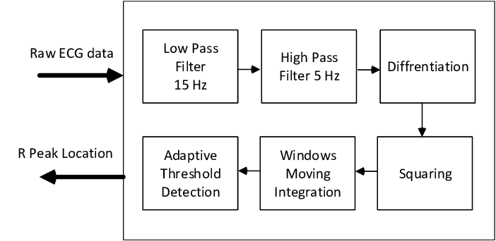
Stage 1: Pan-Tompkins method

Slide 9
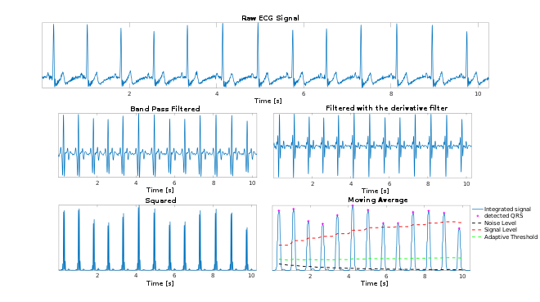
Stage 1: Pan-Tompkins method

Slide 10
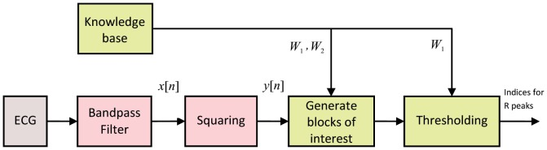
Stage 2: Elgendi method

Slide 11
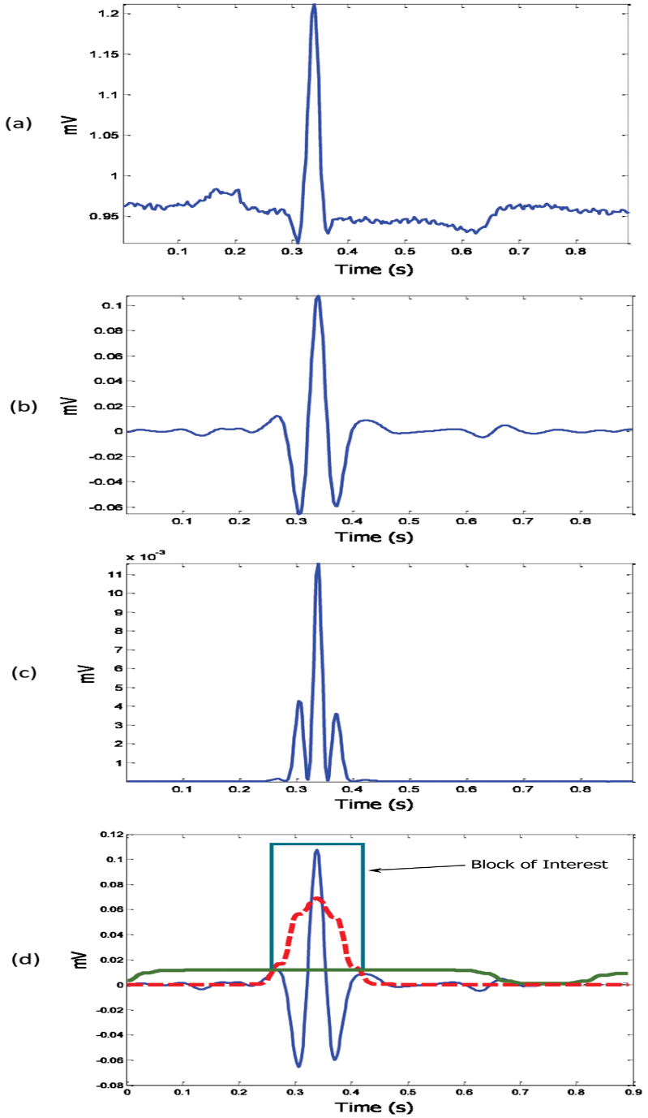
Stage 2: Elgendi method

Slide 12
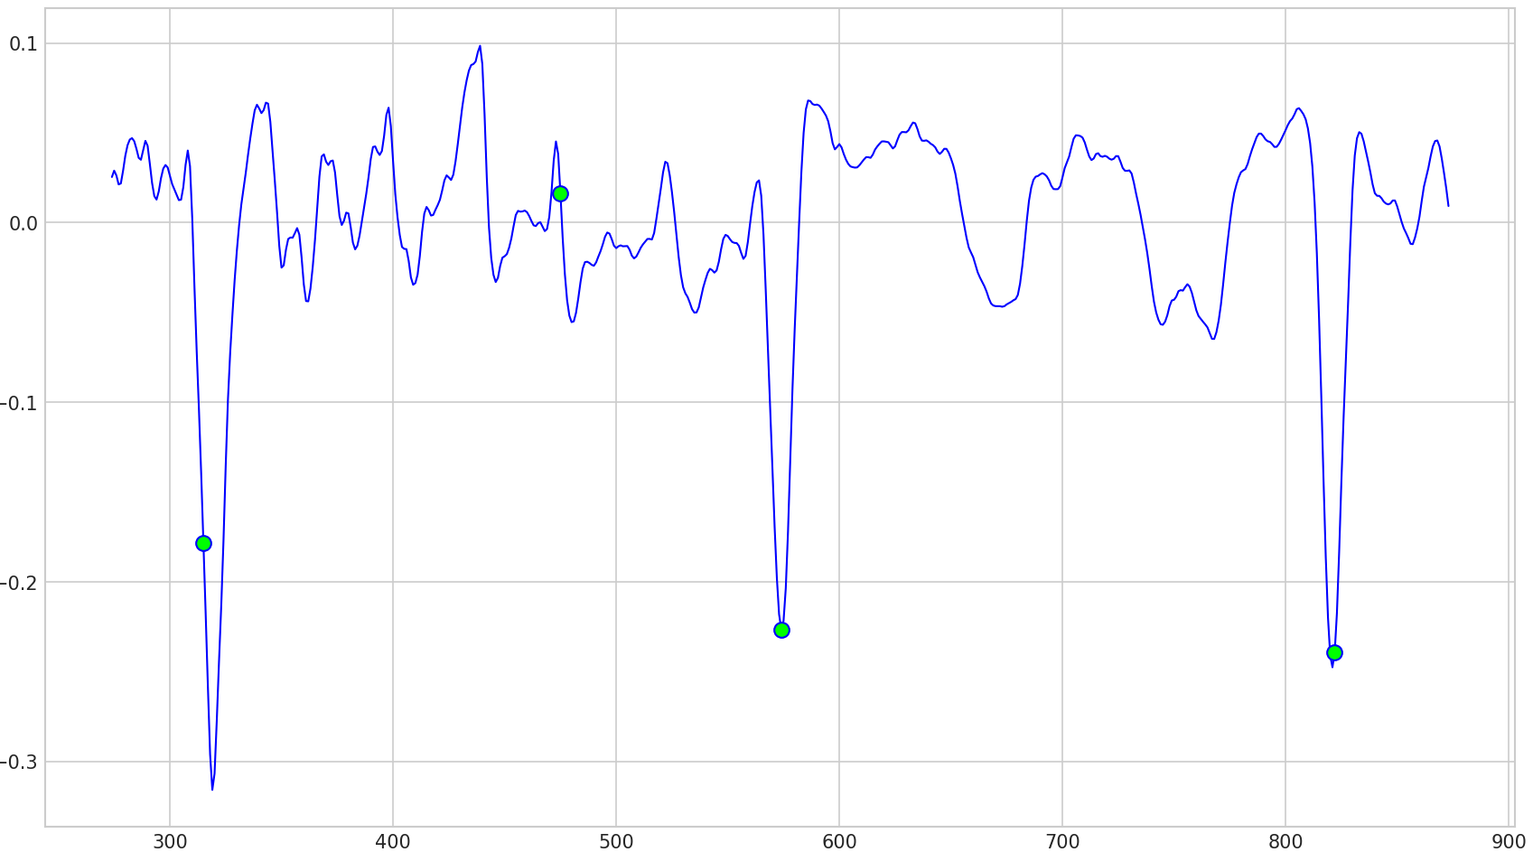
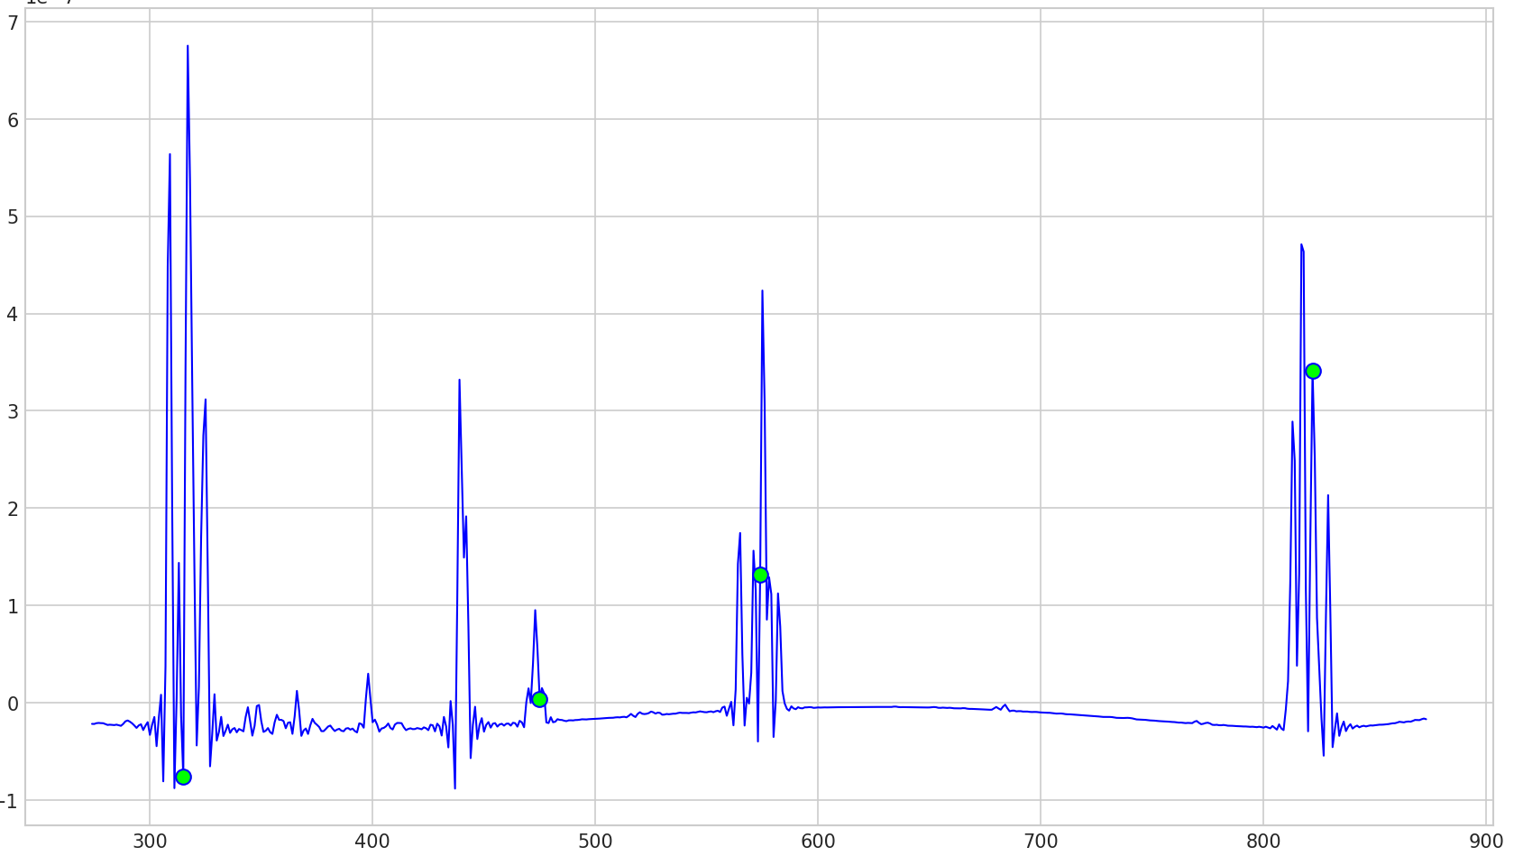
Post-processing
False R-peak
Threshold of Fake R-peak
1. Marginal derivative peaks * 0.05 >
2. 60th percentiles of Marginal 10 Peaks *0.05 >
when 1, 2 are both satisfied
Compare the magnitude of derivates

