Slide 1



STAR: Sub-Entry Sharing-Aware TLB f​or Multi-Instance GPU
Bingyao Li¹, Yueqi Wang¹, Tianyu Wang¹, Lieven Eeckhout², Jun Yang¹, Aamer Jaleel³, Xulong Tang¹
¹University of Pittsburgh, ²Ghent University, ³NVIDIA
Notes:
a new approach to improve multi-instance GPU utilization through efficient TLB management.

Slide 2
GPU Underutilization → MIG
GPUs are everywhere in the cloud ..
… but, they are severely underutilized
e.g., Graph neural network for quantum chemistry -- 45% [1]
What is a potential solution?
GPU resource sharing allows better utilization
[1] https://dl.acm.org/doi/pdf/10.1145/3542929.3563510
Notes:
Major cloud providers like AWS, Google Cloud, offer GPUs on demand.
GPUs in the cloud are usually underutilized.
for example, below 45%
not all workloads can fully exploit this parallelism
so how to solve this problem?
one effective way is to enable GPU resource sharing among multiple applications.

Slide 3
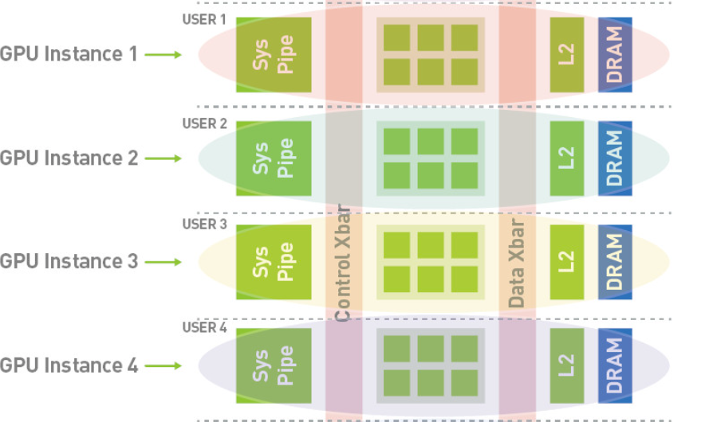
MIG to Improve Utilization
SM
Multi-Instance GPU (MIG)
resource isolation, security …
[2] https://docs.nvidia.com/datacenter/tesla/mig-user-guide/index.html
Notes:
the Multi-Instance GPU is a promising solution.
It splits a single GPU into multiple independent instances, each GPU instance has its own system pipeline, SM, cache, and DRAM.
MIG stands out as it provides a very good isolation and security.

Slide 4

Problem with MIG
GPU Instances share the on-chip Last-level TLB (L3 TLB)
Shared TLB dynamically allocates resources based on the demand
TLB contention limits performance
Performance of co-running applications on NVIDIA’s A100.
Lead to TLB contention among multi-tenancy
Notes:
MIG isn’t perfect partition every component. the Last-Level TLB (L3 TLB) didn’t divided.
The good thing
But, If multiple applications demand TLB entries, end up competing for shared TLB resources.
how this L3 TLB sharing impact on performance in the real case.
difference between running alone and co-running comes from how the L3 TLB is used. When an application runs alone, it gets exclusive access to the TLB. But when applications run together, they compete for TLB entries.

Slide 5

TLB Structure
Valid/
Dirty
Virtual Base
Address
16 Sub-entries
L3 TLB entry
1 MB range
64 KB page
Contiguous in virtual address
Good for isolated workloads that use large contiguous memory
What are the implications under a multi-tenant setup?
[3] Zhang, Z., Allen, T., Yao, F., Gao, X., & Ge, R. TunneLs for Bootlegging: Fully Reverse-Engineering GPU TLBs for Challenging Isolation Guarantees of NVIDIA MIG. In Proceedings of the 2023 ACM SIGSAC Conference on Computer and Communications Security.
Lead to TLB contention among multi-tenancy
Notes:
Different from what we think before
every TLB entry now holds 16 individual one-to-one address mappings.
The benefit of that is by compressing multiple translations, reducing hardware overhead. This sub-entry TLB design performs well for isolated workloads that use large contiguous memory.
what happens dealing with a multi-tenant setup,

Slide 6
TLB Structure
Memory access
App 1
App 1
Valid/
Dirty
Virtual Base
Address
Sub-entries
0xA000
…
0xA00F
0xA010
…
0xA01F
0xA00
0xA01
Time
0xB00
Notes:
All the sub-entries in these two TLB entries get completely filled

Slide 7
TLB Structure
Memory access
eviction
App 1
App 1
App 2
App 3
Valid/
Dirty
Virtual Base
Address
Sub-entries
underutilized
0xA000
…
0xA007
…
0xA00F
0xA010
…
0xA019
…
0xA01F
0xA00
0xB000
…
0xB007
Multi-tenancy interference causes TLB sub-entry underutilization
0xA01
Time
0xC000
…
0xB00
TLB entries full
Notes:
Now, we have multiple applications.

Slide 8
TLB Sub-Entry Utilization
Substantially lower utilization under co-running compared to isolated run
Category applications into High, Medium, Low based on their L2 TLB MPKI values
Notes:
we quantify the utilization of TLB sub-entries when applications are run alone versus when they are run together. We categorized the applications based on their L2 TLB MPKI (Misses Per Thousand Instructions) values into High (H), Medium (M), and Low (L). and we have different combinations of varying MPKI.
addressing this drop in utilization will be key to improving performance in MIG environments.

Slide 9
Problem Summary
Problem:
MIG performance is hampered by TLB sharing
TLB sub-entry underutilized due to multi-tenancy interference
Goal:
Improve TLB performance in MIG by enhancing sub-entry utilization
Notes:
to brief summarize where are we.
we identified problem of xxx

Slide 10
STAR (Sub-enTry shAring-awaRe TLB)
Allow two different bases sharing one TLB entry
How to support sharing ?
sub-entry
index
virtual page base
TLB index
Page offset
Virtual address
Sub-entries
v/d
Base 1
L3 TLB entry
v/d
Base 2
Notes:
The key idea behind STAR is to allow two different base addresses to share the same TLB entry.
So, how do we support this sharing? I’ll first introduce the format of our TLB. 4 -> 3 bits

Slide 11
STAR – TLB Format
Allow two different bases sharing one TLB entry
How to support sharing ?
sub-entry
index
virtual page base
TLB index
Page offset
Virtual address
0/1
2 pages share one sub-entry
Which one is occupying ?
Sub-entries
v/d
Base 1
L3 TLB entry
v/d
Base 2
Notes:
only one can be stored in this slot. And we don’t know which translation is occupying the slot.

Slide 12
STAR – TLB Format
Allow two different bases sharing one TLB entry
How to support sharing ?
sub-entry
index
virtual page base
TLB index
Page offset
Virtual address
0/1
compare
Address Identify Bit (AIB)
Sub-entries
v/d
Base 1
L3 TLB entry
v/d
Base 2
Notes:
the AIB helps determine the access belongs to which translation.

Slide 13
STAR – TLB Format & Sub-Entry Layout
Adaptive layout of sub-entry allocation
Applications show diverse access patterns, e.g., sequential, stride
sub-entry
index
Which layout to adopt?
sub-entry
index
Virtual
address
AIB
AIB
layout-bit (‘00’ initial)
v/d
01
10
L3 TLB
entry
Base 1
v/d
Base 1
v/d
Base 2
v/d
Base 2
Sequential layout for contiguous access
Stride layout for interval access
Notes:
Considering applications have different memory access patterns, which two entry compete for same slot becomes important
based on the usage patterns observed.
To identify which layout is adopting, what bit used to index position, we also introduce a layout-bit.

Slide 14
STAR – When to Share?
Less than half of the sub-entries are utilized
Only one base address is occupying the entry
v/d
00
Base
v/d
Base 1
01
v/d
Base 2
Notes:
Now we know the basic TLB format of our approach. it’s important to know when sharing should happen.

Slide 15
STAR – When to Share?
Dynamic shifts between the shared and non-shared state
Application with increasing demand -> exclusively use
v/d
Base 1
01
v/d
Base 2
v/d
Base 1
00
Notes:
But application demand always change. also supports dynamic shifts between shared and non-shared states to adapt to changing workloads.

Slide 16
STAR – Lookup Process
sub-entry
index
AIB
Virtual address
1
2
4
3
way-n
set m
 | Base 1 | 0 1
 | Base 2
 |  |  | ...

Slide 17
STAR – Insertion process
sub-entry
index
AIB
Scenario 1: Base hit, sub-entry empty
Virtual address
Scenario 2: Base hit, sub-entry occupied
Scenario 3: Base miss
2
1
occupied
 | Base 1 | 0 1
 | Base 2
 |  |  | ...
 |  | 0 0
replace
3
 | Base 1
 | Base 2
1 0
stride access
Notes:
the first case, If the base address is found in the TLB, and there is an available sub-entry.
If the base is found, but the sub-entry is already occupied
If the requested base is not present in the TLB

Slide 18
Methodology
Simulator: MGPUSim [ISCA 2019]
Workloads:
Applications classified by L2 TLB MPKI into High, Medium, and Low
Each workload contains 3 applications
Nine classes of workloads

Slide 19
Evaluation – Overall Performance
STAR improves performance by an average of 28.7%

Slide 20
Evaluation – Sub-entry Utilization
STAR improves sub-entry utilization by an average of 31.4%

Slide 21
More Design Details and Results
Process of shared/non-shared shifts
Design overheads
Sensitivity Studies
stride size
number of sharing bases
instance sizes
......
Comparison to state-of-the art
Notes:
area overheads and power consumption, which is negligible

Slide 22
Summary
Problem: TLB performance in multi-instance GPU
Sub-entry underutilization in shared L3 TLB
STAR:
Sub-entry sharing-aware TLB allows multiple bases sharing one entry
Adaptive layout of sub-entry allocation
Dynamic switch between shared and non-shared states
Improves performance by 28.7% on average , with negligible complexity

Slide 23
STAR: Sub-Entry Sharing-Aware TLB f​or Multi-Instance GPU
Thanks! Q&A
Bingyao Li¹, Yueqi Wang¹, Tianyu Wang¹, Lieven Eeckhout², Jun Yang¹, Aamer Jaleel³, Xulong Tang¹
¹University of Pittsburgh, ²Ghent University, ³NVIDIA

Slide 24
Evaluation – Hit Rate
STAR improves hit rate by an average of 32.8%

