Slide 1


IDYLL: Enhancing Page Translation in Multi-GPUs via Light Weight PTE Invalidations
Bingyao Li¹, Yanan Guo¹, Yueqi Wang¹, Aamer Jaleel², Jun Yang¹, Xulong Tang¹
¹University of Pittsburgh, ²NVIDIA

Slide 2


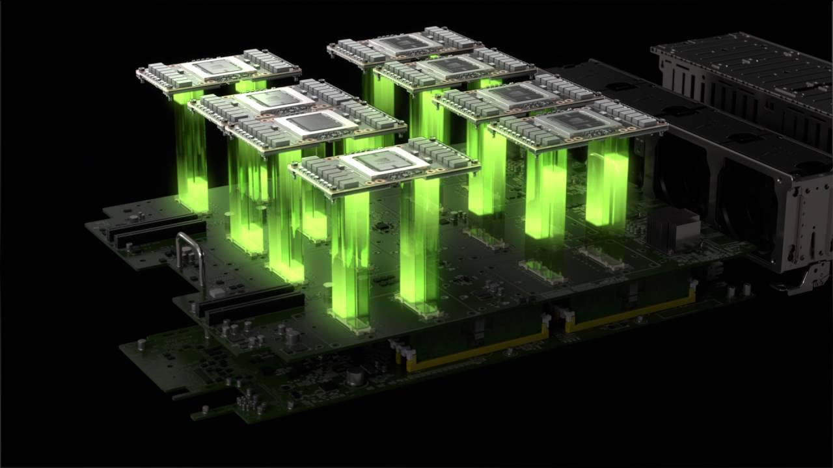
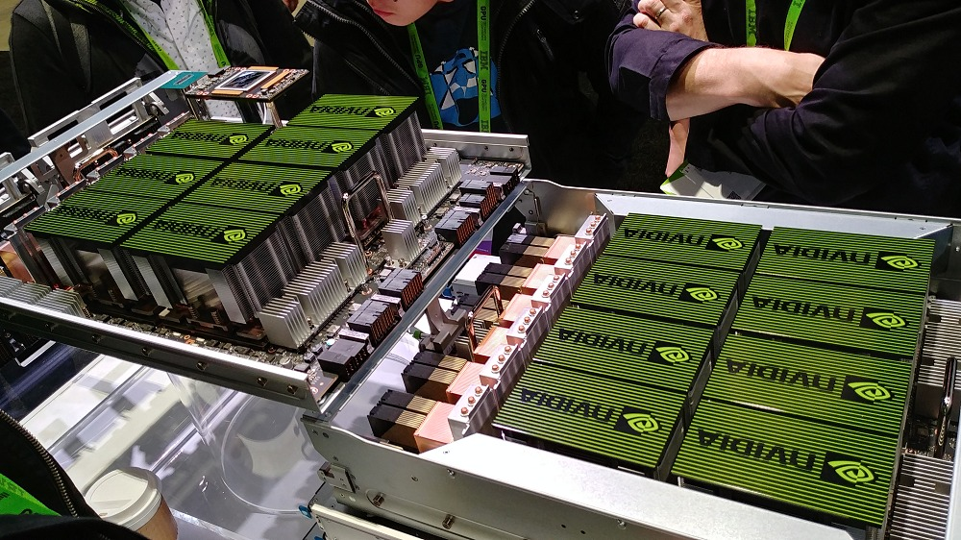


Multi-GPU is Popular
Graph Processing
DNN
Multi-GPU is here ! (NVIDIA DGX, Intel Xe)
ChatGPT
Datacenter Workloads
Ever-growing application complexity and input dataset sizes
Multi-GPUs provide aggregated memory capacity
Unified virtual memory simplifies application deployment

Slide 3
Multi-GPU Scalability
Why performance gap:
x
NUMA data access
Data transfer
Address translation
……
x
x
2.4x
1.8x
x
x
[1] https://developer.nvidia.com/blog/easy-multi-gpu-deep-learning-digits-2/

Slide 4
Multi-GPU Scalability
Why performance gap:
x
NUMA data access
Data transfer
Address translation
x
x
2.4x
1.8x
x
Occupies 30%-80% of execution time
(T. Allen et al. [SC’21], B.Li et al. [MICRO’21],
S. Shin et al. [MICRO’18])
x
[1] https://developer.nvidia.com/blog/easy-multi-gpu-deep-learning-digits-2/

Slide 5
Address Translation in Multi-GPU
GPU1
GPU0
GPU1
Compute Unit
Compute Unit
memory
memory
L1 TLB
L1 TLB
Page
Page
L2 TLB
demand TLB miss request
GMMU
On critical path
UVM driver
CPU
Page Table
Device Memory
Page Table
Page
invalid
remote
remote mapping
Reduce far faults and page migration
far fault
Long latency handling

Slide 6
Page Sharing Characterization
Observation:
Significant page sharing among multiple GPUs
Reduce NUMA data access -> Frequent page migration

Slide 7
Page Migration with Remote Mapping
Update page table
GPU0
GPU1
Page Table
Page Table
Each GPU
invalidate TLB & PTE
Page
Page
Page
local
local
remote
Initiate migration
GPU2
GPU3
Page Table
Page Table
Page
Page
remote
Broadcast to every GPU
UVM Driver

Slide 8
Problem of Existing Page Migration
Update page table
GPU0
GPU1
Page Table
Page Table
Each GPU
invalidate TLB & PTE
Page
Page
Page
remote
local
remote
Additional memory accesses
Initiate migration
GPU2
GPU3
Page Table
Page Table
Page
Page
remote
Unnecessary
Broadcast to every GPU
UVM Driver

Slide 9
PTE Invalidation Characterization
27.2%
Observation:
Substantial PTE invalidation requests
PTE invalidations accounts for a quarter of total requests to the page walker.

Slide 10
PTE Invalidation Characterization
32%
Observation:
Substantial PTE invalidation requests
PTE invalidations accounts for a quarter of total requests to the page walker.
One-third of PTE invalidations broadcasted are unnecessary.

Slide 11
PTE Invalidation Characterization
32%
How is performance impacted by PTE invalidations?
Observation:
Substantial PTE invalidation requests
PTE invalidations accounts for a quarter of total requests to the page walker.
One-third of PTE invalidations broadcasted are unnecessary.

Slide 12
Invalidation Overhead
Contend with demand TLB miss request.

Slide 13
Invalidation Overhead
Contend with demand TLB miss request.
L2 TLB
Demand TLB miss request
GMMU
PTE invalidation request
UVM driver
Without the interference of invalidation requests, the demand TLB miss request latency reduced by 55.8%.

Slide 14
Invalidation Overhead
Extra latency for waiting page to be migrated.

Slide 15
Invalidation Overhead
Extra latency for waiting page to be migrated.
Request
Access !
Waiting…
GPU0
GPU1
Page Table
Page
Page Table
Page
Page
local
local
remote
Invalidation complete ! Migrate !
30% of total page migration time is spent on waiting page to be migrated.

Slide 16


Problem Summary
Address the overheads associated with PTE invalidations
Problem:
PTE invalidations
Unnecessary broadcast
Contend with the demand TLB miss requests
In-PTE Directory Invalidation
Lazy Invalidation
In-PTE DirectorY and Lazy InvaLidation (IDYLL)

Slide 17
IDYLL : In-PTE Directory Invalidation
Host-side page table holds all up-to-date translations in all GPU.
Host side page table
CR3
63 | 62 52 | 51 12 | 11 9 | 8 | 7 | 6 | 5 | 4 | 3 | 2 | 1 | 0
XD | Unused Bits | 4 KB page frame | UB | G | PAT | D | A | PCD | PWT | R/W | U/S | V
access bits

Slide 18
IDYLL : In-PTE Directory Invalidation
First access request
First access request
GPU0
GPU1
GPU2
Page
Page Table
Page Table
Page Table
local
remote
invalid
remote
far fault
far fault
UVM driver
CPU
Page Table
62 52
 |  |  |  |  |  |  |  | 0 | 0 | 0
1
1
At the time of first far fault, the access bit is set to 1.

Slide 19
IDYLL : In-PTE Directory Invalidation
Initiate migration
GPU0
GPU1
GPU2
Page Table
Page Table
Page Table
Send invalidations only to GPUs with access bits set to 1.
local
remote
remote
UVM driver
CPU
Page Table
62 52
 |  |  |  |  |  |  |  |  | 0
1
1
0
0

Slide 20


IDYLL : Lazy Invalidation
GPU
In-PTE Directory Invalidation -> unnecessary invalidations
L2 TLB
Still substantial valid translation mappings
GMMU
Device Memory
IRMB
Page Table
Invalidation Request Merging Buffer (IRMB)
remote
temporally buffer and batch invalidation requests and lazily update the local page table.
UVM driver

Slide 21
IDYLL : Lazy Invalidation
GPU
IRMB :
L2 TLB
The invalidation request inserted into IRMB instead of performing invalidation immediately.
GMMU
hit
bypass
Device Memory
IRMB
Nearby invalidations are merged into one entry and batched write back to page table
Page Table
remote
batching
Serve as indicator of invalid PTE that, if hit in IRMB, can bypass local page table walk
invalidation
UVM driver

Slide 22
Methodology
Simulator: MGPUSim [ISCA 19’]
Workloads: 9 applications from Hetero-Mark, AMDAPPSDK , SHOC, and DNN Mark benchmark suites.
Hardware setup:
 | Configuration
L2 TLB | 512 entries, 16 way, CUs shared
Page table walk | GMMU 8 shared page table walker, 100-cycle latency per level
Page table cache | 128 entries shared across page table walker
Access counter threshold | 256

Slide 23
Evaluation
69.9%
IDYLL achieves an average of 69.9% performance improvement.

Slide 24

Evaluation
IDYLL nears zero-latency invalidation performance.

Slide 25
More in the Paper
Detailed lookup process of IDYLL
Experiment configurations
Performance improvement breakdown
Performance sensitivity to :
IRMB size
Number of page table walk threads
L2 TLB size
Number of GPUs
Number of unused bits
Access counter threshold
Comparison with Large Page, Page Replication, State-of-the-art

Slide 26
Summary
Problem: PTE invalidation overheads in multi-GPU systems.
Unnecessary PTE invalidation broadcast
Contend with demand TLB miss request
IDYLL:
In-PTE Directory reduces unnecessary PTE invalidations
Lazy Invalidation amortizes and minimizes PTE invalidation overheads
Improves performance by 69.9% on average.

Slide 27
IDYLL: Enhancing Page Translation in Multi-GPUs via Light Weight PTE Invalidations
Thanks! Q&A
Bingyao Li¹, Yanan Guo¹, Yueqi Wang¹, Aamer Jaleel², Jun Yang¹, Xulong Tang¹
¹University of Pittsburgh, ²NVIDIA
Email: bil35@pitt.edu

