Slide 1


GRIT: Enhancing Multi-GPU Performance with Fine-Grained Dynamic Page Placement
Yueqi Wang*¹, Bingyao Li*¹, Aamer Jaleel², Jun Yang¹, Xulong Tang¹
¹University of Pittsburgh, ²NVIDIA

Slide 2
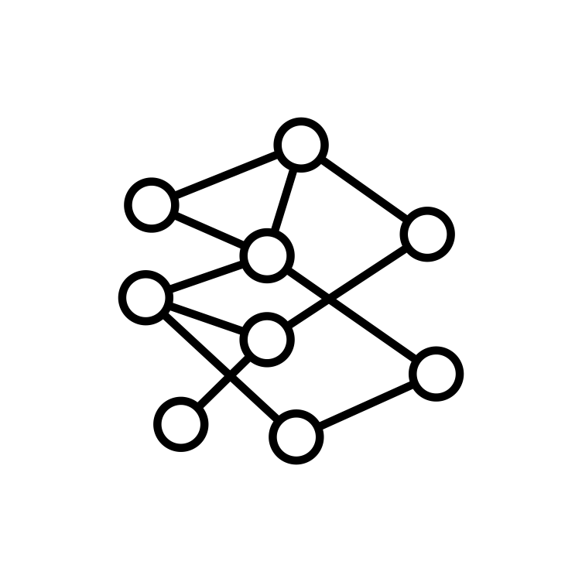
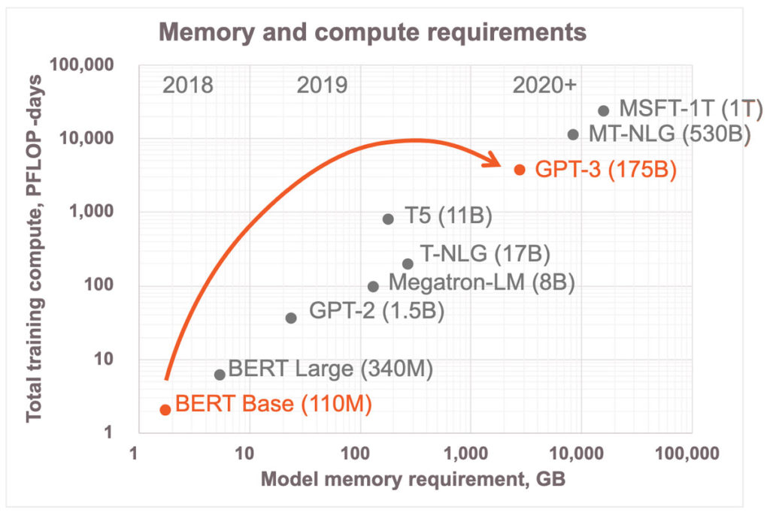
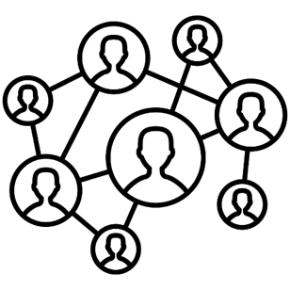


Multi-GPU is Popular
Graph Processing
DNN
ChatGPT
Datacenter Workloads
Ever-growing application complexity and input dataset sizes.
[1] https://www.cerebras.net/blog/harnessing-the-power-of-sparsity-for-large-gpt-ai-models
Notes:
Gpus are dominating and getting popular in many application fields, such as xxxx
as you might notice, the recent nvidia stock has a rocket spiking in the market.
However, we all witness that the applications are getting much more complicated and large-scale. the right figure using deep learning model as exmples and plots computing power and memory compacity requirement over years.
clearly, this is far beyond the capability of a single GPU .

Slide 3
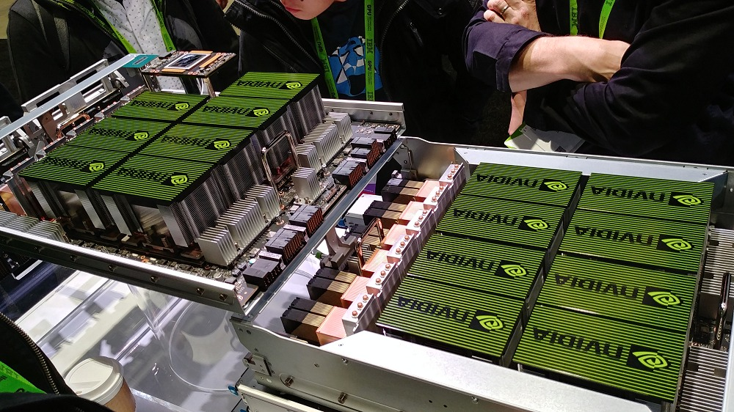
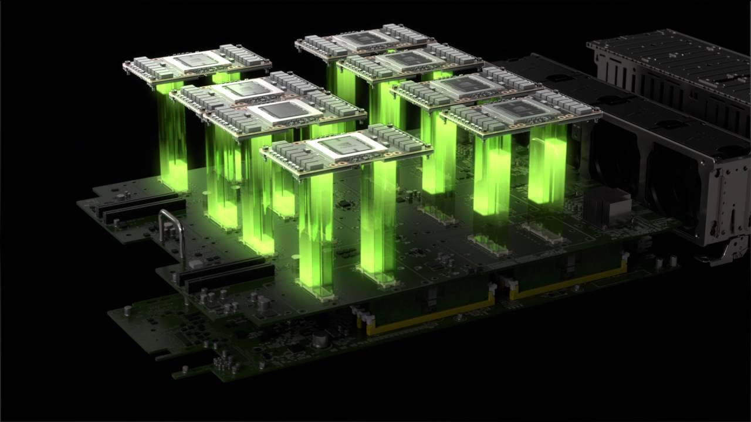
Multi-GPU is Popular
Multi-GPU is here ! (NVIDIA DGX, Intel Xe)
Graph Processing
DNN
ChatGPT
Datacenter Workloads
Ever-growing application complexity and input dataset sizes.
[1] https://www.cerebras.net/blog/harnessing-the-power-of-sparsity-for-large-gpt-ai-models

Slide 4
UVM for Multi-GPU
Growing trend of multi-GPUs leveraging Unified Virtual Memory (UVM)
Simplify development & deployment
Global pointer to devices
Heterogeneity
Compatibility
GPU
GPU
GPU
CPU
CPU
…
…
…
Unified Memory
Notes:
To harness the advantages of multi-GPU systems, increasing trend
provides single memory space for the applications
there are plenty of benefits from UVM.

Slide 5
Multi-GPU Scalability
Why performance gap:
x
x
NUMA data access
Data transfer
Address translation
……
x
2.4x
1.8x
x
x
[2] https://developer.nvidia.com/blog/easy-multi-gpu-deep-learning-digits-2/
Notes:
However, we all know there is no free-lunch. The UVM comes with its cons.
Delivered performance doesnot scale with the number of GPUs

Slide 6


Multi-GPU Page Placement Schemes
1. On-Touch Migration: Request, Migrate.
Request
GPU₀
GPU₀
GPU₁
GPU₁
Page
Page
GPU₀
Migrate
GPU₁
UVM Driver
GPU₀
Every memory access is local
Ping-Pong effect

Slide 7

Multi-GPU Page Placement Schemes
2. Access Counter-based Migration: Reaching threshold, Migrate.
Request
GPU₀
GPU₁
GPU₁
Page
Page
+1
GPU₀
Page
Access counter
+1
+1
> Threshold
Migrate
UVM Driver
Reduce Ping-Pong migration
Substantial remote access

Slide 8
Multi-GPU Page Placement Schemes
3. Page Duplication: Read, Duplicate.
Read
Write
GPU₀
GPU₁
GPU₀
GPU₁
GPU₂
Page
Page
Page
Page
Page
Duplicate
Protection
fault
Page invalidation
UVM Driver
UVM Driver
Reduce migration & remote access
Significant collapsing overhead

Slide 9
Performance of Page Placement Schemes
No “one-size-fits-all” page placement scheme

Slide 10
Page Access Characteristics
The page-sharing / read-write patterns vary within the same application
A dynamic page placement scheme that can accommodate variations in page access characteristics
Private / Share
Read / Write

Slide 11
Problem Summary
Problem:
Delivered performance is constrained by NUMA overhead
No “one-size-fits-all” page placement scheme
Goal:
Effectively reduce NUMA overhead in multi-GPU by determining
page placement scheme at runtime

Slide 12
GRIT (Fine-GRained dynamIc page placemenT)
Scheme change
metric
Dynamically determine page placement scheme at runtime
Notes:
propose GRIT,
to dynamically determine scheme
when the scheme is identified as improper and should change, so in other words, it’s important to know the metric of scheme change

Slide 13
GRIT – Scheme Change Metric
Request
Write
Current scheme is unsuitable
GPU₀
Page duplication should
be avoided
Page
page protection fault
UP
local page fault
UP
UVM Driver
Indicator: Number of page faults (local page fault & page protection fault)
Notes:
suppose using on-touch as default scheme,
indicate multiple gpu access the same page, current on-touch is not suitable, maybe a page duplication is suitable to enable pages presented in several devices.
high write collapsing overheads should be avoided.
we employ the page fault as an indicator to trigger the scheme change

Slide 14
GRIT: Dynamic Page Placement Scheme
Scheme change
metric
How to track information ?
Dynamically determine page placement scheme at runtime
Fault-Aware Initiator

Slide 15
GRIT – Page Attribute Table and Cache (PA-Table & Cache)
Additional memory access
Facilitate lookup
Write back
CPU Memory
PA-Cache
PA-Table
VPN | Fault Counter | Read/Write
0xA00 | 10 | 0
0xA01 | 01 | 1
… | … | …
Way 0
…
Way 3
VPT | FC | R/W
… | … | …
… | … | …
… | … | …
… | … | …
VPT | FC | R/W
… | … | …
… | … | …
… | … | …
… | … | …
Write allocate
Notes:
design page attributes and track the number of page faults read/write. when a page fault received by UVM driver, it need to check the PA-table. However, each fault will check table in memory
hottest, latest

Slide 16
GRIT: Dynamic Page Placement Scheme
Scheme change
metric
How to track information ?
Which scheme to change to ?
Dynamically determine page placement scheme at runtime
Fault-Aware Initiator
PA-Table &
PA-Cache

Slide 17
GRIT – Which Scheme
63 62:54 53:52 51:12 11 10:9
XD | Unused Bits (UB) | 4 KB Page Frame Number (PFN) | UB | Scheme Bits
On-touch
Get access information from PA-Table /PA-Cache
FC Reach threshold?
True
Change Scheme
Scheme information is stored in host PTE.
True
All read?
False
Duplication
Access-counter

Slide 18
GRIT: Dynamic Page Placement Scheme
Scheme change
metric
How to track information ?
Which scheme to change to ?
Dynamically determine page placement scheme at runtime
Fault-Aware Initiator
PA-Table &
PA-Cache
Scheme Decision Mechanism
Notes:
three technique works together to achieve dynamic page placement

Slide 19
GRIT: Dynamic Page Placement Scheme
Performance gap due to improper scheme before trigger scheme change
Notes:
Is this good enough to solve the problem/is the problem completely resolved? the answer is Not really.
As one can observe, while GIRT-dynamic performs good in application such as c2D, it is worse than duplication in application such mm.
Why is that? well, our approach uses the page fault number to capture and change the scheme, it needs to accumulate the fault counts to reach the threshold. This is, kind of we call learning phase. since for each page, we need to learn the behavior individually in page grunularity, this learning overheads can dominating and offset the performance gains.

Slide 20
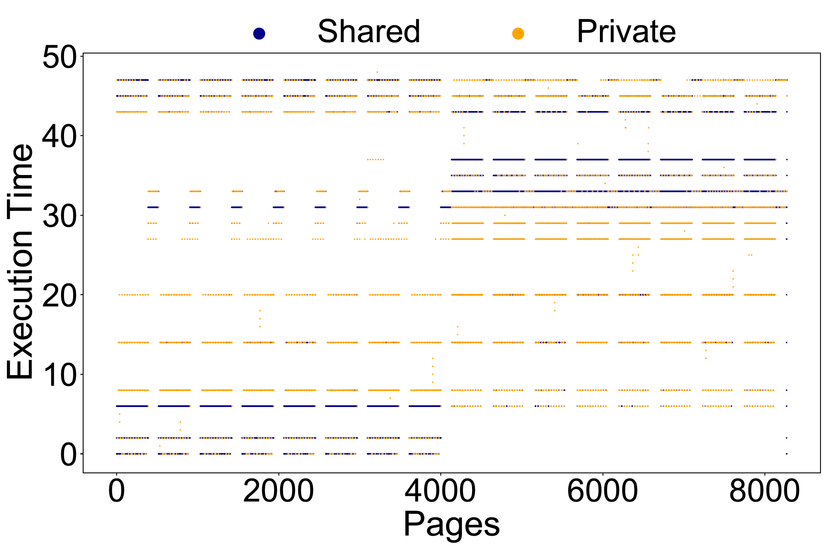
Page Attributes Characterization
The neighboring pages tend to exhibit similar access attributes
Proactively determine page placement scheme
for neighboring pages
Notes:
Then what can we do. Well, we can use larger granularity to amortize the learning overheads. But is there any opportunity for that?
look from bottom to top, the attributes of specific pages change over time
even though the attributes changes, neighboring pages exhibit similar page attributes.

Slide 21
GRIT: Neighboring-Aware Prediction
Scheme change
metric
How to track information ?
Which scheme to change to ?
Proactively decide
neighboring scheme
Dynamically determine page placement scheme at runtime
Fault-Aware Initiator
PA-Table &
PA-Cache
Neighboring-Aware Prediction
Scheme Decision Mechanism
Notes:
neighboring aware prediction

Slide 22
GRIT: Neighboring-Aware Prediction
63 62:54 53:52
XD | Unused Bits (UB) | Group Bits
Page Table
0xF000
0xF001
0xF002
0xF003
0xF004
0xF005
0xF006
0xF007
00
00
00
00
00
00
00
00
00
Recursively
Promote
00
00
Promote
00
01
01
00
01
01
00
01
01
00
10
00
00
32KB page group
…
VPN
Scheme
256KB page group

Slide 23
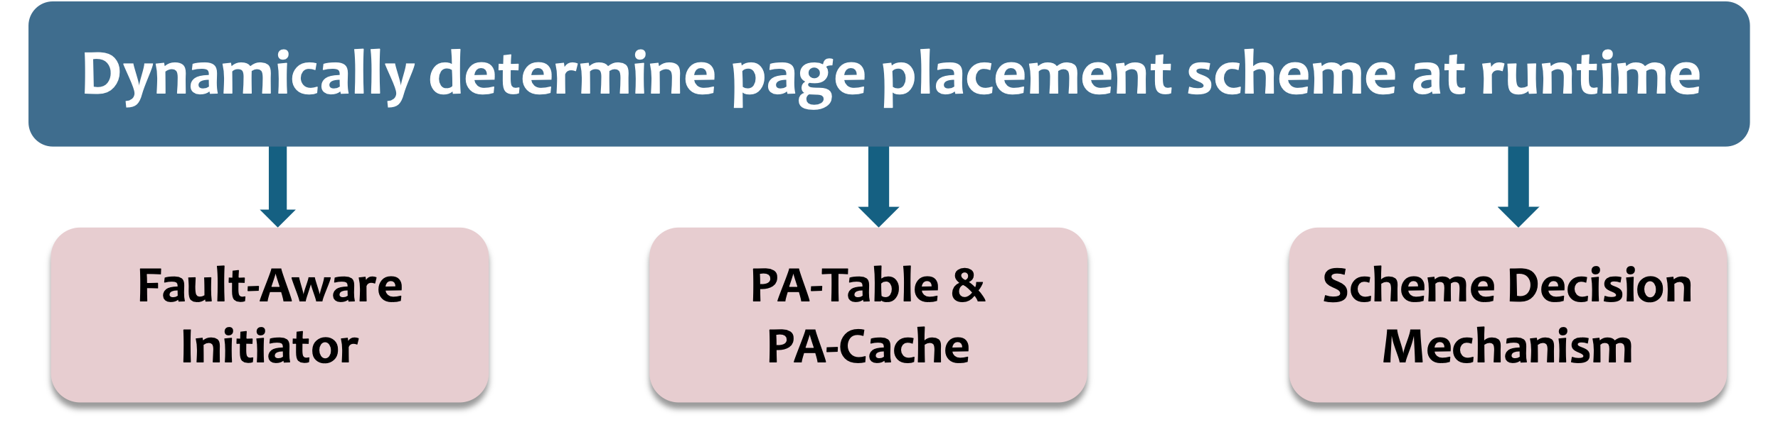
GRIT – Put All Together
UVM Driver
Yes,
change scheme
Fault reach threshold？
No, resolve fault
resolve fault

Slide 24
Methodology
Simulator: MGPUSim [ISCA 19’]
Workloads: 8 applications from Hetero-Mark, AMDAPPSDK , SHOC, and DNN Mark benchmark suites, including random, adjacent, and scatter-gather access patterns.
Detailed page placement scheme modeling in paper

Slide 25

Evaluation – Overall Performance
GRIT achieves 60%, 49%, and 29% performance improvement compared to uniformly employing on-touch, access counter-based, and page duplication scheme.

Slide 26
Evaluation – Scheme Breakdown
GRIT is able to distinguish page attributes and consistently select
the most suitable scheme accordingly.

Slide 27
Summary
Problem: NUMA overheads in multi-GPU systems
No “one-size-fits-all” page placement scheme
GRIT:
Dynamic page placement scheme determines schemes in a fine-grained manner
Neighboring-aware prediction proactively determines adjacent page scheme
Improves performance by 60% on average.

Slide 28
GRIT: Enhancing Multi-GPU Performance with Fine-Grained Dynamic Page Placement
Thanks! Q&A
Yueqi Wang*¹, Bingyao Li*¹, Aamer Jaleel², Jun Yang¹, Xulong Tang¹
¹University of Pittsburgh, ²NVIDIA

Slide 29

GRIT (Fine-GRained dynamIc page placemenT)
Dynamically determine scheme at runtime
Key Observations:
1
Page-sharing patterns vary among/within application
2
Neighboring pages exhibit similar access attributes
Proactively decide neighboring scheme

