Slide 1



Trans-FW: Short Circuiting Page Table Walk in Multi-GPU Systems via Remote Forwarding
HPCA 2023 – section 3B
Bingyao Li¹, Jieming Yin², Anup Holey³, Youtao Zhang¹, Jun Yang¹, Xulong Tang¹
¹University of Pittsburgh, ²Lehigh University, ³NVIDIA

Slide 2
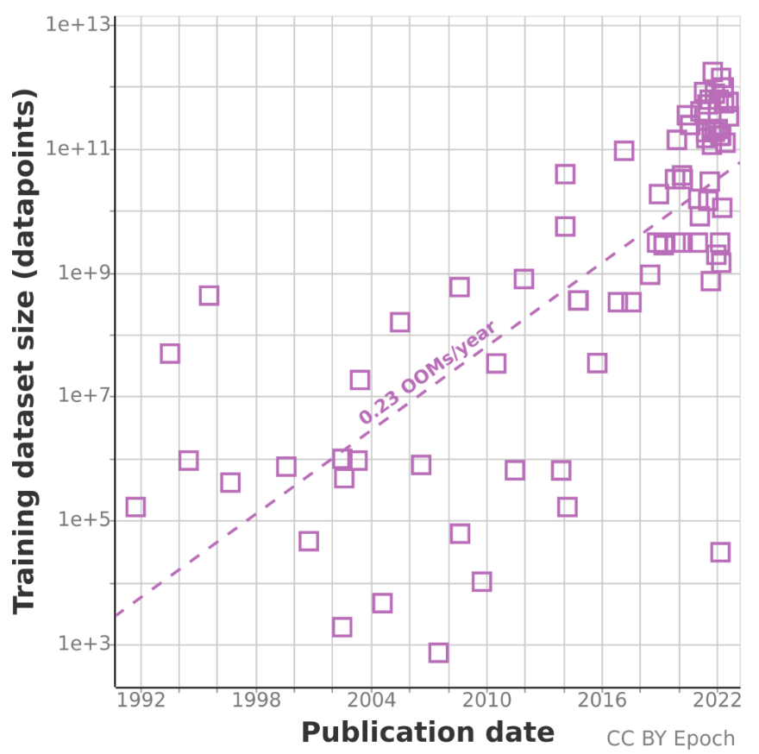
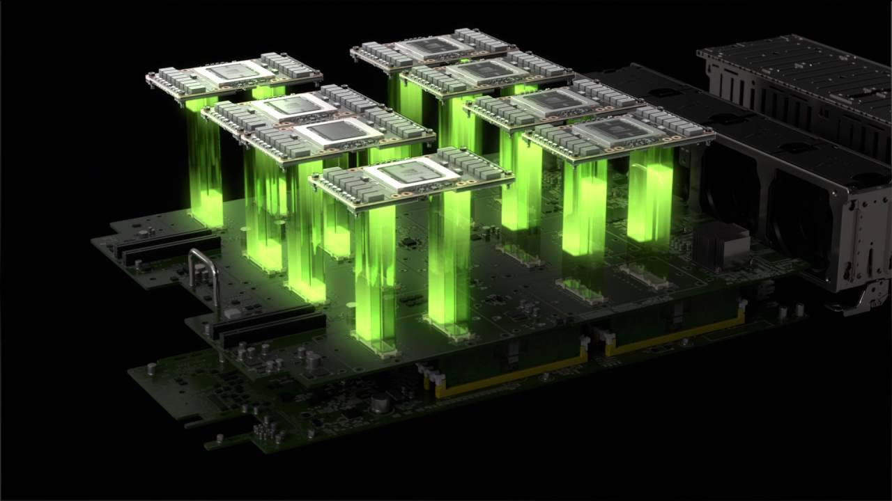
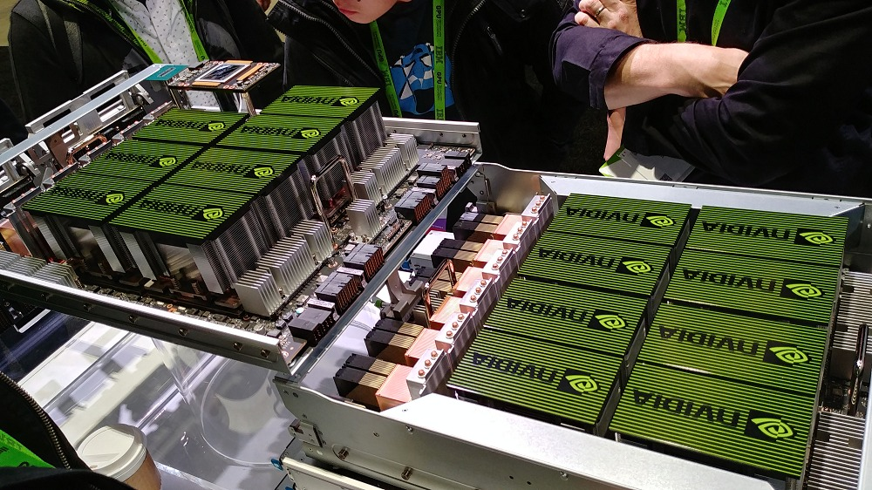
Why Multi-GPU Systems?
Multi-GPU is here ! (NVIDIA DGX, Intel Xe)
Ever-growing application complexity and input dataset sizes
Single GPU is insufficient to satisfy performance demands
Multi-GPU systems enable further scaling

Slide 3
Multi-GPU Scalability
x
NUMA data access
Data transfer
Address translation
……
x
2.4x
1.8x
x
x
x
x
[1] https://developer.nvidia.com/blog/easy-multi-gpu-deep-learning-digits-2/

Slide 4
Multi-GPU Scalability
x
NUMA data access
Data transfer
Address translation
x
2.4x
1.8x
x
x
x
Before data access
On the critical path
x
[1] https://developer.nvidia.com/blog/easy-multi-gpu-deep-learning-digits-2/

Slide 5
Address Translation Hampers Scalability
GPU0
GPU1
Driver handled local page fault
Compute Unit
Compute Unit
Compute Unit
Compute Unit
Host MMU handled local page fault
L2 TLB
Device memory
L2 TLB
Device memory
GMMU
GMMU
Host MMU approach
1
PW-queue
PW-queue
Address translation process
latency penalties :
PW-cache
Page
table
PW-cache
Page
table
2
PT-walk
PT-walk
Local page fault
Waiting in the GMMU PW-queue
Memory access in the GMMU PT-walk
Handling local page fault
3
1
CPU
+
UVM driver (Software)
Host MMU
TLB
2
+
PW-queue
PW-cache
PT-walk
3

Slide 6
Performance Overhead for Address Translation
GPU
Local page fault latency
Compute Unit
Compute Unit
Address translation related – 50%
L2 TLB
Device memory
Host MMU PW-queue – 20%
GMMU
Why such high local page faults
handling overheads?
PW-queue
PW-cache
Page
table
PT-walk
CPU
Host MMU
Handling local page faults causes significant overhead Accounts for 86.1% of the L2 TLB miss latency
TLB
PW-queue
PT-walk
PW-cache

Slide 7
Page Sharing Characterization
Observation:
Observation:
Significant pages shared by multiple GPUs
Page migration -> local page faults
Address translation sharing
Local PW-cache misses and page faults can
be resolved by other GPUs

Slide 8
Insights
The current address translation process is not efficient due to substantial local page faults.
Significant local page faults make the GMMU page table walk unnecessary.
It is beneficial to mitigate host MMU contention by employing the remote GPU to serve the translation requests.

Slide 9
Trans-FW (Translation Forwarding)
Request
GPU L2 TLB miss
Pending
Request Table
Remote
GMMU₁
GMMU₀
Short circuiting in GMMU
Host MMU
Short circuiting in host MMU
Forwarding Table

Slide 10


Short Circuiting in GMMU
GPU
Compute Unit
Compute Unit
Short circuit the translation in GMMUs by eagerly sending the request to the host MMU upon an L2 TLB miss.
unnecessary
L2 TLB
Device memory
GMMU
 | invalid
PW-queue
Allow the potential local page faults to be served early by the host MMU.
PW-cache
Page
table
PT-walk
CPU
An excessive number of requests being sent to the host MMU.
Host MMU
TLB
PW-queue
PT-walk
PW-cache

Slide 11
Short Circuiting in GMMU
GPU
Pending Request Table (PRT) :
Compute Unit
Compute Unit
tracks the translations of all pages that reside in the GPU’s local memory.
L2 TLB
Device memory
GMMU
PRT
PRT
VPN | offset
Employ a Cuckoo filter
PW-queue
key
PW-cache
Page
table
VPN forms fingerprint
bucket
finger print
……
PT-walk
h₁(key)
Cuckoo hash
If hits PRT, performs local PT-walk.
CPU
Host MMU
h₂(key)
If misses PRT, bypass GMMU, early forwarded to the host MMU without a GMMU PT-walk.
finger
print
TLB
PW-queue
compare
……
PT-walk
PW-cache
True/False

Slide 12
Short Circuiting in Host MMU
GPU₀
GPU₁
Short circuit the translation in host MMU by sending translation requests to remote GPUs.
Compute Unit
Compute Unit
Compute Unit
Compute Unit
L2 TLB
Device memory
L2 TLB
Device memory
GMMU
GMMU
PRT
PRT
Avoid the contention and potential overheads in host MMU.
PW-queue
PW-queue
PW-cache
Page
table
PW-cache
Page
table
PT-walk
PT-walk
The location of valid page can only be obtained after host MMU page table walk.
CPU
Host MMU
TLB
PW-queue
PW-cache
PT-walk

Slide 13
Short Circuiting in Host MMU
GPU₀
GPU₁
Forwarding Table (FT) :
Compute Unit
Compute Unit
Compute Unit
Compute Unit
tracks which GPU has the valid page.
L2 TLB
Device memory
L2 TLB
Device memory
Employ the same Cuckoo filter
GMMU
GMMU
PRT
PRT
VPN + GPU_{id} forms fingerprint
PW-queue
PW-queue
PW-cache
Page
table
PW-cache
Page
table
PT-walk
PT-walk
Accessing remote page tables may take longer than accessing the host page table due to network congestion and remote PT-walk contention.
CPU
When to forward ?
Host MMU
Forwarding Table
TLB
PW-queue
PW-cache
PT-walk

Slide 14
Short Circuiting in Host MMU
GPU₀
GPU₁
When to forward :
Compute Unit
Compute Unit
Compute Unit
Compute Unit
L2 TLB
Device memory
L2 TLB
Device memory
GMMU
GMMU
PRT
PRT
PW-queue
PW-queue
PW-cache
Page
table
PW-cache
Page
table
PT-walk
PT-walk
CPU
Host MMU
Forwarding Table
TLB
PW-queue
PW-cache
PT-walk

Slide 15
Short Circuiting in Host MMU
GPU₀
GPU₁
When to forward :
Compute Unit
Compute Unit
Compute Unit
Compute Unit
If the number of queued requests less than forwarding threshold, only rely on the host MMU to perform PT-walk.
L2 TLB
Device memory
L2 TLB
Device memory
GMMU
GMMU
PRT
PRT
PW-queue
PW-queue
PW-cache
Page
table
PW-cache
Page
table
PT-walk
PT-walk
CPU
Host MMU
Forwarding Table
TLB
PW-queue
PW-cache
PT-walk

Slide 16
Short Circuiting in Host MMU
GPU₀
GPU₁
When to forward :
Compute Unit
Compute Unit
Compute Unit
Compute Unit
If the number of queued requests less than forwarding threshold, only rely on the host MMU to perform PT-walk.
If exceeds forwarding threshold, also forwarded to a remote GPU according to the FT.
L2 TLB
Device memory
L2 TLB
Device memory
GMMU
GMMU
PRT
PRT
PW-queue
PW-queue
PW-cache
Page
table
PW-cache
Page
table
PT-walk
PT-walk
CPU
Host MMU
Forwarding Table
TLB
PW-queue
PW-cache
PT-walk

Slide 17
Short Circuiting in Host MMU
succeed
GPU₀
GPU₁
When to forward :
Compute Unit
Compute Unit
Compute Unit
Compute Unit
If the number of queued requests less than forwarding threshold, only rely on the host MMU to perform PT-walk.
If exceeds forwarding threshold, also forwarded to a remote GPU according to the FT.
If the remote lookup succeeds but the request still waits in the host PW-queue, the request is removed from the PW-queue.
L2 TLB
Device memory
L2 TLB
Device memory
GMMU
GMMU
PRT
PRT
PW-queue
PW-queue
PW-cache
Page
table
PW-cache
Page
table
PT-walk
PT-walk
CPU
Host MMU
Forwarding Table
TLB
PW-queue
PW-cache
PT-walk

Slide 18
Methodology
Simulator: MGPUSim [ISCA 19’]
Workloads: 10 applications from Hetero-Mark, AMDAPPSDK , SHOC, and DNN Mark benchmark suites.
Hardware setup:
 | Configuration
Host MMU TLB | 2048 entries, 64 way, GPU shared
Page table walk | Host MMU 16 shared page table walker, GMMU 8 shared page table walker, 100-cycle latency per level
Page table cache | 128 entries shared across page table walker
CPU-GPU interconnection | 150-cycle latency

Slide 19
Evaluation
Trans-FW achieves an average of 53.8% performance improvement.

Slide 20
Evaluation
The reduced percentage of each latency component.
40%

Slide 21
More Results in the Paper
Sensitivity to forwarding threshold, number of GPUs, PT-walk threads, host-MMU configuration …
Sensitivity to remote access latency
Compared with page replication, remote mapping, large page
Compared with state-of-the-art PW-cache prefetching, TLB optimization

Slide 22
Summary
Problem: Address translation overheads in multi-GPU systems under unified virtual memory.
Three latency penalties in address translation process
Key idea: address translation sharing and forwarding
Trans-FW:
Short circuit in GMMU reduces unnecessary page table walks
Short circuit in host MMU mitigates contention in host MMU
PRT & FT with minimal hardware overhead
Improves performance by 53.8% on average.

Slide 23
Trans-FW: Short Circuiting Page Table Walk in Multi-GPU Systems via Remote Forwarding
Thanks! Q&A
Bingyao Li¹, Jieming Yin², Anup Holey³, Youtao Zhang¹, Jun Yang¹, Xulong Tang¹
¹University of Pittsburgh, ²Lehigh University, ³NVIDIA
Email: bil35@pitt.edu

Slide 24
Backup slides

Slide 25
Driver Handled VS. Host MMU Handled Page Fault
x
x
x
x
x
~ 4.5x
Address translation overheads: driver 4.5x higher than host MMU
Increasing gap between driver approach and host MMU approach
Host MMU approach

Slide 26
Evaluation
Percentage of replicated PT-walk to all host MMU PT-walk.
65% of those replicated requests (i.e., 22.6%) in host MMU are eliminated.
Short-circuiting the local GMMU reduces 49.6% of the total GMMU PT-walk memory accesses.

