Slide 1

Human-to-Human Real-Time
Help Service Using Gmap
"AuburnHelp"
With our app, you will
be helped instantly!
New immigrants

Slide 2

Motivation
New Chinese immigrants
Not good at speaking English
Huge difference between estern and western culture
I want to go to walmart, but I don't have a car
Any good
restaurants
in Auburn?
I lost my wallet. I'm desperate...
Where is Foy-Hall? I need to register for this semester.
I want to buy a car
1

Slide 3


Design
optimal candidate 1
optimal candidate 2
Connect successfully
optimal candidate 3
Android App
Anyone who needs help
optimal candidate 4
optimal candidate 5
2

Slide 4
Implementation
Needs help
Provide help
Help describtion
Tag
UserID,UserName, Password,
Gender, Email, Phone
English_level
Living_years
Times_help
Times_vote
Tag
3 optimal candidates
match
Many-to-Many
3

Slide 5
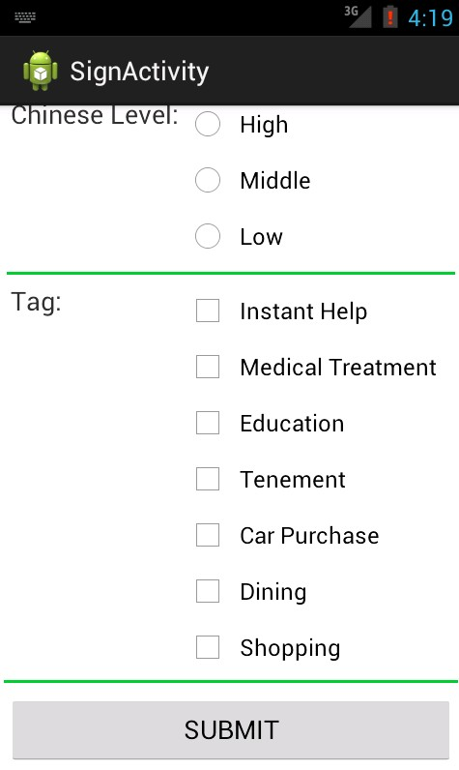
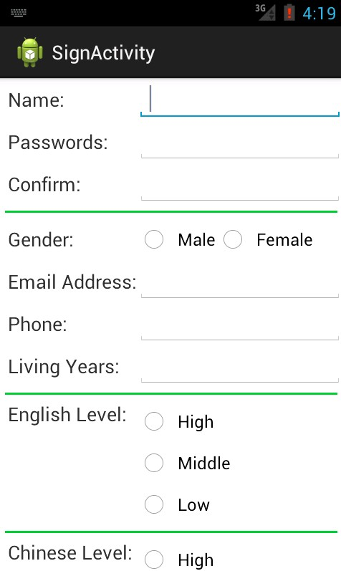
Registration step
4

Slide 6
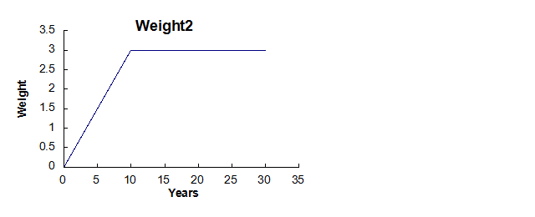
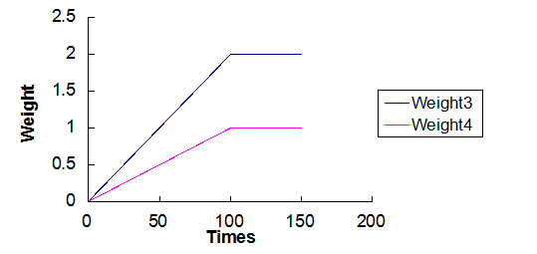
Algorithm Design for Matching Process
1. English_level Chinese_level
2. Living_years
3. Times_help
4. Times_vote
Algorithm design
Max weight: W1=4; W2 = 3; W3=2; W4=1
Total weight = (W1+W2)*(W3+W4)
Weight1
Level | 1 | 2 | 3
Weight | 1.33 | 2.66 | 4.00
5

Slide 7
Implementation
Registration
User registration
Success
Save user information
into system
Failure
Request Help Service
Send request to server
Search optimal
candidates who can
provide help
Fill request form
D:
Search available
users who can
provide help
Response a Gmap
6

Slide 8
Implementation
Module: Search Helpers
Input:
Description
Tag
LocationX
LocationY
Obtain Locations of Candidates
Get Request from Client
Search Module
Locations:
UserID
LocationX
LocationY
Request Candidates Information
List of helpers:
UserID
Language Level
Living Years
Times of helping others
Times of being voted
7

Slide 9
Implementation
Module: Response A Gmap
List of Helpers
Generate Map
Display
Map
Obtain location information to generate map
Input:
Description
Tag
LocationX
LocationY
Locations:
UserID
LocationX
LocationY
8

Slide 10
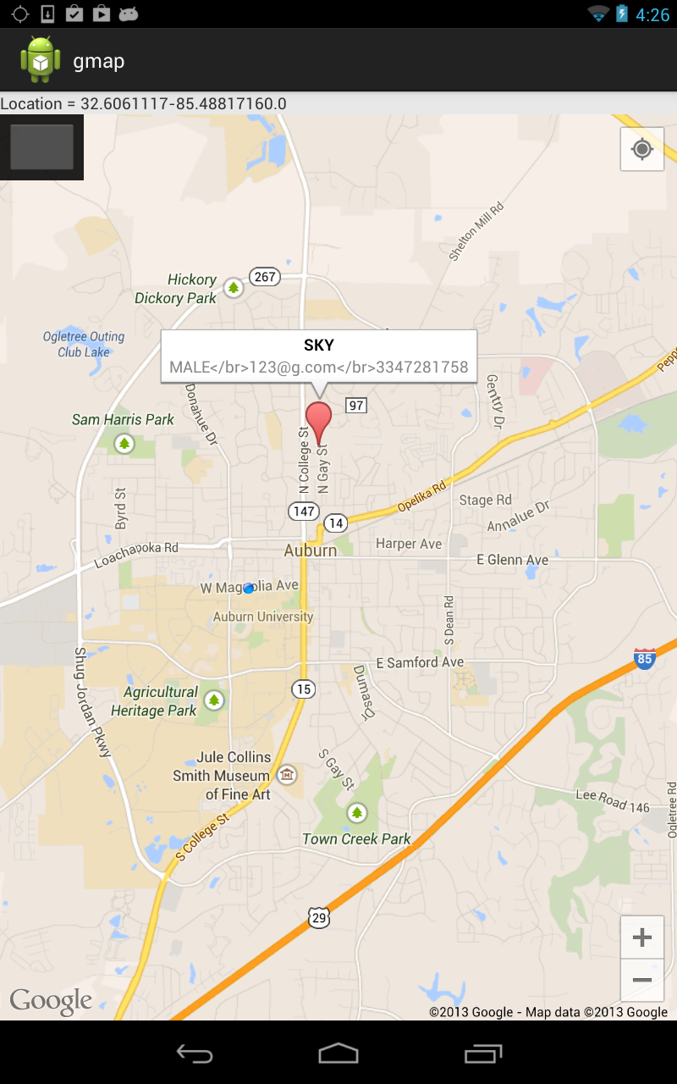
Resulted Gmap
9

Slide 11
Future Development
Dynamic update of user location table
Web application
Remote assistance
10

Slide 12


