Slide 1

Statistical Debugging Using Compound Boolean Predicates
Piramanayagam Arumuga Nainar,
Ting Chen, Jake Rosin, Ben Liblit
University of Wisconsin – Madison

Slide 2
Cooperative Bug Isolation (CBI)
Post deployment bug hunting
  Mine feedback data for causes of failure
Actual runs are a vast resource
  Real-world executions are more interesting
  Number of real runs >> number of testing runs
Notes:
Windows Vista - 40 million licenses in 100 days
Halo 2: 500 million online games from 9-Nov-2004 to 20-Jun-2006 (1.6 years)
nearly 10 per second; one new game every tenth of a second
35,431 during this talk

Slide 3
Bug Isolation Overview
if
p₁
++x
p₂
++y
Program
Source
Predicates
Shipping
Application
Executable

€
ƒ
‚
P observed: No. of times line of P was reached
P true: No. of times P was true
ƒ
€
Statistical
Debugging

Counts
& ☺/☹
Top bugs with
likely causes

Slide 4
Simple Predicates
Each predicate partitions runs into 2 sets
  Runs where it was true
  Runs where it was false
Accurately predict bugs that match the partition
Unfortunately, bugs are complex – They require a richer set of partitions

Slide 5
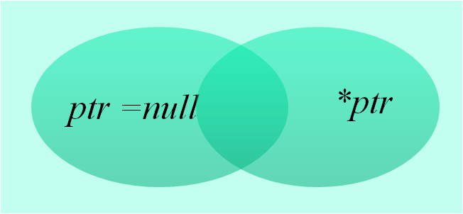

Motivation: Null Pointer Errors
In function exif_mnote_data_canon_load:
    for (i = 0; i < c; i++) {
    ...
    n->count = i + 1;
    ...
    if (o + s > buf_size) return;
    ...
    n->entries[i].data = malloc(s);
    ...
    }
Crash when the uninitialized pointer n->entries[i].data is accessed
Notes:
Version 0.6.9

Slide 6
Motivation
Experiment | Best Predicate | Score
Simple | new value of len == old value of len | 0.71
Compound | o + s > buf_size ∧ offset < len | 0.94
In function exif_mnote_data_canon_load:
    for (i = 0; i < c; i++) {
    ...
    n->count = i + 1;
    ...
    if (o + s > buf_size) return;
    ...
    n->entries[i].data = malloc(s);
    ...
    }
Crash when the uninitialized pointer n->entries[i].data is accessed

Slide 7
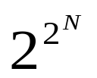
Issues
Too many compound predicates
  functions of N simple predicates
  N² for conjunction, disjunction of two variables
  N ~10³ even for small applications
Incomplete information due to
  Sampling (random observation of events)
Predicates at different locations
Notes:
2. Collapse: compact the feedback report
Sampling: reduce overhead – statistically fair random sample of the events
3. Predicates at same location: conjunction easily defined
Different location: It is not clear what a conjunction means.

Slide 8
Conservative Definition
A conjunction C = p₁∧ p₂ is true in a run iff
  p₁ is true at least once and
  p₂ is true at least once
(disjunction is defined similarly)
Cons:
  Imprecise: C may be true even if p₁, p₂ are never true simultaneously
Pros:
  Monitoring phase does not change
  p₁∧ p₂ is just another predicate
Notes:
Just another predicate:
compose further
existing analysis and tools automatically applied

Slide 9
Truth Tables
A predicate has three possible values in a run
  True, not true & not observed
Technically, not true ≠ false
Conjunction p₁∧ p₂
p₂ p₁ | T | F | ?
T | T | F | ?
F | F | F | F
? | ? | F | ?
Disjunction p₁∨ p₂
p₂ p₁ | T | F | ?
T | T | T | T
F | T | F | ?
? | T | ? | ?
Notes:
Not observed when
Execution did not reach the predicate
Skipped because of sampling
Not true != false: because of sampling

Slide 10
Analysis with Compound Predicates
Compute score of C as harmonic mean of
  Increase(C) = −
  Sensitivity =
  F(C) = # of failed runs where C observed true
  F(C obs) = # of failed runs where C observed
  numF = # of failed runs
Retain C if score is greater than its components
F(C)
F(C) + S(C)
Background Prob. of failure when C is observed
Prob. of failure when C is true
F(C obs)
F(C obs) + S(C obs)
log F(C)
log numF
Notes:
Background prob. Of failure of just reaching C: irrespective of whether C is true or not
Program already doomed

Slide 11
Complexity
Complexity: N²∙R
  N – Number of simple predicates
  R – Number of runs being analyzed
  20 minutes for N ~ 500, R ~ 5000
Optimization: Pruning
  Estimate upper bound of score and discard if too low
  Reduces O(R) operation to constant time
Notes:
Complexity for computing the score of all complex predicates

Slide 12
Upper Bound On Score
↑ Harmonic mean
  ↑ Increase(C) = −
  ↑ Sensitivity:
Upper Bound on C = p₁∧ p₂
  Find ↑F(C), ↓S(C), ↓F(C obs) and ↑S(C obs)
  In terms of corresponding values for p₁, p₂
↑F(C)
↑ F(C) + ↓ S(C)
↓ F(C obs)
↓ F(C obs) + ↑S(C obs)
↑ log F(C)
log numF
Notes:
If this value is less than score of p1, p2 – prune

Slide 13
↑F(C) and ↓S(C) for conjunction
↑F(C): true runs completely overlap
F(p₁)
Min( F(p₁), F(p₂) )
F(p₂)
numF
↓S(C): true runs are disjoint
S(p₁)
0
0 or
S(p₁)+S(p₂)- numS
S(p₂)
numS
(whichever is maximum)
Notes:
Find a configuration where the objective bound is obtained

Slide 14
↑S(C obs)
Maximize two cases
  C = true: true runs of p₁, p₂ overlap
  C = false: false runs of p₁, p₂ are disjoint
S(p₁)
S(¬p₁)
Min(S(p₁), S(p₂))
+ S(¬p₁) + S(¬p₂)
or
numS
(whichever is minimum)
numS
S(p₂)
S(¬p₂)

Slide 15
Pruning Conclusion
Refer to paper for
  ↓F(C obs)
  All four bounds for disjunctions
Recap:
  Compute upper bound of C
  If upper bound > threshold:
    Apply truth tables and compute exact values of F(C) etc.
    Apply score formula
Notes:
Bounds for disjunctions are dual to those of conjunctions

Slide 16
Usability
Numerous predicates trouble programmer
  Has to infer predicate relations
  Will prefer ∧ or ∨ of related predicates
  effort(p₁, p₂) = proximity of p₁and p₂ in PDG
  Fraction of entire program
  PDG = CDG ∪ DDG
  Per Cleve and Zeller [ICSE ’05]
Useful only if effort < 5 %
Notes:
So far: addressed from computational standpoint
More important: must be usable by programmer
Compute only usable compound predicates

Slide 17
Evaluation
Notes:
Another case study: Ccrypt: predicate implications – see paper

Slide 18
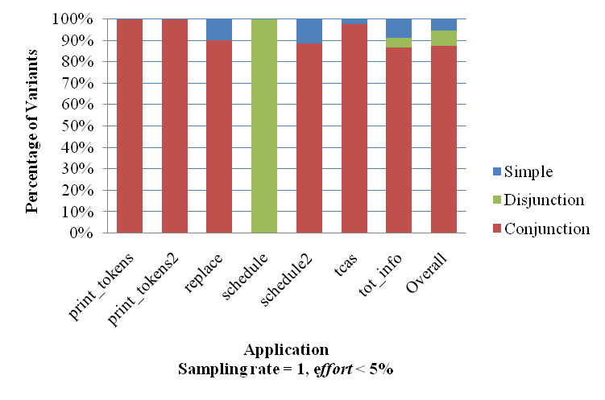
Usefulness – What kind of predicate has the top score?
Notes:
Siemens – variants per application from 7 to 41
Compound predicates do a better job of describing the difference b/w successful and failing runs

Slide 19
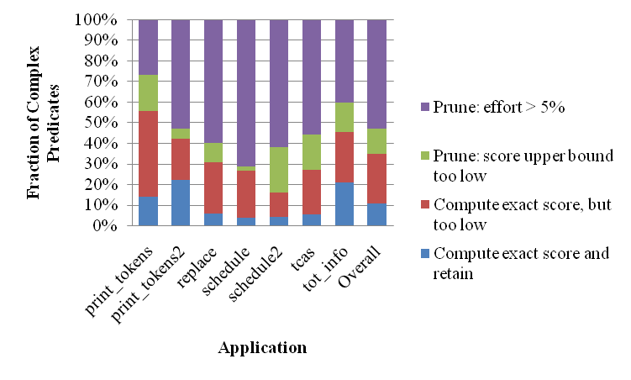
Practicality
Analysis time reduces from ~20 minutes to ~6 minutes
(Just 1 minute for aggressive pruning)
Notes:
Aggressive pruning:
Interested only in top scoring predicate
Used by a iterative elimination algorithm used for pgms with multiple bugs [PLDI ’05]

Slide 20
Related Work
Daikon [Ernst et al.] – Invariant Detector
  Generates implications
Bug Isolation Tools:
  SOBER [Liu et al.]
  Tarantula [Jones et al.]
Notes:
SOBER – probabilistic model
Tarantula - statement coverage as predicates

Slide 21
Conclusion & Future Work
Enrich vocabulary of bug predictors
Employ 3-valued logic, set estimation, static program structure
Demonstrate usefulness and practicality
Future work:
  Implication of compound predicates in related analyses: Bi-clustering (Zheng et al.), BTRACE (Lal et al.)

Slide 22
Thank You

Slide 23
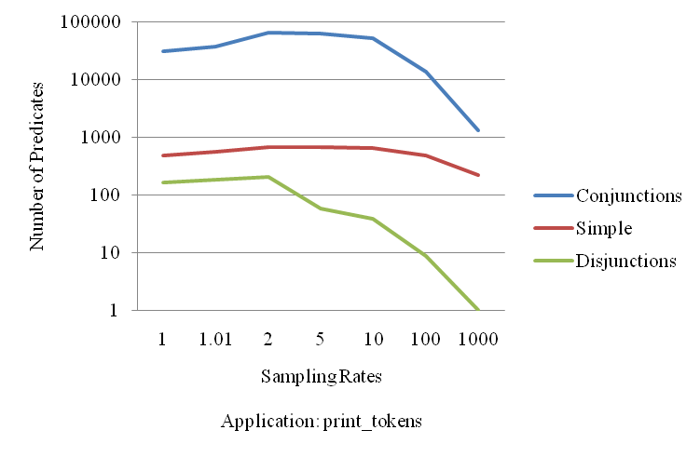
Effect Of Sampling

Slide 24
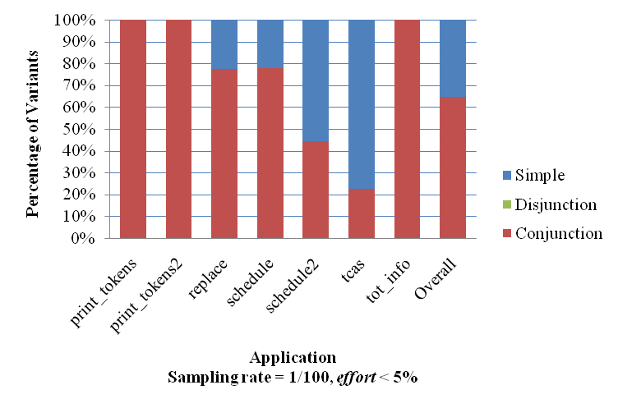
Usefulness At Lower Sampling Rates

Slide 25
↓F(C obs)
Minimize two cases
  C = false: false runs of p₁, p₂ overlap
  C = true: true runs of p₁, p₂ are disjoint
F(p₁)
F(¬p₁)
F(¬p₂)
numF
= numF’
F(p₂)
- Min(F(¬p₁), F(¬p₂))
0
and
F(p₁) + F(p₂) – numF’
Max(F(¬p₁), F(¬p₂))
+ Max of
Notes:
Bounds for disjunctions are dual to those of conjunctions

