Slide 1
Multi-Level Linked List Library libm3l
Adam Jirásek

Slide 2
Libm3l Task
Enable creating, deleting, updating, maintaining and sharing data sets through byte stream communication (TCP/IP sockets)

Slide 3
Required Features
Features
  Data set
    Hierarchical data structure
    Store data of different type
  Operations with data during program run
    add/link/remove/locate
    Sharing data set within process and between separate processes through TCP/IP
  Data format not tied to any specific solver
  Simple API

Slide 4
Overview
Programming language
  ANSI C

Slide 5
Data Structure
Data structure
  Linked list
    Each data set is List
      List has a name, type and carries actual data
    Each List is connected to other lists in a list tree
    Structure of Linked List similar to file system
      List - DIR (directory)
      - FILE type (contains data)
      - LINK (links)
  Unlike in file system, one DIR can contain number of lists with the same name
    Location is specified by path and path_specification

Slide 6
Basic Element
Basic element is List of type node_t *
    Name of the list
    Type of the list
    Number of dimension of array
    Array dimensions
    Connectivity info
      Each list connected to parent, previous, next and child node
    Information about links
    “payload” ie. actual data
data_t union{
int, float, doule ….}
previous
parent
child
find_t structure
contains info about links
next
Name of the list
type of the list
Ndim
dims

Slide 7
List Types
Example of list
  DIRs
  FILE types
  Links
FILE types
DIR
LINK
Linked list #1
Linked list #2

Slide 8
DIR List
DIR list
  Similar to directory – contains other Lists
  When deleted, all content deleted with it
DIR

Slide 9
FILE Type Lists
FILE type list
  Contains data
    Data in one FILE list have the same type
    Internal arrays are one dimensional arrays
      Integer, float, character etc.
      Example: - List with name name_of_grid, containing 8 string text CSM_grid
  name_of_grid C 1 9
  `CSM_grid`
  - List with name Index_W, containing matrix 2x3 array of integers with values 2 4 6 8 10
  Index_W I 2 2 3
  2 4 6 8 10 12

Slide 10
LINK List
LINK
  List is linked to other list
    Either within the same list tree or to different list tree
LINK
LINK
Linked list #1
Linked list #2

Slide 11
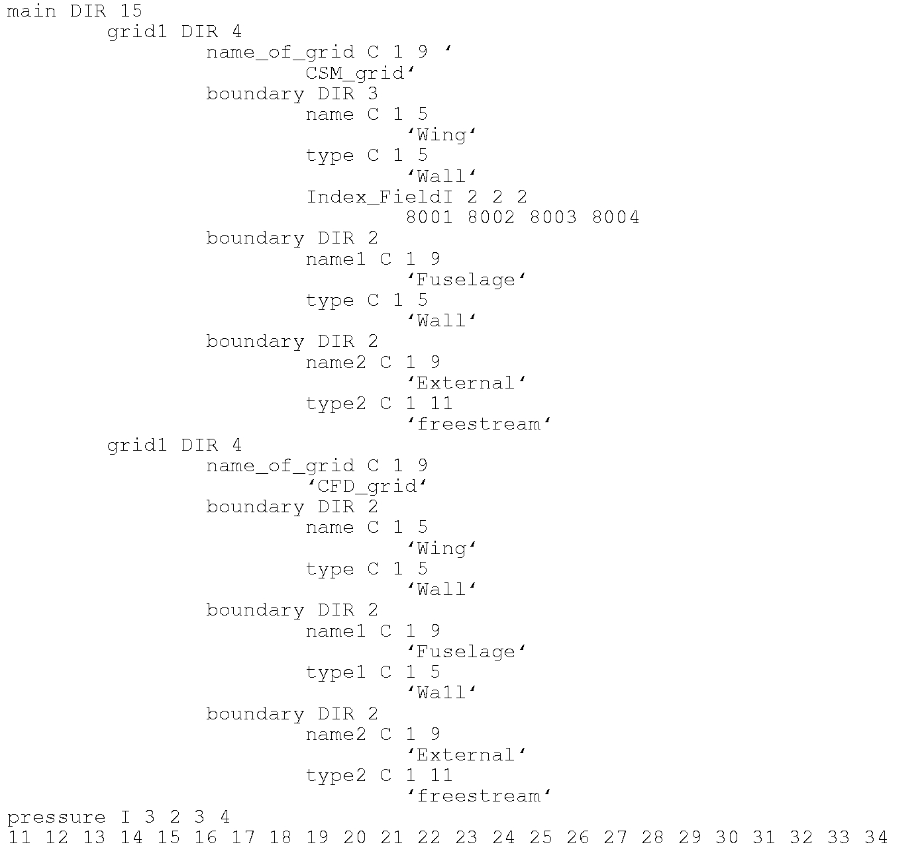
Example of File
Data set example
  Main node
    contains two grids
    Pressure field
  Each grid contains
    file with name of grid
    Boundary conditions
      BC contains:
        Name of BC
        Type of BC
        One BC contains additional integer field Index_Field

Slide 12
Functions
Basic operations which are already available
  Add list
  Copy list
  Create list
  Move list
  Remove list
  Link list
  Locate (Find) list
  IO operations (disk, TCP/IP socket)

Slide 13
Invoking Function
Each function has API
  Either called with parameters through caller
    List is located using path and location
    Using short and long options
  Or directly with filled structure with options
    List needed to be specified through pointer
    Opts is a structure containing values of options, ex: Opts.opt_i = ‘i’
  Example = move item from List2 to List1
    m3l_Mv(List1, “/list1/data/grid1”, “/*/*/*”, List2, “/list2”, “./”, “--ignore”, (char *)NULL)
    m3l_mv_list (List1, List2, *Opts)

Slide 14
Server Client Scenario
Server-Client Scenario with CFD solver
  Requirements:
    Two or more separate processes need to share data and be synchronized (blocking TCP/IP sockets)
    Need to send all kinds of data, type of data can change during process run
    Processes supposed to be running on separate computers
        Need to be submitted through queuing system
        If required, each processor should be able to communicate, not just through the master node (ie. if required, each partition should be able to send and receive data)

Slide 15
Inter-Process Communication, IPC
Do not want to use disk I/O
  Time consuming and unreliable for process synchronization
TCP/IP one solution for inter-process communication and synchronization (IPC)
  Enables sharing data between different computers
    Simplifies IPC between processes on different computers
    Simplifies IPC for process running on a number of processor
  If blocking socket used – can be used for synchronization
  Problem – byte-stream communication, TCP/IP does not use real/double/integers etc. types, everything are just bytes

Slide 16
Sending Data Over TCP/IP
Sharing data between processes using libm3l similar to calling subroutine or function
  Makes interface so that data are converted to bytes and upon receiving them as bytes, libm3l converts back to their original form
    Ex: If P1 sends Linked List containing array of integers, array of doubles and array of characters, P2 process receives an identical copy ie. list with array of integers, array of doubles and array of characters

Slide 17
Simple Server Client Scenario
Server waits for client
Client sends request
Server processes request and sends back to client
Client
Server
1. Generate data set
2. Libm3l – prepare data for TCP/IP
3. Send data to server/socket
4. Wait for data from server
5. libm3l – decode data from server/socket
6. Process data from server
1. Open listening socket
2. Wait for data from client
3. Receive data from client/socket
3. libm3l – decode data from client
4. Process data from
4. Send answer to client/socket using libm3ll

Slide 18
Possible Server-Client Scenario
Server
  Manages communication between clients
  Synchronization
Server
Synchronization,
communication
TCP/IP layer
Each client and server opens TCP/IP socket and makes IO operations similarly to disk IO
libm3l level
Clients
CFD
CSM
Control
Simulink
Other processes

Slide 19
Example of Sending Data Over TCP/IP
Functions sending and receiving data from socket
  Input is a pointer to list
  Output is pointer to list
  Example
    Process (program) P1 running on one computer
    Process P2 on different computer
    P1 sends entire data structure or a subset of the structure to P2
      Use pointers to specify which data set to export
    P2 received the data set have the same type as send data set, ie. integers, chars, double etc.

Slide 20
Example of Sending Data Over TCP/IP
Client - Send_to_tcpip(node_t *L1, ip_address of P2 process, port #)
Server - Node_t *R = Receive_from_tcpip(port #)
Pointer L1
Pointer R
P1 process data set L1 P2 received data set R

Slide 21
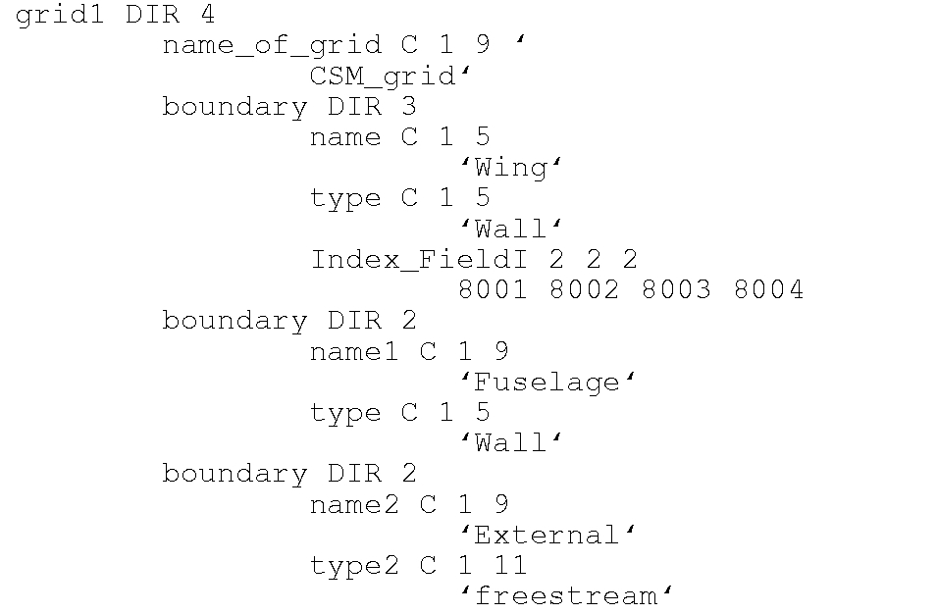
Example of Sending Data Over TCP/IP
Send_to_tcpip(node_t *L2, ip_address of P2 process, port #)
Node_t *R = Receive_from_tcpip(socket #)
Pointer L2
Pointer R
P1 process data set L2 P2 received data set R

Slide 22
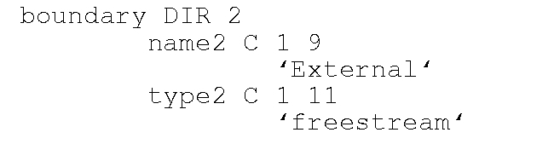
Example of Sending Data Over TCP/IP
Send_to_tcpip(node_t *L3, ip_address of P2 process, port #)
Node_t *R = Receive_from_tcpip(socket #)
Pointer R
Pointer L3
P1 process data set L3 P2 received data set R

Slide 23
Example of Sending Data Over TCP/IP
Send_to_tcpip(node_t *L4, ip_address of P2 process, port #)
Node_t *R = Receive_from_tcpip(socket #)
Pointer R
Pointer L4
P1 process data set L4 P2 received data set R

Slide 24
Current Status and Next Steps
About 8000+ lines of C code
OSS LGPL licensing
First preliminary tests working well
  Tests done at PC with Linux SUSE and Gentoo Linux and cluster with Cent OS
  Coupled CFD-CSM analysis Edge – TRNITAS tests
    Data sets shared every time step
    Edge interpolates data from CFD mesh to CSM mesh and sends forces in structural mesh DOF
    TRINITAS sends displacement
    After that, Edge performs mesh deformation
    http://www.foi.se/en/Customer--Partners/Projects/Edge1/Edge/
    http://www.solid.iei.liu.se/Offered_services/Trinitas/

Slide 25
Example
Solvers – Client1 and Client2 are iterating and sharing data every iteration
  Client1
    makes 10 size array called pressure and fills them with random numbers
    Send through Server to Client2
    Waits for answer from Client2, once data arrives, print them out on the screen
  Client2
    Waits for data from Client1
    Once the data arrives, Client2 finds pressure data set, calculates average value and send back to Client1
    Waits for new data set (in code example, Client2 sleeps 0.1 secs before sending data to Client1, can be set in Client2.c, see statement tim.tv_nsec = 100000000L)
Codes in example will make 5 iterations

Slide 26
Example
Clinet1 and Client2 are on the same level in process hierarchy
  Work as solvers – ie. create and analyze data
  Use server to communicate
  None of them synchronizes, they just send and receive the data and waits for data to arrive
Server
  Passes data from Client1 to Client2 and vice versa
  Does not do any calculations

Slide 27
Example
Server
Synchronization,
communication
Client2
Calculate average value
Client1
Produces pressure array

Slide 28
Example
Open three terminals
Execute command server with port number, example:
  ./Server_Example.out 31000
Execute clients1 and 2 with IP address (name) of server computer and port number. If running on the same computer as server, use IP address localhost or 127.0.0.1
  ./Client1.out localhost 31000
  ./Client1.out localhost 31000
  NOTE: can execute clients in random order, Clients will wait for data so if there is a delay between executing Client1 and Client2, they will wait

