Slide 1

SFS: Smart OS Scheduling for Serverless Functions
Supercomputing Conference 22
Authors: Yuqi Fu, Li Liu, Haoliang Wang, et al.
UVa, GMU, Adobe
Presented by Chengqing Zhao

Slide 2
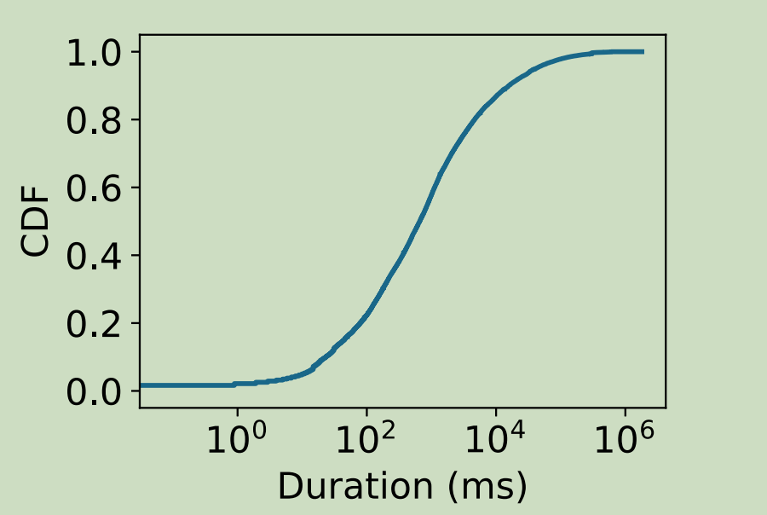
Motivation: Faas workloads feature — short time
about 37.2%, 57.2%, and 99.9% of the functions have an average execution duration shorter than 300ms, 1 second, and 224 seconds, respectively
Optimizing the execution duration of these short functions will provide a huge benefit.

Slide 3
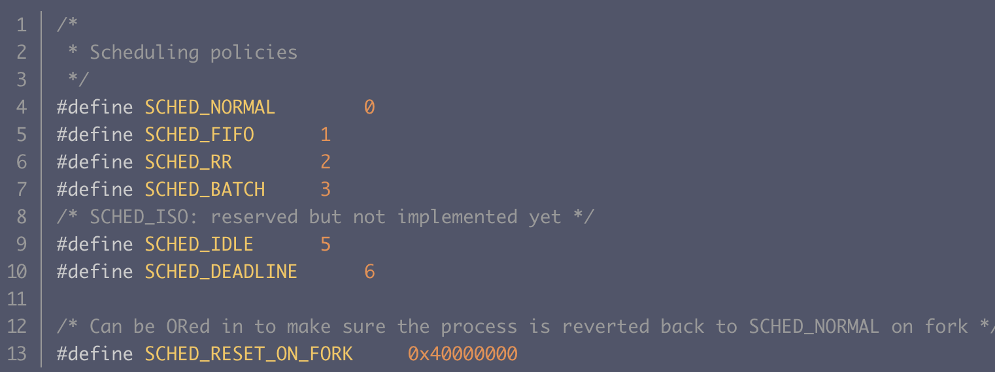
Motivation: FaaS workloads not adapted to CFS
Linux kernel essentially supports just six scheduling policies:
CFS, BATCH, IDLE, FIFO, RR, DEAD_x0002_LINE【Syrup sosp21】
CFS
Completely Fair Scheduler
FIFO
First Come First Served
该策略 不涉及 CPU 时间片机制 ( 分时复用机制 ) , 在没有
高优先级程的前提下 , 只能 等待其它进程主动释放 CPU 资源
RR
Round-Robin
是 " 实时进程调度策略 " , 使用的是时间片轮转机制
【Syrup sosp21】:
It is important to note that while the round-robin policy is
better for this workload, it is no panacea
linux-5.6.18\include\uapi\linux\sched.h
IDLE和DEAD LINE只能在内核中使用 , 应用进程无法使用这两个调度器

Slide 4
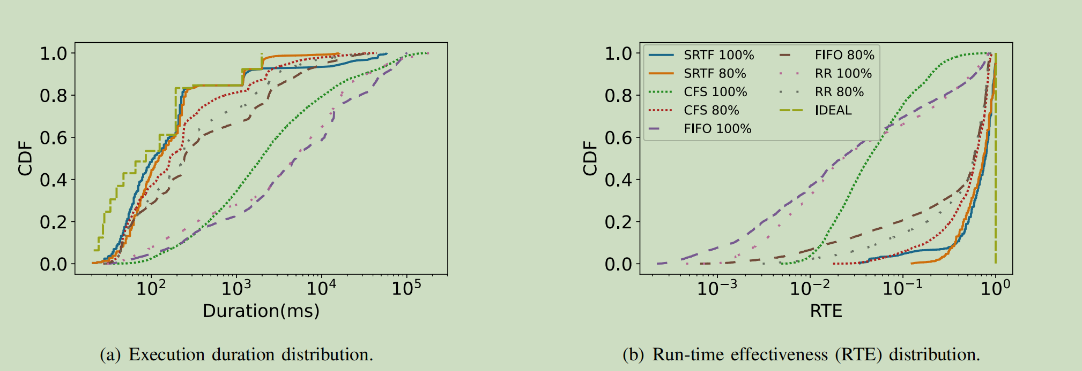
Motivation: FaaS workloads is adapted to SRTF
SRTF approached the IDEAL performance
None of Linux’s three CPU schedulers was able to offer good performance under both the 80% and 100% load under practical FaaS workloads performance boost for short serverless functionsAccelerators
SRTF is provably optimal for turnaround time!

Slide 5
Motivation: SRTF is an offlfline algorithm
FaaS workloads have unique characteristics that make existing Linux’s “fair” scheduler actually unfair
it is impossible to directly apply SRTF as it is an offlfline algorithm
SRTF is not practical as it assumes a priori knowledge about job duration
SFS works entirely in the user space, leveraging existing kernel scheduling policies (FIFO and CFS) to approximate SRTF

Slide 6
Motivation: HW and SW
Hardware
the small VM (c5a.4xlarge) with 6 vCPU and 64 GB memory
亚马逊网络服务平台（AWS）多个可比较系统：Intel Skylake (c5.4xlarge)、AMD Zen-2 (c5a.4xlarge)
a large, bare_x0002_metal, m5.metal EC2 instance with 96 vCPUs and 384 GB memory
Software
opensource FaaS platform (OpenLambda)
Linux schedtool
The Azure Functions workload datasets
the only publicly available FaaS workload traces that we have access to

Slide 7
Challenges
How to mitigate this amplification for short-job-dominant FaaS workloads is an open challenge
How to balance the tradeoff between the performance improvement for short jobs and performance loss for long jobs
The design principle and challenges of SFS
Effective strategies, should prioritize short functions in a timely manner with minimal impact on longer functions
Works entirely in the userspace and does not require kernel modifications
works
Alongside (rather than replacing) OS schedulers
While being transparent to FaaS servers

Slide 8
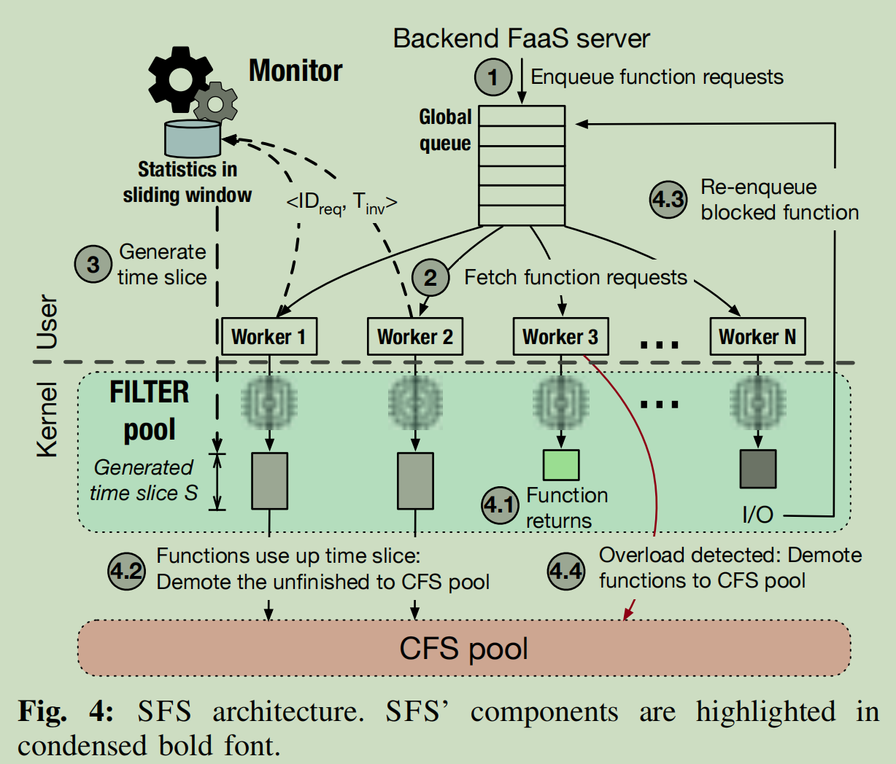
Function abstractions
1. Faas服务器：分发任务到一个全局队列
2. 从1中的队列获取请求分到每个Work上
通过元组信息来过滤每个进程，形成FILTER POOL
调度通过过滤器，此时的调度策略切换成FIFO
3. Montior根据收集的统计数据(ID,T)定期重新计算全局时间片参数S
4. 具体的几个案例
一个短函数完成执行并在耗尽时间片S之前返回
SFS工作程序标记其完成，从全局队列中删除相应的条目，获取下一个函数请求，并重新启动时间片计时器
SFS工作人员跟踪过滤器函数的运行时，在它的时间片过期时强制抢占它，并将其降级为CFS
如果一个函数被某个事件阻塞（IO)，Work将立即优先执行它并返回它到global queue
观察不断增加的排队延迟（超过某个阈值）来检测到瞬态过载，暂时禁用过滤器，使用CFS直接调度下一个请求

Slide 9
Function abstractions： Dynamically Adapting Time Slices
基于排队理论对时间片参数S进行估计和动态适应
SFS动态地改变时间片以响应变量请求到达率，这是使用历史IAT( inter-arrival times)估计的
与CFS连接的单级 FILTER pool，以近似达到SRTF效果
A high-priority queue for short functions
CFS as a black-box, lower-priority queue for longer functions

Slide 10
Function abstractions： Handling I/Os
SFS工作人员通过定期向操作系统发出轮询请求来跟踪该函数的内核级进程状态
When a function is in its CPU burst, its kernel-level status is in running mode
the SFS worker detects this transition, stops its timekeeping and records the unused time slice
reduces its priority, and schedules the next available function from the global queue
When the status of a waiting function changes to runnable, SFS adds it back to global queue. When this function gets rescheduled in the FILTER pool, it will execute until it completes or it uses up.the rest of the time slice. We use 4 ms as the polling interval
Note that, when a high-priority function blocks by I/O, CFS automatically sneaks in and executes other functions that have been filtered by SFS

Slide 11
Function abstractions: Handling Overload
SFS temporarily switches to CFS When a function is in its CPU burst, its kernel-level status is in running mode

Slide 12
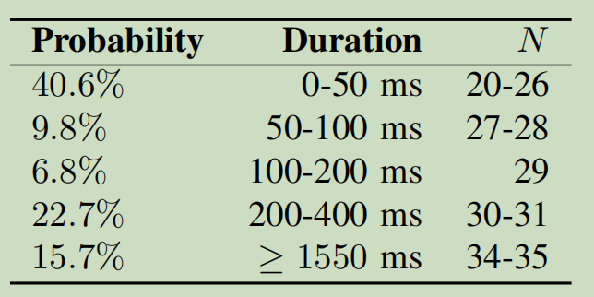
Implementation and Optimization
侦测I/O事件：
SFS workers detect blocking events by periodically (4 ms) polling the function process’ OS status using a go process utilities library gopsutil
调度器转换：
SFS workers use schedtool to change a running function process’ OS scheduling policy
全局队列的实现：
the SFS global queue：structure using Go’s built-in
SFS workers: goroutines (a lightweight user-level thread of execution managed by the Go runtime)
FaaSBench:Generating FaaS Workloads

Slide 13

Evaluation
Setup
The small VM (c5a.4xlarge) with 6 vCPU and 64 GB memory
亚马逊网络服务平台（AWS）多个可比较系统：Intel Skylake (c5.4xlarge)、AMD Zen-2 (c5a.4xlarge)
a large, bare_x0002_metal, m5.metal EC2 instance with 96 vCPUs and 384 GB memory
Baselines
处理I/O
处理过载
端到端的效率
尾部时间延迟测试和上下文切换
算法开销

Slide 14
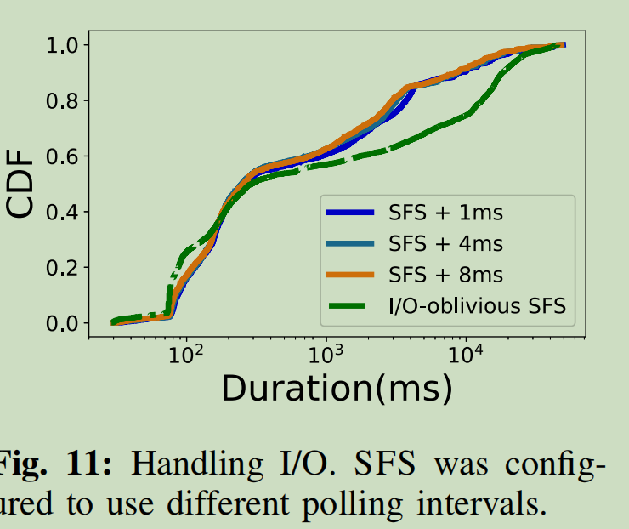
处理I/O：
I/O-oblivious的性能较差，因为等待I/O，过滤器池浪费了时间切片，导致它们被过滤到CFS
轮询间隔从1 ms改变到8 ms，发现性能对轮询频率不敏感
相同时延下，占比更低

Slide 15
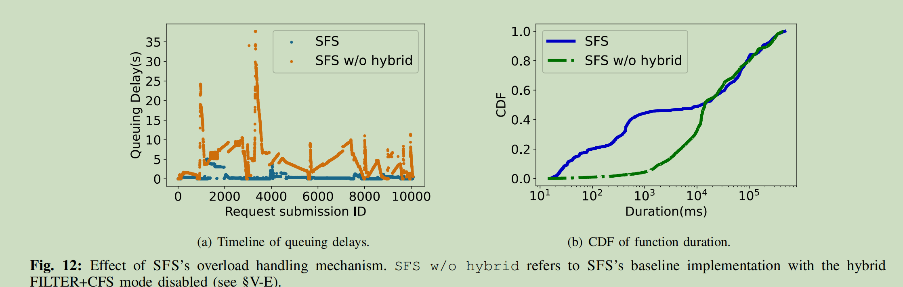
处理Overload
Timeline of queuing delays
a smoothqueuing delay curve
CDF of function duration
considerable reduction of turnaround times for about 50% of function requests.
overload
更多的低时延分布

Slide 16
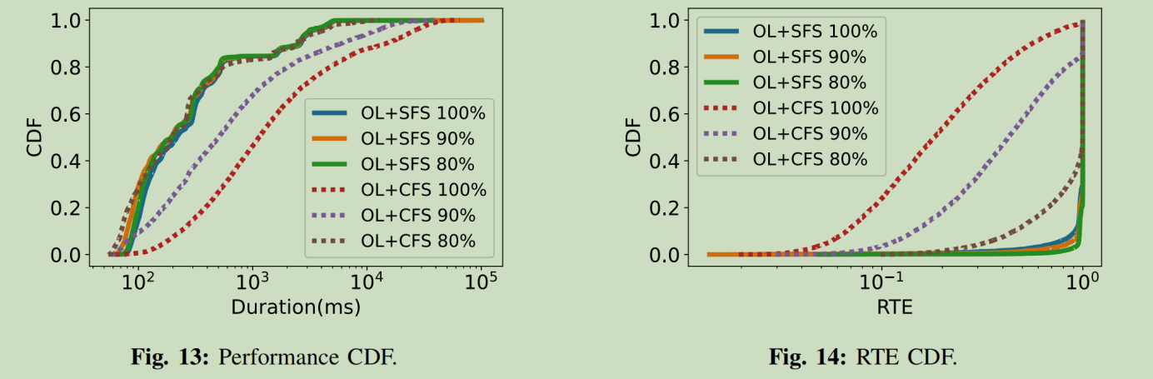
端到端的效率
使用 FaaSBench测试工具产生3种负载：Fibonacci sequence (fib)--cpu密集型, markdown generation (md)--I/O密集型, and sentiment analysis (sa)--io and cpu密集型
faas工具：OpenLambda was deployed to use 72 CPU
使用IAT产生3个级别的负载: 80%, 90%, and 100%
SFS比CFS要好

Slide 17
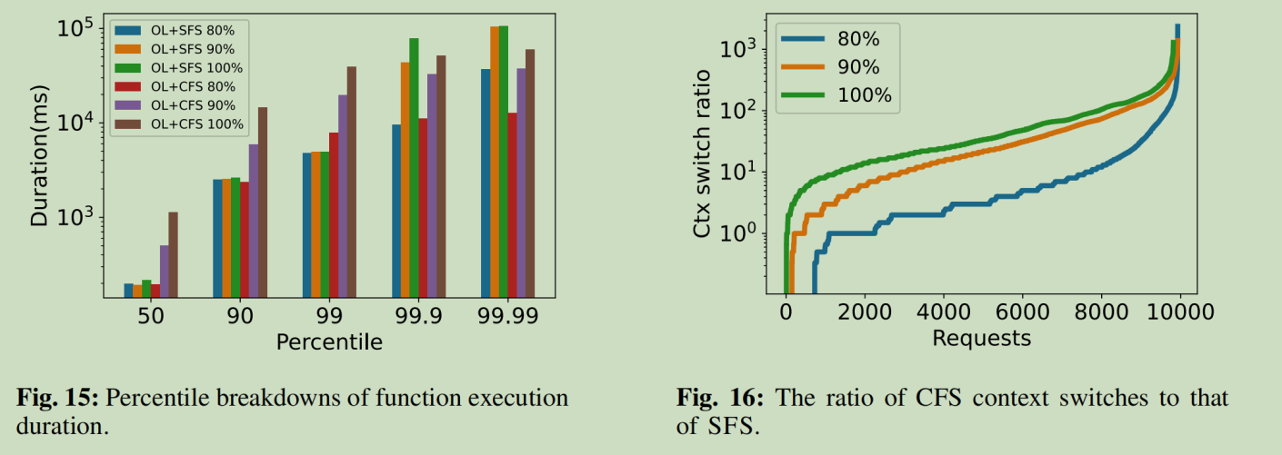
尾部时间延迟测试和上下文切换测试：
more than 99% of function requests scheduled by CFS had more context switches than SFS
SFS尾部时间延迟

Slide 18
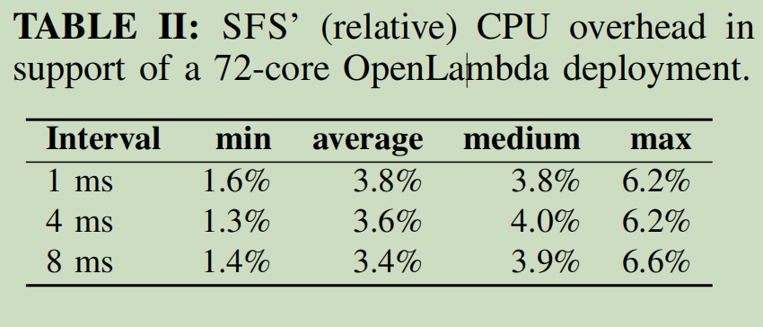
算法开销：
Azure-sampled workload, meaning that an extra of 2.6 cores were needed in order to boost a 72-core OpenLambda deployment, a relative overhead of only 2.6/72 = 3.6%

Slide 19
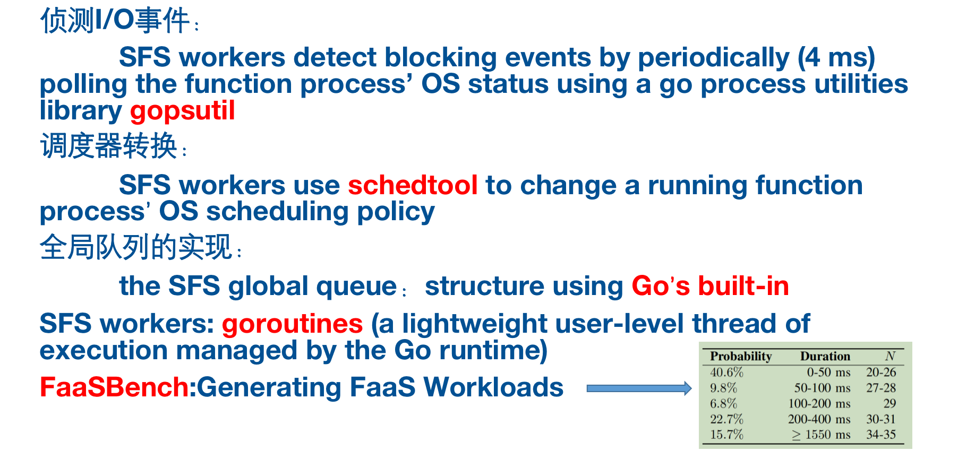
Thinking
预测
ghost
wrk

