Slide 1
Learning from partial labels
Combustor liners
6 geometries (3 inner liner, 3 upper) – changing positions of 5 ports (3 chuted, 2 unchuted)
‘Liner’ faces are “pre-labelled”. Only the presence (or not) of labels for faces belonging to unchuted port, chuted port, banana slot, inner mcr hole, and outer mcr hole are changing.
Testing different partial labelling strategies. For each strategy:
For each geometry (point cloud sampled once), get R(=10) stochastic labelled states (based on strategy),
for each labelling state, run training for M₁(=3) models randomly initialised and M₂ (=3) models from MFCAD++ pretraining.
(Perhaps keep the same set of randomly initialised models constant from the start??)
For each strategy:
total runs = num_geoms x num_labelled_states x num_models
= 6*10*6 = 360

Slide 2
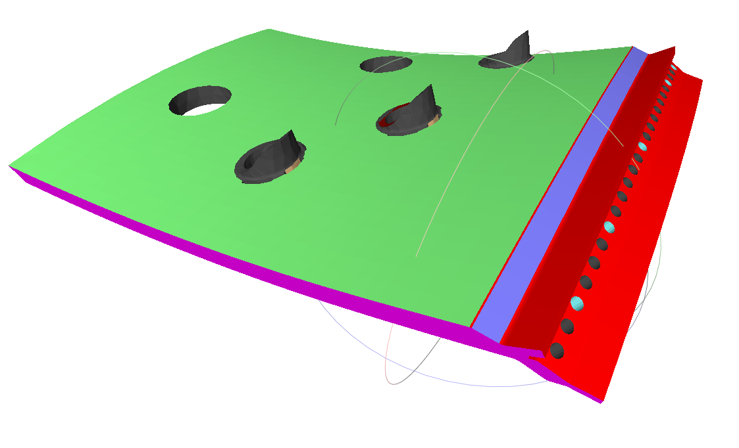
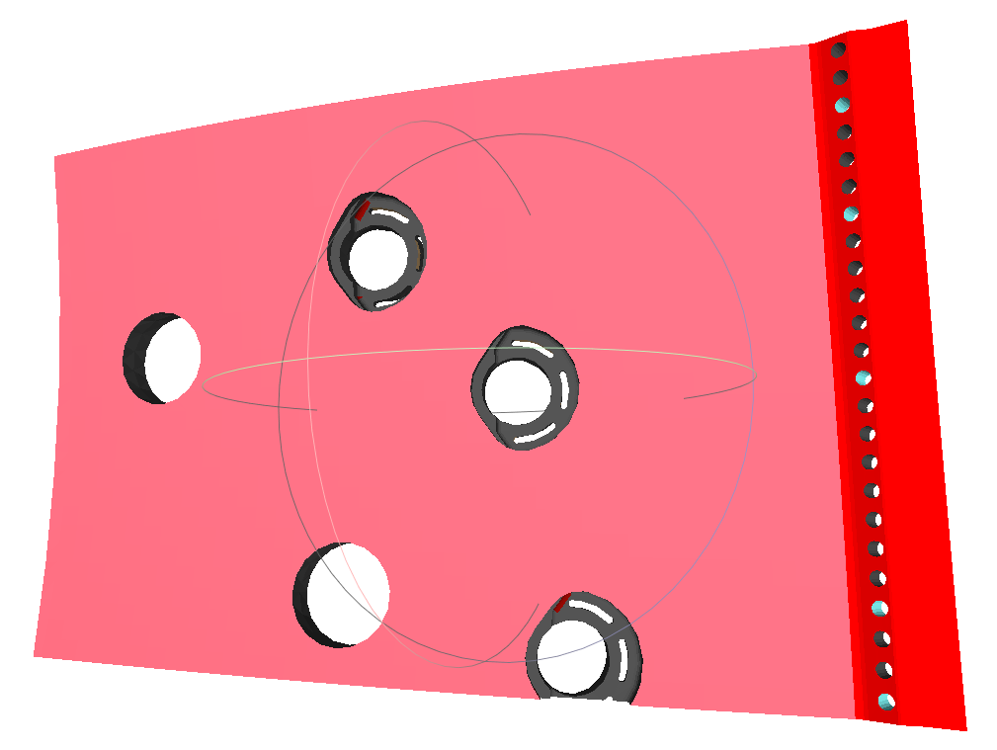
Example partially labelled geometry
Random 10% of ‘available’ faces pre-labelled

Slide 3
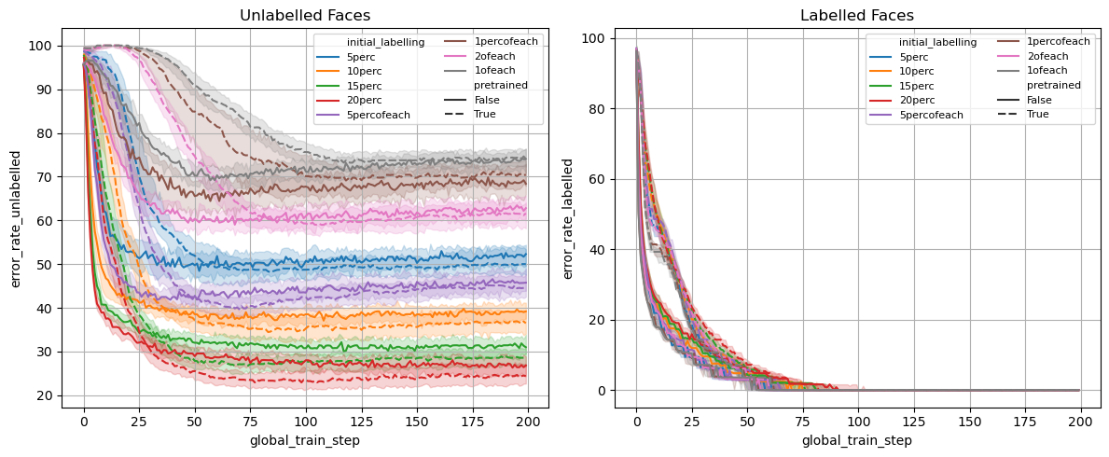
Overall error rates
Median lines and 99.9% confidence interval shaded
More labelled, lower error rates. Better stratified selection of faces to label is better – 5% of each feature (purple) vs 5% of all unlabelled faces (blue).
Randomly initialised models ‘learn faster’ (evidenced by error rate on known/training faces and error rate on unknown faces at early training steps).
Pretrained initialisation catches up and settles on a (slightly) lower error rate for unlabelled faces for labellings >= ~5%.
Better generalisation to unlabelled faces? Randomly initialised models always better on known/training faces.

Slide 4
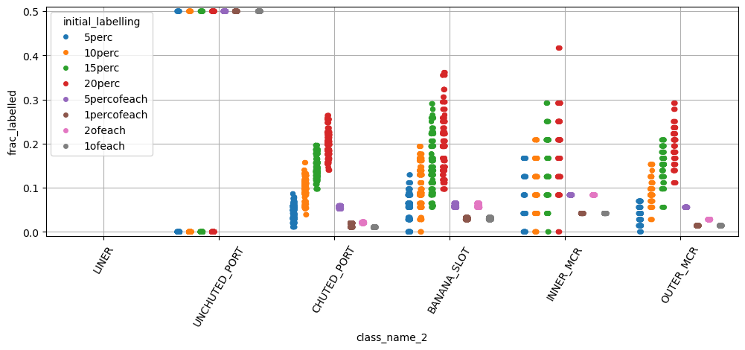
Fraction labelled per class

Slide 5
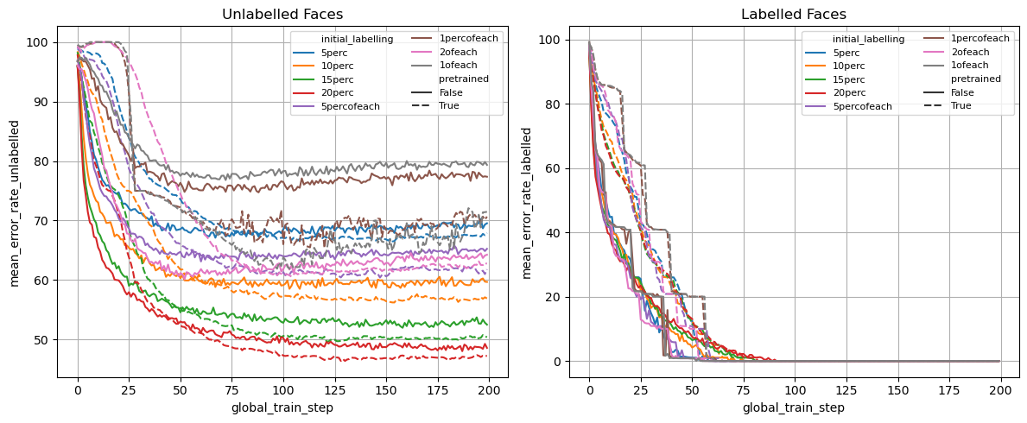
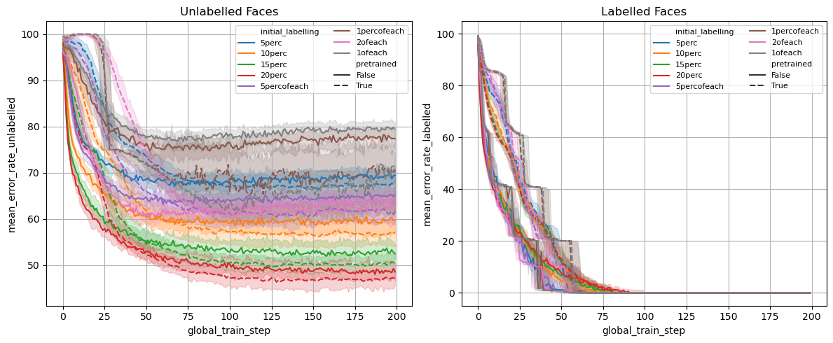
Mean error rates per class (macro)
Median lines and
99.9% confidence interval shaded
Accounts for class imbalance.
Not so useful as a ‘goal’ here, because of interactivity we want minimal number of incorrect faces regardless of class.
More of a flag to look deeper to per-class results.
Similar general trends.
Behaviour of randomly initialised and pretrained initialisation models diverges more for very low label cases.

Slide 6
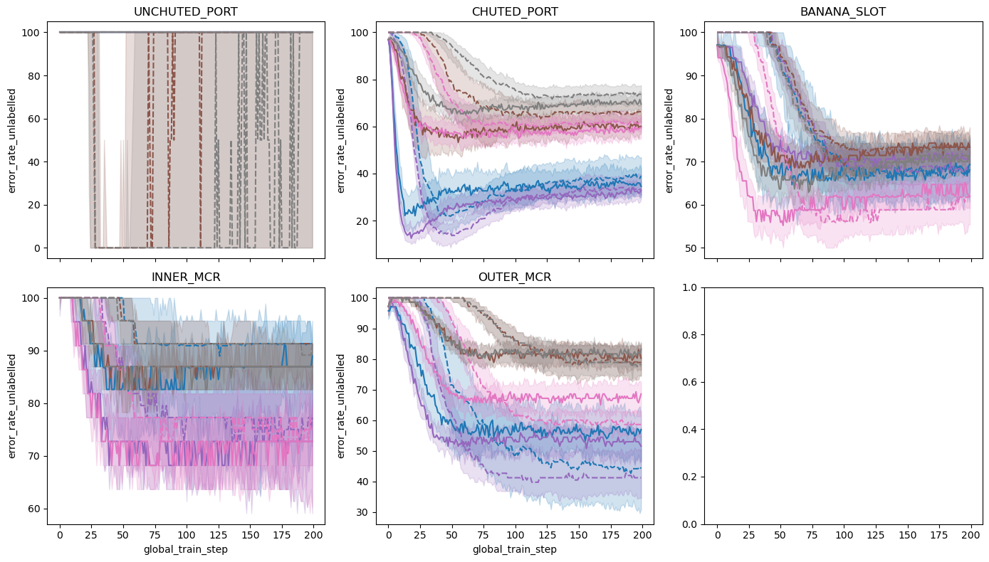
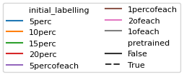
Median lines and 99.9% confidence interval shaded
‘Overfitting’ observed for chuted port – increase in error rate after minimum (when labelling >=5%). (Error rates actually reach 0% for pre-trained models when labelling at least 15% of all faces @ ~25 training steps)
More complex picture here when comparing random initialisation and pretrained initialisation.
But remember that we have interaction available…

Slide 7
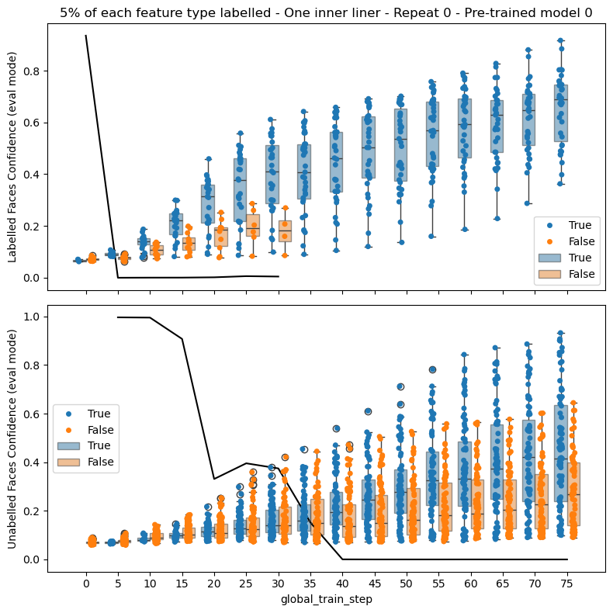
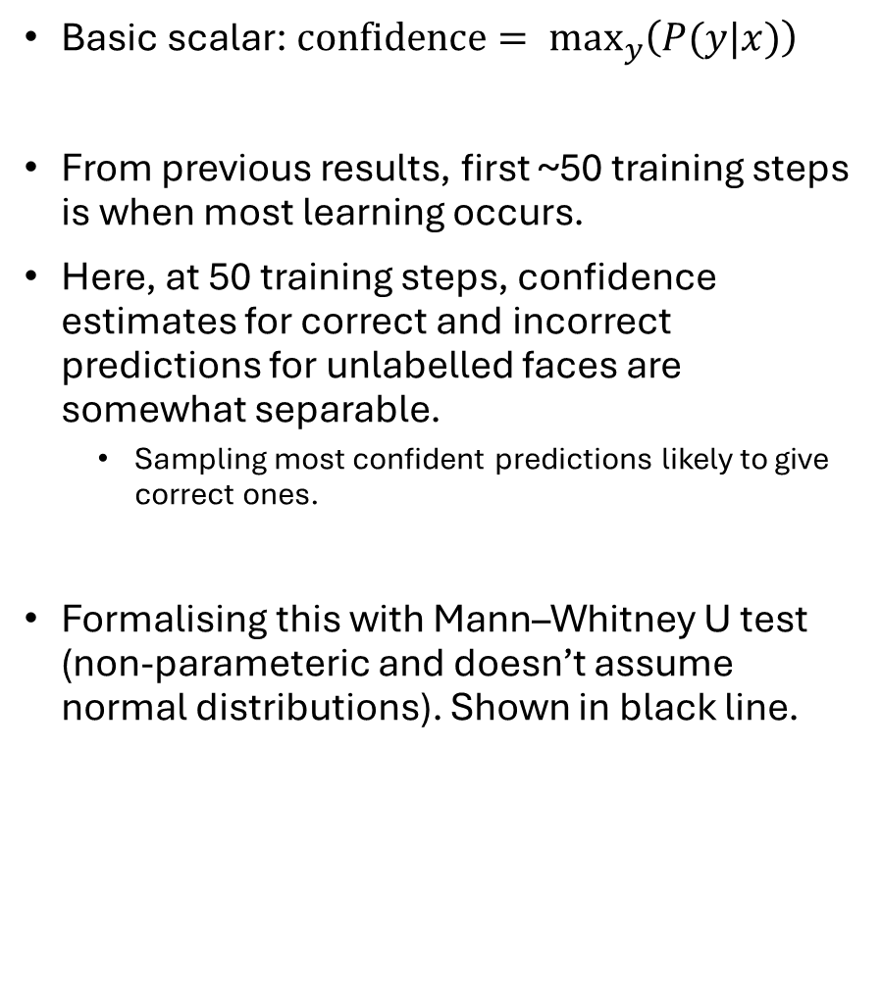
Uncertainty estimation
Basic scalar: $confidence= \max_{y}\left(P(y|x)\right)$
From previous results, first ~50 training steps is when most learning occurs.
Here, at 50 training steps, confidence estimates for correct and incorrect predictions for unlabelled faces are somewhat separable.
Sampling most confident predictions likely to give correct ones.
Formalising this with Mann–Whitney U test (non-parameteric and doesn’t assume normal distributions). Shown in black line.

Slide 8
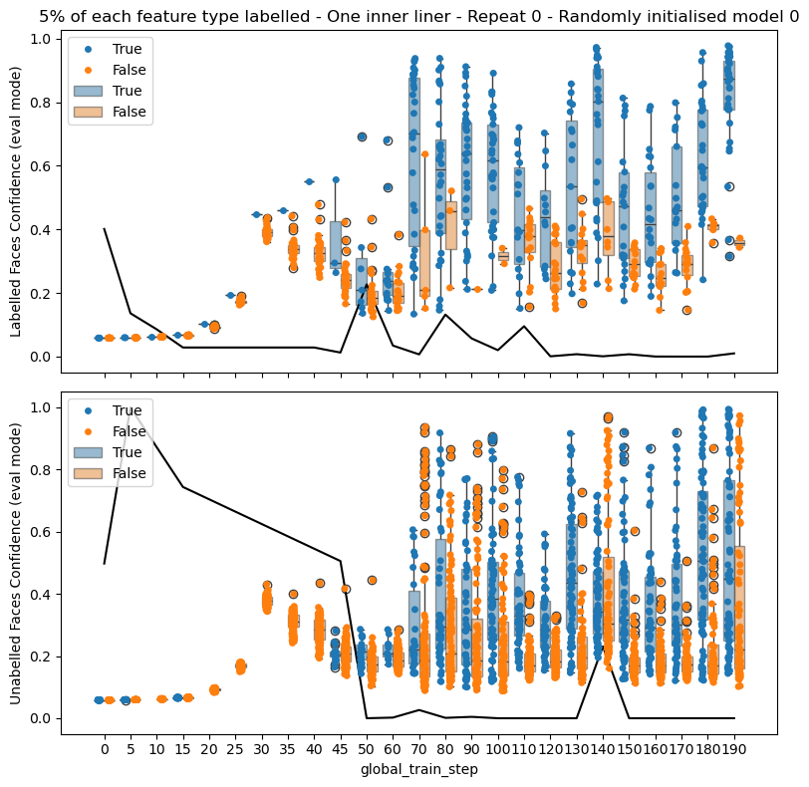
Randomly initialised model’s confidence estimates are not as well behaved!

Slide 9
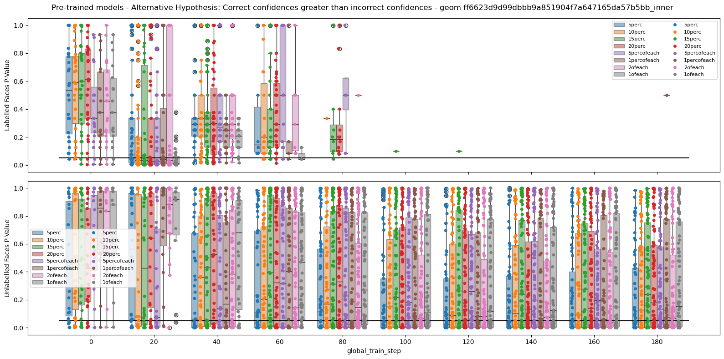

Slide 10
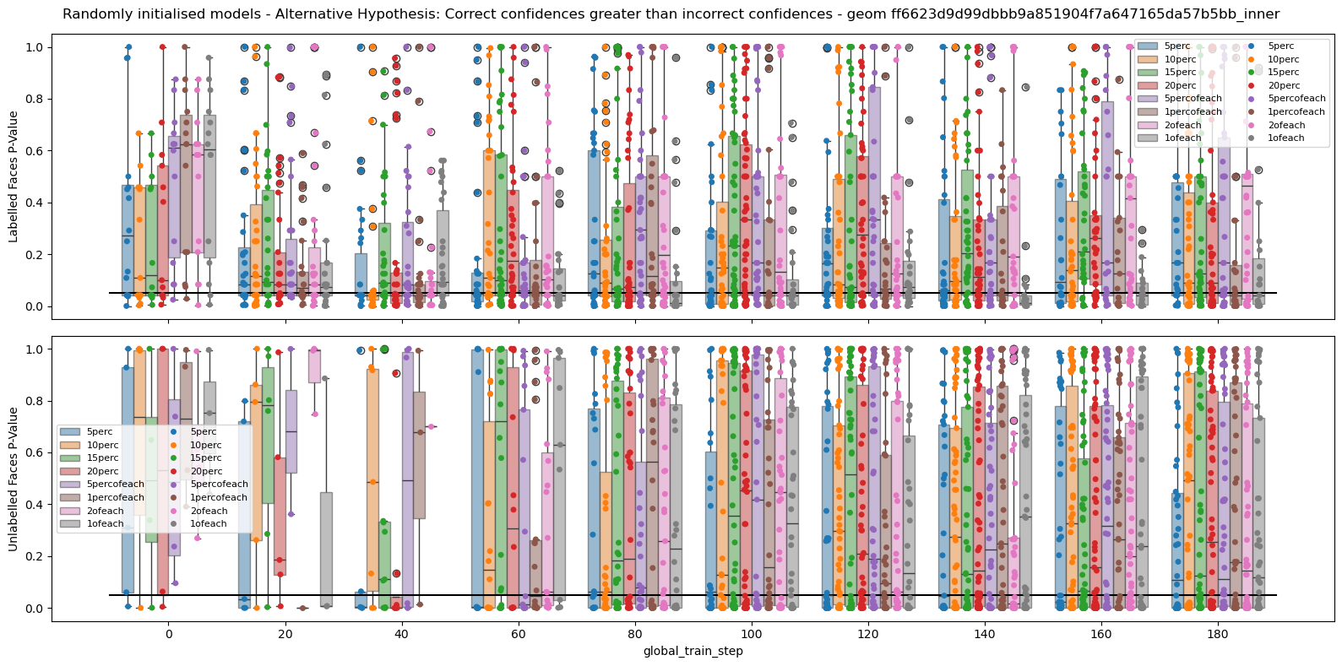

Slide 11
Not as clear when looking across all models, repeats, and labelling strategies.
But how ‘useful’ is it for active learning? Actual downstream goal.

Slide 12
Adding information iteratively
The same 6 geometries and constant labelled faces (liner faces).
Same labelled state sampling repeats and models.
(Some pre-trained cases didn’t run over xmas…)
‘Active learning case’
Within a run, additional faces are labelled every N training steps.
NN’s label predictions are not being used but confidences can be used to select which additional faces are labelled.
Strategy configuration options:
Initial labelling (amount and spread)
Number of labels added at each ‘interaction step’
Training steps in between interaction (or stopping criteria to start next interaction)
Faces to label (after first step) selection strategy

Slide 13
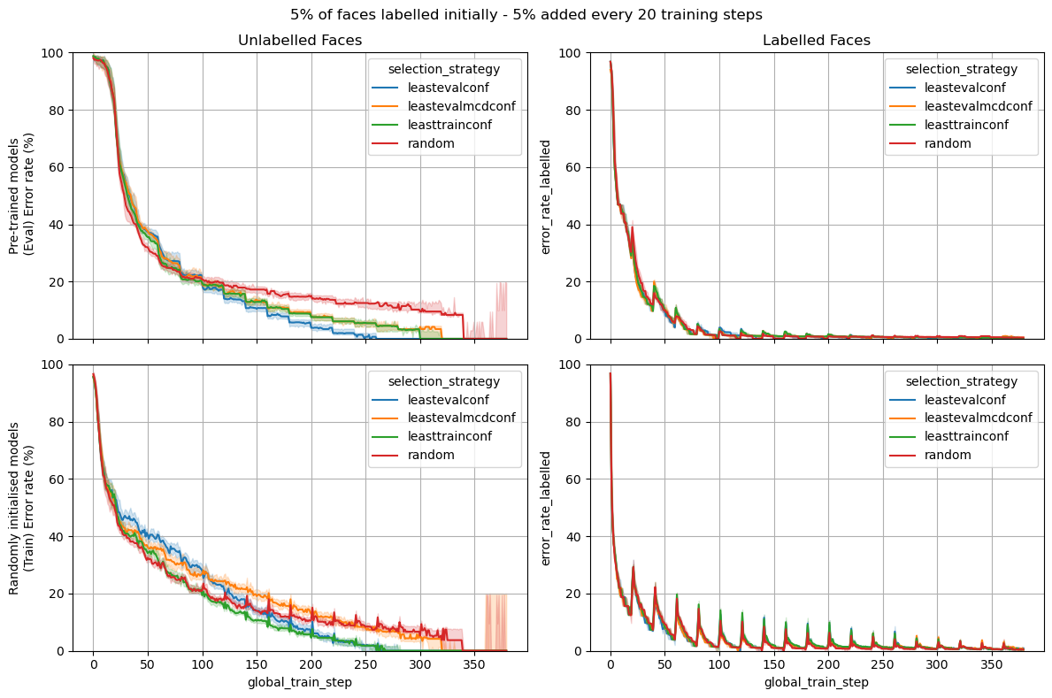
Median lines and 99.9% confidence interval shaded
More results in progress…

Slide 14
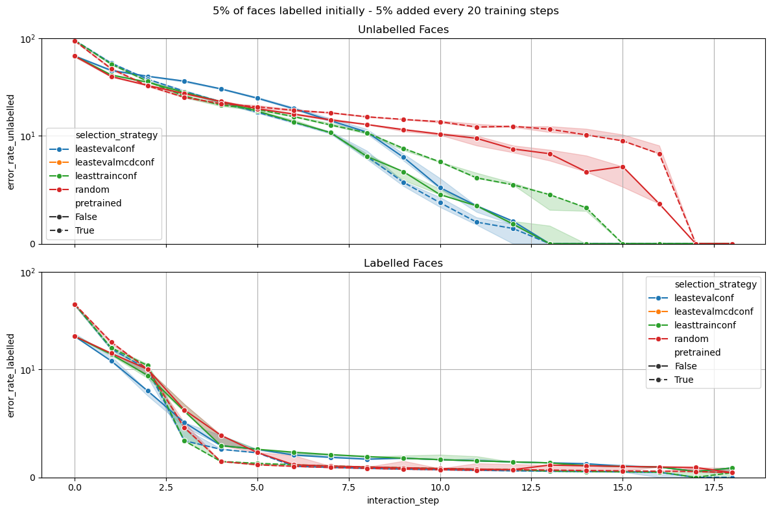
0-10 is
linear
scale

Slide 15
Main conclusions and open questions
Model can learn from partial labels.
Expected trade-off is shown – more labels, lower error rates.
Predictive accuracy can be improved with better selection of faces to label, given fixed “manual effort budget”.
Randomly initialised models and pre-trained models perform similarly (with random learning faster) but uncertainty estimation of pre-trained models slightly more calibrated.
Preliminary – when adding labels iteratively, using confidence estimates can achieve lower error rates at a given “annotation budget”.
Better range of strategies for active learning needed.
Large error rate variance within the ‘same’ strategy – i.e. same initial labelling budget but different exact faces being labelled. Some faces more informative than others?
Correlation across (random) labellings not found. Better to create some representative labelling spreads manually?
How to incorporate the deep ensemble method? We previously showed that this was especially good for scarce training data cases in terms of predictive accuracy and confidence calibration.
Conclusions hold for NUSKU?
Data (mostly) generated, to be analysed…

