Slide 1
Information from computers?
Let’s get into cyberspace.

Slide 2
I’m not going to be a technician, so why should I learn computers?
Internet confuses me…

Slide 3
Computers are tools for
making good grades in school
doing better at work
AND ...

Slide 4

FOR DOING ALL THESE FUN STUFF
play music
watch videos
chat
get the news
store data
study and learn
buy things
send e-mail
play games

Slide 5
This presentation will…
Show how computers are used in everyday living
Understand common computer terms
Define the Internet
Provide tips on navigating the Internet
Point to resources available in our College Web page

Slide 6
The desk top computer
software
hardware
CPU
Monitor
Speakers
Printer
Etc..
Programs
Plug-ins
Drivers
Etc…

Slide 7

Computer Input :

Slide 8
Computer output
Screen
Printer
Speakers

Slide 9
HOLDING AND CLICKING THE MOUSE
HOLD THE MOUSE CORRECTLY
LEFT CLICK
RIGHT CLICK

Slide 10
At first, computers were mainly for computing…
Ancient times: Abacus
1964-1971- 3rd
generation computers
1945-1963- mainframe Supercomputers

Slide 11
Mainframes were used by the military
Big businesses
universities
homes

Slide 12
Computers can do a lot of things
Mathematical computations
Word processing
Keep records on databases
Share information

Slide 13
We share information through the Internet
NETWORK
MIT, 1964

Slide 14
THE INTERNET
WORLD WIDE NETWORKING

Slide 15


WE ARE ALL CONNECTED

Slide 16
To get into the Internet…
you must get online
Be connected

Slide 17
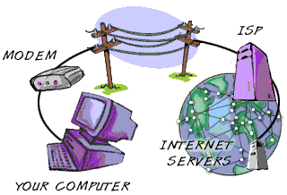
How to get a connection
Routers and switches

Slide 18
Where do I want to go ?
cyberspace
What do I want to do ?
How do I get there?

Slide 19
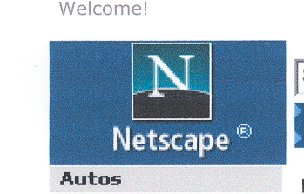

Browsers - allow you to get to Internet resources
Most popular browsers

Slide 20
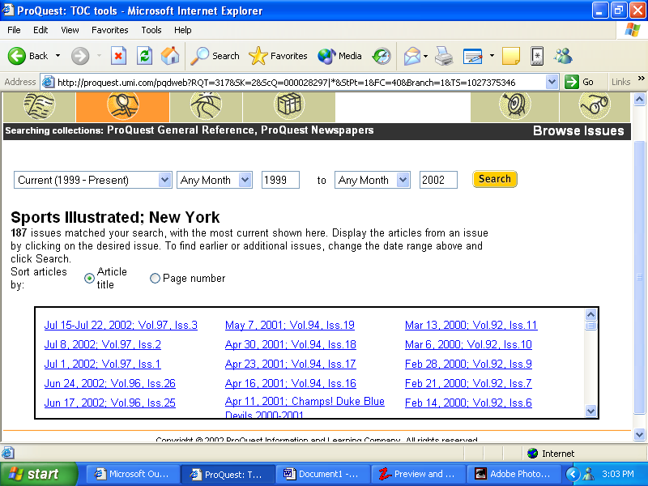
INTERNET EXPLORER
TITLE BAR
MENU BAR
NAVIGATION BAR
LOCATION BOX
TASK BAR

Slide 21
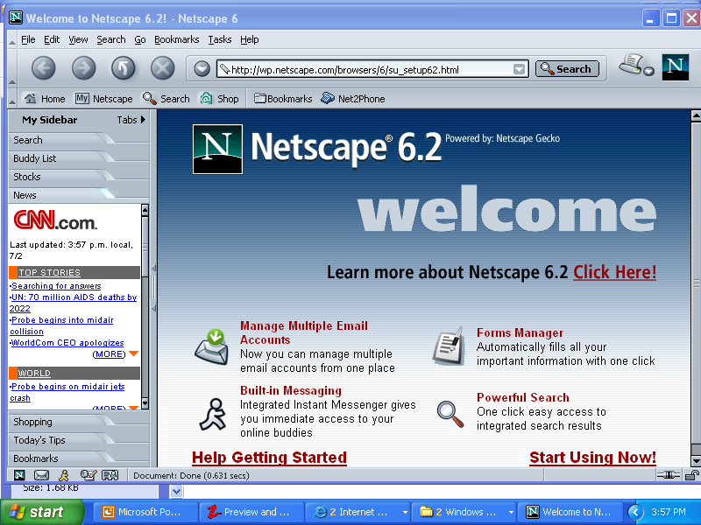
NETSCAPE WAS ONE OF THE EARLY BROWSERS

Slide 22
THE URL:
If you know the URL or address of an Internet site, you can just type it in the Location box.
But if you do not know it, you have to use a SEARCH ENGINE. Okay let us try one.
CLICK HERE

Slide 23
HAPPY SURFING ON THE NET
the end....
GOOD LUCK
A production of:
Nenita B. Buenaventura
Created by :
eleanor l. sonido

