Slide 1
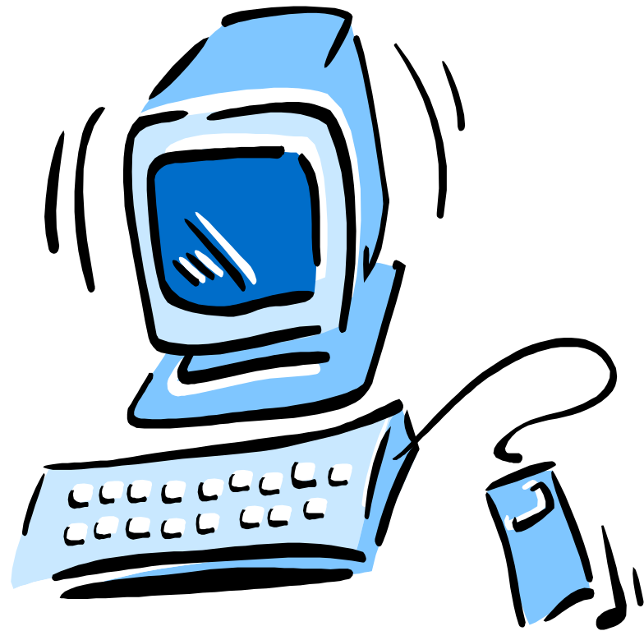
Presented by
Dena Laney
Interim Systems Librarian
Long Beach City College
3/29/2007

Slide 2
Why is it important?
Anyone can publish on the Internet
As students, how can you determine whether a source is reliable or not?

Slide 3
Using the Web as a resource
I was told “NEVER to use Internet sources”
for my research.
You can, if you know what to look for!
There are a lot of excellent resources
available on the Web – statistics, primary
documents, digital collections.

Slide 4
Five criteria to consider
Accuracy
Authority
Objectivity
Currency
Coverage

Slide 5
1: ACCURACY
Determine the purpose
    Informational
    Advertisement
    Advocacy/Interest Group
    News
    Personal
    Entertainment

Slide 6
1: ACCURACY
Determine author
Check for contact information
Facts documented for verification
Free from careless errors

Slide 7
2: AUTHORITY
Determine publisher
  Library
  College
  Personal
  Organization/Agency
Author qualifications listed

Slide 8

2: AUTHORITY
Check the domain (.edu, .org, .com, .gov) and
url for clues as to publisher, purpose.

Slide 9
3: OBJECTIVITY
Minimal bias presented
Goals of the Web site
Intended audience
Attempt to sway your opinion

Slide 10
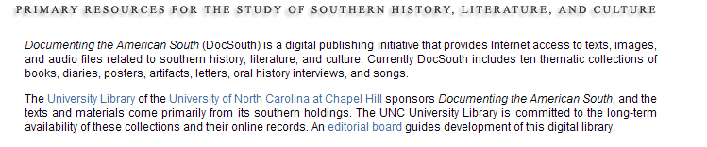
3: OBJECTIVITY
Goals or purpose of the Web site (can be found in About section)

Slide 11

4: CURRENCY
Check for published or last updated date
Ensure the content is not out-of-date
Broken/dead Web site links

Slide 12
5: COVERAGE
Relevant links
Access to information
  No additional software required
  No password/payment needed
Depth of material and topics
Free of advertisements

Slide 13
It is possible to use Web sites for research purpose.
Remember to evaluate these five criteria to make that determination.

Slide 14
Additional Resources
Library of Congress Research Center
http://www.loc.gov/rr/business/beonline/selectbib.html
UC Berkeley Finding Information on the Internet
http://www.lib.berkeley.edu/TeachingLib/Guides/Internet/Evaluate.html
Internet Detective: Wise up to the Web
http://www.vts.intute.ac.uk/detective/index.html
Screenshots taken from Documenting the American South
http://docsouth.unc.edu/

