Slide 1
Welcome to the Library!
Library Services Available to You!
By Jennifer Gallegos, LIB 204

Slide 2

Services Available to Patrons at the Library
Check out books, cds, movies, and more
Reference Materials (in print and on the web)
Online databases
Homework help
Job searching assistance
Reading programs
Computer Access
Arts and crafts

Slide 3
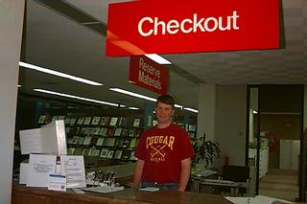

Library Media
Check it Out!
  Books – audio, language & test preparation, books for children, teens and adults, magazines and much more.
  CDs, DVDs, VHS and BluRay discs!
  Leap Frog and Phonics equipment is available to check out for students who are interested
  Want media in other languages? We have books, audio cassettes and movies in Spanish, Khmer, and a variety of other languages.

Slide 4
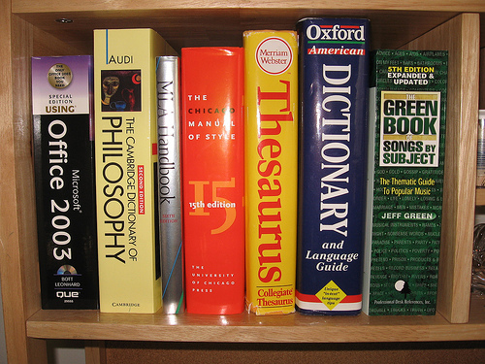
Reference Materials in print
A More Traditional way of getting information
  Dictionaries
  Test Preparation
  Encyclopedias
  Almanacs
  Atlases
  Microfilm
  Lots more!

Slide 5

Reference on the Web
E-Reference available to patrons on the Library website:
Encyclopedia of Science
College Blue Book
World Book
EBSCO Host
Ferguson's Career Guidance Center
Health & Wellness Resource Center
Lawchek.com
Much more!

Slide 6
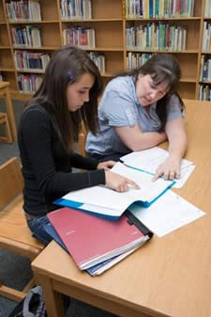
Homework Help
The library provides homework centers for students. There are helpers available to assist students with homework, research, and using the computers.

Slide 7

Need to Look for a Job?
The Career Guidance center database
Resume software available on library computers
Job Listings catalogs
Online access to fill out job applications
Helpful workers here to assist you with any problems/questions

Slide 8
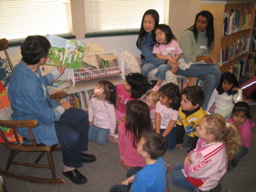
Reading Programs
Tiny Tots Storytime once a week
Book clubs for children, teens, and adults
Summer reading programs
Available in select libraries:
Reading specialists available to help children (grades K-8) improve their reading skills.

Slide 9
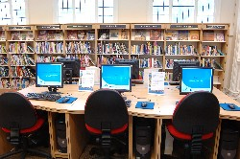
Computer Access
The library is equipped with computers so you can:
  Surf the web
  Do homework/ research/ job hunting
  Read E-books and view online databases
  Browse the Library catalog
  Check out/ renew/ hold material from the library
Computer Lab

Slide 10
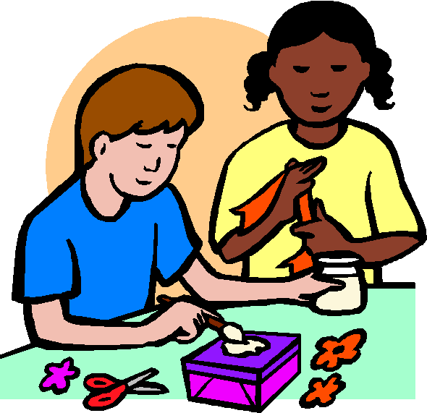
Arts and Crafts
There are always fun events in the library!
Movie days
Holiday Arts and crafts
Games
Contests
Much More!

Slide 11

We’ll see you at the library!

