Slide 1

Read 85 Jordan Fabish Instructor
Bob Wiegand
Librarian

Slide 2
What is the Oxford English Dictionary?
The Oxford English Dictionary, often just called the OED, is a unique source of scholarly information on meaning, history, and pronunciation of words both past and present. It is the accepted authority on the evolution of the English language over the last millennium.

Slide 3
History of the Dictionary
How it began
1857: The Philological Society of London calls for a new English Dictionary
More work than they thought
1884: Five years into a proposed ten-year project, the editors reach ant
One step at a time
1884-1928: The Dictionary is published in fascicles
Keeping it current
1933-1986: Supplements to the OED
Making it modern
1980s: The Supplements are integrated with the OED to produce its Second Edition
Into the electronic age
1992: The first CD-ROM version of the OED is published
The future has begun
The present: The OED is now being fully revised, with new material published in parts online

Slide 4
OED milestones
A chronology of events relevant to the history of the OED
http://www.oed.com/about/milestones.html

Slide 5
What are the coverage of the OED?
The OED includes:
  The meaning, history, and pronunciation of over a half a million words;
  The usage of words through 2.5 million quotations from a wide range of international English language sources, from classic literature and specialist periodicals to film scripts and cookery books;
  Etymological analysis, lists of variant spellings, and pronunciation using the International Phonetic Alphabet;
  Words from across the English-speaking world, from North America to South Africa, from Australia and New Zealand to the Caribbean.

Slide 6
When to use the OED?
Find a term when you know the meaning but have forgotten the word;
Find the history of a familiar phrase;
Find words that have come into English via a particular language;
Search quotations from a specific year;
Search for all quotations from a particular author and/or work;
Gain unique online access to at least 1,000 new and revised words each quarter;
See how language changed and how new scholarship has increased understanding of our linguistic and cultural heritage.

Slide 7
Special Characters used in the OED
Pronunciations are shown in the standard characters of the International Phonetic Alphabet.
Greek characters are displayed but are not searchable.
Accented letters If you want to use a Find Word or Full text search to look for a word with an accented letter (e.g. café) simply type a plain letter in place of the accented one (e.g. cafe).
Hyphens In a Find Word search ignores hyphens and does not distinguish hyphens and spaces. This means that typing database will find database, data-base, or data base.
In a Full Text search, however, typing data-base will find both data-base and data base, but not find database you have to type it in exactly, I.e. as one word.
Case In a Find Word or Full Text search you can use upper or lower case letter to type your search term. For example, “dickens” will find “Dickens” and “dickens.”

Slide 8
What is a Wildcard?
A wildcard is a character which stands for any letter. You can include wildcards
In a Find Word or Full Text search to make your search more flexible. There are
two wildcards available in OED:
  The question mark ? Represents the occurrence of any one single character.
  For example: c?t finds cat, cot, cut
  The asterisk * represents the occurrence of any number of characters (or no character at all).
  For example: c*t finds cat, caught, commencement, conflict, consent, cot, cut, etc.

Slide 9
How can wildcards help me in a search?
Wildcards are useful
  if you do not know how to spell a word;
  if you are not sure in what form the term you want appears in the dictionary, or
  If you want to find several terms beginning with the same root.
    For example:
      The search term *sychok?n?s?s finds psychokinesis
      The term colo*r matches color and colour
      The term chonograph* finds chronographer, chronographic, chorographical

Slide 10
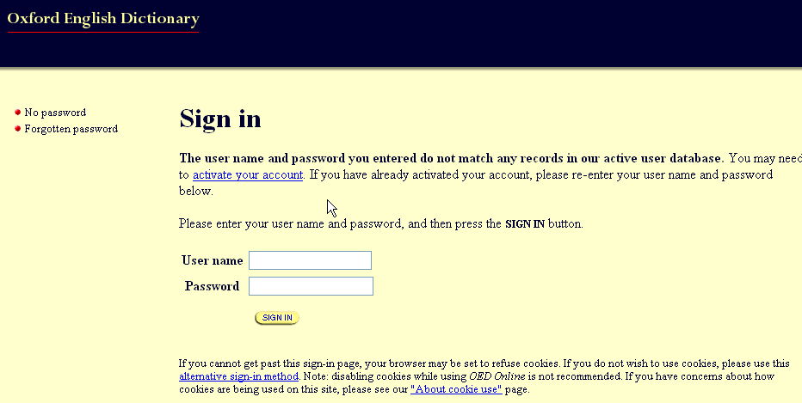
The OED Quick Guide
You can access the OED from any computer or work station in the library and also at your home.
The web access address (URL) http://www.oed.com/
Username: lacpcc
Password: longbeach

Slide 11
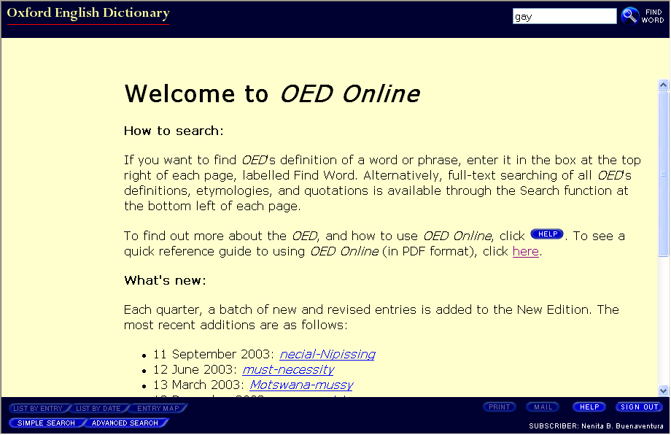
The Welcome to the OED screen also provide some search assistance
Click on the blue Help button to learn more about searching the OED or print out the quick reference guide (.pdf) for future reference.

Slide 12

How to Search
There are two ways to look up a word in the dictionary:
“Find Word” search
A quick search which finds main dictionary entries, such as “alphabet,” “break,” “xylophone.” It also finds subordinate entries such as the phrase in alphabet, or compounds such as “alphabet book.” The search form is located at the top right of the browser window.
“Full text” search
A full search of the entire dictionary text. It finds your term wherever it occurs in the dictionary. This could be in the form of an entry name, part of another word’s definition, in a quotation, etc.
The search form is displayed by clicking the button in the bottom left corner of the screen marked “Simple Search.”
Display the simple full text search form

Slide 13
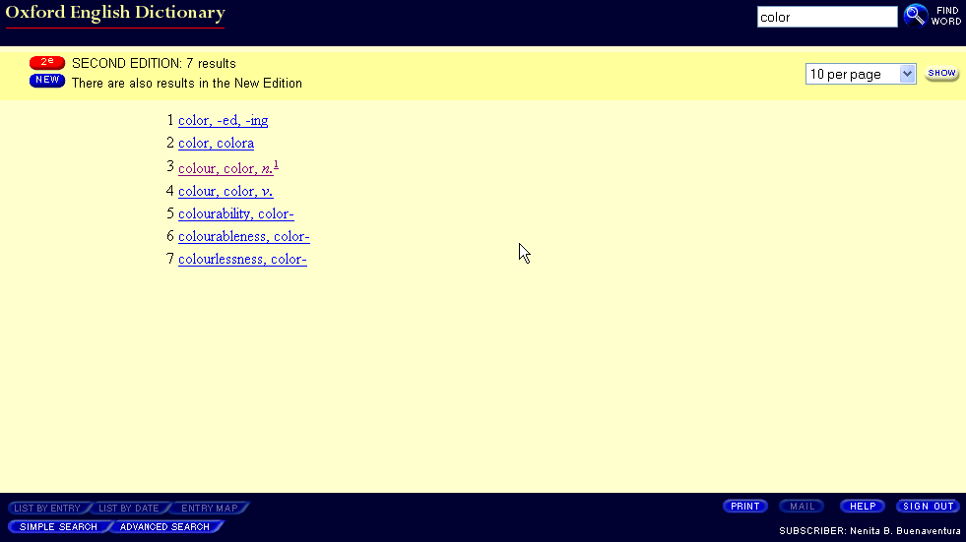
How can I run a “Find Word” search?
Type the word you want to find into the “Find Word” box, located at the top righ-hand side of the browser window.
Click on the “Find Word” icon.
A list of results is displayed, or, if there is a single result, the entry is displayed automatically. When there is a single result, the latest version of the entry is shown.
Click on any of the entry names to display the entry

Slide 14
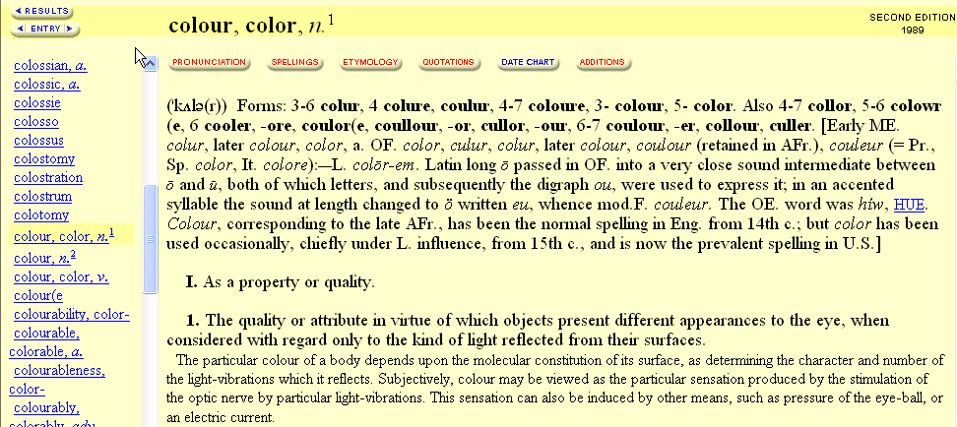
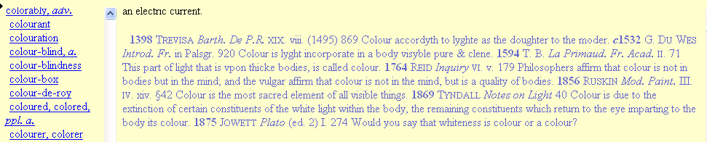
Search term
Part of speech
Variant spelling of the word
Etymology. For an explanation of the abbreviations
Definition of the word. Scroll down to see additional or secondary definitions.
Use of the word in a phrase or quotation. The first known written use of the word will always be listed first
Word list. The highlighted word is displayed on the right side.

Slide 15
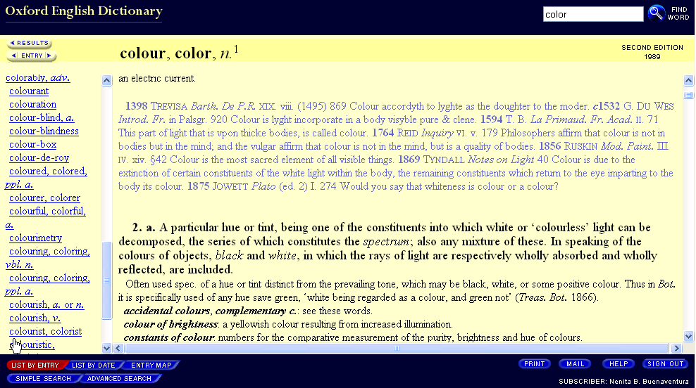
How can I run a “Full text” search?
Switch to Full Text search mode by clicking the button marked “Simple Search” at the bottom left hand corner of the screen.

Slide 16
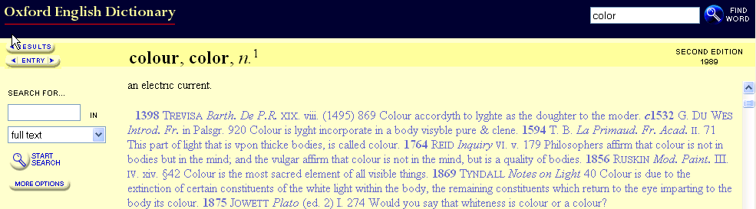
The Full Text search panel is displayed on the left of the main window

Slide 17
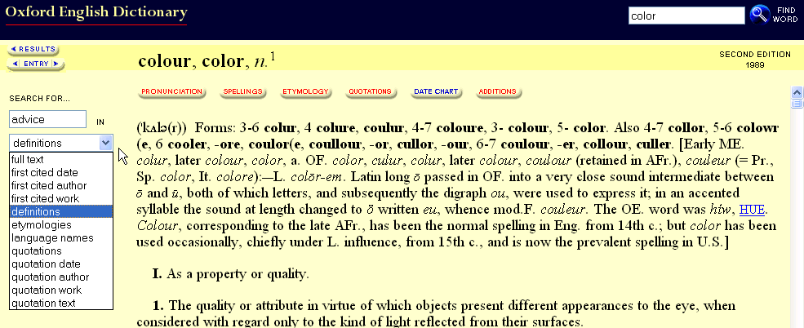
Type the word or phrase you want to find into the SEARCH FOR … BOX.
Select your search area (which part of the dictionary entries you want to search); full text (i.e. the entire text of the entries), definitions, etymologies, or quotations.

Slide 18
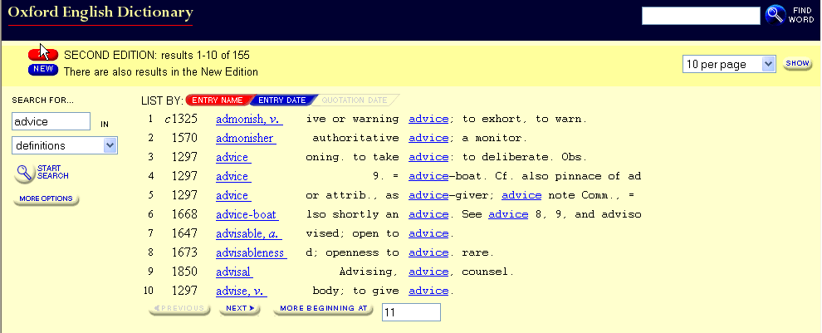
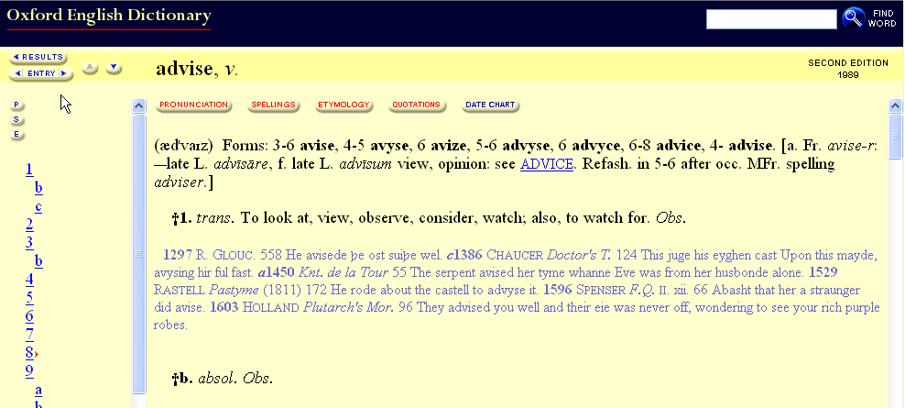
A list of results is displayed. Click on any of the entry name to open one of them.

Slide 19
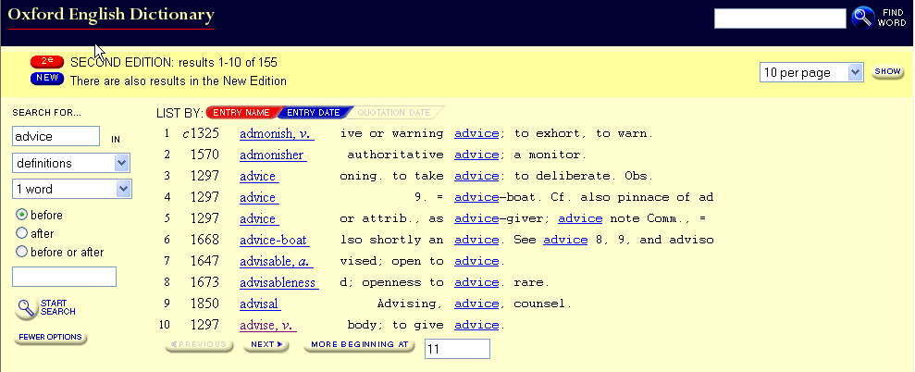
Click on the More Options button to see additional search options
To search for terms within a certain range of each other, use the proximity feature

Slide 20
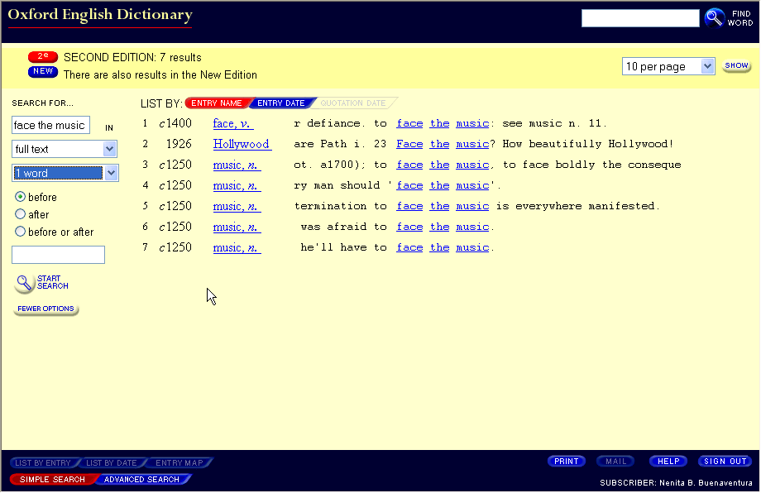
How do I find a phrase?
Make sure the Full Text search panel is displayed (Click on the button in the bottom left-hand corner of the screen marked “Simple Search”)
Type the full phrase into the top input box (e.g. face the music).
Choose full text from the search area drop down menu.
Start the search by clicking on the “Start Search” icon.
Search statement

Slide 21

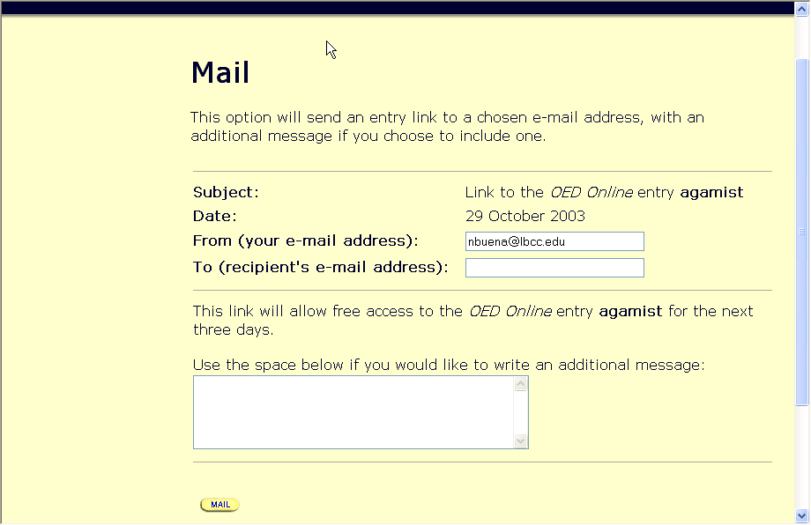
Printing and saving and Emailing
You can print, save or email your search results.
To print your results, click on the Print button in the bottom right hand corner of the screen, Text will appear in a new browser window.
To return to original search window click on file at the top of the screen and select close.
To save your results to disk, click on the Print button to reformat the screen for printing. Text will appear in a new browser window. Click on file then click on save as .. Type your disk drive and filename. Example: a:myfile. Click on save
To email your results, click on the mail button in the bottom right hand corner of the screen. Fill out the form and click on the Mail button at the bottom of the screen.
Note: You must fill out both the To: and From: fields even if you are sending the e-mail to yourself. Enter your e-mail address in both fields.

Slide 22
Beginning a new search
Ending a search
To begin a new search, type the word you want to find into the Find Word search box located at the upper right-hand side of the OED browser window OR click on the simple search box located at the lower left corner.
To ending a search, click the sign out option on the bottom right corner of the screen.
Remember: If you need help or advice, ask the Reference librarian.

Slide 23
Citing the OED
When citing the OED, the editors of the OED recommend the following:
Example of reference to an entry from the Second Edition:
“plough, n².” Oxford English Dictionary. Ed. J. A. Simpson and E. S. C. Weiner.
2nd ed. Oxford: Clarendon Press, 1989. OED Online. Oxford University Press. 31 Oct. 2003. http://oed.com/cgi/entry/00181778
Example of reference to an entry from the New (third) Edition:
“magistrate, n.” Oxford English Dictionary. Ed. John Simpson, 3rd.ed. OED Online. Draft Mar. 2000. Oxford University Press. 31 Oct. 2003. http://oed.com/cgi/entry/00299451>
See the web site at http://www/oed.com/public/guide/citing.htm
for additional recommendations.

Slide 24
Summary: Hints for searching Oxford English Dictionary(OED)
To get the best result
  Find a word: to make a quick search which finds main dictionary entries, such as alphabet, break, xylophone or subordinate entries such as the phrase in alphabet, or compounds such as alphabet book, use the search form in the upper right corner of the screen.
  Truncation: to search for all words beginning with a particular stem, use the wildcard truncation symbol * which represents the occurrence of any number of characters (including zero). The truncation can also be used in combination with the ending of a word I.e. ann*lation will find annihilation, annulation and annullation. The wildcard ? represents a single occurrence of any character.

