Slide 1


KDE Plasma

Slide 2
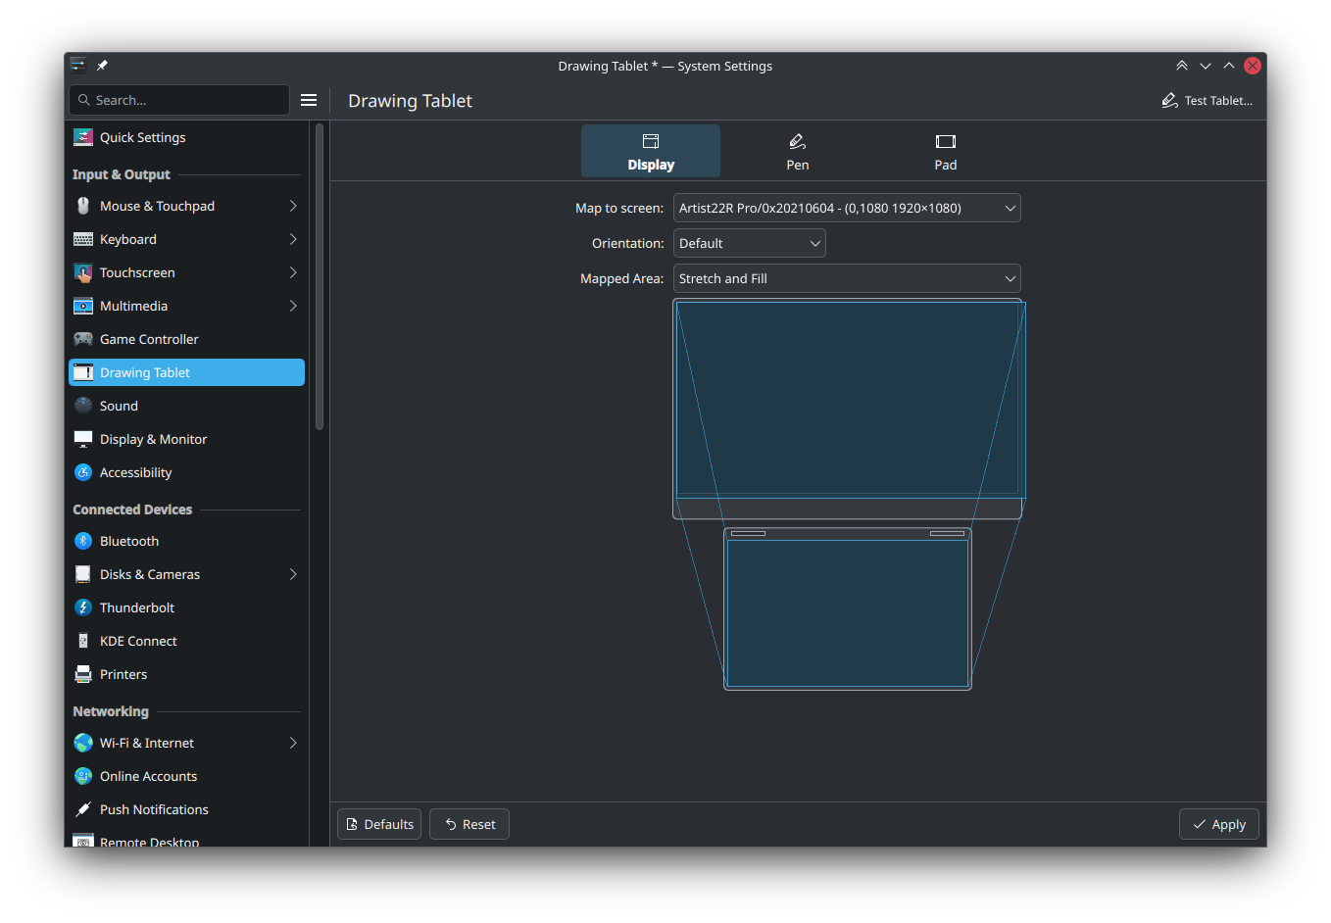
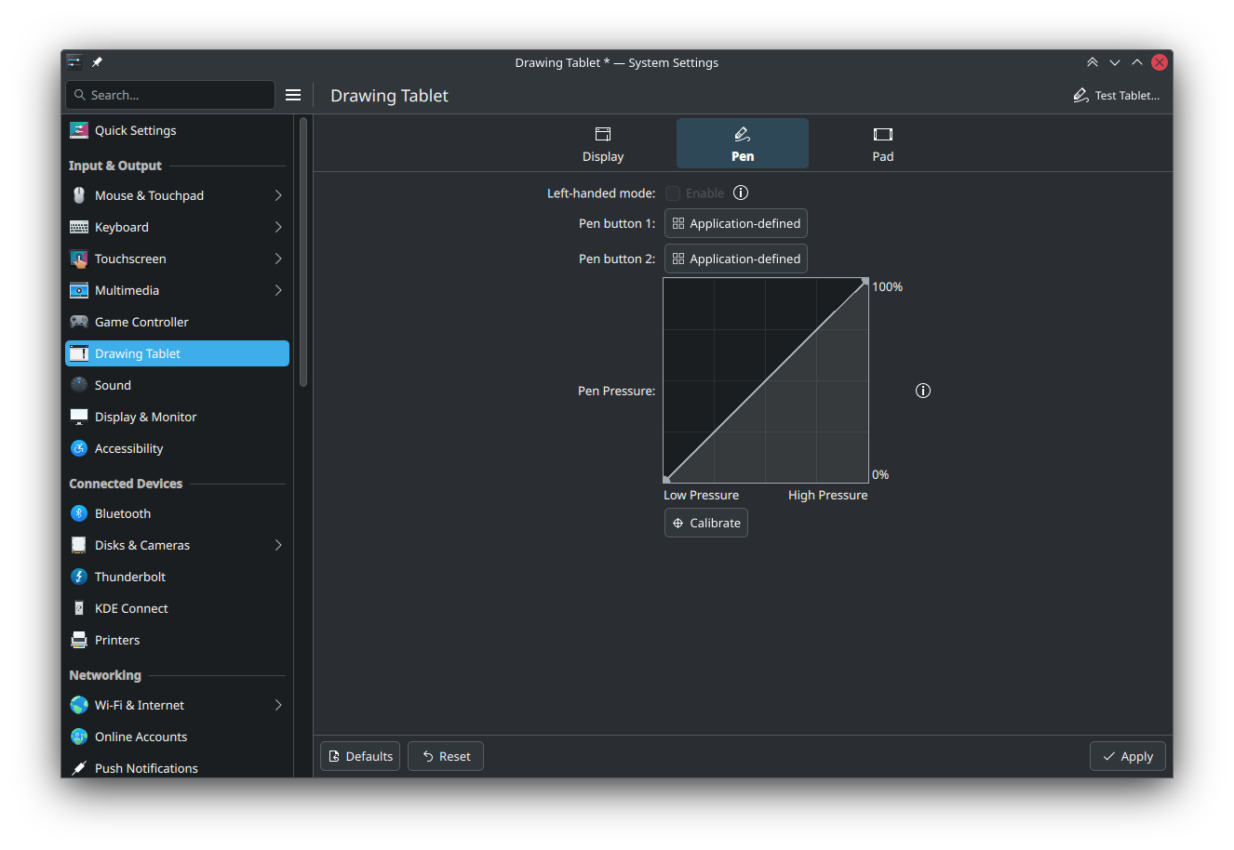
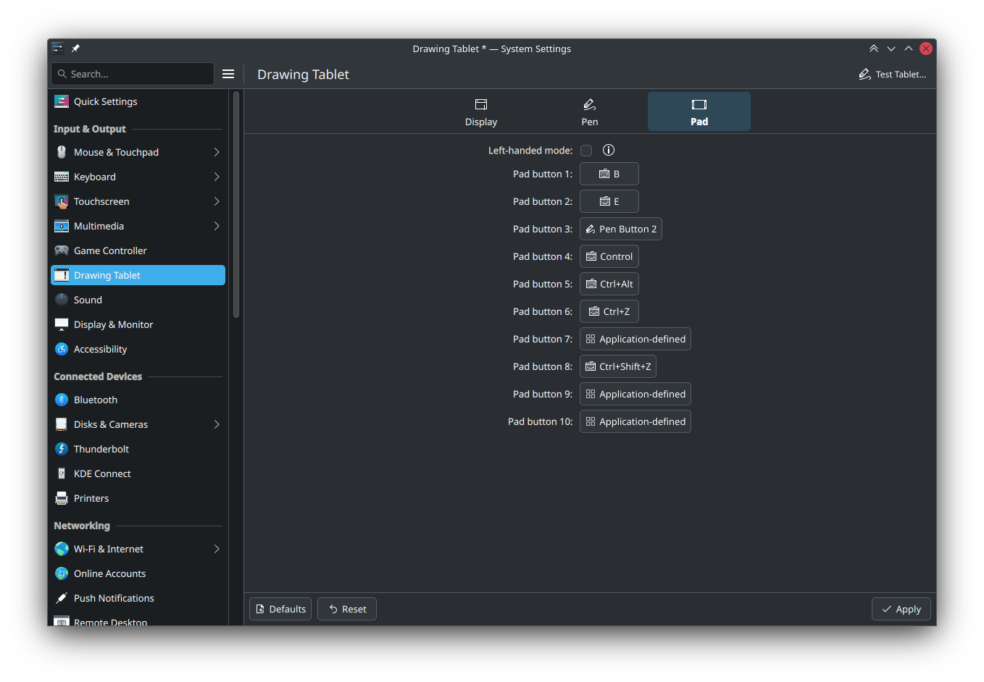
Improved Tablet Settings

Slide 3
More Color Management Features
Support for the upstream Wayland color management and color representation protocols
More accurate night light
Tone mapping for HDR content
Support for up to 16 bits per color
Improved efficiency with HDR and ICC profiles

Slide 4

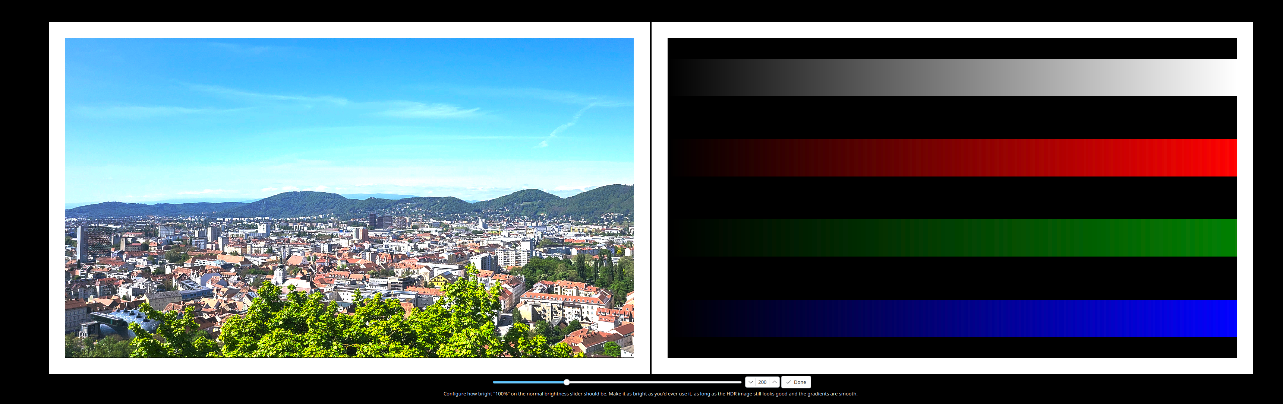
Built-in HDR calibration tool

Slide 5
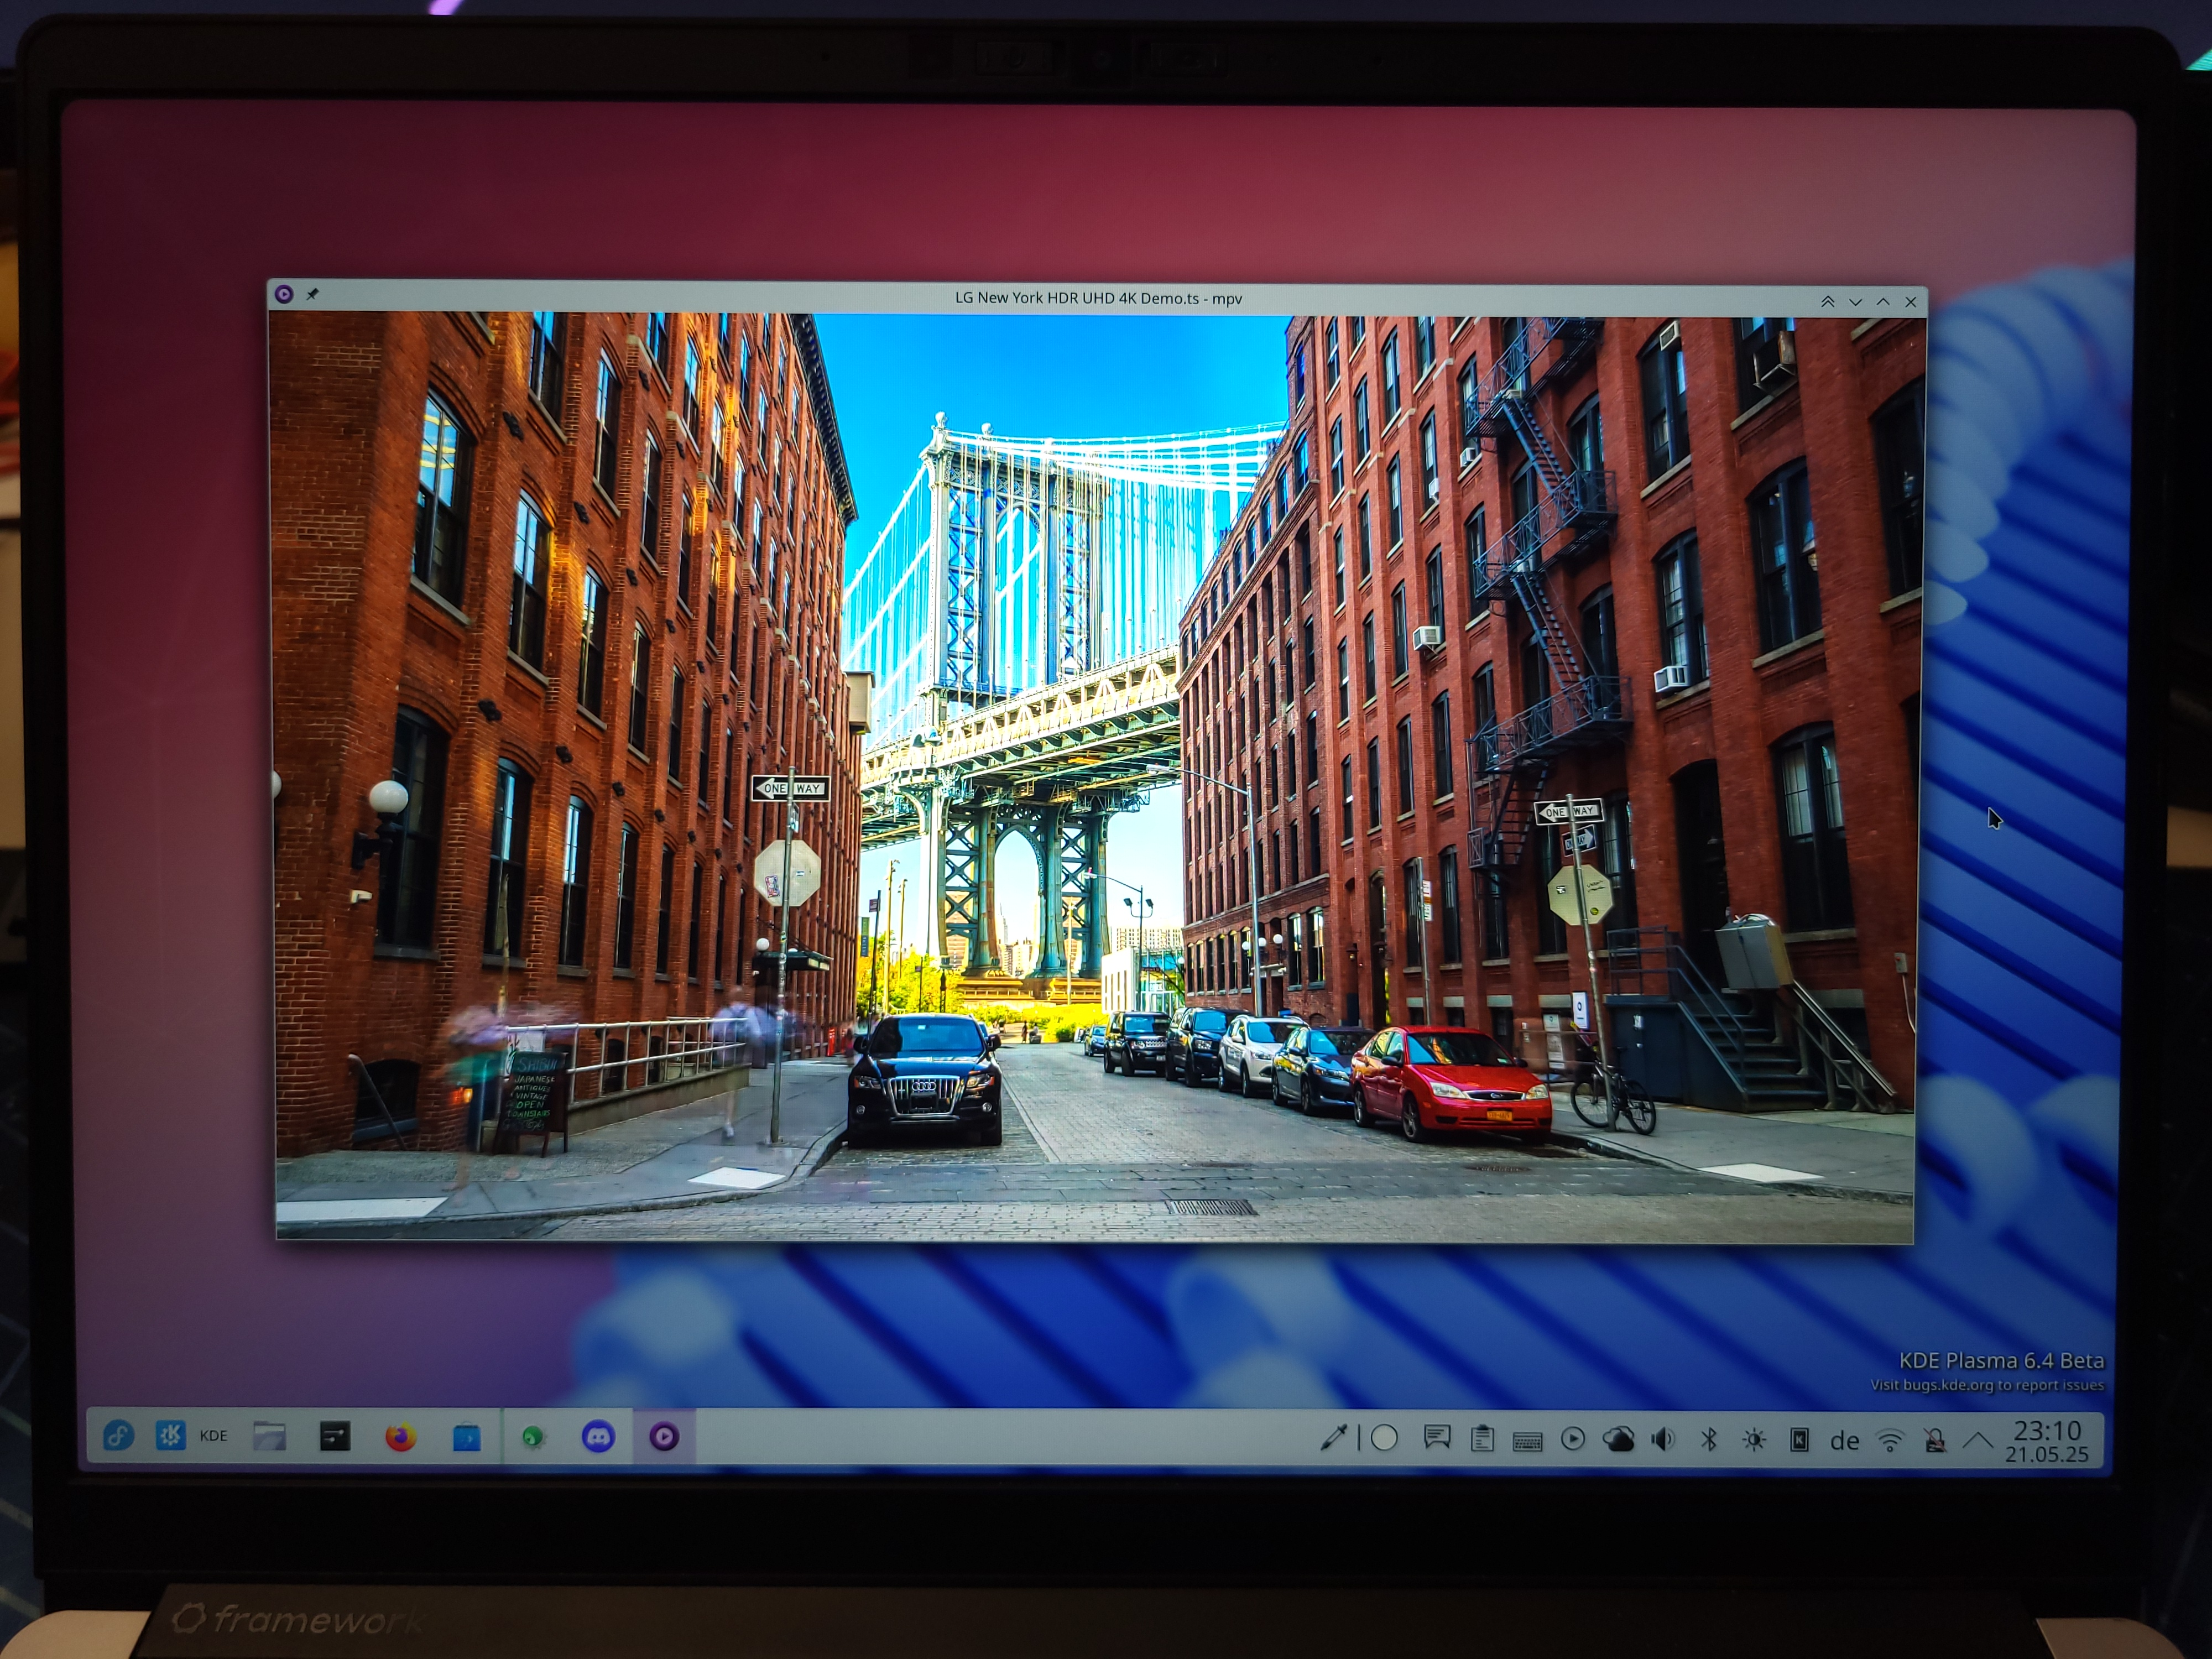
HDR on “SDR” laptop displays

Slide 6
What’s next?
Support for tablet dials
Integrated display profiling tool
More hardware offloading of color management operations for better performance and efficiency
HDR support in Qt

