Slide 1

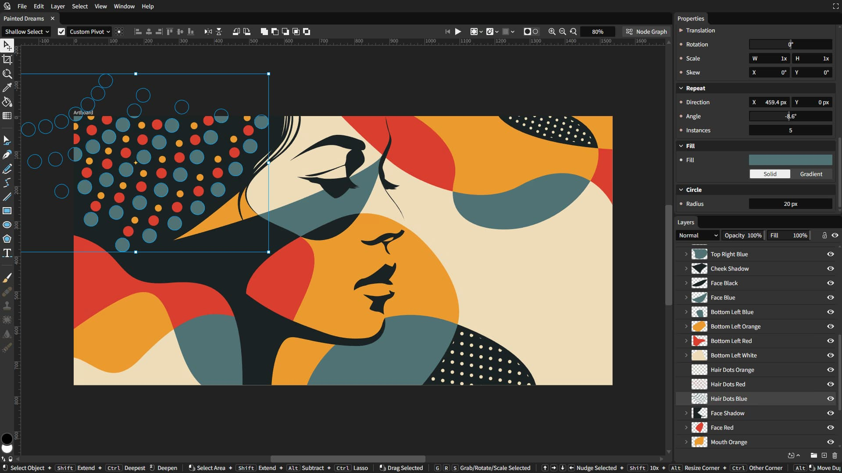
Vector graphics editor & animation engine
Layer-based compositing +
node-based generative design
Non-destructive editing
More like a game engine than
a conventional creative app
Can run in a browser or as a desktop app
Forever free and open source

Slide 2
Recent Achievements:
Morph between shapes
Clipping masks
Parametric animation
Instancing
Table-based graphical data
format and introspection
GPU-accelerated rendering (Vello)

Slide 3
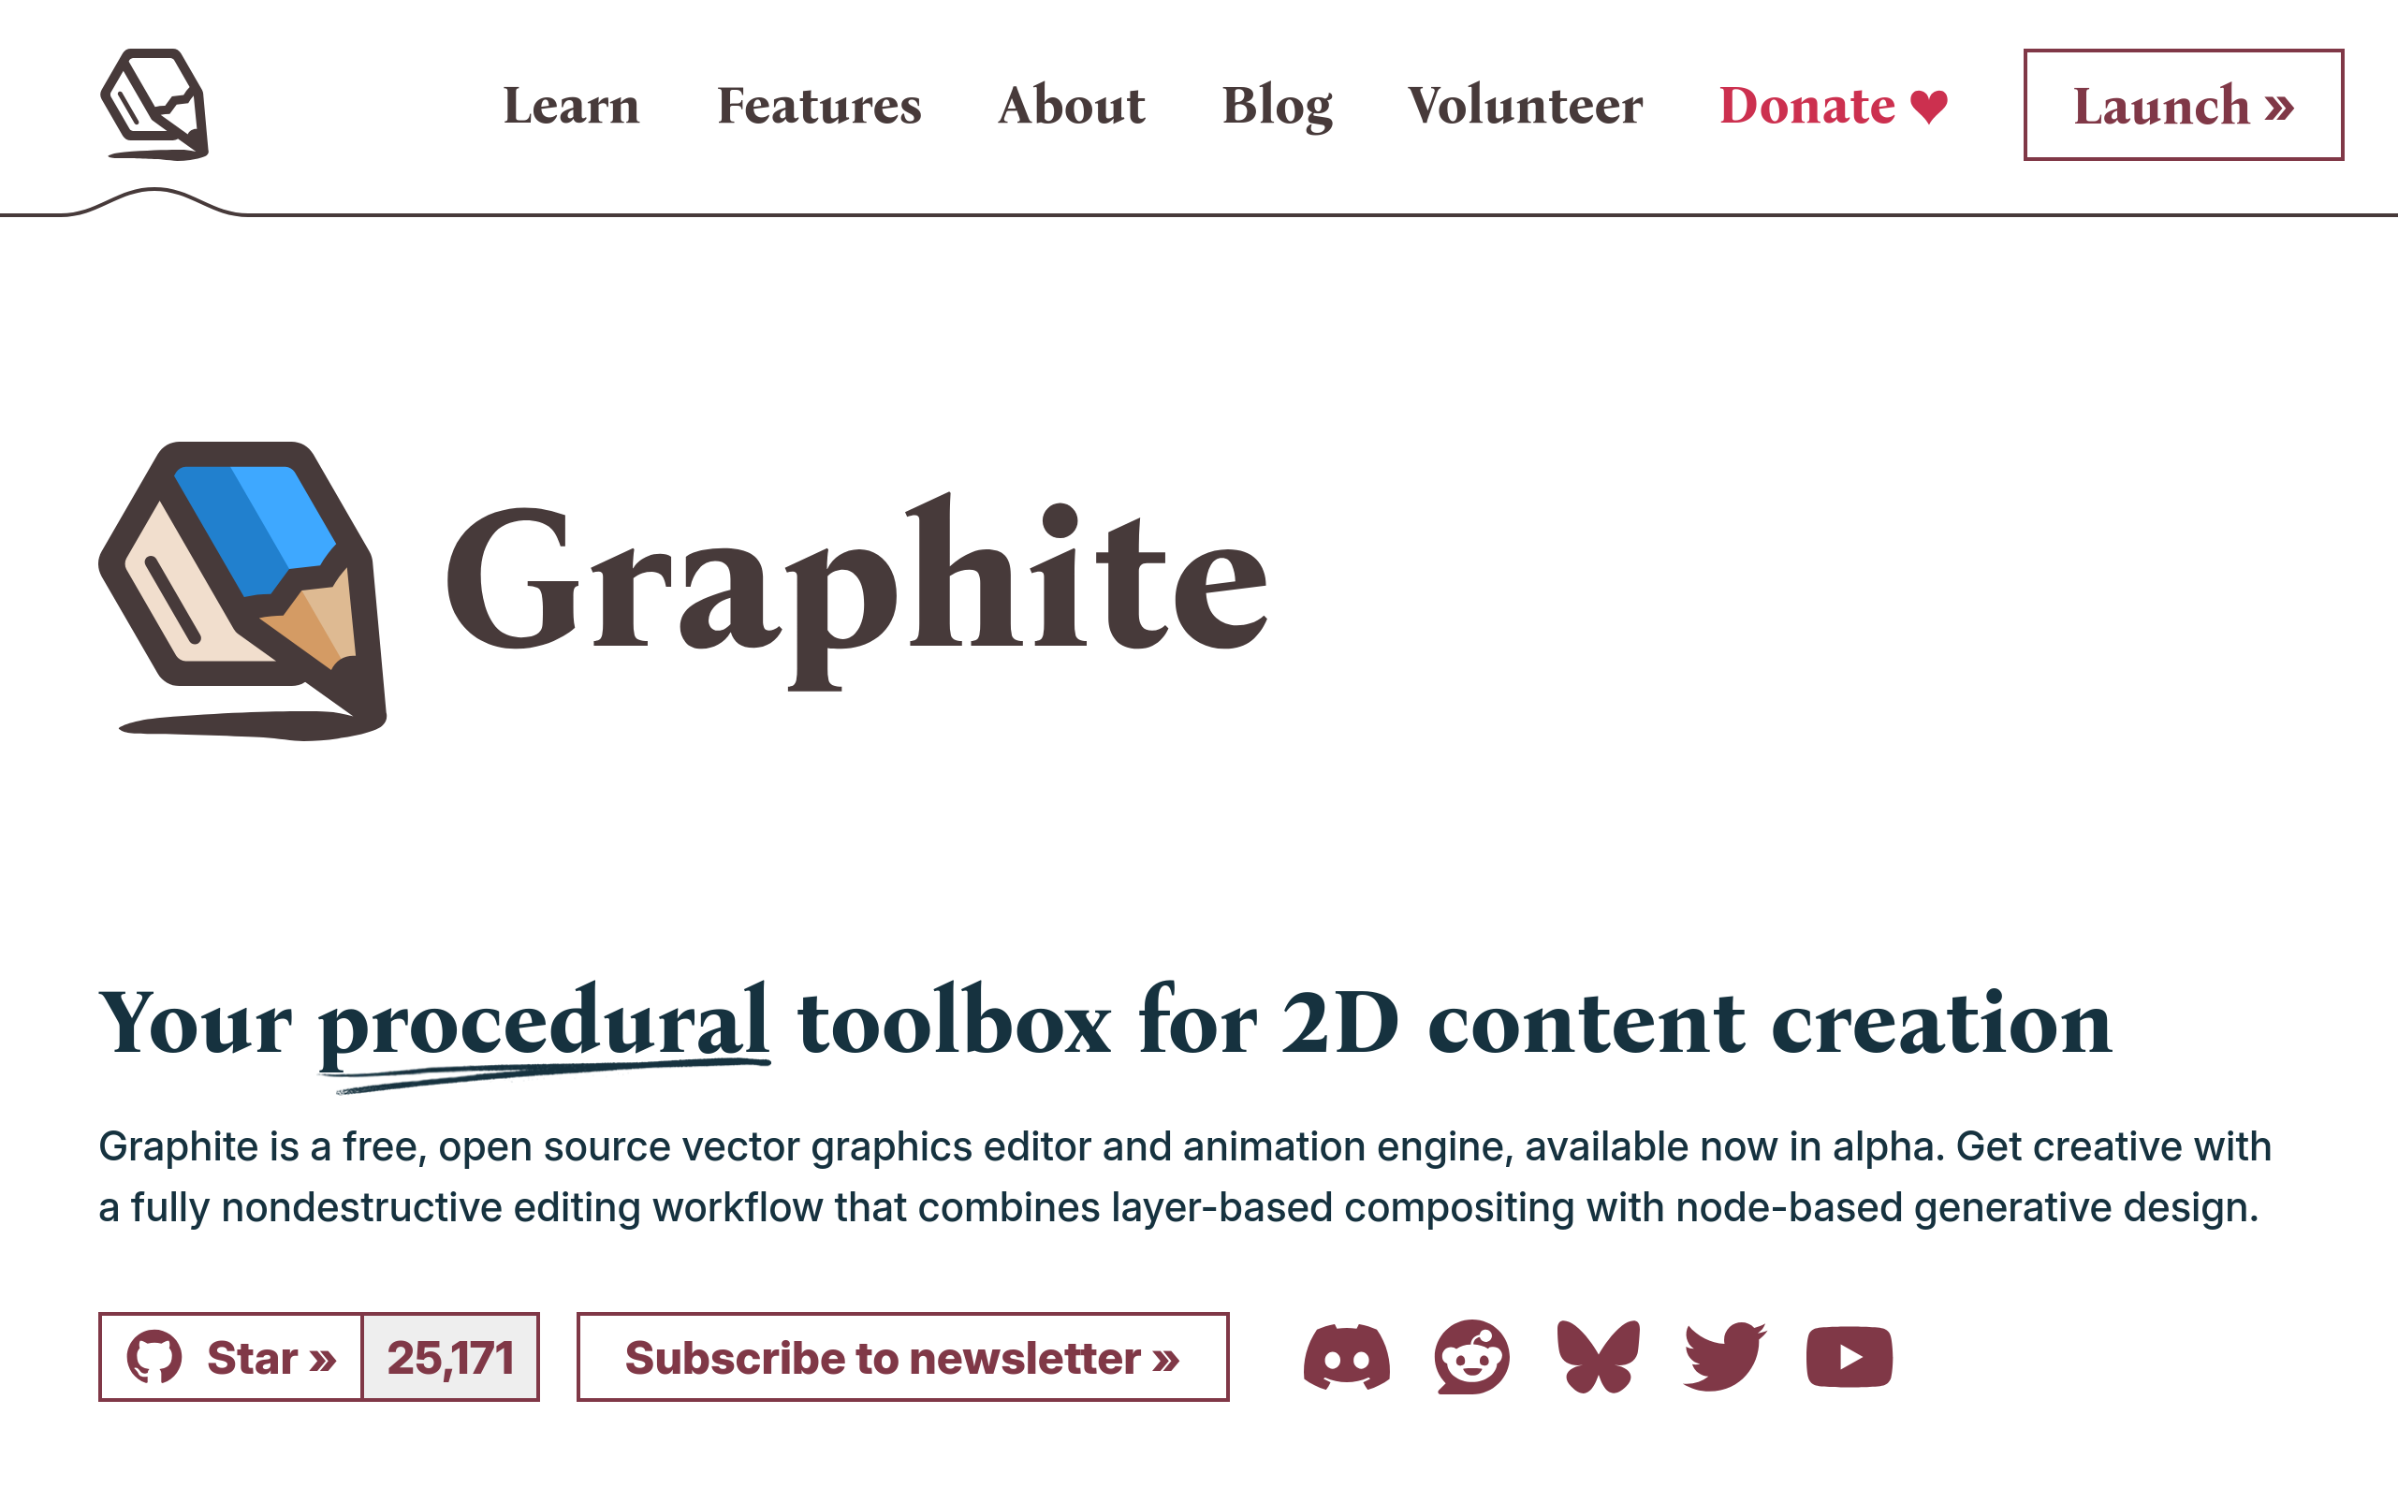
Near-term Roadmap:
Version 1.0 to be released soon
Native desktop application
(engine, renderer), GUI uses web tech
Stable document format
GUI improvements
Timeline panel for animation curves
...
https://graphite.art

