Slide 1
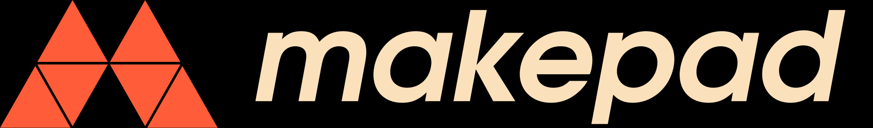
Makepad Studio:
GUI framework
(Makepad) +
development system +
IDE, all in one
Integrates code &
design for live creation
Work in progress
https://makepad.dev/

Slide 2
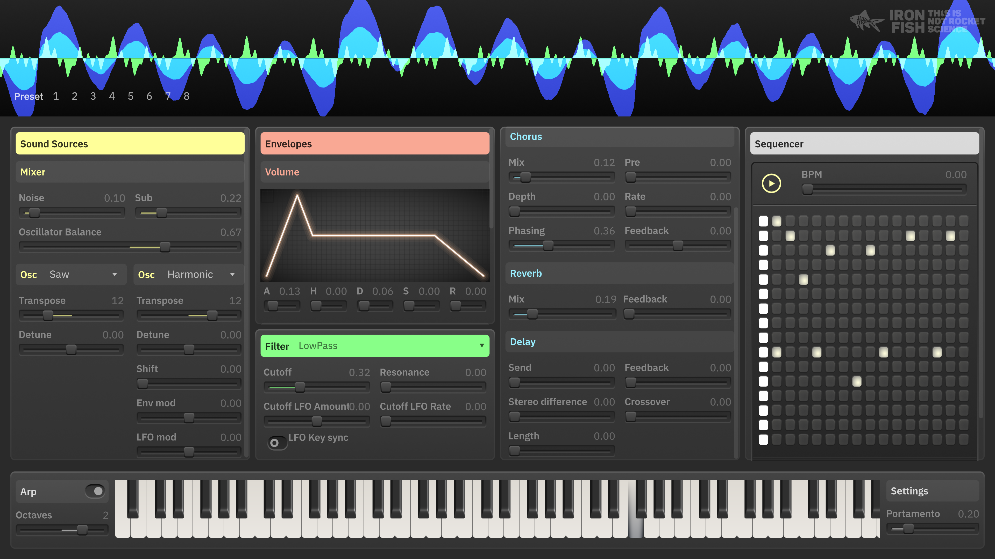
Makepad:
Cross-platform, open-source
UI framework
Built in and for Rust
Domain-Specific Language +
Live Reloading
Runs natively and on the web
Pixel-based shaders
https://makepad.nl/
Demo app:
Ironfish Synthesizer
Notes:
Windows, Linux, macOS, iOS, Android

Slide 3
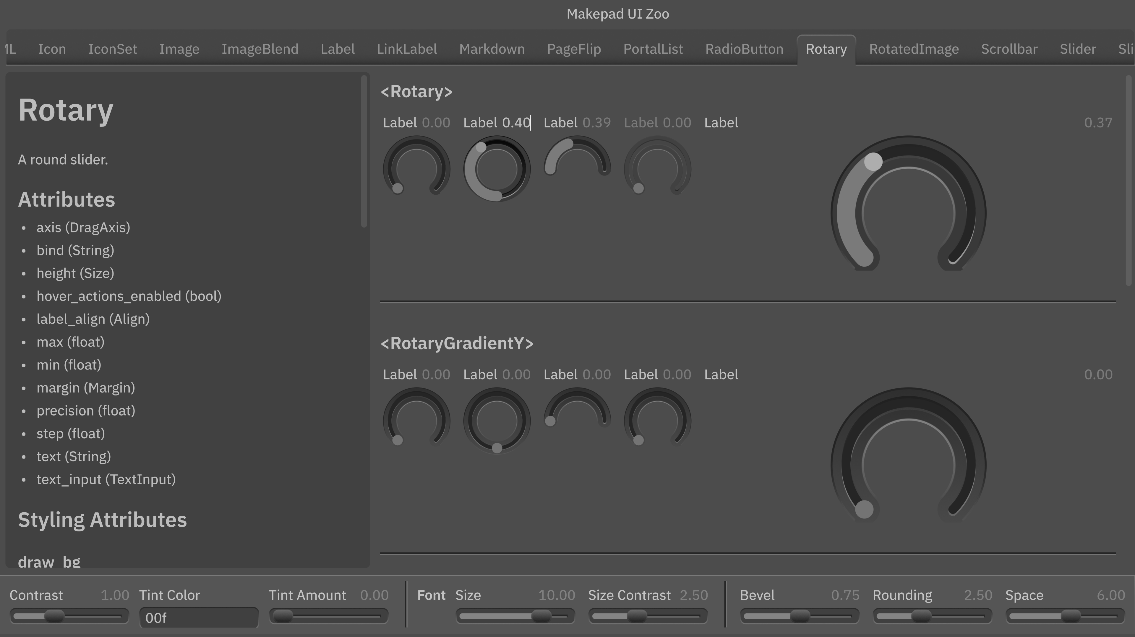
Achievements & Roadmap:
Makepad:
  Version 1.0 released ~1 year ago
  Version 2.0 expected soon
Makepad Studio:
  Not ready for prime-time
  but you can play with it!
Demo app: UI Zoo
Notes:
Windows, Linux, macOS, iOS, Android

