Slide 1
Web Basic Lecture
Jaunty Liu @SCGY - USTC

Slide 2
Foreword - about last lecture
Problems:
  Obscure explainations about architetures and layers
  Too complicated for beginners
HTTP <-> HTML {CSS/JS} => Bootstrap / React..
FRAMEWORK FOR FAST WEB DEVELOPMENT

Slide 3
“Frontend Development”
The first part of our lecture
whose aim is to show informations in a beautiful way.

Slide 4
What is HTML?
Hypertext Markup Language
Parsed by browser
Pairs as basic elements, constructed and interpreted as a tree
<html>....</html>
w3school can be a perfect choice for beginners

Slide 5
What is CSS?
Websites could be built just with HTML.
https://www.w3.org/TR/REC-html32/
http://edition.cnn.com/EVENTS/1996/year.in.review (More Beautiful)
At that time, we use <table> to layout. (Inspect Element can tell us.)
“The <table> element was not designed to be a layout tool! The purpose of the <table> element is to display tabular data. So, do not use tables for your page layout! They will bring a mess into your code. And imagine how hard it will be to redesign your site after a couple of months.”
@http://www.w3school.com/html/html-layouts.html
HTML 3.2 (1996) => HTML 4.0 (1997) => HTML 4.01 (1999)
CSS: Cascade Stylesheet
INTRODUCED!!

Slide 6
CSS: Powerful tool to layout
Layout
  CSS Floats
  CSS3 Flexbox
...
Separate layout from HTML
  Easily read for spiders of different search engines (Semantic Web)
    https://www.zhihu.com/question/20455165
  Clean & Tidy codes, easily read and modified
    https://www.zhihu.com/question/21278237
    DIY Wikipedia by editing CSS only!!

Slide 7
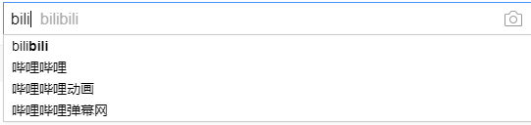

Javascript: Make webpages alive
Javascript: the most widely used browser script
  Run in browsers, not servers
Use? EVERYWHERE
  Baidu Search Input
    Javascript and “Ajax”
  Bilibili - “Scroll Bar” - nav.js & home.b72513be.js

Slide 8
Javascript is somewhat similar to C
//Get greatest common divisior
function gcd(a,b){
if(a % b == 0) {
return b;
} else {
return gcd(b, a % b);
}
}

Slide 9
While it's more easy to use
//Owing to the advantage of weak-type language
document.getElementById("numlog").innerHTML+= "<p>找到解 x = " + x + "</p>";
document.getElementById("numlog").innerHTML+= "<p>L - R = " + eval_func(x) + "</p>";
document.getElementById("numlog").innerHTML+= "<p>迭代次数 = " + iteration_count + "</p>";
//Forget about buf[MAX_SIZE], strcpy() and Segmentation Fault !!
Try It! http://home.ustc.edu.cn/~jauntyliu/algebra.html

Slide 10
Ajax: the technology that changed the Web
Ajax: Asynchronous Javascript And XML
Update webpage without refreshing the whole page
Typical Use:
  Web Maps - Which would be terrible without ajax; imagine having to download a large picture and scroll; once you are out of the map border you'll have to wait for the whole page refreshing
  Weibo, etc - Dynamic Updates, “Like”s, Notifications, etc.
Require server-side support ( Back-end Developing )
To be discussed after “HTTP Protocol” Section

Slide 11
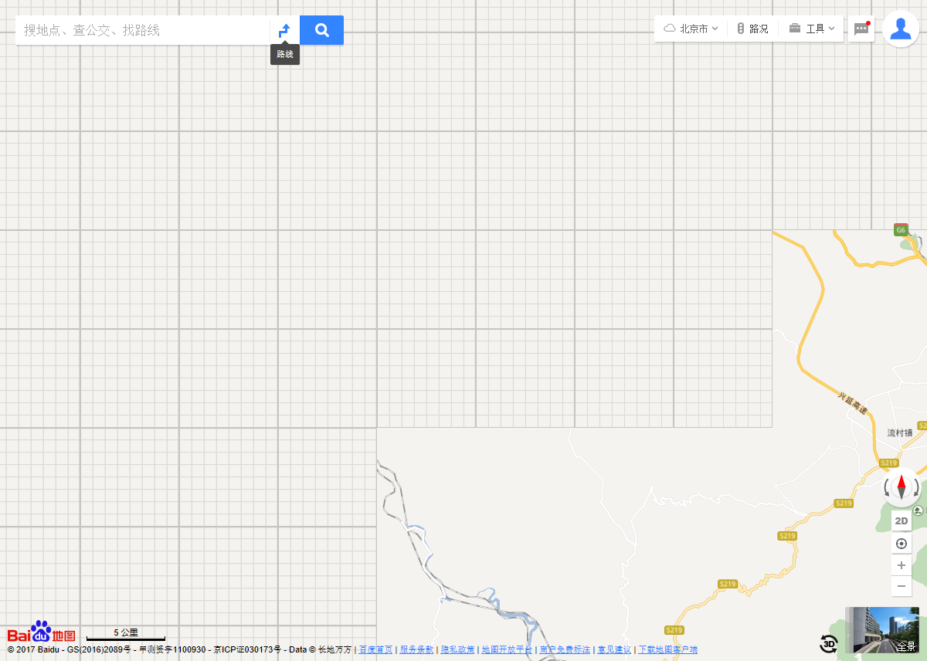
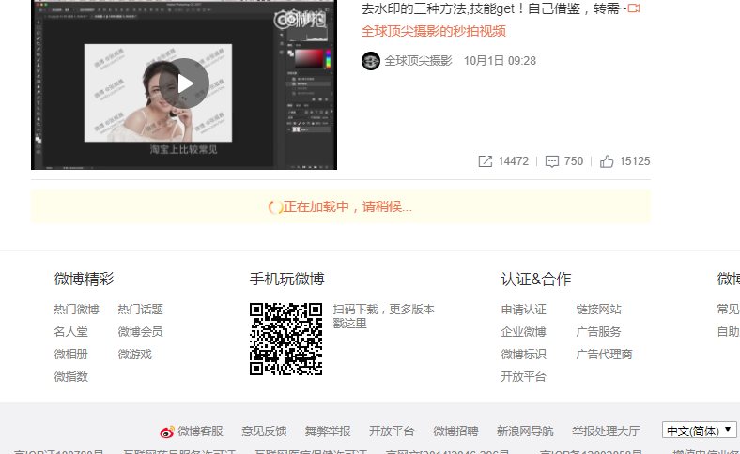
Examples of Ajax

Slide 12
What's next?

Slide 13
“Backend Development”
How do we transfer HTML to the browsers all over the world?
The second part of our lecture
whose aim is to generate information and deliver those info to the frontend.

Slide 14
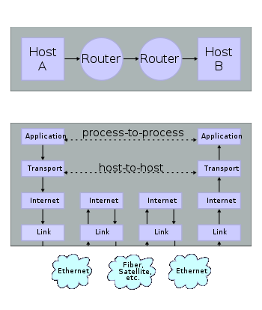
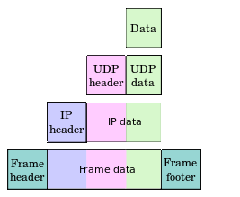
Layers and protocols

Slide 15
Internet protocol suite
Application layer
  DHCP DNS FTP HTTP NTP POP ONC/RPC RTP RTSP SMTP SSH Telnet TLS/SSL
Transport layer
  TCP UDP
Internet layer
  IP ( IPv4 IPv6 ) ICMP ICMPv6
Link layer
  ARP Tunnels (L2TP) PPP MAC (Ethernet DSL ISDN FDDI)
(Full version see https://en.wikipedia.org/wiki/Internet_protocol_suite)
No need to consider more -- Thanks to the abstraction of layers!!

Slide 16
What is HTTP? How it works?
HTTP, Hypertext Transfer Protcol
  The Carrier: TCP (New protocols like HTTP/2, SPDY will be discussed later)
  http://www.rfc-editor.org/info/rfc1945 ( http/1.0 )
TCP, Transmission Control Protocol
  A Duplex Stream Protocol

Slide 17
Protocol?
A discipline used for communication:
Cheating in an exam:
  A: Hey B, i need answer for "question_1"! I'm a stupid boy!
  B: Okay, it's here: ZXHAKFLSKJFQOH%^$&^%$&**^%*^%
HTTP Transfer
  Client: GET /contact.html HTTP/1.0
  Server: 200 OK
  <html><head><title>contact.......................(My HTML File)
I need contact.html in your root directory! I can only understand 1.0 version of our protocol!
Ok!! I found it, and here it is!~

Slide 18
A brief example - connect to a testfile
F:\Code\HTML>nc home.ustc.edu.cn 80
GET /~jauntyliu/test_nc.html HTTP/1.0
Host: home.ustc.edu.cn
HTTP/1.1 200 OK
Date: Mon, 02 Oct 2017 10:14:57 GMT
Server: Apache/2.0.52 (Red Hat)
Last-Modified: Mon, 02 Oct 2017 10:04:54 GMT
ETag: "45f44cf-1f-818ddd80"
Accept-Ranges: bytes
Content-Length: 31
Connection: close
Content-Type: text/html
this is the content of the file

Slide 19
A invalid request will return a different code
<!DOCTYPE HTML PUBLIC "-//IETF//DTD HTML 2.0//EN">
<html><head>
<title>404 Not Found</title>
</head><body>
<h1>Not Found</h1>
<p>The requested URL /~jauntyliu/test_nc.htm was not found on this server.</p>
<hr>
<address>Apache/2.0.52 (Red Hat) Server at home.ustc.edu.cn Port 80</address>
</body></html>
F:\Code\HTML>nc home.ustc.edu.cn 80
GET /~jauntyliu/test_nc.htm HTTP/1.0
Host: home.ustc.edu.cn
HTTP/1.1 404 Not Found
Date: Mon, 02 Oct 2017 10:06:56 GMT
Server: Apache/2.0.52 (Red Hat)
Content-Length: 303
Connection: close
Content-Type: text/html; charset=iso-8859-1

Slide 20
HTTP Response - Some Status Codes in HTTP/1.0
200 OK
301 Moved Permanently
302 Moved Temporarily
304 Not Modified
400 Bad Request
401 Unauthorized
403 Forbidden
404 Not Found
500 Internal Server Error
502 Bad Gateway
503 Service Unavailable

Slide 21
HTTP Response - Response Header and Body
HTTP/1.1 404 Not Found
Date: Mon, 02 Oct 2017 10:06:56 GMT
Server: Apache/2.0.52 (Red Hat)
Content-Length: 303
Connection: close
Content-Type: text/html; charset=iso-8859-1
Header_Field: Header_Field_Content
[those line feed characters are “\r\n\” in C, not “\n”.]

Slide 22
RFC1945 10.2 Content-Encoding
The Content-Encoding entity-header field is used as a modifier to the media-type. When present, its value indicates what additional content coding has been applied to the resource, and thus what decoding mechanism must be applied in order to obtain the media-type referenced by the Content-Type header field. The Content-Encoding is primarily used to allow a document to be compressed without losing the identity of its underlying media type.

Slide 23
RFC1945 10.4 Content-Length
The Content-Length entity-header field indicates the size of the Entity-Body, in decimal number of octets, sent to the recipient or, in the case of the HEAD method, the size of the Entity-Body that would have been sent had the request been a GET.
Applications should use this field to indicate the size of the Entity-Body to be transferred, regardless of the media type of the entity. A valid Content-Length field value is required on all HTTP/1.0 request messages containing an entity body.

Slide 24
Skipping those fields, back when necessary
......
I don't want to type any more words for those concepts which can be easily accessed through the Internet.
Study costs; don't waste your memory.

Slide 25
HTTP Operations - GET
The GET method means retrieve whatever information (in the form of an entity) is identified by the Request-URI. If the Request-URI refers to a data-producing process, it is the produced data which shall be returned as the entity in the response and not the source text of the process, unless that text happens to be the output of the process.

Slide 26
刚才RFC文档说了啥？
GET方法就是要得到请求URI所对应的信息
  如果“信息”是html这类静态的网页就直接传过来
  如果“信息”是脚本等数据处理过程就运行一下，把结果传过来
没错，知道上面这些，你就知道了CGI的基本原理
CGI, Common Gateway Interface
  (可以自己上Wikipedia搜)
  http://akaedu.github.io/book/ch37s05.html 这里涉及了CGI协议的介绍和HTTP服务器逻辑的简单实现

Slide 27
HTTP Operations - POST
POST is designed to allow a uniform method to cover the following functions:
  Annotation of existing resources;
  Posting a message to a bulletin board, newsgroup, mailing list, or similar group of articles;
（上面都是废话，下面是本质：可以把数据提交给服务器）
Providing a block of data, such as the result of submitting a form, to a data-handling process; Extending a database through an append operation.

Slide 28
How do HTML and HTTP Relates?
通过HTML的<form>标签，网页可以让浏览器POST一个表单里的内容
Javascript脚本里可以向自己网站的服务器提交POST请求
  这就是Ajax技术

Slide 29

An example of POST @w3school.com.cn
<!DOCTYPE HTML>
<html>
<body>
<form action="/demo/welcome.php" method="post">
姓名：<input type="text" name="name"><br>
电邮：<input type="text" name="email"><br>
<input type="submit">
</form>
</body>
</html>

Slide 30
Request sent from my browser
POST /demo/welcome.php HTTP/1.1
Host: www.w3school.com.cn
Connection: keep-alive
Content-Length: 38
Content-Type: application/x-www-form-urlencoded
Accept: text/html,application/xhtml+xml,application/xml;q=0.9,image/webp,image/apng,*/*;q=0.8
name=jauntyliu&email=abc%40example.com
完整Header很长，所以PPT上省略到了Server还能认出来的程度
URI 转义
避免如@,/的字符影响URI定位
每个字符都有转义

Slide 31
Server Response
HTTP/1.1 200 OK
Date: Mon, 02 Oct 2017 15:35:02 GMT
Content-type: text/html
Content-Length: 87
<html>
<body>欢迎 jauntyliu<br>您的邮件地址是：abc@example.com</body></html>
这里也省略了一些和现阶段内容没什么关系的响应头

Slide 32
What do we get?
其实POST就发生在我们登陆的过程
我们在一个表单上输入用户名和密码，点击登陆，数据就被POST到服务器，服务器返回一个页面
可能是登陆成功的跳转也可能是登陆失败的跳转（这需要“数据处理过程”发挥作用
这就是网站登录的基本原理

Slide 33
Besides, GET can also provide data..
http://cn.bing.com/search?q=trail&qs=HS&sc=7-0&cvid=4F15E83CFAC045D995AF6F562501276A&FORM=QBLH&sp=1
HTTP Request:
  GET /search?q=trail&qs=HS&sc=7-0&cvid=4F15E83CFAC045D995AF6F562501276A&FORM=QBLH&sp=1 HTTP/1.1
  Host: cn.bing.com
?后面就是URI传送信息的一种方法
刚才的form如果改成method=”get”，那么浏览器就会GET这个URI：
/welcome.php?name=jauntyliu%email=abc%40example.com
换句话说，Bing搜索就是用GET后面URI的参数来知道用户搜什么

Slide 34
GET vs POST @w3school.com.cn
通过 GET 方法从表单发送的信息对任何人都是可见的（所有变量名和值都显示在 URL 中）。GET 对所发送信息的数量也有限制。限制在大于 2000 个字符。不过，由于变量显示在 URL 中，把页面添加到书签中也更为方便。
GET 可用于发送非敏感的数据。
通过 POST 方法从表单发送的信息对其他人是不可见的（所有名称/值会被嵌入 HTTP 请求的主体中），并且对所发送信息的数量也无限制。
此外 POST 支持高阶功能，比如在向服务器上传文件时进行 multi-part 二进制输入。
不过，由于变量未显示在 URL 中，也就无法将页面添加到书签。

Slide 35
Special Notice
虽然其它用户看不到，但是POST并不会比GET在HTTP协议下安全多少
因为HTTP是明文传输的，所以过程中TCP包经历的任何一个网关都可以监听和伪造HTTP通讯，这就意味着用户POST的数据相当于是透明的
基于SSL/TLS的HTTPS协议基本可以解决链路的不安全问题
现在的登陆页面，基本都采用HTTPS或者Javascript的后台HTTPS方案

Slide 36
What‘s More?
Server-side Backend Programming?
Browser-side Frontend Programming?
Web Server Maintenance?
......
Android App Development?
3D Game development based on C and Open Graphics Library?
Build a tiny operating system on our own?
Some other cool stuff??
  Robots? RC Helicopters? Solar & Solar Controller?

Slide 37
Willing to hear your opinion!!

Slide 38
Interesting Articles
http://news.sina.com.cn/society/netsurvival/
  See eShop and Online Order Services in “ancient” days
Recommended C Lectures
  https://akaedu.github.io/book/
  Sean Soong, published under GFDL ( GNU Free Documentation License )
  有C语言和Linux体系结构的讲解，深入浅出，是学习参考的绝佳资料
  手动安利！！！！

Slide 39
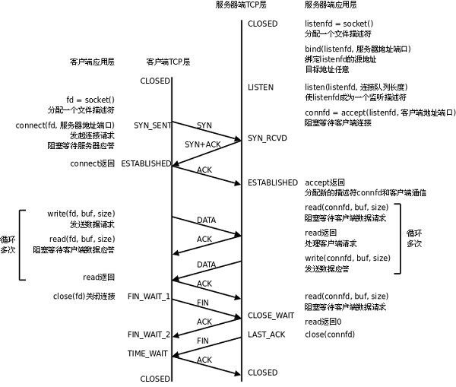
TCP Diagram

