Slide 1

The Alternative CV
doi: 10.53962/vaq3-x2tv
A workshop by:
Daan Rutten (d.rutten@uvt.nl)
Chris Hartgerink (chris@libscie.org)
Notes:
Hi everyone.
We’re doing this design workshop today on imagining alternative CVs, as a way to step beyond the practicalities of the day to day.
We want you to step beyond the how in this workshop, and focus on the why.
There might be information already available to us that would be valuable when presented in a CV, but also allow yourself to come up with things that are not yet feasible.
We are here to imagine, so we have vision for what we want to build next.
---
We do have a full schedule for this workshop.
For your fullest participation, we ask you to be fully present. Focus on the task at hand. We know it is difficult, but let’s try for each other.
The success of the workshop will in a large part depend on your participation. We’ll do our best to guide things along!
---
Some house rules:
Don’t hog speaking time, don’t let your valuable insights go unheard.
In a group of N, try to speak 1/Nth of the time.
In that sense, if you talk a lot, take a step back. If you know you talk a little, take a step forward.
This workshop is about creating new ideas together, and we all need each other to do this.

Slide 2
Spectogram exercise
Statements
Notes:
https://facilitation.aspirationtech.org/index.php/Facilitation:Spectrogram
We’re going to start off with a small spectogram exercise. For this, please get up out of your seat!
If you agree, you go to <point> this end of the room, if you disagree you go to <point opposite end> of the room.
If you fall somewhere along the spectrum, you stand wherever you feel comfortable.

Slide 3
I am excited for this workshop
Notes:
Which leads us to the first statement: “I am excited for this workshop”
So <point> if you agree, <point opposite end> if you disagree.
For those who said anything but very much agree, thank you for your honesty.
For those who very much agreed – please check social desirable answers at the door. If you are still very excited about this workshop, thank you for being so kind!
Now that we understand how this works, here’s the next statement.

Slide 4
CVs allow me to present all my accomplishments
Notes:
CVs allow me to present all my accomplishments
If you agree, go to that side of the room, if you disagree to that side. Or anywhere along the spectrum.

Slide 5
The current CV is future proof

Slide 6
Agenda (75min)
Welcome – 10min
Brainstorm – 10min
Make groups – 5min
“Rough sketching” exercise – 20min
Mix and match – 15min
Share out – 10min
Notes:
Welcome – 10min - Chris
Brainstorm – 10min - Daan
Make groups – 5min - Chris
Wireframe – 20min - Chris
Construct CV alternatives – 15min - Daan
Share out – 10min – Chris
It is important we don’t get stuck in our heads, so if you have an idea, get it out. Don’t overthink it.
We’re not focusing on how right now. We’re focusing on imaging alternatives we want to see.
If somebody starts talking about the fact that we don’t have that information – call ‘em in to imagine what we could do if we did.

Slide 7
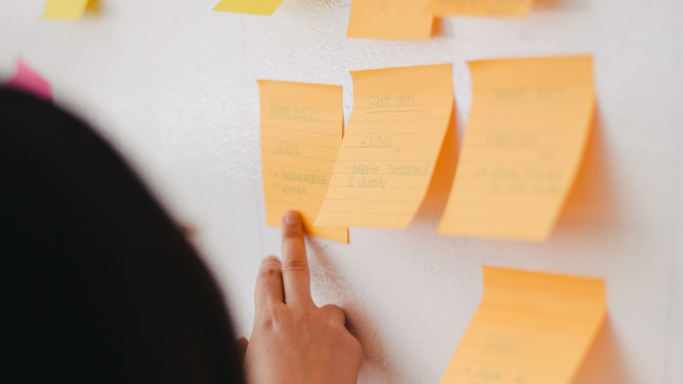
Brainstorm
What elements should go into a CV?
Notes:
Today we’ll start with brainstorming. Remember, rules of the game: Ideas flow and don’t check yourself.
Not all ideas will be great, and that’s okay. We’ll trim it down later!
So the question for the brainstorm is “What elements do we want in a CV?”
For each element that comes to mind, write it down on a sticky note and come stick it up on these flipovers.

Slide 8
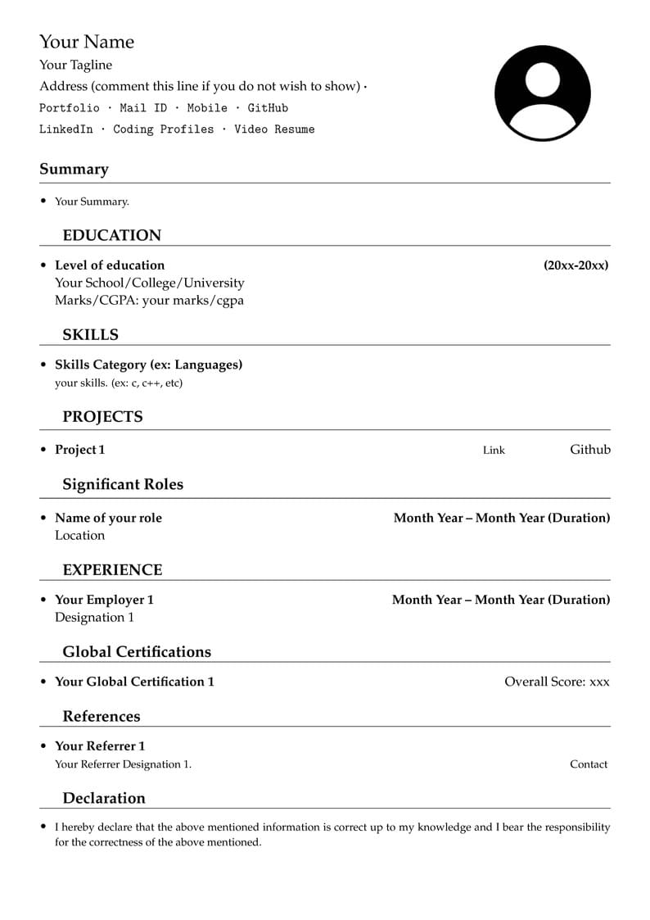
Notes:
For inspiration, here’s a template CV right now. This might give you some ideas already.

Slide 9
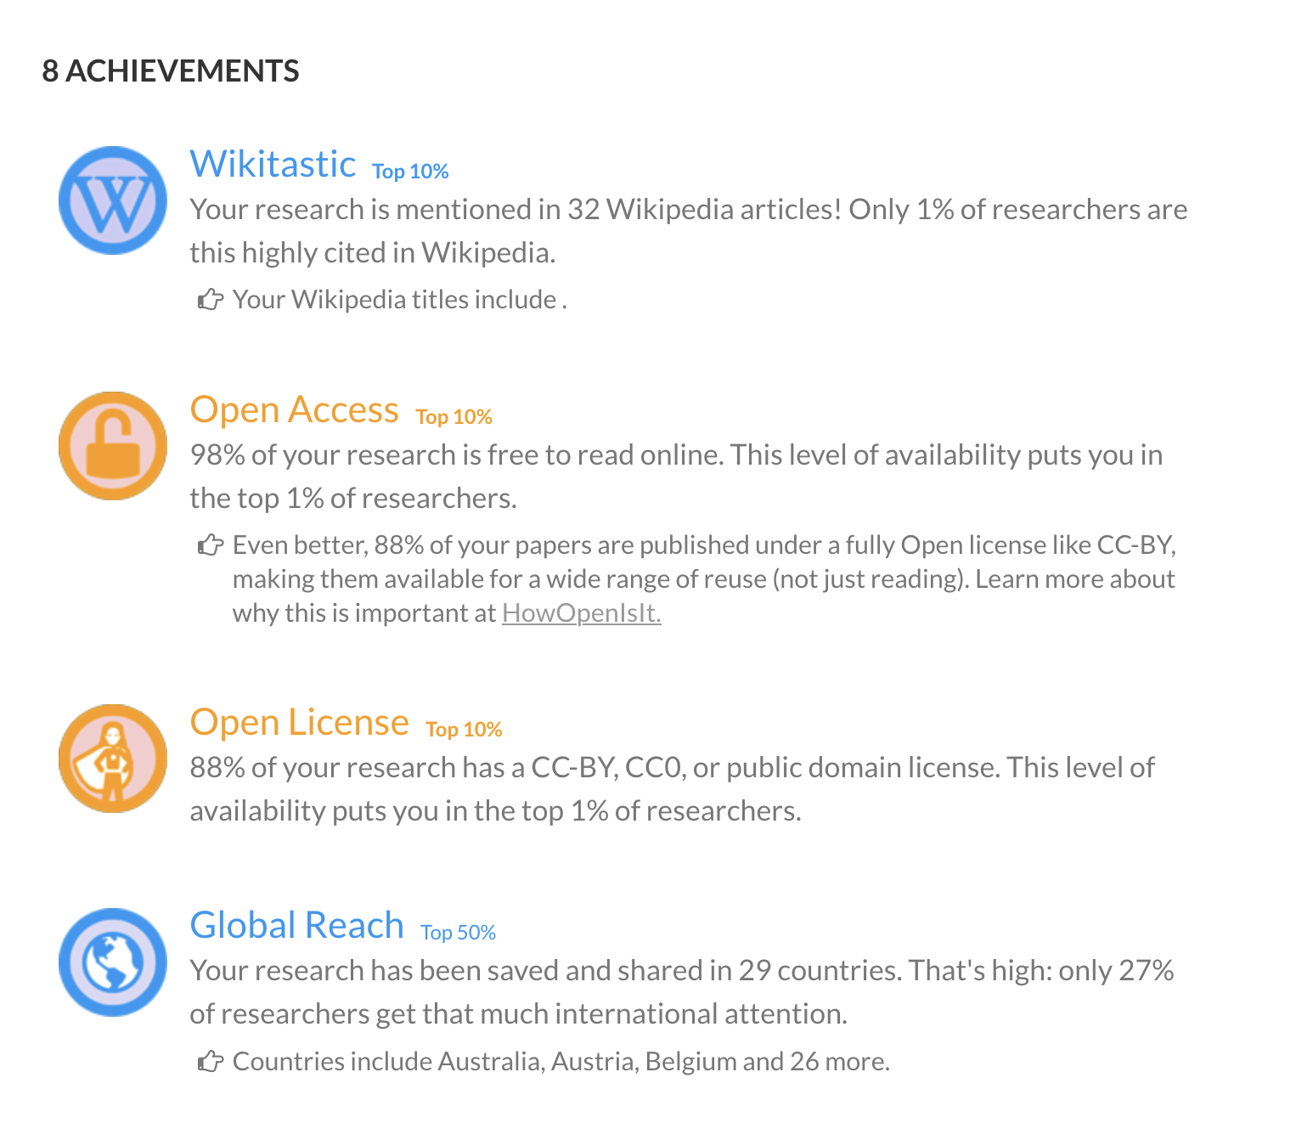
Notes:
Here’s some examples that are not as traditional, courtesy of ImpactStory.

Slide 11
Brainstorm
What elements should go into a CV?
Biographical?
Education?
Skills?
Achievements?
Service?
Relations?
Reflections?

Slide 12
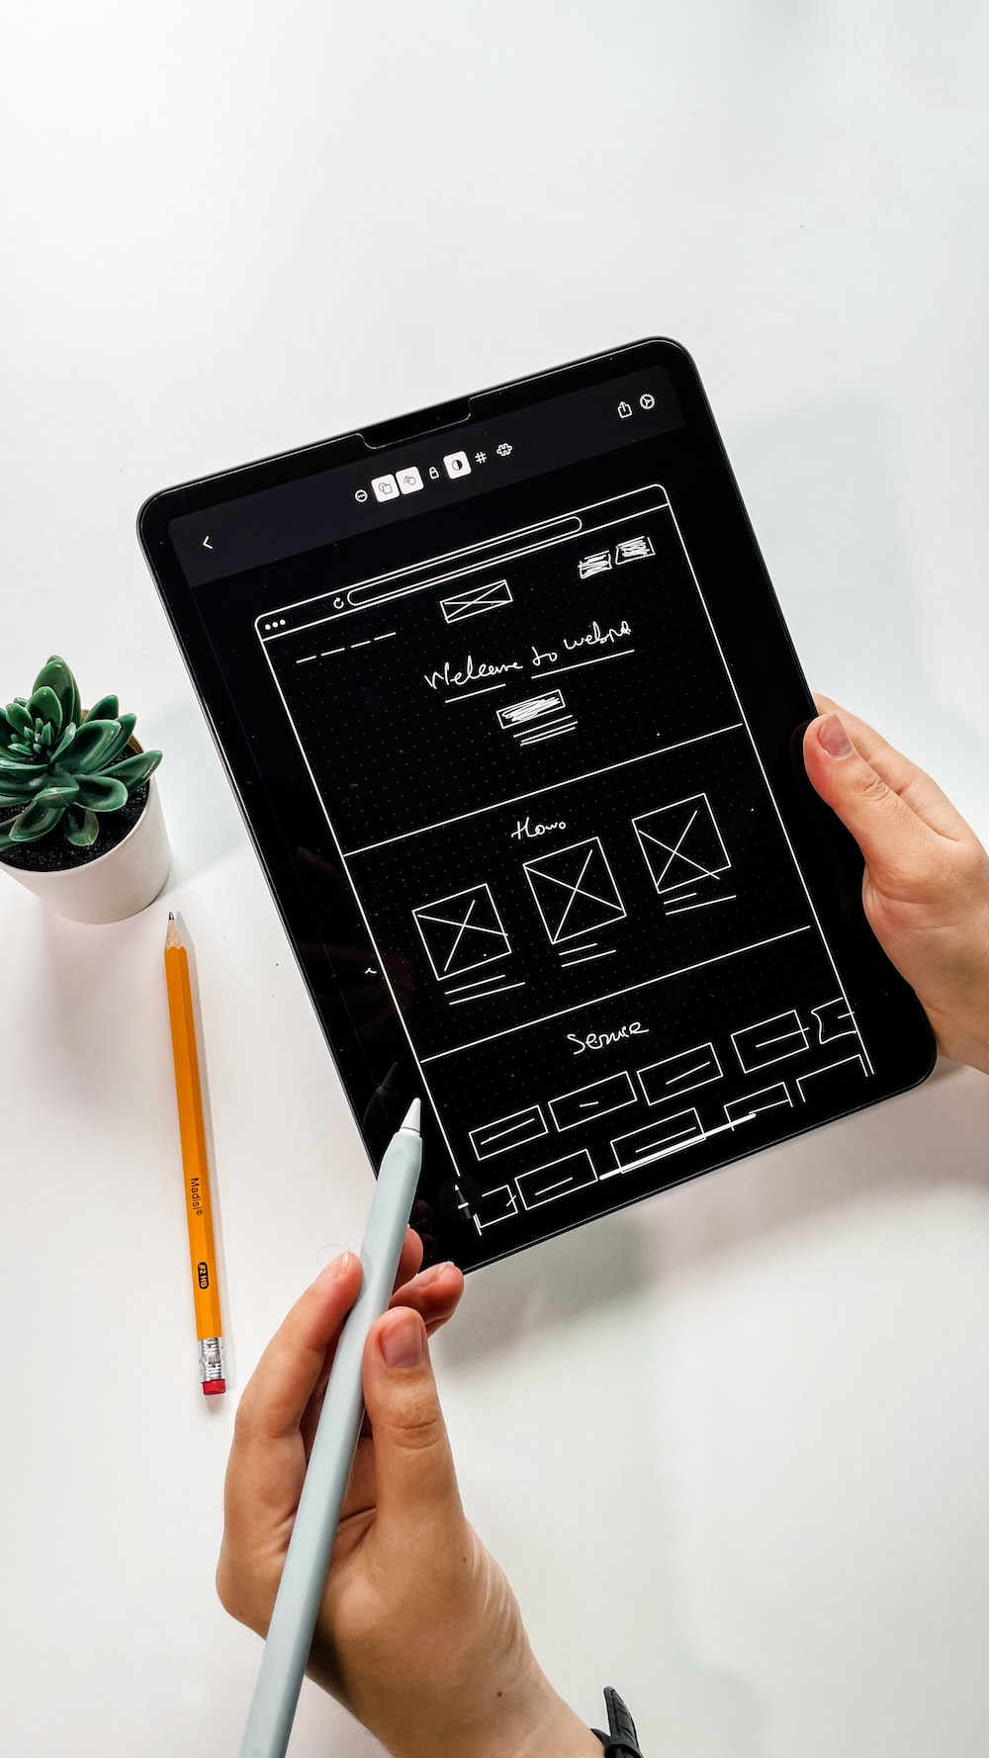
Wireframing
“Rough sketching”

Slide 13
Element: Image
Notes:
Will be added

Slide 14
Element: Text
Notes:
Will be added

Slide 15
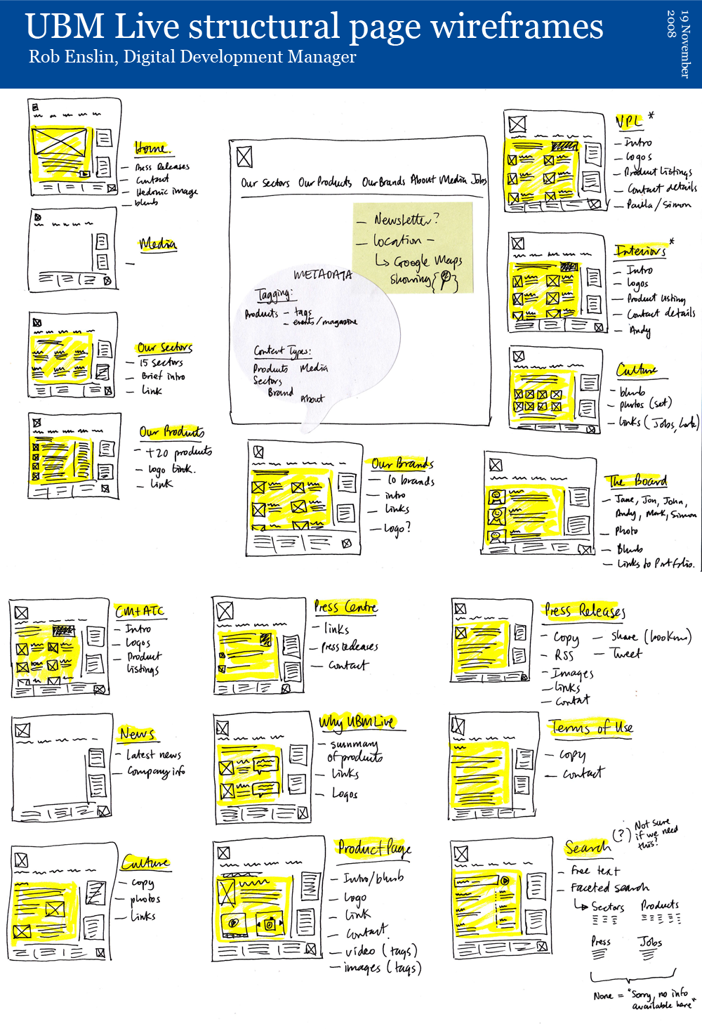
Example
"UBM Live: structural page wireframes" by Rob Enslin is licensed under CC BY 2.0.

Slide 16
Mix and match
Notes:
In the next step of this workshop we take all the elements and combine them into a alternative CV.
We have the collection of elements, and now it’s up to each group to combine those they want into a CV. You get to choose a maximum of 5 elements today.
After this, we will come back for a short reportback from each group. So be prepared to say a sentence or two!

Slide 17
Reportback
Notes:
In the next step of this workshop we take all the elements and combine them into a alternative CV.
We have the collection of elements, and now it’s up to each group to combine those they want into a CV. You get to choose a maximum of 5 elements today.
After this, we will come back for a short reportback from each group. So be prepared to say a sentence or two!

Slide 18
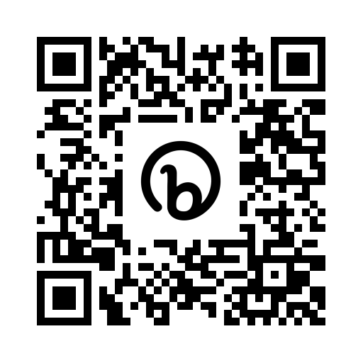

Thanks for participating!
doi: 10.53962/vaq3-x2tv
A workshop by:
Daan Rutten (d.rutten@uvt.nl)
Chris Hartgerink (chris@libscie.org)
Two questions:
http://bit.ly/recognitionrewards
Notes:
Hi everyone.
For today

