Slide 1


Research Data Management towards FAIR
orcid.org/0000-0001-5482-8370
Nami Sunami (Data Steward)
Library and Information Services (LIS), TU Eindhoven
Sunami, N. (2024, July 3). Research Data Management towards FAIR. ResesarchEquals. https://doi.org/10.53962/kr9t-rzak
Photo Credit: Bart van Overbeeke Photography

Slide 2
Managing research data is challenging

Slide 3
Data Stewards can help you

Slide 4


A Data Steward can help you with …
Responsible Science
Privacy & GDPR
Agreements
Ethical Review Board (ERB) applications
Open Science & RDM
FAIR Data
Sharing
Sustainable Workflow

Slide 5

Open Science & RDM

Slide 6
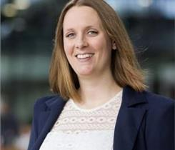







TU/e Data Steward Team
Floor Luub
M&CS
Neda Norouzi
BME, ME
Lucia Forrová BE
Mariana Oshima Menegon ID
Edyta Cios
IE&IS
Nami Sunami
CE&C, APSE
Angela Aleksovska
EE
Liz Guzman-Ramirez
Coordinator

Slide 7
What’s Research Data Management?

Slide 8
Research Data Management refers to the way you collect, analyze, store, share, archive and publish research data.

Slide 9
Why do we want to manage research data better?

Slide 10
Managing research data well makes your science sustainable.

Slide 11
Improving research data management is a key to Open Science.

Slide 12
Managing data well will benefit the world benefit you as a researcher

Slide 13
For the world:
You can share about your research better, maximizing your contribution to the world.

Slide 14
For you:
You can easily go back and build on to what you did in the past, helping yourself to do science better.

Slide 15




As a research community & society, we hold each other accountable to manage data well.
Code of Conduct for Research Integrity
Funder Requirements
GDPR
Code of Conduct for Research Integrity: nwo.nl/en/netherlands-code-conduct-research-integrity
NWO Grant Rules: nwo.nl/en/nwo-grant-rules

Slide 16
What do we mean by “doing a good job” managing data?

Slide 17
FAIR data principles can guide us to define a good RDM.

Slide 18
Findable
Accessible
Interoperable
Re-usable
FAIR stands for:
https://www.go-fair.org/fair-principles/

Slide 19
Findable

Slide 20
Findable data means that humans and machines can find your data easily.

Slide 21
Findable data has persistent identifier & metadata, and is indexed in a searchable resource.

Slide 22
Persistent identifier (PID) is a globally unique ID assigned to any object.
DOI: Digital Object Identifier
ORCID: Open Researcher and Contributor ID
ROR: Research Organization Registry

Slide 23
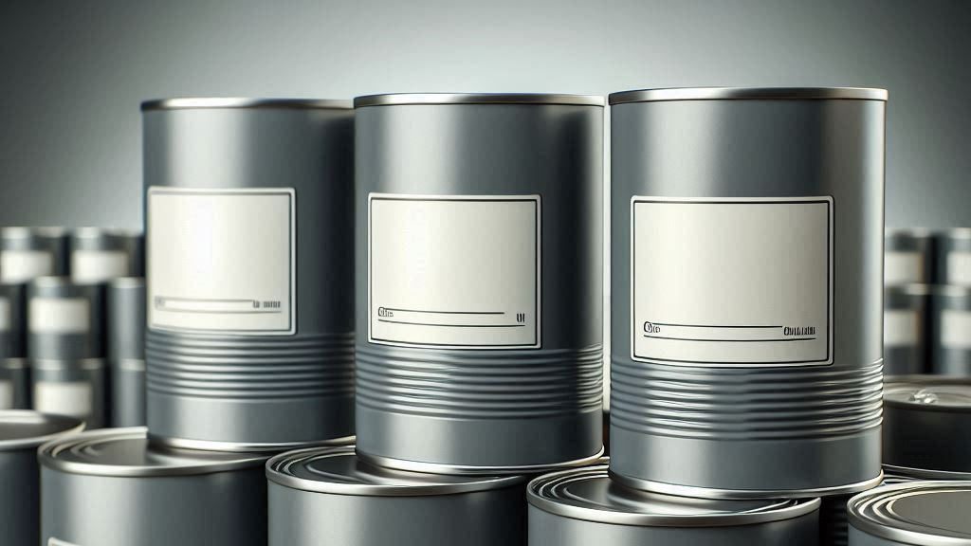
Metadata refers to data about data. Like a label on a can.
Such as, title, author, data collection date, and DOI
Image generated by Microsoft Co-Pilot

Slide 24

You can register your data to online registry (data repositories) & assign a DOI & metadata.
4TU.ResearchData
Zenodo

Slide 25
You can choose to share only metadata. Making data findable does not mean making the data accessible.

Slide 26
Accessible

Slide 27
Accessible data means that there’s a way to access the data.

Slide 28
Metadata is best to be kept always accessible.

Slide 29
When needed, require authentication or authorization for accessing the data.
You can do so in major data repositories.
Authentication means verifying the identity of the person. Authorization means assigning an access right.

Slide 30
You may have access to data. But can you connect with other pieces of knowledge?

Slide 31
Interoperable

Slide 32
Interoperable data means that the data can be integrated with other data.

Slide 33
Use common & sustainable file formats, preferably open ones.
File Formats | How to FAIR: https://howtofair.dk/how-to-fair/file-formats/

Slide 34
Use a machine-readable schema to document your metadata & data
Data repositories can export metadata to different schema.
Common schemas include JSON-LD, XML, RDF

Slide 35
Use a structured vocabulary to link concepts.
Structured vocabulary is a machine-actionable, curated dictionary
Examples include: WikiData

Slide 36
Link your data with other data using a persistent identifier (such as DOI).

Slide 37
You now understand the data.
But can you use it to create new knowledge?

Slide 38
Re-usable

Slide 39
Re-usable data means that others can use the data for a new purpose and can replicate your data.

Slide 40


Assign an accessible license to allow re-use
CC-BY 4.0
MIT
https://www.go-fair.org/fair-principles/r1-1-metadata-released-clear-accessible-data-usage-license/

Slide 41
FAIR ≠ OPEN

Slide 42
Access-restricted data can be FAIR.

Slide 43
Open data is not always FAIR.

Slide 44
Now we know about FAIR principles.

Slide 45
But practicing FAIR principles is a journey.
Where can we start?

Slide 46
Where to start doing RDM towards FAIR

Slide 47
First step is to think of research data in a life cycle.

Slide 48





Traditionally, we thought research data as something to be consumed, with a dead end
Paper
Data never to be looked at again
Create Data
Consume Data
Data loss & research waste

Slide 49
Instead, we want to think of research data as something to be nurtured in a life cycle, to be re-used.

Slide 50





Research data lifecycle
Plan
Share & Reuse
Collect
Process & Analyze
Archive
Adopted from RDMkit: https://rdmkit.elixir-europe.org/data_life_cycle

Slide 51
The end of one’s research becomes another’s beginning.

Slide 52
What are key action areas for each step?

Slide 53
Research data lifecycle
Plan
Share & Reuse
Collect
Process & Analyze
Archive
Adopted from RDMkit: https://rdmkit.elixir-europe.org/data_life_cycle

Slide 54

Plan

Slide 55
Completing a data management plan (DMP) can highlight what’s needed for your data.

Slide 56
Writing a good plan takes time, but it will pay off in a long run. It will save time and money.

Slide 57
A data management plan is a living document. Don’t let your perfectionism deter you.

Slide 58
A typical data management plan includes
What type of data you will collect, and how much
How you will address privacy and intellectual property challenges
How you will archive and publish your data
How you are going to achieve FAIR principles
How much is the RDM cost
Funders such as NWO and European Commission require a DMP
UU | Cost of Data management: uu.nl/en/research/research-data-management/guides/costs-of-data-management
NWO DMP: nwo.nl/en/research-data-management

Slide 59
If your data includes personal data, you may need additional precautions.
Personal data is “any information relating to an identified or identifiable natural person.”
Apply techniques such as data minimization, pseudonymization, and anonymization
fpf.org/blog/a-visual-guide-to-practical-data-de-identification/

Slide 60
If you are getting data from a third-party, you may need an agreement
Such as data sharing agreement

Slide 61
Research data lifecycle
Plan
Share & Reuse
Collect
Process & Analyze
Archive
Adopted from RDMkit: https://rdmkit.elixir-europe.org/data_life_cycle

Slide 62


Collect

Slide 63
Start your research project strong, with your folder organized.
.
├── README.md
├── metadata.json
├── data/
│ ├── raw
│ └── processed
├── code/
├── output/
└── documentation/
├── methods
├── lab_notebooks
└── administration

Slide 64
A README file is always a good idea for us humans
A README file is a human-readable text file document that explains the project.
No one can read your mind—not even you in the future.
Make a README: makeareadme.com/
Guide to writing “readme” style metadata | Cornell: data.research.cornell.edu/data-management/sharing/readme/

Slide 65
A metadata file is also good—but for machines.
On 4TU.ResearchData or Zenodo, you can start a dataset to prepare and download a metadata file, even without data.
You can also use metadata generators, such as DataCite Metadata Generator
DataCite Metadata Generator: dhvlab.gwi.uni-muenchen.de/datacite-generator/

Slide 66
Name files meaningfully, distinctly, and consistently—and document it.
No special characters. Whitespaces are discouraged.
Case style: Do you want a camelCase, PascalCase, snake_case, or kebab-case?
ISO date format is good to use: “2024-07-03”

Slide 67
Store your data in a secured space with backups, where two or more people retain access.
PAR Solution Searcher | Storage: https://research-it.pages.tue.nl/solution-searcher/category-storage.html

Slide 68
Now you collected data.
How will you process and analyze?

Slide 69
Research data lifecycle
Plan
Share & Reuse
Collect
Process & Analyze
Archive
Adopted from RDMkit: https://rdmkit.elixir-europe.org/data_life_cycle

Slide 70

Process & Analyze

Slide 71



Use open-source tools, whenever possible.
Python
JASP
R
Jamovi

Slide 72
If the original dataset is in a proprietary format, convert it to an open format.

Slide 73

Archive

Slide 74
Archiving data means storing data to demonstrate the integrity of research
Typically, each publication requires an archival package

Slide 75
You can prepare an archival data package to include information needed to demonstrate the integrity.
Preserving Data |UU: uu.nl/en/research/research-data-management/guides/after-research/preserving-data

Slide 76
An archival package is meant to be accessed only when it’s needed—for example, an integrity audit.

Slide 77
When you want to share your data, you can prepare a publication data package.

Slide 78
Research data lifecycle
Plan
Share & Reuse
Collect
Process & Analyze
Archive
Adopted from RDMkit: https://rdmkit.elixir-europe.org/data_life_cycle

Slide 79

Share & Reuse

Slide 80
Often, publication package is different from archival package

Slide 81
The goal of a publication package is to share data with the world.
The goal of an archival package is to demonstrate integrity.

Slide 82
By default, anyone can access a publication package.
For an archival package, the default is restricted access.

Slide 83




Publication Package
Archival Package
To share
To demonstrate integrity
Main Goal
Public
Restricted
Access
By default

Slide 84
You can deposit data in a data repository & connect your publication.
Your discipline may have specialized data repositories. Use re3data.org to find out.
You can use generic repositories, such as 4TU.ResearchData & Zenodo.

Slide 85
Remember to assign an open license when depositing your data.
Data, documentation, non-code materials
Code
CC BY 4.0
MIT

Slide 86
It’s best to share data “as openly as possible, as closed as necessary”.
Privacy, intellectual property, or collaboration agreements may pose challenge
FAIR Data Management in Horizon 2020: ec.europa.eu/research/participants/data/ref/h2020/grants_manual/hi/oa_pilot/h2020-hi-oa-data-mgt_en.pdf

Slide 87
Now that you shared the data, someone else may use the data.
And it could be you in the future.

Slide 88
What a ride!
Questions?
Thoughts to share?
rdmsupport@tue.nl

Slide 89
Footnotes
Icons in this slide deck are from Lucide, open-source icon library (https://lucide.dev/icons/rainbow)
This slide deck is licensed under CC BY 4.0

