Slide 1
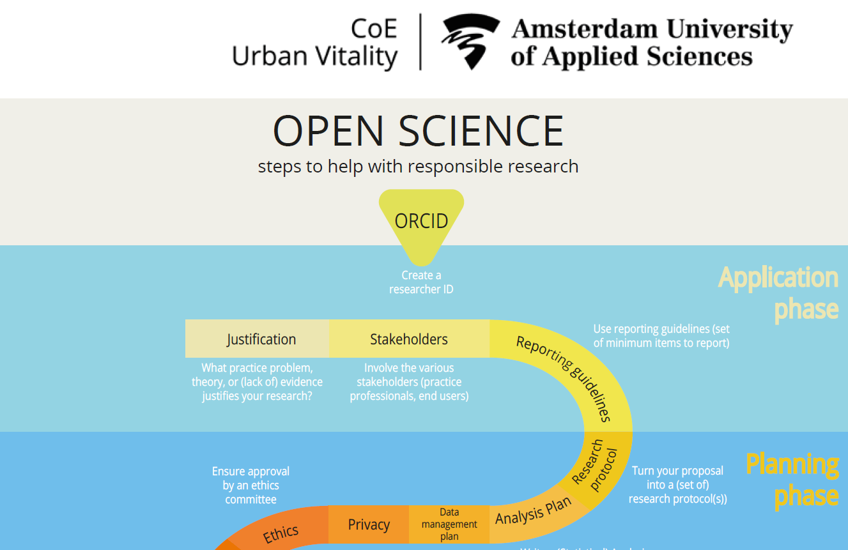
Gerben ter Riet, MD PhD
Anne de Jong, MSc
opensciencesupport@hva.nl
Notes:
https://doorwerking-hbo-onderzoek.nl/portfolio/open-science-checklist/ [in Dutch]
https://uvaauas.figshare.com/articles/online_resource/Open_science_checklist_Urban_Vitality/12213467
https://www.amsterdamuas.com/uv-openscience
https://hbo-kennisbank.nl/details/amsterdam_pure:oai:pure.hva.nl:publications%2F00c80703-c54b-4bf5-a3c5-bcc8f339995b?has-link=yes&q=support+desk

Slide 2

Urban Vitality Open Science Checklist
Ensure privacy for participants
Consider ethics advice
Preregister protocol and (S)AP
Document your research
Report completely
Publish open access
Archive using FAIR principles
Get an ORCID
Justify relevance
Involve end-users
Consider reporting guidelines
Write detailed protocol
Write detailed analysis plan
Write data management plan
Notes:
https://doorwerking-hbo-onderzoek.nl/portfolio/open-science-checklist/ [in Dutch]
https://uvaauas.figshare.com/articles/online_resource/Open_science_checklist_Urban_Vitality/12213467
https://www.amsterdamuas.com/uv-openscience
https://hbo-kennisbank.nl/details/amsterdam_pure:oai:pure.hva.nl:publications%2F00c80703-c54b-4bf5-a3c5-bcc8f339995b?has-link=yes&q=support+desk
https://www.go-fair.org/fair-principles/

Slide 3
SOURCES OF Inspiration FOR THe CHECKLIST
Dutch code scientific integrity 2018
(New release 2026)
Avoidable Research Waste (Lancet 2014)
Replication crisis (Nosek, www.osf.io)
Open Science literature (UNESCO, citizen science, FAIR)
Notes:
https://www.thelancet.com/campaigns/efficiency

Slide 4
OSSD Adherence project: objectives
Main goal: Based on systematically collected data, initiate a broad dialogue with all faculty research stakeholders about the 14 principles and how we conduct research within FGSB and organize support.
Subgoal 1: Gather data on the 2020–2023 trends in the extent to which our researchers embraced the 14 principles of responsible research.
Subgoal 2: Understand the reasons behind any trends.

Slide 5
OSSD Adherence project: methods
Go through the 14 steps yourself (RMS, ECO, preregistration in osf.io)
Get a project overview for the faculty via the Finance department
Sample projects
Send invitations for interviews
Do desk research based on project output prior to each interview
Audio recordings and interview summaries → scores (0,1) and (0,½,1)
Scores 0,1 → logistic regression (against project start time)
Scores 0,½,1 → ordinal logistic regression (against project start time)

Slide 6
Ideal sampling projects for OSSD Adherence project 2025 4 years, 6 lectorates → 24 projects
2020
2021
2022
2023

Slide 7


What the sample truly looks like: 6 lectorates = ; 4 years =

Slide 8
Project Limitations
No strict random sampling
Unit of analysis sometimes unclear: project or (larger) work package
Combined interviews covering multiple projects can be difficult (1×3, 2×2??)
Standardization of scoring was incomplete
Limited precision (n=23)
Small sample for 2020 (n=2)
Notes:
Unit of analysis: PD en onderwijsinnovatie (Comenius)

Slide 9
Next slides have many graphs
Look at:
1. Trend (the slope of the lines)
2. Where abouts the y-axis is the trend occurring. A light slope downward at levels between 85 and 95% is different from a light downward slope at around 20% in terms of adherence.
3. In the graphs with partial adherence, partial counts as full (the line shows probability of (partial + full adherence))

Slide 12
 | Binary | Trichotomous | Change
No | 5 | 0 | 5 ⬇
Partial |  | 13 | 13
Yes | 16 | 8 | 8 ⬆
Missing | 1 | 1 | 0
Not applicable | 1 | 1 | 0
Total n | 23 | 23

Slide 13
 | Binary | Trichotomous | Change
No | 4 | 2 | 2 ⬇
Partial |  | 6 | 6
Yes | 18 | 14 | 4 ⬆
Missing | 1 | 1 | 0
Not applicable
Total n | 23 | 23

Slide 14
 | Binary | Trichotomous | Change
No | 10 | 8 | 2 ⬇
Partial |  | 1 | 1
Yes | 10 | 10 | 0
Missing | 1 | 1 | 1
Not applicable | 2 | 3 | 1
Total n | 23 | 23

Slide 15
 | Binary | Trichotomous | Change
No | 6 | 5 | 1 ⬇
Partial |  | 4 | 4
Yes | 16 | 12 | 4
Missing | 1 | 1 | 0
Not applicable |  | 1 | 1
Total n | 23 | 23

Slide 16
 | Binary | Trichotomous | Change
No | 9 | 3 | 6 ⬇
Partial |  | 10 | 10
Yes | 11 | 6 | 5 ⬆
Missing | 1 | 1 | 0
Not applicable | 2 | 3 | 1 !
Total n | 23 | 23

Slide 17
 | Binary | Trichotomous | Change
No | 2 | 2 | 0
Partial |  | 1 | 1
Yes | 21 | 20 | 1 ⬆
Missing
Not applicable
Total n | 23 | 23

Slide 18
 | Binary | Trichotomous | Change
No | 4 | 4 | 0
Partial |  | 1 | 1
Yes | 19 | 18 | 1 ⬆
Missing
Not applicable
Total n | 23 | 23

Slide 19
 | Binary | Trichotomous | Change
No | 3 | 3 | 0
Partial |  | 1 | 1
Yes | 18 | 17 | 1 ⬆
Missing | 1 | 1 | 0
Not applicable | 1 | 1 | 0
Total n | 23 | 23

Slide 20
 | Binary | Trichotomous | Change
No | 14 | 11 | 3⬇
Partial |  | 3 | 3
Yes | 7 | 6 | 1 ⬆
Missing | 1 | 1 | 0
Not applicable | 1 | 2 | 1
Total n | 23 | 23

Slide 21
 | Binary | Trichotomous | Change
No | 3 | 1 | 2⬇
Partial |  | 5 | 5
Yes | 18 | 14 | 4
Missing | 1 | 1 | 0
Not applicable | 1 | 2 | 1
Total n | 23 | 23

Slide 22
Item 12 cannot be analysed
Complete reporting has too many n.a.’s and missings

Slide 23
 | Binary | Trichotomous | Change
No | 1 | 1 | 0
Partial |  | 1 | 1
Yes | 9 | 8 | 1
Missing | 1 | 1 | 0
Not applicable | 12 | 12 | 0
Total n | 23 | 23

Slide 24
 | Binary | Trichotomous | Change
No | 4 | 3 | 1
Partial |  | 1 | 1
Yes | 2 | 1 | 1
Missing | 1 | 1 | 0
Not applicable | 16 | 17 | 1
Total n | 23 | 23

Slide 25
Findings in 4 sentences
The overall trend in the probability of adherence was negative (odds ratio 0.94 (95%CI 0.88 to 1.01).
Seven items had stable high adherence, 3 medium and decreasing adherence, 2 high but decreasing adherence, 1 low but increasing adherence.
Awareness and findability of the checklist were suboptimal and its application to qualitative projects was doubted.

Slide 26
Conclusions
Of 7 items stably adhered to well, 6 were connected to policies imposed by funders, law or the research institute. Five items with decreasing trends were open science-related items (e.g. preregistering study protocols).
For discussion:
What is your interpretation of these results?
What should be the focus of the upcoming dialogue with researchers and institute leaders?

Slide 27


