Slide 1
Visibility for all your research work
Chris Hartgerink (they/them)
@chartgerink@akademienl.social
chris@libscie.org
Notes:
Hi and welcome everyone. ForLiberate Science, I’m Chris Hartgerink.
Today I’ll be talking about getting visibility for all your research work, and I’ll talk about two specific concepts to do so, namely
1. Modular publishing
2. Overlay journals
I’ll

Slide 2
Today
Modular publishing (+demo)
Overlay journals (+demo)

Slide 3

Modular publishing

Slide 4
Research is process of documenting information
Notes:
In order to introduce the concept of research modules, I first want to take a step back. In the first place, research is the process of documenting information. This is an important point because it can help us highlight some of the issues with how we document the process now.

Slide 5
Notes:
If we think about a 100 studies being done, we

Slide 6

Notes:
We ultimately only see a subset of that work in the literature.
This leaves a lot of work undocumented

Slide 7
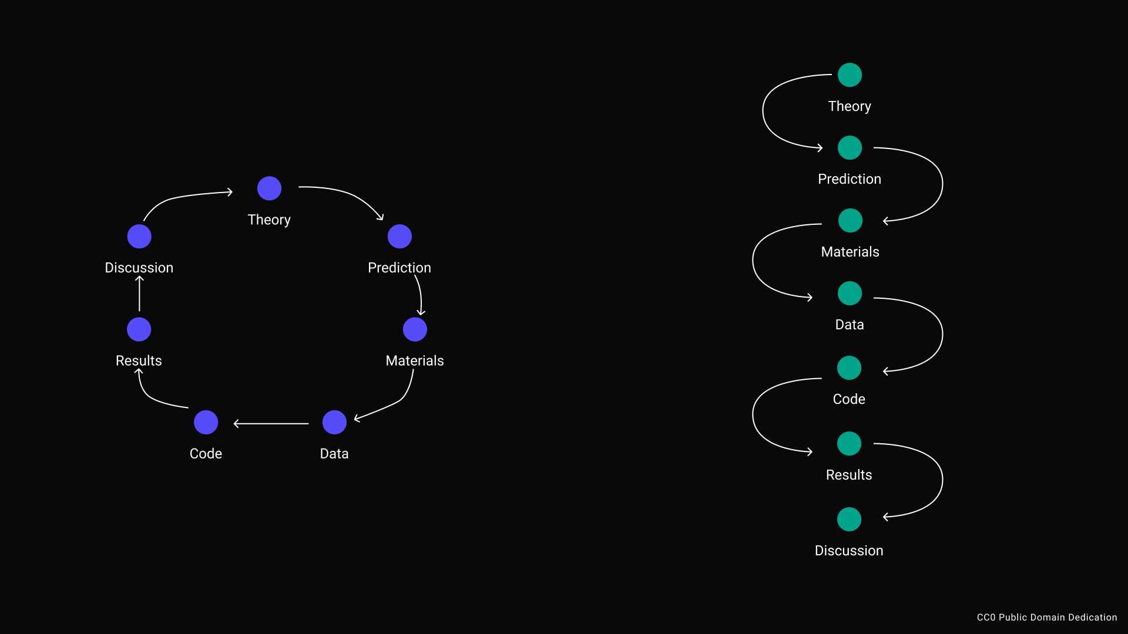
Embed chronology
DOI
Notes:
Let’s zoom in on one of those papers.
It has been certified by peer review
It got a DOI

Slide 8
Embed chronology
Notes:
But we don’t know what goes behind it.
It might be a regular research process.

Slide 9
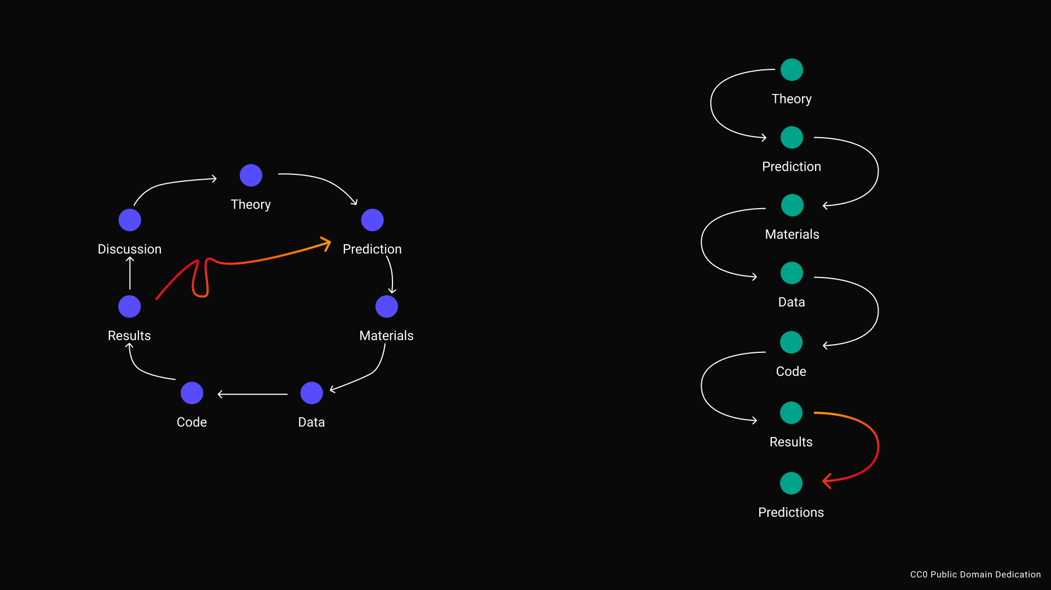
Notes:
Or a research process that can be harshly defined as HARKing or p-hacking, but I’ll redefine in a moment.

Slide 10
Embed chronology
Notes:
We end up only seeing the paper, the output, and have to reconstruct the process behind it.
Now this may be fine for other domains in our society, like literature, but in research it is not.

Slide 11
Our understanding can only be as good as the process
Notes:
That’s because, the understanding that research brings can only be as good as the process.

Slide 12
Science privileges a dominant way of knowing
Notes:
And because science privileges a dominant way of knowing, the peer reviewed paper, we struggle with breaking open the fundamental issue that the article is after the fact. It only presents results, not the process. And that is but a reconstruction, not a construction in and of itself.

Slide 13
Embed chronology
Notes:
So when we think back, we might have an output where we know for some reason there is a regular empirical cycle behind it.

Slide 14
Embed chronology
Notes:
If we would take a process approach, we could share each step of that process separately and connect them in sequential order.

Slide 15
Embed chronology
DOI
DOI
DOI
DOI
DOI
DOI
DOI
Notes:
Each of those research steps would have a DOI, so that you can granularly refer to it, build on it, and give visibility for it.
If you look closely you also see that that means that things that are hard to capture today in our article outputs are put front and center.
Data.
Materials
Code.
All of it can be made visible, and doesn’t even need to have the same authors.

Slide 16
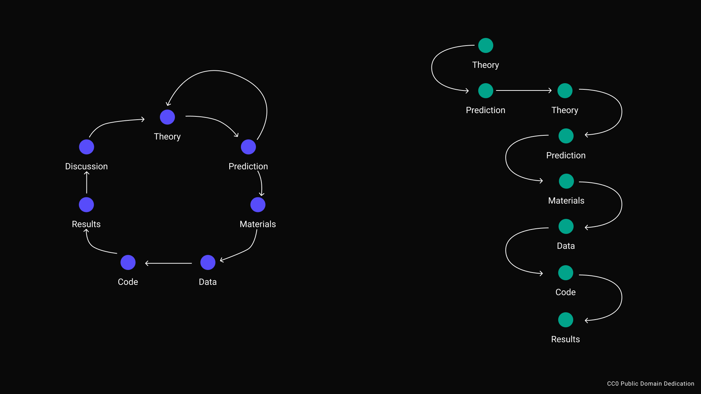
DOI
DOI
DOI
DOI
DOI
DOI
DOI
DOI
Notes:
We might also end up in the situation where we iterate on our work, because our process leads us to new insights.
In a regular article, it is hard to see this and especially hard to reconstruct these insights. This is a shame because insights can be valuable too!
In a process based model, we would make those insights visible to, as you see on the right.

Slide 17
DOI
DOI
DOI
DOI
DOI
DOI
DOI
Notes:
In this style, p-hackign or HARKing is simply a limitation of the output format.
From a process perspective, we see this is simply a next step.
Because we play this game of reconstructing the research process, we define this behavior as problematic, whereas the behavior itself is a form of learning and could be represented in a process based model of sharing research.
In sum, we can say research modules are the steps that go into a research process, and by sharing those steps over time we can understand how good our process, and the resulting understanding actually is.

Slide 18
Modular publishing
Share each step of the research process
Can be text, but does not have to be
What are research outputs you

Slide 19
Modular publishing with ResearchEquals (demo)

Slide 20
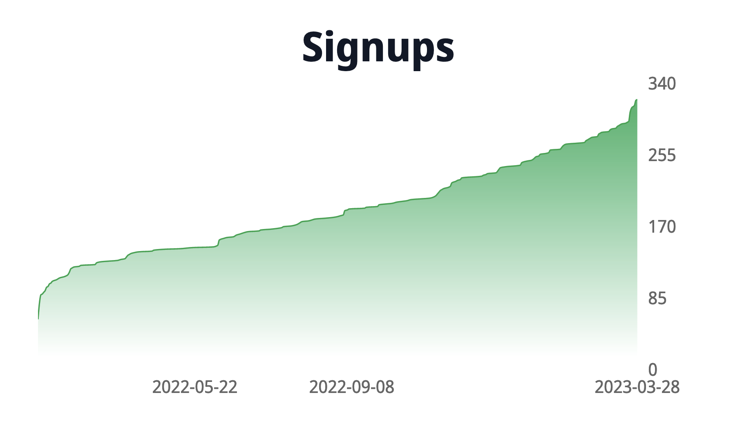

Slide 21
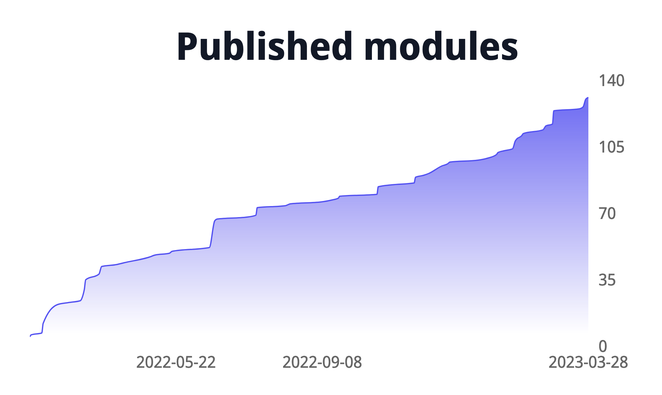

Slide 22





Slide 23

ORCID Integration
Published module 09.41AM
Received email from ORCID at 11.03AM:

Slide 24

Overlay journals
“a[ journal], that does not produce its own content, but selects from [what is] already freely available online.”
Notes:
Paul Ginsparg, who created the original arxiv, introduced the concept of overlay journals back in 1996, as a way to deconstruct the journal. I love this idea as an overlay journal does not produce its own content, but curates what’s already out there.
As researchers, we do a lot of curation work anyway, so there is the opportunity to utilize overlay journals to make that work visible!
https://discovery.ucl.ac.uk/id/eprint/19081/

Slide 25
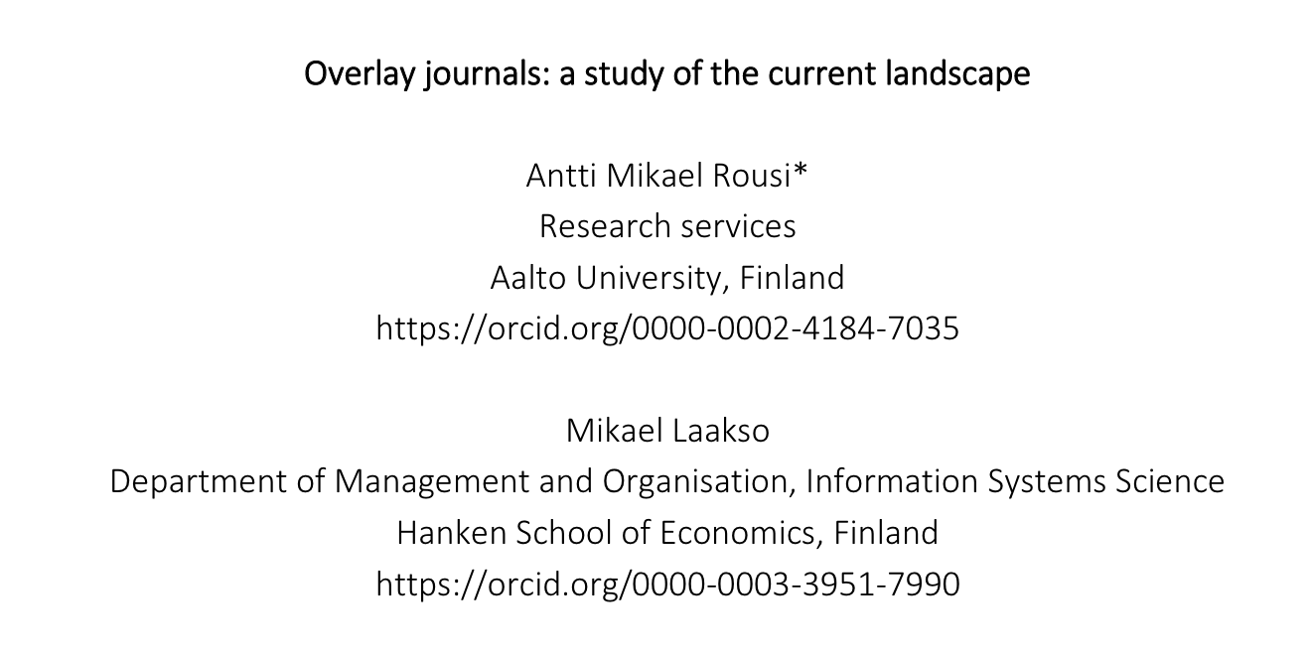
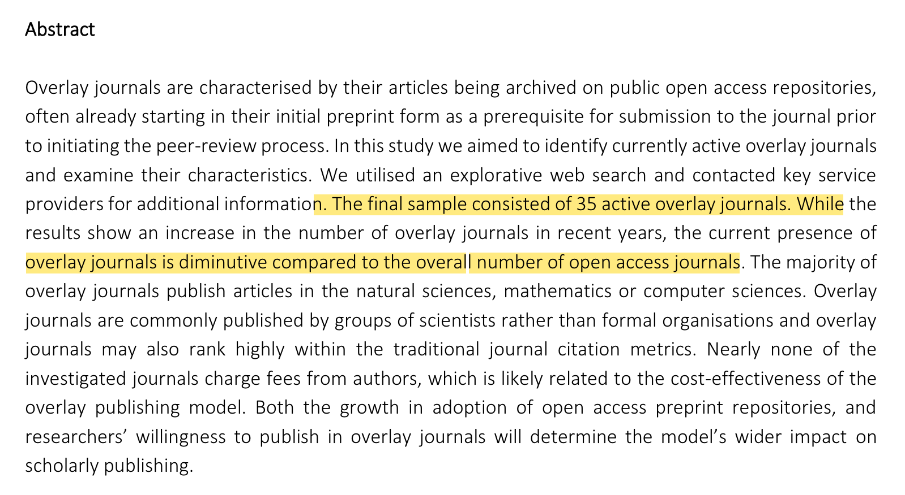
10.48550/arXiv.2204.03383
Notes:
However, preprint from last summer indicated that the infrastructure to do so is mostly absent. Only 35 active overlay journals existed at the time they did their study.
So this notion of overlay journals seems to not have caught on, yet is it because the infrastructure has not been there or because people don’t want to use it?

Slide 26
Creating overlay journals with ResearchEquals (demo)

Slide 27
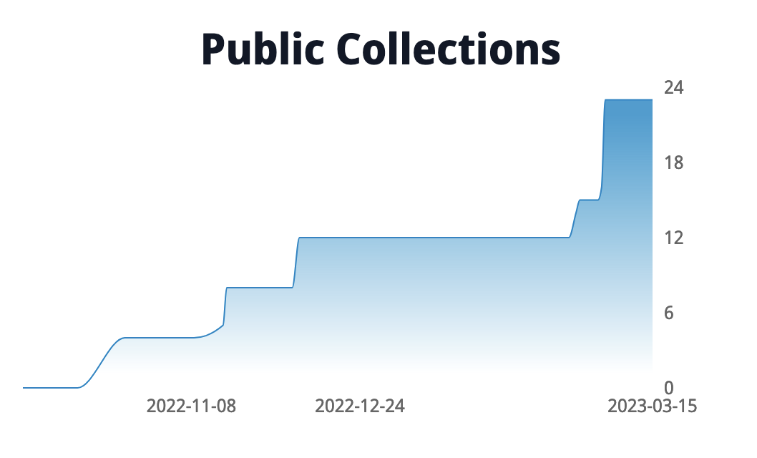

Slide 28
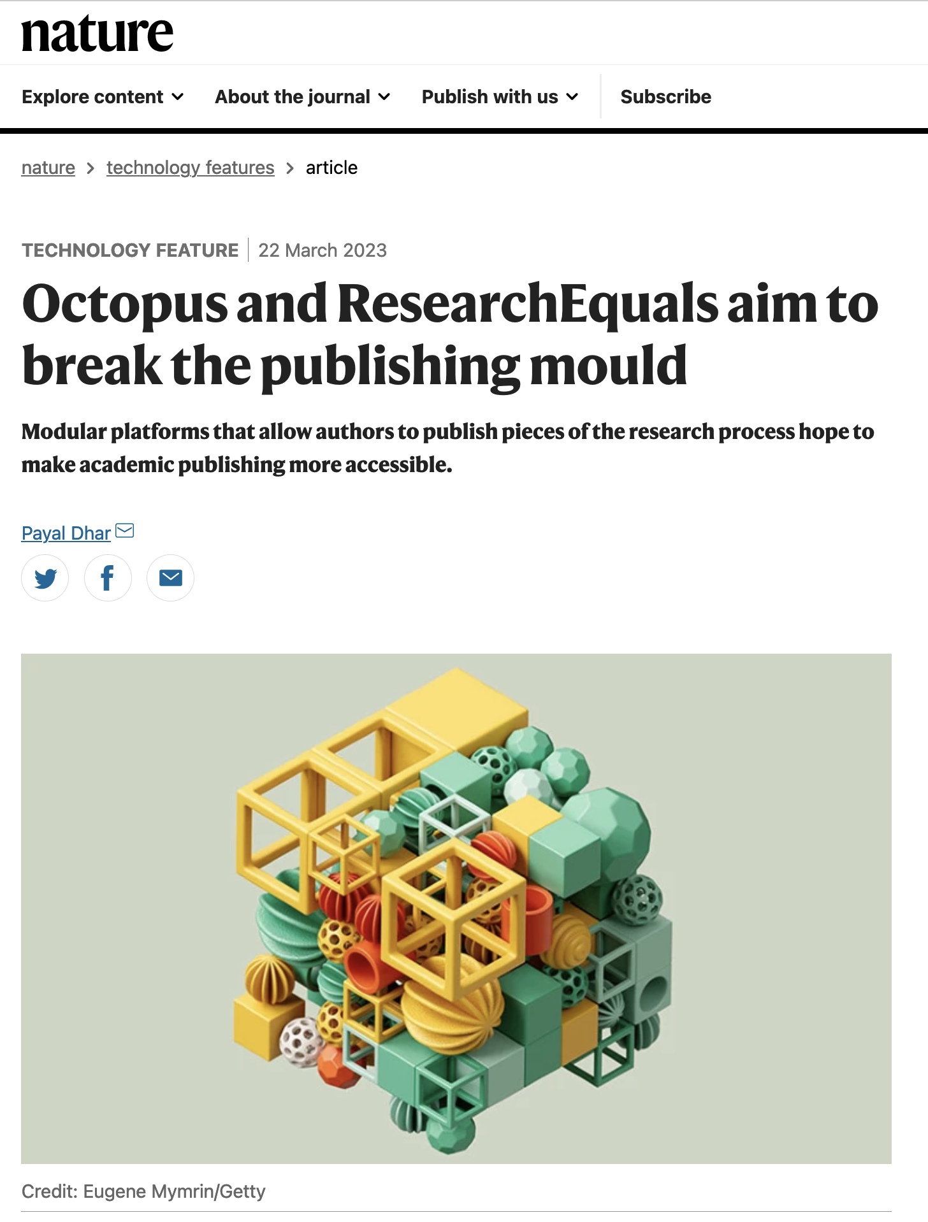

Slide 29
Governance

Slide 30


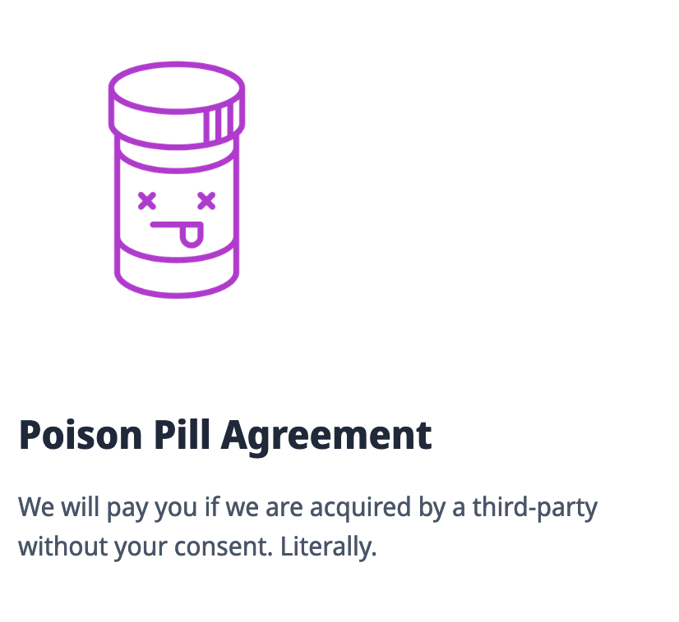


Notes:
We also

Slide 31


Slide 32
Summary
Modular publishing
Overlay journals
Research is more than the report
Each step in the research process = a module
Can be more than text
Curated content by editors
Non-competitive for content
We all do curation work, but don’t learn to share that openly

Slide 33
Q&A
Contact details:
@chartgerink@akademienl.social
chris@libscie.org
(and I’ll be around until 4.30PM-ish)
Notes:
Hi and welcome everyone. ForLiberate Science, I’m Chris Hartgerink.
Today I’ll be talking about getting visibility for all your research work, and I’ll talk about two specific concepts to do so, namely
1. Modular publishing
2. Overlay journals
I’ll

