Slide 1

Intro to
Publishing research steps
PANNE group – 19.07.2022
Dr. Chris Hartgerink
@chartgerink
Notes:
Hey what’s going on everybody
For liberate science, I’m Chris Hartgerink
<intro>
And today I want to start with a small exercise.
What is that you are working on today? Take a moment to pick one thing. It doesn’t need to be super specific
it could be something like writing analysis code, revising a manuscript,
Now think about whether that work gets recognized in your career evaluation.
If you’re comfortable, please share it in the chat so that we can get a sense of whether people’s work today is visible towards

Slide 2
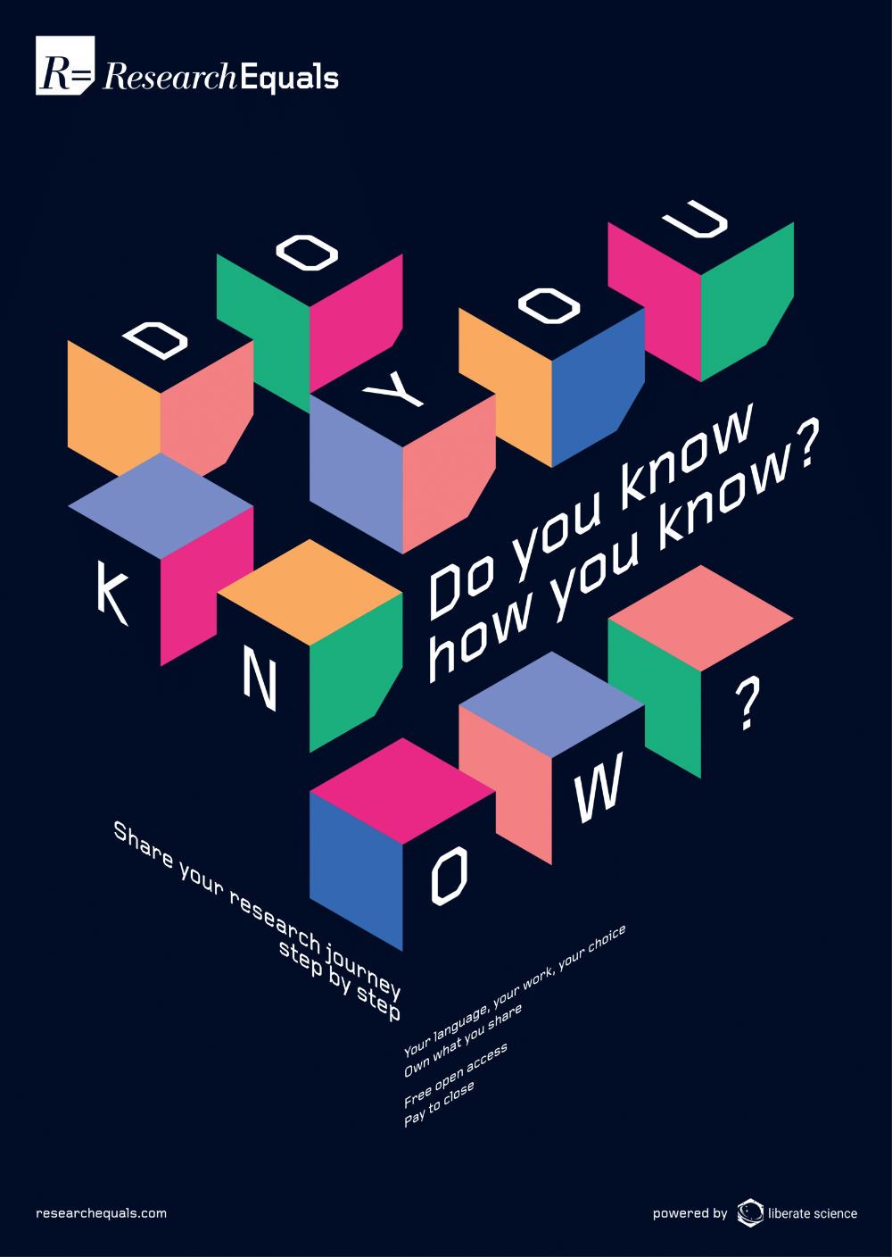
Notes:
And the reason I ask this, is because we know that rewards and incentives are misaligned with how research is done.
Or how we like to ask, whether we know how we know.
Because if purely go off of the published literature, there is a clear lack of visibility towards many things. And I’ll get back to this in a second.

Slide 3

Notes:
If there’s only one thing you take away today let it be this:
By transforming publishing from an output based model towards a process based model, we can make all research work visible and recognized.
And ResearchEquals is a place you can do that of course.

Slide 4
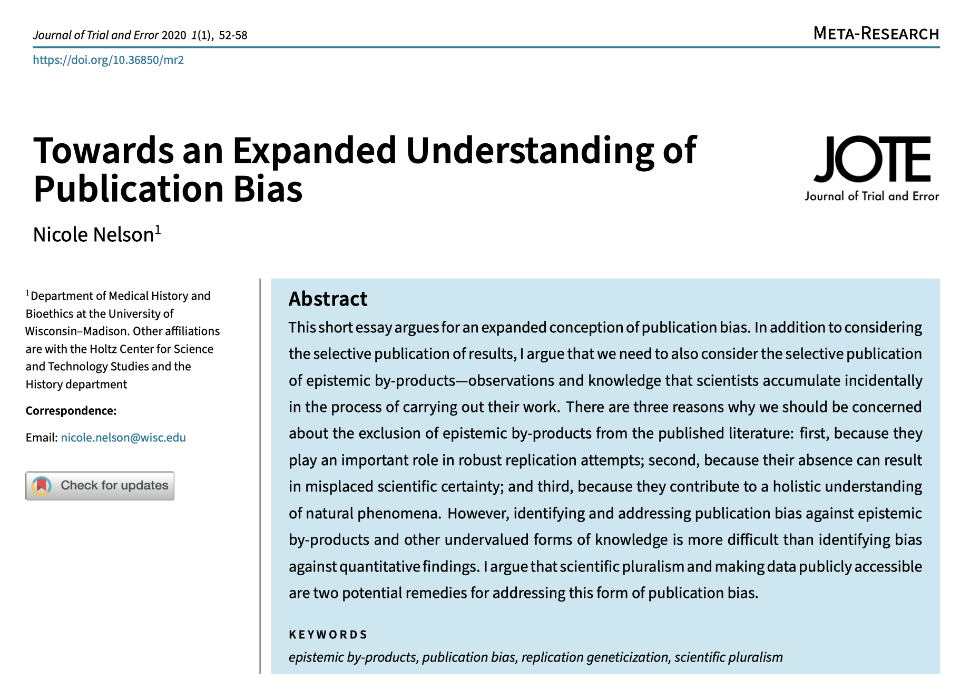
Notes:
I think especially relevant for this group is seeing this in light of an expanded understanding of publication bias.
Is it only the selective publication of results based on their statistical significance?
Or can we think more broadly about what work gets visibility and what work does not?
This is of course not an easy question, but I’d like to explore this with you today and tickle you with some ideas.

Slide 5


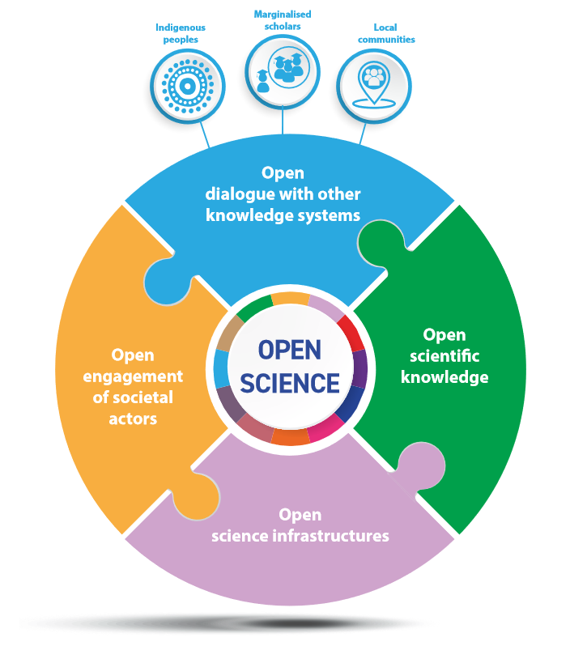
Notes:
https://en.unesco.org/science-sustainable-future/open-science/recommendation
Last November, 193 UNESCO member states adopted the recommendation on open science. This is really a landmark document that I recommend you to take a look at, because it has a very wide definition of open science
And it may help you to instigate change in your institution.
Now why I bring it up in terms of making work visible, it is this idea of what is considered research.
Here in this image we see
Exchanging knowledge systems
Open scientific knowledge
Open infrastructures
Engagement with societal actors
Now out of these, only the publication part tends to get sufficient visibly and recognition to be a rewarding aspect of people’s careers
I would argue, that all of these parts, and many more, should be visible, because they’re part of the research process. The open scientific knowledge, only being the output of that process.

Slide 6
Can’t evaluate the process by sharing only outputs
Notes:
But we can’t evaluate the process by sharing only outputs.
And this is why as I mentioned at the beginning, it is so important to shift towards a process based model of research instead.

Slide 7
Theory of change
A model to change the world
Notes:
In order to evaluate this point of transforming towards a process based model of science, we at liberate science are continuously developing our theory of change, which I want to scratch the surface of today.

Slide 8
Like all models…
…they’re useful, not “true”
…rest on assumptions
…are underdetermined
Notes:
And a theory of change is a model, which simplifies the world into something comprehensible.
This also means that no model is “true”,
It rests on assumptions that we need to be aware of,
And that the model is underdetermined.

Slide 9
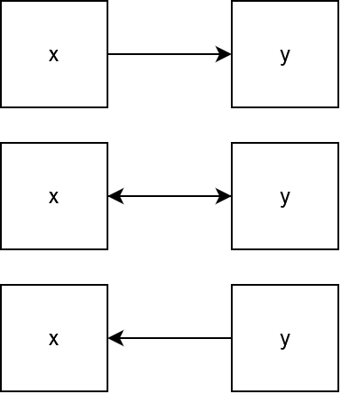
Like all models…
…they’re useful, not “true”
…rest on assumptions
…are underdetermined
Notes:
Being underdetermined means a model is only one lens of many.

Slide 10
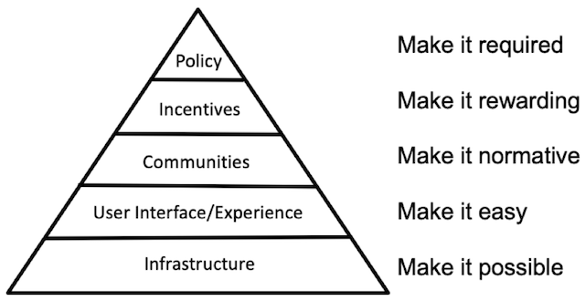
COS’ theory of change
Notes:
One such theory of change you might’ve come across is that of the Center for Open Science. You may have seen it in this form or →

Slide 11
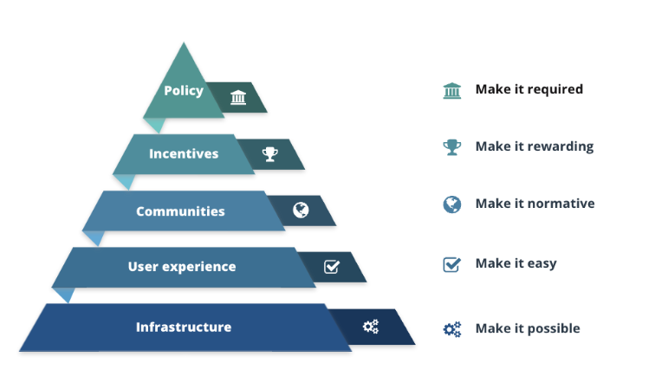
COS’ theory of change
Notes:
In this form.
And the Center for Open Science’s theory of change is incredibly clear. It models open science behaviors hierarchically, for certain conditions to be met to make it possible.
This theory of change has influenced me since it came out, and has inspired me to take up some of the work I did. Over time, I also started discovering some of its limitations, and why an alternative lens may be helpful and wrong in it’s own unique way.
Today I want to primarily focus on the assumptions of our theory of change at liberate science, and how this lens is the basis for our open access platform ResearchEquals

Slide 12
Science is a reflection of systems of power that privileges a dominant way of knowing.
Assumption 1
Notes:
First off, our theory of change embeds the notion that science is a reflection of systems of power, which privileges a dominant way of knowing.

Slide 13
Science is a reflection of systems of power that privileges a dominant way of knowing.
Assumption 1
Notes:
Now to explain this I’m going to dissect it into two pieces.
The first piece is that science is a reflection of systems of power. And that immediately affects which works becomes visible.
Let me explain.

Slide 14
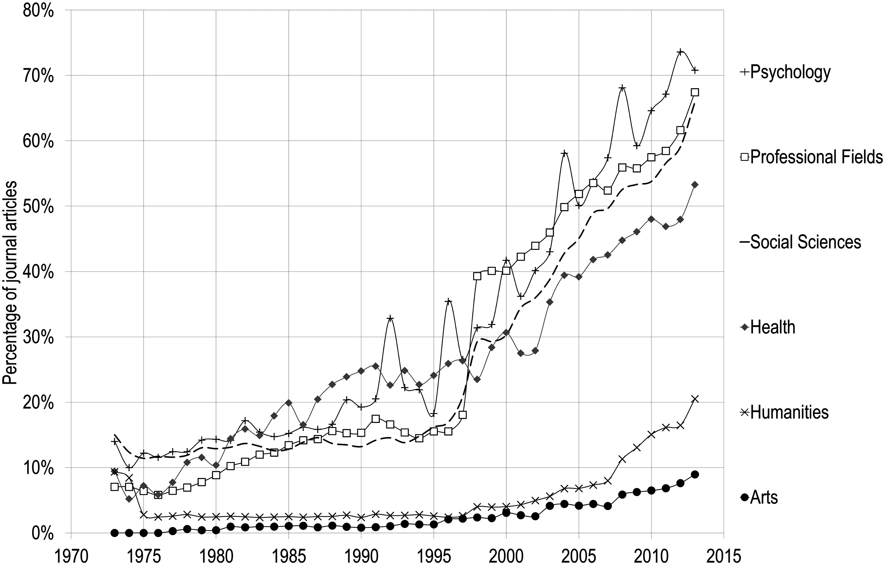
Who controls publishing?
% share for five biggest publishers
Elsevier
Wiley
Taylor & Francis
Sage
Springer
Notes:
One such system of power is Whenever we want to improve any of these issues we have to go through the evermore consolidated publishing space.
A researcher might can improve their work all they want, if the publciations don’t recognize that, their career won’t either and they will either adapt or leave academia altogether.
Here we see that over the past decades, the social science domain has become dominated by five major publishers, who account for circa 70% of all articles.
You might have your own anecdotes about improving your work and all of that remaining obscure.
Like writing Rmarkdown files, which go into the void
Or analysis scripts being screenshotted and uploaded as unusable supplements.
This allows us to see publishing for a system of power, and creates the question of whether researchers are in power, or the publishers.
----
https://doi.org/10.1371/journal.pone.0127502

Slide 15
Misogyny
“The gender inequalities observed among authors who made equal contributions […] raise concerns about female authors not receiving proper credit for publications”
https://doi.org/10.7554/eLife.36399.001
Notes:
Another example is that of misogyny, the policing behavior of societal sexism
For example, there are gender inequalities in who gets credited for publications.
There’s of course many more examples, but this highlights yet again how these power systems affect what becomes visible, and how it is perceived.

Slide 16
Queer- and transphobia
“These results are most consistent with a productivity cost on nondisclosure of LGBTQA identity in professional settings, and suggest a concrete need to improve scientific workplace climates for sexual and gender minorities.”
https://doi.org/10.1371/journal.pone.0263728
Notes:
More examples are queer- and transphobia, where those who are not out, or cannot come out because of an unsafe work environment, are less productive. This results in a lack of their becoming visible.

Slide 17
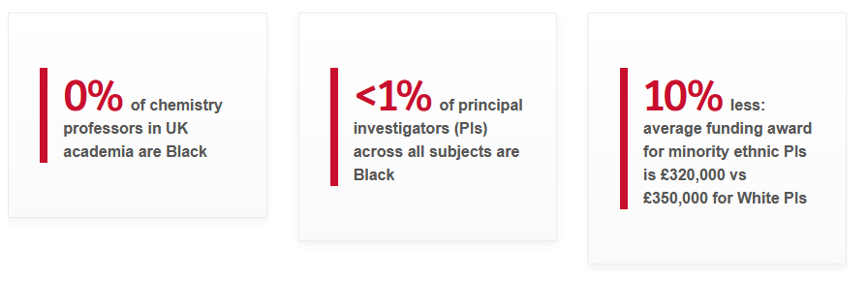
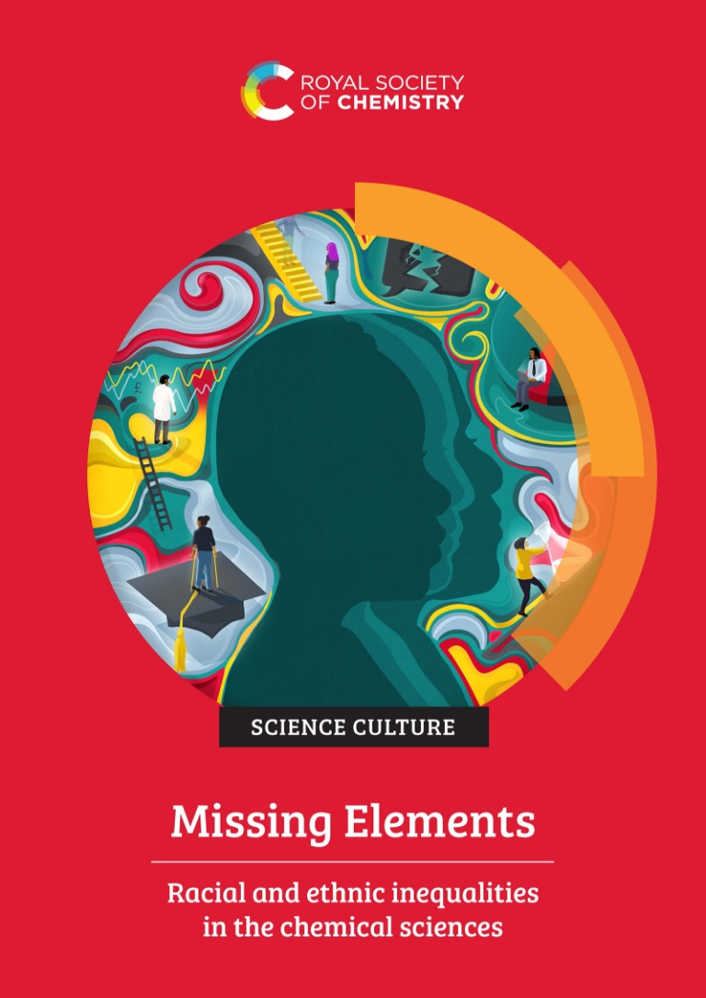
White supremacy
Notes:
I can keep giving examples all day, but here I want to especially highlight another dimension of systems of power: White supremacy.
In the UK this report came out by the Royal Society of Chemistry which highlighted the disparities black and brown people, versus white people.
Less funding, fewer professor positions.
In other words: Fewer resources to make their work visible.

Slide 18
Science is a reflection of systems of power that privileges a dominant way of knowing.
Assumption 1
Notes:
As a result of these systems of power, the dominant way of knowing is a white, cis, non-disabled, man, and western point of view on the world.
This is nothing new, but using this as our lens to approach how we improve research is important, because it helps us understand our actions in a meaningful manner.
It raises questions around whether we are creating new, dominant and powerful ways of knowing, such as elevating preregistered research over unregistered work, or that we are creating space for various, non-dominating forms of knowing to co-exist.
Because ultimately, if the systems of power from which those new dominant ways of knowing originate, than that means they won’t work for everyone either. Which is a new system of power in itself and will result in less visibility for those not in power.

Slide 19
Research is process of documenting information
Assumption 2
Notes:
Which leads me to the second assumption for our theory of change, which is that research is the process of documenting information.

Slide 20
Notes:
If we think about a 100 studies being done, we

Slide 21

Notes:
We ultimately only see a subset of that work in the literature.
This leaves a lot of work undocumented

Slide 22
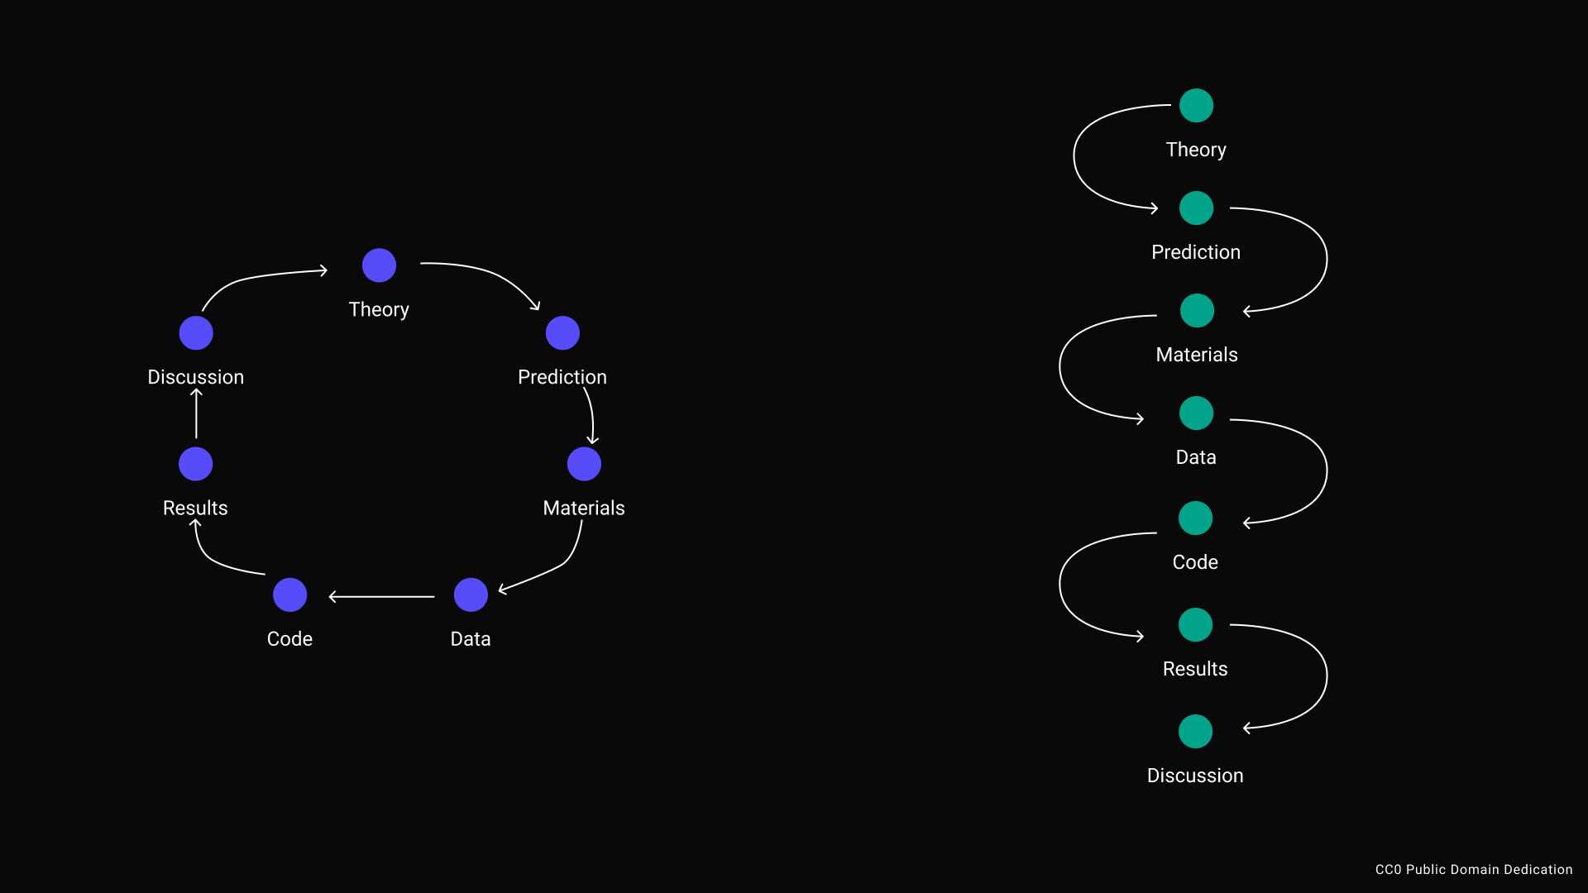
Embed chronology
DOI
Notes:
Let’s zoom in on one of those papers.
It has been certified by peer review
It got a DOI

Slide 23
Embed chronology
Notes:
But we don’t know what goes behind it.
It might be a regular research process.

Slide 24
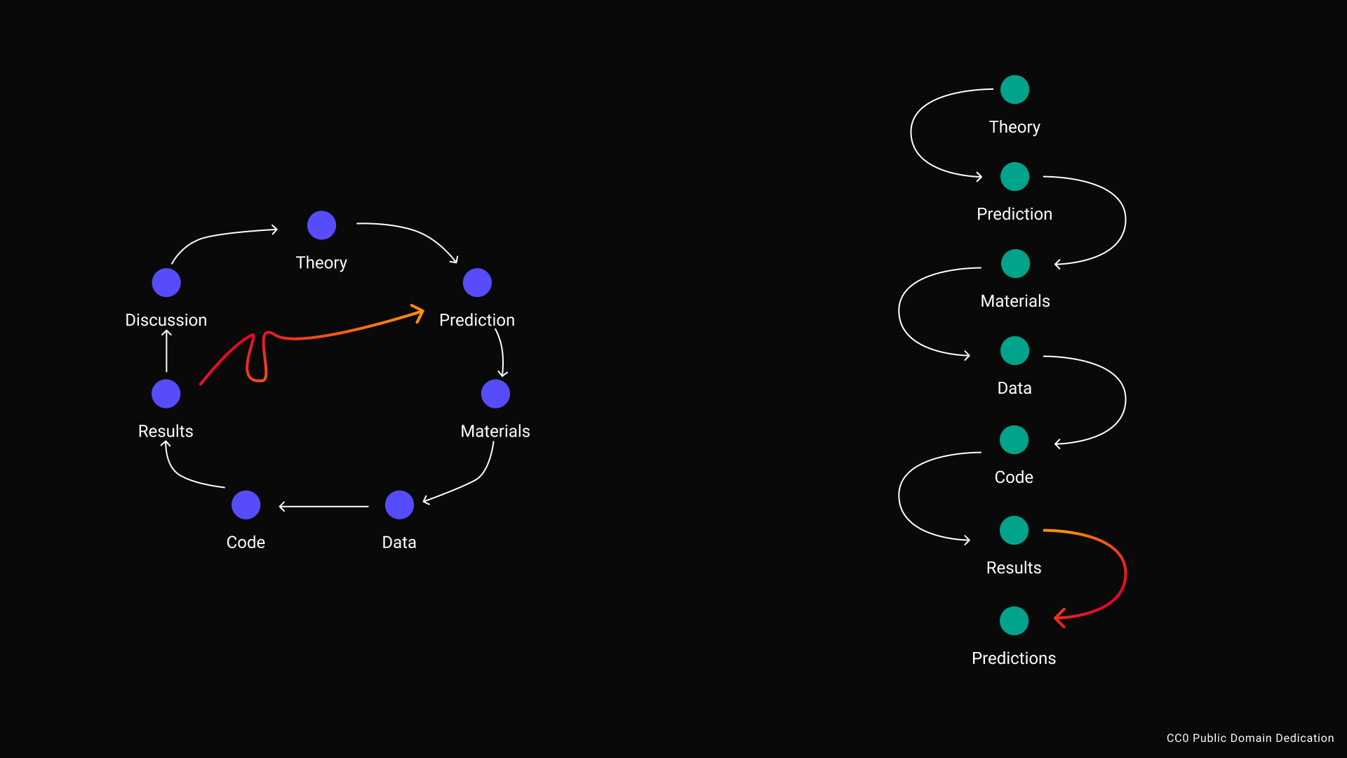
Notes:
Or a research process that can be harshly defined as HARKing or p-hacking, but I’ll redefine in a moment.

Slide 25
Embed chronology
Notes:
We end up only seeing the paper, the output, and have to reconstruct the process behind it.
Now this may be fine for other domains in our society, but in research it is not.

Slide 26
Our understanding can only be as good as the process
Assumption 3
Notes:
That’s because, our understanding can only be as good as the process. This is our third assumption.

Slide 27
Embed chronology
Notes:
So when we think back, we might have an output where we know for some reason there is a regular empirical cycle behind it.

Slide 28
Embed chronology
Notes:
If we would take a process approach, we could share each step of that process separately and connect them in sequential order.

Slide 29
Embed chronology
DOI
DOI
DOI
DOI
DOI
DOI
DOI
Notes:
Each of those research steps would have a DOI, so that you can granularly refer to it, build on it, and give visibility for it.
If you look closely you also see that that means that things that are hard to capture today in our article outputs are put front and center.
Data.
Materials
Code.
All of it can be made visible, and doesn’t even need to have the same authors.

Slide 30
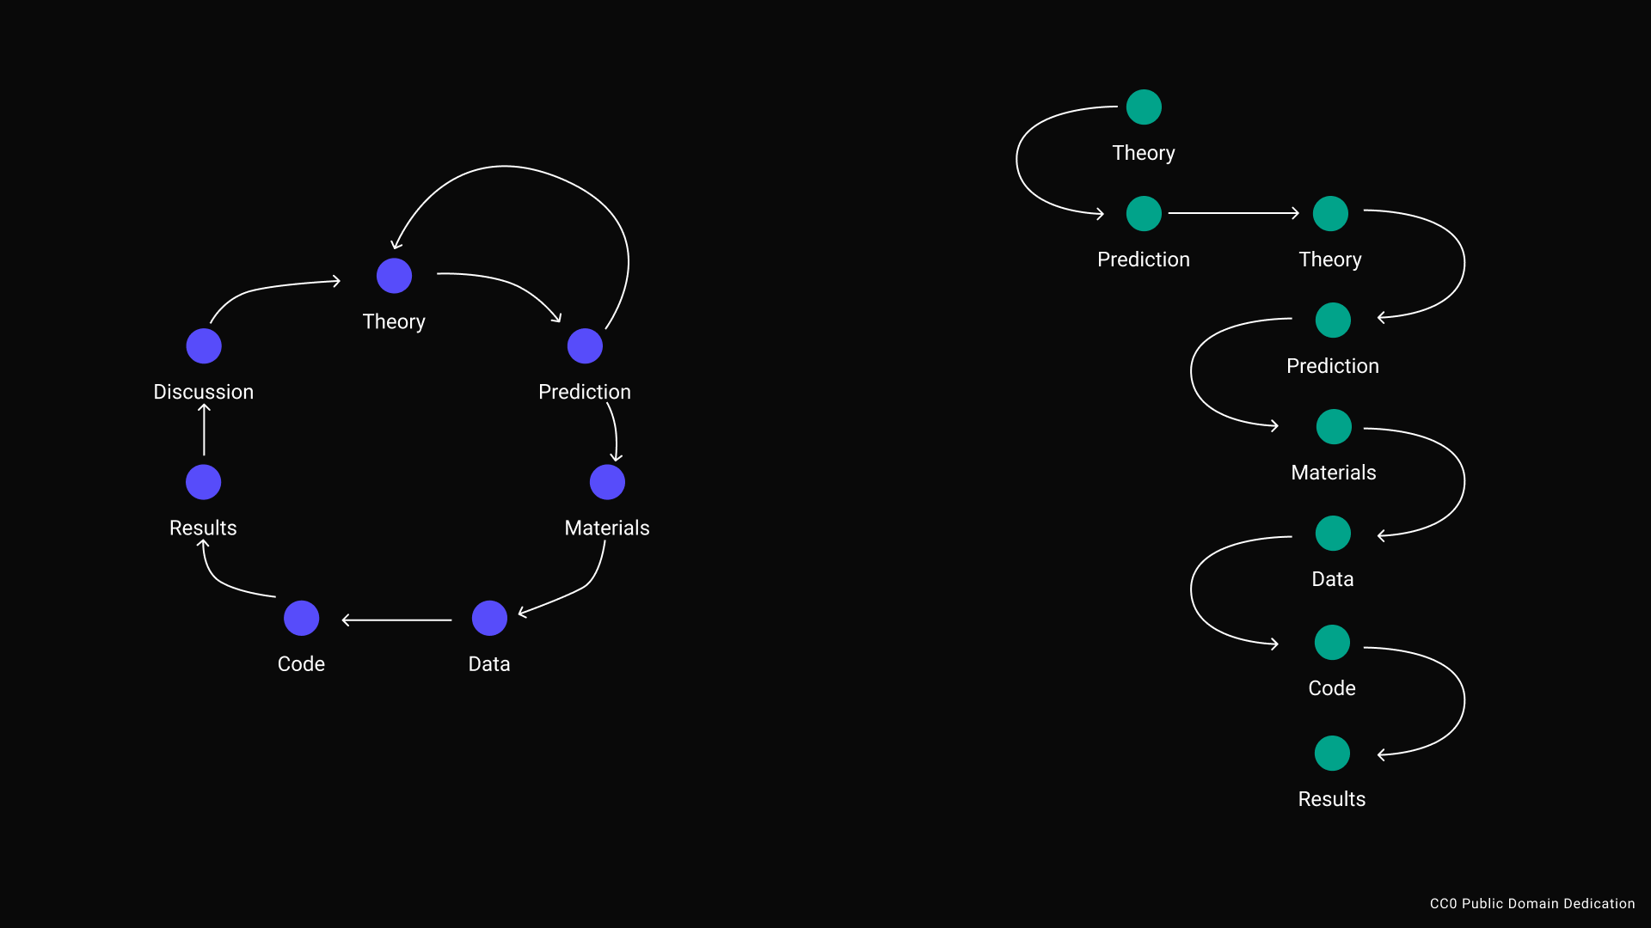
DOI
DOI
DOI
DOI
DOI
DOI
DOI
DOI
Notes:
We might also end up in the situation where we iterate on our work, because our process leads us to new insights.
In a regular article, it is hard to see this and especially hard to reconstruct these insights. This is a shame because insights can be valuable too!
In a process based model, we would make those insights visible to, as you see on the right.

Slide 31
DOI
DOI
DOI
DOI
DOI
DOI
DOI
Notes:
In this style, p-hackign or HARKing is simply a limitation of the output format.
From a process perspective, we see this is simply a next step.
Because we play this game of reconstructing the research process, we define this behavior as problematic, whereas the behavior itself is a form of learning and could be represented in a process based model of sharing research.

Slide 32

Notes:
And this model is where ResearchEquals comes in.
I spoke about the model for years, and since February 1st this open access publishing platform is online. I am happy to demo it to you today, but before I do that, I would like to open the floor for clarification questions.

Slide 33
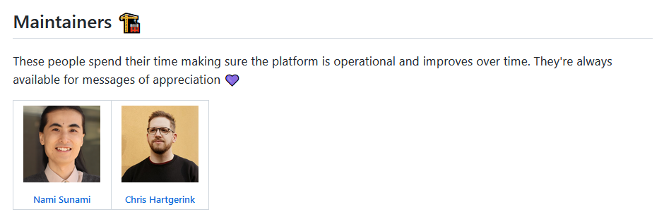
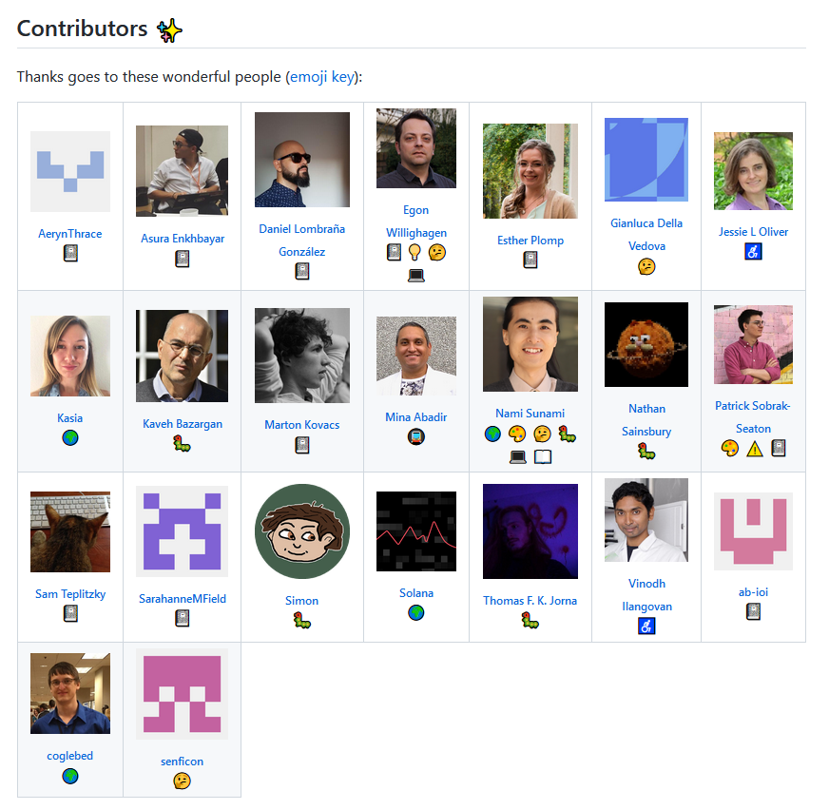

Notes:
ResearchEquals is a scholar led project, powered by Liberate Science, the organization I founded when I left academia.
You too can influence the direction it takes, by joining the community to change research to a process based model.

Slide 34
Calls to action
Join ResearchEquals
Publish how you know starting today
https://researchequals.com
Sign up to hear about upcoming ResearchEquals cohorts
https://nut.sh/ell/forms/339732/KScduC
Notes:
Specifically, if you’re interested in joining our community of practice, I recommend you sign up on researchequals.
We understand it’s a big change, so we’re launching ResearchEquals cohorts in the near future, where we’ll support you every step of the way.

