Slide 1


License your code & pay it forward
Nami Sunami
Data Steward, TU Eindhoven
orcid.org/0000-0001-5482-8370
DOI: 10.53962/s5nv-a779
This work is marked with CC0 1.0

Slide 2
Question: Who here works with code built by others?

Slide 3
Scenario: You shared code on a repository

Slide 4
“Can I use your work?”
Yes!
“Can I use your work?”
Yes…
….
….
“Can I use your work?”

Slide 5

Notes:
Meme from: https://makeameme.org/meme/answering-the-same-5ae8bf6341

Slide 6
No license = All rights reserved

Slide 7
When you create something, you hold a copyright.*
*If you are employed, your employer may own it.
Copyright | UU: https://www.uu.nl/en/organisation/copyright-information-office/copyright

Slide 8
You don’t want to write a legal agreement each time someone request to re-use your work
For example, an end-user license agreement
License can help you

Slide 9
Sharing code does not make sense expect in the light of licensing.

Slide 10
Why should you license?

Slide 11
Licensing your work saves your time
No more answering, “Can I use your work for …?” questions.
If you have a collaborator, no need to do a consensus-building activity every time.

Slide 12
At TU/e, “we strive for maximal disclosure of results and findings”
TU/e Strategy 2030

Slide 13
Licensing your work helps others, including you in the future

Slide 14
How to decide which license to use?

Slide 15
Use choosealicense.com

Slide 16


Code or non-code?
Code
Non-code
Examples
MIT
CC BY 4.0

Slide 17
Licensing a code with non-code license is like sharing the meal without the recipe

Slide 18



Forego copyright?
SQLite
Public Domain
yt-dlp
Notes:
SQLite: https://www.sqlite.org/copyright.html

Slide 19

Copyleft or permissive?
Copyleft
Permissive
Examples
GPL
MIT
“Once open, always open”
“I don’t care”

Slide 20
Use a copyleft license if you care about how others use your code

Slide 21
Are you building on other projects? Check if it’s marked with a copyleft license.

Slide 22
When should you license?

Slide 23
As early as possible
(At the start of the project)

Slide 24
How to put a license?

Slide 25
Place licensing info in LIICENSE & README files
LIICENSE
README
Good for metadata
Descriptive
Contained
Human-friendly
Easy to copy

Slide 26
What to do when I have a mix of code and content?
Place LICENSE file for code
Note the complexity in the README file
E.g., “The code is licensed under MIT, and other non-code materials are licensed under CC BY 4.0”

Slide 27

What are your questions?
License your code, because your future user could be you
Photo by ivan zakharenko on Unsplash

Slide 28

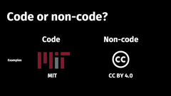
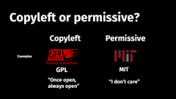
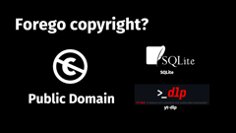

What are your questions?

