Slide 1
Computer Graphics Hw2 Tips
2011/11/3
by Matthew
v2.

Slide 2
3 Tips
How to Read File
World space and Screen space
Step-by-Step Transformation

Slide 3
How to read file
Hw2 has only file input, no mouse, no keyboard,
so do everything in displayFunc().
code might look like:
// Display function
void displayFunc(void){
// clear the entire window to the background color
glClear(GL_COLOR_BUFFER_BIT);
glClearColor(0.0, 0.0, 0.0, 0.0);
// draw the contents!!! Iterate your object's data structure!
ReadFile();
glFlush();
}
add a function here, and do everything inside.

Slide 4
How to read file
Let’s see how to implement ReadFile() function.
hw2.in is a simple text file, you can open it by Notepad or other text editor you like.
#include<fstream> //1. don’t forget this
…
void ReadFile() {
ifstream fin("hw2.in"); //2. open file
string command;
while (fin>>command) { //3. read text from file
// 4. parse command
}
}

Slide 5
How to read file
void ReadFile() {
fstream fin("hw2.in"); //open file
string command;
while (fin>>command) {
// a big if-else structure for all commands
if (command=="square") {
create_square();
} else if (command=="translate") {
float tx, ty;
fin >> tx >> ty; // read parameters if needed
translate(tx, ty);
} else if (…)
…
}
}
Do different jobs according to the value of “command” string.

Slide 6
World Space
What is world space ? Screen space?
The whole scene of Super Mario Level 1
Everything has a absolute position in 2D world, called “World coordinates”.
Y
X

Slide 7
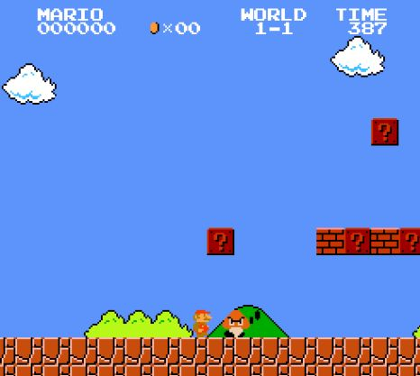
Screen Space
But only a small part of world will be display on Screen.
So we define a rectangle area, only the object inside rectangle will be drawn on screen. The rectangle area is called “Clip Area”.

Slide 8
Screen Space
If we want to draw Mario to screen, world coordinates did not help.
The only thing we want to know is How To Draw Pixels!
In other words, we need the screen coordinates of Mario

Slide 9
Screen space
That’s why we transform world space to screen space.
To determine transform, we need
Clip Area (World Space)
Viewport (Screen Space)
So the transform will do the world to screen mapping.

Slide 10
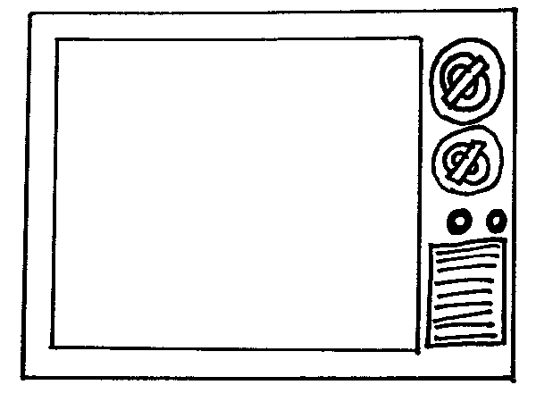
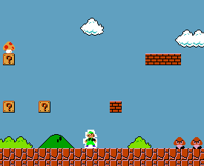
World space to Screen space
A example:
1 world,
2 clip area,
2 viewport,
1 screen.

Slide 11
Step-by-Step “hw2A.in”
Show what happened step-by-step for input file “hw2A.in”
We need to maintain 2 global variable
The Current Transform Matrix.
A Objects Array to store all polygon and vertices.

Slide 12
Step-by-Step
reset
scale 2.0 2.0
rotate 45.0
translate 10.0 10.0
square
view 0.0 20.0 0.0 20.0 100 400 100 400
end
Set current transform matrix to Identity
[1 0 0]
[0 1 0]
[0 0 1]

Slide 13
Step-by-Step
reset
scale 2.0 2.0
rotate 45.0
translate 10.0 10.0
square
view 0.0 20.0 0.0 20.0 100 400 100 400
end
Multiply current matrix by scaling matrix
[2 0 0] [1 0 0] [2 0 0]
[0 2 0]x[0 1 0] = [0 2 0]
[0 0 1] [0 0 1] [0 0 1]

Slide 14
Step-by-Step
reset
scale 2.0 2.0
rotate 45.0
translate 10.0 10.0
square
view 0.0 20.0 0.0 20.0 100 400 100 400
end
Multiply current matrix by rotation matrix
[cos45 –sin45 0] [2 0 0] [1.41 -1.41 0]
[sin45 cos45 0]x[0 2 0] = [1.41 1.41 0]
[ 0 0 1] [0 0 1] [ 0 0 1]

Slide 15
Step-by-Step
reset
scale 2.0 2.0
rotate 45.0
translate 10.0 10.0
square
view 0.0 20.0 0.0 20.0 100 400 100 400
end
Multiply current matrix by translation matrix
[1 0 10] [1.41 -1.41 0] [1.41 -1.41 10]
[0 1 10]x[1.41 1.41 0] = [1.41 1.41 10]
[0 0 1] [ 0 0 1] [ 0 0 1]

Slide 16
Step-by-Step
1. Create a square with 4 vertices
( 1, 1, 1)
(-1, 1, 1)
(-1, -1, 1)
( 1, -1, 1)
reset
scale 2.0 2.0
rotate 45.0
translate 10.0 10.0
square
view 0.0 20.0 0.0 20.0 100 400 100 400
end
2. Multiply vertices by current matrix.
[1.41 -1.41 10]
[1.41 1.41 10]
[ 0 0 1]
3. Get the world coordinates of square
(10.00, 12.82, 1)
( 7.17, 10.00, 1)
(10.00, 7.17, 1)
(12.82, 10.00, 1)
Save them all.

Slide 17
Step-by-Step
1. According to view parameters, create the window-viewport matrix (WVM)
[ 15 0 100]
[ 0 15 100]
[ 0 0 1 ]
reset
scale 2.0 2.0
rotate 45.0
translate 10.0 10.0
square
view 0.0 20.0 0.0 20.0 100 400 100 400
end
2. Multiply all vertices by WVM
(250, 292, 1)
(208, 250, 1)
(250, 208, 1)
(292, 250, 1)

Slide 18
Step-by-Step
Finally, we get the screen coordinates.
(250, 292, 1)
(208, 250, 1)
(250, 208, 1)
(292, 250, 1)
reset
scale 2.0 2.0
rotate 45.0
translate 10.0 10.0
square
view 0.0 20.0 0.0 20.0 100 400 100 400
end
Clipping edges if needed.

Slide 19
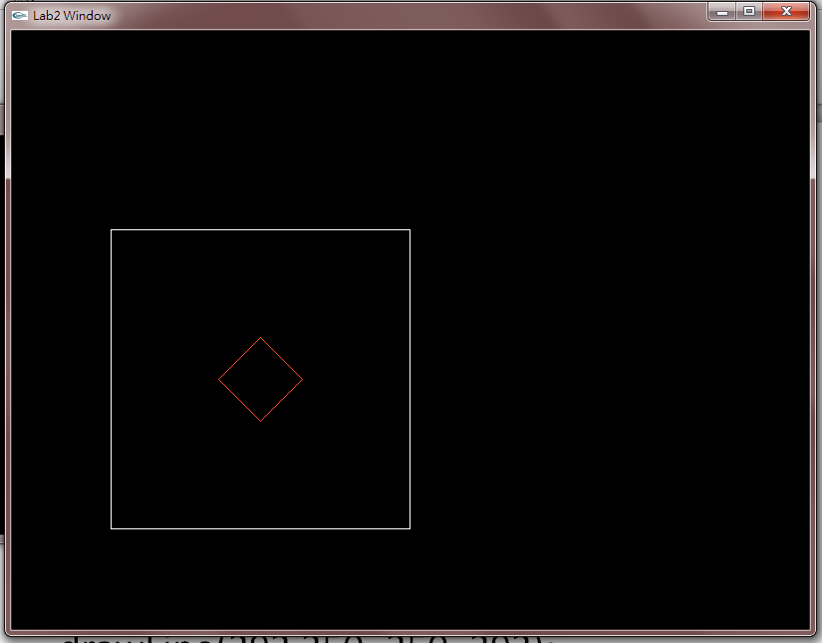
Step-by-Step
At Last, call function drawLine() that you finished in hw1 to draw polygon edges.
drawLine(250,292, 208, 250);
drawLine(208,250, 250, 208);
drawLine(250,208, 292, 250);
drawLine(292,250, 250, 292);
That’s all!

