Slide 1
3D Computer Graphics
Homework #3

Slide 2
Goal
Implement an OpenGL-like 3D Rendering Pipeline.
OS
WS
ES
PS
SS

Slide 3
Goal
You are to write a program
  Read a set of commands from file.
  Display result on screen.
The command set will tell you how build 3D world, and how to display it on screen.
The commands file called hw3.in.

Slide 4
Commands
All valid commands are list below:
  object filename
  translate X Y Z
  scale X Y Z
  rotate X Y Z
  reset
  observer PX PY PZ CX CY CZ Tilt Near Far FOV
  viewport VL VR VB VT
  end

Slide 5
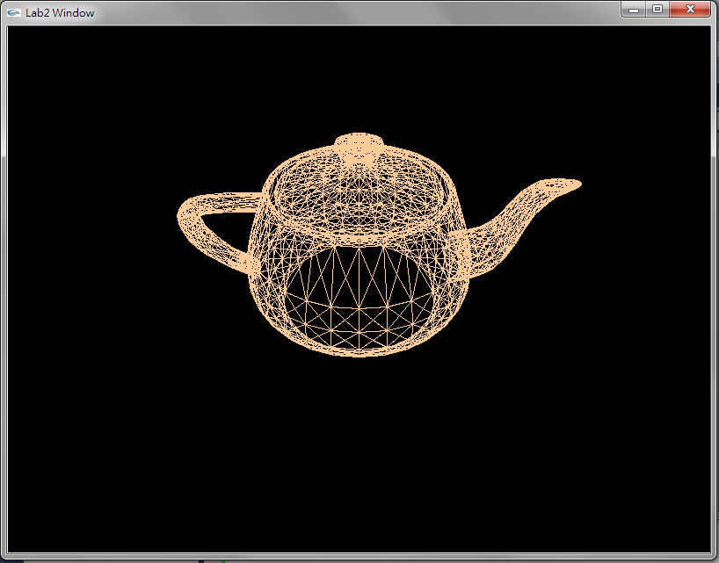
object command
object [filename]
  Load a 3d model file.
  Apply current modeling transform to the object.
  Ex. object teapot.asc

Slide 6
Modeling Transform
Modeling Transform:
  translate
  rotate
  scale
  reset
To position and orient a model.
Your progam Must maintain a Modeling Matrix.

Slide 7
Modeling Transform
translate X Y Z
  do a translation by (X, Y, Z)
  multiply current modeling matrix by T(X, Y, Z)
scale X Y Z
  do a scaling by (X, Y, Z)
  multiply current modeling matrix by S(X, Y, Z)

Slide 8
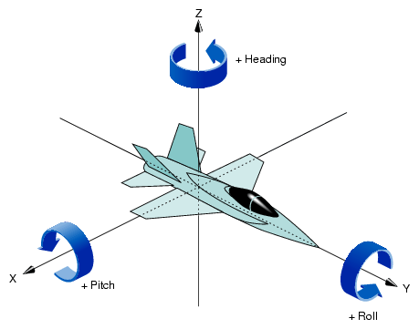
Modeling Transform
rotate X Y Z
  rotate X,Y,Z degree around the X-Axis, Y-Axis,
  and Z-Axis
  multiply current model matrix by Rotation
  Matrix Rx,Ry,Rz.
reset
  reset modeling matrix
  to identity.

Slide 9
Modeling Transform
scale 2 2 2
translate 10 0
rotate 0 90 0
translate 0 0 50
Modeling Transform Matrix =
T(0,0,50)*R(0,90,0)*T(10,0,0)*S(2,2,2)

Slide 10
Observer
  observer PX PY PZ CX CY CZ Tilt zNear zFar hFOV
    (PX, PY, PZ) : Eye’s position
    (CX, CY, CZ) : COI (Center of Interest)
    Tilt : tilt degree of camera
    zNear: distance of near clipping plane
    zFar : distance of far clipping plane
    hFOV : half Field of View

Slide 11
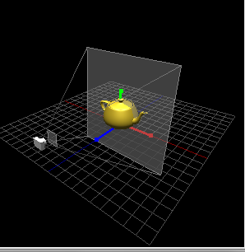
Observer
Tilt degree
COI
half FOV degree
Eye’s Position
zNear plane
zFar plane

Slide 12
Observer
Eye Transform
  (PX, PY, PZ) : Eye’s position
  (CX, CY, CZ) : COI (Center of Interest)
  Tilt : tilt degree of camera
Projection Transform
  zNear: distance of near clipping plane
  zFar : distance of far clipping plane
  hFOV : half Field of View

Slide 13
Command Viewport
  viewport VL VR VB VT
    the viewport rectangle area
Glut Window
(View Right, View Top)
(View Left, View Bottom)

Slide 14
Display Command
Display
  Run Rendering Pipeline.
  Draw the world on Screen!

Slide 15
Other Commands
end
  the end of commands.
#
  a line start with ‘#’ is comment, skip this line.

Slide 16
Sample #1
# load a teapot
object teapot.asc
# set viewport
viewport 0 800 0 600
# Eye (0,0,10) Look at (0,0,0)
observer 0 0 10 0 0 0 0 1 100 45
display
end

Slide 17
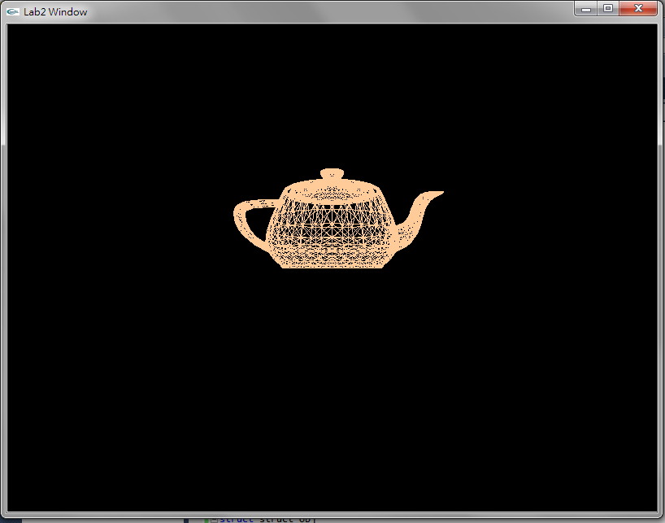

Slide 18
# load a teapot
object teapot.asc
# set viewport
viewport 100 400 100 400
# Eye (0,0,10) Look at (0,0,0)
observer 0 0 10 0 0 0 0 1 100 45
display
end

Slide 19
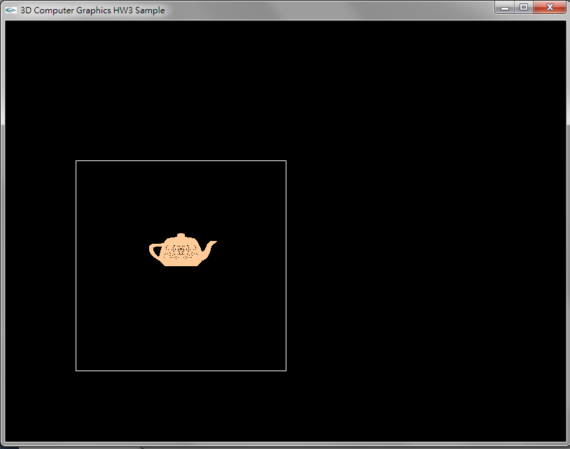

Slide 20
# modeling trasnform
translate 3 0 0
# load a teapot
object teapot.asc
# set viewport
viewport 0 800 0 600
# Eye (0,0,10) Look at (0,0,0)
observer 0 0 10 0 0 0 0 1 100 45
display
end

Slide 21
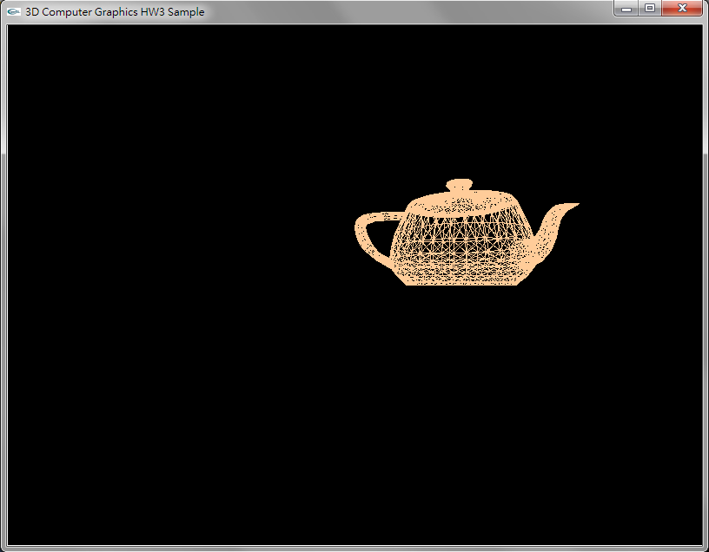

Slide 22
# modeling trasnform
translate 3 0 0
# load a teapot
object teapot.asc
# set viewport
viewport 0 800 0 600
# Eye at(5,5,5) Look at (0,0,0)
observer 5 5 5 0 0 0 0 1 100 45
display
end

Slide 23
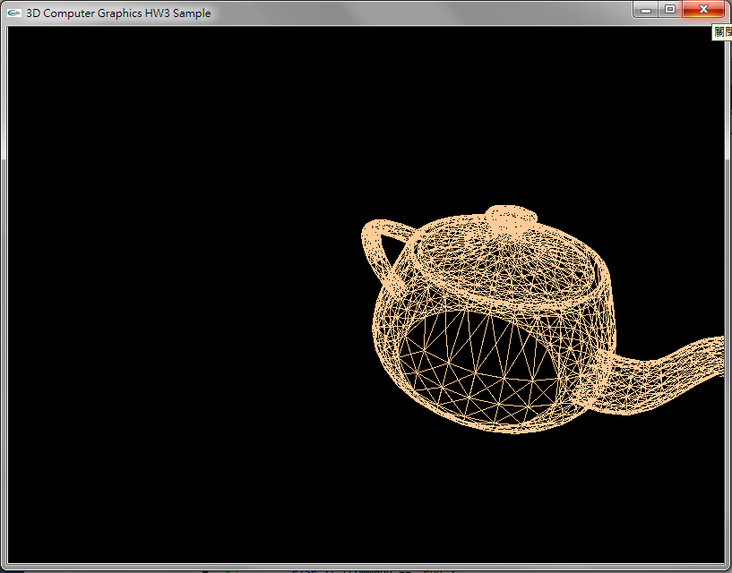

Slide 24
# modeling trasnform
rotate 0 90 0
translate 3 0 0
# load a teapot
object teapot.asc
# set viewport
viewport 0 800 0 600
# Eye (0,0,10) Look at (0,0,0)
observer 5 5 5 0 0 0 0 1 100 45
display
end

Slide 25
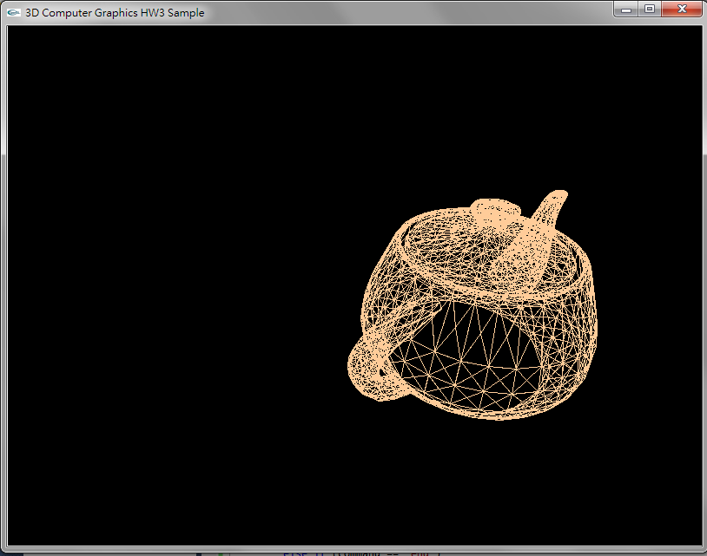

Slide 26
ASC file format
[number of vertices] [number of faces]
[x y z]
…
[x y z]
[3 v0 v1 02]
…
[3 v0 v1 02]
Total [number of vertices] lines
Total [number of face] lines

Slide 27
How to read ASC file
ASC file format is very simple.
We can define a struct to keep asc model data.
struct ASCModel
{
int num_vertex;
int num_face;
float vertex[MAX][3];
int face[MAX][4];
};

Slide 28
struct ASCModel cube;
ifstream fin("cube.asc");
// get number of vertex/face first
fin >> cube.num_vertex >> cube.num_face;
// read vertex one by one
for(int i=0; i<asc.num_vertex; ++i) {
fin >> cube.vertex[i][0] >> cube.vertex[i][1]>> cube.vertex[i][2];
}
// read face one by one
for(int i=0; i<asc.num_faces; ++i) {
fin >> n
>> asc.face[i][0] >> asc.face[i][1]
>> asc.face[i][2] >> asc.face[i][3];
}
To Read an ASC model file is easy & straightforward
because ifstream skip all whitespace, \t, \n, by default.
Here is a sample to read cube.asc:

Slide 29
8 6
-0.5 0.5 0.5
0.5 0.5 0.5
0.5 -0.5 0.5
-0.5 -0.5 0.5
-0.5 0.5 -0.5
0.5 0.5 -0.5
0.5 -0.5 -0.5
-0.5 -0.5 -0.5
4 1 2 3 4
4 5 6 2 1
4 8 7 6 5
4 4 3 7 8
4 2 6 7 3
4 5 1 4 8

