Slide 1
Computer Graphics HW#4

Slide 2
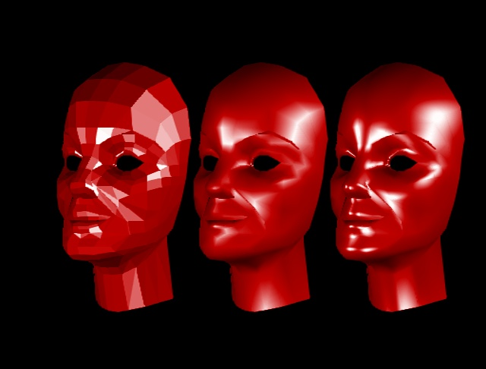
Homework #4 Goal
Implement Gouraud Shading or Phong Shading based on Hw3
Flat
Gouraud
Phong

Slide 3
Homework #4 Goal
You are to write a program
  Read a set of commands from file.
  Display result on screen.
The command set contains the necessary information to build the 3D world and display it on screen.
The commands file called hw4.in.

Slide 4
Commands
These commands are the same as Hw3
  observer PX PY PZ CX CY CZ Tilt Near Far FOV
  translate X Y Z
  scale X Y Z
  rotate X Y Z
  display
  Reset
  end
Just follow the rule of Hw3.

Slide 5
Commands
New commands of Hw4 are list below:
  object [filename] R G B Kd Ks N
  ambient Ka
  background R G B
  light N Intensity X Y Z
Caution! No more ‘viewport’ command.
  The Size (Width/Height) of window will be given at the first line of input file.

Slide 6
Object (new)
  object [filename] R G B Kd Ks N
  Load a 3d model file.
  Apply current modeling transform to the object.
  (R, G, B) is the Material Color of 3D Model.
  Kd, Ks, N is Constants for Lighting Equation.

Slide 7
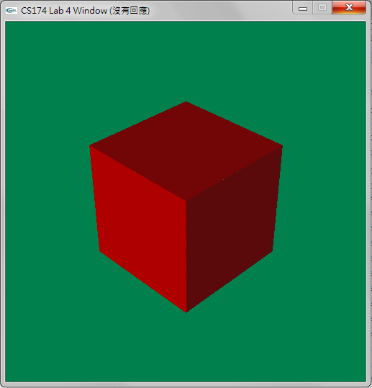
ambient/backgound
ambient Ka
  The ambient light intensity for current 3d scene.
  background R G B
  The background Color of window.
Background color(0.0, 0.5, 0.3)

Slide 8
Light
  light ID Ip X Y Z
  create a point light source at Position(X, Y, Z)
  Ip is intensity of point light source.
  ID is an ID number (1~4) of light source.
  There are at most 4 light sources.

Slide 9
Simple.in
800 800
ambient 0.2
object triangle.asc 1.0 0.0 0.0 .7 .3 4
observer 0 0 5 0 0 0 0 1 1000 15
background 0.5 0.5 0.4
light 1 .8 5.0 10.0 20.0
display
end
Define the window size (Width and Height).

