Slide 1
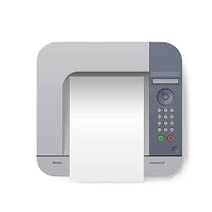

DATA ANALYTICS CERTIFICATION EXAMINATION
Pens and Printers Sales Strategy Presentation
By: Angelica Adjei-Kwarteng

Slide 2
PROJECT OBJECTIVE
W
W
WHY
Update on the new product line sales approaches.

Slide 3
PROJECT OBJECTIVE
W
W
WHO
WHY
The Executive Team
Update on the new product line sales approaches.

Slide 4
WHAT THEY NEED TO KNOW
Total customers by approach
Overall spread of revenue
Revenue spread by method
Recommended methods and others
?

Slide 5
WHAT THEY NEED TO KNOW
Total customers by approach
Overall spread of revenue
?
Recommended methods and others
Revenue spread by method

Slide 6
ABOUT THE DATASET
Some wrong datatypes
Null values and data quality.
E.g.: Incorrect entries.
8 columns and 15000 rows
3 distinct approaches.
Missing values in Revenue column.
Set a threshold of 5% to drop or impute missing values with median value.
Data validation: Wrong/Incorrect entries updated.
Dataset duplicated & renamed
Updated column datatypes
Imputed missing values.
Ensured data validation.

Slide 7
ABOUT THE DATASET
8 columns and 15000 rows
Some wrong datatypes
Null values and data quality.
E.g.: Incorrect entries.
3 distinct approaches.
Missing values in Revenue column.
Set a threshold of 5% to drop or impute missing values with median value.
Data validation: Wrong/Incorrect entries updated.
Dataset duplicated & renamed
Updated column datatypes
Imputed missing values.
Ensured data validation.

Slide 8
FINDINGS & INSIGHT
Total Customers by approach
7466
15,000 TOTAL CUSTOMERS.
Email strategy: 7466 customers.
Call strategy : 4962 customers.
Email + Call strategy: 2572 customers.
4962
2572
Email
Call
Email + Call

Slide 9
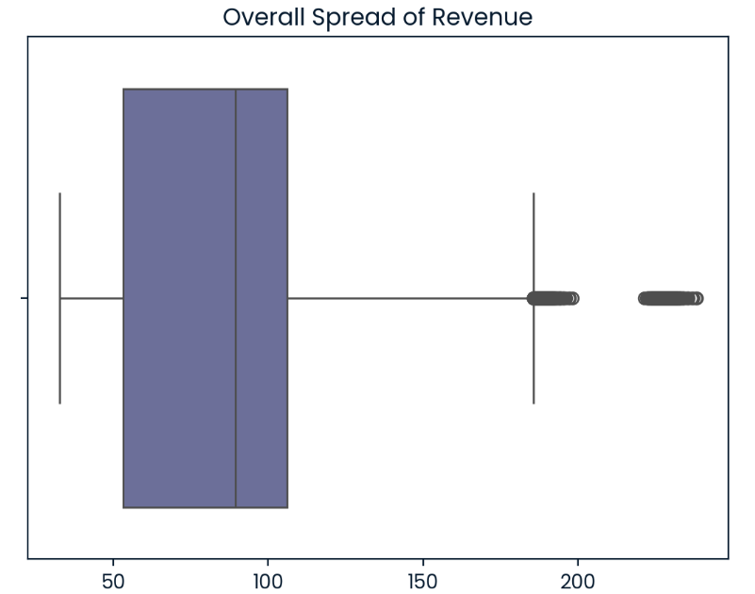
FINDINGS & INSIGHTS
Overall spread of revenue is between 80 – 100.
Spread of revenue by each method ranges from 50 – 180.

Slide 10
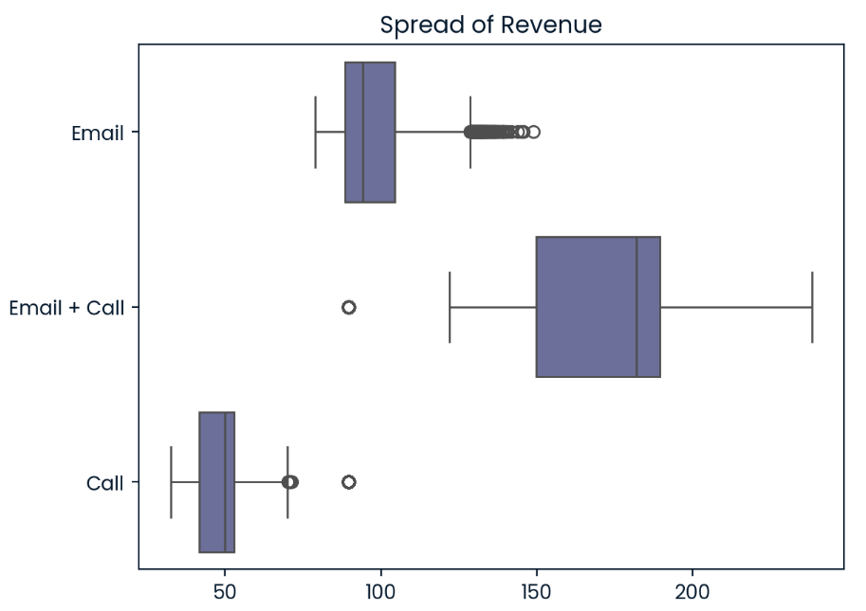
FINDINGS & INSIGHTS

Slide 11
FINDINGS & INSIGHTS
Weeks by Each Approach
1244
Average Number of Weeks Recorded
Email strategy: 1244 weeks.
Call strategy : 827 weeks.
Email + Call strategy: 429 weeks.
827
429
Email
Call
Email + Call

Slide 12
LIMITATIONS
Outliers.
Email strategy recorded very high outliers indicating that very few customer activities yielded higher sales hence further investigations must be made about revenue above 120 to be sure the business captured the right data.

Slide 13
LIMITATIONS
Revenue by weeks.
Some weeks recorded a decline in revenue. Further investigation needed.

Slide 14


RECOMMENDATIONS
Tailor our sales to cut down budget and meet customer demands.
Best approach: Email + Call strategy.
Reason: More revenue within few weeks.
Based on our findings,

Slide 15
APPENDIX
To view detailed analysis, find project in my SQL project repository here.
Project was also done using Python. View detailed analysis in python here.

Slide 16
Q&A
Do share your feedback.
Thank you!!

