Slide 1
Dropbox like Storage
Haipeng Liu
Jianing Geng
Lixu He
Li Cao
Yucheng He

Slide 2
Project Objectives
In this project, we are going to create a dropbox-like data storage system which could result in less storage capacity and increased productivity.
Dropbox-like storage in this project should accept the following functions:
Creating a local file system
Loading and encoding of text files
Retrieving back and decoding of text files
Listing of loaded files
Deleting of text files
Programming language:c++
Programming language:c++

Slide 3
For Storage
——difficult
Internal Metadata Database: will keep track of all files, chunks, their versions and their location in the file system.
Chunker: will split the files into small chunks called blocks. It will also be responsible for rebuilding files from chunks.
Watcher: will monitor the local workspace folder and notify the indexer of any action performed by the user, for example, when the user creates, deletes or updates files or folders. The watcher also listens for any changes that occur on other clients broadcast by the synchronization service.
Indexer: will process events received from the monitor and update the internal metadata database with information about the blocks of modified files. Once the blocks are successfully committed/downloaded to Cloud Storage, the Indexer will communicate with the remote synchronization service to broadcast the changes to other clients and update the remote metadata database.

Slide 4
A simple file system
The business code mainly needs to complete, firstly, to determine the operation request to be implemented now, to load the file （divide the file into fixed size blocks, each block needs to be compared with the previous block, and if the block content is the same, it is not repeatedly stored, and Huffman is used for compression）, to list the existing files, and to delete the file （delete only the block associated with the file when requesting deletion, and to mark it）.
So the core code includes block generation, duplicate block detection, huffman compression, etc.
The business code implements a simple file system by calling the core code in a logical way.

Slide 5
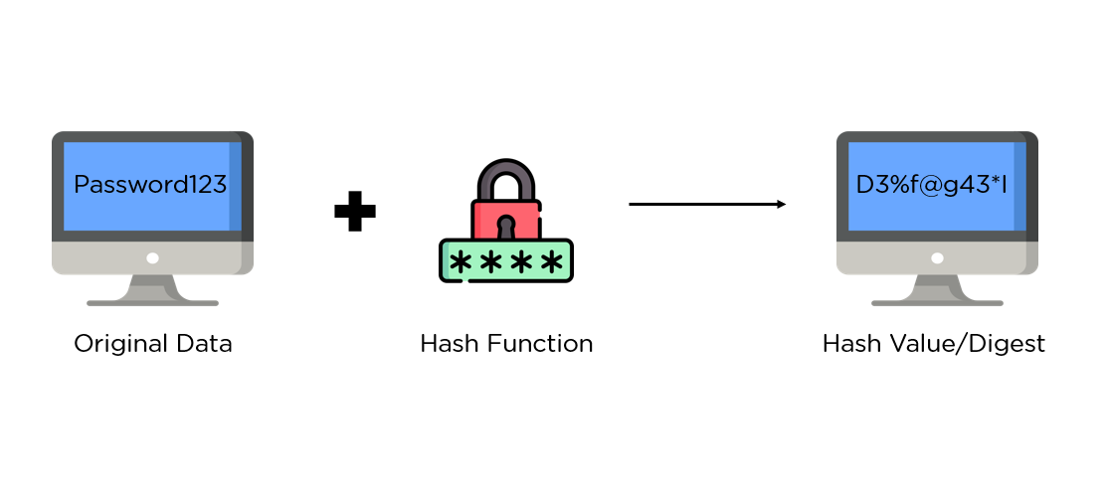
What is hashing?
The process of scrambling raw information to the extent that it cannot reproduce it back to its original form.

Slide 6
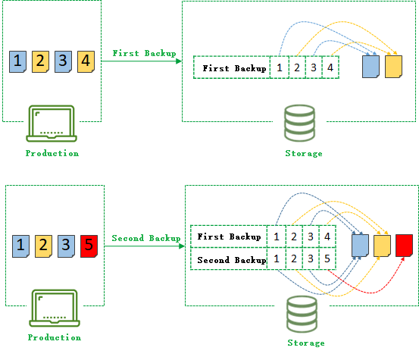
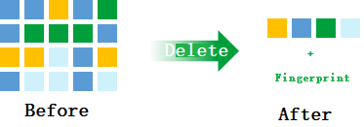
Delete duplicate blocks
It is a technique used to eliminate duplicate copies of data to improve storage utilization. It can also be applied to network data transfers to reduce the number of bytes that must be sent. For each new incoming block, we can calculate its hash value and compare that hash value with all the hashes of existing blocks to see if the same block already exists in storage.

Slide 7
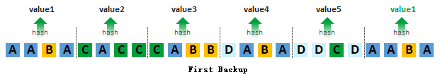
The data stream or file is chunked in a certain way, and the hash calculation is performed on a block-by-block basis to find the same block of data for deletion.

Slide 8
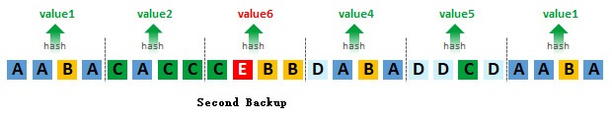
CABB->CEBB
the hash value of the third data chunk in the whole string has changed, which does not affect the hash values of other data chunks, so the overall redeletion effect is better

Slide 9
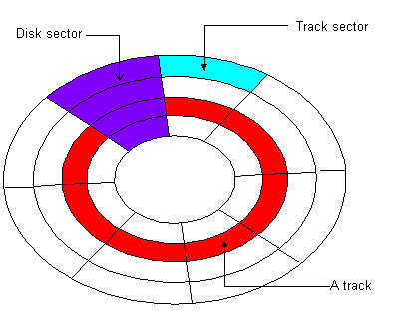
Divide a file into Chunks
Data storage system can put chunks into different blocks

Slide 10
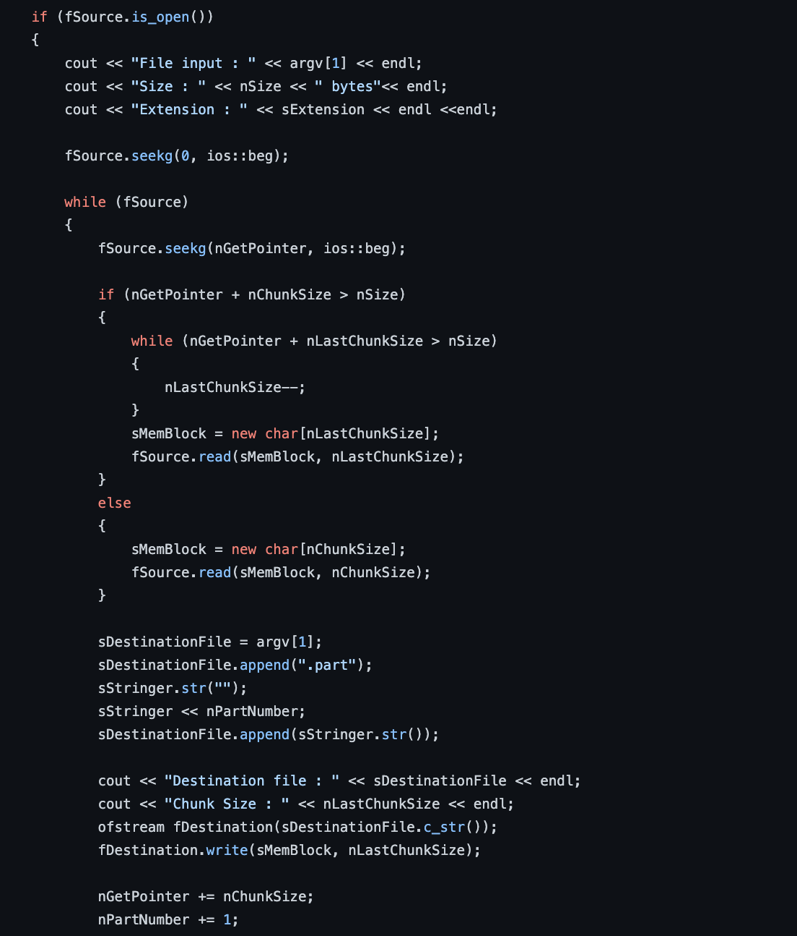
After receive a file it will read the size of the file and cut it to specified size (by bytes）

Slide 11
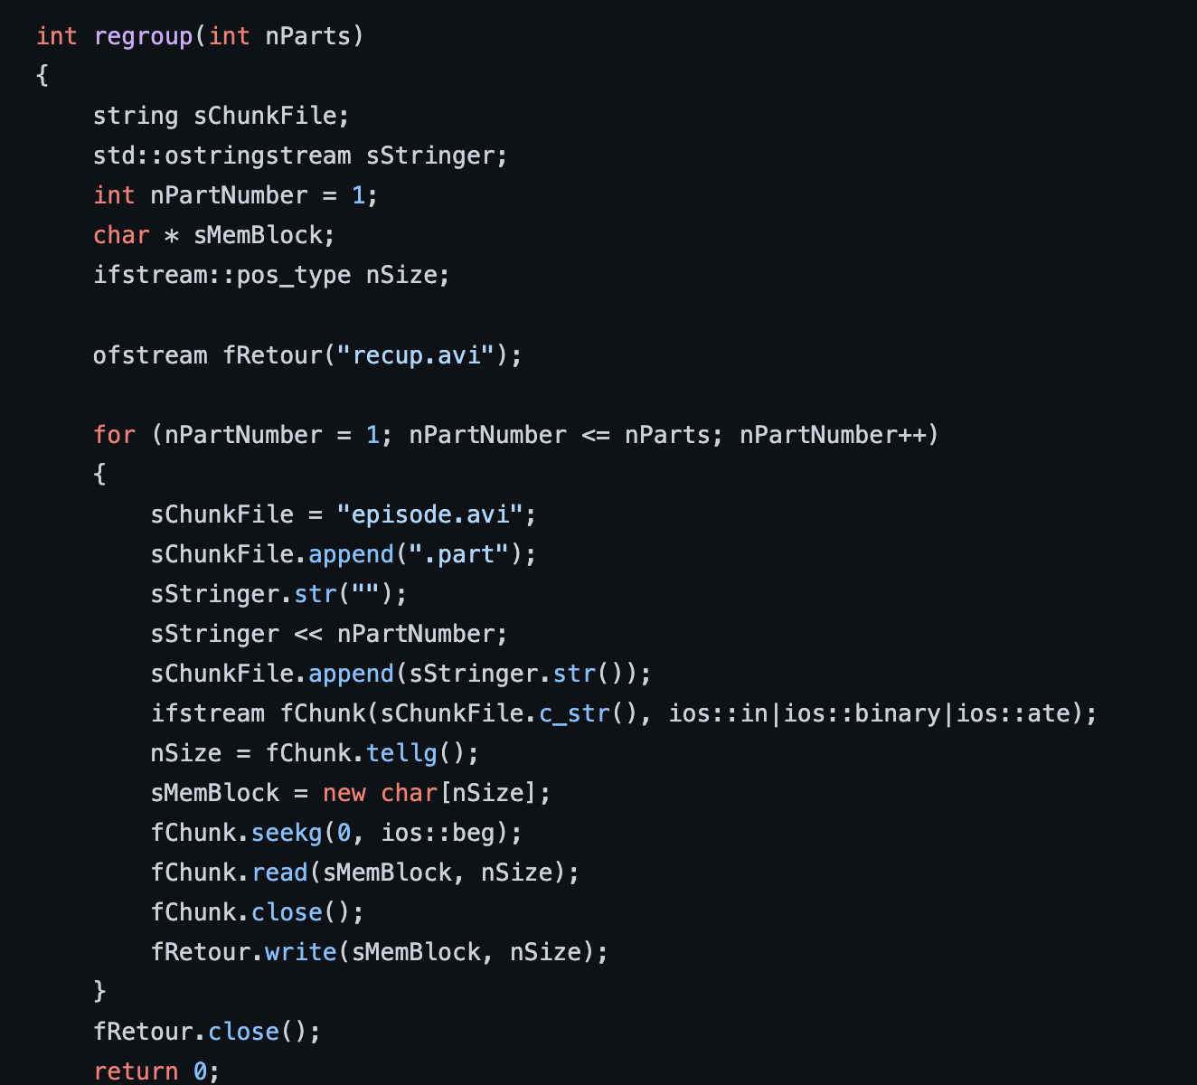
Re-group chunks back to file

Slide 12

User input file
Divide into chunks
Compress data use huffman tree

Slide 13
Huffman coding
Huffman coding is a lossless data compression algorithm. The idea is to assign variable-length codes to input characters, lengths of the assigned codes are based on the frequencies of corresponding characters. The most frequent character gets the smallest code and the least frequent character gets the largest code.

Slide 14
Example
For example, there is a string of text: aaaabbbccd, if we store the string in the file alone, it will at least take up 10 bytes. So in order to save our valuable disk space and transfer time, we can use Huffman coding.
This string of text, a appeared 4 times, b appeared 3 times, c appeared 2 times, and d appeared only once. So we can recode it.
a | 0
b | 10
c | 111
d | 110

Slide 15
Example
So now we can convert original string of text into: 00001010 10111111 110.
By replacing the original characters with binary bits, the string is compressed by replacing the more frequent characters with a shorter code.
The codes obtained by this method are prefix codes: the code of any character is not a prefix of the code of another character. This ensures the uniqueness of the decoding code.

Slide 16
HuffmanTree Pros&Cons
Pros: Huffman coding is the theoretically optimal compression coding.
It’s lossless so we can unpack it correctly.
It’s more space-efficient than binary encoding

Slide 17
HuffmanTree Pros&Cons
Cons:
It needs to be decoded from the beginning of the text to get the correct result. We cannot decode from halfway, and even if the text is long, we also need to decode from the beginning.
If the order is messed up somewhere, the whole text may be wrong
It’s not secure enough

Slide 18
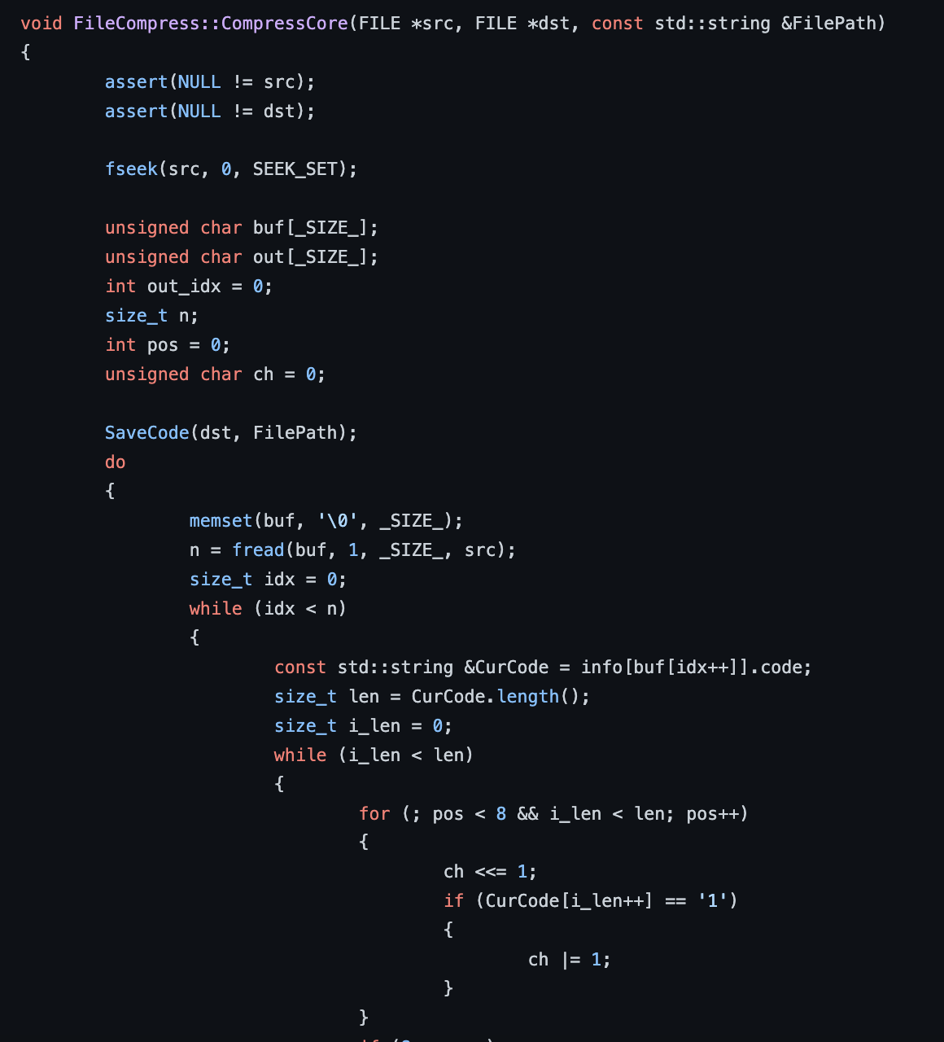
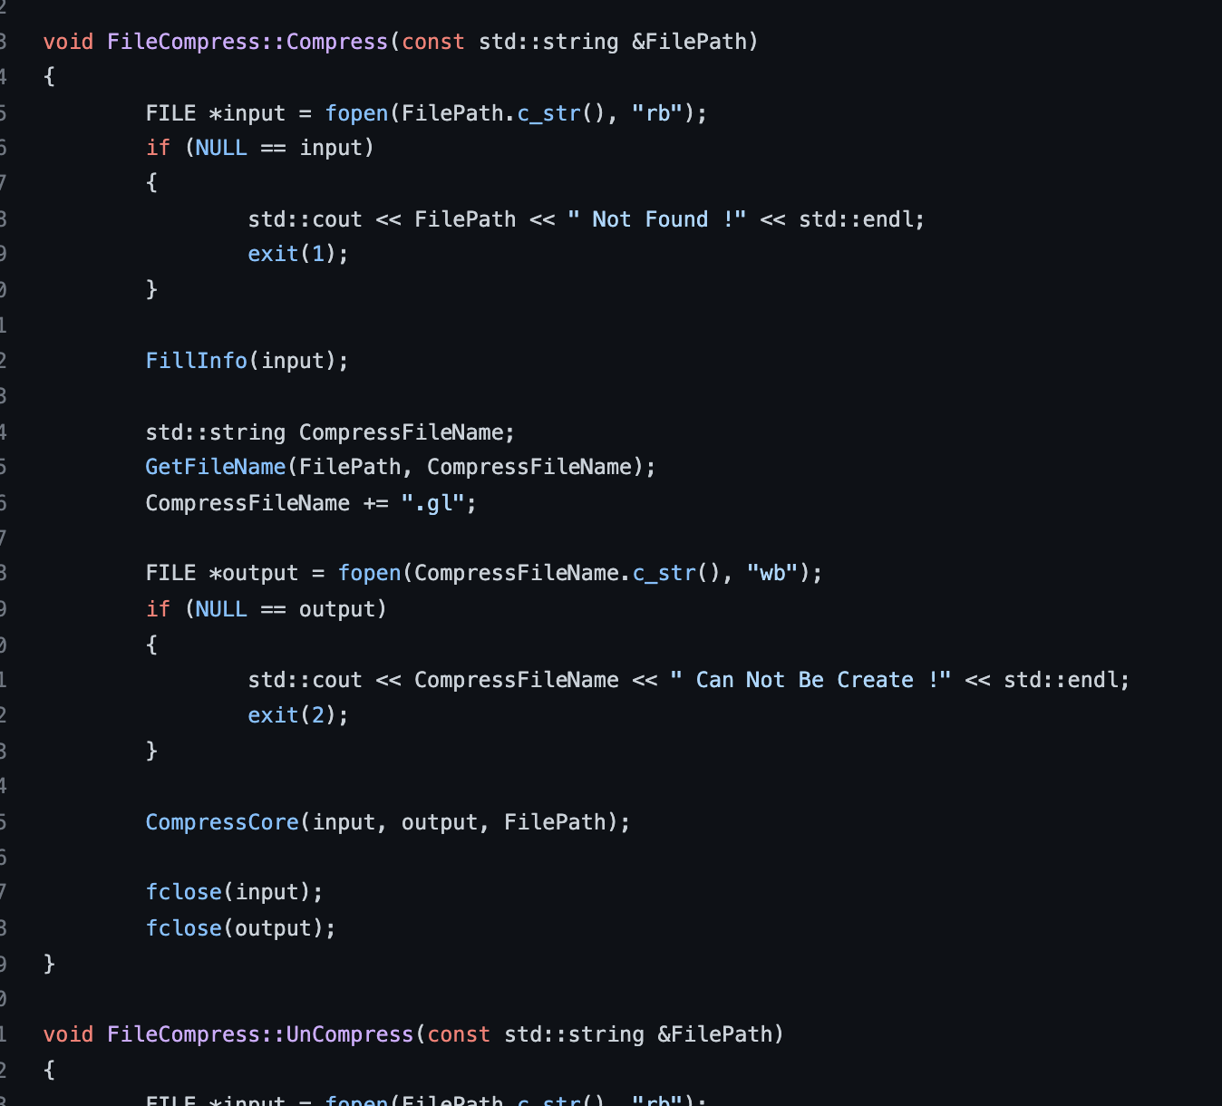
How we write Huffman Tree as A data structure to store our data
Compress data code

Slide 19
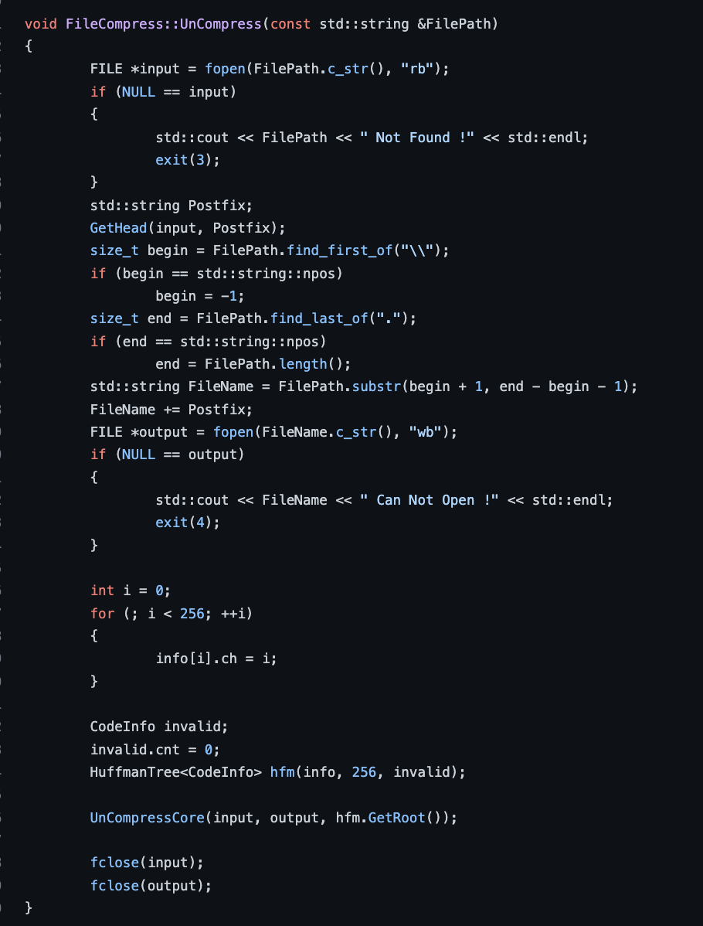
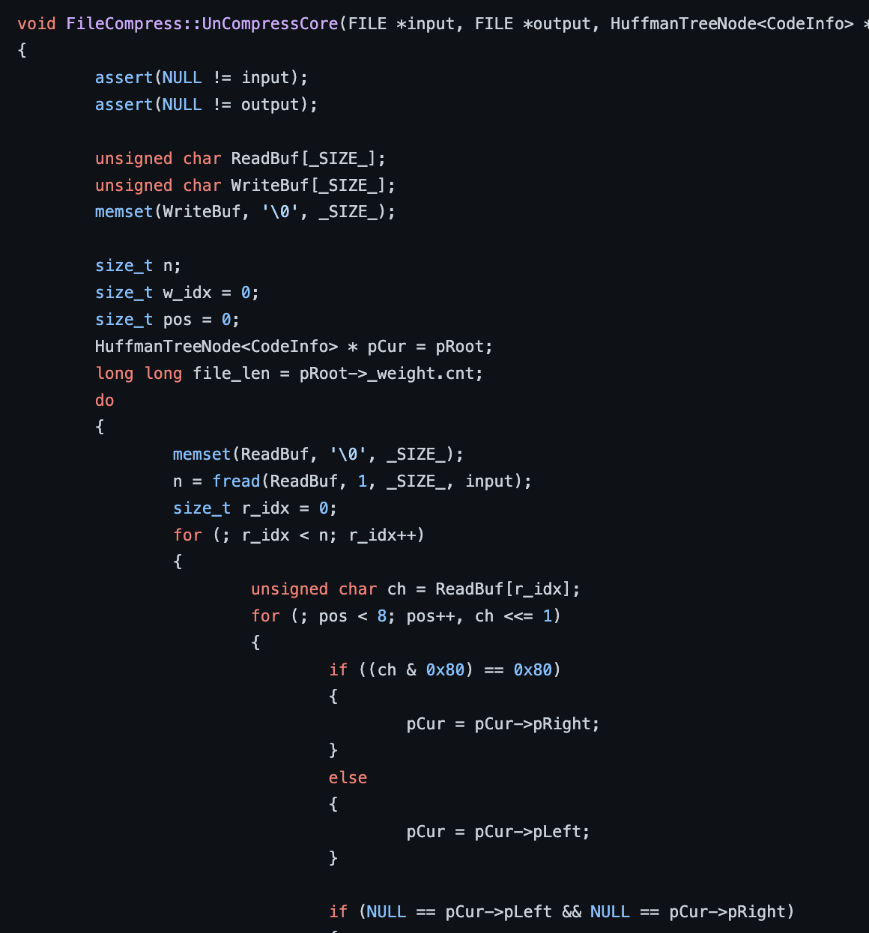

Uncompress code
Original file
Data chunks
Uncompress data

Slide 20
User input file
Divide into chunks
Request a new disk used to fill with data
Compress data use huffman tree

Slide 21
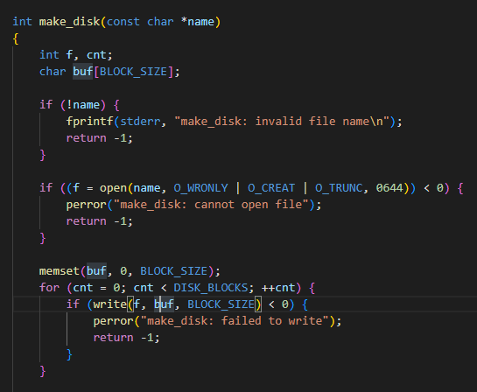
Used command line to show all files

Slide 22
The general structure of the file system
The file system is mainly responsible for managing the space on the disk. The disk must contain at least three parts of data: superblock, inodes, and data blocks.
Superblock
The super block is at the root of each file system. The super block describes and maintains the state of the file system.
Inode
Each object (file or directory) managed in the file system is represented as an inode in Linux. The inode contains all the metadata needed to manage the objects in the file system, including the operations that can be performed on the objects.
Data block
Read the data block (one or more) pointed by the inode, and parse the content of the data block according to the file type.

