Slide 1

Request for
CO Interface Test
with Full-Rainbow DISTI
Logistics Reformation WG
BPI/EA Projet
Date : 13th, Oct 2016
Information Systems Division
RENESAS ELECTRONICS CORPORATION

Slide 2
Contents
Information of Interface Test
Background
Test Scope
Test Steps
Test Schedule
Interface List between REL and Agent/DISTI
Change Points
Test Cycle
Communication Path

Slide 3
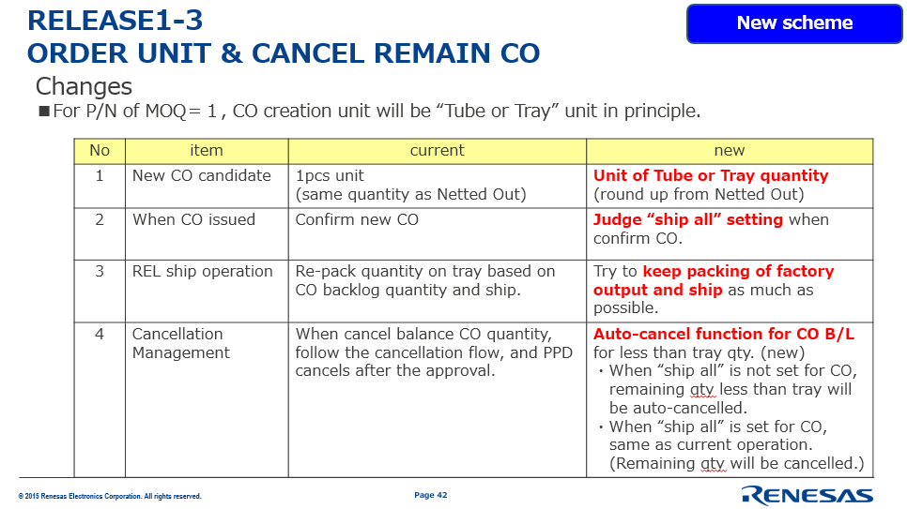
1. Information of Interface Test
[Background]
As explained in “Change of REL system (BPI/EA) Briefing For Disti” sessions held on September, Renesas system and operation will implement some new schemes to improve Logistics and SCM efficiency.
As a part of those schemes, CO Interface for Full Rainbow DISTI will have 2 new fields.
We would like to conduct interface test with DISTI, with the help of Renesas OSCs communication support.
[Test Scope]
CO interface (link from Renesas to DISTI)
*In total, there are 11 interfaces between REL and DISTI as in Page 4.
For this time, only CO interface will be changed.
[Test Steps]
There are 4 steps for this test.
1. REL to create a test file.
2. REL to put the test file in e-percel client.
Folder name C:\RENESAS_QAS\receive
3. DISTI to get the test file from the e-percel client.
4. DISTI to check if the test file can be imported and processed.
[Test Schedule]
1st Nov 2016 ~ 18th Nov 2016
For more detail see Page 6.
Please refer to the pages of “ORDER UNIT & CANCEL REMAIN CO” in September’s session material.

Slide 4
2. Interface List between REL and Agent/DISTI
This time, Test Scope for DISTI is CO I/F only.
From
I/F
To
Agent
(Japan)
Agent
(Oversea)
Disti
Change point
DISTI Test
Need or Not
REL
Logistics
CO
Agent/
Disti
Mandatory
Mandatory
Mandatory
Additional Fields
Need
Shipped result
Mandatory
Optional
Optional
None
No need
Check result
Mandatory
-
-
None
No need
Billing
Mandatory
Optional
Optional
None
No need
Charge
Mandatory
-
-
None
No need
REL
SCM
CO candidate
Mandatory
(only Forward Process)
Mandatory
(only Forward Process)
Mandatory
(only Forward Process)
Additional Fields
No need
CO promise reply date
Optional
Optional
Optional
None
No need
Business reply date
Optional
Optional
Optional
None
No need
WIP
Optional
Optional
Optional
None
No need
JSF
Optional
Optional
Optional
None
No need
REL Logistics
Packing information
Optional
Optional
Optional
Change
No need
REL
SCM
PSI err
Mandatory
Mandatory
Mandatory
None
No need
PartNo master
Optional
-
-
None
No need
Agent/
Disti
PSI
REL SCM
Mandatory
Mandatory
Mandatory
None
No need
Check
REL Logistics
Mandatory
-
-
None
No need
CF
REL SCM
Optional
Optional
Optional
None
No need
CO confirmation
Mandatory
(only Forward Process)
Mandatory
(only Forward Process)
Mandatory
(only Forward Process)
Additional Fields
No need

Slide 5
3. Change Point of CO I/F format
Table Name | File | Change point
CO | IF Format_CO_Ver 1.1.xls | 2 New fields will be added No.30 Ship All Flag No.31 Automatically Canceled CO Flag

Slide 6
4. Test Cycle Plan
November 2016
1 | 2 | 3 | 4 |  | 7 | 8 | 9 | 10 | 11 |  | 14 | 15 | 16 | 17 | 18
Tue | Wed | Thu | Fri |  | Mon | Tue | Wed | Thu | Fri |  | Mon | Tue | Wed | Thu | Fri
Disti
Week2. Receive, Import
& Process Test
Week3. Spare week
REL
Week1. Data Preparation & Transmission
Week1
1. REL HQ IT Create test file.
2. REL HQ IT Put test file in test server.
Folder name C:\RENESAS_QAS\receive
3. REL HQ IT Update preparation status in SharePoint
4. REL HQ IT Inform REL OSC, and ask to start to
communicate with DISTI.
5. REL OSC Inform DISTI to start testing.
Week2
7. DISTI Receive the file and check if the file can be
imported and processed,
report the result to REL OSC.
8. REL OSC Inform the test result to REL HQ IT.
If result is OK, update the status in Sharepoint.
If result is NG, go to 9.
9. REL HQ IT
Investigate the cause and take countermeasure.
Go back to step 1 / 2 according to the situation, and
continue the test.

Slide 7


5. Communication Path
REL HQ IT
REL OSC (HK)
HK DISTI
HK DISTI
10 DISTIs
REL OSC (SH)
SH DISTI
5 DISTIs
SH DISTI
REL OSC (TW)
TW DISTI
TW DISTI
5 DISTIs
REL OSC (SG)
SG DISTI
7 DISTIs
SG DISTI
・ REL HQ IT request REL OSC to support communication with DISTIs in each region.
・ REL HQ IT and REL OSC will use e-mail and sharepoint for communication.
(Sharepoint Path will be informed to each OSC in charge person by e-mail.)

Slide 8
www.renesas.com

