Slide 1
What is PSI data ?

Slide 2
1. Workings of Rainbow

Slide 3
1. Workings of Rainbow - Support Model
On this page, please understand that there is SO (Sales Order) line and CO (Committed Order) line.
Calculation of Rainbow starts from SO line and end up with SO line.
Rainbow’s Support Model
auto calculation
manual input
CO Line Demand
Shipping Demand
Stock
SO Line Demand
End Sales Demand
Demand/Supply
Engine
REL
Stock Point
Customer
CO
SO
auto calculation
auto calculation
CO Line Reply
Shipping Reply
Stock
SO Line Reply
End Sales Reply
Rainbow defines Single Stock Point between REL and Customer in every case of Sales Route.
Between "Customer" and "Stock Point" => treated as SO --- [SO Line]
Between "REL" and "Stock Point" => treated as CO --- [CO Line]
Rainbow sequentially calculates SO line demand => CO line demand => CO line reply => SO line reply

Slide 4
1. Workings of Rainbow - Changing Point
Business Route through Disty
REL
OSC
Disty
Customer
Current Implementation
out of SCM scope
REL
OSC
Disty
= Customer
Customer
CO
SO
Stock
To-Be Implementation
REL
OSC
Disty
Customer
CO
SO
stock less
Stock
Disty will change from Customer to Stock Point.

Slide 5
1. Workings of Rainbow - to be Stock Point
User inputs JSF only.
And following items are calculated by Rainbow automatically everyday.
How are they calculated automatically ?
manual input
JSF (Judged Sales Forecast)
= demand date base forecast
How many pieces of SO you will
receive from customer ?
3
Netted SF Out
4
CO,UO+NettedOut
2
Adjusted SF Out
JSF
1
Shipping
Demand
Stock
End Sales
Demand
Demand/Supply
Engine
REL
Disty
Customer
CO line
SO Line
Shipping
Reply
Stock
End Sales
Reply
5
AATP Ex-W
6
Shippable-AATP
AATP

Slide 6
1. Workings of Rainbow - to be Stock Point
SO line
manual
input
JSF
forecast of demand date base SO booking
after current week
plus factor
minus factor
sales
shipped SO
sales
delinquent
SO
inventory
level
logistic
TAT
daily batch
CO line
Adjusted SF Out
Netted Out
daily batch
remaining qty to ship from disty to customer
remaining qty to ship from REL to disty
channel
inventory
REL ship
consignment
on hand
in transit
shipped &
pre-in stock
inventory
Disty GR
purchase
PSI data are necessary for this
calculation. Stock Point must
create PSI and send it to REL.
red frame
data REL does not have
= need to receive from disty
PSI data
=> Purchase, Sales, Inventory

Slide 7
2. What is PSI ?

Slide 8
2. What is PSI ? - mandatory requirement 1
1. Purchase
(1) goods receipt
2. Sales
(1) SO booking
(2) SO backlog
(3) SO ship
3. Inventory
(1) on hand inventory
(2) consignment inventory
All items must be managed
by Customer and PartNo
of SO.

Slide 9
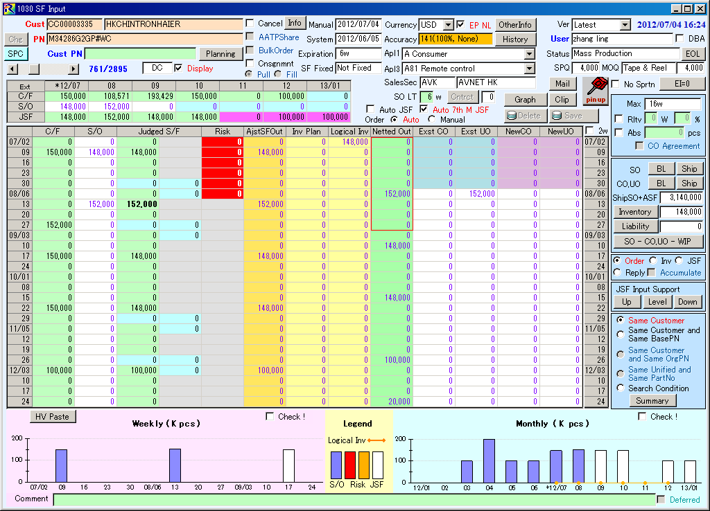
2. What is PSI ? - mandatory requirement 1
JSF input screen is prepared by Customer & PartNo.
And [SO] data are reflected in this screen automatically.
It means as follows.
Customer of this screen = Customer of SO
PartNo of this screen = PartNo of SO
Namely demand must be managed by Cust/PN of SO.
And CO line demand is calculated to subtract inventory.
It means that inventory must be managed by Cust/PN of SO.
=> All inventory must be allocated to individual customers.

Slide 10
2. What is PSI ? - mandatory requirement 1
inventory by customer
If your company manages inventory by customer, there is no problem.
But I guess a lot of companies manage inventory by PartNo.
Assumption : inventory is managed by PartNo.
=> How should inventory data by customer be created ?
There are three ways to create inventory data by customer.
I'd like to explain them one by one.
warehouse (inventory by Cust/PN)
warehouse (inventory by PartNo)
PartNo1
for CustA
xxx pcs
PartNo1
for CustB
xxx pcs
PartNo1
xxx pcs
PartNo2
xxx pcs
PartNo2
for CustA
xxx pcs
PartNo2
for CustB
xxx pcs
PartNo3
xxx pcs
PartNo4
xxx pcs
no problem
Each inventory should be allocated to customer.

Slide 11
2. What is PSI ? - mandatory requirement 1
inventory by customer
Inventory Management by Cust/PN : Option 1
Modify ERP itself to mange inventory by Cust/PN
=> add "Customer" as a key to manage inventory
This seems hard to realize but best.
PartNo
Customer
Qty
R1111
AAA
3,000
PartNo
Qty
R1111
BBB
5,000
R1111
10,000
R1111
CCC
2,000
R2222
5,000
R2222
BBB
5,000
R3333
20,000
R2222
DDD
0
R3333
AAA
5,000
R3333
DDD
15,000

Slide 12
2. What is PSI ? - mandatory requirement 1
inventory by customer
Inventory Management by Cust/PN : Option 2
NOT modify ERP itself but change meaning of PN to mange inventory by Cust/PN
=> concatenate PartNo and Customer and treat it as PartNo
This seems not so hard but hard to utilize one inventory among plural customers.
PartNo
Qty
R1111/AAA
3,000
PartNo
Qty
R1111/BBB
5,000
R1111
10,000
R1111/CCC
2,000
R2222
5,000
R2222/BBB
5,000
R3333
20,000
R2222/DDD
0
R3333/AAA
5,000
R3333/DDD
15,000

Slide 13
2. What is PSI ? - mandatory requirement 1
inventory by customer
Inventory Management by Cust/PN : Option 3
NOT modify ERP itself and allocate inventory to each customer outside of ERP
=> allocate inventory through PSI creation logic
This seems realistic but error handling is necessary to keep consistency.
PSI data (with customer)
PartNo
Customer
Qty
ERP (no change)
R1111
AAA
3,000
PartNo
Qty
R1111
BBB
5,000
inventory
allocation
logic
R1111
10,000
R1111
CCC
2,000
R2222
5,000
R2222
BBB
5,000
R3333
20,000
R2222
DDD
0
R3333
AAA
5,000
This allocation system must be developed by disty.
R3333
DDD
15,000

Slide 14
2. What is PSI ? - mandatory requirement 1
inventory by customer
sample logic of Option 3
ERP
yesterday's status
R1111 = 10,000
R1111 & AAA : 3,000
R1111 & BBB : 5,000
yesterday's allocation
R1111 & CCC : 2,000
GR from REL
ship to customer
AAA : 2,000
in
ERP
today's status
R1111 = 7,000
out
BBB : 4,000
CCC : 1,000
CCC : 2,000
(yesterday) (in) (out)
today's inventory of AAA = 3,000 + 2,000 - 0 = 5,000
today's inventory of BBB = 5,000 + 0 - 4,000 = 1,000
today's inventory of CCC = 2,000 + 1,000 - 2,000 = 1,000
------------------------------------------------------------------------------
total = 7,000
Today's inventory can be calculated
based on yesterday's inventory,
today's GR and today's ship.

Slide 15
2. What is PSI ? - mandatory requirement 1
inventory by customer
sample logic of Option 3 : error handling
(yesterday) (in) (out)
today's inventory of AAA = 3,000 + 2,000 - 0 = 5,000
today's inventory of BBB = 5,000 + 0 - 4,000 = 1,000
today's inventory of CCC = 2,000 + 1,000 - 2,000 = 1,000
------------------------------------------------------------------------------
total = 7,000
error 1
This result could be negative.
In such a case, inventory should
be changed to zero.
error 2
There could be a gap between total of
logical inventory and inventory in ERP.
In such a case, logical inventory should
be changed to meet ERP.
=> When zero adjust is done to cater for error 1,
total of logical inventory is never equal to ERP.
GR from REL
ship to customer
AAA : 2,000
in
ERP
today's status
R1111 = 7,000
out
BBB : 4,000
CCC : 1,000
CCC : 2,000

Slide 16
2. What is PSI ? - mandatory requirement 1
inventory by customer
sample logic of Option 3 : example of error handling
yesterday's allocation
ship to customer
R1111 & AAA : 3,000
in
ERP
today's status
R1111 = 5,000
out
R1111 & BBB : 5,000
no GR
CCC : 5,000
R1111 & CCC : 2,000
total : 10,000
(yesterday) (in) (out)
today's inventory of AAA = 3,000 + 0 - 0 = 3,000 => 3,000 (OK)
today's inventory of BBB = 5,000 + 0 - 0 = 5,000 => 5,000 (OK)
today's inventory of CCC = 2,000 + 0 - 5,000 = -3,000 => 0 (error 1)
-------------------------------------------------------------------------------------------
total = 8,000
gap : 3,000 must be reduced
rule to cater for error 2 : reduce inventory from a customer who has the largest inventory
(yesterday) (in) (out)
today's inventory of AAA = 3,000 + 0 - 0 = 3,000 => 3,000 (OK) => 3,000
today's inventory of BBB = 5,000 + 0 - 0 = 5,000 => 5,000 (OK) => 2,000 (error 2)
today's inventory of CCC = 2,000 + 0 - 5,000 = -3,000 => 0 (error 1) => 0
---------------------------------------------------------------------------------------------------------------------------------
total = 8,000 => 5,000 (no gap with ERP)

Slide 17
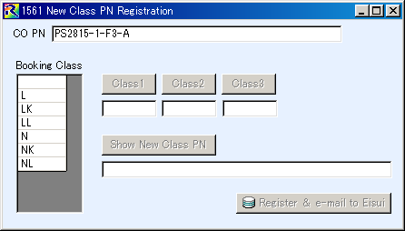
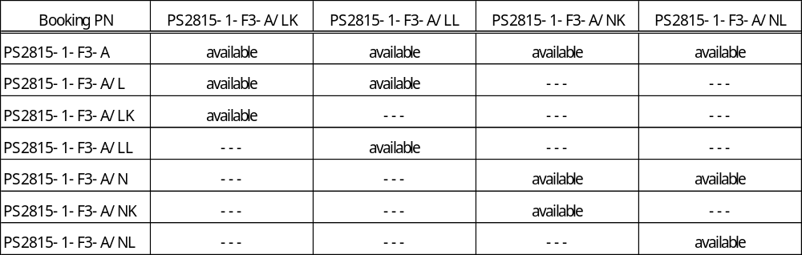
2. What is PSI ? - mandatory requirement 1
class PN
This is a case of class PN. "PS2815-1-F3-A" is a class PN and has 6 booking classes.
But there are only 4 variations that can physically exist.
concept to get together
physically exist
PS2815-1-F3-A
PS2815-1-F3-A/L
PS2815-1-F3-A/LK
PS2815-1-F3-A/LL
PS2815-1-F3-A/N
PS2815-1-F3-A/NK
PS2815-1-F3-A/NL

Slide 18
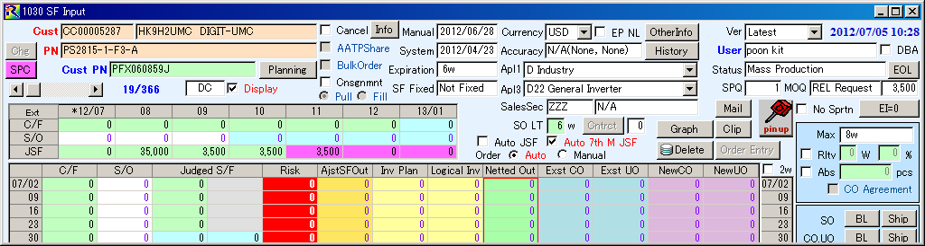
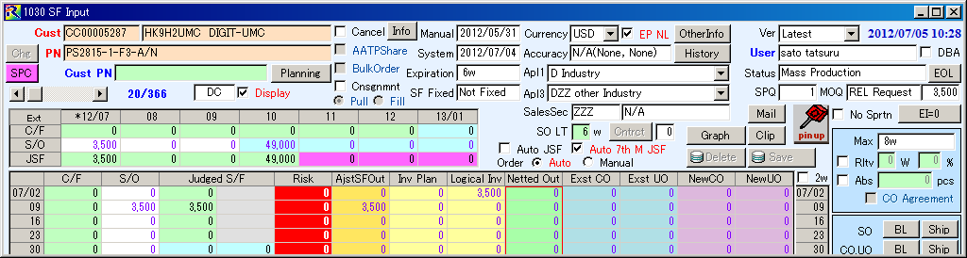
2. What is PSI ? - mandatory requirement 1
class PN
CC00005287
PS2815-1-F3-A
One customer uses two booking PN.
It means that all classes are available for some products
and only "N" classes are available for other products.
PS2815-1-F3-A/N

Slide 19
2. What is PSI ? - mandatory requirement 1
class PN
SO PN
physical inventory's PN
PS2815-1-F3-A/LK
PS2815-1-F3-A
PS2815-1-F3-A/LL
inventory data to be
transferred as PSI
PS2815-1-F3-A/NK
PS2815-1-F3-A/NL
SO PN
PS2815-1-F3-A/N
inventory allocation to SO PN
Inventory data must be created under SO PN not physical one.
When inventory data is created under physical inventory's PN,
Rainbow cannot reflect such data to correct Cust/PN combinations.
Even if there are enough inventory, Rainbow will show no inventory
in "SF Input" screen and will create excess NettedOut (CO line demand).

Slide 20
2. What is PSI ? - mandatory requirement 1
class PN
Solution 1 : Allocate physical inventory to SO PN logically through PSI creation process
physical inventory's PN
SO PN
PS2815-1-F3-A/LK
PS2815-1-F3-A
PS2815-1-F3-A/LL
PS2815-1-F3-A/NK
SO PN
PS2815-1-F3-A/N
PS2815-1-F3-A/NL
PSI data by SO PN is created by logic.
Inventory management in ERP
is done by physical inventory's PN.
It is difficult to keep consistency between yesterday and today.
Consistency of PSI is very important for Rainbow's calculation.

Slide 21
2. What is PSI ? - mandatory requirement 1
class PN
Solution 2 : Manage inventory in ERP by both SO PN and physical PN
Inventory Management in ERP
PS2815-1-F3-A
PS2815-1-F3-A/LK
1,000 pcs
10,000 pcs
PS2815-1-F3-A/LL
2,000 pcs
PS2815-1-F3-A/NK
3,000 pcs
PS2815-1-F3-A/NL
4,000 pcs
"NK" and "NL" are
separated in ERP.
PS2815-1-F3-A/N
PS2815-1-F3-A/NK
5,000 pcs
11,000 pcs
PS2815-1-F3-A/NL
6,000 pcs
It is very easy to keep the consistency of PSI.
Therefore this solution is preferable.
The way to manage inventory only by SO PN can be taken.
But in this case it will be difficult to swap inventory.
create PSI data

Slide 22
2. What is PSI ? - mandatory requirement 2
synchronization
PSI data must be synchronize among items.
Rainbow cannot calculate correctly without synchronization.
synchronization 1
- GR (= transaction)
- increase of inventory
GR from REL
Inventory
Ship to Customer
SO backlog
synchronization 2
- SO shipment (= transaction)
- decrease of inventory
- decrease of SO backlog

Slide 23
2. What is PSI ? - mandatory requirement 2
synchronization
synchronization 1 : When cargo is received, inventory must increase.
synchronized
CO backlog
= demand
CO Shipment
GR from REL
Disty
warehouse
Inventory
demand
+ inventory
day n
1,000 pcs
0
0
0
1,000 pcs
not shipped yet
in transit = 0
day n+1
0
1,000 pcs
0
0
1,000 pcs
shipped but
not received yet
in transit = 1,000 pcs
day n+2
0
1,000 pcs
1,000 pcs
1,000 pcs
1,000 pcs
shipped and
received
in transit = 0
PSI from Disty

Slide 24
2. What is PSI ? - mandatory requirement 2
synchronization
synchronization 1 : Assuming cargo received but inventory NOT increase
NOT synchronized
CO backlog
= demand
CO Shipment
GR from REL
Disty
warehouse
Inventory
demand
+ inventory
day n+1
0
1,000 pcs
0
0
1,000 pcs
shipped but
not received yet
reduced
unfairly
in transit = 1,000 pcs
day n+2
0
1,000 pcs
1,000 pcs
0
0
shipped and
received
in transit = 0
GAP
CO backlog has been consumed already.
But there is no inventory.
Then, new demand is calculated unfairly.
PSI from Disty

Slide 25
2. What is PSI ? - mandatory requirement 2
synchronization
synchronization 2 : When cargo is received, inventory must increase.
Inventory
1,000 pcs
Ship to Customer
0
3,000 - 1,000 = 2,000 pcs
should be bought from REL.
SO backlog
3,000 pcs
1,000 pcs was shipped.
Inventory
0
Ship to Customer
1,000
2,000 - 0 = 2,000 pcs
should be bought from REL.
SO backlog
2,000 pcs

Slide 26
2. What is PSI ? - mandatory requirement 2
synchronization
synchronization 2 : Assuming shipped to customer but inventory NOT decrease
Inventory
1,000 pcs
Ship to Customer
0
3,000 - 1,000 = 2,000 pcs
should be bought from REL.
SO backlog
3,000 pcs
1,000 pcs was shipped.
Inventory
0
Ship to Customer
1,000
3,000 - 0 = 3,000 pcs
should be bought from REL.
=> new demand is calculated
unfairly
SO backlog
3,000 pcs

Slide 27
2. What is PSI ? - mandatory requirement 3
ROM Programming
case
(1) buy blank Flash MCU from REL
(2) write ROM in your site
(3) ship programmed Flash MCU to customer
REL warehouse
disty warehouse
customer WH
CO
SO
blank PN
blank PN
blank PN
CO PN is blank.
programmed 1
programmed 1
programmed 2
programmed 2
Basically, inventory PN is blank.
SO PN is programmed PN.
Basic Rule : Inventory PN should be equal to SO PN.
=> Blank inventory should be separated into programmed PN in line with this rule.
But in many case, programmed PN is not fixed until just before shipment.
Therefore it is very difficult to separate blank inventory into each programmed PN.

Slide 28
2. What is PSI ? - mandatory requirement 3
ROM Programming
When you handle ROM programmed PN, all PN must be converted to blank PN.
=> SO backlog PN = Inventory PN = SO shipment PN
blank part SO
blank part SO1
ROM1 SO
blank part SO2
How to create PSI
(1) SO backlog, SO shipped result
PSI data for programmed products must
be converted to blank part number
ROM2 SO
blank part SO3
(2) inventory
add both programmed and blank part number
and consider as single part inventory.
blank part
inventory
blank part
inventory
ROM1
inventory
ROM2
inventory
PSI data to REL

Slide 29
3. Level of Customer Management

Slide 30
3. Level of Customer Management
All data level must be equal to that of SO. This is an absolute rule to use Rainbow.
However there are a lot of small customers. How should small customers be handled ?
=> Plural small customers can be treated as one virtual customer.
Renesas cannot
see this process.
Please discuss with Renesas people
about how to treat small customer.
ERP
PSI data
big customer 1
big customer 1
big customer 2
big customer 2
small customer 1
virtual
customer
small customer 2
From Renesas point of view,
this is ONE customer.
And if all data are synchronized
with this level, there is no problem.
........................
small customer n

Slide 31
4. Definition of PSI data

Slide 32
4. Definition of PSI data - File variations
File variations | File ID | Cycle | Notes
SO Booking | JA | Daily | Sales order from customer
SO Ship （Goods Issue) | JB | Daily | Shipment to customer
SO Backlog | JC | Daily | SO balance from customer
Inventory | JD | Daily | On hand + consignment inventory by customer & part no
Goods Receipt | JJ | Daily | Goods receipt from supplier
Control Master ( Count File ) | JZ | Daily | Information of above 5 files. (total count, total quantity, total amount etc.)

Slide 33
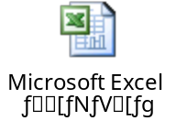
4. Definition of PSI data - File format
Please refer "IF Format_Agent PSI_Ver.1.2.xls".

Slide 34
5. Reversed Order Process

Slide 35
5. Reverse Order Process - CO Issue
All processes related to CO issue
are in Rainbow.
(1) disty user inputs JSF
Rainbow calculates necessary qty
to buy from REL in line with PSI,
current CO BL and JSF.
(2) JSF input user confirms a new CO
candidate.
(3) His/her boss reconfirms confirmed
a CO candidate.
Reconfirmed CO turns to actual order
through night batch process.
Disty
reverse order
Rainbow
JSF input by disty user
1
PSI
CO backlog
Manual Input JSF
New CO Candidate
confirm by JSF input user
2
Confirmed
New CO Candidate
Disty issues CO using Rainbow.
reconfirm by disty manager
3
But at this time point, there is no order in
disty system. Rainbow sends newly issued
CO data to disty and disty creates backlog
accordingly. The order to create backlog
is reversed. Then, this process is called
Reverse Order Process.
Reconfirmed
New CO Candidate
night batch process
Newly Issued
CO

