Slide 1
Question generation
Chenghai Li
Beihang University
2019.10

Slide 2
Outline
1. Definition & Motivation
2. Task Objective
3. Evaluation metrics & Dataset
4. Current Method
5. Related work
6. Future Work

Slide 3
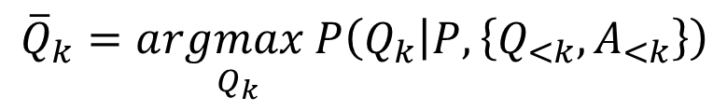
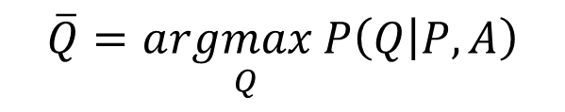
1. Definition & Motivation
Type1: Neural Question Generation (NQG)
Inputs: Passage + Target answer(Optional)
Outputs: Question
$$\overline{Q}=a\underset{Q}{rgmax}P\left(Q | P,A\right)$$
Type2: Conversation Question Generation (CQG)
Inputs: Passage + Conversation(Question-answer pair)
Outputs: Question
$${\overline{Q}}_{k}=a\underset{Q_{k}}{rgmax}P\left(Q_{k} | P,\left\{Q_{<k},A_{<k}\right\}\right)$$

Slide 4
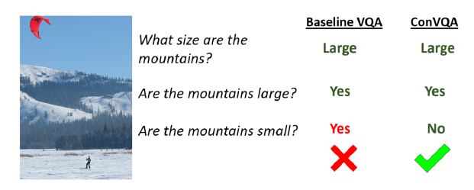
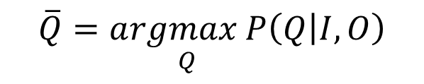
Type3: Visual Question Generation (CQG)
Inputs: Image + selected_object(optional)
Outputs: Question
such as :
$$\overline{Q}=a\underset{Q}{rgmax}P\left(Q | I,O\right)$$
Type4: Knowledge Base Question Generation (KBQG)

Slide 5
Applications:
Education: as an assessments tool for both teachers and students
Chatbot: To start a conversation, to request feedback or to get to the point quickly (forward-looking).
For QA: as a data augmentation method or auxiliary task

Slide 6
2. Task Objective
Two main part: “How to ask” &“What to ask”
1. The generated questions are grammatically correct
2. The questions are answerable /
can be answered by the given answer (semantically correct)
The questions require high cognitive level (deep questions)
such as: “Who were the key influences on <Person>
in their childhood?”
Generate inspiring & open questions (for teaching & open discussion)
such as: “Do all dogs have long tails?”
5. The generated question are relevant to the given conversations (CQG)

Slide 7
3. Evaluation metrics & Dataset
Human Evaluation
Automatic Evaluation:
BLEU -1~4
GLEU
METEOR
ROUGE –L
Answerability
embedding metrics - such as Word Mover’s Distance (WMD)
All consider Word-overlap lexical
Specific designed for QG

Slide 8
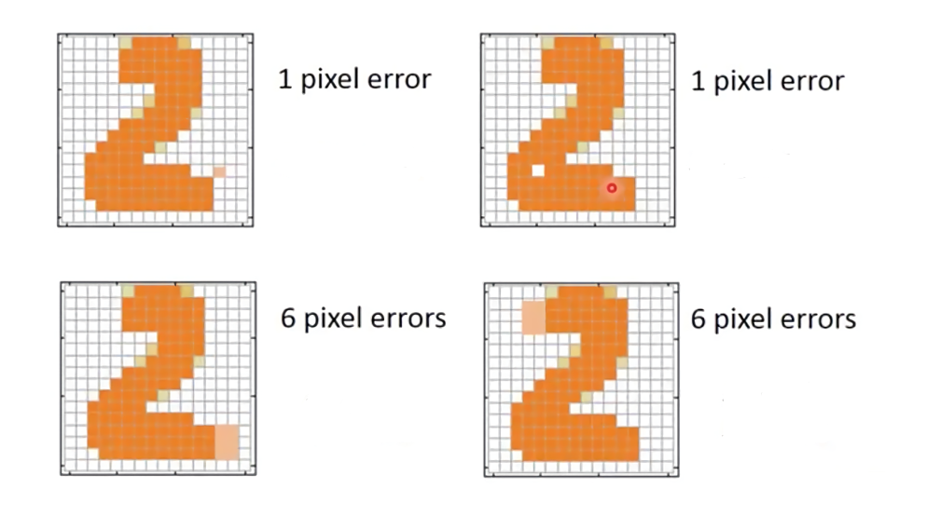
A simple example in CV
Not good
though only changing one pixel
Pixels in different positions should have different weights in calculating loss/distance.
Best
though having max pixel errors

Slide 9
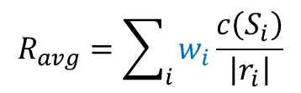
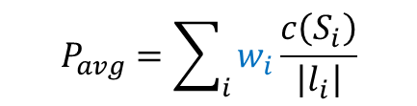
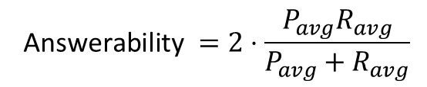
Metric for QG need attention too
Answerability
relevant words
named entities
question words
function words
$$P_{avg}=\sum_{i}{w_{i}\frac{c\left(S_{i}\right)}{\left|l_{i}\right|}}$$
$$R_{avg}=\sum_{i}{w_{i}\frac{c\left(S_{i}\right)}{\left|r_{i}\right|}}$$
$$\text{Answerability} =2⋅\frac{P_{avg}R_{avg}}{P_{avg}+R_{avg}}$$
$$Q−\text{BLEU}4=δ \text{Answerability} +\left(1−δ\right)\text{BLEU}4$$
D18-1429

Slide 10
What is a good question?
QG is not a one to one task. It is one to many.
There is not a best question.
The criterion can be various.
Supervised learning is a training method.
But in test set the generated questions do not need exactly match.
Can we train a neural network as metrics?

Slide 11
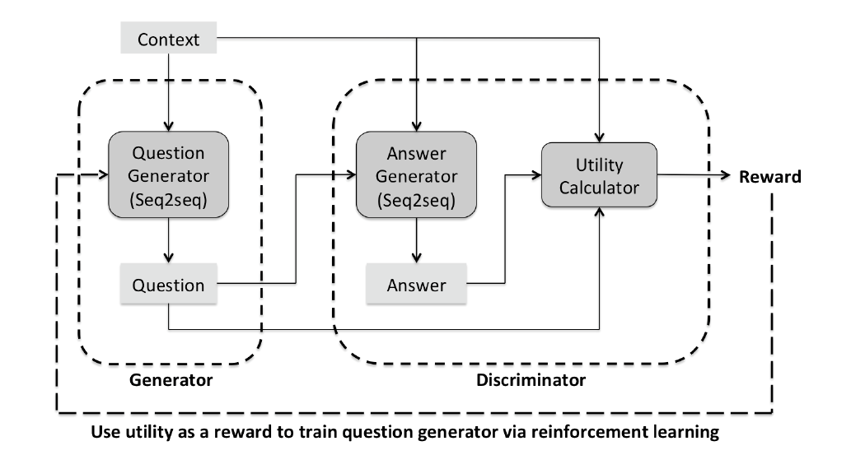
Answer-based Adversarial Training for Generating Clarification Questions
Question is pre-trained
Answer generator and Utility calculator are pre-trained and frozen.
N19-1013

Slide 12
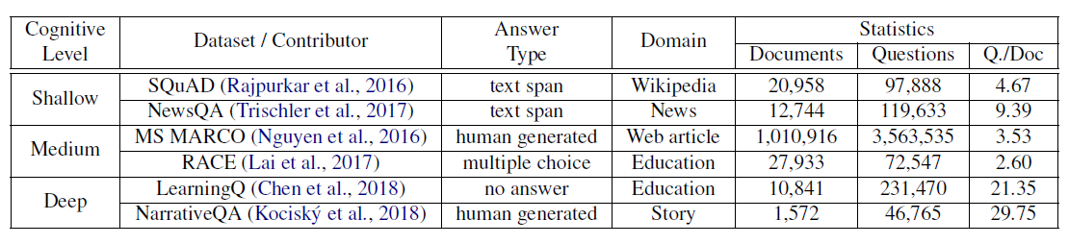
Dataset
HotpotQA (Medium), CoQA (for CQG)

Slide 13
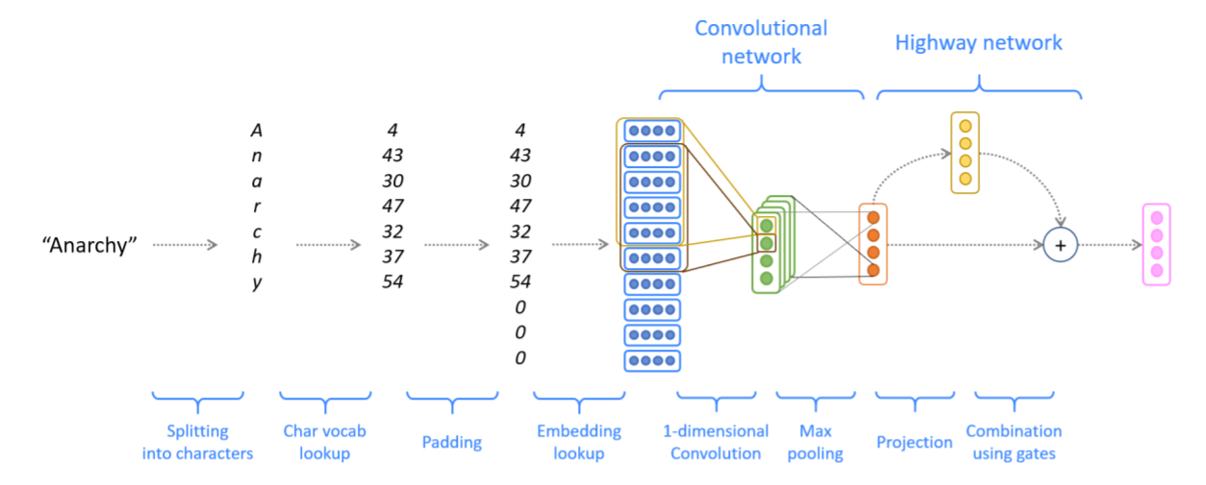
4. Current Method
A baseline model
Embedding Layer
Character Embedding
1d-CNN
Passage
Word Embedding
GloVe.84B.300d (pre-trained)
Answer tagging
0/1 or Begin/In/Out
Character Embedding
Answer
Word Embedding

Slide 14



A baseline model
(concatenate the forward and backward)
Hidden states
$$h_{i}^{p}$$
Final hidden states
$$h^{a}$$
Contextual Layer
Bi-LSTM / Bi-GRU
Bi-LSTM / Bi-GRU
Passage embedding
Answer embedding
Passage-Answer Fusion Layer
$$\tilde{h_{i}^{p}}=\tanh\left(W_{u}\left[h_{i}^{p};h^{a};h_{i}^{p}⊙h^{a}\right]\right)$$

Slide 15
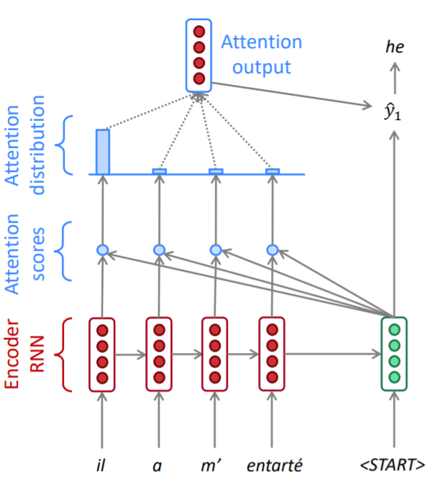
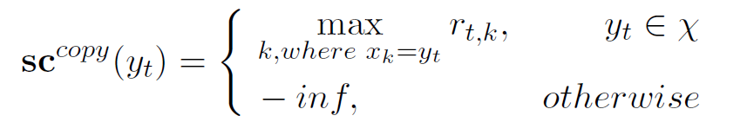


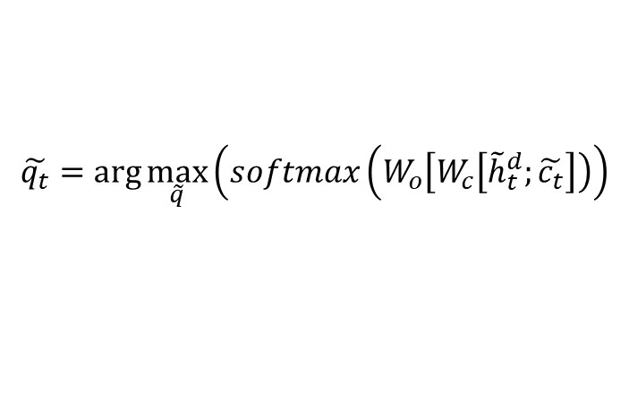
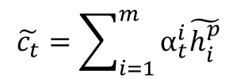
A baseline model
Decoder
With soft-attention & max-out pointer
$$\tilde{h_{t}^{d}}=LSTM\left(\left[e_{w}\left({\tilde{q}}_{t−1}\right);{\tilde{c}}_{t−1};h^{a}\right],{\tilde{h}}_{t−1}^{d} \right)$$
$$\tilde{c_{t}}=\sum_{i=1}^{m}{α_{t}^{i}\tilde{h_{i}^{p}}}$$
$${(α}_{t}^{i} − attention score)$$
$$\tilde{q_{t}}=\arg{\max_{\tilde{q}}\left(softmax\left(W_{o}\left[W_{c}\left[{\tilde{h}}_{t}^{d};\tilde{c_{t}}\right]\right)\right)\right.}$$
concat

Slide 16
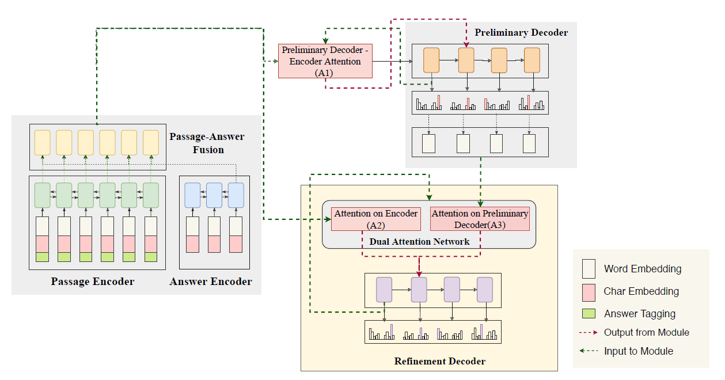

4. Current Method
Ref-Net
Added second decoder
Inputs from both encoder
and preliminary decoder
$W_{o}$ is shared in two decoders
REINFORCE with a baseline
Reward can be fluency score or answerability score
1909.09355

Slide 17
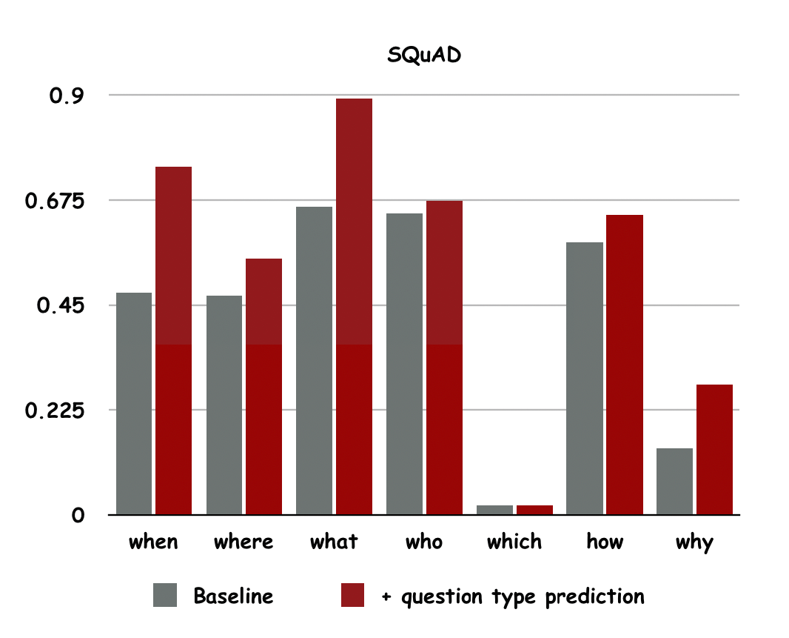
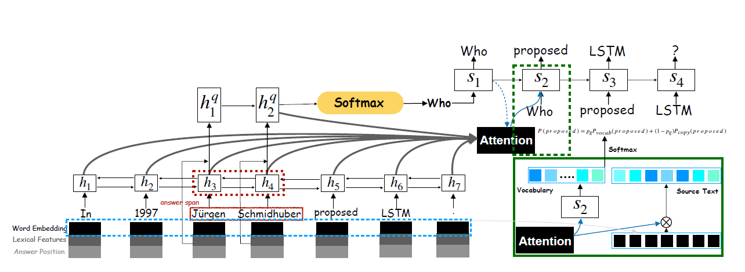
Question-type Driven Question Generation
Generate question word independently by using the input target answers.
Type ‘which’ has a low accuracy.
1909.00140

Slide 18
Other techniques
Mask the answer in the passage: 1809.02393
to solve the problem that generated questions may contain answers
2. Add lexical features into the embedding vector
Named Entity Recognition(NER), Part-of-speech(POS)tagging
and Dependency Parsing (DEP)

Slide 19
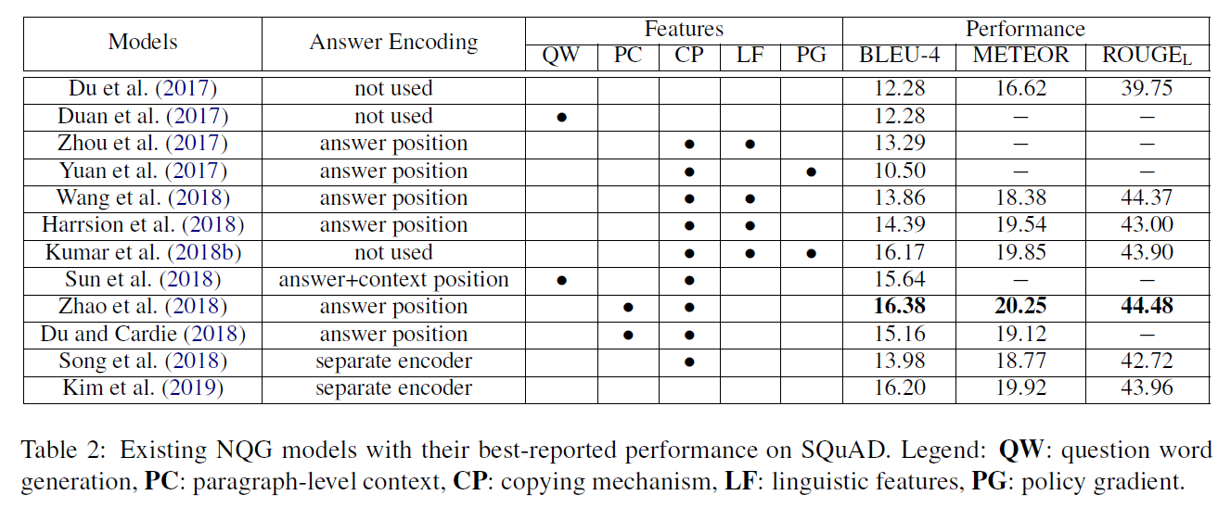
An incomplete summary
1905.08949

Slide 20
How human read?
Hierarchical attention
Dual process theory :
System 1: retrieve relevant information following attention via an implicit, unconscious and intuitive process (or maybe Bayesian)
System 2: explicit, conscious and controllable reasoning process
fast and wide then slow but deep
In CV, the basic CNN model gradually decreases feature map’s size but increase inceptive field.

Slide 21

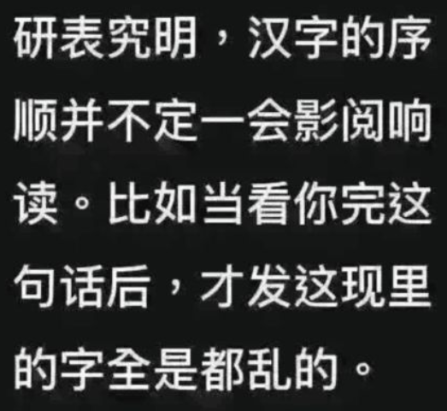
Two examples:

Slide 22
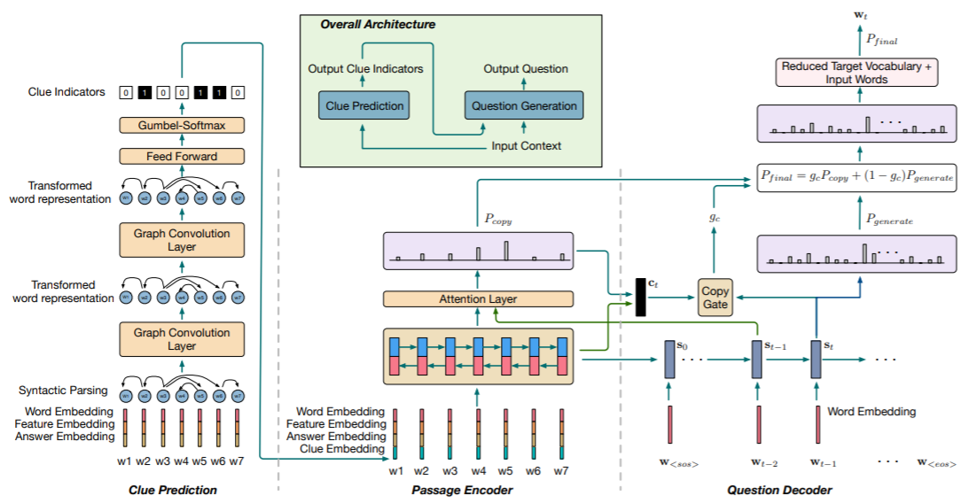
Learning to Generate Questions by Learning What not to Generate
Clue chosen
Decide the words have
a high relevant to the answer,
which need to pay more attention
to when generate questions
Added
1902.10418

Slide 23
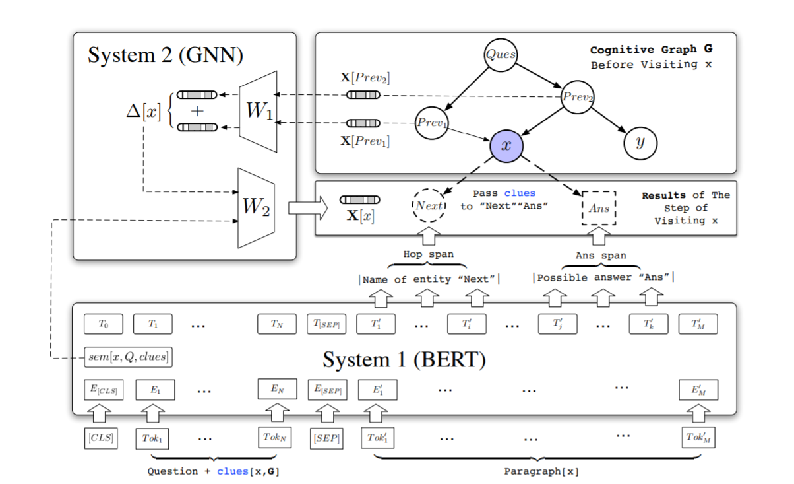
Cognitive Graph for Multi-Hop Reading Comprehension at Scale
Using GNN and BERT
Using full-Wiki data
Build a cognitive graph for selecting potential answers.
Make the reasoning process explicit
Increase interpretability
Have a very good performance in HotpotQA
P19-1259

Slide 24
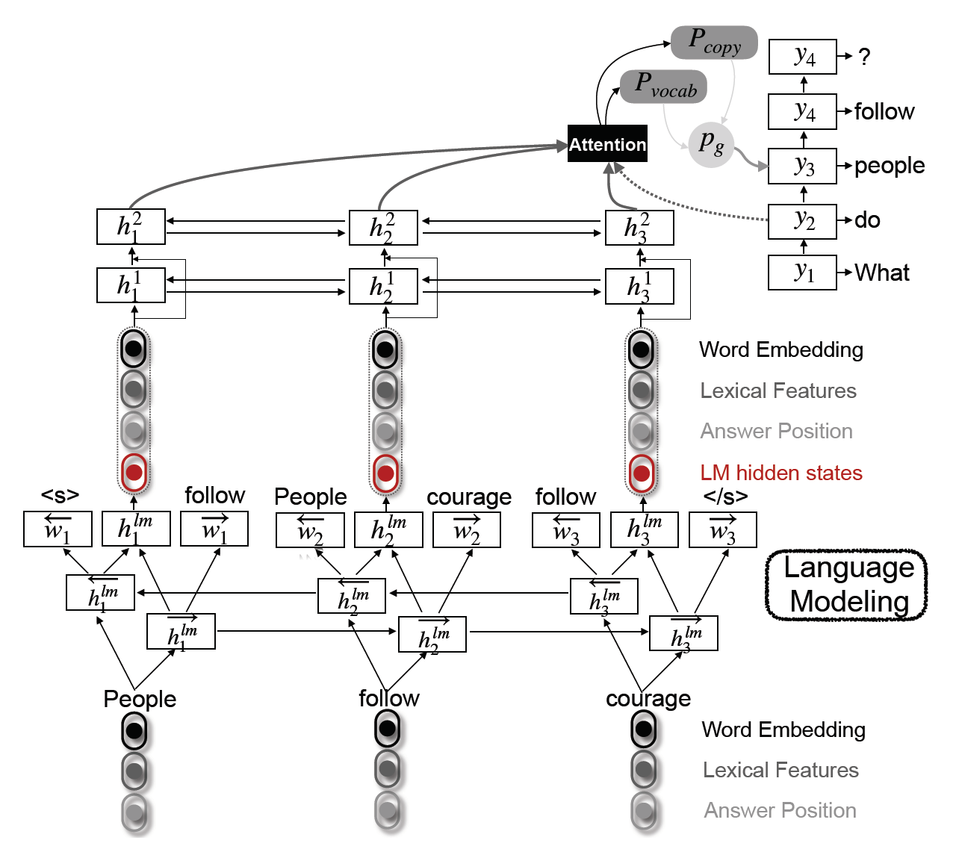


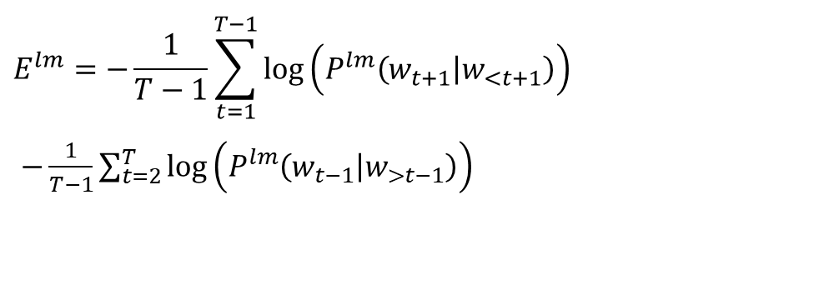

Multi-Task Learning with Language Modeling（LM）
predict the next word and the previous word
Better than simply adding a 1-layer encoder
$$P^{lm}\left(w_{t+1} | w_{<t+1}\right)=softmax\left(W_{f}\vec{h_{t}^{lm}}\right)$$
$$P^{lm}\left(w_{t−1} | w_{>t−1}\right)=softmax\left(W_{b}\overset{←}{h_{t}^{lm}}\right)$$
$$E^{lm}=−\frac{1}{T−1}\sum_{t=1}^{T−1}{\log\left(P^{lm}\left(w_{t+1} | w_{<t+1}\right)\right)}$$
$−\frac{1}{T−1}\sum_{t=2}^{T}{\log\left(P^{lm}\left(w_{t−1} | w_{>t−1}\right)\right)}$
$$E^{\text{total}}=E+βE^{lm}$$
1908.11813

Slide 25
Why multi-task learning?
Models are over-parameterized and multi-task learning
can act as a regularization method: (Hard & Soft mode etc.)
the multiple task losses are less likely stuck into a local minima
Making the inputs be better used :
Such as in QA: In single-task supervised learning, the model mainly learns what counts in deciding answer, but ignores some inner relation of words and sentences.
As a consequence, the model may have better generalization ability.
E17-2026

Slide 26
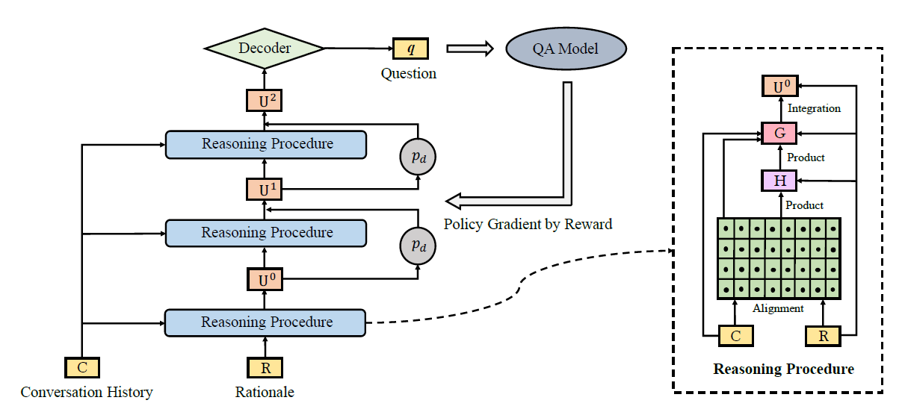
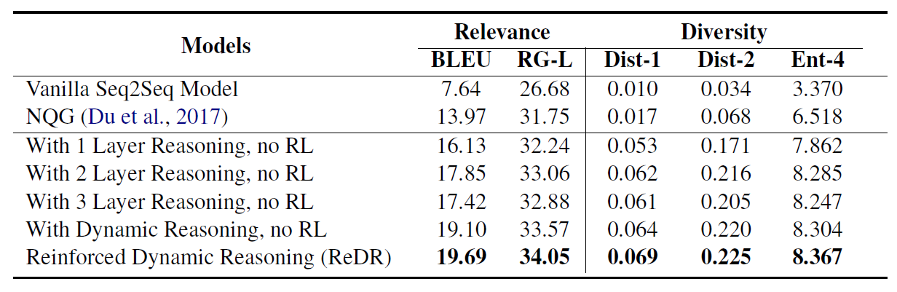
Reinforced Dynamic Reasoning for Conversational Question Generation
A CQG model
Dataset: CoQA
Bi – LSTM
Bi – LSTM
P19-1203

Slide 27
Overall
Mostly use Encoder-Decoder structure
Give more information(features) in embedding vector
Add separate encoder/decoder for auxiliary tasks
Reinforcement learning by metrics/QA award
Break QG down into several tasks
Reasoning for QG seems a weak part.

Slide 28
6. Future Work
Deep / Open question (need to aware which part is worthy to ask)
Create multiple question to select
More work in VQG / KBQG
More auxiliary tasks
Neural metrics
transformer?

Slide 29
Thank you!

