Slide 1
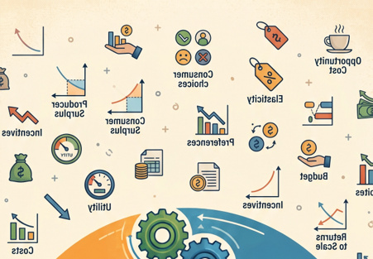
Chapter 1
The Principles and Practice of Economics
ECON 003
UC Riverside · Summer 2026
Notes:
ECON 003 · Summer B 2026 · Lecture 1 of 10
Chapter 1 — The Principles and Practice of Economics
Target runtime: 70:00. Every content slide carries a [start – end] marker in its notes.
Source: Acemoglu, Laibson & List, Microeconomics 3e, Ch. 1 (Pearson instructor deck),
restructured into four parts and re-paced for a recorded lecture. Pearson's live-classroom
activities have been converted into narrated examples.
Coverage: 1.1 Scope · 1.2 Three Principles · 1.3 Optimization · 1.4 Equilibrium ·
1.5 Empiricism · 1.6 Is Economics Good for You? · both Evidence-Based Economics segments.

Slide 2
Where This Course Is Going
TODAY
Weeks 1–2
Weeks 3–4
Week 5
Ch. 1 — the foundation
Optimization, supply & demand
Firms, competition, trade
Policy, taxes, monopoly
Everything in this course rests on three ideas — and you will meet all three in the next 70 minutes.
Optimization. Equilibrium. Empiricism.
Every model we build for the rest of the term is some version of these three. Chapter 1 is the
shortest chapter in the book, and the one that everything else is built on top of.
Notes:
[0:00 – 1:30] Opening — 1.5 min
• Welcome. Chapter 1 is short and it is the map for the whole term.
• Point at the four columns: today is the foundation; everything after is an application.
• Sell the three words before defining them: optimization, equilibrium, empiricism.
• Line to use: "If you understand these three ideas, the rest of this course is bookkeeping."
• Do NOT do syllabus/logistics here — that lives in the separate welcome announcement.

Slide 3
Today's Roadmap
01
The Scope of Economics
Choice, scarcity, and what economists actually study
02
The First Principle: Optimization
Trade-offs, budget constraints, opportunity cost
03
The Second Principle: Equilibrium
When nobody wants to change what they are doing
04
The Third Principle: Empiricism
Using data to find out what is actually true
Notes:
[1:30 – 2:45] Roadmap — 1.25 min
• Read the four sections out loud; students should be able to name them at the end.
• Flag the shape of the lecture: section 1 is vocabulary, sections 2–4 are the actual machinery.
• Tell them the exam-relevant vocabulary is heaviest in section 1, and the reasoning is heaviest in section 2.

Slide 4
PART 1
The Scope of Economics
Notes:
[2:45 – 3:00] Section transition — 15 sec. Covers Pearson 1.1.

Slide 5
Economics Is About Choice, Not Money
WHAT PEOPLE ASSUME
WHAT IT ACTUALLY IS
Economics is about money — prices, stock
markets, interest rates, the Federal Reserve.
A subject about finance, for people who
want to work in finance.
Economists study human behavior.
Choice — not money — is the unifying
feature of everything economists study.
Price is one very important variable that helps explain behavior. But it is the behavior we are after:
the decision to lease a car, to skip class, not to wear a seat belt, or how fast to take a hairpin corner.
Notes:
[3:00 – 5:30] Scope of economics, part 1 — 2.5 min
• Start with the misconception on the left. Most students walk in with it.
• The pivot: economists study CHOICE. Money is a measuring stick, not the subject.
• Run the seat-belt example — no money changes hands, and it is still economics: costs, benefits,
a decision-maker weighing them.
• Ask rhetorically: "Name a part of your life with no economics in it." Then answer: every candidate
turns out to involve a scarce resource and a choice. (Pearson runs this as a live prompt — in a
recording, pose it and answer it yourself in one breath.)

Slide 6
Who Is an Economic Agent?
An economic agent is any individual or group that makes choices.
INDIVIDUALS
GROUPS
a consumer · a student · a worker
a voter · a parent · a criminal
a senator · a business leader
a government · an army · a firm
a university · a labor union
a family · a sports team
And you. You are an economic agent, making an enormous number of choices every day.
Notes:
[5:30 – 7:30] Economic agents — 2 min
• Definition first, then the two buckets. The point of the right-hand column is that agents are not
only individuals.
• Economists often simplify by treating a group as if it were a single decision-maker — "the firm
chooses," "the government chooses." Flag that this is a modelling shortcut we will lean on all term.
• Close by making it personal: they are agents too. This sets up the "is economics good for you?"
slide at the end.

Slide 7
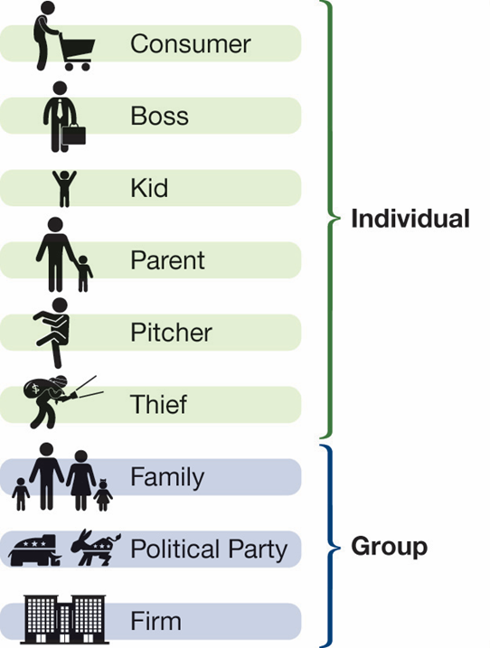
Agents and Their Choices
Economic agent | One choice they make
A consumer | Which cell phone to purchase
A parent | Whether and how to reward a teenager for good behavior
A student | To attend class or to skip it
A citizen | Whether to vote — and which candidate to support
A worker | To do the job or to slack off
A business leader | Where in the world to open a new production facility
A senator | To vote for or against a Supreme Court nominee
Every row is a scarce resource being allocated by somebody making a choice.
Notes:
[7:30 – 9:15] Exhibit 1.1 — 1.75 min
• Do not read all eight. Pick three and expand: the student (attend or skip — an opportunity cost
problem we will formalize in 20 minutes), the worker (effort is a choice), the senator.
• The criminal example from the text is worth a sentence: choosing to sell drugs is a choice with
costs and benefits, which is why economists study crime.
• Land the bottom line — every row is somebody allocating something scarce.

Slide 8

Scarcity: The Problem Underneath Everything
A bowl of chocolates is passed around a class of 100 students.
There are exactly 100 chocolates. Everyone is told: take as many as you want.
Notes:
[9:15 – 11:45] Scarcity — 2.5 min
• Walk the scenario slowly. The supply exactly equals the number of people, so the naive answer is
"nothing is scarce here."
• Then the twist: somebody takes three. Now somebody gets none. Nothing about the quantity changed —
what changed is that wants exceed the quantity available.
• Even if everyone takes exactly one, ask the "what if" — what if one student wanted two? Still scarce.
• This is the definition students most often get wrong on the exam: scarcity is about WANTS vs.
RESOURCES, not about a shortage.

Slide 9
SCARCE RESOURCES VS SCARCITY
SCARCE RESOURCES
SCARCITY
Things that people want, where the
quantity people want exceeds the
quantity available.
A resource does not have to be luxurious:
toilet paper, subway seats, clean
drinking water, anything that is limited.
The situation of having unlimited wants
in a world of limited resources.
The world does not have enough resources
to give everyone everything they want,
for free.
Scarcity is why choice is unavoidable — and choice is why economics exists.
Notes:
[11:45 – 13:45] Scarce resources vs. scarcity — 2 min
• A resource is scarce; scarcity is the condition. Students blur these — the exam does not.
• Push the "does not have to be luxurious" point: gold is scarce, and so is a seat on the 6pm train.
• Free goods are the useful contrast — is air scarce? Clean air in Riverside on a bad day? That
usually lands, and it previews Chapter 9.
• End on the bridge sentence at the bottom; it takes us to the definition of economics.

Slide 10
The Definition of Economics
Economics studies how agents make choices among scarce resources
and how those choices affect society.
Notes:
[13:45 – 16:30] The definition of economics — 2.75 min
• Read the definition once, whole. Then split it — the second half is the part that is new to them.
• "How agents make choices among scarce resources" is everything from the last three slides.
• "And how those choices affect society" is new, and it is what makes this a social science rather
than a decision-making seminar.
THE BURRITO — run it as a chain, one card at a time
• Card 1. Two scarce resources, $9 and one lunch hour, and you allocated both in about four seconds.
Ask them to notice they did a constrained optimization without calling it one.
• Card 2. Now follow the money outward. The burrito place staffs up. The dining hall over-ordered and
cuts back. Somewhere a supplier ships fewer tortillas. Nobody intended any of this.
• Card 3. Scale it. Twenty thousand students making that choice every day is what decides which
businesses survive within a mile of campus, and who is employed there.
• The punchline is the bottom line: half the definition is your decision, the other half is everything
downstream of it. You cannot opt out of the second half.
WHY THIS EXAMPLE
• It is deliberately trivial. Students expect "affects society" to mean voting or pollution. Showing it
in a lunch choice makes the claim general rather than reserved for big decisions.
• Forward link: this is the machinery behind supply and demand in Chapter 4 — lots of small private
choices producing an outcome nobody chose.

Slide 11
Positive vs. Normative Economics
POSITIVE ECONOMICS
NORMATIVE ECONOMICS
Describes what people actually do.
“Some students took more than one,
so not everyone got a chocolate.”
Descriptive. Testable against data.
Recommends what people — or society —
ought to do.
“Each student should take just one
so that everyone gets a chocolate.”
Advisory. Requires a value judgment.
A normative claim always hides a decision about what counts as fair — and you have to defend it.
Notes:
[16:30 – 19:30] Positive vs. normative — 3 min
• The chocolate scenario gives you both sentences from the same facts. Use it.
• Push on "everyone should take one": why is that fair? What about the student who is diabetic and
does not want one? The one having an awful day for whom two would genuinely help? The one taking
ten to bring to kids at the hospital where they volunteer?
• The point is not that equal division is wrong — it is that "fair" is an assumption you are making,
and a different assumption gives a different recommendation.
• Test-taking tip worth saying out loud: if a sentence contains "should" or "ought," it is normative.

Slide 12


Microeconomics vs. Macroeconomics
MICROECONOMICS
MACROECONOMICS
The study of how individuals, households,
firms, and governments make choices —
and how those choices affect prices, the
allocation of resources, and the well-being
of other agents.
One piece of the economy: the market for
coal-fired electricity.
The study of the economy as a whole.
Economy-wide phenomena:
· the growth rate of total output
· the inflation rate
· the unemployment rate
Notes:
[19:30 – 21:15] Micro vs. macro — 1.75 min
• Quick and clean. The distinction is about the level of aggregation, not about different tools.
• Useful framing: macro is built out of micro. Inflation is a lot of individual price decisions;
unemployment is a lot of individual hiring and job-search decisions.
• Say plainly that this course is micro, and that ECON 002 is where the right-hand column lives, so
nobody spends the term waiting for GDP.

Slide 13
The Three Principles of Economics
What separates economics from the other social sciences.
OPTIMIZATION
EQUILIBRIUM
EMPIRICISM
Making the best choice you
can with the information
you have.
People do not always
succeed — but they try.
Everyone is optimizing at
once, so nobody would
benefit by changing their
own behavior.
Using data to work out
whether the theory actually
matches how people
behave.
Anthropology, history, political science, psychology and sociology all study human behavior too.
These three commitments are what make the economist’s version of that project distinctive.
Notes:
[21:15 – 23:45] The three principles (Pearson 1.2) — 2.5 min
• This is the hinge of the lecture: everything before was vocabulary, everything after is one of these
three cards unpacked.
• Optimization: emphasise TRY. Economists do not claim people are perfect calculators — Chapter 3
is largely about the ways people get it wrong in predictable directions.
• Equilibrium: note that it is optimization plural. One person optimizing is not an equilibrium.
• Empiricism: evidence-based analysis. Used both to build theory and to test it.
• Tell them the next three sections of the lecture map one-to-one onto these three cards.

Slide 14
PART 2
The First Principle:
Optimization
Notes:
[23:45 – 24:00] Section transition — 15 sec. Covers Pearson 1.3.

Slide 15
What Optimization Means
Optimization = making the best feasible choice with the information available.
Notes:
[24:00 – 26:45] What optimization means — 2.75 min
• Definition first, and make the two qualifiers do work. "Best FEASIBLE choice" and "with the
information AVAILABLE." Nearly every student misreading of optimization comes from dropping one
of those two words.
REGISTRATION AT 7 A.M. — the example they have all lived
• Card 1, feasible. The 9 a.m. section with the good instructor is full. It is not a worse option —
it is not an option at all. Your optimum is defined over the menu you actually face, not the menu
you wish you faced.
• Card 2, information. You have two reviews and a rumour. That is a thin basis, and you optimize on it
anyway, because at 7 a.m. it is all that exists. Waiting for better information has its own cost:
the seats go.
• Card 3, the payoff. The section turns out to be a slog. Were you irrational? No. You made the best
available choice given what you knew. A bad outcome is not evidence of a bad decision.
THE POINT TO LAND
• Economists do not claim people are calculating machines or that they always succeed. The claim is
that people TRY, and that trying is systematic enough to model.
• Chapter 3 is where this gets interesting: when people make mistakes that are predictable — always
in the same direction — that is not noise, it is something we can study and sometimes correct.
• Bottom line on the slide is the sentence to repeat: optimizing is not being right.

Slide 16
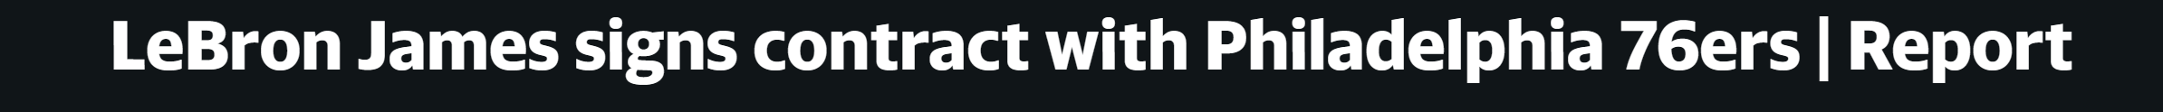
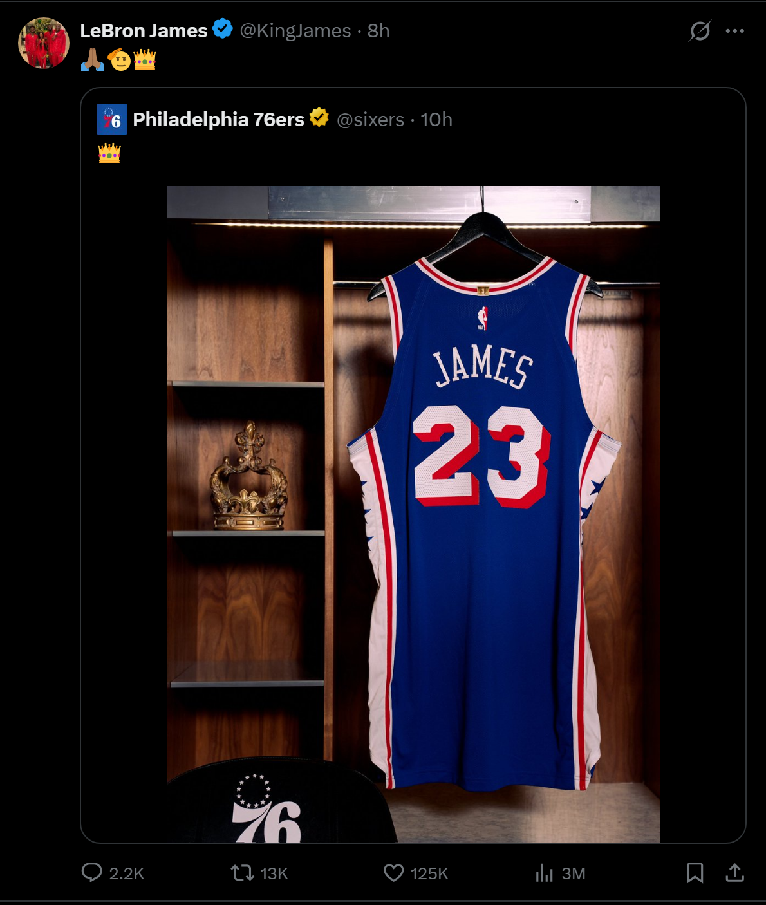




Every Optimization Involves a Trade-off
Trade-offs arise when some benefits must be given up in order to gain others.
Notes:
[26:45 – 29:00] Trade-offs — 2.25 min
• Ask the question, pause a beat on the recording, then give the instinctive answer yourself: zero.
• Then spring the constraint. Zero crime is achievable; it is just extraordinarily expensive. Every
dollar spent getting from "low" to "zero" is a dollar not spent somewhere else.
• Their specific answer does not matter. What matters is that they see the trade-off is forced on
us by the constraint, not chosen out of callousness.
• COVID is a good second example if you want one: governments were not simply maximising lives saved,
they were trading off health, income, schooling and freedom of movement all at once.

Slide 17
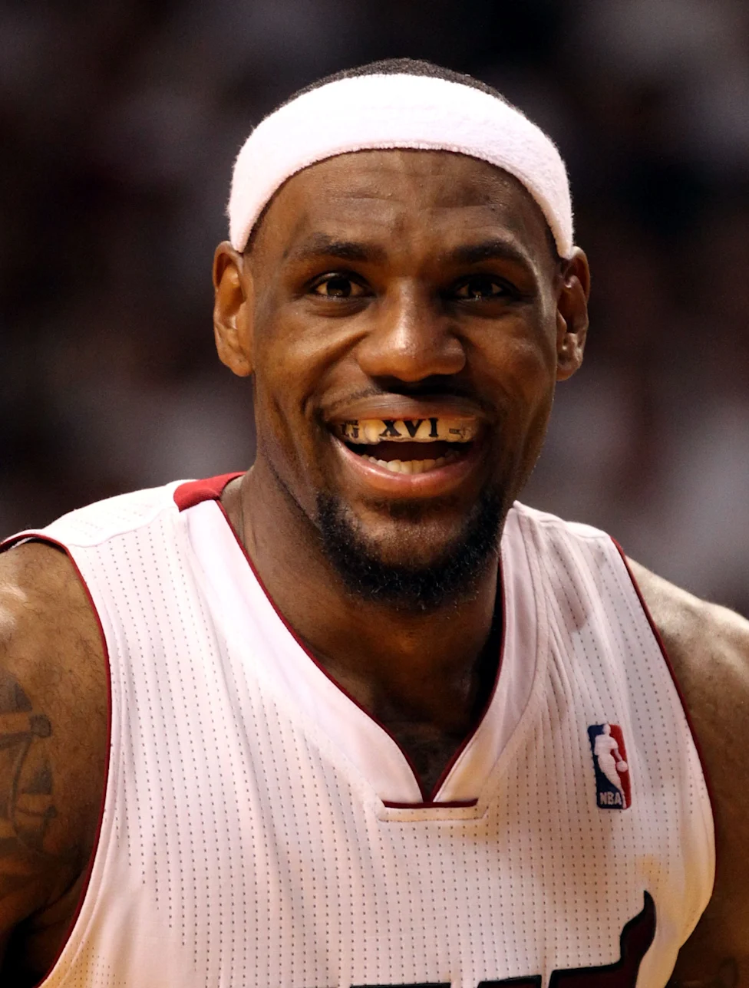

Opportunity Cost
Opportunity cost is the value of the best alternative use of a resource.
WHAT LEBRON JAMES CHOSE · July 2026
Philadelphia 76ers — $8M in two years
Two years, $8M total, veteran minimum, player option
HIS NEXT-BEST OPTION
Golden State Warriors — about $75M
Opportunity cost ≈ $67 million
Notes:
[29:00 – 32:00] Opportunity cost — 3 min
THE DEFINITION FIRST
• This is the single most examinable idea in the chapter. Say so.
• "Best alternative" — singular, and best. Not the sum of everything you gave up; the one thing you
would actually have done instead.
THE EXAMPLE — LeBron to Philadelphia, July 2026
• Set it up as a question before you show the numbers: LeBron James signed with the 76ers this month.
What did that decision cost him?
• What he gets: the veteran minimum. $3,876,529 in year one, two years and $8 million in total, with
a player option for a 25th season. Round it to $3.9M on the slide.
• Best line available to you: that is LESS than his rookie contract paid him in 2003 — $4,018,290.
Twenty-three seasons of superstardom and he signed for below his rookie salary.
• His next-best option: keep taking max money. The Lakers paid him about $52.6 million for 2025–26,
and at 41 he could still command near that somewhere.
• So the opportunity cost of playing in Philadelphia is roughly $48.7 million — the biggest pay cut
in NBA history.
THE POINT THAT MAKES IT ECONOMICS, NOT TRIVIA
• Do NOT let it land as "he threw away $48.7 million." He is optimizing. He gave up $48.7M because
what he bought with it was worth more TO HIM.
• Quote him, because he says it himself: "I'm not going for money. I'm not going for family. What am
I really playing for at this point? ... I still want to compete, to win and to have a chance at the
feeling of winning another championship."
• The pay cut is the mechanism, not a side effect: signing for the minimum is what lets Philadelphia
keep enough talent around him to contend. He is buying championship odds with salary.
• Same logic as the TikTok slide and the Europe slide — the objective function is not dollars. Dollars
are just the unit we measure the alternatives in.
THE HONEST CAVEAT — and it is a good one
• How do we know the alternative was $52.6M? We do not, exactly. Reports put the pay cut between
$45M and $48M depending on which baseline they use. The counterfactual has to be ESTIMATED.
• That is the hard part of every opportunity-cost calculation: the road not taken has no receipt.
It is also a preview of empiricism — measuring what would have happened is most of the job.
• If you want one more anchor: by production metrics, analysts valued his 2025–26 season at roughly
$28 million. Three defensible numbers, three different answers.
TRANSITION
• Next slide: two ordinary purchases where most people get the opportunity cost wrong.

Slide 18
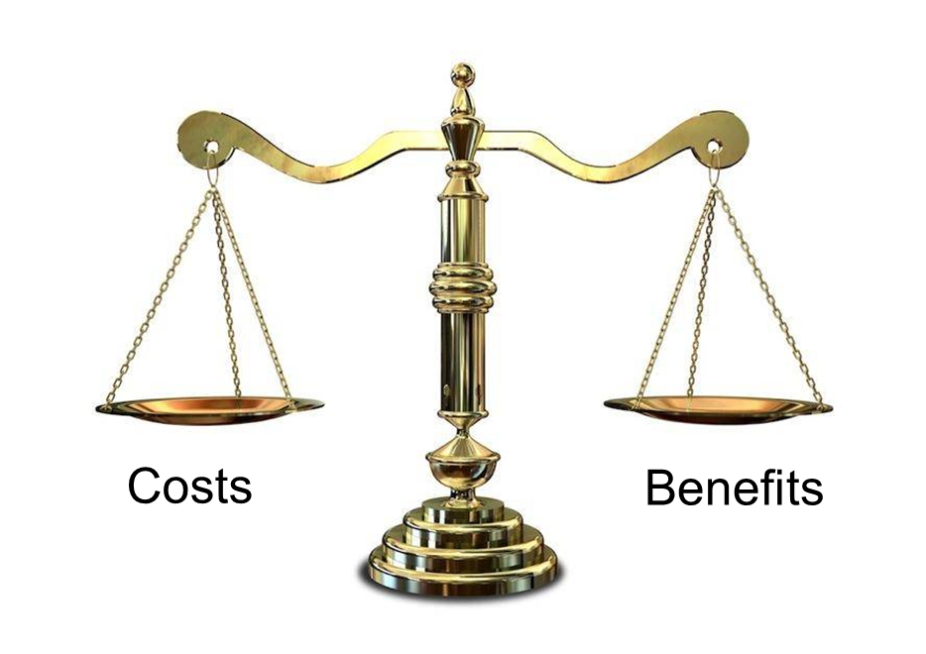
Cost-Benefit Analysis and Trade-offs
A calculation that identifies the best option by summing benefits and subtracting costs.
Net benefit = total benefits − total costs
COSTS OF GOING TO 76ERS
BENEFITS OF GOING TO 76ERS
$67 million.
Probably a great chance to win the champion a fifth time.
Notes:
[32:00 – 34:15] Cost-benefit analysis — 2.25 min
• Define it, put the formula on the board, then run the drive through it.
• The reason we insist on a common unit is that otherwise you are adding minutes to dollars to
aesthetic preferences and the comparison is meaningless.
• Work a number if you want: if their time is worth $15/hour, 20 minutes of driving costs $5, plus
maybe $1.50 of fuel — net benefit of about $3.50, so drive. If their time is worth $40/hour, do not.
• Same framework, different inputs, different answer — and that is fine. That is what optimization
looks like when people differ.

Slide 19




Is Tiktok Free?
You pay $0 to open the app.
What do you give up when you spend an hour on TikTok?
If you put a value on the activities you gave up, which is the highest?
PAID WORK
STUDY
OTHER RECREATION
An hour of wages you did not earn
An hour you did not spend on this course
Video games, soccer, sleep, a friend, a walk
$17
$20
$25
Notes:
[34:15 – 36:30] Is TikTok free? — 2.25 min
• This is the chapter's Evidence-Based Economics question. Open by reminding them of the instinctive
answer: yes, it's free, I never pay anything.
• Then apply the tool we just built. Price and cost are different words and this is the cleanest
demonstration of it in the whole course.
• The textbook's line is worth quoting: a typical college student who went cold turkey on social
media and put that time into paid work would earn enough to lease a sports car for a year.
• Next slide puts an actual number on it.

Slide 20
Putting a Price on Your Attention
97 min
$16.90
$9,970
Per day on Tiktok,
average Tiktok user, 2025
Opportunity cost
of an hour of time in California
Per U.S. adult,
per year
≈ 1.5 hour / day × 365 days × $17 / hour ≈ $10,000 per year
Across all U.S. adults, the opportunity cost of time on social media came to roughly $1.2 trillion in 2019.
So, no — Tiktok is not free. It is one of the most expensive things many people consume.
Notes:
[36:30 – 38:45] The $9,970 calculation — 2.25 min
• Walk the arithmetic slowly; this is the first time this course turns a concept into a number.
• Honest footnote, worth saying if you are asked: the textbook rounds 56 minutes up to a full hour.
365 hrs x $13 = $4,745 exactly. Doing it with 56 minutes gives about $4,430. Same order of magnitude,
same conclusion — and it is a nice early lesson in reading an estimate for what it is.
• The $13 is an assumption about the value of time. Invite them to redo it with their own wage —
that is the whole point of an opportunity-cost calculation being personal.

Slide 21
Budget Constraints
A budget constraint is the set of things a person can choose to do (or buy)
without breaking her budget.
MONEY
TIME
ATTENTION
$60 to spend on food
this week.
24 hours in a day.
168 in a week.
You cannot read two
things at once, however
much you want to.
Notes:
[38:45 – 40:45] Budget constraints — 2 min
• Give the formal definition, then immediately generalise past money. Time is the constraint students
feel most, and it is the one that makes the social-media example land later.
• The money budget is the one we will draw in Chapter 5 (consumer choice) — flag that a budget
constraint will become an actual line on a graph.
• Bottom line is the sentence to repeat: constraints are what make choice necessary.

Slide 22
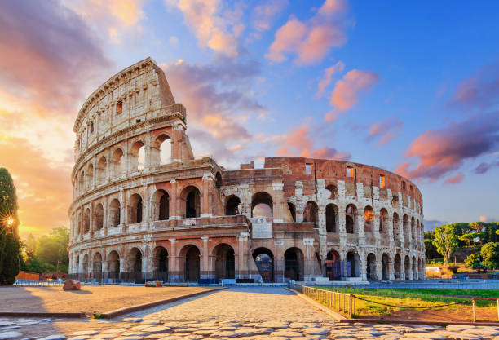


Planning a $10,000 Trip to Europe
Same $10,000, same 14 days. Plan A sees five cities; Plan B sees two.
Item | Plan A — breadth (5 cities) | Plan B — depth (2 cities)
Flights | $1,300 | $1,300
Trains between cities | $650 | $150
Hotels | $2,800 | $4,000
Food & drink | $1,250 | $1,250
Sights, tours, museums | $3,000 | $1,000
Shopping & extras | $1,000 | $2,300
TOTAL · 14 days | $10,000 | $10,000
BUDGET CONSTRAINT
TRADE-OFF
OPTIMIZING
Both columns cost exactly $10,000
over the same 14 days.
Breadth pays for trains and tickets.
Depth pays for hotels and shopping.
Comfort vs Experience
Notes:
[40:45 – 43:45] Budget constraint, trade-offs, optimization — 3 min
FRAME IT — and drop the moralizing
• Say out loud what the last two slides did NOT claim. Time on TikTok is not money set on fire.
Leisure is consumption; it yields utility. The narrow, honest claim is that $10,000 of your time
went somewhere, and the economist's question is whether you would have picked a different bundle —
not whether you should feel guilty about it.
• So turn it into a planning problem. You have $10,000 and 14 days. Plan the trip.
BUDGET CONSTRAINT
• Both columns cost exactly $10,000 over exactly 14 days. So does every other combination that sums
to $10,000 — that whole set is the budget constraint.
• Under $10,000 is feasible but leaves room unused. Over is unavailable however much you would enjoy
it. The constraint is not advice, it is arithmetic.
• Two constraints bind here, not one: dollars and days. Fourteen days constrains even a student with
unlimited money — the point slide 18 made about time budgets.
THE TRADE-OFFS — read across the rows
• Trains: $650 against $150. Five cities has to move four times; two cities moves once. Variety
carries a transport bill.
• Sights: $2,900 against $1,150. Breadth is buying quantity of experiences; depth is buying fewer,
unhurried.
• Hotels: $2,800 against $4,050. Depth can afford better rooms precisely BECAUSE it saved on trains
and tickets. The money did not vanish — it moved.
• Shopping: $1,100 against $1,900. Same story. Every dollar breadth spends on movement is a dollar
depth spends on something it takes home.
• So the trade-off is not "more trip versus less trip." It is what KIND of trip. Both students come
home having spent $10,000 and used 14 days.
HOW TO OPTIMIZE
• The constraint cannot pick a column. Two students with identical budgets should rationally choose
differently, because optimization runs over preferences, not over dollars.
• The rule is marginal: where does the next $100 do more — a fifth city, or a better hotel? When
adding a city stops paying for itself, stop adding cities.
• That is cost-benefit analysis from slide 22, applied at the margin rather than to the whole trip.
THE POINT TO LAND
• Plan B sees fewer places. That is NOT less utility — it is a different bundle. Someone who knows
two cities well may be better off than someone who photographed five. Economics does not rank the
columns for you; it only insists you notice you were choosing.
• Leave a question hanging: which column would YOU pick, and what does your answer tell you about
your own preferences?
IF SOMEONE ASKS FOR THE PER-NIGHT NUMBERS
• Roughly $200 a night in Plan A against roughly $290 in Plan B, and short stays genuinely do cost
more per night than longer ones. Deliberately left off the slide — the totals make the point and
the unit prices only invite arguments about whether they are right.

Slide 23
PART 3
The Second Principle:
Equilibrium
Notes:
[43:45 – 44:00] Section transition — 15 sec. Covers Pearson 1.4.

Slide 24
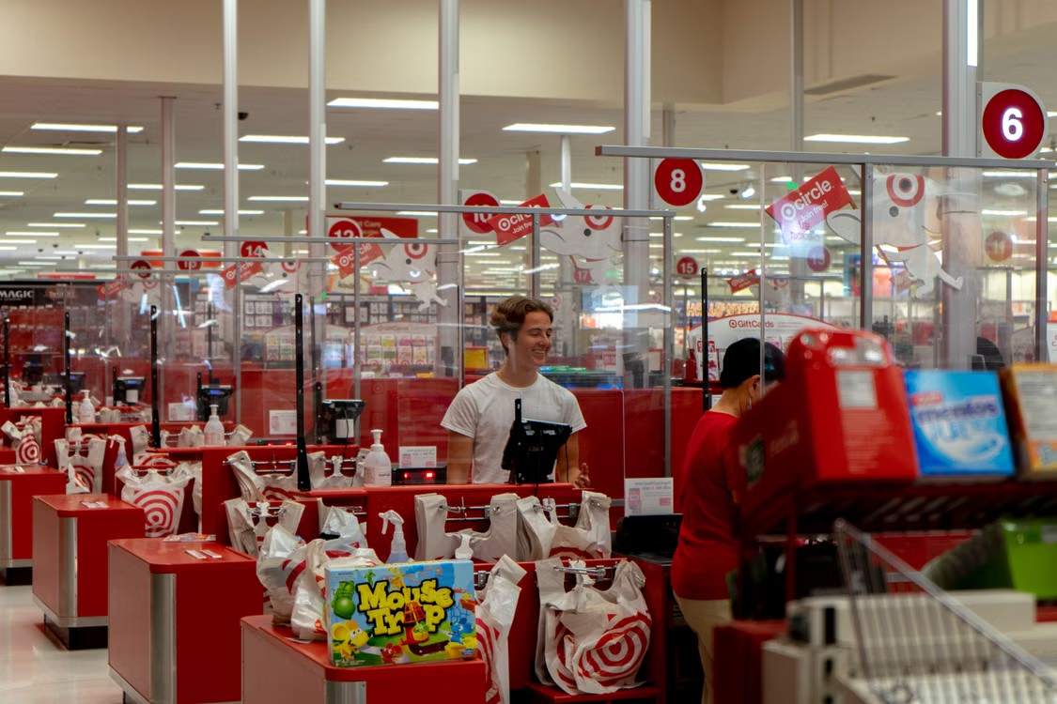
What Is Equilibrium?
Equilibrium is a situation in which nobody would benefit by changing his or her own behavior.
THE LINK TO OPTIMIZATION
Equilibrium is what you get when
everyone is optimizing at the same time.
One person optimizing is not enough.
Equilibrium does not mean “good.”
It means nothing is pushing anyone to change.
Notes:
[44:00 – 46:30] Equilibrium defined — 2.5 min
• Definition first. Then the two qualifiers, because both get tested.
• "His or her OWN behavior" — an agent in equilibrium might love to change what SOMEBODY ELSE is
doing. They just cannot improve by changing their own move.
• "Believes" is the second qualifier. Equilibrium is about expectations, not omniscience.
• The bottom line matters for later chapters: an equilibrium can be terrible for everyone and still be
an equilibrium. That is the whole of Chapter 12 and the free-rider slide coming up.

Slide 25
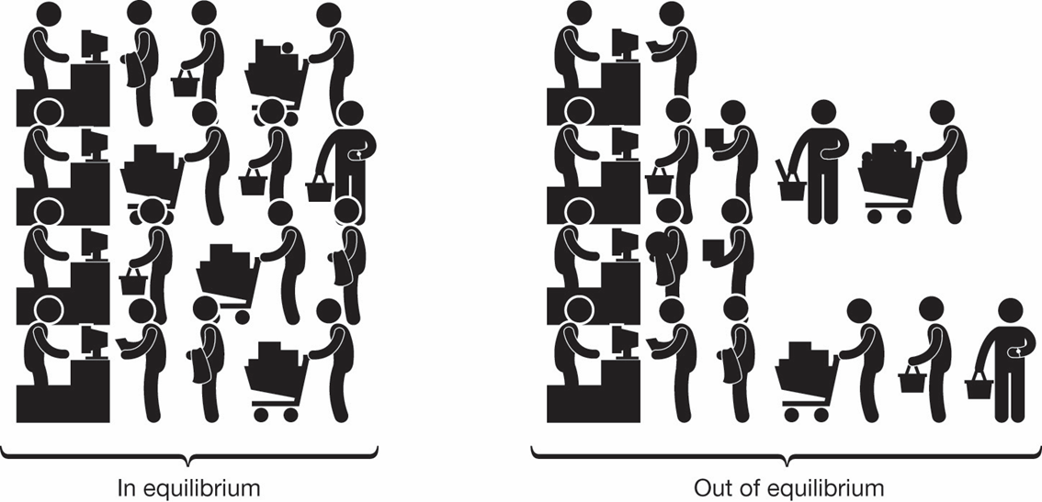
Checkout Line
01
A line is shorter than the others
02
A line is longer than the others
03
Short lines fill up; long lines drain
04
Every line takes about the same time
Notes:
[46:30 – 49:00] The checkout line — 2.5 min
• Best intuition pump in the chapter. Everyone has stood in this equilibrium.
• Walk the four steps as a process, not a picture. The convergence is the mechanism: optimizing
behaviour by individuals produces a pattern nobody planned.
• Note how much information people are actually using — how many items are in each cart, who looks
slow, which cashier is new. That is the "beliefs about others" clause from the last slide, in the wild.
• Say plainly that supply and demand in Chapter 4 is exactly this argument with prices instead of lines.

Slide 26


The Free Rider Problem
A free rider enjoys the benefits of a situation without incurring the costs.
Where’s my show?
IS HOMER IN EQUILIBRIUM?
IS PBS IN EQUILIBRIUM?
Yes. No incentive to change.
No. They have to force an incentive onto the viewers.
Markets have no mechanism to decide what is fair.
Notes:
[50:00 – 53:00] Free riders — 3 min
• Every student has lived this, which is why the textbook uses it.
• Make sure they see BOTH questions get asked. The common error is to say "that's not an equilibrium
because it's unfair" — fairness is a normative question and equilibrium is a positive one.
• Two equilibria coexist here: the free rider's individual one, and the group's (which fails).
• Note in passing that "fair share" is a normative phrase. Circle back to slide 11 for one sentence.
• Flag the forward link: this is public goods, Chapter 9. Free riding is the reason we have taxes.

Slide 27
PART 4
The Third Principle:
Empiricism
Notes:
[53:00 – 53:15] Section transition — 15 sec. Covers Pearson 1.5.

Slide 28
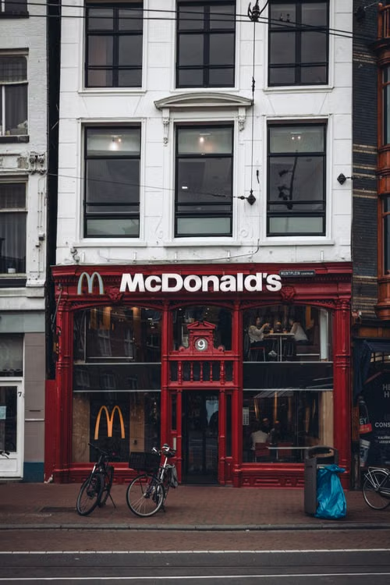

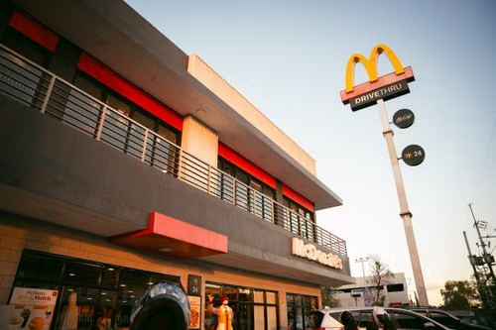
Empiricism: Testing Ideas with Data
Empiricism is evidence-based analysis — using data to test whether our theories
about human behavior match what people actually do.
Where should McDonald’s put its next restaurant?
Predict, then measure. The gap between them is where economics actually happens.
Notes:
[53:15 – 55:45] Empiricism — 2.5 min
THE PRINCIPLE
• Frame it as the discipline's quality control. Anyone can tell a plausible story about why people
behave a certain way. Economics insists you check.
• Both directions matter — data builds theories as well as testing them.
THE EXAMPLE — siting a McDonald's
• Set it up as a job, not a lecture: you work for McDonald's and you have to pick the next location.
What do you actually do?
• Step 1, predict. You are not guessing. You have theory — people buy from what is convenient, demand
falls with drive time, competitors take share — and you have local data: traffic counts, commute
patterns, schools, offices, where the other chains already are. Out comes a number: $4.2M.
• Step 2, open it. This is the part students underrate. You cannot settle the question in the
spreadsheet. Building the store is what generates the evidence.
• Step 3, compare. It does $3.6M. Your model was 14% high.
• For scale, the average US McDonald's does roughly $4M a year, so both numbers are in the right
neighbourhood — worth saying so nobody thinks the figures are invented.
THE POINT TO LAND
• A 14% miss is not a failure. It is information. The interesting question is WHICH assumption was
wrong — did you overweight the traffic count, underweight the competitor two blocks over, miss
that half the passing cars are commuters who never stop?
• That is the loop: theory makes a prediction, data judges it, the theory gets better. A theory that
never meets data is just a confident story.
• Optimization and equilibrium from the last two sections are exactly this kind of claim. They
predict behaviour, so they can be wrong, so they have to be checked.
THE BRIDGE TO CHAPTER 2 — worth 20 seconds
• Ask what number you do NOT have. Revenue at the site you rejected. You only ever observe outcomes
at the locations you chose to open, and you chose them because you expected them to do well.
• So your data is not a fair sample of all possible sites — it is a sample of the ones you already
believed in. Same structure as the LeBron slide: the road not taken has no receipt.
• That is selection, and untangling it is what Chapter 2 is for. Do not solve it here — just plant it.

Slide 29
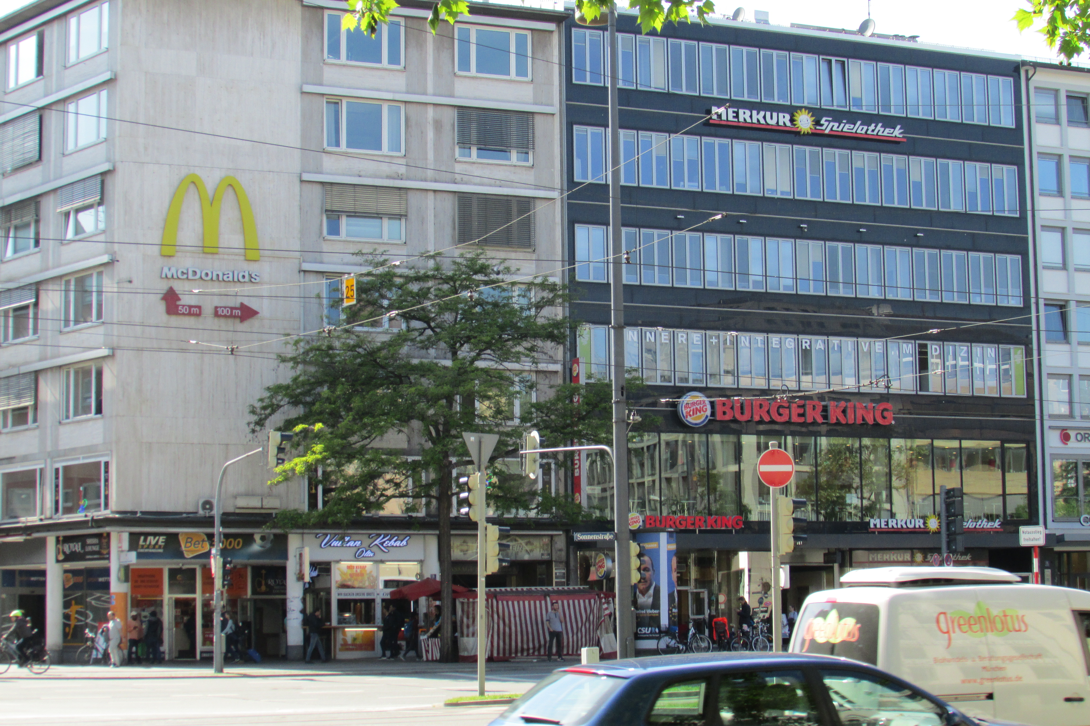
Correlation Is Not Causation
“We often see fast-food chains together. We should locate our next McDonald’s right next to a Burger King.”
The correlation is real but not the cause.
Locations near a Burger King really do post
higher sales.
The causation is otherwise.
Traffic causes good sales.
Highway exits, traffic counts, busy corridors have high customer volume.
They can share supply chains as well.
Photo: Chris Light · CC BY-SA 4.0 · via Wikimedia Commons (curid 95567816)
Notes:
[55:45 – 58:45] Correlation vs. causation — 3 min
WARM-UP, TEN SECONDS
• The obvious version first so they know the shape of the error: crowded beaches and hot days go
together, so ban beachgoing to cool the weather. Everyone sees why that fails — summer causes both.
• Then say the hard part out loud: real cases do not look silly. Here is one from the job you were
just doing.
THE CLAIM ON THE SLIDE
• Read it straight, no wink: "We often see fast-food chains together. We should locate our next
McDonald's right next to a Burger King."
• Let it sit. It sounds like a data-driven recommendation, and half the room will half-believe it.
BOX ONE — the correlation is real
• Insist on this before you debunk anything. The pattern is not a fluke, not a small sample, not bad
measurement. Run it again next year and it is still there.
• Students expect "correlation is not causation" to mean the number was wrong. It usually is not.
The number is fine. The sentence built on top of it is the problem.
BOX TWO — traffic causes both
• Both chains run essentially the same site screen: highway exits, traffic counts, commercial density.
So a nearby Burger King is EVIDENCE of a good location, not a cause of one.
• The lurking variable is traffic, exactly as summer was for the beach.
• Make the consequence concrete, because that is what makes it stick: follow the advice literally and
you would also open next to Burger Kings in dying strip malls. You would be copying the symptom and
ignoring the thing that produced it.
IF YOU WANT A SECOND FLAVOUR — reverse causality, 20 seconds
• Stores with double drive-thru lanes sell more. So build second lanes everywhere?
• No — McDonald's installs the second lane where volume is ALREADY high. The sales caused the lane.
Same correlation, different broken arrow: not a third variable, a reversed one.
THE LINE TO CLOSE ON
• In every one of these the data is telling the truth. The story you attach to it is what fails.
• Sorting that out is most of what applied economics is, and it is what Chapter 2 is for.

Slide 30
Chapter 1: The Full Picture
 | The core claim | Key terms | Story
Scope | Wants exceed resources, so choice is unavoidable | Economic agent, scarce resources, scarcity, positive vs. normative, micro vs. macro | The bowl of chocolates
Optimization | People try to pick the best feasible option | Trade-off, budget constraint, opportunity cost, cost-benefit analysis, net benefit | Lebron James’ choice for next team.
Equilibrium | Everyone optimizes at once; nobody gains by changing alone | Equilibrium, free rider problem | Homer watching PBS.
Empiricism | Data decides whether the theory is right | Empiricism, causation vs. correlation | Choosing a location for McDonald's
Four rows. Everything else this term is one of them, in more detail.
Notes:
[58:45 – 60:00] Consolidation table — 1.25 min
• This is the slide to tell students to screenshot. It is the chapter's vocabulary in one frame.
• Read down the "key terms" column once — those are the exam definitions.
• Read down the "where you saw it" column once — those are the examples that make the definitions stick.
• Say which chapters extend which row: Ch. 3 and 5 extend optimization, Ch. 4 and 7 extend equilibrium,
Ch. 2 extends empiricism.

Slide 31
KEY TAKEAWAYS
Chapter 1: Principles and Practice
Economics is the study of choice under scarcity — not the study of money
Positive economics describes; normative economics prescribes, with a value judgment
Optimization: pick the best feasible option, and measure cost as opportunity cost
Equilibrium: everyone optimizing at once, so nobody gains by changing alone
Empiricism: data decides — and correlation is not causation
Notes:
[60:00 – 62:15] Wrap — 2.25 min
• Read the five lines. These are the five things you would put on an exam from this chapter.
• Repeat the two most-missed definitions: scarcity (wants vs. resources, not shortage) and opportunity
cost (value of the BEST alternative forgone).
• Point them at Chapter 3 as the direct continuation of Part 2 of today's lecture.
• Close on the deadline: Ch. 1 and Ch. 3 homework and quizzes, Sunday Aug 2, 11:59 PM. Unlimited
attempts on homework, two on the quiz — do the homework first.
TOTAL RUNTIME: 70:00

