Slide 1
Application:
What Does a Year of College Cost?
What you give up | How it adds up | One year
Tuition and fees | UC tuition plus campus fees | $17,000
Books and supplies | roughly, over three quarters | $2,000
Forgone earnings | a year of full-time pay you did not earn | $48,000
Total, one year | out of pocket + opportunity cost | $67,000
Not counted: housing and food, about $21,000. You have to live and eat either way —
so only the difference between the dorm and the alternative is a cost of going.
The bill says $19,000. The cost is $67,000 — because the real price of a degree is the years, not the tuition.
Notes:
[0:00 – 1:45] Cold open — what a year of college costs — 1.75 min
NUMBERS TO SAY — ROUND ONES ONLY, AND THEY ARE ALL ON THE SLIDE
Tuition and fees: $17,000
Books and supplies: $2,000
On the bill: $19,000
Forgone earnings: $48,000
Total, one year: $67,000
Not counted: about $21,000 of housing and food
Say the round numbers. Do not read decimals off a slide — they are the easiest thing to
get wrong out loud and they add nothing to the argument.
EXACT PUBLISHED FIGURES, if a student asks or emails: UCR's 2026–27 cost of attendance for
a California resident lists $15,588 UC tuition, $1,202 campus and technology fees, $1,700
books and supplies, $13,793 housing and $7,282 food. Forgone earnings here are 52 weeks at
$930, the BLS median usual weekly earnings for a full-time worker aged 25+ with a
high-school diploma (2024 annual average) — $48,360. Unrounded total: $66,850.
OPEN COLD — BEFORE THE TITLE CARD, NO PREAMBLE
• First words of the recording: "Chapter 1 said economics is the study of choice under scarcity.
Let's put numbers on a choice almost everyone in this room has made."
• Chapter 1 finished without ever computing anything at the end. This is that missing slide, and
it happens to be the perfect on-ramp to Chapter 3.
• Keep the register neutral and analytical. This is a worked example about a decision people
make, not a verdict on anyone's decision — and not a pitch for this course.
THE OUT-OF-POCKET HALF — MOVE FAST, THIRTY SECONDS
• Seventeen thousand in tuition and fees, two thousand in books. Nineteen thousand on the bill.
• Say once that this is the sticker price and that most students pay less after aid — you come
back to it on the next slide.
FORGONE EARNINGS — THE HALF THAT IS NOT ON ANY BILL
• Forty-eight thousand dollars: a year of full-time pay at the median for someone with a
high-school diploma. That is what you gave up by being here instead of there.
• Two and a half times the tuition, and it appears on no invoice anywhere. Pure opportunity
cost — Chapter 1's definition, with a number attached for the first time.
• It is a median for one comparison group. Anyone who would have earned more should scale it
up; anyone who would have worked part-time should scale it down. Invite them to substitute
their own number — the round figures make that easy to do in their head.
HOUSING AND FOOD — SPEND TWENTY SECONDS, IT IS THE BEST IDEA ON THE SLIDE
• About twenty-one thousand dollars of the published cost of attendance is rent and groceries.
You would be paying for somewhere to sleep and something to eat whether or not you enrolled.
• Only the DIFFERENCE counts. If the dorm runs three thousand more than living at home, three
thousand is a cost of going. The other eighteen is not.
• A cost only counts if it changes when the decision changes. That sentence is the whole of
marginal analysis, arriving about fifty minutes before it gets its name.
THE POINT TO LAND
• Sixty-seven thousand, not nineteen. The gap is almost entirely time — the resource Chapter 1
kept calling scarce and the one no bill ever mentions.

Slide 2
And What Does It Return?
Median full-time pay: about $1,500 a week with a degree, about $900 a week without.
$1,500 − $900 = $600 a week
$600 × 52 weeks ≈ $30,000 a year
$67,000 × 4 years = $268,000
$268,000 ÷ $30,000 a year ≈ 9 years
Nine years of work after graduating, and the degree has paid for itself.
Notes:
[1:45 – 3:15] Cold open — the return, and the bridge — 1.5 min
THE WHOLE SLIDE IS ONE CALCULATION. WALK DOWN IT, ONE LINE AT A TIME.
$1,500 − $900 = $600 a week
$600 × 52 weeks ≈ $30,000 a year
$67,000 × 4 years = $268,000
$268,000 ÷ $30,000 ≈ 9 years
• Line 1. The gap. Fifteen hundred a week with a degree, nine hundred without — six hundred
dollars a week of difference.
• Line 2. Annualise it. Six hundred times fifty-two is about thirty thousand a year.
• Line 3. The cost side, straight off the previous slide: sixty-seven thousand a year, times
four, is two hundred and sixty-eight thousand.
• Line 4. Divide. Nine years.
• Then say the sentence at the bottom and stop: nine years of work after graduating and the
degree has paid for itself. Everything after that is on the upside.
WHY THE ARITHMETIC IS THIS CLEAN
• Every number is rounded so the division comes out whole and you can do it out loud without
a calculator — and so can they, with their own numbers.
• The point of the slide is not nine. It is that a benefit with no invoice attached — "a
degree" — got converted into dollars per year and became comparable with a cost. That is
step one of every procedure in today's lecture.
CAVEATS — SAY THESE OUT LOUD, THEY ARE DELIBERATELY NOT ON THE SLIDE
• The $600 gap compares people who finished degrees with people who did not, and those two
groups differ in more than the degree. Chapter 1's correlation-versus-causation section was
about exactly this — treat nine years as an upper bound on what the degree itself does.
• The sticker price is not what most people pay. Financial aid moves the cost side a lot, and
differently for different students, so for many the payback is faster.
• It ignores interest, and it assumes the gap is constant across a career. Concede both if
asked. A model whose limits you can state is worth more than one whose limits you cannot.
• Rounding note, for your own confidence: both roundings ran against the degree — cost up,
benefit down — so nine years is the conservative figure. The unrounded answer is 8.4.
THE BRIDGE — SAY IT, THEN GO TO THE TITLE CARD
• "Notice the three moves. Everything into one unit. Put a price on the thing with no invoice.
And throw out the costs that are identical either way — rent, groceries — because they cannot
break a tie."
• "That last move is the one with a name, and today you get it: marginal analysis. Seventy
minutes on comparing what differs instead of adding up what does not."
• Then the title card, then the roadmap.

Slide 3

Chapter 3
Optimization: Trying to Do the Best You Can
ECON 003
UC Riverside · Summer 2026
Notes:
ECON 003 · Summer B 2026 · Lecture 2 of 10
Chapter 3 — Optimization. Second half of Week 1; posts Wednesday.
Slides 1–2 are a cold open — the Chapter 1 cost-benefit example, with numbers, that the Ch. 1 deck skipped. They run before this title card.
Planned runtime 75:30. Chapter 1 was planned at 62:15 and delivered at 77:42 (+25%), so budget closer to 85 minutes of recording time unless you cut.
If you need to come in under 75: the two slides marked CUT CANDIDATE in their notes (the work-hours extension pair) remove 5 minutes and cost nothing that is examined.

Slide 4
Where We Left Off
Chapter 1 gave you three principles. Chapter 3 takes the first one apart.
TRADE-OFF
BUDGET CONSTRAINT
OPPORTUNITY COST
Choosing one thing means
giving up another.
There is no option that
costs nothing.
The set of things you can
actually choose.
Money, hours, attention —
all of them bind.
The value of the best
alternative you gave up.
This is the one we will
put a dollar sign on today.
Chapter 1 said people try to pick the best feasible option. Chapter 3 shows you how to actually find it.
Notes:
[3:15 – 4:15] Opening — where Chapter 3 sits — 1 min
FRAME THE WEEK
• Two lectures, one week. Chapter 1 was the map of the whole discipline — three principles,
optimization, equilibrium, empiricism. Chapter 3 zooms all the way in on the first one and
stays there for seventy minutes.
• Say why we skip Chapter 2: it is the maths-and-graphs toolkit, and it is assigned reading,
not lecture. Anyone shaky on reading a table or a line graph should read it before the
homework. This lecture uses both, gently.
THE THREE CALLBACKS — spend about twenty seconds each
• Trade-off. Last week's version: every choice gives something up. Today you will put a number
on the thing given up, for the first time.
• Budget constraint. Last week: $60 of food money, 24 hours in a day, attention you cannot
split. Today it becomes the word "feasible," which is doing more work than students expect.
• Opportunity cost. Last week you priced an hour of scrolling. Today you price an hour of
commuting, and that price decides where somebody lives.
THE POINT TO LAND
• Chapter 1 was vocabulary. Chapter 3 is a procedure — by the end of the hour they should be
able to take four options and a price for time, and produce the right answer, twice, two
different ways.

Slide 5
Today's Roadmap
01
What Optimization Is
The best feasible option — and why “feasible” is the load-bearing word
02
Optimization Using Total Value
Convert to common units, add it all up, pick the best number
03
Optimization Using Marginal Analysis
Compare the change between options, not the level of each one
04
Evidence, and Four Problems
Does distance really price housing? Then practice, with a warning attached
Notes:
[4:15 – 5:15] Roadmap — 1 min
READ IT AS A SHAPE, NOT A LIST
• Parts 2 and 3 answer the same question with different arithmetic and get the same answer.
Say that now, so when they see it happen they recognise it as the point rather than as a
coincidence.
• Part 1 is about fifteen minutes of definitions. Warn them: it is the driest stretch of the
hour and everything after it is numbers. Promise the apartment problem by minute sixteen and
then keep the promise.
WHAT THEY ARE EXAMINED ON
• MyLab Chapter 3 problems are almost entirely Part 2 and Part 3 mechanics — build a total-cost
column, build a marginal column, read off the optimum. Tell them this. It changes how they
watch the middle of the lecture.
• Part 4 is where the exam questions come from that are not mechanical: comparative statics
("the wage rises — which way does the optimum move?").
THE QUESTION TO PLANT
• Pose the chapter question now and leave it open: how does location affect the rental cost of
housing? Tell them Part 4 answers it with Portland data. It gives the hour an arc.

Slide 6
PART 1
Choosing the Best
Feasible Option
Notes:
[5:15 – 5:30] Section transition — 15 sec

Slide 7
Optimization, Defined
Optimization is choosing the best feasible option,
given the information available.
THE WORDS TO KEEP
WHAT THE CLAIM IS NOT
Economists call the best feasible
option the optimal choice, or
simply the optimum.
Best out of the menu you face —
not the menu you wish you faced.
Not that people always succeed.
The claim is that people try, and
that trying is systematic enough
to model — and to predict.
Economists use optimization to predict most of the choices that people, households, firms and governments make.
Notes:
[5:30 – 7:15] Optimization defined — 1.75 min
DEFINITION FIRST, THEN MAKE THE QUALIFIERS WORK
• Read the definition off the slide. Then say: there are two qualifiers in that sentence and
almost every student misunderstanding of this chapter comes from dropping one of them.
"Feasible" gets the next slide to itself. "Given the information available" is this one.
• The optimum is not the best imaginable outcome. It is the best entry on a list you did not
get to write.
THE VOCABULARY THEY WILL BE TESTED ON
• optimal choice = optimum = best feasible option. Three names, one thing. MyLab uses all three.
ASK THE QUESTION PEARSON ASKS
• "Do you always make the best choice?" Pause. In a recording, pause anyway — leave three
seconds of silence so the question lands. Then: nobody does. And economists know that.
• The model does not require perfection. It requires that mistakes are not the whole story —
that behaviour points in the direction of what people want, most of the time, in situations
they have seen before.
THE POINT TO LAND
• Optimizing is trying, not succeeding. A bad outcome is not proof of a bad decision, and a good
outcome is not proof of a good one. You will come back to this when the raise flips the
apartment answer at the end of the hour.

Slide 8
“Feasible”
Three constraints, all of them from Chapter 1, all of them still binding.
MONEY
TIME
AVAILABILITY
$1,200 a month for rent.
The $2,000 loft is not a
worse option. It is not an
option at all.
Twenty-four hours a day.
Two things you would enjoy
at 8 p.m. — you get one of
them, and only one.
The 9 a.m. section is full.
Your optimum is defined over
the seats that are left, not
the seats you wanted.
Change the constraint and the optimum changes — without anybody changing what they want.
Notes:
[7:15 – 8:45] Feasible, and the budget constraint — 1.5 min
WHY THIS SLIDE EXISTS
• Students treat "feasible" as filler. It is the entire difference between economics and wishing.
Run all three cards fast and concretely; none of them needs more than twenty-five seconds.
THE CARDS
• Money. The $2,000 loft is not on the list. Not "worse" — absent. If a student says "but I'd
prefer the loft," agree, and say that is exactly the point: preference over an infeasible
option changes nothing about what you do.
• Time. Use their Tuesday night. Two things at 8 p.m., you get one. Time constrains people who
have plenty of money, which is why every problem in this chapter prices hours.
• Availability. Registration at 7 a.m. — the example from Lecture 1. The good section is gone.
You optimize over what is left.
THE SENTENCE AT THE BOTTOM IS THE ONE THAT MATTERS
• Change the constraint, change the optimum, with preferences held completely fixed. That is
where predictions come from in this course. Every comparative-statics question they will ever
see is this sentence.
• Flag forward: in about half an hour you will raise one price — the value of an hour — and watch
somebody move house without their taste in apartments changing at all.

Slide 9



Do People Always Optimize?
No. Optimization is a model of behaviour, not a claim that everybody gets it right.
LIMITED INFORMATION
TOO MUCH INFORMATION
INEXPERIENCE
Information is costly to get,
so you decide on less than
all of it.
Nobody reads every review.
Sometimes there is so much
of it that you cannot tell
where to start sorting.
The first time you face a
situation you cannot use the
information you do have.
Rookie mistakes are real.
Behavioral economics is the branch that studies exactly where this breaks down — procrastination, self-control, addiction.
Notes:
[8:45 – 10:15] The limits of optimization — 1.5 min
BE HONEST HERE — IT BUYS CREDIBILITY FOR THE REST OF THE CHAPTER
• Some students arrive already suspicious that economics assumes people are calculating machines.
Concede the point before they raise it. The model does not need people to be perfect and the
textbook says so explicitly in 3.1.
THE THREE FAILURES
• Limited information. It is costly to gather, so rationally you stop gathering before you know
everything. Not reading every review is itself an optimization.
• Too much information. Forty apartments and one weekend. Sorting has a cost too, and past some
point the sorting costs more than the better answer is worth.
• Inexperience. The first hand of poker. You hold information you cannot yet use. This is why
optimization describes experienced behaviour far better than first attempts — which is the
next slide.
BEHAVIOURAL ECONOMICS — ONE MINUTE, NO MORE
• A whole field studies when optimization fails and why: it combines economic models with
psychology. Name procrastination and self-control problems as the classic cases.
• Do not editorialise about addiction beyond naming it as the textbook's example — it is one word
in ALL and it should be one word here.
• Forward pointer for the strong students: if they like this, ECON courses in behavioural
economics exist and this is the seam they enter through.
THE POINT TO LAND
• "People try to optimize" is a modelling assumption that earns its keep by predicting well. It
is not a moral claim about anybody.

Slide 10
When the Model Earns Its Keep
WHERE OPTIMIZATION PREDICTS WELL
WHERE IT PREDICTS BADLY
Choices people make repeatedly.
· Weekly grocery shopping
· The route to work
· A firm pricing the same product
for the tenth year running
Practice is the mechanism: mistakes
get corrected because the
situation comes round again.
Choices people make once.
· Your first poker hand
· Choosing a mortgage
· Picking a major at eighteen
No feedback loop, no correction —
and often the stakes are
highest here.
The useful question is never “are people rational?” — it is “is this a situation where the model earns its keep?”
Notes:
[10:15 – 11:30] Where optimization applies — 1.25 min
THIS IS THE SLIDE THAT ANSWERS THE SCEPTIC
• A student who wants to argue "people aren't rational" is arguing against a claim economics
does not make. Give them the sharper version of their own objection: the model is better in
some situations than others, and here is the dividing line.
THE DIVIDING LINE IS REPETITION
• Repetition gives you feedback, feedback gives you correction, correction gives you behaviour
that looks like optimization whether or not anyone is doing arithmetic.
• The grocery shopper is not solving a constrained maximisation problem in the aisle. After two
hundred trips their basket looks as if they had.
• The mortgage is the uncomfortable case: once in a lifetime, enormous stakes, no practice. This
is precisely where policy tends to intervene — disclosure rules, cooling-off periods. Plant it;
Chapter 10 comes back to it.
THE POINT TO LAND
• The apartment problem you are about to spend twenty-five minutes on is a repeated,
high-stakes, well-defined choice with a small menu. It is exactly the kind of decision the
model handles well. Say so — it justifies the example.

Slide 11
Two Techniques
net benefit = total benefits − total costs
marginal net benefit = change in benefits − change in costs
OPTIMIZATION USING TOTAL VALUE
OPTIMIZATION USING MARGINAL ANALYSIS
Compute the net benefit of every
option. Pick the biggest number.
Works on levels: what is this
option worth, all in?
Compute the change in net benefit
when you move from one option to
the next. Keep moving while it helps.
Works on differences.
They always give the same answer. Use whichever is easier for the problem in front of you.
Notes:
[11:30 – 13:15] The two techniques — 1.75 min
TWO EQUATIONS, ONE ABOVE THE OTHER — POINT AT THE PARALLEL
net benefit = total benefits − total costs
marginal net benefit = change in benefits − change in costs
• Read them one after the other and say what is identical: same structure, same minus sign,
same two things being compared. The only difference is the word "change."
• Total value works on levels. Marginal analysis works on differences. That is the whole
distinction, and it is now two lines instead of a paragraph.
• Everything the two options have in common cancels in the second equation. In the apartment
problem the square footage and the appliances never get written down at all, because
identical things subtract to zero.
• Tell them to copy both lines down. Exhibit 3.7 later in the hour is literally the second
equation, computed column by column.
THE SENTENCE THAT SETS UP THE CLIP
• "They always give the same answer." Say it, and say it firmly — because the next two slides
are ninety seconds of somebody for whom they did not, and the whole point is that the
disagreement is the tell that something was mis-costed.

Slide 12
What “Marginal” Means
Marginal means the change — what happens when you move from one alternative to the next.
LEVELS
DIFFERENCES
Total cost of Close: $1,190
Total cost of Far: $1,180
.
Marginal total cost of moving
from Close to Far: $1180-$1190=−$10
Marginal analysis is usually faster, because everything the two options have in common cancels out and never gets written down.
Notes:
[13:15 – 14:45] Marginal, defined — 1.5 min
NUMBERS TO SAY EXACTLY: Close $1,190. Far $1,180. The move between them, −$10.
THE WORD IS THE OBSTACLE
• "Marginal" in ordinary English means unimportant. In economics it means the change at the edge —
the effect of one more, or of one step. Say that out loud; it is the single most confusing piece
of vocabulary in the first half of this course.
• Every time you say "marginal" for the rest of the term, they should hear "the change."
LEVELS VERSUS DIFFERENCES
• The left card is two numbers about two things. The right card is one number about the move
between them. Same information, different question.
• Marginal total cost of moving from Close to Far is minus ten dollars. Negative, because the move
makes you better off. Insist on the sign — students lose marks on signs more than on arithmetic
in this chapter.
WHY IT IS FASTER
• Everything the two apartments share cancels. Same square footage, same appliances, same
neighbourhood — they never appear in a marginal comparison at all, because they are identical
and identical things subtract to zero.
• That is why marginal analysis scales. When options are complicated but similar, the difference
is short even though the levels are long.
THE POINT TO LAND
• Marginal analysis is not a second theory. It is the same optimization, asked one step at a time.
It will not change the answer. It changes how much arithmetic you have to do to find it.

Slide 13
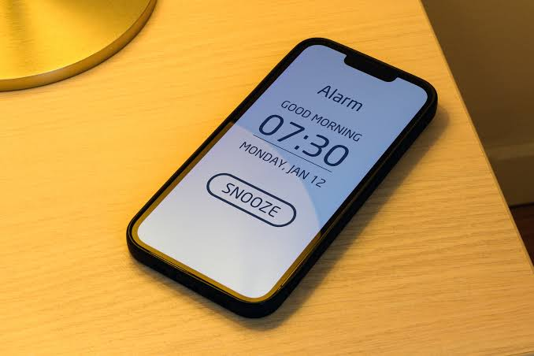
“Need More Snooze”
EVERY SNOOZE, FROM THE FIRST TO THE TENTH
marginal cost
5 minutes
marginal benefit
5 minutes of sleep
Ten snoozes later, the next one still costs five minutes. The comparison is identical every time — so nothing inside it ever tells him to stop.
Photo: BitsAndSplits / Getty Images
Notes:
[16:30 – 17:45] Why ten identical comparisons never say stop — 1.25 min
NUMBERS TO SAY EXACTLY: marginal cost 5 minutes. Marginal benefit 5 minutes of sleep.
Ten repetitions. Fifty minutes gone.
THE ONE IDEA ON THIS SLIDE
• Read the two lines in the box. Marginal cost of one snooze: five minutes. Marginal benefit
of one snooze: five minutes of sleep. Benefit beats cost, because sleep at six in the
morning is worth more to him than five minutes of anything else.
• Now the sentence that matters: that comparison is EXACTLY the same on snooze ten as it was
on snooze one. Nothing in it grew. Nothing in it turned. So nothing in it ever told him
to stop.
• Fifty minutes have gone and the next decision still looks like a five-minute decision.
WHY THIS IS THE INTERESTING FAILURE
• The previous slide said the mistake is the price tag. This slide says why the price tag is
so convincing: it is genuinely the same decision every time, and each instance really does
pass its own test.
• Contrast it out loud with the apartments coming up. There, marginal rent savings SHRANK —
ninety, sixty, thirty — so the comparison eventually turned against moving further out and
the arithmetic itself said stop. Here the marginal cost is flat by construction, so the
stopping rule never fires.
• State the general lesson: marginal analysis only stops you when something in the comparison
changes. Price the next step as identical to the last and you have built a rule that can
never say no.
THE FIX, IF SOMEONE ASKS WHAT HE SHOULD HAVE DONE
• Price the step properly and the flatness disappears: the tenth snooze does not cost five
minutes, it costs the meeting. Or commit in advance — alarm across the room, option removed.
Constraints beat willpower, which is the "feasible" slide from Part 1 arriving from the
other direction.
DELIVERY
• Short slide. Two lines from the box, then the punchline, then the divider. Do not re-tell
the clip — they watched it thirty seconds ago.

Slide 14

The Second Chip and the Second Slice
CHIPS
PIZZA
Every chip is about as good as the last, so
marginal utility barely falls. Nothing says stop
until you notice the bag is empty.
The second slice is worth much less than the
first, and by the third you are full. Marginal
utility falls fast — and it tells you when to stop.
Notes:
[17:45 – 19:15] Chips and pizza — 1.5 min
TWO GOODS, TWO SHAPES OF MARGINAL UTILITY
• Same question for both: what is the next one worth? That is all marginal utility means —
the value of one more unit, and it is the benefit side of the second equation.
CHIPS — THE FLAT CASE
• The tenth chip tastes about like the first. Marginal utility barely declines, so the
comparison "is the next chip worth it?" returns yes every single time.
• Which means nothing inside the decision ever stops you. What stops you is running out —
an external constraint, not the arithmetic. Students recognise the moment: you look down
and the bag is finished and you never decided to finish it.
• Same structure as Homer and the snooze button two slides ago. A flat margin builds a rule
that cannot say no.
PIZZA — THE DECLINING CASE
• The first slice is worth a lot. The second is worth clearly less. By the third or fourth
you are full and the next slice is worth close to nothing — some people would pay to not
eat it.
• Marginal utility falls fast, so the comparison turns on its own. You stop because the
arithmetic told you to, not because the pizza ran out.
• This is diminishing marginal utility, and it is the normal case in economics — Chapter 5
builds consumer choice on exactly this shape.
THE POINT TO LAND
• Marginal analysis stops you only when something in the comparison changes. Pizza changes.
Chips barely do. That is why the same method feels reliable with one and useless with the
other.
• Forward pointer: the apartments coming up behave like pizza — the rent savings shrink
ninety, sixty, thirty — which is exactly why the table has an optimum in the middle
instead of at an end.
IF SOMEONE ASKS WHETHER CHIPS REALLY HAVE CONSTANT MARGINAL UTILITY
• Strictly, no — it does decline, just very slowly, and salt and fat are engineered to keep
it high. Concede that. The teaching point survives: how FAST marginal utility falls decides
whether your stopping rule ever fires.

Slide 15
PART 2
Optimization Using
Total Value
Notes:
[19:15 – 19:30] Section transition — 15 sec

Slide 16
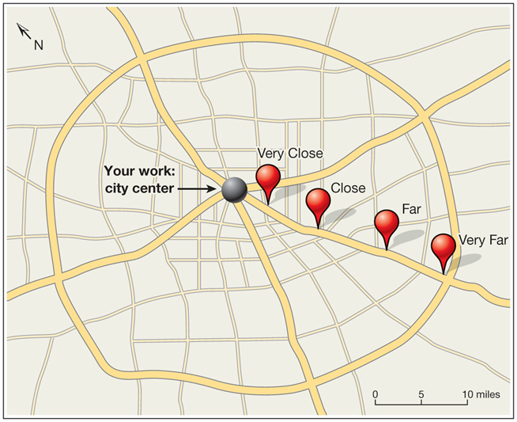
The Problem: Where Should You Live?
WHERE SHOULD YOU LIVE?
Your job is in the city centre. Four
apartments, identical except for two things:
the commute and the rent.
Rent falls as you move out. Commuting time rises.
Acemoglu, Laibson & List, Microeconomics 3e
Notes:
[19:30 – 20:45] Setting up the apartment problem — 1.25 min
NUMBERS TO SAY EXACTLY: Very Close 5 hours a month. Close 10. Far 15. Very Far 20.
Rents run the other way — Very Close is dearest, Very Far cheapest. Figures on the next slide.
TELL IT AS A STORY, NOT AS A PROBLEM SET
• They have graduated. They have a job downtown. This is the first real decision of adult life
and it is a constrained optimization. Most of this room will make this exact choice within
four years, and several are making it now about Riverside.
• Walk the map left to right: work is the grey dot in the centre, then Very Close, Close, Far,
Very Far strung out along the road. The scale bar matters — Very Far is only about ten miles
out. This is a normal commute, not an extreme one.
THE TRADE-OFF IS THE POINT
• Two things move in OPPOSITE directions as you go out: rent falls, commuting rises. That is
the entire reason there is a decision. If both moved the same way there would be nothing to
choose.
• Ask them to guess now, before any numbers: closer or further? Take the guess seriously —
you check it against the arithmetic in ten minutes, and again after the wage changes.
WHY THE CENTRE COSTS MORE
• Do not explain it with supply and demand — that is Chapter 4 and they do not have it yet.
Say only what they know from living: limited space near the centre, lots of people want it.
• Park the question. Part 4 brings the Portland data and the answer is yes, strongly, with a
wrinkle where the ring highways are.
DELIVERY
• The map does most of the work. Read the box once, point at the four pins, and move to the
table. Do not linger — the numbers are the next slide and that is where the lecture starts
computing.

Slide 17
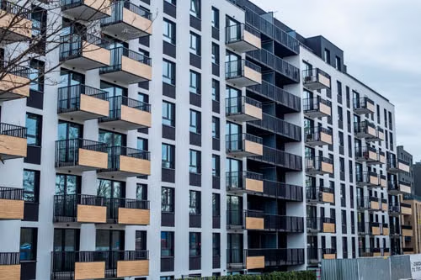
Exhibit 3.1 — Your Short List
Four apartments, differing only in commuting time and rent.
Apartment | Commuting time (hours / month) | Rent ($ / month)
Very Close | 5 hours | $1,180
Close | 10 hours | $1,090
Far | 15 hours | $1,030
Very Far | 20 hours | $1,000
Notes:
[20:45 – 22:00] Exhibit 3.1 — the short list — 1.25 min
NUMBERS THAT MUST BE SAID EXACTLY — READ THEM, DO NOT RECALL THEM
Very Close 5 hours $1,180
Close 10 hours $1,090
Far 15 hours $1,030
Very Far 20 hours $1,000
RUN IT AS A QUESTION
• Ask which apartment they would pick. In a recording, ask anyway and pause.
• The answer you want is "I can't tell yet." If you were live you would push until somebody said
it. Recorded, say it for them after the pause: you cannot choose, because the table is
incomplete.
WHAT IS MISSING, IN ORDER
• The cost of commuting. Hours are on the table but they are priced at nothing, so the table
currently says Very Far — it is $180 a month cheaper than Very Close and there is no visible
reason not to take it.
• Anticipate the objection "I don't know my income." Answer: assume all four are affordable. This
is a cost-minimisation problem, not an affordability problem.
• Anticipate "what about the neighbourhood?" Answer: identical by assumption, and there is a slide
later that takes that assumption seriously.
THE POINT TO LAND
• A column of hours next to a column of dollars cannot be added up. That single observation is
the whole of the next slide and most of what this chapter teaches.

Slide 18
What Does It Cost to Commute?
OUT OF POCKET
WEAR AND TEAR
YOUR TIME
Fuel. Transit fares.
Parking. Tolls.
Real money, easy to
measure — and we are
going to ignore it.
The car depreciates faster
the more you drive it.
Real, and almost nobody
counts it.
What you would have to be
paid to sit in traffic
instead of doing
something else.
This is the one we price.
Assume an opportunity cost of time of $10 per hour
Notes:
[22:00 – 23:30] The cost of commuting, and pricing time — 1.5 min
NUMBER TO SAY EXACTLY: the assumed opportunity cost of time is $10 per hour.
ASK BEFORE YOU SHOW
• "What does it cost to commute?" Let them generate the list — fuel, parking, the bus fare, the
car wearing out. In a recording, ask and pause; then reveal.
• Then narrow, deliberately and out loud: we are going to price exactly one of these, the time,
and set the rest to zero. Say that this is a simplification and that the last slide of Part 2
puts the others back.
DEFINE OPPORTUNITY COST OF TIME PROPERLY
• It is not "your wage." It is what you would have to be paid to spend that hour commuting
instead of doing whatever else you would have done with it. Sometimes that is the wage.
Frequently it is not.
• Ask why two students would have different numbers. Answers you want: different wages, but also
different things waiting at home, different tolerance for traffic, whether you can work on the
train.
• Note the direction this pushes: someone who can answer email on a train has a much lower
opportunity cost of commuting than someone who has to drive. That is a real prediction about
who lives where.
THE POINT TO LAND
• $10 an hour is an assumption, not a fact, and every answer in the next twenty minutes is
conditional on it. When you change it to $15 in Part 2, nothing else about the problem will
change and the answer will still move. That is the payoff for being careful here.

Slide 19
Optimization Using Total Value: Three Steps
01
Translate everything into common units
Here, dollars per month.
02
Compute the total net benefit of each alternative
Total benefits minus total costs, for every option on the list.
03
Pick the alternative with the highest net benefit
Notes:
[23:30 – 25:00] The three steps of total-value optimization — 1.5 min
THIS IS THE PROCEDURE THEY WILL BE GRADED ON — SLOW DOWN
• Step 1 is the one students skip and the one that costs them marks. Common units. In this
problem, dollars per month. Say the unit out loud every time you use it: not "dollars,"
dollars per month.
• Step 2: every alternative, including the ones you are sure are wrong. The one you skip is the
one the exam asks about.
• Step 3: highest net benefit wins. There is no tie-breaker and no second criterion.
THE SIMPLIFICATION ON THE BOTTOM LINE — SAY IT CAREFULLY
• Benefits are equal across the four apartments because we assumed they are identical in every
other respect. When benefits are equal, the option with the highest net benefit is just the
option with the lowest cost.
• So for the next fifteen minutes we minimise total cost. That is a special case, not the general
rule. If a student writes "optimization means minimising cost" on the exam they have learned
the wrong sentence.
• The practice problems at the end of the hour break this deliberately — there, one apartment has
a benefit the other does not, and you have to run the full net-benefit comparison.
THE POINT TO LAND
• Three steps, in order, every time. The reason this chapter feels easy is that the procedure is
short. The reason people get it wrong is that they start at step 2.

Slide 20
Exhibit 3.2 — Total Cost at $10 an Hour
Apartment | Commuting time (hours / month) | Commuting cost ($ / month) | Rent ($ / month) | Total cost ($ / month)
Very Close | 5 | $50 | $1,180 | $50+$1,180=$1,230
Close | 10 | $100 | $1,090 | $1,190
Far | 15 | $150 | $1,030 | $1,180
Very Far | 20 | $200 | $1,000 | $1,200
Very Far: 20 hrs × $10 = $200, + $1,000 = $1,200
Far: 15 hrs × $10 = $150, + $1,030 = $1,180
Rent alone says Very Far. Total cost says Far. The cheapest rent is not the cheapest apartment.
Notes:
[25:00 – 27:30] Exhibit 3.2 — the total cost table — 2.5 min
NUMBERS THAT MUST BE SAID EXACTLY — READ THEM
Very Close 5 hrs $50 rent $1,180 total $1,230
Close 10 hrs $100 rent $1,090 total $1,190
Far 15 hrs $150 rent $1,030 total $1,180 ← optimum
Very Far 20 hrs $200 rent $1,000 total $1,200
BUILD THE COLUMN LIVE — DO NOT JUST READ IT
• Do the Very Far row out loud, slowly: twenty hours, at ten dollars an hour, is two hundred
dollars a month of commuting. Add the thousand dollars of rent. Twelve hundred dollars a month,
all in.
• Then Far, which is the answer: fifteen hours at ten dollars is a hundred and fifty, plus ten
thirty of rent, eleven eighty. Both calculations are on the slide — read them off it.
• Let them do Close and Very Close. Pause. Then confirm.
THE THING TO POINT AT
• Rent is monotonic: it falls the whole way out. Total cost is not — it falls, bottoms out at
Far, and rises again. The turn happens because past Far the commuting you add is worth more
than the rent you save.
• Very Far has the cheapest rent in the table and is the third-best apartment. That is the sentence
students remember from this chapter.
COMMON MISTAKE TO PRE-EMPT
• Someone will say the answer is Very Close because "time is money and the commute is short."
Very Close has the shortest commute and the worst total cost of all four. Short commute is not
the objective; low total cost is.
THE POINT TO LAND
• The optimum is Far, at $1,180 a month. Say the number. You will use it again in three
different ways before the hour is out.

Slide 21
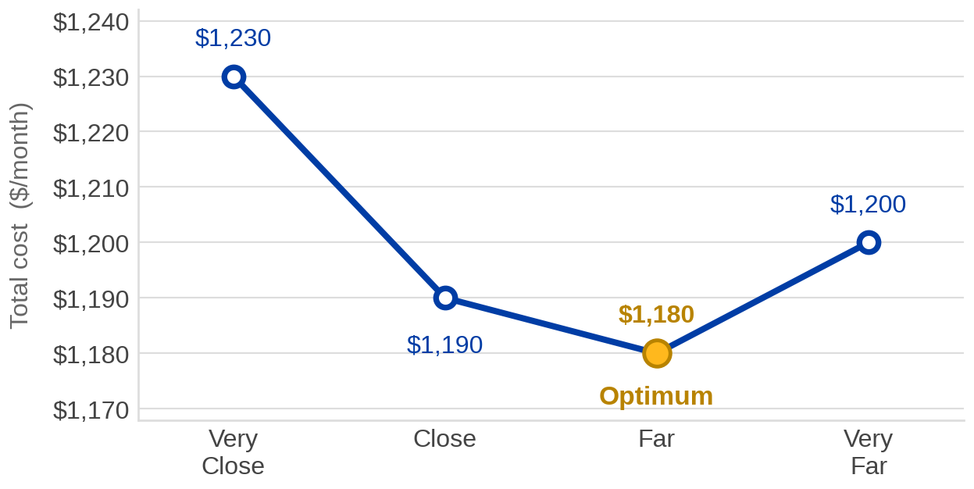
Exhibit 3.3
The curve is U-shaped because two costs move in opposite directions: rent falls as you move out, commuting cost rises.
Notes:
[27:30 – 29:00] Exhibit 3.3 — the total cost curve — 1.5 min
SAME NUMBERS, DIFFERENT ORGAN
• Nothing new is on this slide. Say that. It is the previous table, drawn. Some students read
tables better and some read pictures better and the exam uses both.
TEACH THEM TO READ IT
• Horizontal axis is not distance in miles — it is the four apartments, in order, closest to
furthest. It is a list, not a measurement.
• Vertical axis is total cost per month, and the window is narrow: $1,170 to $1,240. Point that
out. The differences look dramatic and they are seventy dollars.
• The optimum is the lowest point. In a cost-minimisation problem the optimum is the bottom of the
curve, and students who have seen graphs elsewhere will want it to be the top. Say it explicitly.
THE SHAPE IS THE ARGUMENT
• Two forces, opposite directions. Rent pulls the curve down as you move right. Commuting pushes
it up. Where the second overtakes the first, the curve turns.
• That U-shape is going to reappear constantly this term — costs in Chapter 6, and anything with
a trade-off between two opposing pressures. Tell them to get comfortable with it now.
THE POINT TO LAND
• Both representations answer the same question and pick the same apartment. If the table and the
picture ever disagree, you have made an arithmetic error.

Slide 22
Exhibit 3.4 — Total Cost at $15 an Hour
Apartment | Commuting time (hours / month) | Commuting cost ($ / month) | Rent ($ / month) | Total cost ($ / month)
Very Close | 5 | $75 | $1,180 | $75+$1,180=$1,255
Close | 10 | $150 | $1,090 | $1,240
Far | 15 | $225 | $1,030 | $1,255
Very Far | 20 | $300 | $1,000 | $1,300
Far was $1,180 at $10/hr. Now $1,255.
Close was $1,190. Now $1,240 — and it wins.
The optimum moved one step closer to the centre. Nobody’s preferences changed — one price did.
Notes:
[29:00 – 30:45] Exhibit 3.4 — the optimum moves — 1.75 min
NUMBERS THAT MUST BE SAID EXACTLY — READ THEM
Very Close 5 hrs $75 rent $1,180 total $1,255
Close 10 hrs $150 rent $1,090 total $1,240 ← new optimum
Far 15 hrs $225 rent $1,030 total $1,255
Very Far 20 hrs $300 rent $1,000 total $1,300
REBUILD ONE ROW, THEN JUMP TO THE ANSWER
• Do Close out loud: ten hours at fifteen dollars is a hundred and fifty, plus ten ninety, is
twelve forty. That is enough demonstration — they have seen the arithmetic twice now.
• Note that every total went up. Of course it did; commuting got more expensive and everybody
commutes. What matters is that they did not all go up by the same amount.
THE ASYMMETRY IS THE MECHANISM — SPEND TIME HERE
• Very Close added $25. Very Far added $100. The further out you live, the harder the price
increase hits you, because you were buying more hours of commuting.
• So a rise in the price of time is not a uniform tax on everyone. It falls hardest on the people
who consume the most of the thing that got expensive. That is a general result and it will come
back in the taxation chapter.
THE ANSWER, AND THE NEAR-MISS
• Close wins at $1,240. Point out that Very Close and Far are now tied at $1,255 — the curve has
become almost symmetric around the new optimum. If a student notices that, it is a good notice.
• Check it against the prediction from the previous slide. Whoever guessed "closer in" was right,
and they got it right from the logic, not the table.
THE POINT TO LAND
• Nobody's taste in apartments changed. One price changed and somebody moved house. That is the
entire predictive content of this chapter in one sentence.

Slide 23
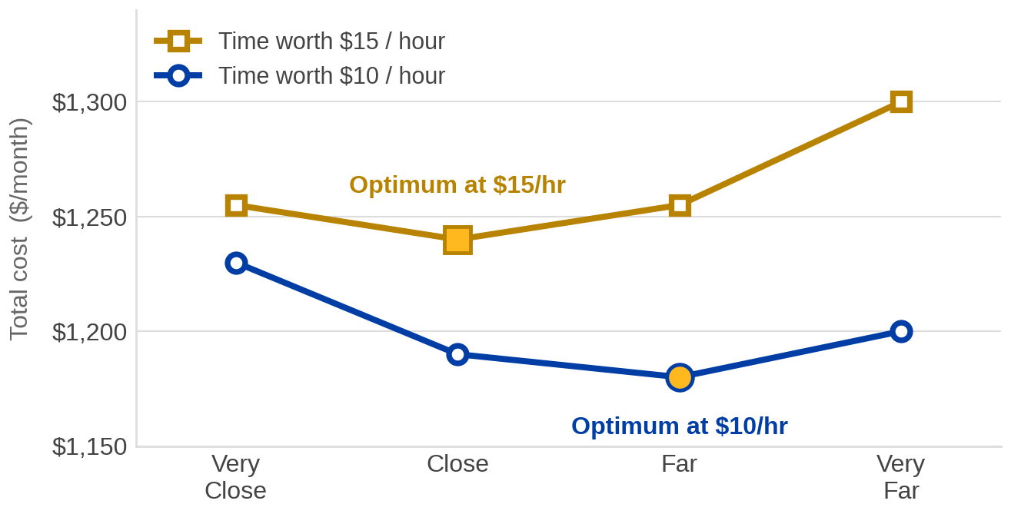
Exhibit 3.6 — Both Curves Together
People whose time is worth more should live closer in. That is a prediction about the world — and Part 4 checks it against data.
Notes:
[30:45 – 32:15] Exhibit 3.6 — comparative statics, drawn — 1.5 min
READ THE PICTURE IN TWO MOVES
• First: the gold curve is above the blue one everywhere. Commuting got dearer, so every
apartment costs more. That is the level effect and it is not the interesting part.
• Second: the gold curve's minimum sits one step to the left of the blue one's. That is the shape
effect, and it is the whole point. Say "the curve did not just rise, it tilted."
WHY IT TILTED
• The gap between the two curves is not constant. At Very Close it is $25; at Very Far it is $100.
The penalty grows with the length of the commute, which drags the low point leftward.
• If you want one sentence: raising the price of time raises the cost of distance, so people buy
less distance.
TURN IT INTO A TESTABLE CLAIM
• This is now a prediction about real cities: high-wage workers, and anyone whose hours are
precious for non-wage reasons, should be found closer to the centre and paying for it in rent.
• That is falsifiable, and Part 4 goes and looks. Set that up here — it is the transition into
the empiricism half of the hour.
THE POINT TO LAND
• Comparative statics is how economics earns predictions rather than descriptions. One price
moved, and the model told us the direction of the response before we looked.

Slide 24
PART 3
Optimization Using
Marginal Analysis
Notes:
[32:15 – 32:30] Section transition — 15 sec

Slide 25
Marginal Analysis in Three Steps
01
Translate everything into common units
Dollars per month.
02
Compute the marginal consequences of moving between alternatives
For each step from one option to the next: what changes, and by how much?
03
Choose the alternative you would not leave in either direction
Moving to it makes you better off; moving away from it makes you worse off.
Step 3 is the whole idea. An optimum is a place you would not want to walk away from — forwards or backwards.
Notes:
[32:30 – 33:45] The three steps of marginal analysis — 1.25 min
PUT IT NEXT TO THE OTHER PROCEDURE
• Step 1 is word-for-word identical to total value. Common units first, always. Point at that —
it is the step both methods share and the one students skip.
• Step 2 is where they diverge: differences instead of levels.
• Step 3 is the definition of an optimum in marginal language, and it is the sentence the textbook
calls the Principle of Optimization at the Margin. You will name it formally in three slides.
MAKE STEP 3 PHYSICAL
• Ask them to picture standing at the bottom of a valley. Step forwards, you go up. Step backwards,
you go up. That is what "you would not leave in either direction" means, and it is why the
optimum sat at the bottom of the U on Exhibit 3.3.
• Both directions matter. A student who only checks one side will confidently pick an endpoint —
and Very Far is an endpoint, which is exactly the trap the table sets.
WHAT THIS BUYS THEM ON THE EXAM
• They do not have to compute every total. They can start anywhere and walk downhill until the
next step goes up. On a long list that is much less arithmetic.
• Warn them about the one condition: it works cleanly because this cost curve has a single valley.
Nobody in ECON 003 will be handed a two-valley problem — but they should know the assumption is
there, because the next courses remove it.

Slide 26
Exhibit 3.7 — Cost and Marginal Cost
Still at an opportunity cost of time of $10 an hour. Marginal columns read “change from the row above.”
Apartment | Commuting cost | Marginal commuting cost | Rent | Marginal rent | Total cost | Marginal total cost
Very Close | $50 | — | $1,180 | — | $1,230 | —
Close | $100 | +$50 | $1,090 | −$90 | $1,190 | −$40
Far | $150 | +$50 | $1,030 | −$60 | $1,180 | −$10
Very Far | $200 | +$50 | $1,000 | −$30 | $1,200 | +$20
Read the last column: −$40, then −$10, then +$20.
Keep moving while the number is negative. Stop the step before it turns positive.
Notes:
[33:45 – 36:15] Exhibit 3.7 — building the marginal columns — 2.5 min
NUMBERS THAT MUST BE SAID EXACTLY — READ THEM, ALL OF THEM
Marginal commuting cost: +$50, +$50, +$50 (constant — five more hours each step)
Marginal rent: −$90, −$60, −$30 (falling, and shrinking)
Marginal total cost: −$40, −$10, +$20
Check: −$90 + $50 = −$40. −$60 + $50 = −$10. −$30 + $50 = +$20.
THIS IS THE CENTRAL SLIDE OF THE LECTURE. GIVE IT THE FULL FOUR MINUTES.
BUILD IT ONE MOVE AT A TIME, AS QUESTIONS
• Very Close to Close. Should you move? Commuting costs $50 more. Rent falls by $90. So you are
$40 better off. Yes, move.
• Close to Far. Commuting costs $50 more again. Rent falls by $60. You are $10 better off. Yes,
move — but notice the gain is shrinking.
• Far to Very Far. Commuting costs $50 more, same as always. Rent only falls by $30. You are $20
worse off. Stop.
THE PATTERN IS THE ECONOMICS
• Marginal commuting cost is constant at $50 because every step out is five more hours at ten
dollars. Flat.
• Marginal rent savings shrink: ninety, sixty, thirty. The first move out saves a lot; the last one
barely saves anything.
• A constant gain against a shrinking benefit has to cross, and where it crosses is the optimum.
This is the shape of nearly every optimization problem in economics — say that, because it is
the transferable insight, not the apartment.
CONNECT IT BACK
• The last column is the slope of Exhibit 3.3. Negative while the curve falls, positive once it
rises. If you want to be explicit: marginal total cost is what the graph's steepness was, in
numbers.
• Far is the answer, again. Same apartment as total value, arrived at without ever computing a
total. Say that out loud — it is the theorem doing its work.
COMMON MISTAKE TO PRE-EMPT
• Students read the +$20 row and conclude "Very Far is the optimum" because it is the row the
positive number sits in. It is not. The positive number is the cost of getting there, which is
why you do not go. The optimum is the row above.

Slide 27
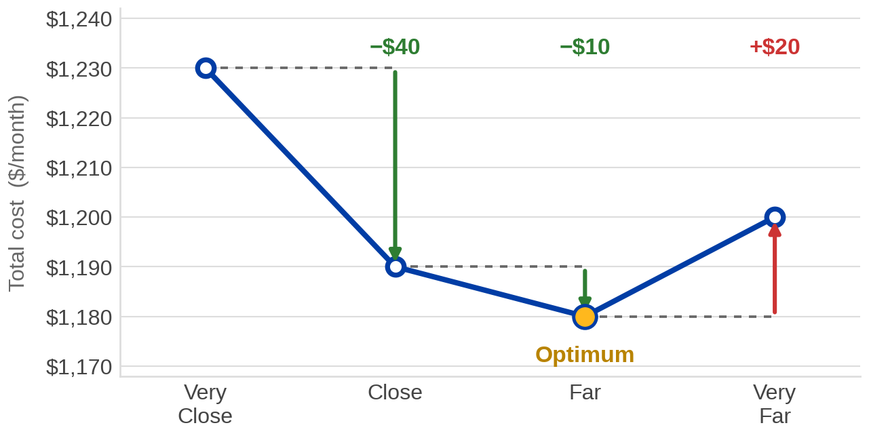
Exhibit 3.8 — Marginal Cost as a Picture
Every arrow is the marginal total cost of one move. The optimum is the last point you reach before an arrow starts pointing up.
Notes:
[36:15 – 37:30] Exhibit 3.8 — marginal cost, drawn — 1.25 min
WHAT THE ARROWS ARE
• Dashed line across: hold the previous apartment's cost level. Arrow down or up: the change when
you move to the next apartment. The length of the arrow is the marginal total cost.
• Two green arrows, both downward: −$40 and −$10. One red arrow, upward: +$20.
MAKE THE LINK TO THE CURVE EXPLICIT
• The arrows are the steps of the same blue curve they saw on Exhibit 3.3. Nothing has been
added — the picture has been annotated with the differences instead of leaving them implicit.
• Say the sentence: total cost is the level, marginal cost is the step between levels. The graph
shows both at once, which is why this exhibit is worth two minutes.
WALK THE VALLEY OUT LOUD
• Start at Very Close. Step right: down forty. Step right: down ten. Step right: up twenty. Stop.
You are standing at Far and both directions are uphill.
• That physical description is what the Principle of Optimization at the Margin says formally, and
it is the next slide. Do not name the principle yet — let the picture do it first.
THE POINT TO LAND
• Notice the arrows shrink: forty, ten, then reverse to twenty. The gains from moving out are
running down, and once they run out the direction flips. Optimum is the turning point, not an
endpoint.

Slide 28
The Principle of Optimization at the Margin
An optimal feasible alternative has the property that moving to it
makes you better off, and moving away from it makes you worse off.
MOVING TO FAR
MOVING AWAY FROM FAR
From Close:
pay $50 more commuting,
save $60 on rent —
so you are $10 better off. Go.
On to Very Far:
pay $50 more commuting,
save only $30 on rent —
so you are $20 worse off. Stay.
Total value and marginal analysis picked the same apartment. They always will.
Notes:
[37:30 – 39:00] The principle, named — 1.5 min
NUMBERS TO SAY EXACTLY: moving to Far, +$50 commuting against −$60 rent, net −$10 (better off).
Moving away from Far, +$50 commuting against −$30 rent, net +$20 (worse off).
NAME IT FORMALLY — THIS IS A DEFINITION THEY ARE EXAMINED ON
• Read the box word for word. "Moving to it makes you better off and moving away from it makes you
worse off." Both halves. A one-sided check is not the principle.
• Point out that it is stated without any reference to totals. That is deliberate: it is a local
test. You can verify an optimum by looking only at its two neighbours.
WORK THE TWO CARDS AS A PAIR
• Left card: the last move you should make. Right card: the first move you should not. The optimum
is the point between them.
• The commuting cost is $50 in both cards — identical. The only thing that differs is how much rent
you save, sixty against thirty. So the answer turns entirely on the rent gradient flattening out.
THE CLOSING SENTENCE MATTERS
• Two methods, two entirely different columns of arithmetic, one apartment. Say it plainly: this is
not luck, it is arithmetic. Net benefit summed is the same information as net benefit differenced.
• Which means on an exam they should pick whichever is less work — and if the two ever disagree
they have made a slip, which is a free error-check worth having.
FORWARD POINTER, TEN SECONDS, OPTIONAL
• In later courses the differences become derivatives and "moving to it makes you better off" becomes
a first-order condition. Same idea, calculus notation. Nothing in ECON 003 requires it.

Slide 29
PART 4
Evidence: Does Location
Really Price Housing?
Notes:
[39:00 – 39:15] Section transition — 15 sec

Slide 30
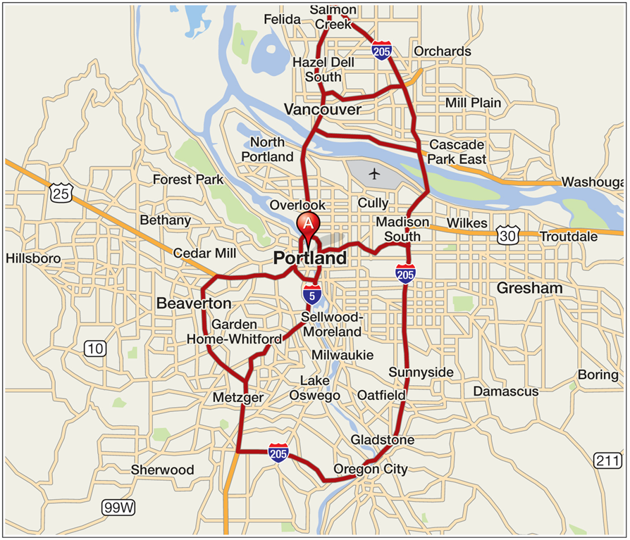
Why Portland's Curve Has a Shelf
THE RING ROADS
Portland is circled by highways about
twelve miles out from the center.
They cut commuting time for the areas
they serve — so those apartments are
effectively closer to downtown than
their mileage suggests.
The model was written in commuting
hours, not miles. Watch what that does
to the rent curve on the next slide.
Acemoglu, Laibson & List, Microeconomics 3e
Notes:
[39:15 – 40:15] The ring road, before the data — 1 min
WHY THIS SLIDE COMES BEFORE THE RENT CURVE
• Show them the road system first and ask for a prediction. If a band of highways lets you
cover twelve miles in the time it takes someone else to cover six, what should rent do out
there? Then reveal Exhibit 3.9 and let them check their own answer.
• That ordering is the difference between a graph they read and a graph they anticipate.
WHAT TO POINT AT ON THE MAP
• The centre pin is downtown Portland. Trace the loop — I-205 to the east and round the south,
I-5 through the middle. It is not a neat circle; it is a rough ring, and that is enough.
• Name a few of the places the ring serves — Gresham, Oregon City, Vancouver across the river.
Those are the neighbourhoods that will show up as the flat stretch in the data.
THE IDEA TO PLANT
• Distance in miles is not what anyone pays for. Distance in MINUTES is. A highway converts
the first into the second at a better rate, and the housing market notices immediately.
• Ask the counterfactual: what would the rent curve look like with no ring road? Smooth, steady
decline, no shelf. Infrastructure shows up in rents — that is a genuine policy result and it
arrives here for free.
LOCAL VERSION, IF YOU WANT ONE
• Riverside to Orange County along the 91 is the same mechanism without the ring: average rent
runs about $2.61 per square foot here against $3.51 in Irvine, and what buys the difference
is roughly forty miles and an hour of driving at peak.

Slide 31
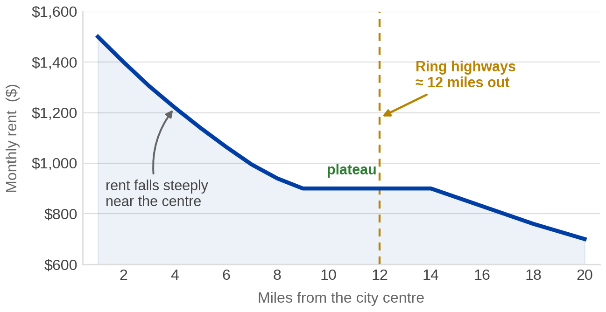
Exhibit 3.9 — Rent and Distance in Portland
Rents fall about 33% between
the city center and identical
apartments six miles out.
WHY THE PLATEAU?
The ring highways cut
commuting time for the areas
they serve — so those flats
are closer than the mileage.
Notes:
[40:15 – 41:45] Portland — the evidence — 1.5 min
NUMBERS TO SAY EXACTLY: rents fall roughly 33% from the city centre to otherwise identical
apartments six miles out. The plateau runs from about nine to about fourteen miles. The ring
highways sit at roughly twelve miles.
Source: Acemoglu, Laibson & List, Microeconomics 3e, Exhibit 3.9.
THE CONTROL IS THE WHOLE CLAIM — SAY IT FIRST
• "Otherwise identical." Apartments differ in size, age, condition and a hundred other things, and
all of those correlate with location. If you do not hold them fixed you are measuring
neighbourhoods, not distance.
• This is Chapter 1's correlation-is-not-causation lesson arriving with actual work attached. The
comparison is only informative because somebody did the controlling.
THE GRADIENT CONFIRMS THE MODEL
• Steep near the centre, roughly a third gone within six miles. Exactly what Part 2 predicted:
people pay for short commutes.
THE PLATEAU IS THE INTERESTING PART — SPEND A MINUTE
• From about nine to fourteen miles, rent stops falling. Ask why before you answer.
• The ring highways. Distance in miles is not what anybody cares about — distance in minutes is.
The highways make a band of neighbourhoods effectively closer than their mileage suggests, so
the market prices them as closer.
• This is a genuinely good moment: the model was written in commuting hours, not miles, and the
data quietly confirms that the hours were the right unit.
THE COUNTERFACTUAL WORTH ASKING
• What would the curve look like with no ring road? Smoother — a steady decline with no shelf.
Infrastructure shows up in rents.
THE POINT TO LAND
• A model is useful when it predicts the pattern and interesting when the deviation from the
pattern is also explainable. This exhibit does both.

Slide 32
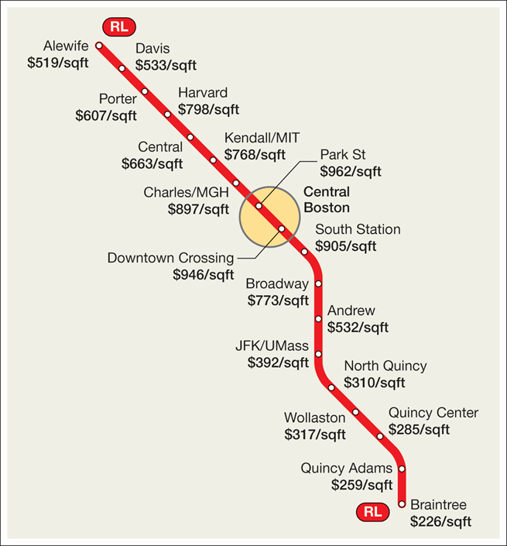
The Same Thing, One Subway Line
PARK STREET IS THE CENTRE
Price per square foot peaks at Park Street, in
the heart of downtown Boston, and falls in
both directions along the line.
Alewife, north end: $519
Park Street: $962
Braintree, south end: $226
Distance from the centre is counted in stops,
not miles. Harvard at $798 is the exception —
a second centre in its own right.
Acemoglu, Laibson & List, Microeconomics 3e
Notes:
[41:45 – 43:00] Boston's Red Line — 1.25 min
NUMBERS TO SAY EXACTLY: Park Street $962 per square foot. Alewife $519. Braintree $226.
That is a factor of 4.3 between the peak and the southern end of the line.
Source: Acemoglu, Laibson & List, Microeconomics 3e.
WHY THIS EXHIBIT EARNS ITS TIME
• Portland was a curve through a cloud of apartments. This is eighteen specific places on one
train line, every one of them somewhere a person could live tomorrow. Same finding, made
concrete.
• The line runs through the centre and out both ends, so you see the gradient twice, mirrored.
That symmetry is the argument: it is not "north is expensive," it is "the middle is expensive."
TWO DETAILS WORTH THIRTY SECONDS
• Harvard at $798 is a local bump — it is a centre in its own right, not just a stop on the way
to one. Ask: distance to WHICH centre? Cities have more than one, and that is why real
gradients are lumpy.
• The drop from JFK/UMass at $392 to North Quincy at $310 is steeper than its neighbours. The
model gives you the trend, not every point.
THE UNIT SWITCHED — POINT AT IT
• Portland measured monthly rent. Boston measures purchase price per square foot. Different
markets, different units, same gradient. That the result survives the change of measurement
is what makes it believable.
BRING IT HOME
• Ask what this predicts between here and downtown Riverside, or Riverside and Los Angeles.
They can test the chapter on a rental site this weekend — and the answer is yes, strongly.

Slide 33
Practice: Two Apartments in Portland
You want to pay about $950 a month near the ring road. You have found two apartments, both at $950.
APARTMENT EAST
APARTMENT WEST
$950 per month.
A great view of Mt. Hood.
Further from the airport.
$950 per month.
No view.
Thirty minutes nearer the airport.
Four questions. Each one changes exactly one number — watch how little it takes to flip the answer.
Notes:
[43:00 – 44:00] Practice — setup — 1 min
NUMBERS TO SAY EXACTLY: both apartments $950 per month. East has the Mt. Hood view. West is 30
minutes nearer the airport. Everything else about them is identical.
SET THE EXERCISE UP PROPERLY
• Tell them what is coming: four questions, each adds exactly one piece of information, and the
answer changes twice. The lesson is in the switching, not in any single answer.
• Rents are equal, so rent cancels immediately in every comparison. Say that now and they will
stop writing $950 down.
• This is the first problem today where benefits differ across options. Part 2 assumed them away.
Now the full net-benefit machinery has to run.
A WARNING FOR YOU, NOT FOR THEM — READ THIS BEFORE YOU RECORD
• The Pearson instructor deck for these four problems states answers that contradict its own
arithmetic from Q2 onward. Their notes say "still choose East" on Q2 where their own numbers make
East fifteen dollars worse, then "choose West" on Q3 and Q4 where their numbers favour East.
• The slides that follow use the arithmetic, not their answer line. Correct sequence: East, West,
East, East.
• If a student turns up with a publisher-sourced answer key, they will have the wrong answers for
three of the four. Slide 34 flags this on-screen deliberately, so you are on record about it
before anyone raises it.

Slide 34
Question 1 — The View
East has a view of Mt. Hood and West does not. You value that view at $25 a month. Which do you rent?
TOTAL VALUE
MARGINAL ANALYSIS
Call the housing itself worth V to you —
the apartments are identical, so V is the
same for both.
East: V + $25 − $950
West: V + $0 − $950
V cancels. East is ahead by $25.
West → East: +$25
East → West: −$25
Moving to East helps; leaving hurts.
Rent Apartment East.
Notes:
[44:00 – 45:00] Q1 — the view — 1 min
NUMBERS TO SAY EXACTLY: the view is worth $25 a month. East is ahead of West by $25.
Both rents are $950 and both cancel.
THE TOTAL-VALUE COLUMN — READ IT SLOWLY, IT IS THE FIDDLY ONE
• The problem never tells you what an apartment is worth to you. It tells you what one costs.
So write the value as V and get on with it: whatever V is, it is the same for both, because
the two apartments are identical apart from the view.
• East gives you V plus twenty-five dollars of view, and costs nine hundred and fifty.
West gives you V, and costs nine hundred and fifty.
• Subtract one from the other and V disappears, along with the rent. East is ahead by
twenty-five dollars. You never needed to know V.
• That is worth naming out loud: the thing you could not measure turned out not to matter,
because it was on both sides of the comparison.
IF A STUDENT HAS THE PUBLISHER'S VERSION IN FRONT OF THEM
• Pearson's notes write East as "$975 benefit − $950 cost = $25". That $975 comes from assuming
the apartment itself is worth exactly its rent, $950, and then adding the view. It is a
harmless assumption and it gets the same answer — but it is an assumption, not a calculation,
and it is not stated anywhere in the problem.
• If someone asks where $975 came from, the honest answer is "from an assumption we do not
need." Set V = 950 and you recover their number exactly.
MARGINAL — TEN SECONDS, IT IS OBVIOUS ONCE TOTAL VALUE IS DONE
• Move from West to East: you gain the view and pay nothing extra. Plus twenty-five. Move back:
minus twenty-five. Better off arriving, worse off leaving — the principle from slide 29 on a
two-item list.
• Notice the marginal column never had to mention V or $950 at all. That is exactly the
advantage claimed back on slide 11: everything the options share drops out.
THE THING WORTH SAYING
• Nobody sends you an invoice for a view. It is a benefit that arrives in no currency at all,
we priced it anyway, and the price decided the answer.
• Where does $25 come from? The student. It is a statement about what they would pay, and two
students would rightly write different numbers and rent different apartments.
THE POINT TO LAND
• Equal rents do not make the apartments equal. Cost is only one column.

Slide 35
Question 2 — The Airport, Twice a Month
West is 30 minutes nearer the airport. You fly twice a month — four drives.
Your time is worth $20 an hour. Which do you rent?
TOTAL VALUE
MARGINAL ANALYSIS
The extra driving: 4 × 30 min = 2 hours,
at $20 an hour = $40 a month.
East: V + $25 − $950 − $40
West: V + $0 − $950
West is ahead by $15.
West → East:
+$25 view − $40 driving = −$15
East → West: +$15
Moving to East hurts. Stay.
Rent Apartment West.
Notes:
[45:00 – 46:30] Q2 — the airport, and the publisher's error — 1.5 min
NUMBERS THAT MUST BE SAID EXACTLY
4 drives × 30 minutes = 2 extra hours a month for East.
2 hours × $20/hour = $40 a month.
Total value: East V + 25 − 950 − 40 ; West V + 0 − 950. West ahead by $15.
Marginal: +$25 view − $40 driving = −$15. Same answer.
Answer: West.
THE TRAP IN THE ARITHMETIC — THIS IS WHERE THEY LOSE THE MARK
• "Fly twice a month" is not two drives. It is four: out and back, twice. Say it slowly. The
question is built so that anyone who reads "twice" and multiplies by one gets a different
answer and never notices.
• Half an hour, four times, is two hours. Two hours at twenty dollars is forty dollars.
RUN BOTH COLUMNS, AND POINT AT WHAT THEY COST YOU
• Total value: the driving is a cost, so it joins the rent on East's side. V still cancels,
and so does the $950, because both apartments carry it.
• Marginal: you never write V or $950 down at all. Twenty-five in, forty out, fifteen short.
• That is the practical argument for marginal analysis, and this slide is where it is most
visible — the left column takes four lines to say what the right column says in one.
THE PUBLISHER FLAG — TWENTY SECONDS, THEN MOVE ON
• Pearson's instructor notes conclude "still choose East" here, while their own numbers make
East fifteen dollars worse. Their answers for Q3 and Q4 are inverted too.
• Say it plainly and without drama: careful material still contains errors, the arithmetic is
the authority, and this is exactly why the sign convention matters. Do not make it a
performance about the publisher.
THE POINT TO LAND
• One new fact flipped the answer. The view did not stop being worth $25. It stopped being
enough.

Slide 36
Questions 3 and 4 — Less Travel, Then a Raise
Q3 YOU NOW FLY ONCE A MONTH
Q4 AND THEN YOU GET A RAISE
Two drives, not four — one extra hour.
1 hour × $20 = $20
TOTAL VALUE
East: V + $25 − $950 − $20
West: V + $0 − $950
MARGINAL
+$25 view − $20 driving = +$5
→ East, ahead by $5.
Still one extra hour, but your time
is now worth $23. 1 × $23 = $23
TOTAL VALUE
East: V + $25 − $950 − $23
West: V + $0 − $950
MARGINAL
+$25 view − $23 driving = +$2
→ Still East — by $2.
Notes:
[46:30 – 47:45] Q3 and Q4 — 1.25 min
NUMBERS THAT MUST BE SAID EXACTLY
Q3: 2 drives × 30 min = 1 extra hour. 1 × $20 = $20.
Total value: East V + 25 − 950 − 20 ; West V − 950. East ahead by $5.
Marginal: +$25 − $20 = +$5. East.
Q4: still 1 extra hour, time now worth $23. 1 × $23 = $23.
Total value: East V + 25 − 950 − 23 ; West V − 950. East ahead by $2.
Marginal: +$25 − $23 = +$2. East, barely.
Q3 — HALVE THE TRAVEL, FLIP THE ANSWER BACK
• The job changed, so the trips halved, so the extra driving halved. Twenty dollars instead of
forty. Now the twenty-five dollar view covers it with five dollars to spare.
• Notice what did not change: the view, the rents, your wage, your preferences. One number about
your job moved and you are moving house again — the same lesson as the $10-to-$15 wage change
in Part 2, arriving from the other direction.
Q4 — THE RAISE THAT ALMOST TAKES IT AWAY
• Good news at work makes the drive more expensive, because your hour is worth more. The view
still wins, by two dollars.
• Two dollars is the interesting part. Ask what a two-dollar margin means: this decision is
nearly a coin toss, and any small thing left out — one extra trip, a slightly different
valuation of the view — would settle it the other way.
• "East by two dollars" is a very different statement from "East is clearly better." Say so.
Noticing that is what separates a student who can compute from one who can think.
BOTH COLUMNS, EVERY TIME
• By now they should see the pattern: V cancels, $950 cancels, and only the two things that
differ ever decide anything. That is the whole chapter, and it is why the marginal column is
one line while the total-value column is four.
THE PUBLISHER FLAG AGAIN, BRIEFLY
• Their key says West for both. Same inversion as Q2, already explained. Ten seconds, no more.
SET UP WHAT COMES NEXT
• Ask: how big would the raise have to be before West wins? At one extra hour a month, East
wins while your time is worth under $25 an hour. Leave it as a question if you cut the
switching-point slide.

Slide 37
Chapter 3: The Full Picture
 | What it says | Key terms | Where you saw it
Optimization | People choose the best feasible option, given the information they have | optimal choice, optimum, feasible | Four apartments, one job downtown
Total value | Convert to common units, compute net benefit for every option, take the highest | net benefit, common units | Far wins at $1,180 a month
Marginal analysis | Compare the change between options, not the level of each; move while moving helps | marginal cost, marginal benefit | −$40, then −$10, then +$20
At the margin | An optimum is a point you would not leave in either direction | optimization at the margin | Far, checked both ways
Four rows. Both methods, on every problem, always agree.
Notes:
[47:45 – 48:45] Consolidation table — 1 min
DO NOT TEACH FROM THIS SLIDE — CONSOLIDATE FROM IT
• Read down the first column only, naming the four things. Ten seconds each. They have seen all of
it; this is retrieval, not instruction.
• Tell them this table is the revision sheet for the Chapter 3 portion of the midterm, and that the
fourth column is there so each idea has a concrete hook attached to it.
THE ONE SENTENCE AT THE BOTTOM
• Both methods always agree. If they take one thing from seventy minutes, that is the one that
saves them marks — because it means they always have a way to check their own answer.
HOUSEKEEPING — SAY IT HERE, NOT OVER THE TAKEAWAYS SLIDE
• MyLab homework and quiz for Chapters 1 and 3 are due Sunday at 11:59 p.m. Unlimited attempts on
the homework, two on the quiz, and the quiz is stricter — do the homework first.
• Chapter 3 problems are mostly building total and marginal columns. If they can rebuild Exhibit 3.2
and Exhibit 3.7 from the raw numbers, they can do the set.
• Next week is Chapter 4, supply and demand, which finally explains why apartments near the centre
cost more in the first place.

Slide 38
KEY TAKEAWAYS
Chapter 3: Optimization
Optimization means choosing the best feasible option with the information you have — not always getting it right
Convert everything to common units first. You cannot compare hours with rent until the hours have a price
Total value: compute the net benefit of every option, and take the highest
Marginal analysis: compute the change between options, and keep moving while the change helps
Both always agree — and an optimum is a point you would not leave in either direction
Notes:
[48:45 – 50:00] Wrap — 1.25 min
CLOSE ON THE PROCEDURE, NOT ON A SUMMARY
• Read the five lines. Then give them the one-sentence version to walk away with: put everything in
the same units, then either add it all up or walk one step at a time — you will get the same
answer.
• The second bullet is the one that costs marks when it is skipped. Say it twice.
THE HONEST CLOSING NOTE
• Every answer this hour was conditional on a price: ten dollars an hour, fifteen, twenty, twenty-three.
Change the price, change the answer, without anybody changing their mind about anything.
• That is what makes this a science of behaviour rather than a set of opinions about apartments.
WHAT COMES NEXT
• Chapter 4: where the rents came from. This chapter took prices as given and optimized against
them. Next week prices become the thing being explained.
• Point them at the homework deadline once more and stop. Do not add a new idea in the last minute.

