Slide 1

Chapter 4
Demand, Supply, and Equilibrium
ECON 003
UC Riverside · Summer 2026
Notes:
ECON 003 · Chapter 4 · Demand, Supply, and Equilibrium — title card, no timing marker.
The clock starts on slide 2. Say the chapter name and move.
Chapter theme image: a buyer choosing fruit at a market stall, the crates priced by the sign.
Source in Resources/CoverArt/Chapter Art/, cut to the wedge by
Resources/ArtScripts/make_title_triangle.py. Remember the wedge is MIRRORED on the slide.

Slide 2
Where We Left Off
Chapter 3 handed you a price and asked what to do about it.
Chapter 4 explains where the price came from.
CHAPTER 3 TOOK PRICES AS GIVEN
BUT PRICES ARE NOT GIVEN
THAT IS THIS CHAPTER
Rent was $1,180 for an apartment, rent decreased as we moved farther away from downtown.
Somebody set that rent. If it is set too high, it takes longer to find a tenant.
Buyers, sellers, and the one
price that makes their plans
fit together.
Chapter 3 parked one question twice: why does an apartment near the center cost more? Today you get the machinery to answer it.
Notes:
Where we left off
OPEN ON THE CALLBACK, NOT ON A PREAMBLE
• First words: "Last time you learned how to choose. Today you learn where the numbers you
were choosing between come from."
• Chapter 3's apartment problem handed you four rents — $1,180, $1,090, $1,030, $1,000 — and
never once asked why the closer apartment cost more. You optimised against a price somebody
else set.
• Point out that this is the normal condition of an individual in a market: prices arrive as
facts. Chapter 4 steps back and asks who made those facts.
THE TWO-SIDED IDEA THEY NEED TODAY
• Nobody sets the market price. Not the landlord, not the tenant. It comes out of what all the
buyers want and all the sellers will part with. That is genuinely strange the first time you
meet it, and it is the whole chapter.
CHAPTER 2 IS STILL SKIPPED
• Say it once more: Chapter 2 is the maths-and-graphs toolkit, assigned reading, not lecture.
Today is heavy on graphs. Anyone shaky on reading a two-axis figure should read it tonight.
THE POINT TO LAND
• Chapter 3 was about one person's decision. Chapter 4 is about what happens when everybody
makes theirs at the same time.

Slide 3
Today's Roadmap
01
What a Market Is
The definition, and the strange conditions that make it "perfectly competitive"
02
How Buyers Behave
The demand curve — and the one distinction that costs the most marks
03
How Sellers Behave
The supply curve — the same logic, running the other way
04
Putting Them Together
Equilibrium, shortages, surpluses, and how to work any shift problem
05
When Price Is Not Free to Move
Price ceilings, campus parking, and the evidence on gasoline
Notes:
Roadmap
READ THE FIVE, THEN SAY WHERE THE WEIGHT IS
• Parts 2 and 3 are the same idea twice — once for buyers, once for sellers. If they follow the
demand half, the supply half is thirty minutes of déjà vu. Tell them that; it lowers the
perceived load of the hour.
• Part 4 is where the chapter actually happens. Everything before it is equipment.
SET THE ONE EXPECTATION THAT MATTERS
• By the end of the hour they should be able to take any news story — a war, a frost, a new
technology, a tax — and say which curve moves, which way, and what happens to price and
quantity. That is the examinable skill and it is worth naming out loud now.
HOUSEKEEPING, TEN SECONDS, THEN STOP
• MyLab problem set for Chapter 4, deadline. Do not elaborate.

Slide 4
PART 1
What a Market Is
Notes:
Part 1 divider
• "First, the word we have been using all along without defining it: market."
• Do not linger. Dividers are for the recording's chapter markers and for the student's sense of
where they are, not for talking.

Slide 5



Market Definition
A market is a group of economic agents trading a good or service,
plus the rules and arrangements for trading it.
WHO
WHAT
HOW
Buyers and sellers. Households,
firms, governments —
anyone on either side of
the transaction.
One good or service at a time.
The market for gasoline is not
the market for oil, and neither
is the market for cars.
Who may trade, how prices are
posted, how disputes settle.
An auction, a shop, an app —
all different rules.
Notes:
A market, defined
READ THE DEFINITION, THEN TAKE IT APART IN THREE PIECES
• Agents. Chapter 1's cast — consumers, firms, governments — now sorted into two roles: buyers
and sellers. Anyone can be either, and the same person is both in the same week.
• The good. Insist on the narrowness. Economists do not talk about "the market"; they talk about
the market for a specific thing at a specific time in a specific place. When we draw a demand
curve today we will always name the good on the axis.
• The rules. This is the half of the definition students skip. eBay's rule is highest bidder wins.
A supermarket's rule is a posted price, take it or leave it. A car dealership's rule is that
you haggle. Same country, same buyers, three different price-setting mechanisms.
THE POINT TO LAND
• The rules are part of the market, not scenery around it. It is why the last part of today's
lecture — what happens when the government writes a rule saying the price may not exceed X —
belongs in this chapter at all rather than in a politics course.

Slide 6

A Market Does Not Need a Place
Some markets have an address. Most of the ones you use do not.
A PHYSICAL PLACE
The farmers' market on University Avenue. The Target checkout. The NYSE floor.
NO PLACE AT ALL
eBay. Uber. The market for used textbooks in a group chat. Buyers and sellers never occupy the same room.
A market you can stand in
The market for oil has no building. It is a price that thousands of people around the world are simultaneously reacting to.
Image: Acemoglu, Laibson & List, Microeconomics 3e
Notes:
Markets without a place
RUN IT AS A LIST OF EXAMPLES, NOT A TAXONOMY
• Start concrete and local: the farmers' market, the Target checkout. Then move to the ones with
no address: eBay, Uber, the group chat where somebody sells last quarter's textbook.
• The point of the second column is that nothing in the definition mentioned geography. Students
arrive with a picture of a bazaar in their heads; the picture is not wrong, it is just one case.
THE ONE THAT DOES THE MOST WORK
• The market for crude oil. There is no building. There is a price, quoted continuously, that a
refinery in Texas and a trader in Singapore are both looking at. When we draw the oil market
later today, that is what the diagram is a picture of.
THE POINT TO LAND
• A market is a coordination device, not a location. If you can name the buyers, the sellers, the
good and the rules, you have found one.

Slide 7
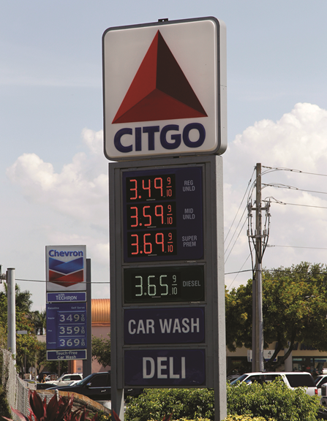
Perfectly Competitive
In a perfectly competitive market: every seller sells an identical good, no single
buyer or seller can influence the price, and everyone trades at the same price.
IDENTICAL GOODS
NOBODY IS BIG ENOUGH
One barrel of West Texas crude is the same as any other.
Nobody asks whose it was.
Crude oil, wheat, sugar, foreign currency — genuinely identical. Coffee shops and sneakers are not.
You buying or not buying gasoline this week does not move the price of gasoline.
You are one of roughly three hundred million American buyers. Your decision is invisible in the price.
One posted price, for all
Almost no real market satisfies all three conditions exactly — and the model still predicts well.
Image: Acemoglu, Laibson & List, Microeconomics 3e
Notes:
Perfect competition
DEFINITION FIRST, THEN THE HONEST CAVEAT
• Read the three conditions. Then say plainly: hardly any market you can name satisfies all
three. That is not a defect of the model, and this is the moment to say why.
• Chapter 1's standard: a model earns its place by predicting well, not by describing everything.
Supply and demand predicts a startling amount about markets that are only roughly competitive.
WORK EACH CONDITION AGAINST ONE EXAMPLE
• Identical goods. Crude oil, wheat, sugar, foreign currency — genuinely identical. Coffee shops,
phones, sneakers — not. When goods differ, this chapter's tools get you the direction of the
answer but not the precision; Chapters 7 and 12 handle the rest.
• Nobody big enough. You are one of roughly three hundred million American consumers of gasoline.
Your decision this week is invisible in the price. Contrast: OPEC's decision is not invisible,
which is exactly why oil is not perfectly competitive and why we still teach it this way.
• One price. Ask why the same coffee costs more at the airport. Answer: it is a different market —
different rules, different feasible alternatives — not a violation of the law of one price.
THE POINT TO LAND
• "Perfectly competitive" is a benchmark, not a description. Everything we do today is exactly
right in that benchmark and approximately right nearly everywhere else.

Slide 8
Price
The market price is the price at which buyers and sellers conduct transactions.
The competitive equilibrium price equates the quantity demanded and the quantity supplied.
A price is a selection device. It picks out the sellers who can produce cheaply
and the buyers who value the good highly — and lets exactly those two groups trade.
ON THE SELLERS' SIDE
ON THE BUYERS' SIDE
At $50 a barrel, a producer whose cost is $30
sells. A producer whose cost is $70 does not.
The market price sorted producers by their efficiency, and the low-cost ones got through.
At $50, the buyer who values a barrel at $80
buys. The buyer who values it at $40 walks.
The people who wanted it most are the people who ended up with it.
Notes:
Price as a selection device
THIS IS THE DEEPEST IDEA IN THE CHAPTER — DO NOT RUSH IT
• Pearson states it in one sentence and moves on. It is worth ninety seconds because it is the
reason economists care about prices at all, and because it is the sentence that makes the
price-control section at the end of the hour make sense.
NUMBERS TO SAY EXACTLY — THEY ARE ALL ON THE SLIDE
Price $50. Low-cost producer $30 — trades. High-cost producer $70 — does not.
High-value buyer $80 — trades. Low-value buyer $40 — does not.
WALK BOTH SIDES SLOWLY
• Sellers. Anyone whose cost is under fifty makes money and produces. Anyone above fifty would
lose money and stays out. The price did the sorting, and it sorted in the direction you would
want: cheap producers produce.
• Buyers. Anyone who values a barrel above fifty buys. Below fifty, they do something else with
their money. Same sorting, same direction: the good goes to whoever wanted it most.
THE THING WORTH SAYING OUT LOUD
• Nobody administered any of that. There is no form to fill in, no queue, no committee deciding
who deserves oil. A single number did the whole job, and it did it using information — every
producer's cost, every buyer's valuation — that no single person in the system has.
FORWARD POINTER, TEN SECONDS
• Remember this when we cap the price of gasoline at the end of the hour. If the price is doing
the selecting, and you freeze the price, something else has to do the selecting instead. Usually
it is a queue.

Slide 9
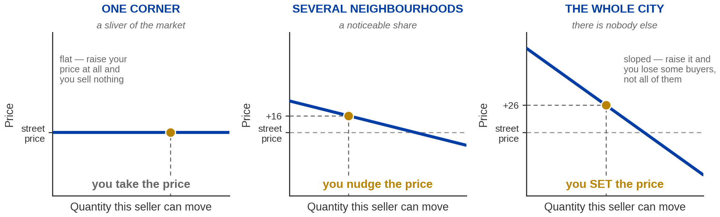
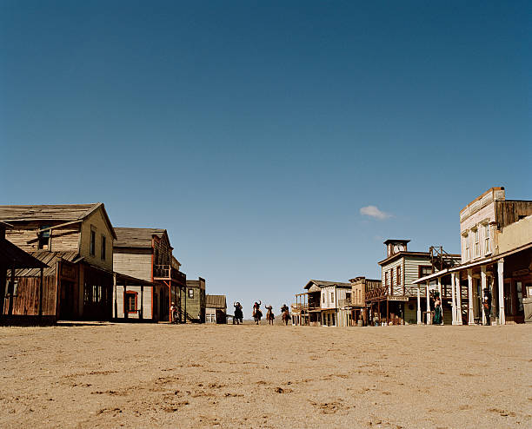
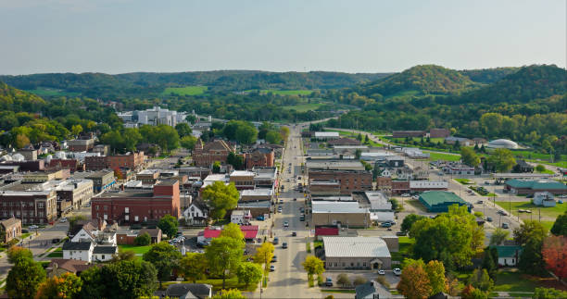
Price Taker to Price Maker
Same product, same buyers, same city. The only thing that moved is how much of the market one seller controls.
PRICE TAKER
IN BETWEEN
PRICE MAKER
Buyers have an identical alternative one corner away. Raise your price and every buyer walks.
Buyers have alternatives much farther away so they may tolerate elevated price to some extent.
The curve you face IS the market curve. Tweak the price to extract max values from customers.
A price taker faces a flat demand curve; a price maker faces a sloped one. The whole difference is whether buyers have somewhere else to go.
Notes:
The clip — page 2 of 2, the analysis
THE ONE QUESTION TO ASK FIRST
• "What actually changed?" Pause. In a recording, pause anyway.
• The answer students reach for is that the product got better or demand went up. Neither happened.
Same product, same buyers, same city. The only change is the share of the market one seller
controls — and that alone is enough to change the price.
WALK THE THREE PANELS LEFT TO RIGHT
• One corner. The line the seller faces is FLAT. Raise your price by a dollar and every buyer walks
to the next corner, because the next corner sells exactly the same thing. You cannot set a price;
you can only accept one. That is a price taker, and it is condition two from three slides ago,
drawn.
• Several neighbourhoods. The line has started to tilt. Raise the price and you lose some buyers —
but not all of them, because the nearest alternative is now inconvenient.
• The whole city. The line the seller faces IS the market demand curve. There is no elsewhere. Raise
the price and you slide up your own curve, losing some quantity and gaining on every unit you still
sell.
THE SENTENCE TO LAND
• A price taker faces a flat demand curve. A price maker faces a sloped one. The whole difference is
whether buyers have somewhere else to go — and that is a fact about the market, not about the
seller.
THE PART WORTH ADDING IF YOU HAVE THE TIME
• Ask why nobody simply enters and competes the price back down, which is what would happen in every
other market we draw today. In this one entry is blocked by law enforcement and by violence.
Barriers to entry are what let market power persist, and that is the actual lesson: market power is
not about being clever, it is about nobody else being able to show up.
• That also answers the student who says "so the model was wrong." No — the model says a market with
free entry and identical goods produces price-taking. Block entry and you get the other case. Both
are in the model.
WHAT NOT TO CLAIM
• Do not say monopoly. Two sellers is a duopoly; the formal treatment is Chapters 12 and 13. "Market
power" is the safe term here.
THE HANDOFF
• "Everything for the rest of today is the price-taking case. Keep this as the edge of it."

Slide 10
PART 2
How Buyers Behave
Notes:
Part 2 divider
• "Now one side at a time. Buyers first."

Slide 11
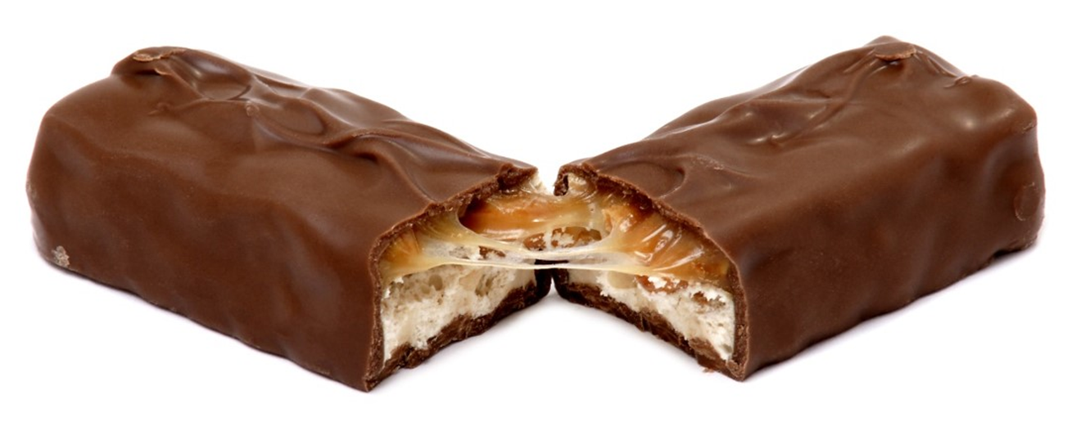
Demand vs Quantity Demanded
QUANTITY DEMANDED
DEMAND SCHEDULE
DEMAND CURVE
The amount of a good buyers
are willing to purchase at a
given price.
A table listing the quantity
demanded at each price,
holding all else equal.
The same information as a list.
The same table, plotted.
Price vertical, quantity
horizontal.
The same information as a picture.
How much would you pay for this?
Everyone writes down a different number — and every one of those numbers is a point on that person's demand curve. And it represents the price at which your quantity demanded equals 1.
Image: Acemoglu, Laibson & List, Microeconomics 3e
Notes:
Quantity demanded, schedule, curve
THREE NAMES FOR ONE RELATIONSHIP — SAY THAT FIRST
• Quantity demanded is a number, and it is meaningless without a price attached. "How much
gasoline do people want?" is not a question until you say at what price.
• The schedule is that number listed at several prices. The curve is the schedule drawn. Nothing
new is added going from one to the next — it is the same information in three formats, and the
homework will move between them without warning.
"HOLDING ALL ELSE EQUAL" — FLAG IT NOW, IT MATTERS IN TWENTY MINUTES
• Every entry in the schedule assumes income, tastes, other prices and everything else are frozen.
The only thing changing down the column is the price of this good. That assumption is what makes
a shift different from a movement, which is the distinction on slide 17.
THE AXIS COMPLAINT — GET AHEAD OF IT
• Somebody in every intro class notices the axes are the wrong way round. Say it before they do.
Marshall drew it this way in 1890, the convention stuck, and every economist since has quietly
put up with it. Naming it makes you look like you know what you are doing; being caught by it
makes the opposite impression.
PEARSON'S PROMPT, CONVERTED TO A POSED QUESTION (their slide 13)
• "Hold up a candy bar. How much would you be willing to pay for it?" Ask it, pause three seconds,
then answer it yourself: everyone in the room writes down a different number, and every one of
those numbers is a point on that person's demand curve.
• Follow with their slide 17: "Why isn't the price the same for everyone?" It is — the PRICE is the
same for everyone. What differs is the quantity each person chooses at that price. That
distinction is the whole reason the curve is drawn the way it is.
THE POINT TO LAND
• Table, graph, sentence. If they can convert between the three by the end of today, most of the
Chapter 4 homework is arithmetic.

Slide 12
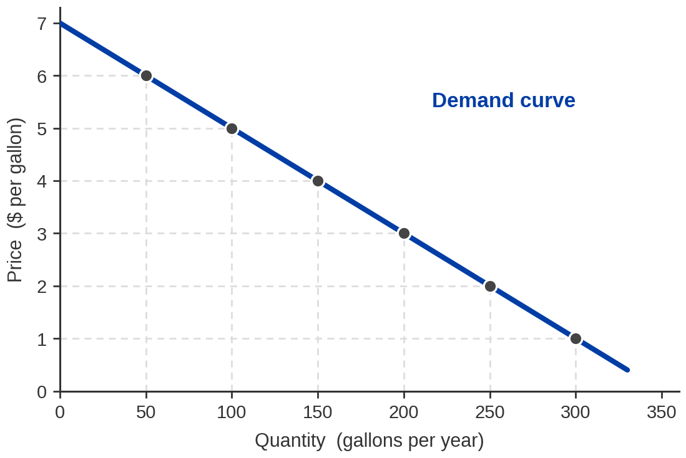
Exhibit 4.1 — One Buyer's Demand for Gasoline
CHLOE'S DEMAND SCHEDULE
Price ($/gal) | Quantity demanded (gallons/year)
$6 | 50
$5 | 100
$4 | 150
$3 | 200
$2 | 250
$1 | 300
Notes:
Exhibit 4.1 — one buyer's demand
NUMBERS THAT MUST BE SAID EXACTLY — READ THEM OFF THE TABLE
$6 → 50 gallons $5 → 100 $4 → 150
$3 → 200 $2 → 250 $1 → 300
Chloe is Pearson's buyer. Keep the name — students who read the book will recognise it.
BUILD THE LINK BETWEEN TABLE AND GRAPH, POINT BY POINT
• Take one row and find it on the graph out loud. "Six dollars, fifty gallons — go up to six on
the vertical, across to fifty on the horizontal, and there is the point." Do it twice more,
slowly. This is the single most useful thirty seconds of the lecture for a student who is shaky
with graphs.
• Then say what the line between the points means: it is an interpolation, an assumption that
the pattern continues smoothly between the rows we were given.
THE SLOPE IS THE WHOLE MESSAGE
• As price falls, quantity demanded rises. Every single row. Ask why before you answer it on the
next slide — leave three seconds of silence even though this is a recording.
WHAT THE NUMBERS ARE NOT
• These are gallons per YEAR, for ONE person. Say it, because Exhibit 4.3 in eight minutes is
billions of barrels for the whole world and students who are not tracking units get badly lost
between them.
• Realism check, offered honestly: 300 gallons a year is roughly 12,000 miles at 40 mpg. Chloe's
schedule is plausible, not arbitrary.
THE POINT TO LAND
• The table and the curve carry identical information. Anything you can read off one, you can read
off the other.

Slide 13
Why Does It Slope Down?
Because the value of one more unit falls as you get more of them —
which is the marginal reasoning from Chapter 3.
THE SECOND SLICE
SO PRICE HAS TO FALL
AND NEW BUYERS ARRIVE
The first slice is worth a lot. The
second is worth less. By the
fourth you are full.
Same for gallons.
You will only buy the fourth
gallon if it costs less than
the fourth gallon is worth
to you.
Cheaper price, more gallons.
In a market curve there is a
second reason: at a lower
price, people who were priced
out entirely start buying
at all.
Remember as we optimize, we compare marginal benefits vs marginal costs.
Notes:
Why the demand curve slopes down
CONNECT IT TO LAST WEEK — THIS IS THE PAYOFF FOR CHAPTER 3
• Do not introduce the downward slope as a fact about the world. Derive it from the principle they
already have: keep moving while marginal benefit exceeds marginal cost, stop when they meet.
• The pizza example is already theirs from last lecture. Reuse it deliberately — "the second slice
and the second chip" — so the callback is visible.
WALK THE LOGIC ONCE, SLOWLY
• Marginal benefit of the first gallon: high. Of the tenth: lower. Of the three-hundredth: quite
low. That is diminishing marginal benefit and it is a fact about people, not about gasoline.
• You buy up to the point where the next gallon's benefit equals its price. Drop the price and
that point moves right — more gallons clear the bar.
• So the quantity you demand rises when the price falls, for reasons that are entirely Chapter 3.
THE SECOND REASON, WHICH ONLY APPLIES TO MARKETS
• Chloe's curve slopes down because Chloe wants fewer at higher prices. The MARKET curve also
slopes down because at high prices some people buy nothing at all, and as the price falls they
enter. Two different mechanisms, same direction. Worth separating — it is a common exam trap.
THE POINT TO LAND
• Nothing about the demand curve is new. It is Chapter 3's marginal principle plotted against
price.

Slide 14
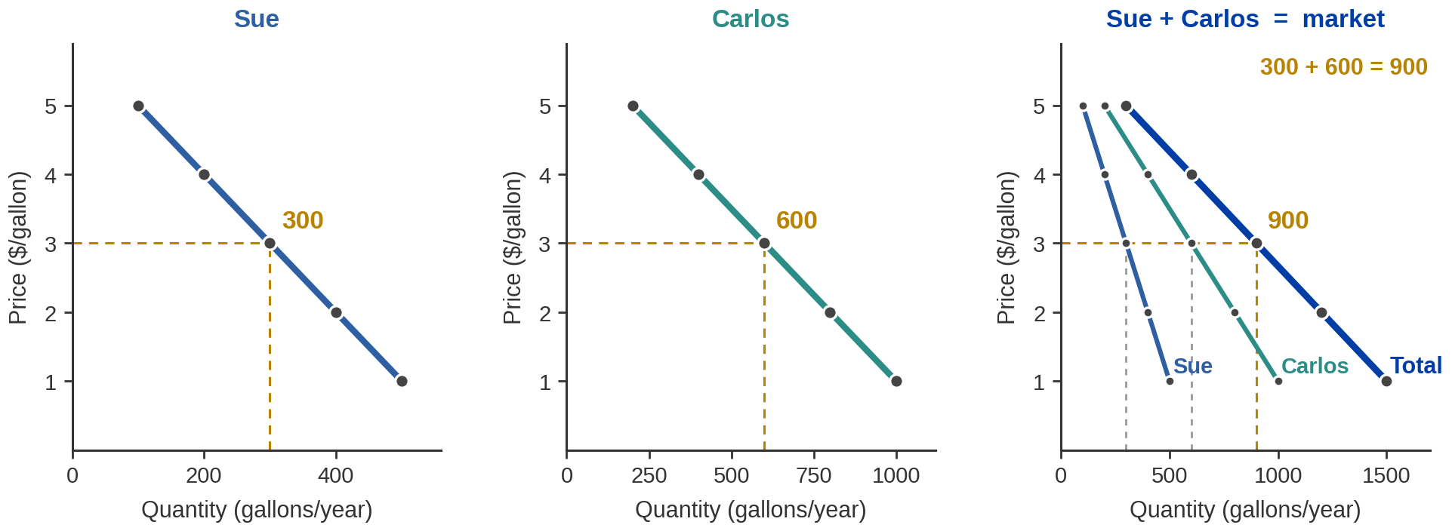
Exhibit 4.2 — Adding Buyers Together
The market demand curve is the sum of every individual buyer's demand — added across, at each price.
at $3 a gallon: Sue's 300 + Carlos's 600 = the market's 900
Add horizontally, never vertically. You are adding quantities at a common price — not prices at a common quantity.
Notes:
Exhibit 4.2 — aggregation
NUMBERS THAT MUST BE SAID EXACTLY — READ THEM
At $5: Sue 100, Carlos 200, market 300
At $3: Sue 300, Carlos 600, market 900
At $1: Sue 500, Carlos 1,000, market 1,500
DO ONE ROW OUT LOUD, THEN LET THEM DO THE NEXT
• Take three dollars. Sue wants three hundred gallons. Carlos wants six hundred. Between them the
market wants nine hundred. Say the addition; do not just point at it.
• Then take one dollar and pause before giving the answer. In a recording, pause anyway.
THE MISTAKE TO PRE-EMPT — IT IS THE MOST COMMON ONE IN THE CHAPTER
• Students add the curves vertically: they see two lines and add the heights. Wrong. You hold the
PRICE fixed and add the QUANTITIES. Horizontal summation. Say the phrase, then say it in plain
English: pick a price, ask everyone how much they want, add up the answers.
• Point out the visual consequence: the market curve is FLATTER than either individual curve, not
steeper. If a student's drawing came out steeper, they added the wrong way.
WHY THIS MATTERS BEYOND THE ARITHMETIC
• Carlos wants twice what Sue wants at every price. The market curve does not tell you that. Once
you aggregate, individual differences vanish and only the total survives — which is exactly what
a seller facing the market sees, and exactly what makes the market curve the useful object.
THE POINT TO LAND
• Two buyers or two hundred million, the procedure is identical: fix the price, add the quantities.

Slide 15
The Law of Demand
In almost all cases, the quantity demanded rises when the price falls, ceteris paribus — holding all else equal.
“IN ALMOST ALL CASES”
CETERIS PARIBUS
There are rare goods where demand rises with price —
you will meet them in a later course.
For this course, and for essentially every good
you will be asked about: down-sloping.
Income, tastes, other prices, expectations — all frozen. Only the good's own price moves.
Notes:
The law of demand
READ IT, THEN SPEND THE WHOLE MINUTE ON THE TWO QUALIFIERS
• "In almost all cases." Economists almost never say always, and the hedge is real: there are
goods whose demand curves slope up. Do not name and explain them here — it costs three minutes
and buys confusion in week two. One sentence: "there are exceptions, you will meet them in
intermediate micro, none of them will be on your homework."
• "Holding all else equal." This is the one to spend time on. Everything else about the buyer's
world is frozen. Their income, what they like, what substitutes cost, what they expect next
month — all held still.
THE PREVIEW THAT MAKES THE NEXT SLIDE EASY
• Say it now: when one of those frozen things unfreezes, the entire curve moves. That is a shift.
When only the price moves, you slide along the curve you already had. That is a movement.
• Getting those two confused is, in my experience, the single largest source of lost marks in this
chapter. Flag it before they see the diagram, not after.
THE POINT TO LAND
• The law of demand is a statement about one variable at a time. That is what "all else equal"
buys you, and it is why the law is usable.

Slide 16
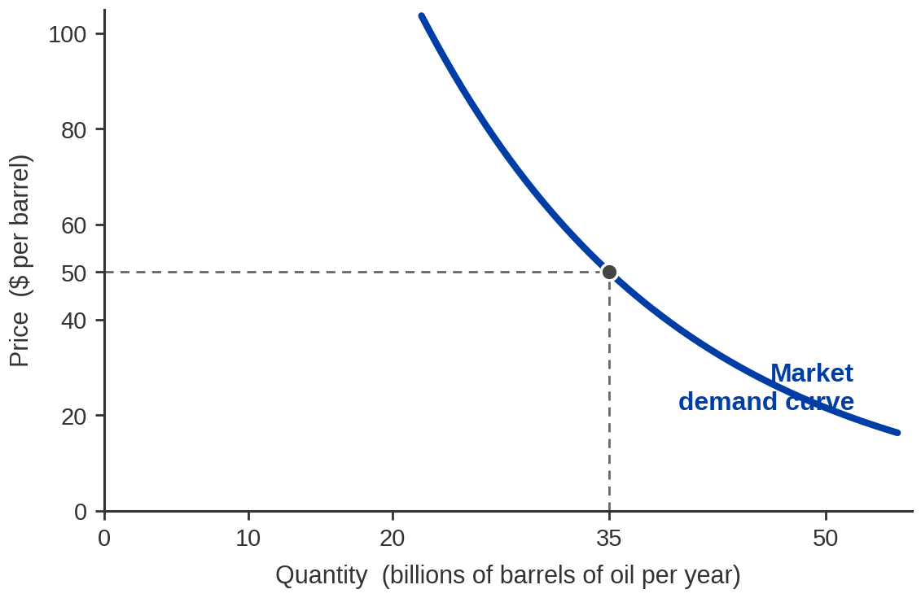
Exhibit 4.3 — The Same Thing, for a Whole Country
SAME CURVE, NEW UNITS
Chloe: gallons a year,
one person.
This: BILLIONS of barrels
a year, everybody in the US.
At $50 a barrel the world
wants about 35 billion barrels a year.
Illustrative figures from Acemoglu, Laibson & List, Microeconomics 3e — not today's market. Brent was about $88 a barrel on 31 July 2026.
Notes:
Exhibit 4.3 — market demand for oil
THE NUMBER TO SAY EXACTLY
At $50 a barrel, quantity demanded is about 35 billion barrels a year. That pair — fifty and
thirty-five — recurs on nine slides from here to the end of the lecture. Fix it now.
WHAT IS NEW HERE AND WHAT IS NOT
• Nothing conceptual is new. This is Chloe's curve after horizontal summation over every buyer of
oil on the planet. Say that explicitly so it reads as continuity rather than a new object.
• What IS new is the units, and units are where students lose the thread. Chloe: gallons per year,
one person. This: billions of barrels per year, everybody. Read the axis labels out loud.
THE HONEST CAVEAT — SAY IT, DO NOT LET A STUDENT CATCH IT
• Fifty dollars is the textbook's illustration, not today's price. Brent was around $88 and WTI
around $86 at the end of July 2026. Say the date with the number; oil moved about 25% in the
month before this lecture and anything you quote will be stale within weeks.
• Do not switch the diagram to today's price. The whole chapter's arithmetic is built on fifty and
thirty-five, and consistency is worth more than currency here. Just flag it once.
THE POINT TO LAND
• The curve is smooth and continuous because we are adding millions of buyers. Individual demand
is lumpy; market demand almost never is.

Slide 17
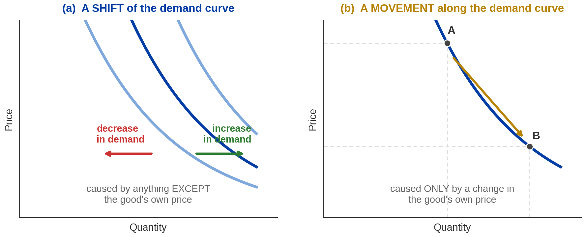
Exhibit 4.4 — The Distinction of Shifts vs Movements
A SHIFT — the whole curve moves
A MOVEMENT — you slide along it
Caused by ANYTHING EXCEPT the good's own price.
We now demand a different amount at every price.
Caused ONLY by a change in the good's own price.
The curve itself never moved.
Notes:
Shift versus movement
THIS IS THE MOST IMPORTANT TWO MINUTES OF PART 2 — SLOW DOWN
• Give it the weight the title claims. If a student leaves today with only one thing, it should be
this, and telling them so makes them listen.
THE RULE, STATED AS A TEST THEY CAN APPLY
• Ask one question of any change: did the price of THIS GOOD change?
— Yes → movement ALONG the curve. The curve did not move.
— No → SHIFT of the whole curve. A different quantity at every price.
• There is no third case. Every exam question in this chapter is one of those two.
WORK BOTH DIRECTIONS OUT LOUD WITH GASOLINE
• Gas goes from $4 to $5 and you drive less. Movement. The curve is unchanged — you are just at a
different point on it.
• Gas stays at $4, but you get a raise and start driving more. Shift, to the right. At $4 you now
want more, and you would also want more at $3 and at $5.
• Gas stays at $4, but the university opens a free shuttle and you drive less. Shift, to the left.
VOCABULARY THAT WILL BE ON THE HOMEWORK
• "Change in quantity demanded" = movement. "Change in demand" = shift. Those two phrases mean
genuinely different things and MyLab uses them precisely. Say both, twice.
THE POINT TO LAND
• Price moves you along the curve. Everything else moves the curve.

Slide 18




Five Things That Shift Demand
TASTES &
PREFERENCES
INCOME &
WEALTH
PRICES OF
RELATED GOODS
NUMBER OF
BUYERS
EXPECTATIONS
ABOUT THE FUTURE
What you
like changes
What you can
afford changes
Substitutes and
complements
More buyers,
more demand
What you think
happens next
None of these is the price of the good itself.
Notes:
The five shifters
READ THE LIST, THEN SAY WHY IT IS CLOSED
• Five items. Pearson's list, and the one MyLab grades against. Worth telling them to memorise it
— not because memorising is good pedagogy, but because a closed list turns a vague question
("what shifts demand?") into a checklist they can run.
• The unifying property: not one of them is the price of the good itself. That is the whole reason
they shift rather than move.
ONE FAST EXAMPLE EACH — TEN SECONDS APIECE, DO NOT ELABORATE
• Tastes: a study links a food to something bad, demand falls at every price.
• Income: you get a job, you eat out more at the same menu prices.
• Related goods: the price of electric cars falls, demand for gasoline falls with it.
• Number of buyers: UCR's enrolment rises, demand for apartments near campus rises.
• Expectations: you hear prices are rising next month, you buy this month.
THE TWO THAT GET THEIR OWN SLIDES
• Income and related goods are next, because each has vocabulary attached — normal and inferior,
substitutes and complements — and that vocabulary is examined.
THE POINT TO LAND
• If a change is not on this list and is not the good's own price, it is not moving the demand
curve. Most wrong answers in this chapter come from inventing a sixth shifter.

Slide 19
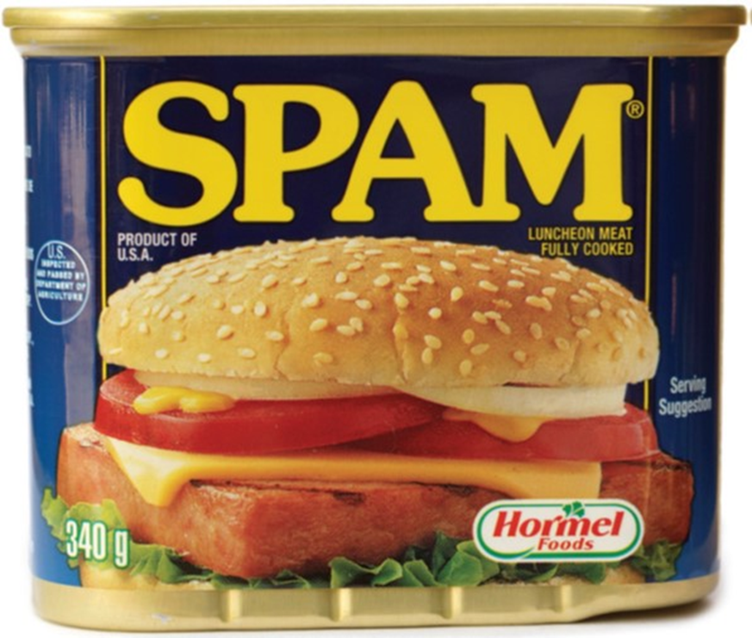
Income: Normal Goods and Inferior Goods
When your income rises, demand for a normal good rises
— and demand for an inferior good falls.
NORMAL GOODS — most things
INFERIOR GOODS — the odd ones
Income up → demand shifts RIGHT.
Restaurant meals. Air travel.
New clothes. You buy more of them
when you can afford to.
This is the ordinary case.
Income up → demand shifts LEFT.
Not bad goods — goods you buy
because the better alternative
was out of reach.
Bought less as incomes rise
Image: Acemoglu, Laibson & List, Microeconomics 3e
Notes:
Normal and inferior goods
DEFINE BY THE RESPONSE, NOT BY THE PRODUCT
• The classification is about how demand moves when INCOME moves. Nothing about the good itself
makes it normal or inferior — the same good can be either, for different people, at different
income levels.
• Say that clearly: a bus ticket is inferior for someone who would rather fly and normal for
someone who currently walks.
KILL THE WORD PROBLEM IMMEDIATELY
• "Inferior" sounds like a judgement and it is not one. Instant noodles are not a bad product;
they are a product people buy less of when they get richer. Make the joke, then move on —
students who mishear this once carry the confusion into the exam.
THE DIRECTION IS WHAT IS EXAMINED
• Normal: income up, curve shifts right. Inferior: income up, curve shifts LEFT. That leftward
shift is the counterintuitive one and it is exactly what MyLab tests.
• Also worth ten seconds: income falling reverses both. In a recession demand for inferior goods
rises — which is why discount retailers do well when everything else does badly.
THE POINT TO LAND
• Two categories, defined entirely by which way the curve moves when the buyer's income changes.

Slide 20
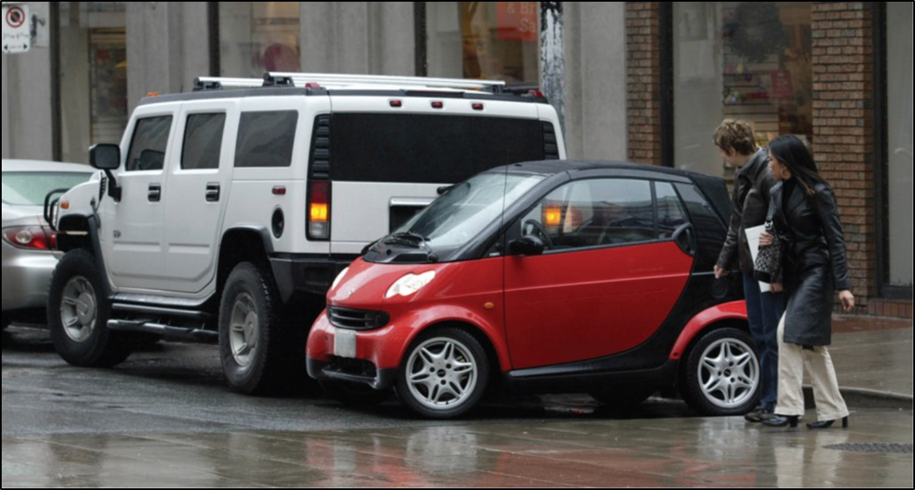
Related Goods: Substitutes and Complements
SUBSTITUTES — used INSTEAD of each other
Price of one goes UP → demand for the other goes UP.
Coffee and tea. Uber and Lyft. Chicken and beef.
COMPLEMENTS — used TOGETHER
Price of one goes UP → demand for the other goes DOWN.
Printers and ink. Phones and cases. Cars and gasoline.
Gasoline gets expensive → demand for large SUVs falls → demand for hybrids rises
One price change, two curves moved in opposite directions. Both of those are shifts, not movements along the demand curves.
Image: Acemoglu, Laibson & List, Microeconomics 3e
Notes:
Substitutes and complements
TWO DEFINITIONS, THEN ONE EXAMPLE THAT USES BOTH AT ONCE
• Substitutes: goods used instead of each other. The price of one rises, buyers move to the other,
so the OTHER good's demand curve shifts right.
• Complements: goods used together. The price of one rises, you do less of the joint activity, so
the other good's demand shifts left.
• The direction is the examinable part. Say each one twice, in both directions.
THE GASOLINE EXAMPLE IS WORTH THE WHOLE SLIDE — RUN IT SLOWLY
• Gasoline gets expensive. Gasoline and large SUVs are complements — you cannot use one without
the other. So demand for SUVs shifts LEFT.
• SUVs and hybrids are substitutes. With SUVs now effectively more expensive to run, demand for
hybrids shifts RIGHT.
• One price change, two different markets, two shifts in opposite directions. This is what
economists mean when they say markets are connected, and it is the first time in the course they
have seen it.
THE TRAP INSIDE THE EXAMPLE — CALL IT OUT
• The price of an SUV did not change. Not once. Both curves shifted because the price of something
ELSE changed. Students routinely mislabel this as a movement; naming it here saves marks later.
THE POINT TO LAND
• A good's demand depends on other goods' prices, and the relationship has a sign: substitutes
positive, complements negative.

Slide 21
PART 3
How Sellers Behave
Notes:
Part 3 divider
• "Same structure, other side of the counter. If Part 2 landed, this is faster than it looks."

Slide 22

Sellers’ Version of the Story
QUANTITY SUPPLIED
SUPPLY SCHEDULE
SUPPLY CURVE
The amount of a good sellers
are willing to sell at a
given price.
A table listing the quantity
supplied at each price,
holding all else equal.
The same table, plotted.
Same axes as before — price
vertical, quantity horizontal.
This one slopes UP.
What would somebody have to pay you to hand this over?
Your quantity supplied at that price you have in mind is 1 — and below it, you supply zero. The price you probably hinges on how much it costs you to get a new one yourself.
Image: Acemoglu, Laibson & List, Microeconomics 3e
Notes:
Quantity supplied, schedule, curve
SAY THE STRUCTURAL PARALLEL FIRST — IT HALVES THE PERCEIVED WORKLOAD
• Three words again, in the same order, meaning the same kind of thing. The only change is who
is doing the deciding and which way the relationship runs.
• Tell them this explicitly. A student who realises Part 3 is Part 2 with a sign flipped relaxes,
and a relaxed student in minute twenty-eight is worth a lot.
THE SIGN FLIP, AND WHY IT IS NOT ARBITRARY
• Demand: price up, quantity down. Supply: price up, quantity UP. Higher prices make selling more
attractive, so sellers offer more.
• Do not justify it yet — slide 24 does that properly. Here, just establish the direction.
SAME AXES, SAME CAVEAT
• Price still on the vertical axis. All else still equal. Both of those matter as much here as
they did for demand, and the shift-versus-movement distinction returns unchanged on slide 29.
PEARSON'S PROMPT, CONVERTED TO A POSED QUESTION (their slide 33)
• "How much would somebody have to pay you to hand over your phone right now?" Pause three seconds.
• Whatever number they thought of is their quantity supplied at that price — and below it they
supply zero. Everyone's number is different, which is exactly why the market supply curve slopes
up rather than jumping.
• It is also the mirror of the candy-bar question from minute eleven. Point at the symmetry;
willingness to pay and willingness to accept are the same idea from opposite sides of the table.
THE POINT TO LAND
• One market, two curves, built the same way from opposite sides.

Slide 23
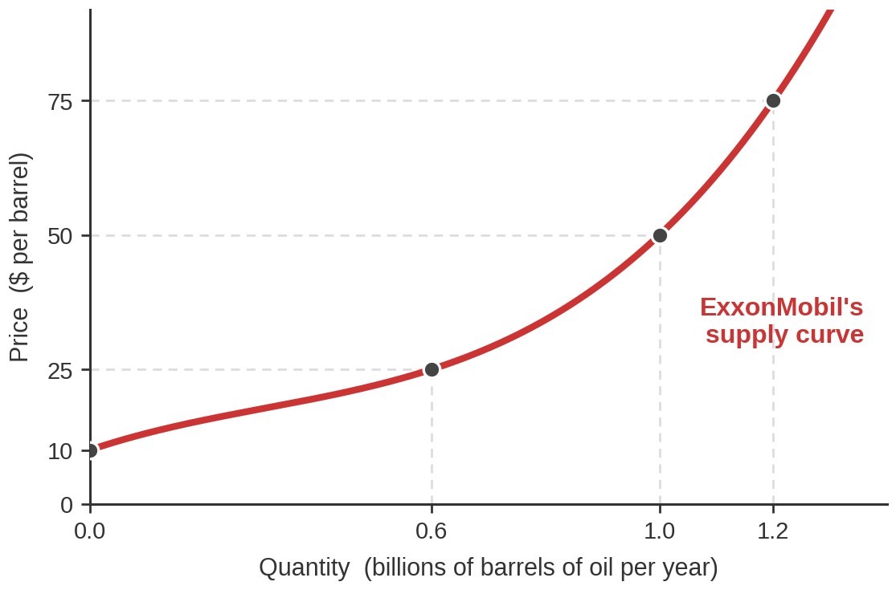
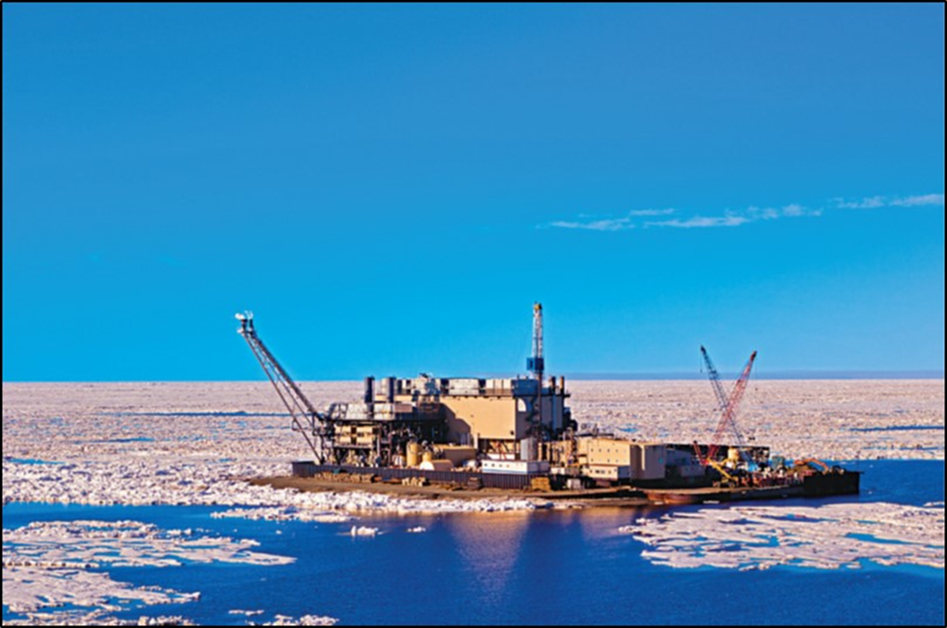
Exhibit 4.6 — One Seller's Supply of Oil
EXXONMOBIL'S SUPPLY SCHEDULE
Price ($/barrel) | Quantity supplied (bn barrels/year)
$10 | 0.0
$25 | 0.6
$50 | 1.0
$75 | 1.2
At $10 a barrel it supplies nothing — no well it owns is worth operating.
Image: Acemoglu, Laibson & List, Microeconomics 3e
Notes:
Exhibit 4.6 — one seller's supply
NUMBERS THAT MUST BE SAID EXACTLY — READ THEM
$10 → 0.0 billion barrels $25 → 0.6
$50 → 1.0 $75 → 1.2
DO THE TABLE-TO-GRAPH WALK AGAIN — IT IS WORTH REPEATING
• Same move as Exhibit 4.1: take one row, find it on the graph out loud. Students who got it for
demand will get it faster here, and the ones who did not get a second chance.
THE ZERO IS THE MOST INTERESTING ROW ON THE SLIDE
• At ten dollars a barrel, ExxonMobil supplies nothing. Not "a little" — nothing. Every well it
owns costs more than ten dollars a barrel to operate, so the optimal quantity is zero.
• That is Chapter 3 again: producing at a loss is a feasible option and it is not the best one.
Zero is a choice, and it is the right one at that price.
WHAT THE CURVATURE MEANS
• Notice the curve gets steeper. Going from $25 to $50 buys 0.4 more billion barrels; going from
$50 to $75 buys only 0.2 more. The easy oil is already flowing; each extra barrel comes from a
harder, more expensive source.
• That is rising marginal cost, and it is the subject of the next slide. Plant it here, explain it
there.
THE POINT TO LAND
• A supply schedule is a list of decisions, one per price. It is not a forecast of what the firm
will do — it is what the firm would do, at each price it might face.

Slide 24
Why Does It Slope Up?
Because producing more costs more per unit — so it takes a higher price
to make the next unit worth producing.
THE CHEAP BARRELS GO FIRST
SO COST PER UNIT RISES
AND NEW SELLERS ARRIVE
A firm pumps its easiest well
before its hardest. The next
barrel always comes from a
more expensive source than
the last one.
Overtime instead of regular
hours. Older rigs. Deeper
water.
More output, higher marginal
cost.
In a market curve, a higher
price also pulls in producers
who could not cover their
costs at the old price.
Same principle as the demand curve, mirrored: sellers keep producing while the price covers the marginal cost, and stop when it does not.
Notes:
Why the supply curve slopes up
DERIVE IT, DO NOT ASSERT IT — SAME MOVE AS SLIDE 13
• Chapter 3's rule, from the seller's side: produce the next unit if the revenue it brings in
exceeds what it costs to make. Stop when it does not.
• So the question is why the cost of the NEXT unit rises. Answer: because firms use their cheapest
capacity first. That is not an assumption, it is what any sensible producer does.
MAKE IT PHYSICAL — OIL IS THE BEST CASE FOR THIS
• A firm with ten wells operates the cheapest one first. To produce more it opens the next
cheapest, then the next. By the tenth well it is spending far more per barrel than on the first.
• Non-oil version, if it helps: a bakery on regular hours, then overtime, then a second shift at a
premium. Each extra loaf costs more than the last.
THE SECOND MECHANISM — SAME STRUCTURE AS DEMAND, WORTH NAMING
• The individual firm's curve slopes up because its own marginal cost rises. The MARKET curve also
slopes up because higher prices bring in firms that were producing nothing before — the
Exhibit 4.6 zero, for other companies.
• Exactly parallel to the two reasons behind the market demand curve. Point at the parallel; it is
what makes the chapter feel designed rather than accumulated.
THE POINT TO LAND
• Both curves come from the same principle. Buyers stop when marginal benefit falls below price;
sellers stop when marginal cost rises above it.

Slide 25
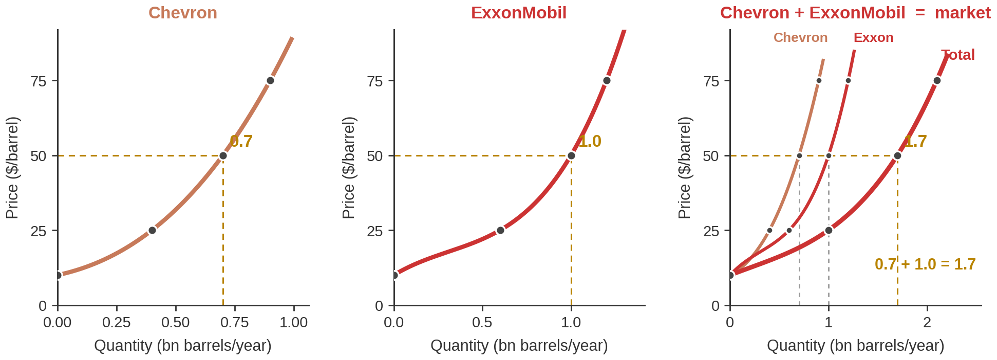
Exhibit 4.7 — Adding Sellers Together
Market supply is built exactly like market demand: fix the price, add the quantities across sellers.
at $50 a barrel: Chevron's 0.7 + ExxonMobil's 1.0 = the market's 1.7 billion barrels
Horizontal again. If your market curve came out steeper than the individual curves, you added the wrong way.
Notes:
Exhibit 4.7 — aggregating supply
NUMBERS THAT MUST BE SAID EXACTLY — READ THEM
At $25: Chevron 0.4, ExxonMobil 0.6, market 1.0
At $50: Chevron 0.7, ExxonMobil 1.0, market 1.7
At $75: Chevron 0.9, ExxonMobil 1.2, market 2.1
At $10: both zero, so the market supplies zero.
RUN ONE ROW, THEN LET THEM RUN THE NEXT
• Fifty dollars. Chevron would pump seven-tenths of a billion barrels, ExxonMobil a full billion.
Together, one point seven. Say the addition out loud.
• Then ask for seventy-five and pause. Answer: 2.1.
THE ZERO ROW IS WORTH TEN SECONDS
• At ten dollars neither firm produces, so market supply is zero. A market supply curve can sit on
the vertical axis for a while before it lifts off — that is normal, not a drawing error.
SAME MISTAKE, SAME WARNING
• Horizontal summation again. Hold the price, add the quantities. The market curve is flatter than
either firm's. Repeat the warning even though you gave it for demand — the two halves of this
chapter are usually studied a week apart.
WORTH SAYING, BECAUSE IT UNDERCUTS THE EXAMPLE HONESTLY
• Two firms is a teaching simplification. Real world oil supply is thousands of producers, and if
it really were just Chevron and ExxonMobil the perfect-competition assumption from Part 1 would
fail badly — each would be big enough to move the price. Say that; students notice.
THE POINT TO LAND
• Identical procedure on both sides of the market. Fix the price, add the quantities, across as
many participants as there are.

Slide 26
The Law of Supply
In almost all cases, the quantity supplied rises when the price rises ceteris paribus.
"Almost all cases" and "holding all else equal“ do the same work here as they did for
demand.
Notes:
The law of supply
DELIBERATELY SHORT — THIS SLIDE IS A HINGE, NOT A LESSON
• The two hedges are identical to the demand version and you already spent time on them. Say so
and do not re-explain; re-explaining reads as padding and students notice.
• Same for shift versus movement: the rule is unchanged, only the curve is different.
THE ONE THING WORTH ADDING
• Supply has FOUR shifters where demand had five. Say the number now so the next slide has a
shape before they see it. There is no "tastes" for sellers — a firm's preferences are not part
of the standard list — and there is no income effect on the selling side.
USE THE LAST FIFTEEN SECONDS TO SET UP PART 4
• "You now have both curves. The rest of the hour is what happens when you draw them on the same
pair of axes." That sentence is the transition and it should land before the divider.

Slide 27



Four Things That Shift Supply
INPUT PRICES
TECHNOLOGY
NUMBER OF SELLERS
SELLERS' EXPECTATIONS
What it costs to make
the thing. Labour, steel,
fuel, rent.
Inputs cheaper → supply
shifts RIGHT.
A better way to produce.
Always shifts supply
RIGHT — you can make
more for the same cost.
More firms in the market
→ supply shifts RIGHT.
Firms exiting → LEFT.
Expect a higher price
next month → store it,
supply LESS now.
Notes:
The four supply shifters
READ THE FOUR, THEN WEIGHT THEM HONESTLY
• Input prices and technology do most of the work in real applications and in the homework. Number
of sellers and expectations are real but rarely the interesting part of a question.
ONE EXAMPLE EACH, TEN SECONDS APIECE
• Input prices: steel gets more expensive, car supply shifts left. Note the direction — costs UP
means supply LEFT, which is the one students reverse.
• Technology: this gets its own slide next, because fracking is the best example in the chapter.
• Number of sellers: a new refinery opens, supply shifts right.
• Expectations: Midwest corn farmers build storage because they expect better prices outside
harvest season — so they supply less now and more later. Pearson's example; it is a good one
because it shows expectations changing behaviour today.
THE DIRECTION RULE, SAID ONCE CLEANLY
• Anything that makes producing EASIER or CHEAPER shifts supply right. Anything that makes it
harder or dearer shifts it left. If they remember only that, they will get most questions right
without memorising the list.
THE POINT TO LAND
• Four shifters, none of them the good's own price. Same logic as demand's five.

Slide 28
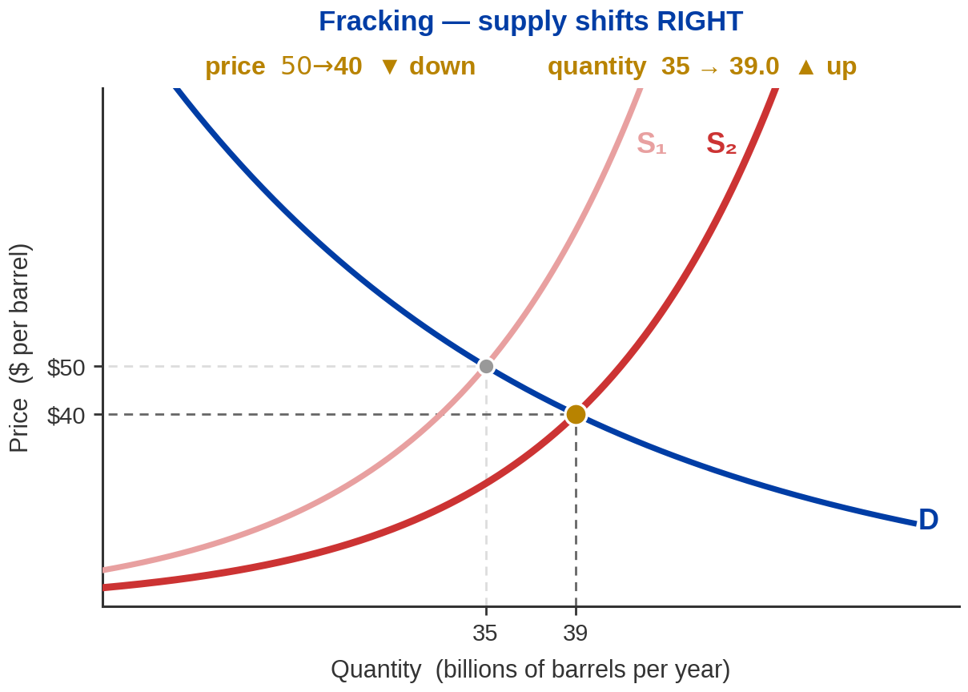
Technology: What Fracking Did to Oil Supply
US CRUDE OIL PRODUCTION
2008 5.0 million barrels a day
2013 7.5
2018 11.0
2025 13.6
A 2.7-fold increase. The US has been
the world's largest crude producer
every year since 2018.
US Energy Information Administration, field production of crude oil, annual. EIA, 9 July 2026. The curve shift above is drawn larger than life for legibility.
Notes:
Fracking
NUMBERS THAT MUST BE SAID EXACTLY — READ THEM, DO NOT RECALL THEM
US crude oil production, million barrels per day (EIA):
2008 5.0 2013 7.5 2018 11.0 2025 13.6
A 2.7-fold increase over 17 years. Largest producer in the world every year since 2018,
when the US overtook Russia. 2025 output was about 40% above the next two producers.
WHY THIS IS THE BEST TECHNOLOGY EXAMPLE IN THE CHAPTER
• Hydraulic fracturing did not change what buyers wanted. It changed what it cost to get oil out
of rock that was previously not worth drilling. That is a pure supply-side shock, uncontaminated
by anything happening on the demand side — which is rare and makes it clean to teach.
• It also happened inside these students' lifetimes, which the 1970s example later does not.
READ THE DIAGRAM OUT LOUD IN THE RIGHT ORDER
• Supply shifts right. At the old price, sellers now want to sell more than buyers want to buy —
a surplus. Price falls until the two match again.
• Result: price DOWN, quantity UP. Say both. Students reliably get the price direction and forget
to state the quantity.
THE HONEST CAVEAT
• The shift drawn on the slide is exaggerated so you can see it. Say that once. Also: the numbers
in the diagram are the textbook's illustrative oil market, not the real one — do not let the
$50 and the 13.6 get tangled together.
THE POINT TO LAND
• Better technology, more supplied at every price, lower price, higher quantity. That sequence is
the answer to a large share of the homework.

Slide 29
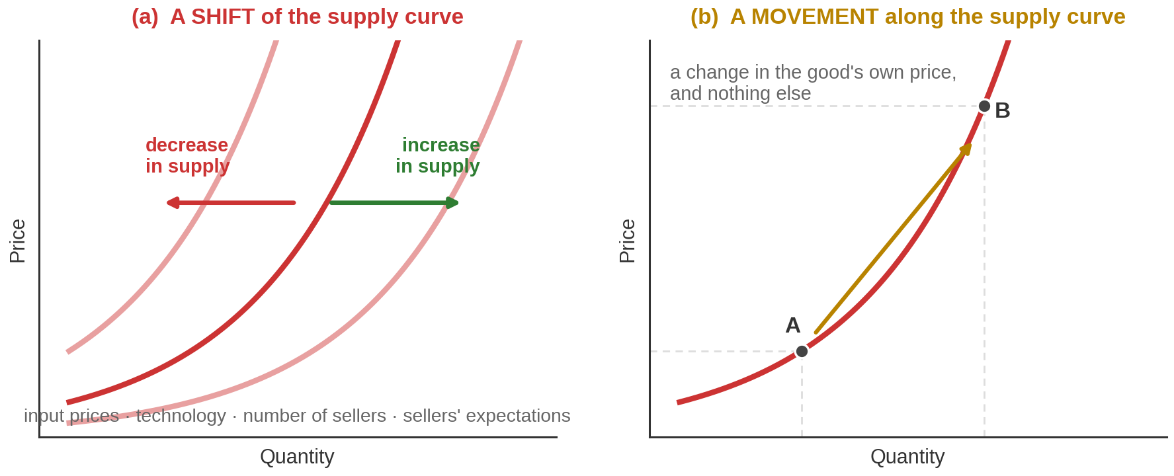
Shift vs Movement
Did the price of THIS GOOD change? Yes → movement along the curve. No → the whole curve shifts.
Notes:
Shift versus movement, supply side
ONE QUESTION, ASKED OF EVERY PROBLEM
• Read the band at the bottom and then say it as a habit rather than a rule: before you draw
anything, ask whether the price of the good itself changed. That single question decides shift
or movement, on either curve, every time.
TWO QUICK TESTS — POSE, PAUSE, ANSWER
• "Oil goes from $50 to $70 and producers pump more." — Movement along the supply curve.
• "Wages for oil workers rise and producers pump less at every price." — Shift, to the left.
• Leave three seconds after each. Recorded lectures still benefit from the beat; students pause
the video.
THE VOCABULARY, MIRRORED
• "Change in quantity supplied" = movement. "Change in supply" = shift. Exactly parallel to the
demand pair, and examined just as precisely.
THE POINT TO LAND
• One test, both curves. You are now ready to put them together.

Slide 30
PART 4
Putting Them
Together
Notes:
Part 4 divider
• "Both curves, one pair of axes. This is the part of the chapter that does the work."

Slide 31

Competitive Equilibrium
The competitive equilibrium price is the price at which quantity demanded
equals quantity supplied. The quantity traded there is the equilibrium quantity.
NOBODY CHOOSES IT
IT IS A RESTING POINT
Not the buyers, not the
sellers, not a regulator.
It is where two independent
sets of plans happen to
fit together.
Chapter 1's word. At this
price nobody has any reason
to do anything differently.
Away from it, somebody does.
Equilibrium is the second of Chapter 1's three principles.
Notes:
Competitive equilibrium, defined
READ THE DEFINITION, THEN SAY THE STRANGE PART
• Quantity demanded equals quantity supplied. That is the whole definition and it is arithmetic.
• The strange part is that nobody arranges it. Buyers are optimising for themselves, sellers for
themselves, and neither side is trying to make the two totals match. They match anyway.
CALL BACK TO CHAPTER 1 EXPLICITLY
• Equilibrium was one of the three principles in week one, and it was the most abstract of the
three. This is the slide where it acquires a picture.
• Last week's checkout-line example is the right callback: you are in equilibrium in a queue not
because you cannot leave but because leaving would not help. Same idea here — at the equilibrium
price, changing your behaviour does not improve your position.
DO NOT OVERCLAIM — THIS MATTERS
• Equilibrium is not a claim that the outcome is good, fair, or that everyone is happy. It is a
claim about rest: no one has an incentive to move. Chapter 1's free-rider discussion already
taught them that markets have no mechanism for deciding what is fair, and the price-control
section at the end of today will make the point again from the other direction.
THE POINT TO LAND
• One price makes two independent groups' plans consistent. The next three slides show what
happens at every other price.

Slide 32
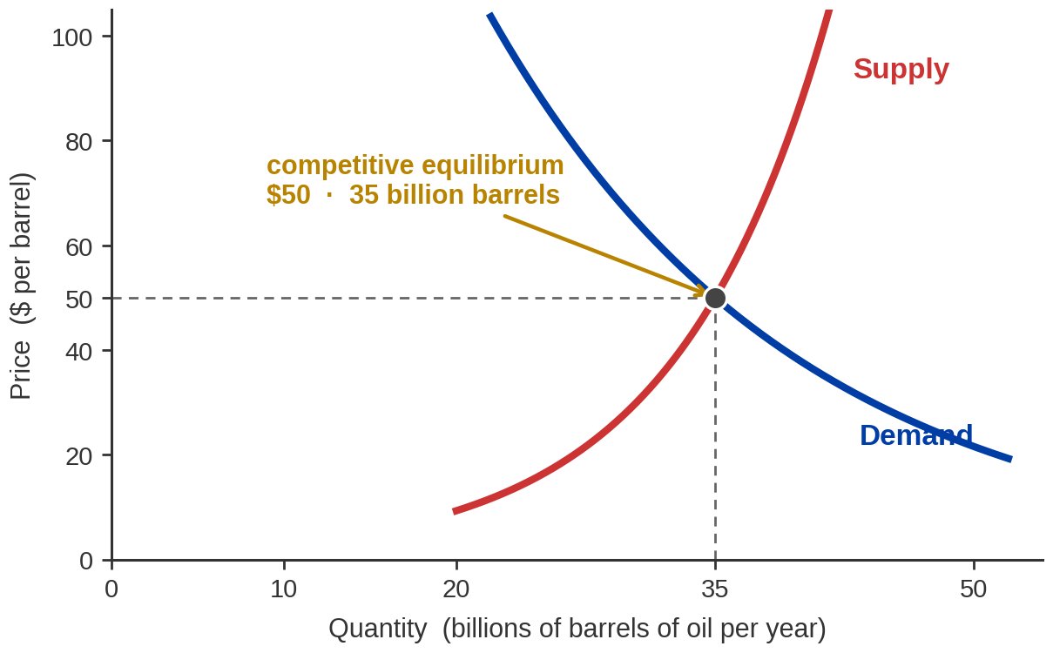
Exhibit 4.10 — Where the Two Curves Cross
READ IT IN THIS ORDER
1. Find the crossing point.
2. Go LEFT to the vertical axis —
that is the equilibrium
price. $50.
3. Go DOWN to the horizontal axis —
that is the equilibrium
quantity. 35 billion barrels.
Notes:
Exhibit 4.10 — the equilibrium diagram
NUMBERS THAT MUST BE SAID EXACTLY
Equilibrium price $50 a barrel. Equilibrium quantity 35 billion barrels a year.
TEACH THE READING PROCEDURE, NOT JUST THE PICTURE
• Steps are on the slide. Say them in order and point as you go: find the crossing, go left for
the price, go down for the quantity. Two numbers come out of one point.
• This sounds trivial. It is not — a meaningful fraction of intro students never learn to read a
crossing point reliably, and every remaining slide today depends on it.
SAY WHAT THE CROSSING MEANS, NOT JUST WHERE IT IS
• At fifty dollars, buyers want exactly 35 billion barrels and sellers want to sell exactly 35
billion barrels. Both groups get precisely what they planned. That is the only price where that
is true.
• At any other price one side is disappointed, and the next two slides are about what the
disappointed side does about it.
CONNECT TO PART 1 — THE PAYOFF FOR THE SELECTION-DEVICE SLIDE
• This is the price that was doing the selecting back at minute ten. Producers below fifty
dollars of cost are in; buyers valuing above fifty are in. The market picked both groups
without anyone administering anything.
THE POINT TO LAND
• Everything from here to the end of the chapter is: something moves a curve, the crossing moves,
read off the new price and quantity.

Slide 33
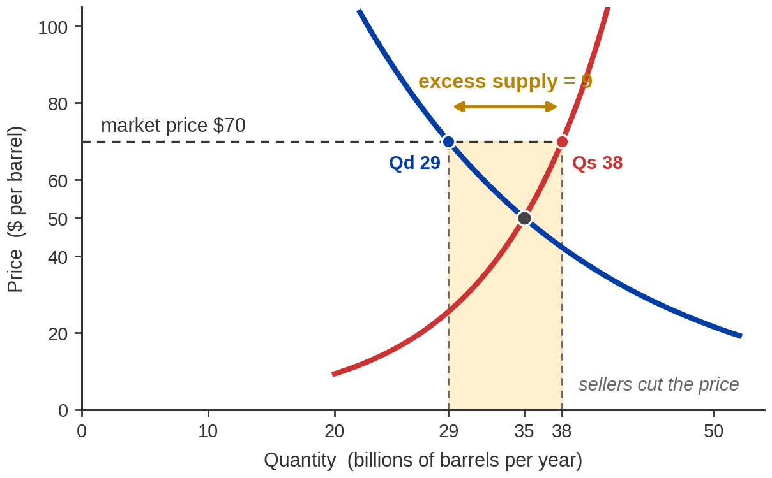
Above Equilibrium: A Surplus
AT $70 A BARREL
Quantity supplied 38
Quantity demanded 29
Excess supply 9
Nine billion barrels a year
that sellers want to sell and
nobody wants to buy.
Unsold oil is a signal, and sellers act on it: they cut the price. The cutting stops at $50, because that is where the surplus is gone.
Notes:
Excess supply
NUMBERS THAT MUST BE SAID EXACTLY — READ THEM
At $70: quantity supplied 38, quantity demanded 29, excess supply 9 billion barrels a year.
Equilibrium, for comparison: $50 and 35.
TELL IT AS A STORY ABOUT A PERSON, NOT A GAP ON A GRAPH
• Suppose the price is seventy. Sellers look at seventy and pump thirty-eight billion barrels.
Buyers look at seventy and want twenty-nine. Nine billion barrels a year pile up.
• Now be concrete about what a seller with unsold inventory actually does. They cut the price.
Not out of civic duty — because unsold oil earns nothing and a lower price earns something.
THE SELF-CORRECTION IS THE POINT
• As the price falls, two things happen at once, and students usually only notice one. Quantity
supplied falls — some wells stop being worth running. AND quantity demanded rises — buyers who
passed at seventy come in at sixty. The gap closes from both ends.
• It stops closing at fifty, because at fifty there is no gap left and no seller has a reason to
cut further.
VOCABULARY
• Excess supply and surplus are the same thing. Both appear in MyLab. Say both words.
THE POINT TO LAND
• A surplus is not a permanent state of the world. It is a temporary condition that contains its
own cure, and the cure is a falling price.

Slide 34
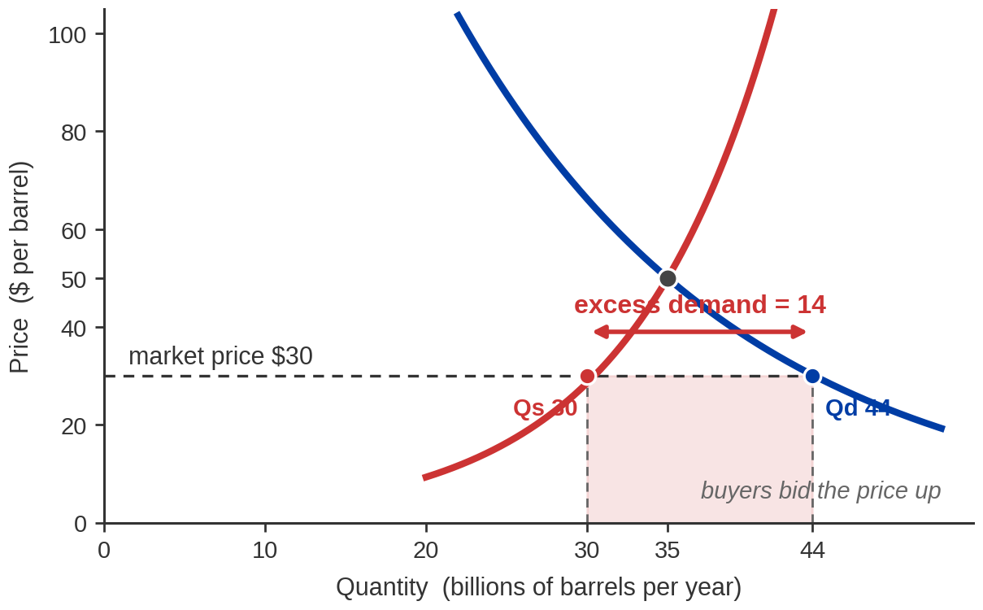
Below Equilibrium: A Shortage
AT $30 A BARREL
Quantity demanded 44
Quantity supplied 30
Excess demand 14
Fourteen billion barrels a
year that buyers want and
no seller will produce.
Buyers who cannot get any bid the price up. The bidding stops at $50 — the same place, arrived at from the other side.
Notes:
Excess demand
NUMBERS THAT MUST BE SAID EXACTLY — READ THEM
At $30: quantity demanded 44, quantity supplied 30, excess demand 14 billion barrels a year.
MIRROR THE PREVIOUS SLIDE DELIBERATELY
• Thirty dollars. Buyers want forty-four billion barrels. Sellers will produce thirty. Fourteen
billion barrels of wanting with nothing behind it.
• What does a buyer who cannot get the good do? Offers more. Somebody offers thirty-one to jump
the queue, and once one buyer does it the rest have to follow.
AGAIN, BOTH ENDS CLOSE THE GAP
• Price rises → quantity demanded falls (some buyers drop out) AND quantity supplied rises (more
wells become worth operating). Say both directions; students consistently see only one.
• It stops at fifty. Same equilibrium, reached from below instead of above. That symmetry is worth
naming — it is why we call fifty a resting point rather than a target.
THE FORWARD POINTER THAT SETS UP PART 5 — DO NOT SKIP THIS
• Ask: what if the price is not allowed to rise? What if there is a law saying it may not go above
thirty? Then the shortage does not close. It just sits there.
• That is the whole of the last section of today's lecture. Plant it here in one sentence and move
on.
THE POINT TO LAND
• Shortage and surplus are both temporary — as long as the price is free to move. That last clause
is doing enormous work and it is about to be tested.

Slide 35
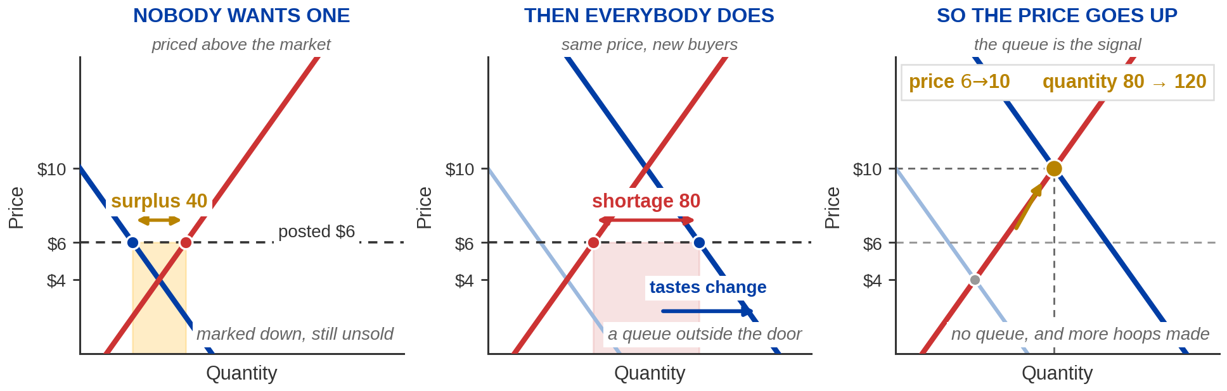
The Same Product, Three Prices, Two Disequilibria
Nothing about the hoop changed. What changed was demand — and then, eventually, the price.
1 — PRICED ABOVE THE MARKET
2 — THEN DEMAND SHIFTS RIGHT
3 — SO THE PRICE RISES
At $6: 80 offered, 40 wanted. A surplus of 40, and marking it down does not shift them.
Tastes change. Still $6: 160 wanted, 80 in existence. A shortage of 80.
Buyers bid it up. It stops at $10, where 120 are wanted and 120 are made.
Notes:
The hula-hoop clip — page 2 of 2, the analysis
NUMBERS THAT MUST BE SAID EXACTLY — THEY ARE ALL ON THE SLIDE
Posted price $6. Before the craze: quantity supplied 80, quantity demanded 40 → surplus 40.
After the craze, still at $6: quantity supplied 80, quantity demanded 160 → shortage 80.
New equilibrium: $10 and 120.
These are the deck's own round numbers, not the film's. Do not attribute them to the film.
ASK BEFORE YOU TELL
• "What happened to the hoop between the beginning of that clip and the end?" Pause.
• Answer: nothing. Same object, same materials, same shop. Everything that moved was on the buyers'
side of the market — and then the price followed.
WALK THE THREE PANELS
• Panel 1. The price is posted above the market-clearing level, so quantity supplied exceeds quantity
demanded. That is a surplus, and it is slide 34 exactly. Note what the shop does about it: marks it
down. Falling price is what a surplus produces, and the film shows the mechanism before it shows
the craze.
• Panel 2. Tastes change — the first item on the demand-shifter list from slide 19 — and the whole
demand curve jumps right. But the posted price has not moved yet. At $6 buyers now want 160 and
only 80 exist. That gap is the queue outside the door, and it is slide 35.
• Panel 3. Buyers who cannot get one offer more. Quantity demanded falls back along the new curve as
the price rises, and quantity supplied rises to meet it. It stops at $10 and 120 — a higher price
AND a higher quantity, which is the signature of a rightward demand shift.
THE DISTINCTION WORTH DRAWING OUT
• The craze was a SHIFT of demand. The subsequent fall in quantity demanded as the price climbed from
$6 to $10 was a MOVEMENT along the new curve. Both things happen in the same ninety seconds of
film, and separating them is exactly the slide-18 skill.
WHY THE PRICE RISE IS NOT A VILLAIN
• Students often read the price going up as the shop being opportunistic. Worth thirty seconds: the
higher price is what ends the queue and what calls forth more hoops. Quantity produced rises from
80 to 120 precisely because the price rose. Hold the price at $6 and you keep the queue and you
never get the extra 40 — which is the price-ceiling section at the end of the hour, arriving early.
THE POINT TO LAND
• A queue is not a fact about the product. It is a fact about a price that has not moved yet.

Slide 36
How to Work Any Shift Problem
Four questions, in this order, every time. Most lost marks come from skipping the first one.
01
02
03
04
WHICH CURVE MOVES?
WHICH WAY?
WHERE IS THE NEW CROSSING?
READ OFF BOTH NUMBERS
Buyers affected → demand.
Sellers affected → supply.
If the good's own price
changed, NEITHER — it is
a movement, not a shift.
More wanted, or easier to
produce → RIGHT.
Less wanted, or harder to
produce → LEFT.
Draw the shifted curve.
Find where it now cuts
the curve that did not
move.
Price: up or down?
Quantity: up or down?
Notes:
The four-question procedure
GIVE THEM AN ALGORITHM — THIS IS THE MOST PRACTICALLY USEFUL SLIDE IN THE DECK
• Students who do badly on this chapter are almost never confused about the concepts. They are
confused about the ORDER of operations, and they answer half the question. An explicit
four-step procedure fixes both problems.
WHY QUESTION 1 COMES FIRST AND WHY IT IS THE ONE THEY SKIP
• "Which curve moves?" forces them to ask who was affected — buyers or sellers. A frost hits
Florida: that is growers, so supply. A study says oranges prevent colds: that is buyers, so
demand.
• And it catches the trick case. If the change IS the good's own price, neither curve moves and
the whole shift apparatus is the wrong tool. Every exam has one of those.
QUESTION 4 IS WHERE THE MARKS ARE
• Say this bluntly: a question asking what happens to price AND quantity is worth two answers, and
students routinely give one. Train the habit of writing both, even when one is obvious.
TELL THEM WHAT IS COMING
• The next four slides are the same four questions, four times, on four different events. Say that
the point is the method, not the individual answers — otherwise they memorise "Hormuz means price
up" and learn nothing transferable.

Slide 37
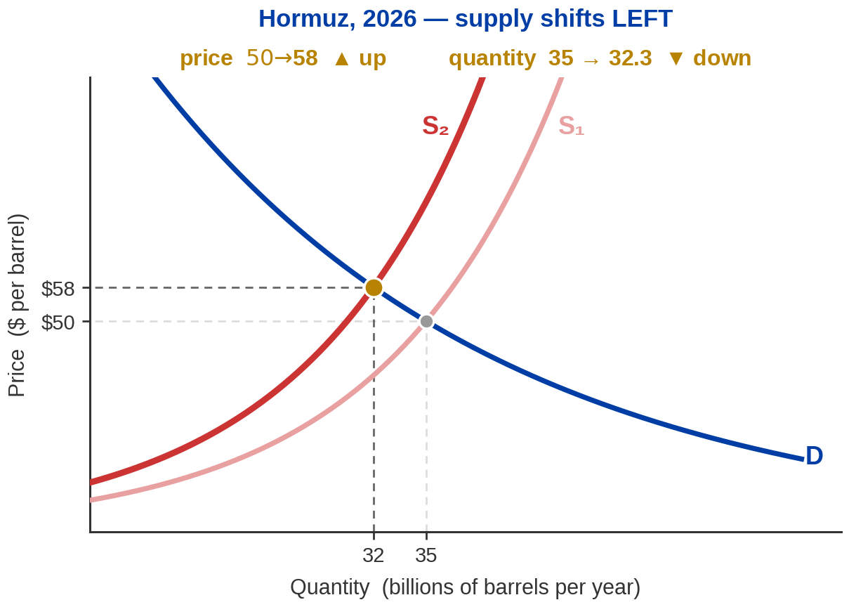

Hormuz, 2026 — a Supply Shock in Progress
Hormuz Strait and Global Oil Production
About 20 million barrels a day — 20% of the world's oil — moves through the Strait.
Flows fell from 20.7 to 14.6 million
barrels a day between Q4 2025
and Q1 2026. Around 30% gone.
Strait volumes: International Energy Agency, February 2026. Quarterly flows: US Energy Information Administration Global Energy Security Data, 13 May 2026. Situation as of 3 August 2026 and moving — check before recording. The curve shift above is drawn larger than life for legibility.
Notes:
Hormuz — the live supply shock
DATES AND FIGURES THAT MUST BE SAID EXACTLY — READ THEM, DO NOT RECALL THEM
Normally through the Strait: about 20 million barrels a day of oil (IEA, Feb 2026)
~15 mb/d of that is crude = about a third of global crude trade
also about a fifth of the world's LNG
Quarterly flows (EIA): 20.7 mb/d in Q4 2025 → 14.6 mb/d in Q1 2026
Bypass pipeline capacity: 3.5–5.5 mb/d combined (Saudi East-West, UAE to Fujairah)
Brent: about $70 before the war began on 28 February
above $126 at the April peak
mid-$80s in the first week of August 2026
WORD IT CAREFULLY — THIS IS THE MOST CATCHABLE THING IN THE LECTURE
• Say "severely disrupted," NOT "closed." The Strait has been restricted, reopened, and restricted
again at least twice this year, and reputable sources disagreed about its status even in the same
week. A binary claim will be wrong by the time somebody checks.
• Do not say prices are at their highest of the crisis. Today is roughly a third BELOW the April
peak. July's rise was a rebound from a ceasefire trough, not a new high.
• Do not quote an Iranian production number. I could not source one to a primary release. "Roughly a
third below pre-war levels" is defensible; a decimal is not.
• Re-check the price the morning you record. This moved 5% in a single day on one social media post.
RUN THE FOUR QUESTIONS — THIS IS THE FIRST DEMONSTRATION OF THE PROCEDURE
• Which curve? Producers and shippers were affected, so supply.
• Which way? Less oil reaching buyers at every price, so LEFT.
• New crossing? Higher up the unchanged demand curve.
• Both numbers? Price UP, quantity DOWN. Say both.
THE NUMBER THAT MAKES THE SLIDE WORK
• Fifteen million barrels of crude normally go through the Strait. Every pipeline built to go around
it adds up to between three and a half and five and a half million. Do that division out loud:
the alternatives carry at most a third of what the Strait carries.
• That is why a threat to one channel two miles wide at its narrowest reprices oil for the whole
planet. Geography is a supply shifter.
THE DISTINCTION WORTH DRAWING, IF THE CLASS IS WITH YOU
• Some of the price move is missing barrels. Some of it is a risk premium — the price of the
possibility that barrels go missing next month. In July, physical flows were RECOVERING while
Brent rose 24%, which can only be the second thing.
• A static supply-and-demand diagram cannot draw a shift in expectations about next quarter's supply
curve. Say that honestly; it is a real limit of today's tool and Chapter 5 onward starts to fix it.
WHY THIS REPLACED LIBYA
• The old version of this slide used Libya in 2011. It worked because it was finished. This one is
not finished, and a slide that says so will age better than one that pretends otherwise.

Slide 38
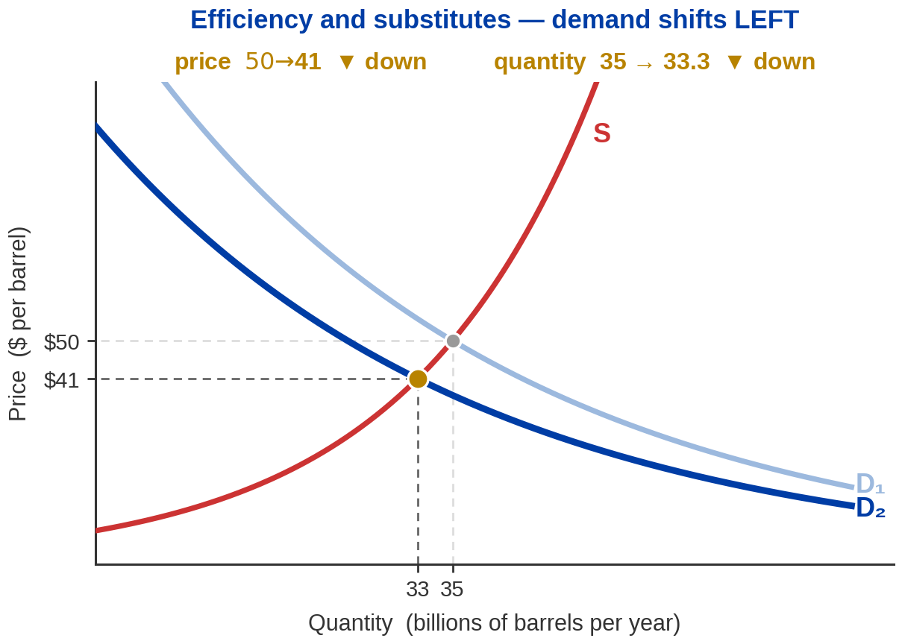
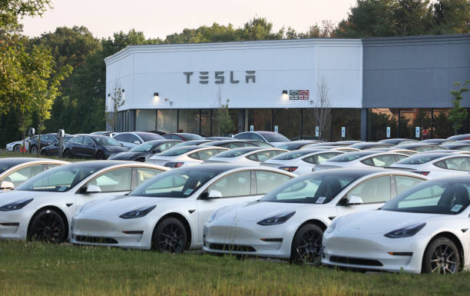
Now Move the Other Curve
DEMAND FOR OIL FALLS
Some sources suggest the global demand for oil also slightly declined.
Better fuel economy. Electric
vehicles. Efficiency standards.
Environmental concern.
In this case, demand falls mainly in reaction to the event.
Notes:
Demand shifts left
THE FIRST DEMAND SHIFT OF THE EQUILIBRIUM SECTION — SLOW SLIGHTLY
• Everything so far moved supply. Say that you are switching sides, or students carry the supply
reflex into the diagram and shift the wrong curve.
• Which curve: buyers were affected, so demand. Which way: less wanted at every price, so LEFT.
Both numbers: price DOWN, quantity DOWN.
THE COMPARISON WITH THE PREVIOUS SLIDE IS THE WHOLE LESSON — DO NOT SKIP IT
• Supply right gave: price down, quantity UP.
• Demand left gives: price down, quantity DOWN.
• Same price direction, opposite quantity direction. So if you only observe that oil got cheaper,
you cannot tell which happened. The quantity is what identifies the cause.
• That is a genuinely important idea and it is the seed of empirical economics — Chapter 1's third
principle. Two stories, one observable, and you need a second observable to separate them.
THE EXAMPLES ARE DELIBERATELY MODERN
• Fuel economy, electric vehicles, efficiency rules. These are shifting oil demand now, in their
lifetimes. Do not overclaim magnitudes — no numbers on this slide, and none should be invented.
THE POINT TO LAND
• Price alone does not identify which curve moved. You need the quantity too.

Slide 39
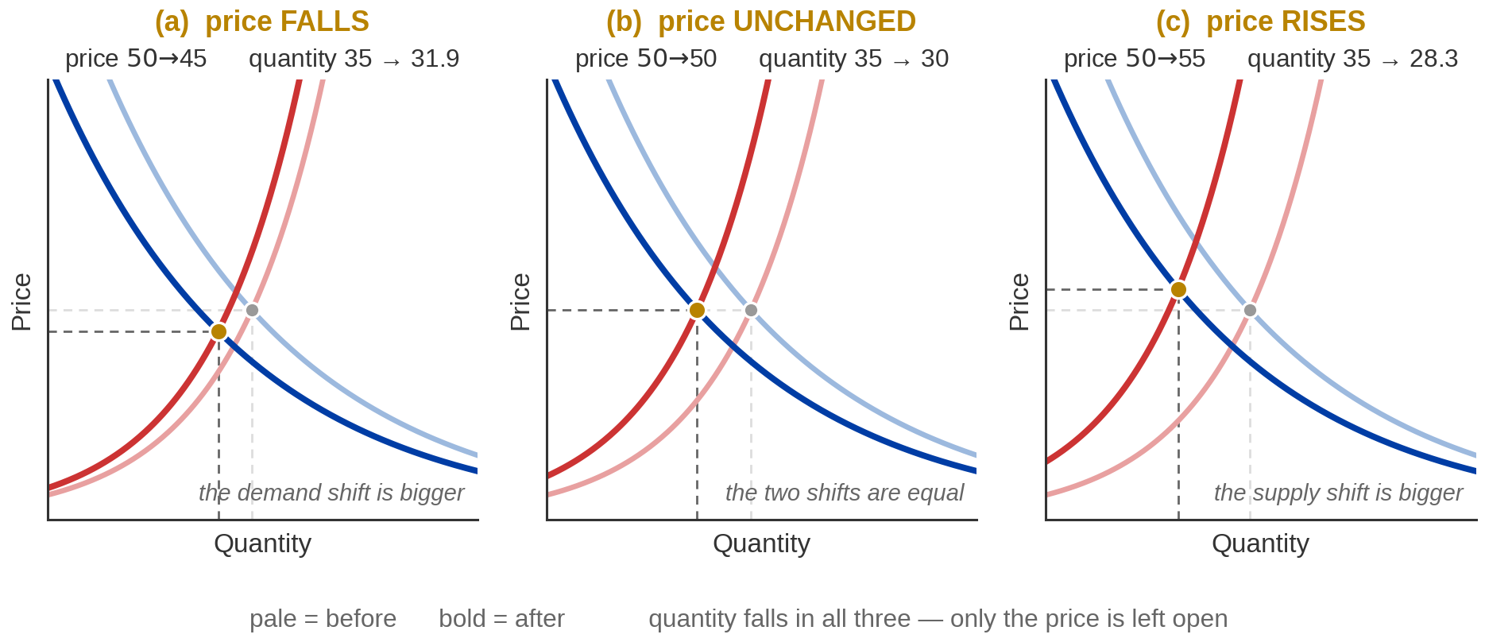
When Both Curves Move at Once
Supply shifts LEFT and demand shifts LEFT. Quantity definitely falls — and the price could do anything.
One direction is determined. The other depends on which shift is bigger — and the diagram alone cannot tell you.
Notes:
Both curves shift
THIS IS THE HARDEST SLIDE IN THE CHAPTER — SLOW DOWN
• Set it up honestly: until now every question had a determinate answer. This one does not, and
saying so is the lesson rather than a failure of the model.
THE SETUP — IT IS THE LAST TWO SLIDES, PUT TOGETHER
• Hormuz pushed oil supply LEFT. Efficiency, electric vehicles and environmental concern pushed
oil demand LEFT. Both are happening at the same time. What does the model predict?
• Do not introduce a new example here. The whole force of this slide is that they have already
seen both shifts, one at a time, on the two slides before it.
WORK THE QUANTITY FIRST, BECAUSE IT IS THE EASY HALF
• Supply left pulls quantity DOWN. Demand left pulls quantity DOWN. Both arrows point the same
way, so quantity falls. Determinate, no ambiguity, done.
THEN THE PRICE — THIS IS WHERE TO SLOW DOWN
• Supply left pushes price UP. Demand left pushes price DOWN. Opposite directions, so the answer
depends entirely on which effect is larger.
• Panel (a): the demand shift is bigger, price falls to $45. Panel (b): the two are equal, price
stays at $50. Panel (c): the supply shift is bigger, price rises to $55.
• The demand shift is the same size in all three panels — only the supply shift changes. Say that,
or it looks as though both curves are being redrawn arbitrarily until the answer comes out.
• All three panels are correct economics. The model is not being vague — it is telling you
precisely which question it cannot answer without more information.
THE GENERAL RULE, WORTH WRITING ON THEIR NOTES
• When both curves shift, one of price and quantity is determinate and the other is ambiguous.
• Shifts in the SAME direction — both left, or both right — settle the QUANTITY and leave the
price open. That is this slide.
• Shifts in OPPOSITE directions settle the PRICE and leave the quantity open. That is the fracking
decade: supply right, demand left, and what we can be sure of is that oil got cheaper.
THE HONEST CLOSE
• "The answer is: it depends on the magnitudes" is a real answer, not a dodge. Saying so out loud
models what economists actually do when the theory underdetermines the outcome — they go and
measure. Which is Chapter 1's third principle, again.
• Measuring the magnitudes is exactly what elasticity is for, and that is Chapter 5.

Slide 40
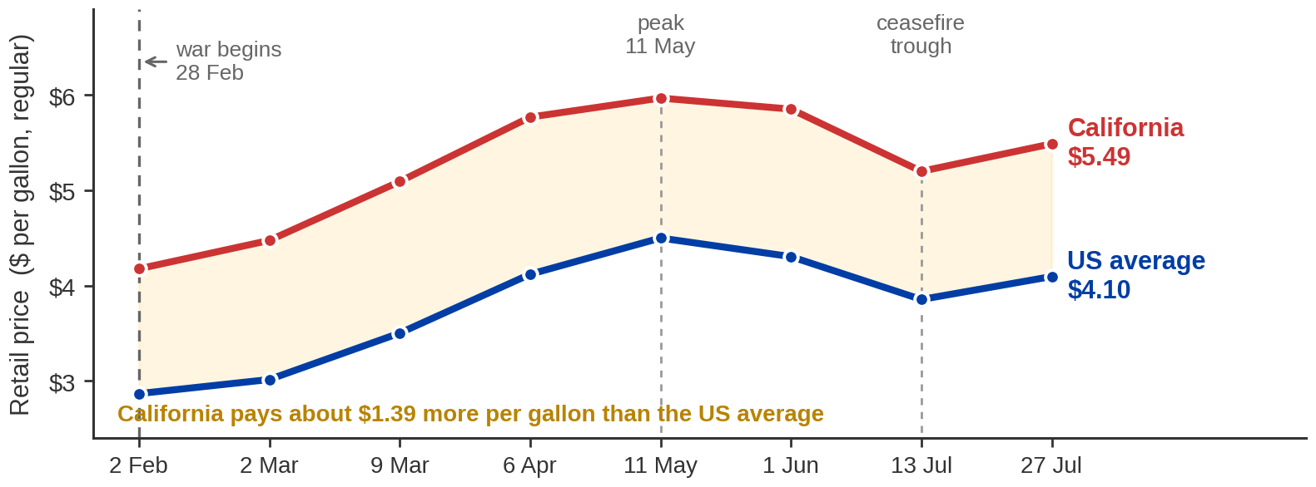
Right Now: What Is Happening to Gas Prices
The US pump price rose 57% to a peak in May, gave back two-fifths of that by mid-July, and is climbing again.
US Energy Information Administration, weekly retail gasoline prices, all formulations, regular. Selected weeks. Prices as of the week of 27 July 2026 — re-check before recording.
Notes:
The live gasoline market — the headline
NUMBERS THAT MUST BE SAID EXACTLY — READ THEM OFF THE CHART
2 February 2026, before the war: US $2.867 California $4.177
11 May 2026, the peak: US $4.500 California $5.969
13 July 2026, the trough: US $3.855 California $5.200
27 July 2026, latest: US $4.096 California $5.489
Six-month move: US up about 43%, California up about 31%.
California premium today: about $1.39 a gallon.
NAME YOUR WINDOW — THIS IS THE EASIEST THING TO GET WRONG
• Over SIX months gasoline is up sharply. Over the last THREE months it is DOWN about 9%, because
three months ago was the May peak. Both statements are true and they sound opposite.
• Say which window you are using, every time. A student with the EIA chart open will catch a loose
"gas has soared lately."
• Do not say record prices. April's national average was the highest since 2022, and today is below
even that.
WHY CALIFORNIA IS A DIFFERENT MARKET — THIS IS THE LOCAL PAYOFF
• The gold band on the chart is the premium your students actually pay, and it is about $1.39.
• Three reasons, all supply-side: California requires its own CARB gasoline blend that almost nobody
else makes; there is no pipeline from the Gulf Coast refineries, so imports arrive by ship on a
three-to-six-week lead time; and refining capacity is shrinking — Phillips 66 in Los Angeles and
Valero's Benicia refinery are both closing or idled.
• In supply-and-demand terms that is a nearly VERTICAL short-run supply curve. Any demand or supply
disturbance shows up almost entirely in the price rather than in the quantity, and the spike lasts
longer because the fix has to sail here.
• That is the same shape as the roses diagram two slides from now. Point at the parallel.
PASS-THROUGH — A CHECKABLE RULE OF THUMB
• A barrel is 42 gallons, so a $1 move in crude is about 2.4 cents a gallon at full pass-through.
• Between 7 and 31 July, Brent rose about $16. That is roughly 38 cents at full pass-through; the
pump moved 24 cents over the two weeks to 27 July. So about two-thirds arrived within a fortnight
and the rest was still coming.
• Crude is only part of the pump price. The rest is refining margin, distribution, and fixed
per-gallon taxes that do not scale with crude at all.
THE POINT TO LAND
• Everything on this chart is a supply story so far. The next slide is the half that does not make
the front page.

Slide 41
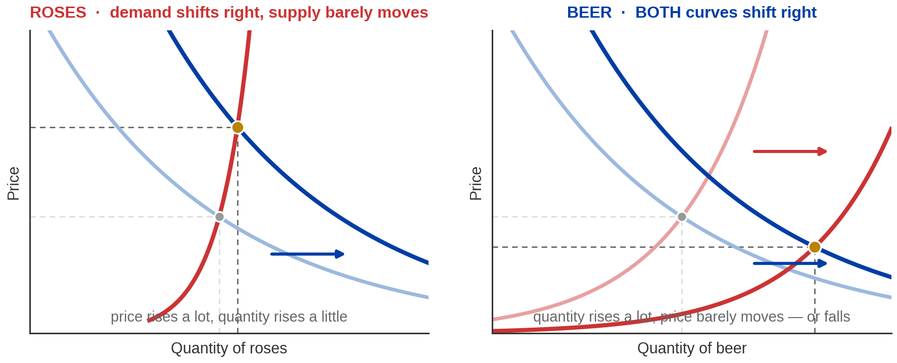
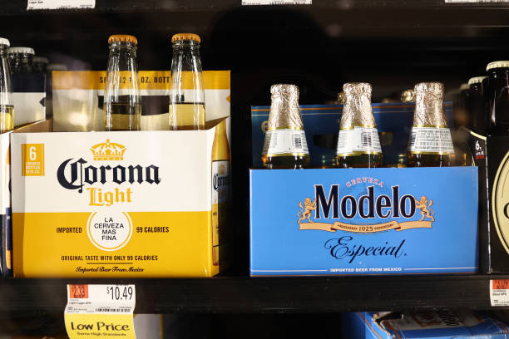

Roses at Valentine's, Beer at a Holiday
ROSES — price roughly triples
BEER — price falls at peak demand
USDA's weekly supermarket series: about $8 a dozen in
August, close to $23 just before Valentine's Day.
Chevalier, Kashyap & Rossi (AER 2003), 7.5 years of scanner
data: beer margins DROP at Memorial Day, July 4th, Christmas.
Roses: USDA supermarket price series, reported by Jay Zagorsky, Boston University, February 2024. Beer: Chevalier, Kashyap & Rossi, “Why Don't Prices Rise During Periods of Peak Demand?”, American Economic Review 93(1), 2003.
Notes:
Roses and beer
NUMBERS THAT MUST BE SAID EXACTLY — READ THEM
Roses: about $8 a dozen in August 2023, close to $23 just before Valentine's Day 2024.
USDA weekly supermarket price series, reported by Jay Zagorsky at Boston University.
Imported stems over the same window: 25 cents to 40 cents — up 60%, far less than retail.
THE ROSES CASE — DEMAND RIGHT, SUPPLY NEARLY VERTICAL
• Everyone wants roses in the same week. Demand shifts hard right. But roses are perishable and
grown on a schedule — you cannot conjure more in February. Supply is close to vertical.
• A big demand shift against an almost-fixed supply produces a big price move and a small quantity
move. That is the diagram on the left, and it is why the price roughly triples.
THE BEER CASE — AND A CORRECTION TO MAKE OUT LOUD
• Pearson asks why beer prices do not spike before the Super Bowl. The mechanism they teach is
right: BOTH curves shift right, because retailers stock up in advance, so quantity rises a lot
and price barely moves.
• BUT: do not attribute a Super Bowl finding to the literature. The canonical paper — Chevalier,
Kashyap and Rossi, American Economic Review, 2003 — studied Memorial Day, the Fourth of July,
Labor Day and Christmas. The Super Bowl is not in it. Say the holidays the paper actually covers.
• Their finding is stronger than "prices don't rise": prices FALL at peak demand, because
retailers cut margins on the item that brings people through the door. Loss leaders.
THE CONTRAST IS THE POINT
• Same event type — a demand spike — opposite price outcomes. Roses: supply cannot respond, price
explodes. Beer: supply responds fully and then some, price falls.
• So "demand rises" does not by itself tell you what happens to price. What the other curve does
matters just as much.

Slide 42
PART 5
When Price Is Not
Free to Move
Notes:
Part 5 divider
• "Everything so far assumed the price could go wherever it needed to go. Last section: what
happens when it cannot."

Slide 43
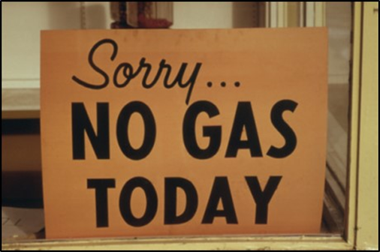
1973–74: Capping the Price of Gasoline
A price ceiling is a legal maximum price. It only does anything
if it is set BELOW the equilibrium price.
WHAT WAS CAPPED
WHAT HAPPENED
WHEN IT ENDED
Crude oil and refined products, including gasoline.
Controls began with Nixon's
1971 wage-and-price freeze —before the embargo — and were extended in 1973.
Queues, station closures and
state-level odd-even rationing
by license plate.
In the last week of February
1974, about 20% of American gasoline stations had no fuel at all.
Carter began phased decontrol in 1979.
Reagan completed it in 1981, exempting all crude oil and refined products from price and
allocation controls.
Not expensive gasoline. No gasoline.
Image: Acemoglu, Laibson & List, Microeconomics 3e
Notes:
The 1973–74 price controls
DATES AND FIGURES THAT MUST BE SAID EXACTLY — READ THEM
August 1971 Nixon's wage-and-price freeze already caps oil — BEFORE the embargo
19 October 1973 Arab oil embargo begins; runs to March 1974
27 November 1973 Emergency Petroleum Allocation Act signed
Late Feb 1974 about 20% of US gasoline stations had no fuel at all
May 1973 → Jun 1974 retail gasoline 38.5 cents → 55.1 cents a gallon
28 January 1981 Reagan's Executive Order 12287 ends controls entirely
Posted crude went from $2.90 to $11.65 a barrel by January 1974 (Federal Reserve History).
BE CAREFUL WITH ODD-EVEN RATIONING
• Say "states adopted odd-even rationing," not "the federal government imposed it nationwide." The
mechanism is well documented — odd plate, odd day — but I could not find a clean federal-level
citation naming which states adopted it when. Also flag that odd-even recurs in 1979, so a
student Googling it may land on the wrong crisis.
THE SEQUENCING POINT IS THE ARGUMENT — MAKE IT EXPLICITLY
• The controls predate the embargo by two years. That matters, because the usual telling is
"shortage caused queues." The economics says: the embargo shifted supply left, the price was not
permitted to rise, and THAT is what produced queues rather than merely expensive gasoline.
• Other countries faced the same embargo without American-style queues. Their prices were allowed
to move.
WHAT NOT TO DO HERE
• Do not turn this into a political argument. Present it as a mechanism with a documented outcome
and let the diagram on the next slide do the work. Some students will have strong priors about
price controls in either direction; the diagram is neutral and the diagram is what is examined.

Slide 44
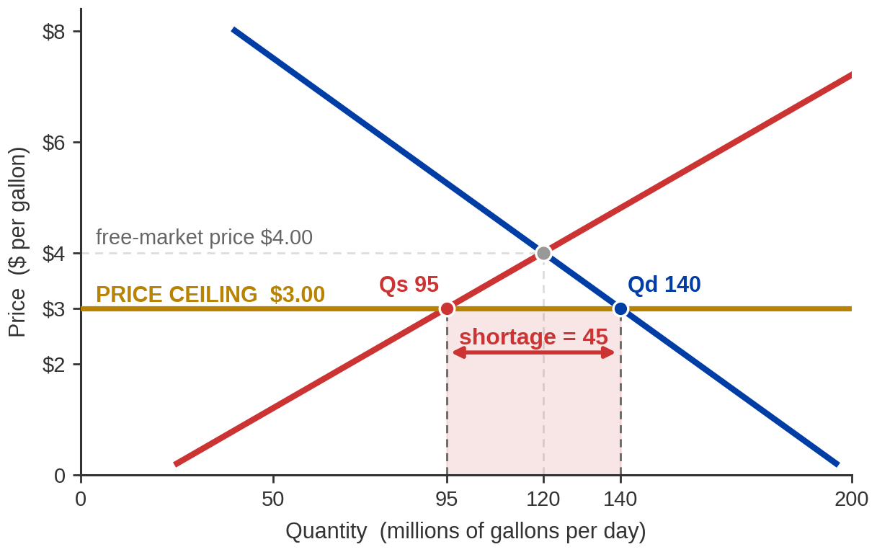
What a Ceiling Does to the Picture
AT A $3.00 CEILING
Free-market price $4.00
Quantity traded 120
Ceiling $3.00
Quantity demanded 140
Quantity supplied 95
Shortage 45
And only 95 gets traded —
LESS than before the cap.
The cap was meant to make gasoline cheaper for buyers. It made it cheaper for the 95 who get some, and unavailable for the rest.
Notes:
The price-ceiling diagram
NUMBERS THAT MUST BE SAID EXACTLY — READ THEM OFF THE PANEL
Free market: price $4.00, quantity traded 120 million gallons a day
Ceiling $3.00: quantity demanded 140, quantity supplied 95, shortage 45
Quantity actually traded under the cap: 95 — DOWN from 120
These are a stylised gasoline market, not real data. The $4.00 is deliberately close to the
actual US average of $4.096 a gallon in the week of 27 July 2026 (EIA), which is worth
mentioning once — it makes the diagram feel like this year rather than 1974.
WALK THE THREE CONSEQUENCES IN ORDER
• 1. Quantity demanded rises to 140. Cheaper gasoline, people want more. Predictable.
• 2. Quantity supplied FALLS to 95. This is the half students miss. At three dollars, wells and
refineries that were marginally profitable at four dollars stop. Less gasoline gets made.
• 3. The gap of 45 is a shortage that CANNOT self-correct, because the mechanism that used to
close it — a rising price — is illegal.
THE SENTENCE THAT MAKES THE WHOLE SECTION LAND
• The short side of the market determines what actually trades. Ninety-five is what gets sold, not
120 and certainly not 140. So the policy intended to help buyers ends with LESS gasoline
available than before it was imposed.
• Say that twice. It is counterintuitive and it is the examinable insight.
WHO GETS THE 95? — CALL BACK TO MINUTE TEN
• At minute ten you said the price is a selection device. Freeze the price and something else does
the selecting. In 1974 it was queueing — whoever was willing to spend an hour in line. Petrol
still went to whoever paid most; they just paid in time instead of money, and the time went to
nobody.
• That is why the queue is not an accident or bad administration. It is the substitute allocation
mechanism.
WHAT NOT TO CLAIM
• Do not say price controls are always bad. Say what the diagram says: a binding ceiling creates a
persistent shortage and reduces the quantity traded. Whether that is worth it against the
distributional goal is a normative question, and Chapter 1 was clear that data does not settle
normative questions.

Slide 45
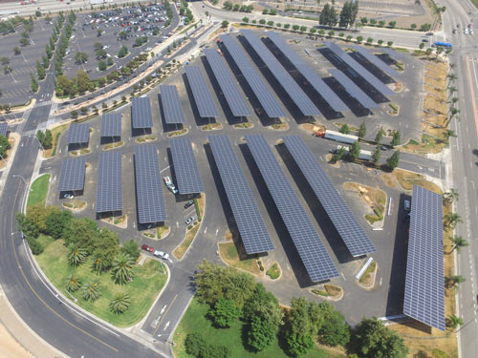
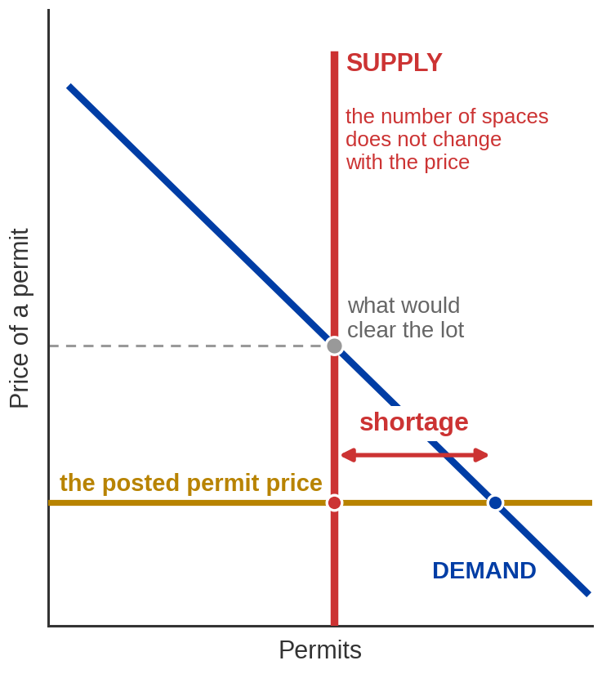
Campus Parking Lot
Why is parking on campus hard to find? Not because there are too many cars — because the permit price is held below the market-clearing level.
THE PRICE IS SET, NOT DISCOVERED
UCR posts permit rates rather than letting them clear. A Gold commuter permit runs on the order of $135–$145 a quarter depending on which rate sheet you read, and Gold Plus is described as available “in limited quantities.”
SO SOMETHING ELSE DOES THE RATIONING
Lot 30: Lot Full on Wednesday afternoons
Arriving at 8:30 a.m. instead of 10am. Circling the lot. Waitlists for specific lots.
The cost did not disappear — it stopped being money and started being time.
Image: Acemoglu, Laibson & List, Microeconomics 3e
Notes:
Campus parking
THIS IS THE MOST LOCALLY USEFUL SLIDE IN THE DECK — BUT CHECK THE NUMBER FIRST
• UCR's published undergraduate permit page still carries "Rates Effective July 1, 2025" while
the graduate page and the daily-rates page say July 1, 2026. Grad Gold went from $135 to $141,
so the undergraduate sheet is very likely a cycle stale.
• Therefore: say "on the order of $135 to $145 a quarter, depending on which rate sheet you're
looking at." Do NOT state a single figure on tape. Or check transportation.ucr.edu the morning
you record and say the exact number with the date.
• There is no published summer-specific permit rate. UCR sells monthly and multi-month permits.
Say that rather than inventing a summer price.
WHAT YOU CAN AND CANNOT CLAIM ABOUT SCARCITY
• CANNOT: any permits-to-spaces ratio. UCR publishes no such number and inventing one would be
exactly the error the Chapter 1 review flagged.
• CAN: Gold Plus permits are described on UCR's own site as "available in limited quantities" —
that is explicit quantity rationing rather than price rationing. And the campus has run
waitlists for specific lots; the 2021 Big Springs Structure 2 opening announcement mentions
contacting people on a waitlist.
• That is enough to make the argument. Do not embellish it.
RUN THE ECONOMICS
• A posted price below the clearing price produces excess demand. The excess demand does not
vanish; it shows up as queueing, early arrival and search time.
• Then the sharp question, which is the same one as the gasoline case: the time spent circling the
lot is a real cost paid by students, and unlike a higher permit price it is not received by
anyone. It is burned.
THE NORMATIVE HONESTY — DO NOT SKIP IT
• A market-clearing permit price would end the queue and would also mean students with less money
park further away. That is a real distributional cost and the diagram has nothing to say about
whether it is worth paying.
• Positive versus normative, from Chapter 1, arriving in a parking lot. Name the callback.

Slide 46
Practice: You Move, the Price Changes
2020 gasoline prices, calculated by Bloomberg. Assume your tastes and income do not change.
 | Price per gallon | Your quantity demanded | Shift or movement?
United States | $2.40 | your baseline | —
Kuwait (subsidised) | $1.27 | RISES | movement ALONG your curve
Netherlands (heavily taxed) | $6.46 | FALLS — lowest of the three | movement ALONG your curve
You take up rock climbing | unchanged | RISES at every price | SHIFT of your curve
Price changed → you slide along the curve. Anything else changed → the curve moves.
Notes:
The four practice questions
NUMBERS THAT MUST BE SAID EXACTLY — READ THEM
United States $2.40 a gallon
Kuwait $1.27 (government subsidises)
Netherlands $6.46 (government taxes heavily)
All 2020, calculated by Bloomberg, via Acemoglu, Laibson & List.
RUN IT AS FOUR POSED QUESTIONS, PAUSING BEFORE EACH ANSWER
• (a) You move from the US at $2.40 to Kuwait at $1.27. Does your quantity demanded rise or fall?
RISES. Law of demand, straightforwardly.
• (b) Then to the Netherlands at $6.46. Rank the three. Netherlands lowest, US middle, Kuwait
highest. And what must you assume to rank them? That your DEMAND CURVE did not change when you
moved — same tastes, same income, same everything except price. Pearson asks this explicitly and
it is the best part of the question.
• (c) Kuwait to the Netherlands — movement or shift? MOVEMENT. Only the price changed.
• (d) You take up rock climbing and drive more at the same price — movement or shift? SHIFT. The
price did not change; your tastes did. That is shifter number one from slide 18.
WHY THE LAST ROW IS HIGHLIGHTED
• It is the only shift in the table and it is the answer students get wrong. Everything above it
is the same curve, read at different prices. The bottom row is a different curve entirely.
THE ASSUMPTION IN (b) IS WORTH TEN EXTRA SECONDS
• In reality moving country changes your income, your commute, your access to trains and what your
neighbours do. Every one of those shifts the curve. The question only works because it tells you
to hold them fixed — which is the "all else equal" clause doing visible work for the first time.
THE POINT TO LAND
• Same test as slide 17, one last time: did the price of the good itself change?

Slide 47
Chapter 4: The Full Picture
 | What it says | Key terms | Where you saw it
Markets | Agents trading a good, plus the rules for trading it. Price is a selection device | market, market price, perfectly competitive
Demand | Buyers want less as price rises, because the value of one more unit falls | quantity demanded, demand schedule, law of demand | Chloe's gasoline; the world's 35 billion barrels
Supply | Sellers offer more as price rises, because the cost of one more unit rises | quantity supplied, supply schedule, law of supply | ExxonMobil supplies nothing at $10 a barrel
Shift vs movement | Own price changes and you slide along the curve; anything else moves the whole curve | change in demand vs change in quantity demanded | Five demand shifters, four supply shifters
Equilibrium | The one price at which quantity demanded equals quantity supplied | competitive equilibrium, excess supply, excess demand | $50 and 35 billion barrels; Hormuz, fracking, roses
Price controls | Cap the price below equilibrium and the shortage cannot close — something else rations | price ceiling, shortage | Gasoline in 1974; parking on campus
Six rows. Two curves, one crossing, and a list of the things that move each of them.
Notes:
The full picture
READ IT AS A MAP, NOT AS NEW CONTENT
• Nothing on this grid is new. Say that first, so nobody starts taking notes as though it were.
It is the whole hour on one screen, and its job is to show them how few moving parts there are.
• Go down the left column naming the six rows, then stop. Do not read the cells — they are there
to be photographed and revisited, not narrated.
THE TWO ROWS TO POINT AT
• Shift vs movement. Say again that this is where marks are lost, and that the vocabulary pair in
the middle column — "change in demand" against "change in quantity demanded" — is used precisely
by MyLab.
• Price controls. It is the only row where the market does NOT reach equilibrium, and that is why
it is last. Everything above it assumed the price could move.
THE SENTENCE TO CLOSE ON
• Two curves, one crossing, and a list of things that move each of them. That is the chapter.

Slide 48
KEY TAKEAWAYS
Chapter 4: Demand, Supply, and Equilibrium
A market is agents, a good, and rules for trading — no address required
Demand slopes down and supply slopes up, both for the marginal reasons from Chapter 3
Own price changes and you move along the curve; anything else shifts the whole curve
Equilibrium is where the curves cross — above it price falls, below it price rises
Freeze the price and the shortage cannot close, so something else rations, usually a queue
Notes:
Wrap
READ THE FIVE, THEN GIVE THE ONE-SENTENCE VERSION
• "Two curves, one crossing, and a list of things that move each of them."
• The third bullet is the one that costs marks when it is skipped. Say it twice, as you did earlier.
THE HONEST CLOSING NOTE
• Every diagram today assumed perfect competition — identical goods, nobody big enough to move the
price. Almost no market they deal with satisfies that exactly. The tools still work, roughly, and
Chapters 7 and 12 deal with what happens when they do not.
WHAT COMES NEXT — MAKE THE HOOK CONCRETE
• Chapter 5 is elasticity, and they have already met the question it answers. Hormuz: about six
percent of world consumption came off the market, and the price of crude roughly doubled. Why
thirteen times over? Because the curves are steep. Elasticity is how economists measure that
steepness — the difference between knowing the direction of an effect and knowing its size.
ADMIN, THEN STOP
• MyLab Chapter 4 problem set and deadline. Do not introduce a new idea in the last minute.

